Slide 1
Make Tachyon ready for next-gen data center platforms with NVM
Bin Fan
Tachyon Nexus
binfan@tachyonnexus.com
Mingfei Shi
Intel
mingfei.shi@intel.com

Slide 2
  Intel Cloud & BigData Engineering Team
  Work with community to optimize Apache Spark and Hadoop on Intel platform
  Improve Spark scalability and reliability
  Deliver better tools for management, benchmarking, tuning
    e.g., HiBench, HiMeter
  Build Spark based solutions

Slide 3
  Tachyon Nexus
Team consists of Tachyon creators, top contributors
Series A ($7.5 million) from Andreessen Horowitz
Committed to Tachyon Open Source Project
www.tachyonnexus.com

Slide 4
Outline
  Memory trend and challenges
  Introduction of Tachyon & NVM
  Performance testing and key learning
  Summary

Slide 5
Outline
  Memory trend and challenges
  Introduction of Tachyon & NVM
  Performance testing and key learning
  Summary

Slide 6
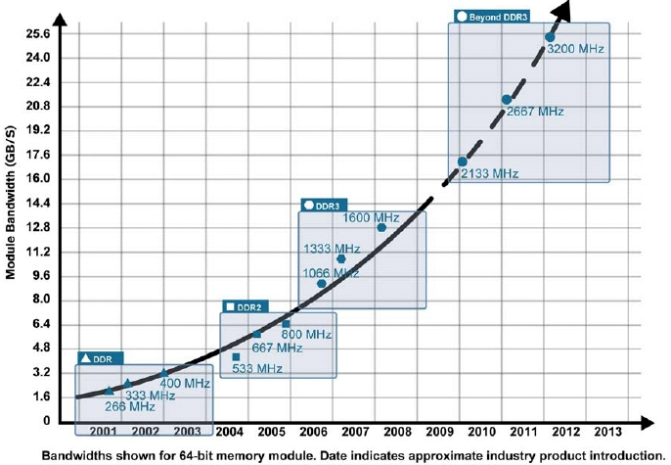
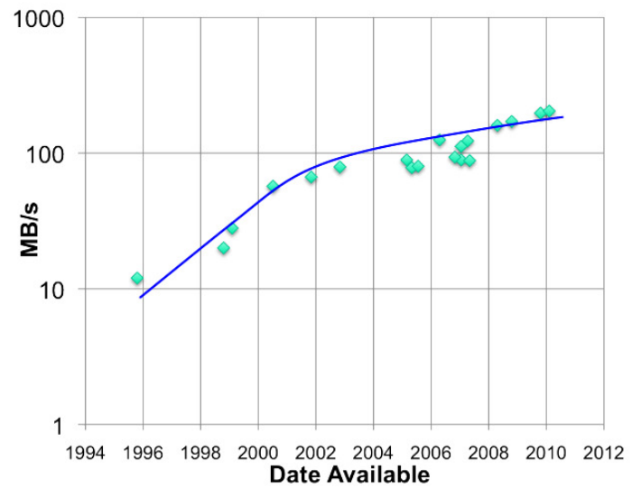
Performance Trend: Memory is Fast
RAM throughput
increasing exponentially
Disk throughput increasing slowly
Memory-locality is important!
Notes:
There are 2 trends that are happening today.

Slide 7
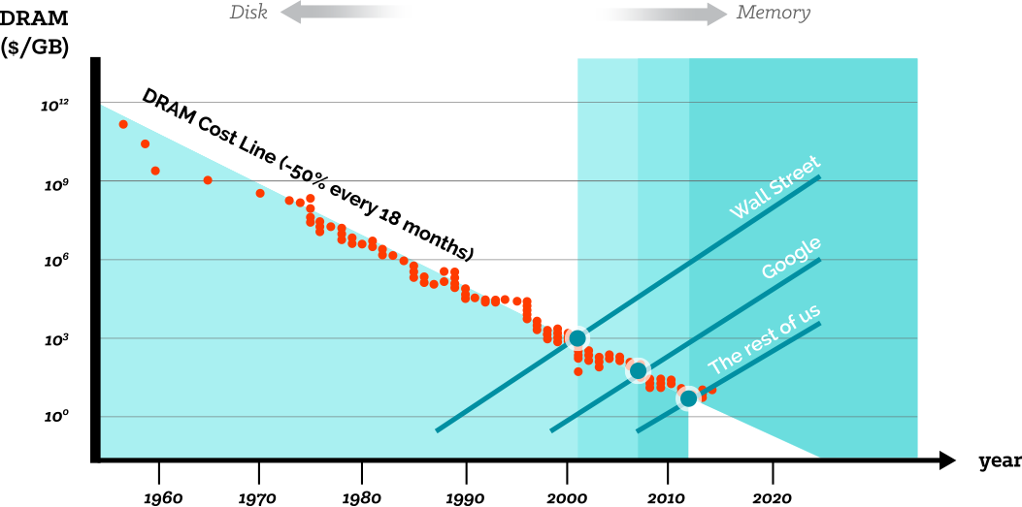
Price Trend: Memory is Cheaper
source: jcmit.com
    $/ GB of Memory is lower, possible to handle huge size of data in memory
Notes:
In memory becomes more important and popular
Cost / capacity of Memory is lower and lower, which makes it possible to handle huge size of data in memory
Many computation frameworks leverage memory
How to manage huge caching data is an interesting problem

Slide 8
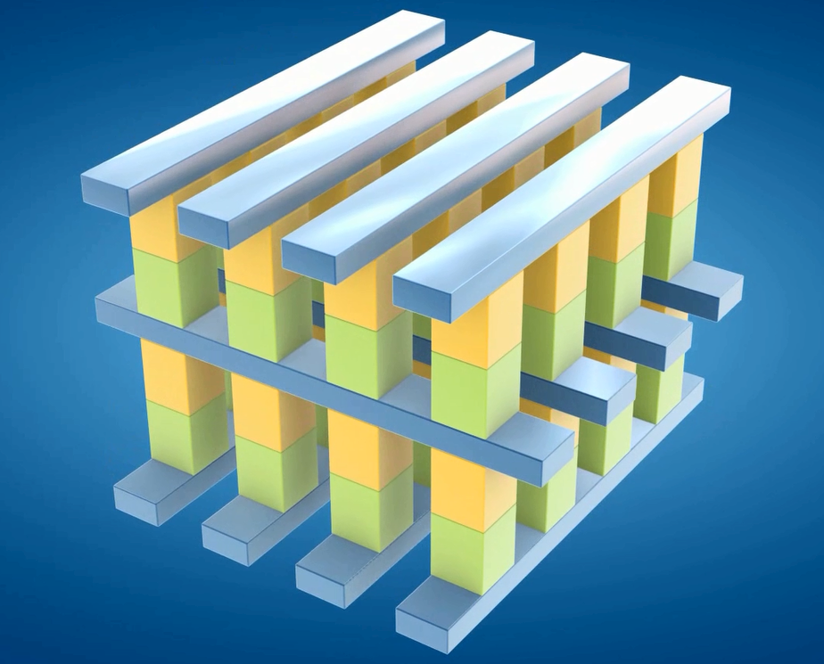
New Memory Technology: Intel's Crazy-Fast 3D XPoint Memory
1,000X faster than NAND
10X denser than DRAM
less costly than DRAM
Shipments may start in 2017

Slide 9



Realized By Many Frameworks:

Slide 10
Challenges
    Effectively share in-memory data among distributed applications.
    GC overhead introduced by in memory caching
    Data set could be larger than memory capacity

Slide 11
Outline
  Memory trend and challenges
  Introduction of Tachyon & NVM
  Performance testing and key learning
  Summary

Slide 12
What is Tachyon?
Notes:
5:00

Slide 13
An Open Source
Memory-centric
Distributed
Storage System

Slide 14
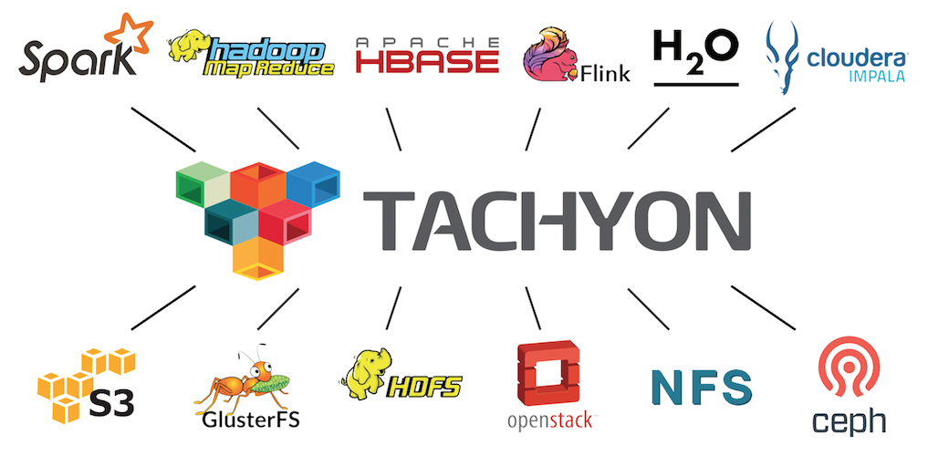
Tachyon Stack

Slide 15

How Easy to Use Tachyon in
  scala> val file = sc.textFile(“hdfs://foo”)
  scala> val file = sc.textFile(“tachyon://foo”)

Slide 16
Issue 1
Data Sharing bottleneck in analytics pipeline: Slow writes to disk
storage engine &
execution engine
same process
Spark Job
Hadoop MR Job
Spark
Memory
YARN
block 1
block 3
HDFS / Amazon S3
block 1
block 2
block 3
block 4

Slide 17

Issue 1 resolved with Tachyon
Memory-speed data sharing among different jobs and different frameworks
storage engine &
execution engine
same process
Spark Job
Hadoop MR Job
Spark mem
YARN
HDFS
disk
Tachyon
in-memory
block 1
block 1
block 2
block 3
block 3
block 4
block 4
HDFS / Amazon S3
block 1
block 2
block 3
block 4

Slide 18
Issue 2
In-Memory data loss when computation crashes
storage engine &
execution engine
same process
Spark Task
Spark Memory
block manager
block 1
block 3
HDFS / Amazon S3
block 1
block 2
block 3
block 4

Slide 19
Issue 2
In-Memory data loss when computation crashes
storage engine &
execution engine
same process
crash
Spark Memory
block manager
block 1
block 3
HDFS / Amazon S3
block 1
block 2
block 3
block 4

Slide 20
Issue 2
In-Memory data loss when computation crashes
storage engine &
execution engine
same process
crash
HDFS / Amazon S3
block 1
block 2
block 3
block 4

Slide 21
Issue 2 resolved with Tachyon
Keep in-memory data safe, even when computation crashes
storage engine &
execution engine
same process
Spark Task
Spark Memory
block manager
Tachyon
in-memory
HDFS / Amazon S3
block 1
block 1
block 2
block 3
block 4
block 3
block 4

Slide 22
Issue 2 resolved with Tachyon
Keep in-memory data safe, even when computation crashes
storage engine &
execution engine
same process
crash
HDFS
disk
Tachyon
in-memory
block 1
block 1
block 2
block 3
block 3
block 4
block 4
HDFS / Amazon S3
block 1
block 2
block 3
block 4

Slide 23
Issue 3
In-memory Data Duplication &
Java Garbage Collection
storage engine &
execution engine
same process
Spark Job1
Spark Job2
Spark
Memory
Spark
Memory
block 1
block 3
block 3
block 1
HDFS / Amazon S3
block 1
block 2
block 3
block 4

Slide 24
Issue 3 resolved with Tachyon
No in-memory data duplication,
much less GC
storage engine &
execution engine
same process
Spark Job1
Spark Job2
Spark mem
Spark mem
HDFS
disk
Tachyon
in-memory
block 1
block 1
block 2
block 3
block 3
block 4
block 4
HDFS / Amazon S3
block 1
block 2
block 3
block 4

Slide 25
Challenges
    Effectively share in-memory data sharing among distributed applications.
      => HDFS compatible, Spark/MapReduce can access Tachyon in-memory data with no modification
    GC overhead introduced by in memory caching
      => No GC overhead as working set files are in memory but off-heap
    Data set could be larger than memory capacity
      => Tiered storage

Slide 26



  Tiered block storage: extend Tachyon space with external storage (e.g., SSD HDD etc.)
  It is available since Tachyon 0.6 Release
    The JIRA for tiered storage: TACHYON-33
  Different tiers have
  different speed and priority
    “hot” data in upper tier
    “warm” data in lower tier
  Multiple directories in single tier
MEM
SSD
HDD

Slide 27
  Data migration among tiers
Data can be evicted to lower layer if it is less “hot”
  Data can be promote to upper layer if it is “hot” again.
  Pluggable Eviction Policy
    LRU, LRFU pre-defined
Promote hot data to upper tier
Evict stale data to lower tier

Slide 28
Non-Volatile Memory (NVM)
  NVM is the next era of computer memory
    Including 3D NAND, solid-state drives, and Intel 3D XPoint™ technology.
  Advantages of NVM
    Fast, comes to memory performance, low latency
    Non-Volatile, Capable of retrieving stored data even after a power outage.
    Inexpensive

Slide 29
When Tachyon Meets NVM
  Data caching & sharing at memory speed
    Local cache for remote data
    Data share in job chain / among different applications
  Eliminate GC overhead
    Storing data off heap on NVM
  Efficient cache management
    Storage hierarchy knowledge for different storage media, MEM SSD HDD etc
    Quota management for different storage

Slide 30
Outline
  Memory trend and challenges
  Introduction of Tachyon & NVM
  Performance testing and key learning
  Summary

Slide 31
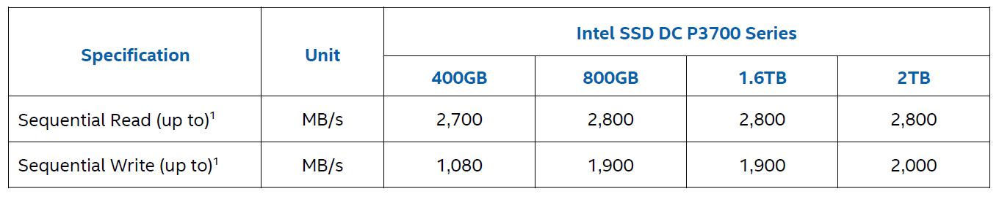
PCI-E SSD(P3700) SPEC
  Due to availability of NVM hardware, use high speed SSD to simulate the usage of NVM
    The NVM can be just used as block device like SSD, with lower latency and higher bandwidth
    The performance of NVM will be better than PCI-E SSD, with similar behavior

Slide 32
Test Bed
  One Tachyon master node
  Four Tachyon worker nodes
Worker node Configuration
CPU | IVB E5-2680 @ 2.8G 40 logical cores
Memory | 192GB DDR3 @ 1066 MHZ
Disk | P3700 SSD * 1 + HDD * 11
OS Distribution | Redhat 6.2 (kernel 2.6.32-220.el6.x86_64)
JDK version | JDK1.8.0_60 (64 bit server)
Spark version | 1.4.1 release
Tachyon version | 0.8.1 release
Hadoop version | 2.5.0

Slide 33
Experiment 1: Big Graph Computation
  Background: Calculate similarity between videos
  A case of Graph Analysis
    Friends-of-friend
    Iteratively compute association
    between nodes
  Challenge
    Generating huge Intermediate data after each iter
A
U
V
B
Y
D
C
X
Notes:
Video recommendation system
similarity
Top list

Slide 34
Architecture: Bagel over Tachyon
  Bagel is a graph processing framework.
    Spark implementation of Google Pregel
    jobs run as a sequence of iterations.
    In each iteration, each vertex runs a user-specified function
      update state associated with the vertex and
      send messages to other vertices for use in the next iteration.
    The message generated and new vertex data will be cached after each iteration
  Intermediate data can be cache in Tachyon
    Tachyon can make full use of high speed device for data caching.

Slide 35
Configuration
  Input data size: 22G
  Caching data size: 1.5TB
  Four configuration to test
Framework | Storage Configuration
Spark | Spark: 11HDD + 1 SSD
Spark | Spark: 11HDD + 4 SSD
Spark + Tachyon | Spark: 11 HDD Tachyon (1 tier): 1 SSD (500GB)
Spark + Tachyon | Spark: 11 HDD Tachyon (2 tiers): 1 SSD (250GB) + 11 HDD (100GB per disk) Eviction strategy: LRU
Notes:
Spark.local.dir = 1 dir on each HDD and SSD (12 dirs in total)
Spark.local.dir = 1 dir on each HDD and 4 dirs on SSD (15 dirs in total)
Spark.local.dir = 1 dir on each HDD (11 dirs in total)
Tachyon tiered store (1 layer) = 1 SSD (500GB)
Spark.local.dir = 1 dir on each HDD (11 dirs in total)
Tachyon tiered store(2 layers) = first layer: 1 SSD (250GB)
second layer: 11 HDD (100GB perdisk)
Eviction strategy: LRU

Slide 36
Test Result
Tachyon with SSD & SSD + HDD outperforms original Spark, gets about 20% performance gain
In Spark + Tachyon(2 tiers), 2/3 of caching data is putted on SSD and 1/3 on Disk
Spark + Tachyon(1 tier) and Spark + Tachyon(2 tiers) have very similar performance

Slide 37
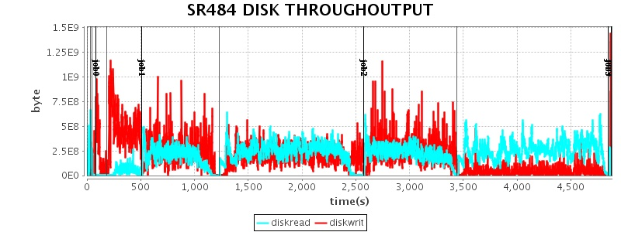
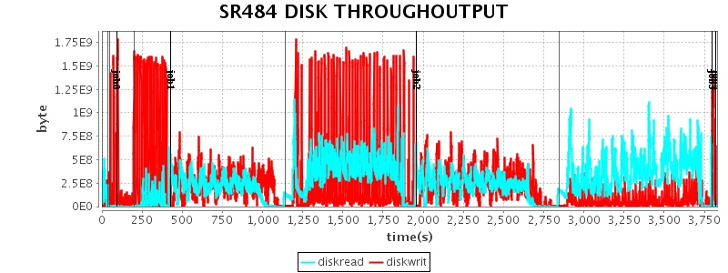
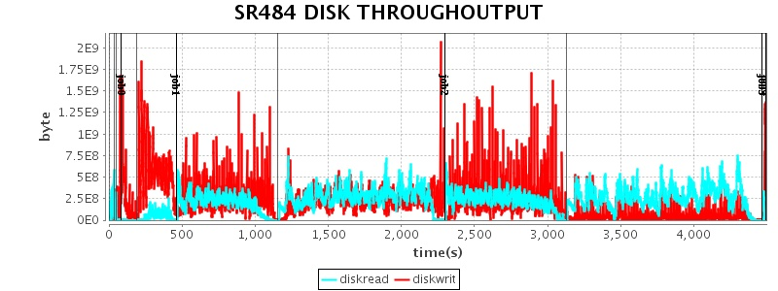
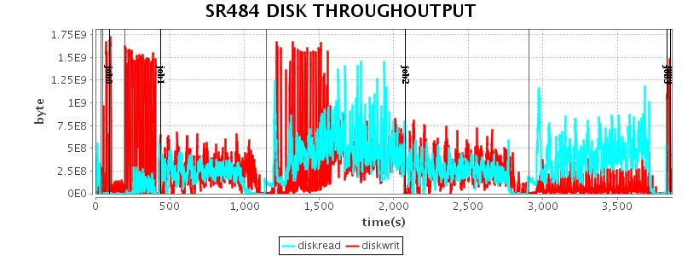
Performance Analysis – Disk utilization
Spark (11 HDD + 1 SSD)
Spark + Tachyon (1 tier)
Spark (11 HDD + 4 SSD)
Spark + Tachyon (2 tiers)
    Tachyon helps achieve higher disk utilization

Slide 38
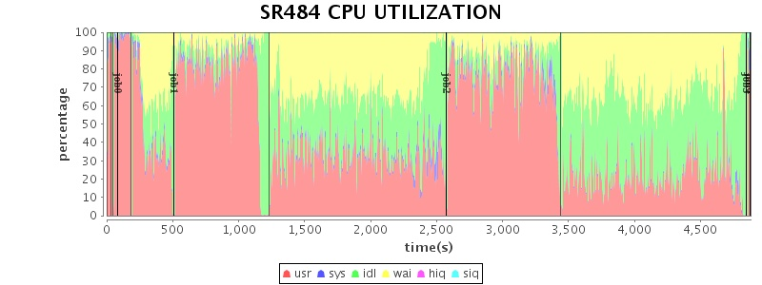
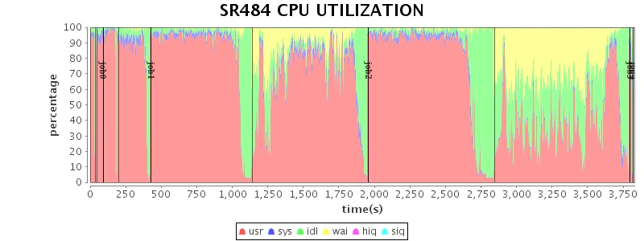
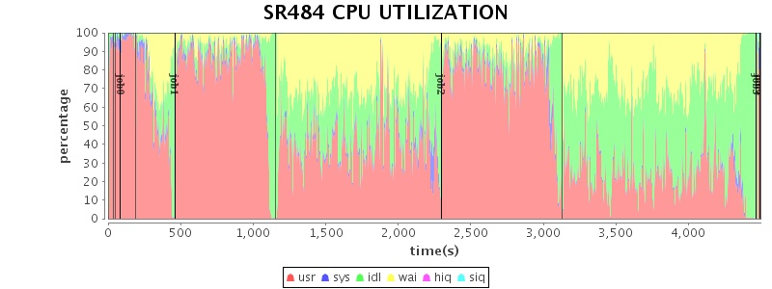
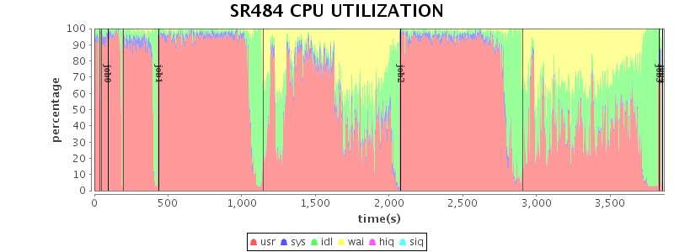
Performance Analysis – CPU utilization
Spark (11 HDD + 1 SSD)
Spark + Tachyon (1 tier)
Spark (11 HDD + 4 SSD)
Spark + Tachyon (2 tiers)
    Tachyon helps achieve higher CPU utilization due to less time in IO

Slide 39
Experiment 1: Summary
  Tachyon significantly speeds up Spark
    Spark takes all kinds of storage as the same storage media, it randomly allocates space and access to all local directories configured.
  With tiered storage and smarter cache management, Tachyon achieves comparable performance while requiring less fast memory resource
    Tachyon tries to use the fast device as much as possible, and has efficient data cache management for “hot” and “warm” data.

Slide 40
Experiment 2: Recommendation System
  Background: data analysis of user event logs
    Job1: Top-K online videos
      IO Bound
    Job2: Visits of advertisement by unique users in one day/week
      CPU Bound
  Challenges:
    storage and computation cluster are separate.
      Data must be transferred from remote data cluster during computation
    Same Input data is used by different applications
      causing redundant network I/O.

Slide 41

Architecture: Tachyon as local cache
    Deploy Tachyon in compute cluster to avoid the duplicated network I/O
Cache
data
Tachyon
Computation Cluster
Storage service
Spark
/
MR

Slide 42
Configuration
  Input data size: 1.2TB
  Tachyon
    1 tier with 500GB SSD on each worker
  Network
    1 Gb connection between computation cluster and data service cluster
    10 Gb connection inside computation cluster

Slide 43
Test Result
Job1 (IO Bound)
Job2 (CPU Bound)

Slide 44
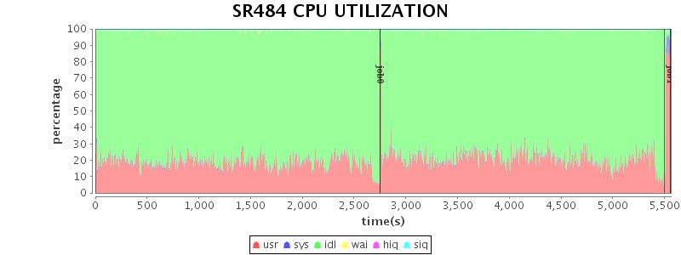
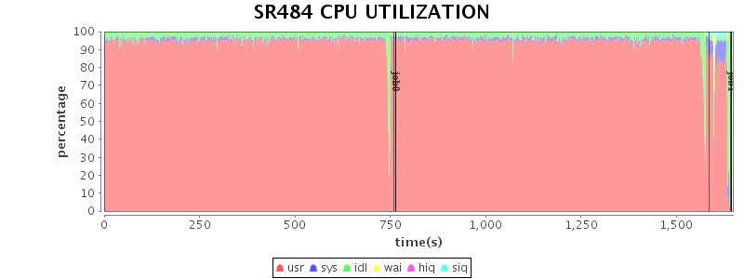
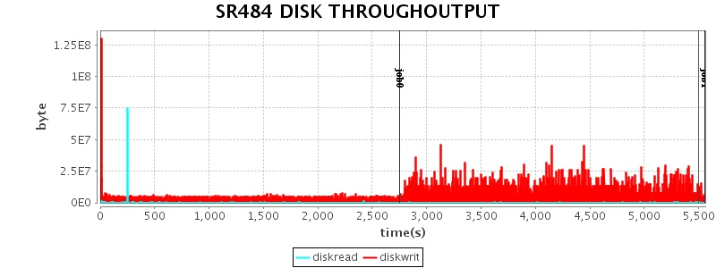
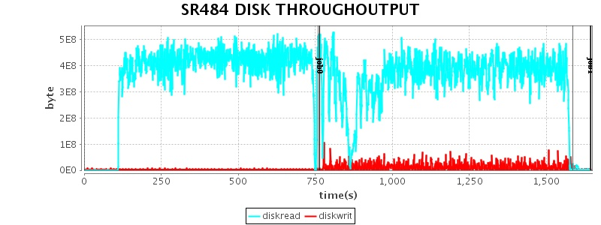
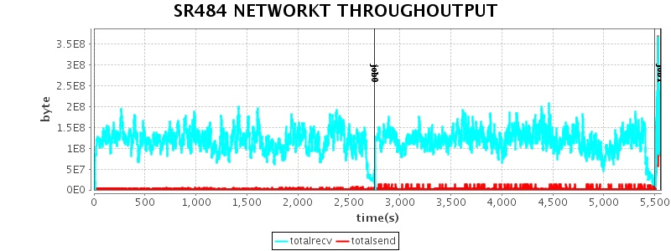
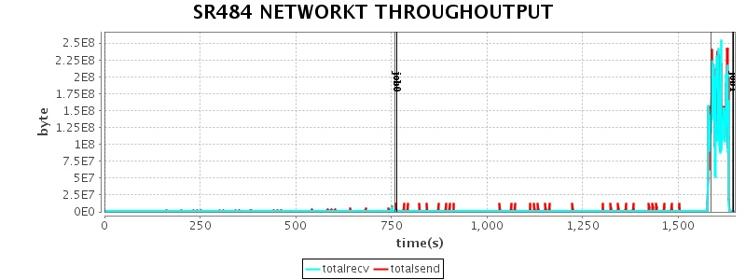
Performance Analysis – Job1
Spark-only
Spark+Tachyon

Slide 45
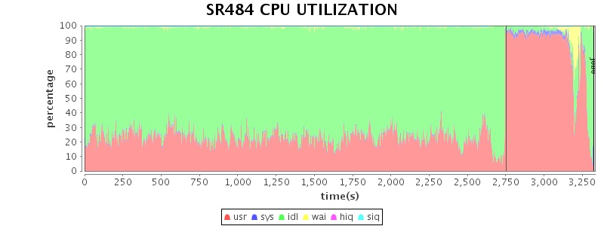
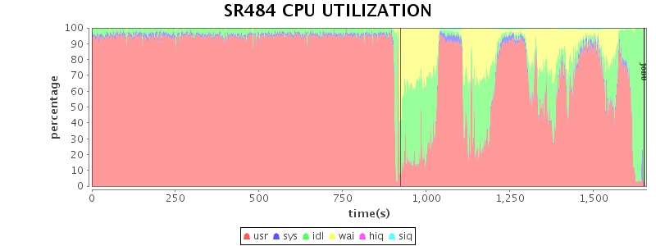
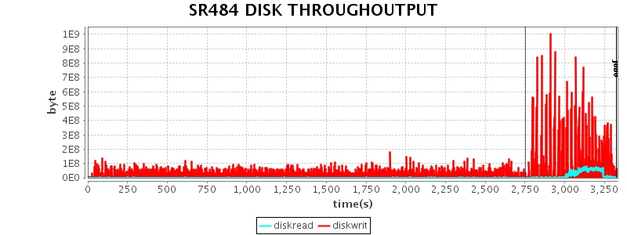
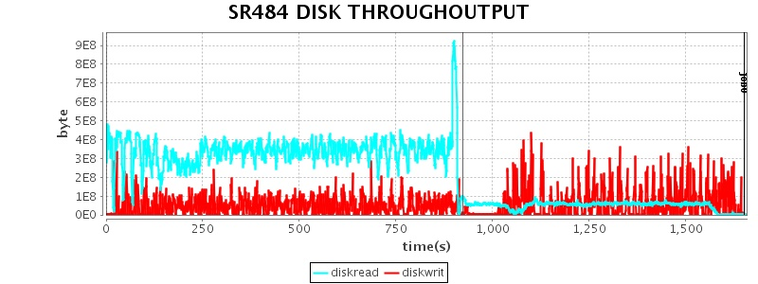
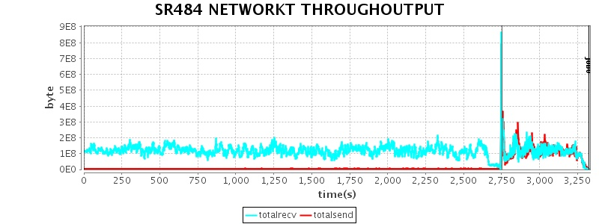
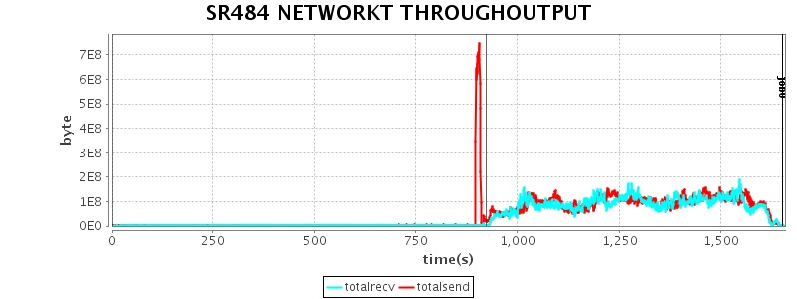
Performance Analysis – Job2
Spark-only
Spark+Tachyon

Slide 46
Experiment 2: Summary
  Using Tachyon as local cache accelerates the application
    For the application is I/O bound, Tachyon greatly improves the performance(3X)
    For the application is CPU bound, Tachyon still brings much performance gain(2X)

Slide 47
Experiment 3: Data Sharing within a Pipeline
  Background:
    Intermediate data is shared in a job chain , the output of one job is the input of another job
  Challenge:
    Without Tachyon, output of the previous job needs to be written into HDFS, and read by another job
Notes:
TeraSort

Slide 48
Architecture
With Tachyon, the output can be cached in Tachyon caching space, and makes the jobs share data without heavy network & HDD I/O
Input
Spark / MR job
HDFS
Tachyon
Intermediate data read / write
Spark/ MR job
Output
Notes:
TeraSort

Slide 49
Data share in job chain – Terasort
  Two jobs in Terasort：
    Data-preparation
    Data-processing
  Data sharing between two jobs:
    Written into HDFS, with 1 replication
    Written into Tachyon
Notes:
Data output of the second job:
Final result
written into HDFS, with 3 replications
Intermediate data(input of another job)
written into HDFS, with 1 replication
written into Tachyon

Slide 50
Configuration
  Input data size: 1TB
  Tachyon caching space
    1 layer with 500G SSD on each worker
  Two rounds of testing for the second phase:
    Data processing-round1:
      Write result into HDFS with 3 replications
    Data processing-round2:
      Write result into HDFS with 1 replication / tachyon

Slide 51
Test Result
Data preparation
Data processing

Slide 52
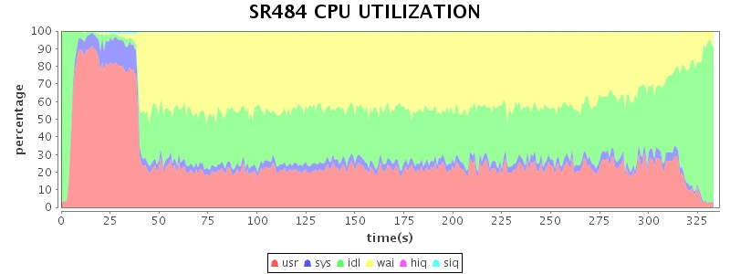
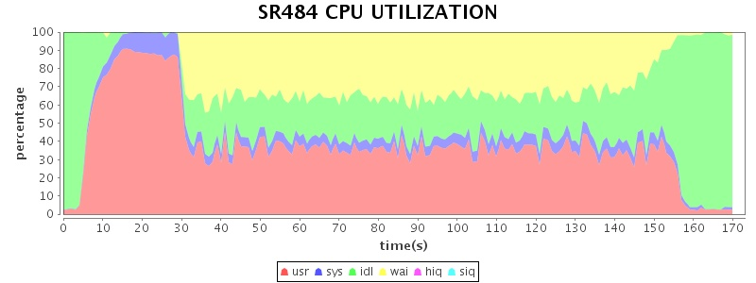
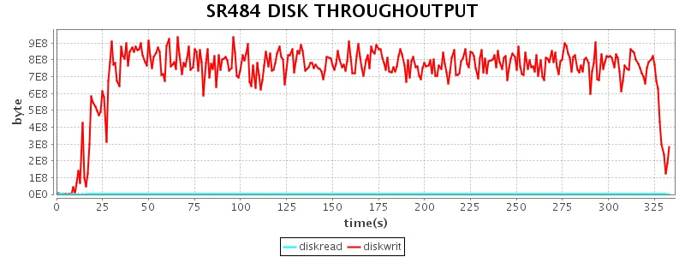
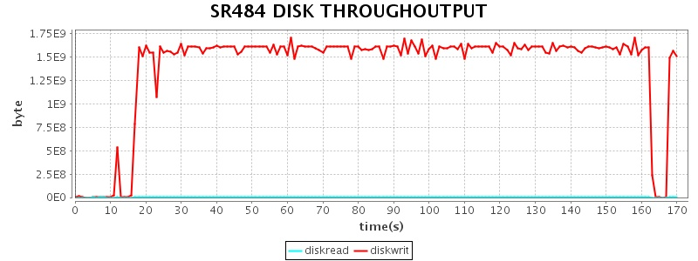
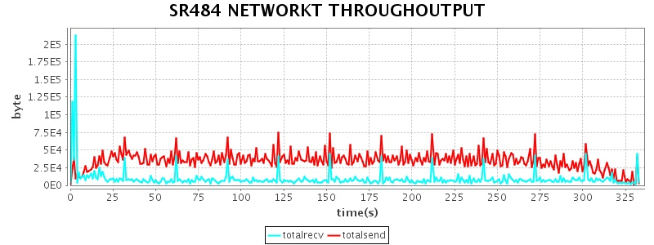
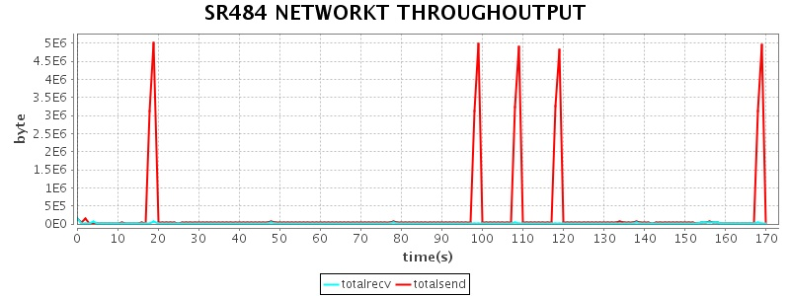
Performance Analysis – Data preparation
Prepare-hdfs-1rep
Prepare-Tachyon

Slide 53
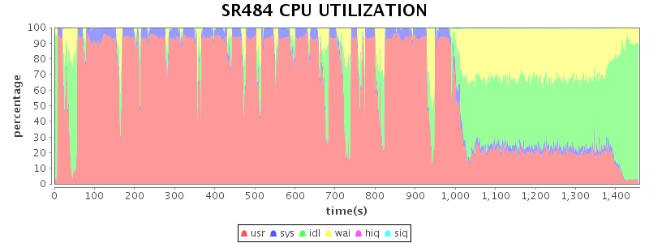
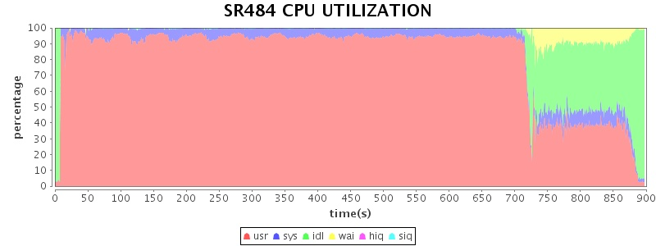
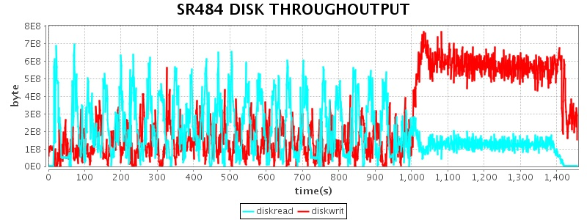
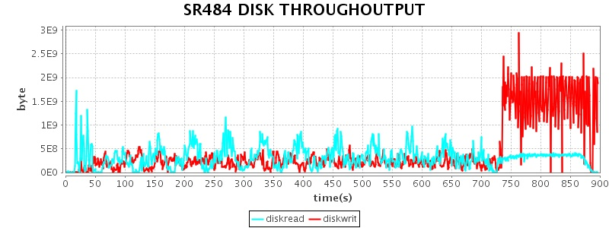
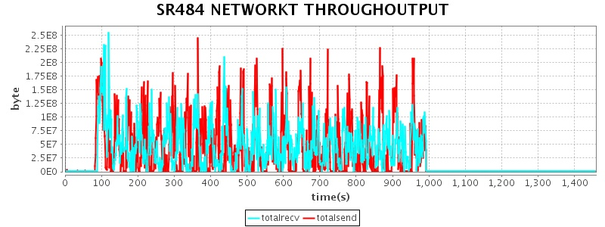
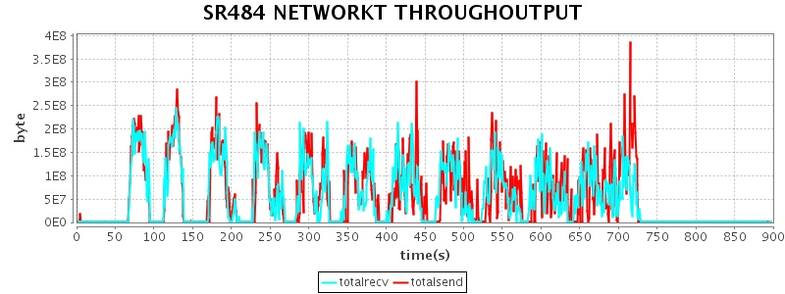
Performance Analysis – Data processing-round1
Run-hdfs-hdfs-1rep
Run-tachyon-tachyon

Slide 54
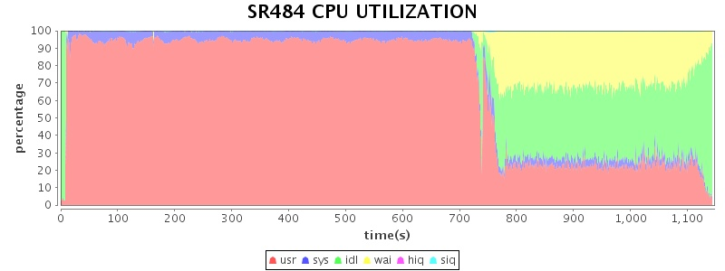
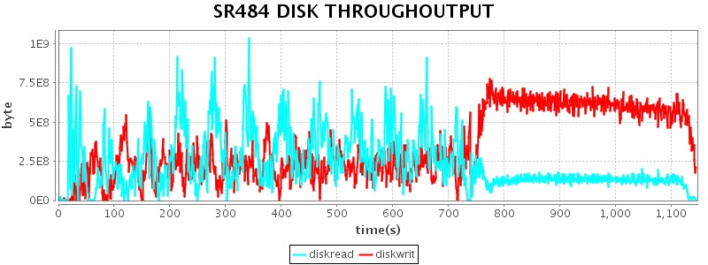
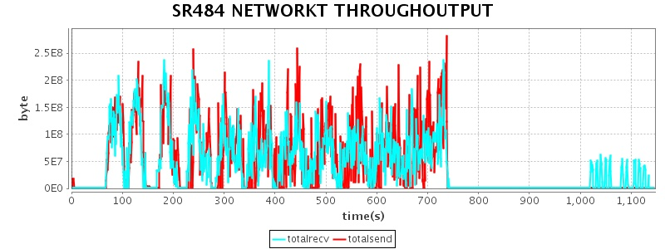
Performance Analysis – Data processing-round2
Run-hdfs-hdfs-1rep
Run-tachyon-hdfs-1rep

Slide 55
Experiment 3: Summary
  Sharing Intermediate data via Tachyon with NVM boost the execution
    For the first phase, which is purely I/O intensive, it brings (2X) performance gain
    For the second phase, it brings 1.2X ~1.6X performance gain

Slide 56
Outline
  Introduction and problem statement
  Introduction of Tachyon & NVM
  Performance testing and key learning
  Summary

Slide 57
Conclusion
  Memory is the new disk
  Tachyon resolves the challenges in in-memory data management
  NVM will offer great performance for data access in Tachyon

Slide 58
Q & A

Slide 60
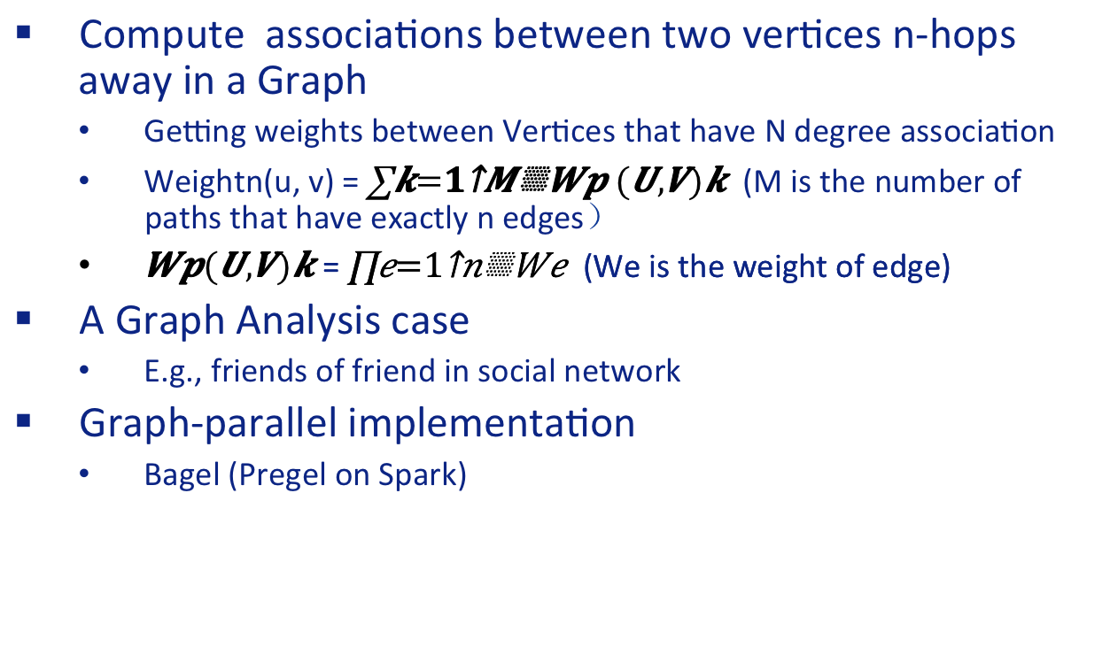
Test 1: Friends-of-friend
  Compute associations between two vertices n-hops away in a Graph
    Getting weights between Vertices that have N degree association
    Weightn(u, v) = (M is the number of paths that have exactly n edges）
    = (We is the weight of edge)
  A Graph Analysis case
    E.g., friends of friend in social network
  Graph-parallel implementation
    Bagel (Pregel on Spark)
A
U
V
B
Y
D
C
X
Notes:
Video recommendation system
similarity
Top list

Slide 61
Problem statement
  In memory becomes more important and popular
    Cost / capacity of Memory is lower and lower, which makes it possible to handle huge size of data in memory
    Many computation frameworks leverage memory
    How to manage huge caching data is an interesting problem
  There are still some challenges
    Data sharing among applications
    GC overhead introduced by in memory caching
    When data is huge, external storage is still needed

Slide 62
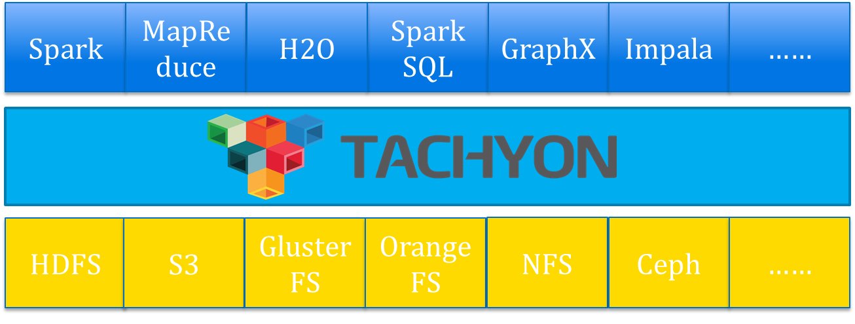
Introduction of Tachyon
http://www.tachyonproject.org/
  Tachyon is an memory-centric distributed storage system enabling data sharing at memor-speed acorss cluster frameworks, such as Spark Mapreduce etc.
    Caches working set files in memory and off-heap
    Enables different jobs/queries and frameworks to access cached files at memory speed
  Features
    Java-like file API
    Hadoop file system compatible
    Pluggable under layer file system
  Tiered block storage
Source: http://www.cs.berkeley.edu/~haoyuan/talks/Tachyon_2014-10-16-Strata.pdf

Slide 63
Test cases for remote data cache
  Input data is used by different applications
    Input: event logs
    Data format:
      Timestamp\Category\ObjectId\EventID\ …
  Input data location:
    Without Tachyon, all data is putted on remote HDFS cluster
    With Tachyon, all data is cached in local Tachyon
  There are two cases, which share the same input data：
    Case1 TopN
    Case2 Nreach

Slide 64
Intro for TopN
  Compute the top N object in each category
    Used fields from input data:
      <Category\ObjectId\...>
    select Category, ObjectId, count(*) as events from Input_data group by Category ,ObjectId order by events desc limit N where category='a';(for all categories)
    Output:
      Category\ObjectId\Visits
  It can be used to calculate:
    The best selling products in each category
    Most popular videos in each category
Notes:
Online video ranking
Different movie category
Object video Id

Slide 65
Intro for Nreach
  Computing unique event occurrence across the time range
    Used fields from input data:
      <TimeStamp, ObjectId, EventId, ...>
    Output:
      <ObjectId, TimeRange, Unique Event#, Unique Event(≥2)#, …, Unique Event(≥n)#>
      Accumulated unique event# for each object and certain time range
  It is used to calculate:
    Visits of certain advertisement by unique users in one day/week
Notes:
Ads unique
ObjectId: ads
EventId: click, display

Slide 66
Tiered storage in Tachyon
  Tiered block storage is used to extend Tachyon’s caching space with external storage, such as SSD HDD etc.
    Different tiers have different speed and priority
    “Hot” data and “warm” data are putted on different layers
    Multiple directories in single tier
  Data migration among tiers
    “Hot” data can be evicted to lower layer, when it
    is not “hot” any longer by eviction strategies.
    “Warm” data can be promote to top layer, when
    it becomes “hot” again.
  It is available since Tachyon 0.6 Release
    The JIRA for tiered storage: TACHYON-33

