Slide 1
Description
Support for aging or disabilities can be complex so Cloud4All is creating infrastructure to automatically apply individual preferences. We demo personalised access and explore related Apache projects.
Abstract
The intraweb and electronic services are an increasingly essential part of life for all of us in work, education, society and leisure. Well-designed websites and services aim to cater for as many people as possible, yet we all have individual needs in our preferred style of user experience. We also have varying access requirements due to physical environment, e.g. when driving or in noisy conditions. In addition as we age we develop more explicit access requirements that make us part of world's largest 'minority' group, the 650 million-odd people with a disability.
The Cloud4All software project is an ambitious collaboration to develop standards and reference implementations for accessibility infrastructure that will allow software systems to automatically adapt their User Experience to individual user preferences . With partners as diverse as Mozilla, Microsoft, Universities and SMEs Cloud4All has the potential to define an approach to inclusive technology that will have a huge impact on the economics of IT solutions and the way we interact with technology.
In this session we demonstrate the initial prototype systems that clearly show the Cloud4All potential on Windows, Linux, desktop, mobile and web applications. We will also explore how some Apache projects already provide initial support for Cloud4All and discuss how easy it is for your own system to utilise the Cloud4All API.

Slide 2
Cloud4All automatic personalised access
ApacheCon EU Nov 2012
Steve Lee
steve@opendirective.com
@SteveALee
Notes:
OpenDirective = Rgardler + myself

Slide 3
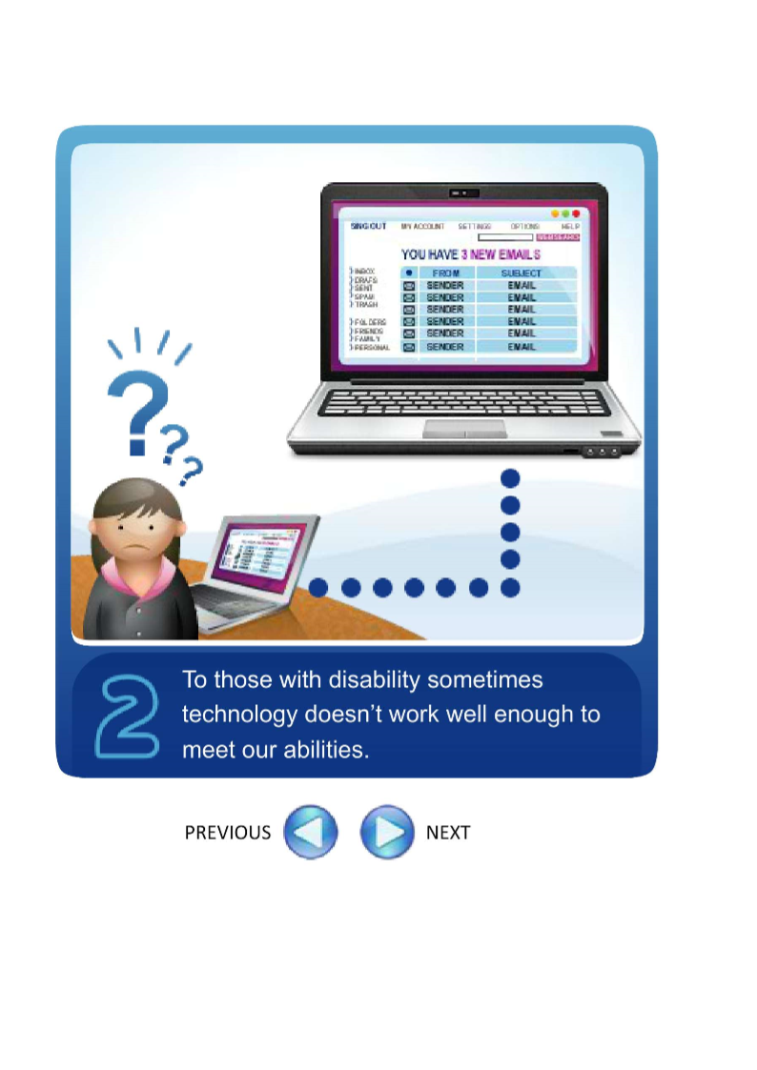
Using essential interweb services
Notes:
Careful design / testing
But access for all is complex and hard to achieve

Slide 4
Access Assumptions
Notes:
Display, mouse. Keyboard (if lucky)
Now touch + speech
Still doesn’t suit all

Slide 5
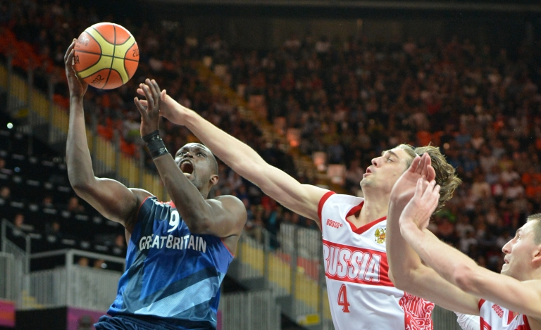
Access for all
Notes:
Disability – congenital or accident
Age relate degeneration
Situational

Slide 6
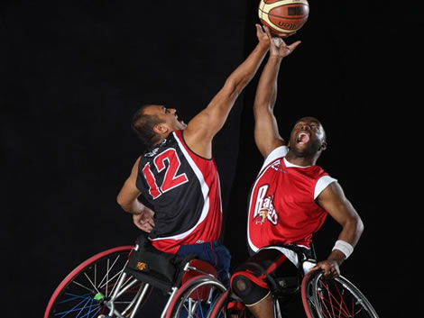
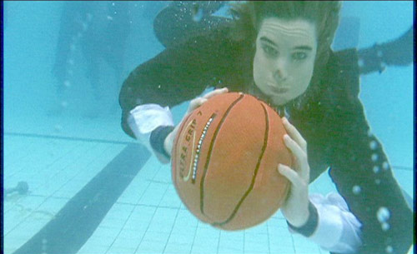

Sometimes we need adaptations
Notes:
Disability – congenital or accident
Age relate degeneration
Situational disability

Slide 7
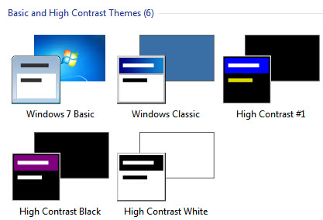
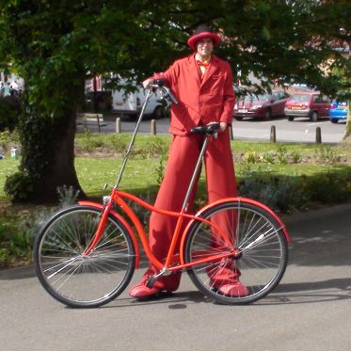
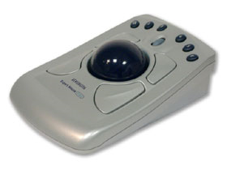
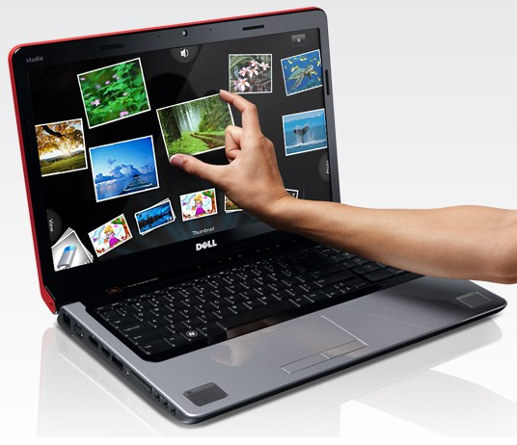
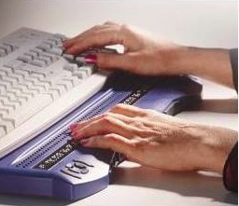

Common approaches
Notes:
Built in accessibility features
Generic modification (Assistive Technology)
Custom design

Slide 8
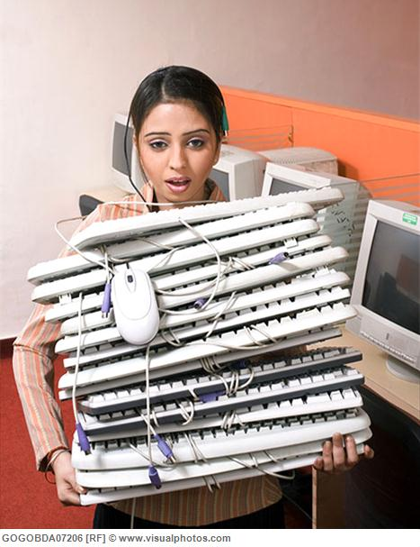


However…
Notes:
All slightly different so need to customise
May need to take customisation with us

Slide 9
Complex selection
Users
Supporters
Suppliers and service providers
Developers and manufacturers
Notes:
Find and implement suitable solutions
Add features

Slide 10
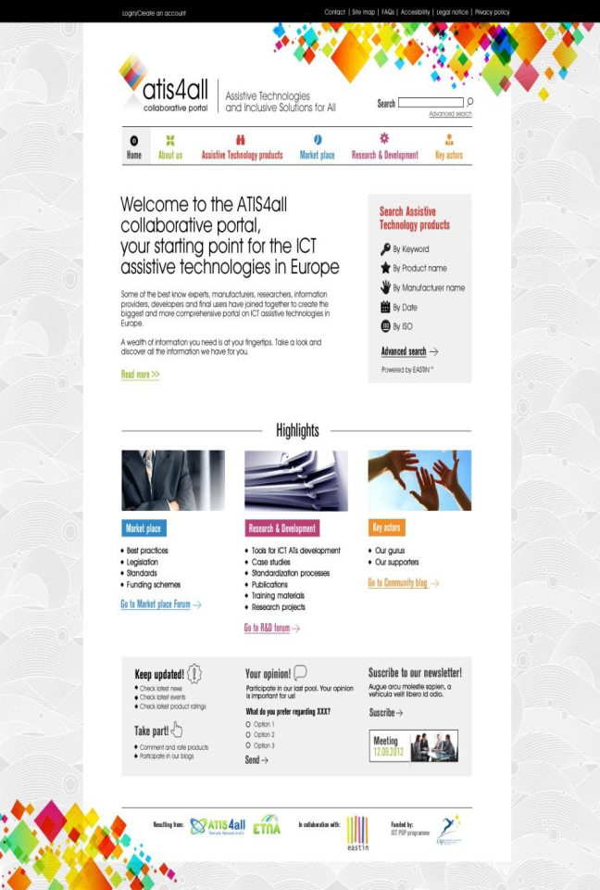
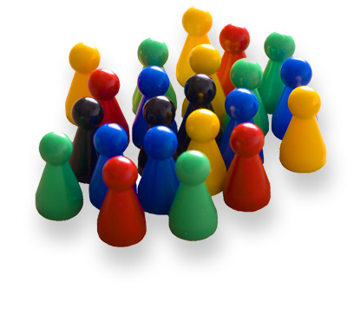
ATIS4all thematic network and portal
Working together to build up an European entry point on ICT assistive technologies and inclusive solutions
The ATIS4all collaborative portal - to be completed at the end 2013 - is being developed in collaboration with ETNA thematic network and EASTIN Association.
Become one of our supporters!
www.atis4all.eu
Notes:
10

Slide 11
Another approach…
Automatic-personalisation of devices
Define personal preferences
Select relevant device features and solutions
Configure best possible match
Notes:
Mainstream devices

Slide 12




Slide 13


























International collaboration
:
Notes:
Large consortium

Slide 14
Other goals
Simplify Accessibility - standards
Increase built-in accessibility – ref models
Grow Market for AT, accessibility and services
Facilitate cross-sector collaboration
Notes:
All for user and developers

Slide 15
Features
Collection of user preferences
Market place for AT and services
Support for making recommendations
Provide developer standards and tools
Notes:
Foster an eco system

Slide 16
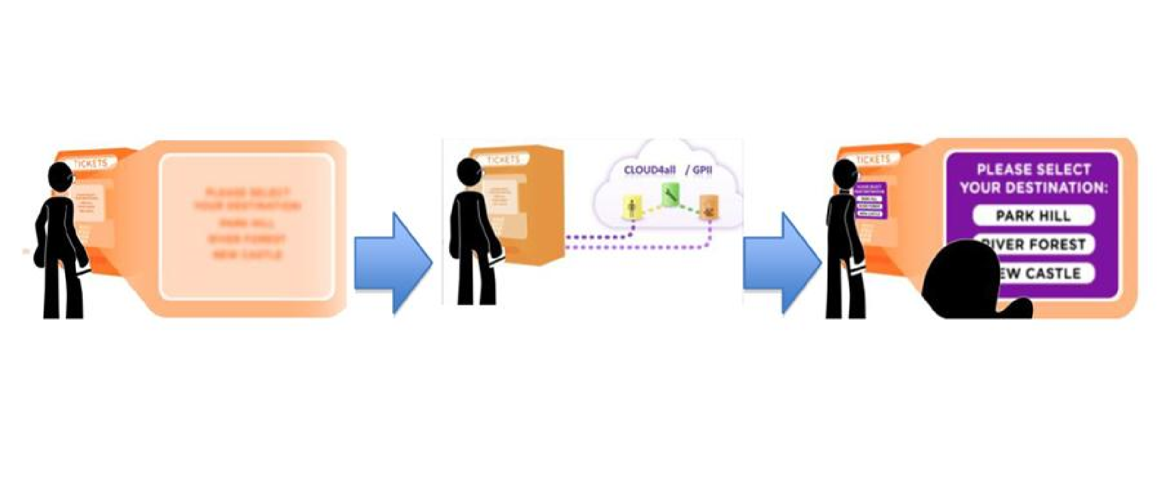
In use
Notes:
Bad eyesite or glare

Slide 17
Progress so far
Project is experimental
Academic research - eg ontologies
Architecture dev team
Commercial solution providers adding
1 year in – no major outputs yet
We think important are so monitoring

Slide 18
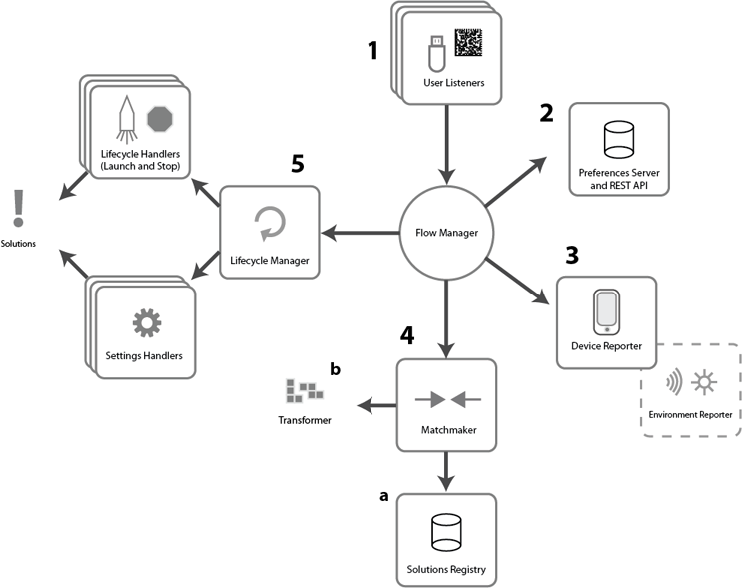
Architecture overview
Notes:
Flexible deployment
User Listeners + Preferences
Device reporter
Match maker and Solutions Registry
Lifecycle manager, Lifecycle handlers and Settings handler

Slide 19
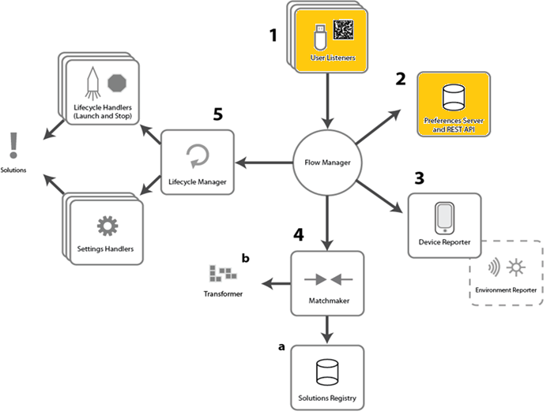
User Preferences
Notes:
Flexible deployment
User Listeners + Preferences
Device reporter
Match maker and Solutions Registry
Lifecycle manager, Lifecycle handlers and Settings handler

Slide 20
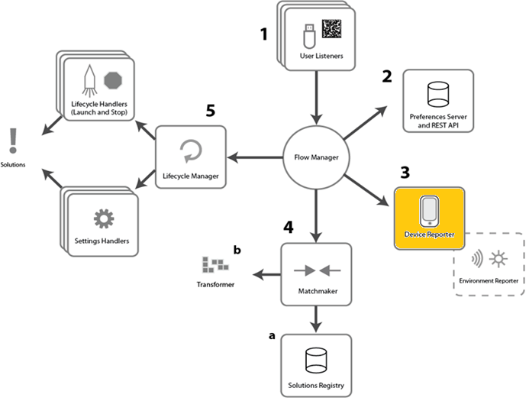
Device capabilities
Notes:
Flexible deployment
User Listeners + Preferences
Device reporter
Match maker and Solutions Registry
Lifecycle manager, Lifecycle handlers and Settings handler

Slide 21
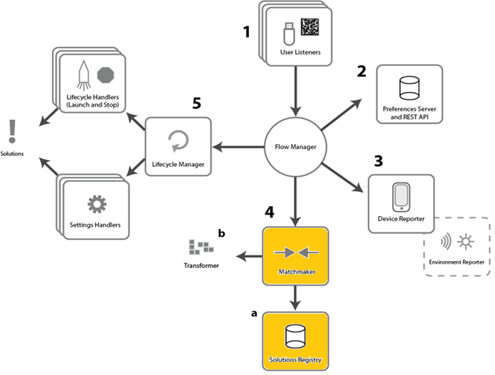
Matching
Notes:
Flexible deployment
User Listeners + Preferences
Device reporter
Match maker and Solutions Registry
Lifecycle manager, Lifecycle handlers and Settings handler

Slide 22
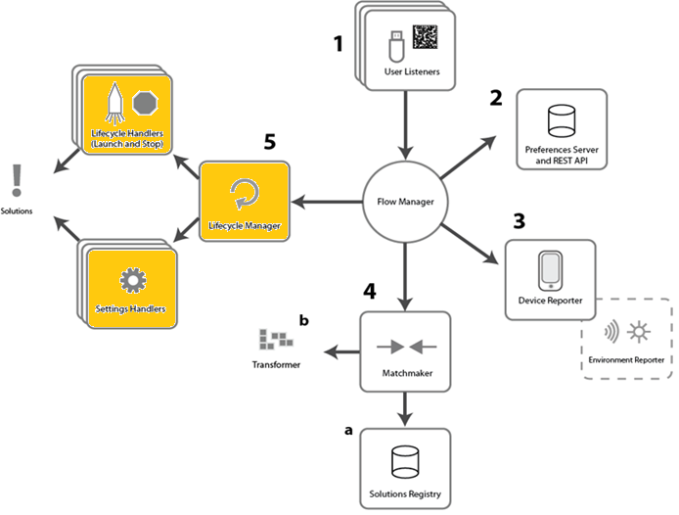
Configure Solutions
Notes:
Flexible deployment
User Listeners + Preferences
Device reporter
Match maker and Solutions Registry
Lifecycle manager, Lifecycle handlers and Settings handler

Slide 23
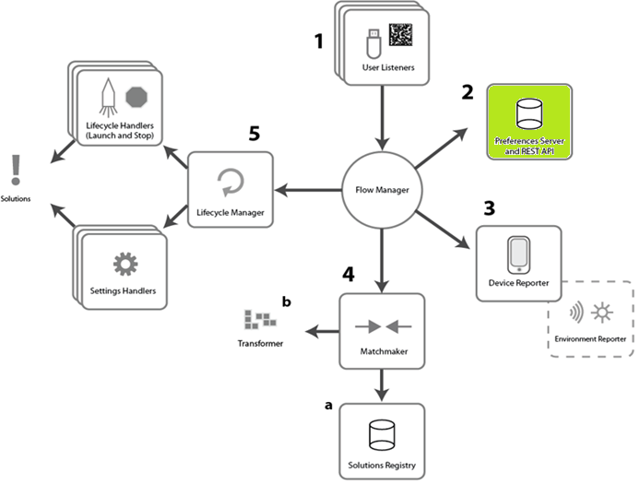
User
Notes:
Wizard

Slide 24
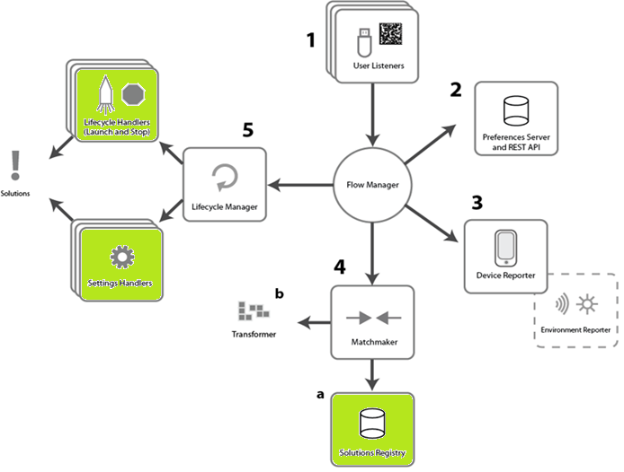
AT Developer
Notes:
Standard handlers support simple config documents

Slide 25
Our contribution
Extending an existing solution
  Dementia patients and carers
  Potential for Learning Difficulties
Notes:
Maavis - Ultra simple UI
HTML Wookie Templates allow maximum deployment flexibility

Slide 26
Our contribution
Tech Details
  Entry in the Solution Regstry
  New JSON Settings handler
  Configure Lifecycle Manager
  Test Profiles
Notes:
Maavis - Ultra simple UI
HTML Wookie Templates allow maximum deployment flexibility

Slide 27
Effort
Notes:
Wizard

Slide 28
A User Profile
{
"display": {
"screenEnhancement": {
"applications": {
"net.opendirective.maavis": {
"name": "maavis",
"priority": 100,
"parameters": {
"theme": "bw"
}
}
}
}
}
}

Slide 29
Solution life cycle (dev version)
User Logs in (simulates listener)
Retrieve user settings
  Set Maavis settings
  Launch Maavis
User logs out (simulates listener)
  Restore Maavis settings
  Exit Maavis

Slide 30
Solution
{
"name": "maavis",
"id": "net.opendirective.maavis",
"contexts": {
"OS": [
{
"id": "win32",
"version": ">=5.0"
}
]
},
"settingsHandlers": [
{
"type": "gpii.settingsHandlers.noSettings",
"capabilities": [
"display.screenEnhancement.applications.net\\.opendirective\\.maavis.name"
]
}
] }
}

Slide 31
Settings Handler
gpii.settingsHandlers.JSONSettingsHandler.set = function(profile) {
var app = fluid.copy(profile);
for (var appId in app) {
for (var j = 0; j < app[appId].length; j++) {
// load the default settings used by MAAVIS
var path = app[appId][j].options.path;
var defaultSettings = require(path);
// record differences between required and default settings
// so that they default settings can be restored
var requiredSettings = app[appId][j].settings;
var changedSettings = fluid.copy(requiredSettings);
for (var settingKey in requiredSettings) {
var oldValue = defaultSettings[settingKey];
var newValue = requiredSettings[settingKey];
changedSettings[settingKey] = {
"oldValue": oldValue,
"newValue": newValue
};
}
app[appId][j].settings = changedSettings;
// merge the required settings and default settings
// this means required settings overwrite default settings
fluid.merge(null, defaultSettings, requiredSettings);
// Write the new settings to a file for MAAVIS to read
fs.writeFileSync(path, JSON.stringify(defaultSettings));
}
}

Slide 32
Lifecycle manager
"lifecycleManager": {
"start": [
"setSettings",
{
"type": "gpii.launch.exec",
"command": "${{environment}.ComSpec} /c \"cd ${{environment}.MAAVIS_HOME} && MaavisPortable.cmd\""
}
],
"stop": [
{
"type": "gpii.launch.exec",
"command": "${{environment}.SystemRoot}\\System32\\taskkill.exe /f /im firefox.exe"
},
"restoreSettings"
]
}

Slide 33
Demo
Maavis

Slide 34
Further contribution
Building into W3C Widget templates
  Within Apache Wookie (Incubating)
  Any widget therefore Cloud4All “compliant”
  Apache Rave – Clou4All compatible systems
Notes:
Maavis - Ultra simple UI
HTML Wookie Templates allow maximum deployment flexibility

Slide 35

Get involved
Building W3C Widgets?
  Use Apache Wookie (Incubating)
  http://www.apache.org
  wookie-dev-subscribe@incubator.apache.org
Building other applications?
  Use cases being built now
  Standards will be published
  http://cloud4all.info

Slide 36
Our user

Slide 37
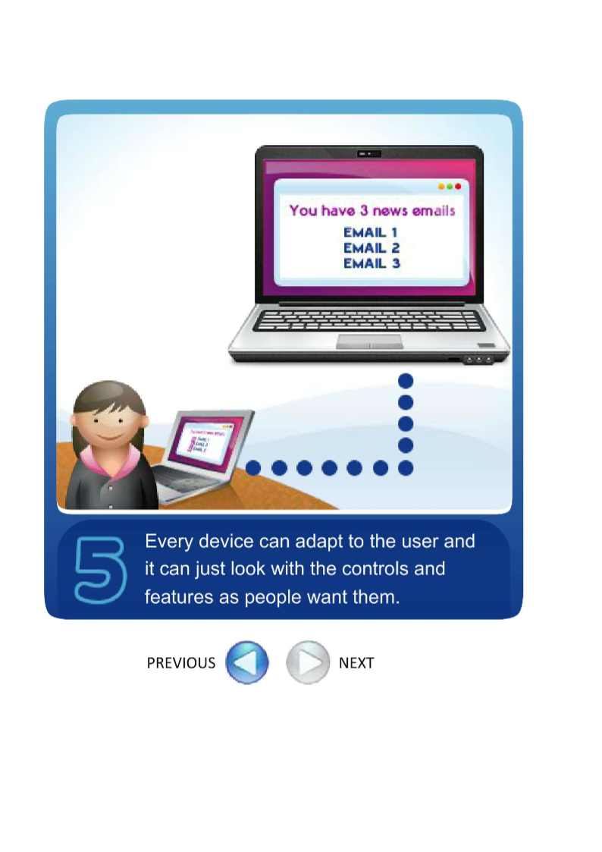
Happy User

Slide 38
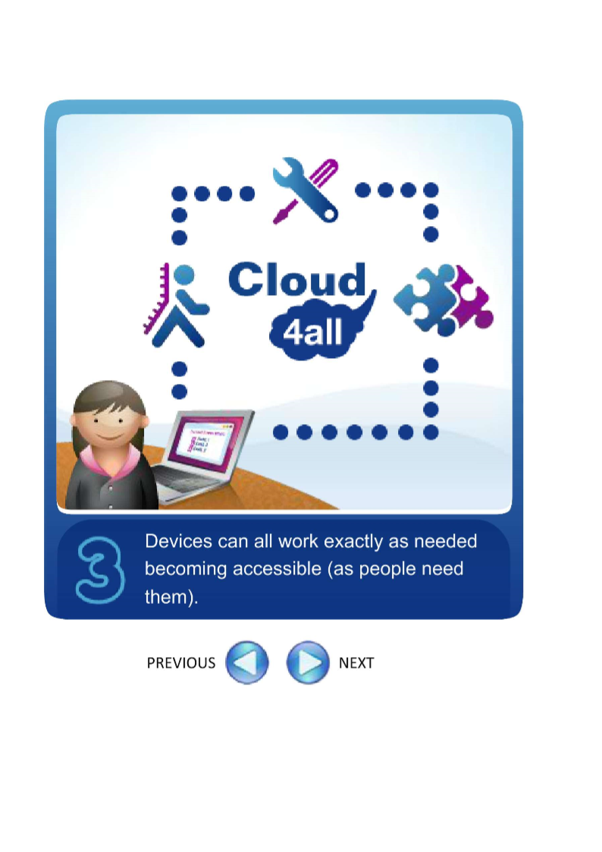
Cloud4All
Notes:
Cloud – users, solutions/devices, developers

Slide 39


Steve Lee
@stevealee
Ross Gardler
@rgardler
OpenDirective.com

Slide 40
GPII Video
Notes:
If we need to fill time

Slide 41
