Slide 1
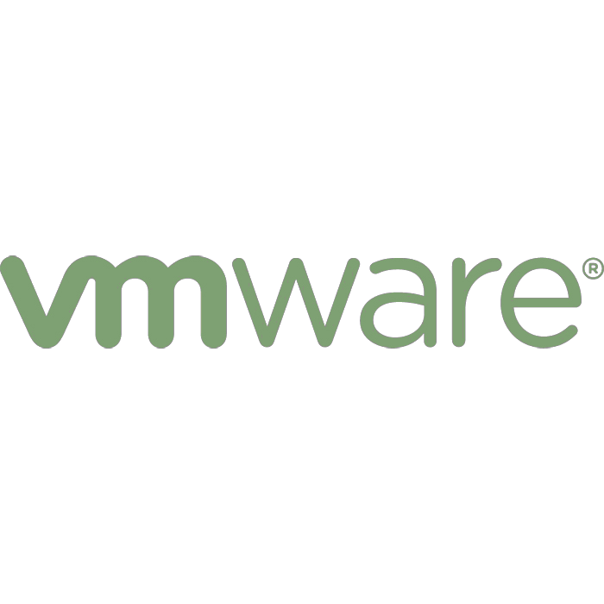
Elastic, Multi-tenant Hadoop on Demand
Richard McDougall,
Chief Architect, Application Infrastructure and Big Data, VMware, Inc
@richardmcdougll
ApacheCon Europe, 2012
  http://www.vmware.com/hadoop
  http://cto.vmware.com/
  http://projectserengeti.org
  http://github.com/vmware-serengeti

Slide 2

Broad Application of Hadoop technology
Horizontal Use Cases
Vertical Use Cases
Log Processing / Click Stream Analytics
Financial Services
Machine Learning / sophisticated data mining
Internet Retailer
Web crawling / text processing
Pharmaceutical / Drug Discovery
Extract Transform Load (ETL) replacement
Mobile / Telecom
Image / XML message
processing
Scientific Research
General archiving / compliance
Social Media
Hadoop’s ability to handle large unstructured data affordably and efficiently makes
it a valuable tool kit for enterprises across a number of applications and fields.

Slide 3
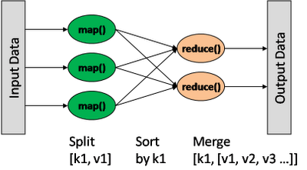
How does Hadoop enable parallel processing?
A framework for distributed processing of large data sets across clusters of computers using a simple programming model.
Source: http://architects.dzone.com/articles/how-hadoop-mapreduce-works

Slide 4
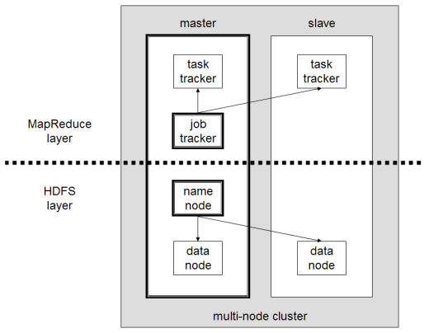
Hadoop System Architecture
MapReduce: Programming framework for highly parallel data processing
Hadoop Distributed File System (HDFS): Distributed data storage

Slide 5

Job Tracker Schedules Tasks Where the Data Resides
Job
Tracker
Job
Input File
Host 1
Host 2
Host 3
Split 1 – 64MB
Task
Tracker
Task
Tracker
Task
Tracker
Split 2 – 64MB
Split 3 – 64MB
Task - 1
Task - 2
Task - 3
DataNode
DataNode
DataNode
Input File
Block 1 – 64MB
Block 2 – 64MB
Block 3 – 64MB

Slide 6
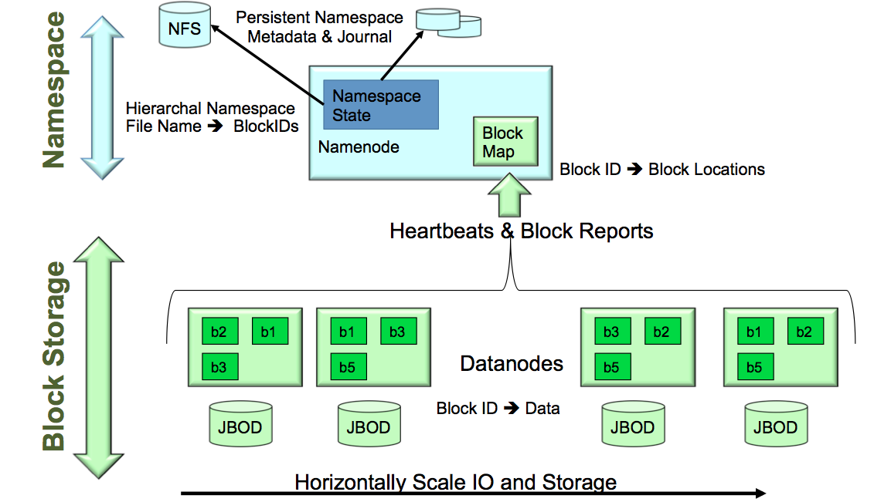
Hadoop Distributed File System

Slide 7
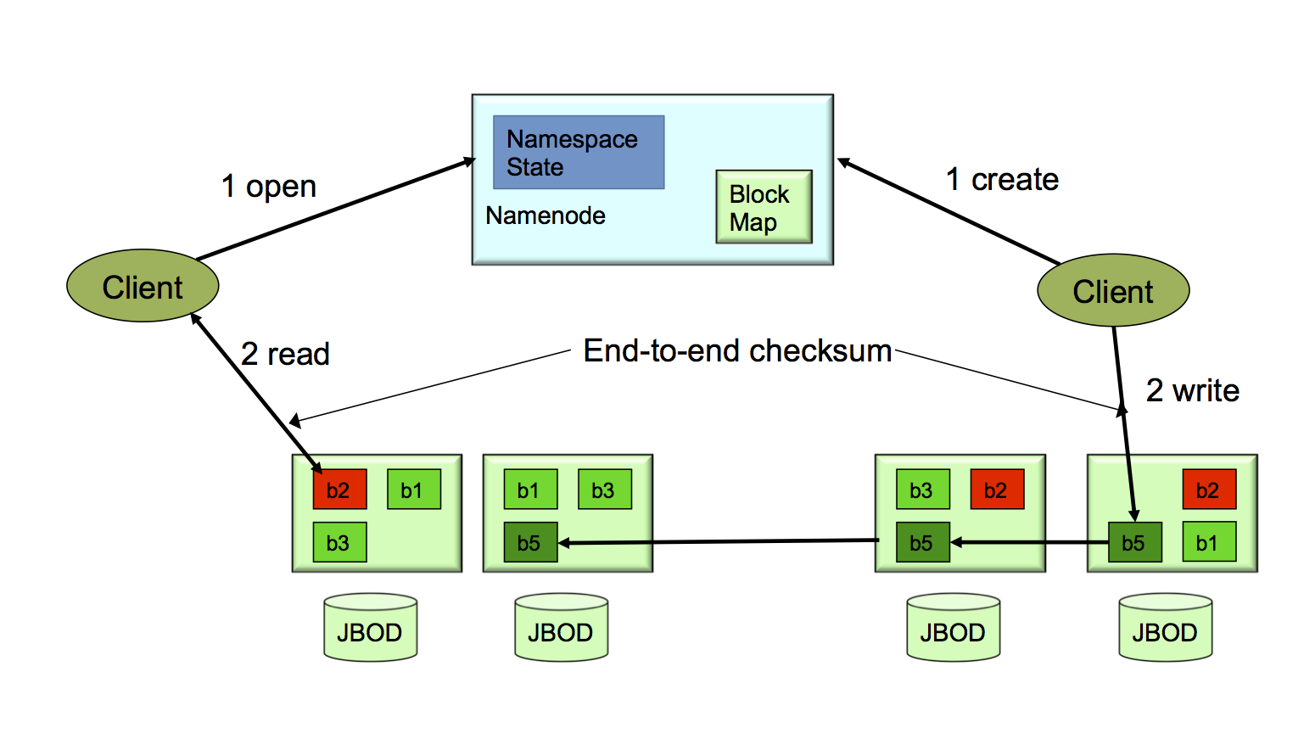
Hadoop Data Locality and Replication

Slide 8



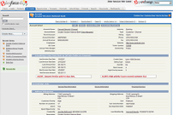
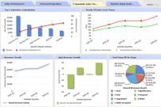





The Right Big Data Tools for the Right Job…
Real Time
Streams
(Social,
sensors)
Machine Learning
(Mahout, etc…)
Real-Time
Processing
(s4, storm,
spark)
Data Visualization
(Excel, Tableau)
ETL
Real Time
Database
(Shark,
Gemfire, hBase, Cassandra)
Interactive Analytics
(Impala,
Greenplum,
AsterData,
Netezza…)
HIVE
Batch
Processing
(Map-Reduce)
(Informatica, Talend, Spring Integration)
Structured and Unstructured Data
(HDFS, MAPR)
Cloud Infrastructure
Compute
Storage
Networking

Slide 9







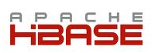

So yes, there’s a lot more than just Map-Reduce…
Hadoop
batch analysis
Big SQL –
Impala
NoSQL –
Cassandra,
Mongo, etc
Other
Spark,
Shark,
Solr,
Platfora,
Etc,…
Compute
layer
HBase
real-time queries
Data
layer
HDFS
Some sort of distributed, resource management OS + Filesystem
Host
Host
Host
Host
Host
Host
Host

Slide 10
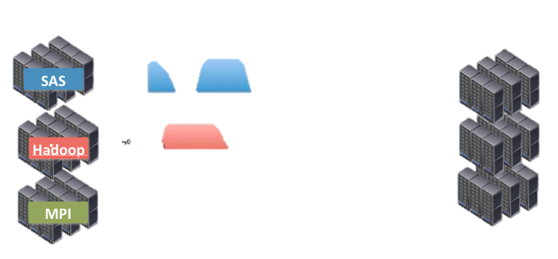
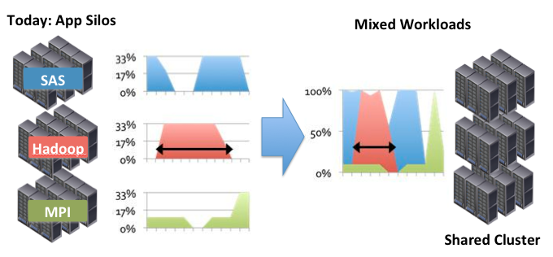
Elasticity Enables Sharing of Resources

Slide 11



Containers with Isolation are a Tried and Tested Approach
Reckless Workload 2
Hungry Workload 1
Sneaky
Workload 3
Some sort of distributed, resource management OS + Filesystem
Host
Host
Host
Host
Host
Host
Host

Slide 12
Mixing Workloads: Three big types of Isolation are Required
Resource Isolation
  Control the greedy noisy neighbor
  Reserve resources to meet needs
Version Isolation
  Allow concurrent OS, App, Distro versions
Security Isolation
  Provide privacy between users/groups
  Runtime and data privacy required
Some sort of distributed, resource management OS + Filesystem
Host
Host
Host
Host
Host
Host
Host

Slide 13

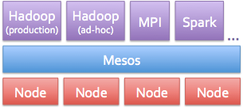
Community activity in Isolation and Resource Management
YARN
  Goal: Support workloads other than M-R on Hadoop
  Initial need is for MPI/M-R from Yahoo
  Not quite ready for prime-time yet?
  Non-posix File system self selects workload types
Mesos
  Distributed Resource Broker
  Mixed Workloads with some RM
  Active project, in use at Twitter
  Leverages OS Virtualization – e.g. cgroups
Virtualization
  Virtual machine as the primary isolation, resource management and versioned deployment container
  Basis for Project Serengeti

Slide 14
Project Serengeti – Hadoop on Virtualization
Simple to Operate
Highly Available
Elastic Scaling
  Rapid deployment
  Unified operations across enterprise
  Easy Clone of Cluster
  No more single point of failure
  One click to setup
  High availability for MR Jobs
  Shrink and expand cluster on demand
  Resource Guarantee
  Independent scaling of Compute and data
Serengeti is an Open Source Project to automate deployment of Hadoop on virtual platforms
http://projectserengeti.org
  http://github.com/vmware-serengeti

Slide 15


Common Infrastructure for Big Data
MPP DB
HBase
Hadoop
Virtualization Platform
Virtualization Platform
Hadoop
HBase
Cluster Consolidation
MPP DB
Simplify
  Single Hardware Infrastructure
  Unified operations
Cluster Sprawling
  Single purpose clusters for various business applications lead to cluster sprawl.
Optimize
  Shared Resources = higher utilization
  Elastic resources = faster on-demand access

Slide 16
Evolution of Hadoop on VMs
Slave Node
VM
VM
VM
VM
Current Hadoop:
Combined Storage/
Compute
Compute
T1
T2
VM
Storage
VM
Storage
Hadoop in VM
VM lifecycle
determined
by Datanode
Limited elasticity
Limited to Hadoop
Multi-Tenancy
Separate Storage
Separate compute
from data
Elastic compute
Enable shared
workloads
Raise utilization
Separate Compute Clusters
Separate virtual clusters
per tenant
Stronger VM-grade security
and resource isolation
Enable deployment of
multiple Hadoop runtime
versions

Slide 17
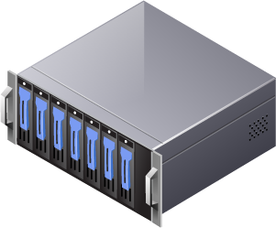
In-house Hadoop as a Service “Enterprise EMR” – (Hadoop + Hadoop)
Production
ETL of log files
Ad hoc
data mining
Compute
layer
Production
recommendation engine
Data
layer
HDFS
HDFS
Virtualization platform
Host
Host
Host
Host
Host
Host

Slide 18

Integrated Hadoop and Webapps – (Hadoop + Other Workloads)
Short-lived
Hadoop compute cluster
Compute
layer
Web servers
for ecommerce site
Hadoop
compute cluster
Data
layer
HDFS
Virtualization platform
Host
Host
Host
Host
Host
Host

Slide 19
Integrated Big Data Production – (Hadoop + other big data)
Hadoop
batch analysis
Big SQL –
Impala
NoSQL –
Cassandra,
Mongo, etc
Other
Spark,
Shark,
Solr,
Platfora,
Etc,…
Compute
layer
HBase
real-time queries
Data
layer
HDFS
Virtualization
Host
Host
Host
Host
Host
Host
Host

Slide 20
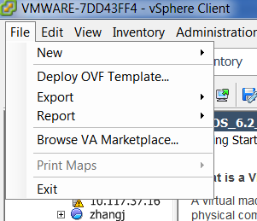
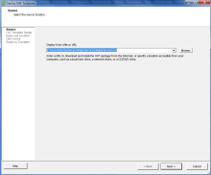
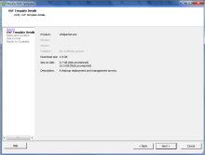
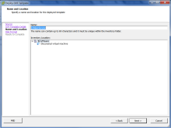
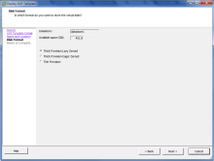
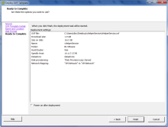
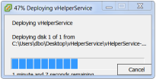
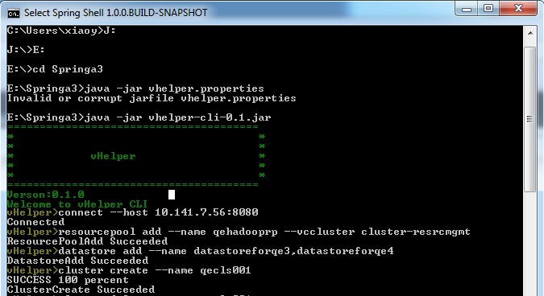
Deploy a Hadoop Cluster in under 30 Minutes
Step 1: Deploy Serengeti virtual appliance on vSphere.
Deploy vHelperOVF to vSphere
Step 2: A few simple commands to stand up Hadoop Cluster.
Select Compute, memory, storage and network
Select configuration template
Automate deployment
Done

Slide 21
A Tour Through Serengeti
$ ssh serengeti@serengeti-vm
$ serengeti
serengeti>

Slide 22
A Tour Through Serengeti
serengeti> cluster create --name dcsep
serengeti> cluster list
name: dcsep, distro: apache, status: RUNNING
NAME ROLES INSTANCE CPU MEM(MB) TYPE
-----------------------------------------------------------------------------
master [hadoop_namenode, hadoop_jobtracker] 1 6 2048 LOCAL 10
data [hadoop_datanode] 1 2 1024 LOCAL 10
compute [hadoop_tasktracker] 8 2 1024 LOCAL 10
client [hadoop_client, pig, hive] 1 1 3748 LOCAL 10

Slide 23
Serengeti Spec File
[
"distro":"apache", Choice of Distro
{
"name": "master",
"roles": [
"hadoop_NameNode",
"hadoop_jobtracker"
],
"instanceNum": 1,
"instanceType": "MEDIUM",
“ha”:true, HA Option
},
{
"name": "worker",
"roles": [
"hadoop_datanode", "hadoop_tasktracker"
],
"instanceNum": 5,
"instanceType": "SMALL",
"storage": { Choice of Shared Storage or Local Disk
"type": "LOCAL",
"sizeGB": 10
}
},
]

Slide 24
Fully Customizable Configuration Profile
Tune Hadoop cluster config in Serengeti spec file
Control the placement of Hadoop nodes
Setup physical racks/hosts mapping topology
Create Hadoop clusters using HVE topology
"configuration": {
"hadoop": {
"mapred-site.xml": {
"mapred.jobtracker.taskScheduler": "org.apache.hadoop.mapred.FairScheduler"
…
"placementPolicies": {
"instancePerHost": 2,
"groupRacks": {
"type": "ROUNDROBIN",
"racks": ["rack1", "rack2", "rack3“]
…
> topology upload --fileName <topology file name>
> topology list
> cluster create --name XXX --topology HVE --distro <HVE-supported_distro>

Slide 25
Getting to Insights
Point compute only cluster to existing HDFS
Interact with HDFS from Serengeti CLI
Launch MapReduce/Pig/Hive jobs from Serengeti CLI
Deploy Hive Server for ODBC/JDBC services
… "externalHDFS": "hdfs://hostname-of-namenode:8020", …
> fs ls /tmp
> fs put --from /tmp/local.data --to /tmp/hdfs.data
> cluster target --name myHadoop
> mr jar --jarfile /opt/serengeti/cli/lib/hadoop-examples-1.0.1.jar
--mainclass org.apache.hadoop.examples.PiEstimator --args "100 1000000000"
"name": "client",
"roles": [
"hadoop_client",
"hive",
"hive_server",
"pig"
], …

Slide 26
Configuring Distro’s
{
"name" : "cdh",
"version" : "3u3",
"packages" : [
{
"roles" : ["hadoop_NameNode", "hadoop_jobtracker",
"hadoop_tasktracker", "hadoop_datanode",
"hadoop_client"],
"tarball" : "cdh/3u3/hadoop-0.20.2-cdh3u3.tar.gz"
},
{
"roles" : ["hive"],
"tarball" : "cdh/3u3/hive-0.7.1-cdh3u3.tar.gz"
},
{
"roles" : ["pig"],
"tarball" : "cdh/3u3/pig-0.8.1-cdh3u3.tar.gz"
}
]
},

Slide 27

Serengeti Demo
Deploy Serengeti vApp on vSphere
Run MapReduce
Scale out the Hadoop cluster
Create a Customized Hadoop cluster
Deploy a Hadoop cluster in 10 Minutes
Use Your Favorite Hadoop Distribution
Serengeti Demo
Notes:
9 second

Slide 28
Serengeti Architecture http://github.com/vmware-serengeti
Serengeti CLI
(spring-shell)
Java
Ruby
Serengeti Server
Serengeti web service
DB
Resource
Mgr
Cluster
Mgr
Network
mgr
Task
mgr
Distro
mgr
Report deployment progress and summary
Deploy Engine Proxy (bash script)
Shell command to trigger deployment
RabbitMQ
(share with chef server)
Chef Orchestration Layer
(Ironfan)
service provisioning inside vms
^{Knife cluster cli}
^{package}
^{server}
Cloud Manager
Cluster provision engine
(vm CRUD)
download packages
Chef server
cookbooks/roles
data bags
Chef bootstrap nodes
Fog
download cookbook/recipes
vSphere Cloud provider
resource services
vCenter
Hadoop node
Hadoop node
Hadoop node
Hadoop node
Client VM
Chef-client
Chef-client
Chef-client
Chef-client
Chef-client

Slide 29




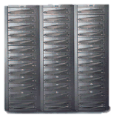
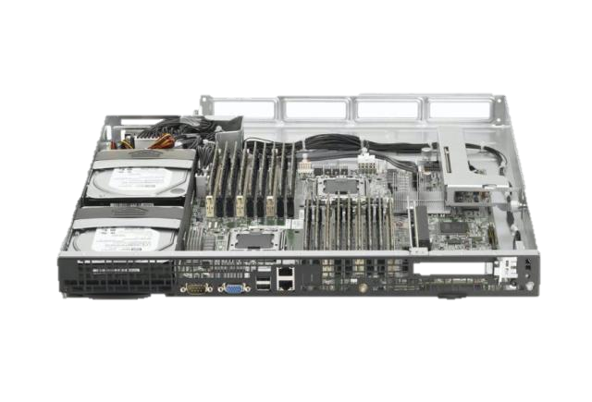

Use Local Disk where it’s Needed
SAN Storage
$2 - $10/Gigabyte
$1M gets:
0.5Petabytes
200,000 IOPS
8Gbyte/sec
NAS Filers
$1 - $5/Gigabyte
$1M gets:
1 Petabyte
200,000 IOPS
10Gbyte/sec
Local Storage
$0.05/Gigabyte
$1M gets:
10 Petabytes
400,000 IOPS
250 Gbytes/sec

Slide 30
Rules of Thumb: Sizing for Hadoop
Disk:
  Provide about 50Mbytes/sec of disk bandwidth per core
  If using SATA, that’s about one disk per core
Network
  Provide about 200mbits of aggregate network bandwidth per core
Memory
  Use a memory:core ratio of about 4Gbytes:core

Slide 31

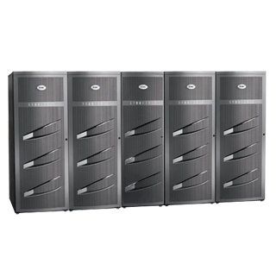
Extend Virtual Storage Architecture to Include Local Disk
Hybrid Storage
  SAN for boot images, VMs, other workloads
  Local disk for Hadoop & HDFS
  Scalable Bandwidth, Lower Cost/GB
Shared Storage: SAN or NAS
  Easy to provision
  Automated cluster rebalancing
Hadoop
Other VM
Other VM
Hadoop
Hadoop
Other VM
Hadoop
Hadoop
Other VM
Hadoop
Other VM
Other VM
Hadoop
Hadoop
Other VM
Hadoop
Hadoop
Other VM
Host
Host
Host
Host
Host
Host

Slide 32


Hadoop Using Local Disks
Other
Workload
Hadoop
Virtual
Machine
Task Tracker
Datanode
Ext4
Ext4
Ext4
Virtualization Host
OS Image - VMDK
VMDK
VMDK
VMDK
Shared
Storage
Notes:
Hybrid Storage
Local Disks, retains fault domains of individual disks

Slide 33
Native versus Virtual Platforms, 24 hosts, 12 disks/host

Slide 34
Local vs Various SAN Storage Configurations

Slide 35
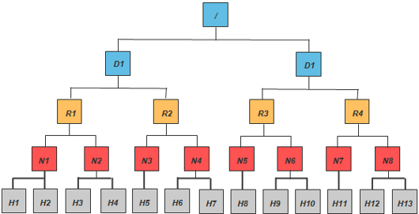
Hadoop Virtualization Extensions: Topology Awareness

Slide 36
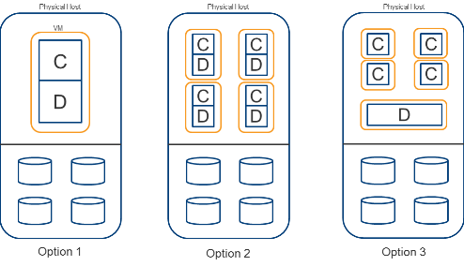
Virtual Topologies

Slide 37
Hadoop Topology Changes for Virtualization

Slide 38
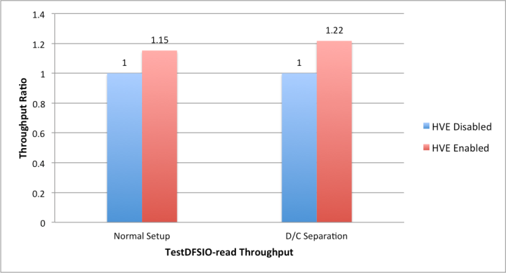
Hadoop Virtualization Extensions for Topology
HVE
Task Scheduling Policy Extension
Balancer Policy Extension
Replica Choosing Policy Extension
Replica Placement Policy Extension
Replica Removal Policy Extension
Network Topology Extension
Hadoop
HDFS
MapReduce
Hadoop Common
HADOOP-8468 (Umbrella JIRA)
HADOOP-8469
HDFS-3495
MAPREDUCE-4310
HDFS-3498
MAPREDUCE-4309
HADOOP-8470
HADOOP-8472

Slide 39
Why Virtualize Hadoop?
Simple to Operate
Highly Available
Elastic Scaling
  Rapid deployment
  Unified operations across enterprise
  Easy Clone of Cluster
  No more single point of failure
  One click to setup
  High availability for MR Jobs
  Shrink and expand cluster on demand
  Resource Guarantee
  Independent scaling of Compute and data

Slide 40
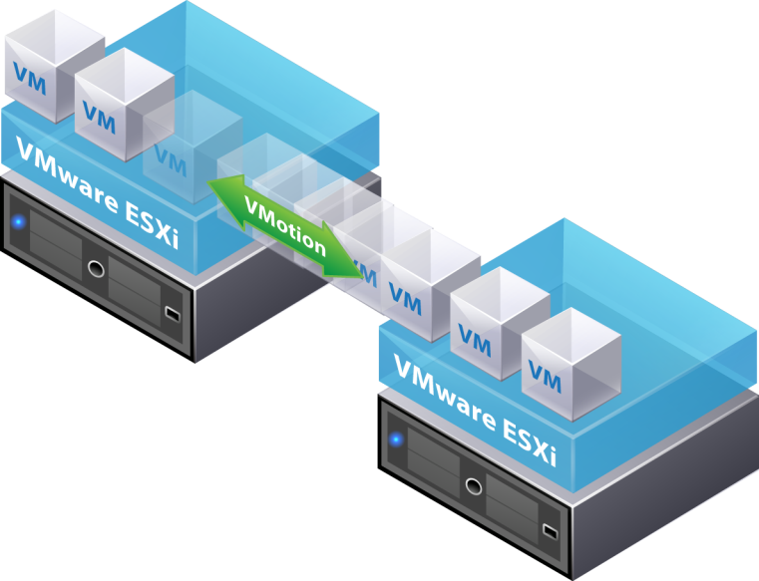
Live Machine Migration Reduces Planned Downtime
Description:
Enables the live migration of virtual machines from one host to another with continuous service availability.
Benefits:
  Revolutionary technology that is the basis for automated virtual machine movement
  Meets service level and performance goals
Notes:
40

Slide 41
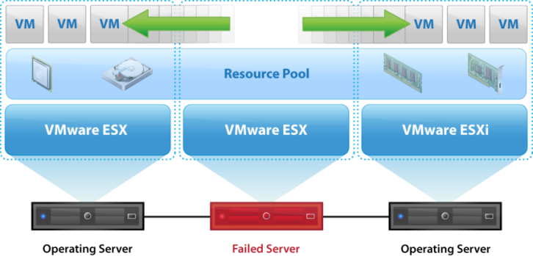
vSphere High Availability (HA) - protection against unplanned downtime
Overview
  Protection against host and VM failures
  Automatic failure detection (host, guest OS)
  Automatic virtual machine restart in minutes, on any available host in cluster
  OS and application-independent, does not require complex configuration changes

Slide 42

Example HA Failover for Hadoop
Serengeti
Server
Namenode
vSphere HA
Namenode
TaskTracker
HDFS Datanode
Hive
TaskTracker
HDFS Datanode
Hive
TaskTracker
HDFS Datanode
Hive
TaskTracker
HDFS Datanode
Hive
hBase
hBase
hBase
hBase

Slide 43


vSphere Fault Tolerance provides continuous protection
Overview
  Single identical VMs running in lockstep on separate hosts
  Zero downtime, zero data loss failover for all virtual machines in case of hardware failures
  Integrated with VMware HA/DRS
  No complex clustering or specialized hardware required
  Single common mechanism for all applications and operating systems
X
X
App
App
App
FT
App
App
App
App
HA
HA
OS
OS
OS
OS
OS
OS
OS
VMware ESX
VMware ESX
X
Zero downtime for Name Node, Job Tracker and other components in Hadoop clusters

Slide 44
High Availability for the Hadoop Stack
ETL Tools
BI Reporting
RDBMS
Pig (Data Flow)
Hive (SQL)
HCatalog
Hive MetaDB
Hcatalog MDB
MapReduce (Job Scheduling/Execution System)
Zookeepr (Coordination)
HBase (Key-Value store)
Jobtracker
Management Server
HDFS
(Hadoop Distributed File System)
Namenode
Server

Slide 45
Performance Effect of FT for Master Daemons
NameNode and JobTracker placed in separate UP VMs
Small overhead: Enabling FT causes 2-4% slowdown for TeraSort
8 MB case places similar load on NN &JT as >200 hosts with 256 MB

Slide 46
Why Virtualize Hadoop?
Simple to Operate
Highly Available
Elastic Scaling
  Rapid deployment
  Unified operations across enterprise
  Easy Clone of Cluster
  No more single point of failure
  One click to setup
  High availability for MR Jobs
  Shrink and expand cluster on demand
  Resource Guarantee
  Independent scaling of Compute and data

Slide 47
“Time Share”
Hadoop
Other VM
Hadoop
Hadoop
Hadoop
Other VM
Other VM
Other VM
Other VM
Other VM
Other VM
Other VM
Other VM
Other VM
Hadoop
Other VM
Other VM
Hadoop
Other VM
Other VM
Other VM
Serengeti
VMware vSphere
HDFS
HDFS
HDFS
Host
Host
Host
While existing apps run during the day to support business operations, Hadoop batch jobs kicks off at night to conduct deep analysis of data.

Slide 48
Hadoop Task Tracker and Data Node in a VM
Other
Workload
Virtual
Hadoop
Node
Task Tracker
Add/Remove
Slots?
Slot
Slot
Datanode
Grow/Shrink
by tens of GB?
Virtualization Host
VMDK
Grow/Shrink of a VM is one
approach

Slide 49
Add/remove Virtual Nodes
Other
Workload
Virtual
Hadoop
Node
Virtual
Hadoop
Node
Task Tracker
Task Tracker
Slot
Slot
Slot
Slot
Datanode
Datanode
Virtualization Host
VMDK
VMDK
Just add/remove more virtual nodes?

Slide 50
But State makes it hard to power-off a node
Other
Workload
Virtual
Hadoop
Node
Task Tracker
Slot
Slot
Datanode
Virtualization Host
VMDK
Powering off the Hadoop VM
would in effect fail the datanode

Slide 51
Adding a node needs data…
Other
Workload
Virtual
Hadoop
Node
Virtual
Hadoop
Node
Task Tracker
Task Tracker
Slot
Slot
Slot
Slot
Datanode
Datanode
Virtualization Host
VMDK
VMDK
Adding a node would require TBs of
data replication

Slide 52
Separated Compute and Data
Virtual
Hadoop
Node
Virtual
Hadoop
Node
Other
Workload
Task Tracker
Virtual
Hadoop
Node
Virtual
Hadoop
Node
Task Tracker
Slot
Task Tracker
Slot
Slot
Slot
Slot
Slot
Virtual
Hadoop
Node
Datanode
Virtualization Host
VMDK
VMDK
Truly Elastic Hadoop:
Scalable through virtual nodes

Slide 53


Dataflow with separated Compute/Data
Virtual
Hadoop
Node
Virtual
Hadoop
Node
NodeManager
Slot
Slot
Datanode
Virtual NIC
Virtual NIC
Virtualization Host
Virtual Switch
VMDK
NIC Drivers

Slide 54
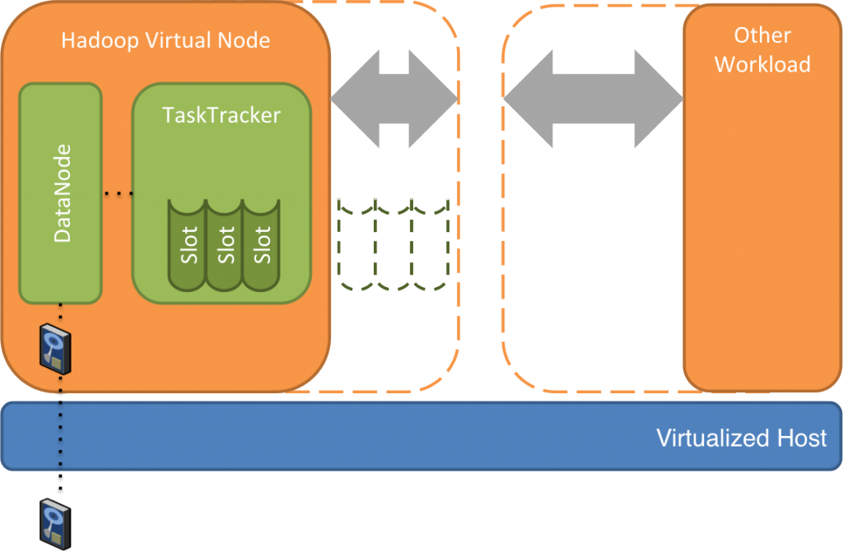
Elastic Compute
Set number of active TaskTracker nodes
Enable all the TaskTrackers in the cluster
> cluster limit --name myHadoop --nodeGroup worker --activeComputeNodeNum 8
> cluster unlimit --name myHadoop

Slide 55
Performance Analysis of Separation
Combined mode
Split Mode
1 Combined Compute/Datanode VM per Host
1 Datanode VM, 1 Compute node VM per Host
Task Tracker
Task Tracker
Task Tracker
Task Tracker
Datanode
Datanode
Datanode
Datanode
Workload: Teragen, Terasort, Teravalidate
HW Configuration: 8 cores, 96GB RAM, 16 disks per host x 2 nodes
Notes:
Some of you may ask, by separate compute and data, would I incur some type of performance penalty because now my compute vm needs to talk to my data vm. Our performance engineering team has investigated this extensively to quantify the impact of separation on performance.
One the left hand side is the combined mode, where the each vm contains both the compute and data node. On the right handside is the split mode, where compute and data nodes are in separate VM. We ran a series of benchmark workloads ranging from teragen, terasort, teravalidate in this study.

Slide 56
Performance Analysis of Separation
Minimum performance impact with separation of compute and data
Elapsed time: ratio to combined
Notes:
This chart shows the elapsed time to compete each benchmark, combined mode is shown in blue, while the split mode is in green. Everything is normalized against the combined mode, so combined mode is always 1, split mode is shown as a percentage of the combined mode. As you can see and What we learned is that the overhead is very small, ranging from 4% to 10% depending the benchmark. It’s small price to pay for the flexibility achieved with separation of data and compute.

Slide 57









Freedom of Choice and Open Source
Distributions
Community Projects
Flexibility to choose from major distributions
Support for multiple projects
Open architecture to welcome industry participation
Contributing Hadoop Virtualization Extensions (HVE) to open source community
cluster create --name myHadoop --distro apache

Slide 58
Elastic, Multi-tenant Hadoop on Demand
Richard McDougall,
Chief Architect, Application Infrastructure and Big Data, VMware, Inc
@richardmcdougll
ApacheCon Europe, 2012
  http://www.vmware.com/hadoop
  http://cto.vmware.com/
  http://projectserengeti.org
  http://github.com/vmware-serengeti

