Slide 1
Inside hadoop-dev
Steve Loughran– Hortonworks
@steveloughran
Apachecon EU, November 2012

Slide 2
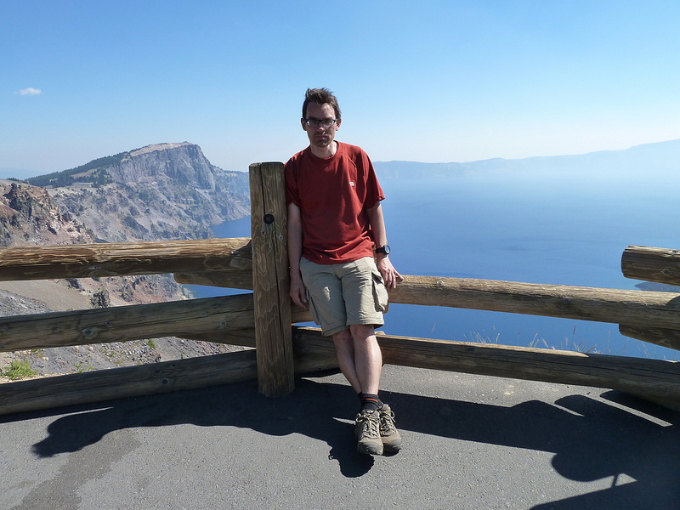
stevel@apache.org
HP Labs:
  Deployment, cloud infrastructure, Hadoop-in-Cloud
Apache – member and committer
  Ant (author, Ant in Action), Axis 2
  HadoopJoined Hortonworks in 2012
  UK based R&D
Notes:
This is my background: key point until 2012 I was working on my own things inside a large organisation; now I am FTE on Hadoop

Slide 3
Hadoop is the OS for the datacentre

Slide 4



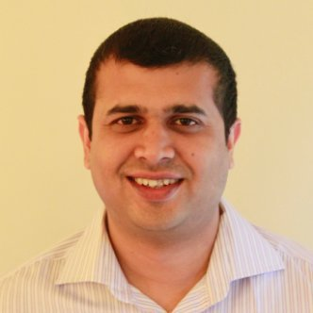
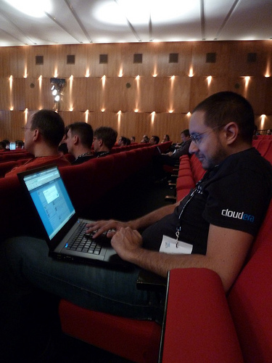

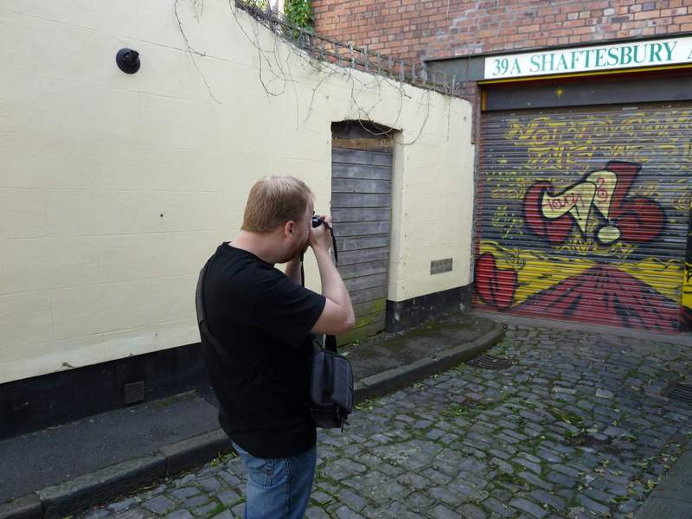
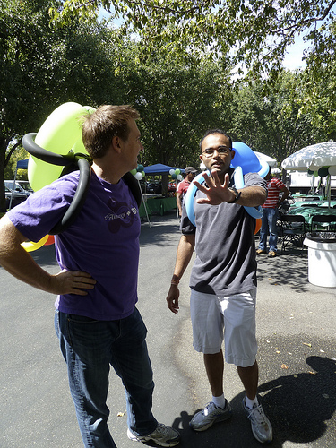
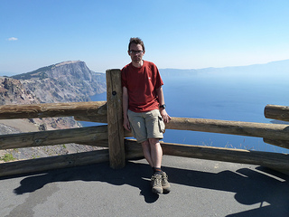




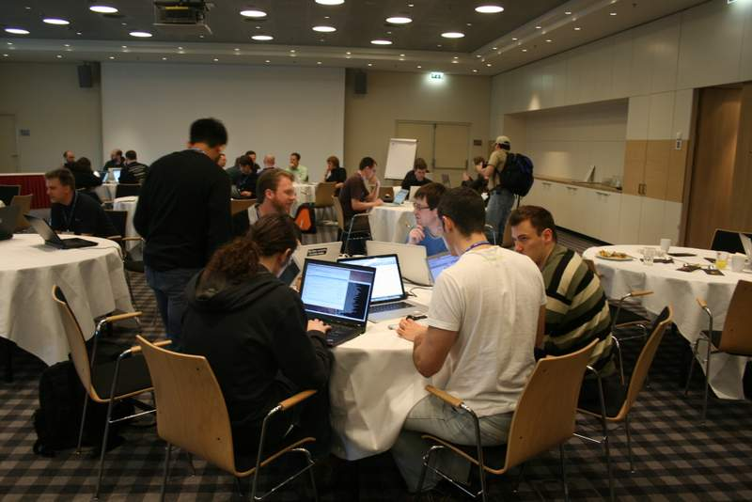


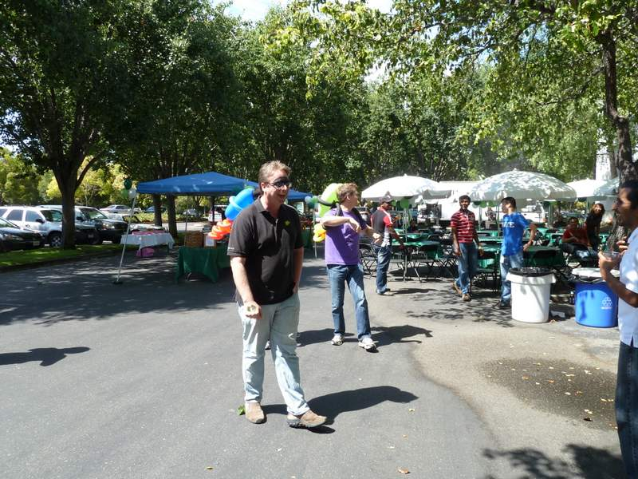






Slide 5
History: ASF releases slowed
64 Releases from 2006-2011
Branches from the last 2.5 years:
  0.20.{0,1,2} – Stable release without security
  0.20.2xx.y – Stable release with security
  0.21.0 – released, unstable, deprecated
  0.22.0 – orphan, unstable, lack of community
  0.23.x
Cloudera CDH: fork w/ patches pushed back

Slide 6
Now: 2 ASF branches
Hadoop 1.x
Stable, used in production systems
Features focus on fixes & low-risk performance
Hadoop 2.x/trunk
The successor
Alpha-release. Download and test
Where features & fixes first go in
Your new code goes here.
Notes:
There's a CoI here between trunk features and branch-1 commits -the latter get into people's hands faster, but threaten the very feature -stability- that justifies branch-1's existence.
All the interesting stuff goes into trunk, which is where I push most of my patches (it's easier to avoid backporting)

Slide 7











Loosely coupled projects form the stack

Slide 8




Incubating & graduate projects
Kafka
Giraph
HCatalog
templeton
Ambari

Slide 9



Integration is a major undertaking
Latest ASF artifacts
Stable, tested
ASF artifacts
ASF + own artifacts
Notes:
Bigtop is ±Fedora: bleeding edge -but also defines RPM installation layout and startup scripts for everyone, for consistency.
Hortonworks -trails with the stable artifacts, team manages the Apache Hadoop releases and QA team tests all.
Cloudera do a mix of ASF + Apache; got own fork of Hadoop with different set/ordering of patches,.
CDH vs HDP is a matter of argument.
One thing to know is that everyone now tends to use Git to manage their individual branches

Slide 10
What does all this mean?

Slide 11
There is more work than we can cope with

Slide 12
Hadoop is CS-Hard
Core HDFS, MR and YARN
  Distributed Computing
  Consensus Protocols & Consistency Models
  Work Scheduling & Data Placement
  Reliability theory
  CPU Architecture; x86 assembler
Others
  Machine learning
  Distributed Transactions
  Graph Theory
  Queue Theory
  Correctness proofs

Slide 13
If you have these skills, come and play!
http://hortonworks.com/careers/
Notes:
If you thinjk

Slide 14
But there are barriers
Notes:
If you thinjk

Slide 15
Your time & cluster
Full time core business @ Hortonworks + Cloudera
Full time projects at others:
LinkedIn, IBM, MSFT, VMWare
Single developers can't compete
Small test runs take too long
Your cluster probably isn't as big as Yahoo!'s
Commit-then-review neglects everyone's patches

Slide 16
Fear of damage
The worth of Hadoop is the data in HDFS
the worth of all companies whose data it is
cost to individuals of data loss
cost to governments of losing their data
∴ resistance to radical changes in HDFS
Scheduling performance worth $100Ks to individual organisations
∴ resistance to radical work in compute layer except by people with track record

Slide 17
Fear of support and maintenance costs
What will show up on Yahoo!-scale clusters?
Costs of regression testing
Who maintains the code if the author disappears?
Documentation?
The 80%-done problem

Slide 18
How to get your code in
Trust: get known in the -dev lists, meet-ups
Competence: help with patches other than your own.
Don't attempt rewrites of the core services
Help develop plugin-points
Test across the configuration space
Test at scale, complexity, “unusualness”
Notes:
Plugin points: yes, I think google guice would be the alternative, but, well…

Slide 19
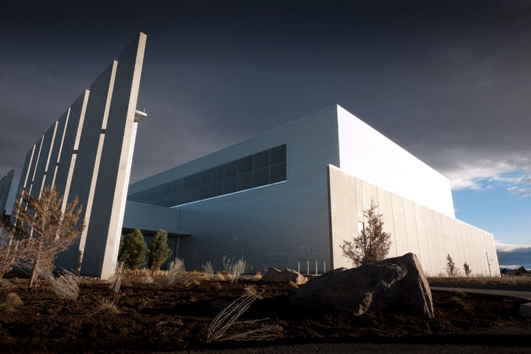
Testing: not just for the 1%
Notes:
Most people here do not have 500+ clusters with double digit PB of storage. Those clusters are the best for the stress testing of the storage and computer layers -but only a few people have them at this scale: Y! FB. We use Y!'s test clusters for all the apache & Hortonworks releases,

Slide 20
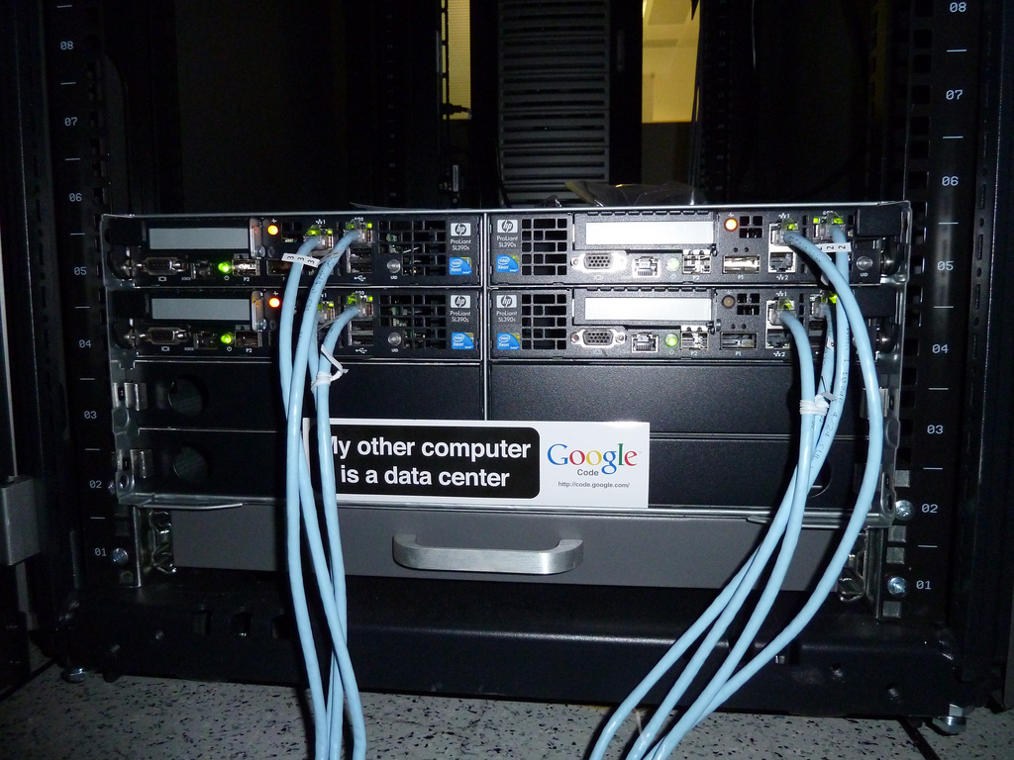
Testing: not just for the 1%
you have network and scale issues
Notes:
you have your own issues. Does it scale down enough? does it assume the LAN is well managed, clocks in sync, DNS and rDNS works. Your problems -especially the networking ones -are your own. This is why testing them matters

Slide 21


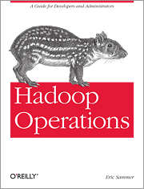

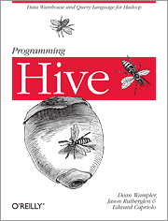




Documentation & Books
Notes:
I'm proposing people write books for the benefit of the project, not the fame and money with comes with writing a book, Anyone else who has written a book will know precisely why I'm doing that.

Slide 22
Challenge: Major Works
YARN and HDFS HA
  Branch w/out RTC then review at merge
  Agile; merge costs scale w/ duration of branch
Independent works
  Things that didn't get in -my lifecycle work, …
  VMWare virtualisations –initial failure topology
  how best to get this stuff in
Postgraduate Research
  How to get the next generation of postgraduate researchers developing in and with Apache Hadoop?

Slide 23
A mentoring program?
Guided support for associated projects, the goal to be to merge into the Hadoop codebase.
Who has the time to mentor?
Notes:
We do have this for the Apache Incubator -but they are projects above and alongside the existing codebase. I'm wondering here how to get medium-sized bits of work done in a way that is timely, not wasted.

Slide 24
Better Distributed Development
Regional developer workshops
  with local university participation?
Online meet-ups: google+ hangouts?
  Shared IDEA or other editor sessions
  Remote presentations and demos
Notes:
There's no easy answers here, but here are some things I think could be good
Git workflow support. Stops people having to resubmit patches all the time; git pull can be used to grab and apply a patch.
Gerrit code review -makes reviewing much, much easier.
We have HUG events -but they tend to not normally delve into the codebase. I'm proposing doing exactly that -in regions other than just the Bay Area. I will back this up by offering to host an all day one at a bar/café near me in Bristol if enough people are interested., I'm also advocating university involvement so that they get more of an idea of Hadoop internals.
For those of outside the Bay Area, remote events are good. We've had some good webex'd events recently (e.g. the YARN one), but could do with more. I'd like to see something more interactive, and think we could/should try with an online only google+ hangout coding event, possibly using a shared IDE.

Slide 25
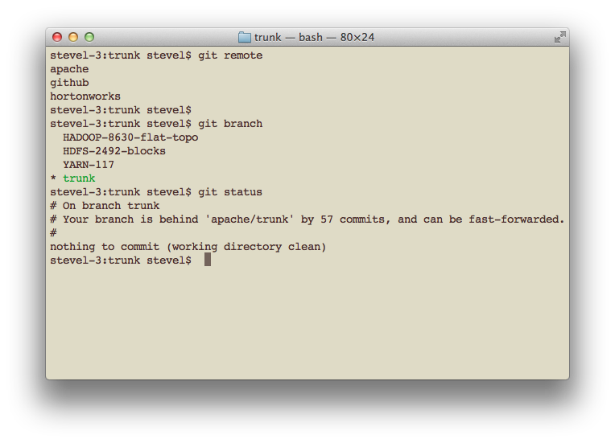
Git + Gerrit

Slide 26
Get involved!
svn.apache.org
issues.apache.org
{hadoop,hbase, mahout, pig, oozie, …}.apache.org

Slide 27
hortonworks.com

