Slide 1


Taking the guesswork out of your Hadoop Infrastructure
Steve Watt HP Hadoop Chief Technologist
Paul Denzinger HP Hadoop Performance Lead
© Copyright 2012 Hewlett-Packard Development Company, L.P. The information contained herein is subject to change without notice.

Slide 2
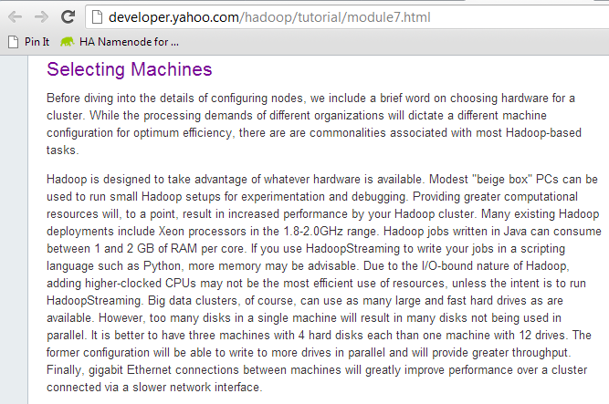
Agenda – Clearing up common misconceptions
Web Scale Hadoop Origins
Single Socket 1.8 GHz
4-8 GB RAM
2-4 Cores
1x 1GbE NIC
(2-4) x 1 TB SATA Drives
Commodity in 2012
Dual Socket 2+ GHz
24-48 GB RAM
4-6 Cores
(2-4) x 1GbE NICs
(4-14) x 2 TB SATA Drives
The enterprise perspective is also different
Notes:
The average enterprise customers are running 1 or 2 Racks in Production. In that scenario, you have redundant switches in each RACK and you RAID Mirror the O/S and Hadoop Runtime and JBOD the Data Drives because losing Racks and Servers is costly. VERY Different to the Web Scale perspective.

Slide 3



You can quantify what is right for you
Balancing Performance and Storage Capacity with Price
$
PRICE
Storage
Capacity
Performance
Notes:
Hadoop Slave Server Configurations are about balancing the following:
Performance (Keeping the CPU as busy as possible)
Storage Capacity (Important for HDFS)
Price (Managing the above at a price you can afford)
Commodity Servers do not mean cheap. At scale you want to fully optimize performance and storage capacity for your workloads to keep costs down.

Slide 4
“We’ve profiled our Hadoop applications so we know what type of infrastructure we need”
Said no-one. Ever.
Notes:
So as any good Infrastructure Designer will tell you… you begin by Profiling your Hadoop Applications.

Slide 5
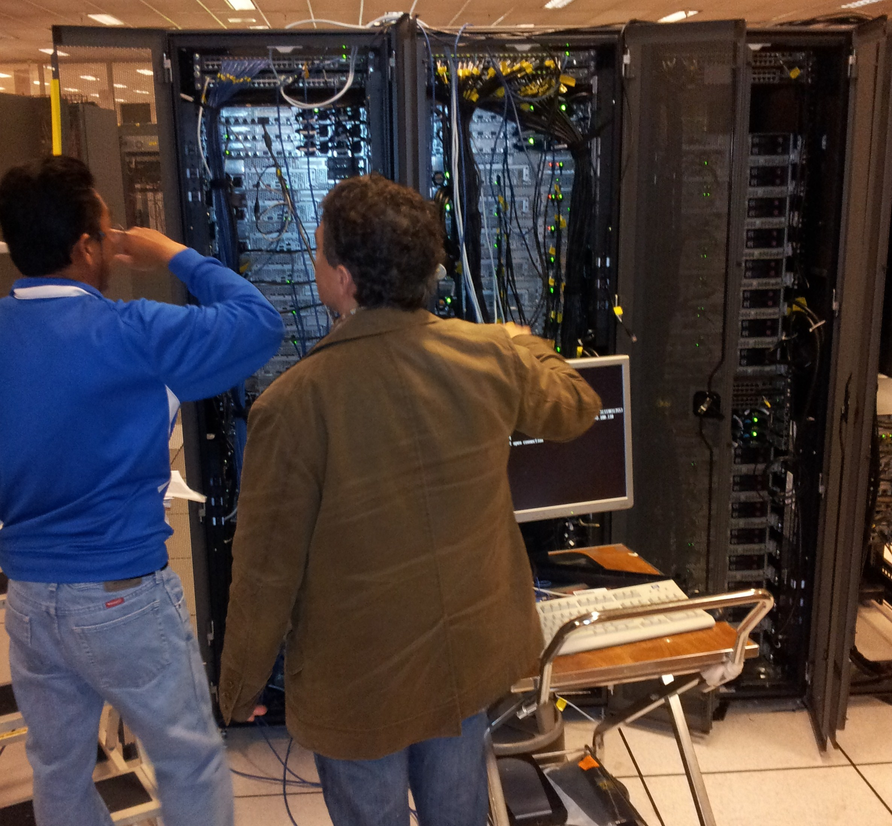
Profiling your Hadoop Cluster
High Level Design goals
Its pretty simple:
Instrument the Cluster
Run your workloads
Analyze the Numbers
Don’t do paper exercises. Hadoop has a way of blowing all your hypothesis out of the water.
Lets walk through a 10 TB TeraSort on Full 42u Rack:
2 x HP DL360p (JobTracker and NameNode)
18 x HP DL380p Hadoop Slaves (18 Maps, 12 Reducers)
64 GB RAM, Dual 6 core Intel 2.9 GHz, 2 x HP p420 Smart Array Controllers, 16 x 1TB SFF Disks, 4 x 1GbE Bonded NICs

Slide 6

Instrumenting the Cluster
The key is to capture the data. Use whatever framework you’re comfortable with
Analysis using the Linux SAR Tool
Outer Script starts SAR gathering scripts on each node. Then starts Hadoop Job.
SAR Scripts on each node gather I/O, CPU, Memory and Network Metrics for that node for the duration of the job.
Upon completion the SAR data is converted to CSV and loaded into MySQL so we can do ad-hoc analysis of the data.
Aggregations/Summations done via SQL.
Excel is used to generate charts.

Slide 7
Examples
Performed for each node – results copied to repository node
sadf csv files:
ssh wkr01 sadf -d sar_test.dat -- -u > wkr01_cpu_util.csv
ssh wkr01 sadf -d sar_test.dat -- -b > wkr01_io_rate.csv
ssh wkr01 sadf -d sar_test.dat -- -n DEV > wkr01_net_dev.csv
ssh wkr02 sadf -d sar_test.dat -- -u > wkr02_cpu_util.csv
ssh wkr02 sadf -d sar_test.dat -- -b > wkr02_io_rate.csv
ssh wkr02 sadf -d sar_test.dat -- -n DEV > wkr02_net_dev.csv
…
/home
/sar_repository
repos
wkr01_cpu_util.csv
wkr01_io_rate.csv
wkr01_net_dev.csv
wkr02_cpu_util.csv
wkr02_io_rate.csv
wkr02_net_dev.csv
File name is prefixed with node name (i.e., “wrknn”)

Slide 8
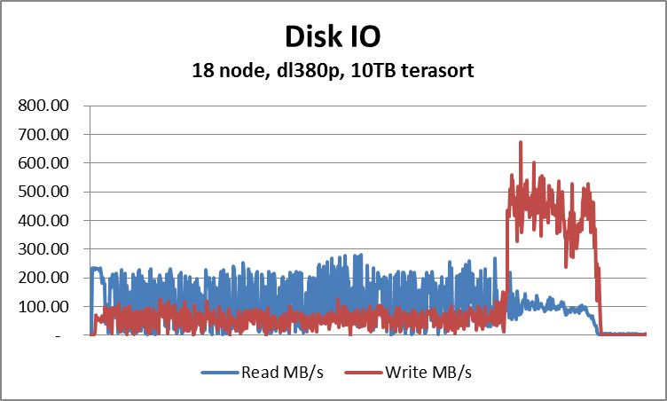
I/O Subsystem Test Chart
I/O Subsystem has only around 10% of Total Throughput Utilization
RUN the DD Tests first to understand what the Read and Write throughput capabilities of your I/O Subsystem
X axis is time
Y axis is MB per second
TeraSort for this server design is not I/O bound. 1.6 GB/s is upper bound, this is less than 10% utilized.

Slide 9
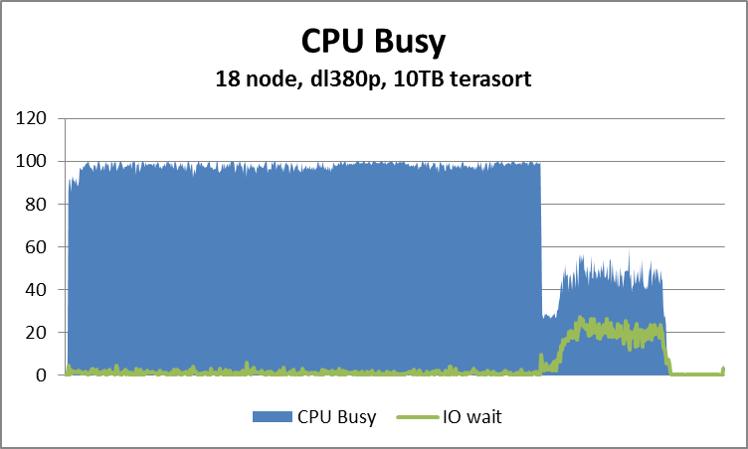
CPU Subsystem Test Chart
CPU Utilization is High, I/O Wait is low – Where you want to be
Each data point is taken every 30 seconds
Y axis is percent utilization of CPUs
X axis is timeline of the run
CPU Utilization is captured by analyzing how busy each core is and creating an average
IO Wait (1 of 10 other SAR CPU Metrics) measures percentage of time CPU is waiting on I/O
Notes:
But generally speaking, you design a pretty decent cluster infrastructure baseline that you can later optimize, provided you get these things right.

Slide 10
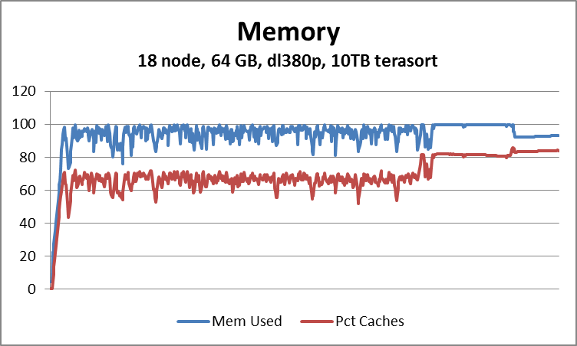
Memory Subsystem Test Chart
High Percentage Cache Ratio to Total Memory shows CPU is not waiting on memory
X axis is Memory Utilization
Y axis is elapsed time
Percent Caches is a SAR Memory Metrics (kb_cached). Tells you how many blocks of memory are cached in the Linux Memory Page Cache. The amount of memory used to cache data by the kernel.
Means we’re doing a good job of caching data so the JVM is not having to do I/Os and incurring I/O wait time (reflected in the previous slide)

Slide 11
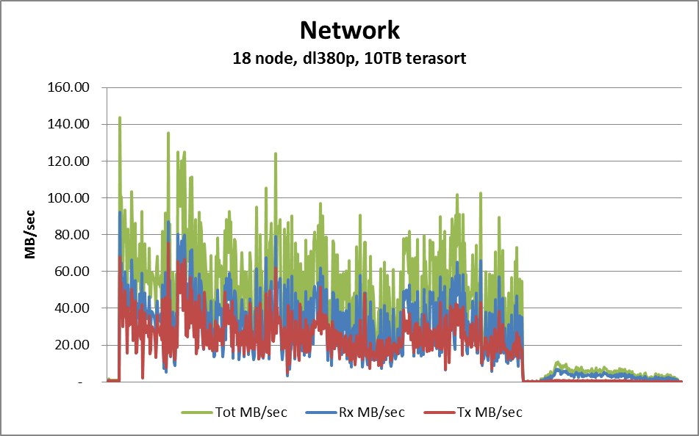
Network Subsystem Test Chart
Network throughput utilization per server less than a ¼ of capacity
A 1GbE NICs can drive up to 1Gb/s for Reads and 1Gb/s for Writes which is roughly 4 Gb/s or 400 MB/s total across all bonded NICs
Y axis is throughput
X axis is elapsed time
Rx = Received MB/sec
Tx = Transmitted MB/sec
Tot = Total MB/sec

Slide 12
HBase Testing – Results still TBD
YCSB Workload A and C unable to Drive the CPU
2 Workloads Tested:
YCSB workload “C” : 100% read-only requests, random access to DB, using a unique primary key value
YCSB workload “A” : 50% read and 50% updates, random access to DB, using a unique primary key value
When data is cached in HBase cache, performance is really good and we can occupy the CPU. Ops throughput (and hence CPU Utilization) dwindles when data exceeds HBase cache but is available in Linux cache. Resolution TBD – Related JIRA HDFS-2246

Slide 13


Tuning from your Server Configuration baseline
We’ve established now that the Server Configuration we used works pretty well. But what if you want to Tune it? i.e. sacrifice some performance for cost or to remove an I/O, Network or Memory limitation?
Types of Disks / Controllers
Number of Disks / Controllers
Type (Socket R 130 W vs.
Socket B 95 W)
Amount of Cores
Amount of Memory Channels
4GB vs. 8GB DIMMS
I/O Subsystem
COMPUTE
Floor Space (Rack Density)
Power and Cooling Constraints
Type of Network
Amount of Server of NICs
Switch Port Availability
Deep Buffering
Data CENTER
Network

Slide 14


Balanced Hadoop Master and Slave Configurations
NameNode and JobTracker Configurations
- 1u, 64GB of RAM, 2 x 2.9 GHz 6 Core Intel Socket R Processors, 4 Small Form Factor Disks, RAID Configuration, 1 Disk Controller
Hadoop Slave Configurations
2u 48 GB of RAM, 2 x 2.4 GHz 6 Core Intel Socket B Processors, 1 High Performing Disk Controller with twelve 2TB Large Form Factor Data Disks in JBOD Configuration
24 TB of Storage Capacity, Low Power Consumption CPU
Annual Power and Cooling Costs of a Cluster are 1/3 the cost of acquiring the cluster
– Tpapi (Flickr)
Notes:
In reality, you don’t want Hadoop Clusters popping up all over the place in your company. It becomes untenable to manage. You really want a single large cluster managed as a service.
If that’s the case then you don’t want to be optimizing your cluster for just one workload, you want to be optimizing this for multiple concurrent workloads (dependent on scheduler) and have a balanced cluster.

Slide 15
Single Rack Config
Single rack configuration
This rack is the initial building block that configures all the key management services for a production scale out cluster to 4000 nodes.
42u rack enclosure
1u 1GbE Switches
2 x 1GbE TOR switches
1u 2 Sockets, 4 Disks
1 x Management node
2u 2 Sockets, 12 Disks
1 x JobTracker node
1 x Name node
(3-18) x Worker nodes
2u 2 Sockets, 12 Disks
Open for KVM switch
Open 1u

Slide 16
Multi-Rack Config
1u Switches
2 x 10 GbE Aggregation switch
Scale out configuration
The Extension building block. One adds 1 or more racks of this block to the single rack configuration to build out a cluster that scales to 4000 nodes.
1 or more 42u Racks
Single rack RA
1u 1GbE Switches
2 x 1GbE TOR switches
2u 2 Sockets, 12 Disks
19 x Worker nodes
Open for KVM switch
2u 2 Sockets, 12 Disks
Open 2u

Slide 17
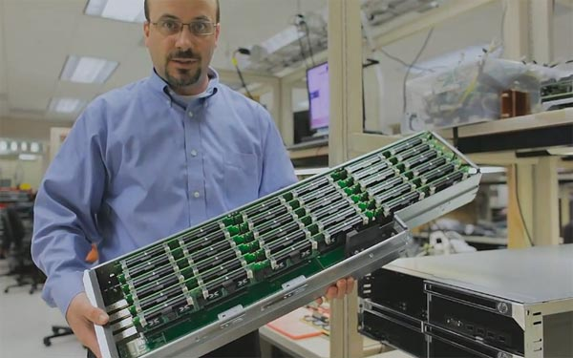
System on a Chip and Hadoop
Intel ATOM and ARM Processor Server Cartridges
Hadoop has come full circle
4-8 GB RAM
4 Cores 1.8 GHz
2-4 TB
1 GbE NICs
Amazing Density Advances. 270 + servers in a Rack (compared to 21!).
Trevor Robinson from Calxeda is a member of our community working on this. He’d love some help:
trevor.robinson@calxeda.com

Slide 18
Thanks! Any Questions?
Steve Watt swatt@hp.com @wattsteve
Paul Denzinger paul.denzinger@hp.comzinger@hp.com
hp.com/go/hadoop
S, Chief Technologist - Hadoop
June 2012

