Slide 1


Building cross-platform hybrid applications using AMQP 1.0 with Apache Qpid
David Ingham (Microsoft)
Robert Godfrey (JP Morgan Chase)
William Henry (Red Hat)

Slide 2

Agenda
Introduction to messaging
The case for a standard protocol
What is AMQP 1.0?
AMQP 1.0 implementations
Demo with code drill-down
Summary

Slide 3



Tightly Coupled
Drivers
Tracking
Store Front End
Shipping Service

Slide 4



Tightly Coupled
Drivers
Tracking
Store Front End
Shipping Service

Slide 5
Loosely Coupled
Drivers
Tracking
Store Front End
Order Queue
Shipping Service

Slide 6

Loosely Coupled
Drivers
Tracking
Store Front End
Order Queue
Shipping Service

Slide 7
Loosely Coupled
Drivers
Tracking
Store Front End
Order Queue
Shipping Service

Slide 8



Loosely Coupled
Tracking
Tracking
Store Front End
Order Queue
Shipping Service

Slide 9
Messaging concepts: queuing
S
R
Queue
R
S
S
R

Slide 10
Messaging concepts: pub/sub
S
R
Subs
Topic
S
R
R
R
S
R

Slide 11
Messaging concepts: message
Message
Properties
Properties
Key/value pairs exposed to the broker
Subscription rules can filter based on properties
Body
Opaque payload not exposed to the broker
Can be used for encrypted data
Key
Value
Key
Value
Key
Value
Key
Value
Body
Body

Slide 12
Message-oriented middleware allows application modules to be distributed over heterogeneous platforms and reduces the complexity of developing applications that span multiple operating systems … -- Wikipedia entry for message-oriented middleware

Slide 13

Proprietary messaging protocols
Difficult to port applications
Requires re-coding all applications
Difficult to integrate
Application level bridges to move messages and translate message formats
Restricted platform support
Limited to whatever vendor provides

Slide 14

AMQP 1.0 Advanced Message Queuing Protocol
Open, standard messaging protocol
Enables cross-platform apps to be built using brokers, libraries and frameworks from different vendors
Features
Efficient – binary connection-oriented protocol
Reliable – fire-and-forget to reliable, exactly-once delivery
Portable data representation – cross-platform, full-fidelity exchange
Flexible – peer-peer, client-broker, and broker-broker topologies
Broker-model independent – no requirements on broker internals
AMQP
Notes:
Efficient: AMQP 1.0 is a connection-oriented protocol that uses a binary encoding for the protocol instructions and the business messages transferred over it. It incorporates sophisticated flow-control schemes to maximize the utilization of the network and the connected components. That said, the protocol was designed to strike a balance between efficiency, flexibility and interoperability.
Reliable: The AMQP 1.0 protocol allows messages to be exchanged with a range of reliability guarantees, from fire-and-forget to reliable, exactly-once acknowledged delivery.
Flexible: AMQP 1.0 is a flexible protocol that can be used to support different topologies. The same protocol can be used for client-to-client, client-to-broker, and broker-to-broker communications.
Broker-model independent: The AMQP 1.0 specification does not make any requirements on the messaging model used by a broker. This means that it’s possible to easily add AMQP 1.0 support to existing messaging brokers.

Slide 15

OASIS AMQP 1.0 Standard released
Last week OASIS announced the ratification of the AMQP 1.0 Standard
Software vendors and end-users can bet on AMQP 1.0 knowing it’s a stable, well-supported protocol standard
The culmination of several years effort by more than 20 companies
Technology vendors: Axway Software, Huawei Technologies, IIT Software, INETCO Systems, Kaazing, Microsoft, Mitre Corporation, Primeton Technologies, Progress Software, Red Hat, SITA, Software AG, Solace Systems, VMware, WSO2, Zenika. User firms: Bank of America, Credit Suisse, Deutsche Boerse, Goldman Sachs, JPMorgan Chase.

Slide 16
“AMQP 1.0 is a novel addition to the growing toolkit of open protocols for transporting data between systems and virtualized application delivery. Standard transports enable lower cost business integration and messaging. AMQP 1.0 admits many use cases by defining safe message transfer between peers, without the constraint of a message broker model. With its open license, we anticipate both AMQP's wide adoption by messaging servers, and its use as a new API for database and integration products.” --Alexis Richardson, Senior Director
VMware

Slide 17
“Red Hat is pleased to see the hard work of the Technical Committee come to fruition. We are a founding member of the AMQP Technical Committee and have been active on the specification since the early days. AMQP 1.0 represents a significant improvement in the messaging arena and we expect to continue to support it in our products to best customer needs.” -- Mark Little, Vice President, Middleware Engineering
Red Hat

Slide 18
“A platform independent and vendor neutral protocol like AMQP removes hurdles in advancing interoperability of message-oriented middleware technologies. As a founding sponsor member of the AMQP TC and the related AMQP Steering Committee, Software AG is very pleased to see AMQP 1.0 transition to an OASIS Standard. Software AG supports numerous standards in its product suite, and AMQP has been an important addition to webMethods Nirvana, increasing interoperability and providing advanced messaging capabilities to our customers.” -- Prasad Yendluri, VP & Deputy CTO
SoftwareAG

Slide 19
“As the enablers of the Living Web and HTML5 WebSocket technology, everyone at Kaazing is excited to support OASIS' ongoing efforts to proliferate open standards and create a superior user web experience. Standardizing AMQP and combining it with WebSocket technology is an excellent strategy when building an event driven architecture. Working alongside OASIS, Kaazing has developed a Living Web in order to create the best possible web experience for users, reduce complexity, and increase interoperability.” -- John Fallows, CTO and Co-Founder
Kaazing

Slide 20
“Microsoft congratulates the AMQP community on approval of AMQP version 1.0 as an OASIS Standard. As an open and interoperable messaging protocol that can scale from mobile clients to the cloud, AMQP has benefitted from the participation of technical experts from around the world, and the achievement of this important milestone will lead to continued growth in the AMQP ecosystem. We look forward to working with the community to promote AMQP-based interoperability and innovation.” -- Scott Guthrie, Corporate VP, Microsoft's Server and Tools Business Division
Microsoft

Slide 21
AMQP user perspective
Rob Godfrey, VP Integration Services, JP Morgan Chase

Slide 22
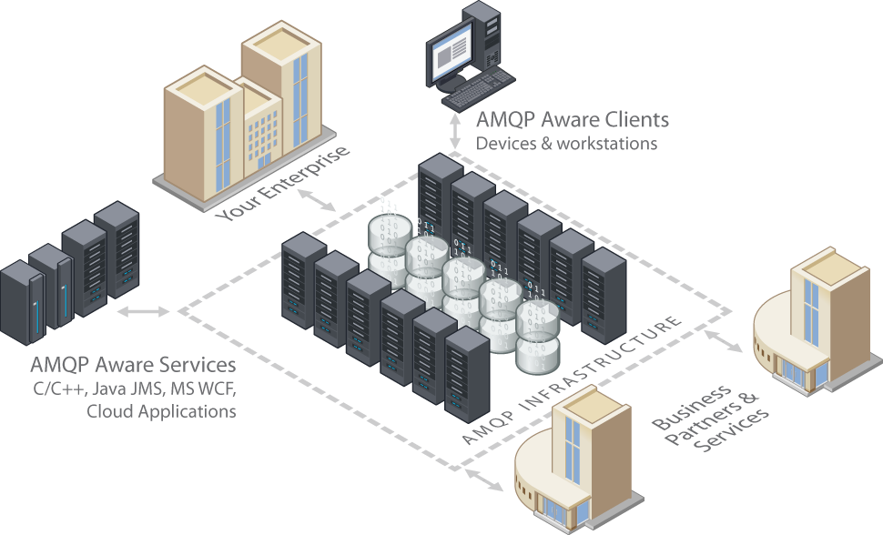
AMQP 1.0
Applicability
Reliability
Interoperability
Ubiquity
© JPMorgan Chase & Co.

Slide 23
Applicability
Simple abstraction for all messaging patterns
Point to point, Pub / Sub, Request / Response
Symmetric peer-to-peer protocol
Brokerless messaging
Mappings to standard APIs (JMS, WCF, SOAP)
Designed for high performance
No inherently synchronous primitives
Allows aggressive pipelining
Low message overhead
Notes:
Sender and receivers may know properties of an address, or they may not. Allows complete decoupling.

Slide 24
Reliability
Comprehensive reliability semantics
at most once
at least once
exactly once delivery
Recovery defined for all failure cases
Well defined error model
fail fast, then recover
Sender
Replay Buffer
Receiver
Idempotence Barrier

Slide 25
Ubiquity
Defines a vocabulary for messaging
Protocol consists of just nine “performatives”
Small number of key concepts (Links, Sources/Targets, Messages, Settlement)
Mapping to multiple messaging models
Existing messaging products implement AMQP 1.0
Stable core protocol
Guarantee compatibility with future versions
Allow for hardware implementations

Slide 26





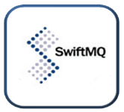

Interoperability
Demonstrate interoperability today
Different languages, different platforms, different vendors
Layered architecture allows extension without changing the core protocol

Slide 27
Flexible topologies
S
R
AMQP Network

Slide 28
Flexible topologies
Broker
S
R

Slide 29
Flexible topologies
Broker
Broker
S
R

Slide 30
Flexible topologies
S
R

Slide 31
AMQP 1.0 implementations

Slide 32

Apache Qpid
Open Source AMQP Messaging
Brokers and Client libraries supporting AMQP
Java Broker
Supports all versions of AMQP, including AMQP 1.0 since 0.18
JMS Client Java JMS client which works with any AMQP 1.0 compliant service C++ Broker AMQP 1.0 support in next release (scheduled for later this month)
Home of Proton toolkit library

Slide 33
Apache Qpid Proton
Proton is toolkit for speaking AMQP, including: The AMQP Messenger API, a simple but powerful interface to send and receive messages over AMQP The AMQP Protocol Engine, a succinct encapsulation of the full AMQP protocol machinery Proton is designed for maximum embeddability: Minimal dependencies Minimal assumptions about threading model Proton is designed to scale up and down: Transparently supports both simple peer to peer messaging and complex globally federated topologies Proton is multi-lingual: Designed for easy language bindings Includes full fidelity data exchange: maps, lists, data structures, ...

Slide 34
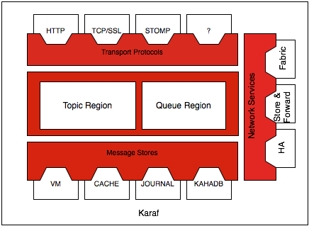
Apache ActiveMQ
Reliable Java broker
Multi-protocol
Multi-OS
Small footprint
Pluggable architecture allows protocols and features to be added or customized
Coming soon AMQP 1.0!
AMQP

Slide 35
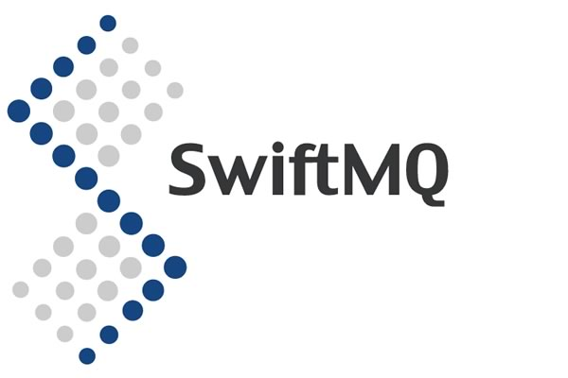
SwiftMQ
Commercial JMS messaging since 2000
Based on a federated router network
Provides High Availability
First AMQP 1.0 implementation
Available since January 2012
Full-featured inc. transactions & link recovery
Fully integrated with JMS
Includes an AMQP bridge
Bridge between AMQP 1.0, AMQP 0.9.1 & JMS

Slide 36

Azure Service Bus
Unified set of messaging capabilities Consistent management and observation capabilities
Service Bus Relay
Rich options for interconnecting apps across network boundaries
Service Bus Brokered Messaging
Queuing, publish/subscribe
Easily build hybrid apps
Available as PaaS & on-premise server
Supports AMQP 1.0

Slide 37


AMQP 1.0 client libraries
Language | Library
C# | Service Bus .NET Client Library
Java | Apache Qpid Java Message Service (JMS) client IIT SwiftMQ Java client
C | Apache Qpid Proton-C
PHP | Apache Qpid Proton-PHP
Python | Apache Qpid Proton-Python
Ruby | Apache Qpid Proton-Ruby (coming soon)
Perl | Apache Qpid Proton-Perl (coming soon)
JavaScript | Apache Qpid Proton-JavaScript (coming soon)

Slide 38
Demo PictureMagic
Showcasing support for cross-platform hybrid apps using AMQP 1.0

Slide 39


MessageId = 1234
ReplyTo = RQ
Subs
Client App
Transform Requests Topic
Image Transformer
App
RQ
MessageId = 5678
CorrelationId = 1234

Slide 40







Linux (Azure)
SwiftMQ
Broker
Monitor
Service Bus
Transform Requests Topic
Transformer
Windows (on-prem)
Archiver
Twitter

Slide 41
Summary
AMQP 1.0 is the OASIS Standard for messaging
Open, standard, efficient, flexible, reliable
Enables cross-platform messaging applications
Mix languages, operating systems and vendors
Business messages exchanged at full-fidelity
Brokers and clients available now:
Apache Qpid Proton, SwiftMQ, Azure Service Bus
Many more coming soon, inc. ActiveMQ

Slide 42
More information
AMQP Member Section at OASIS
http://www.amqp.org
Apache Qpid Java 0.18
http://qpid.apache.org/
Apache Qpid Proton
http://qpid.apache.org/proton/
Apache ActiveMQ
http://activemq.apache.org
SwiftMQ
http://www.swiftmq.com
Microsoft Windows Azure Service Bus
https://www.windowsazure.com/en-us/develop/net/how-to-guides/service-bus-amqp-overview/

Slide 43
Thank You. Any Questions?

Slide 44
Submission details (hidden)
Tuesday 4:15 p.m.–5 p.m. in Level 2 Right
Description
This session will present an overview of the AMQP 1.0 and Apache Qpid including the latest status of the OASIS standards process, vendor support for AMQP, and a demonstration of enterprise messaging interoperability.
Abstract
AMQP is the first open standard for enterprise messaging, and is currently going through the OASIS standardization process. Apache Qpid is a cross-platform implementation of AMQP for enterprise messaging systems, featuring message brokers written in C++ and Java as well as clients for the C++, Java JMS, .NET, Python, and Ruby programming languages. This session will cover the goals and architecture of AMQP 1.0 and Qpid, as well as the status of the OASIS standardization process and AMQP adoption. You will hear the latest news about major implementations and vendor support at the time of the conference. The bulk of the session will focus on an interoperability demonstration that will show how AMQP 1.0 provides robust enterprise-ready messaging capabilities to create diverse systems running in heterogeneous environments.
This session will be co-presented by David Ingham, Rob Godfrey, William Henry and Andreas Mueller.

