Slide 1
Fundamentals of Information Retrieval Illustration with Apache Lucene
By Majirus FANSI

Slide 2
Abstract
Fundamentals of Information Retrieval
Core of any IR application
Scientific underpinning of information retrieval
Boolean and Vector Space Models
Inverted index construction and scoring
Apache Lucene Library
ApacheCon Europe 2012

Slide 3
Definition
ApacheCon Europe 2012

Slide 4
Information Retrieval
Finding material
usually documents
Of an unstructured nature
usually text
That satisfies an information need from within large collections
usually stored on computers
Query is an attempt to communicate the information need
“Some argue that on the web, users should specify more accurately what they want and add more words to their query, we disagree vehemently with this position.” S. Brin and L. Page, Google 1998
ApacheCon Europe 2012

Slide 5
An example IR problem
Corporation’s internal documents
Technical docs, meeting reports, specs, …
Thousands of documents
Lucene AND Cutting AND NOT Solr
Grepping the collection?
What about the response time?
Flexible queries: lucene cutting ~5
ApacheCon Europe 2012

Slide 6
At which scale do you operate?
Web search
Search over billions of documents stored on millions of computers.
Personal search
Consumer operating systems integrates IR
Email program search
Enterprise domain-specific search
Retrieval for collections such as reseach articles
Scenario for software developer
ApacheCon Europe 2012

Slide 7
Domain-specific search - Models
Boolean models
Main option until approximately the arrival of the WWW
Query in the form of boolean expressions
Vector Space Models
Free text queries
Queries and documents are viewed as vectors
Probabilistic Models
Rank documents by they estimated probability of relevance wrt the information need.
Classification problem
ApacheCon Europe 2012

Slide 8
Core notions
Document
Unit we have decided to build a retrieval system on
Bad idea to index an entire book as a document
Bad idea to index a sentence in a book as a document
Precision/recall tradeoff
Term
Indexed unit, usually word
The set of terms is your IR dictionary
Index
“An alphabetical list, such as one printed at the back of a book showing which page a subject is found on” Cambridge dictionary
We index documents to avoid grepping the texts
“Queries must be handled quickly, at a rate of hundreds to thousands per second” Brin and Page
ApacheCon Europe 2012

Slide 9
How good are the retrieved docs?
Precision
Fraction of retrieved docs that are relevant to user’s information need
Recall
Fraction of relevant docs in collection that are retrieved
“People are still only willing to look at the first few tens of results. Because of this, as the collection size grows, we need tools that have very high precision...This very high precision is important even at the expense of recall” Brin & Page
ApacheCon Europe 2012

Slide 10
Index: structure and construction
ApacheCon Europe 2012

Slide 11
Index structure
Consider N = 1 million documents, each with about 1000 words
Nearly 1 trillion words
M = 500K distinct terms among these
Which structure for our index?
ApacheCon Europe 2012

Slide 12
Term-document incidence matrix
 | Doc #1 | Doc #2 | … | Doc #n
Term #1 | 1 | 0 | … | 1
Term #2 | 0 | 0 | … | 1
… | 1 | 0 | … | 0
Term #m | 0 | 1 | … | 0
Matrix is extremely sparse
Do we really need to record the 0s?
ApacheCon Europe 2012

Slide 13
Inverted index
For each term t, we must store a list of all documents that contain t.
Identify each by a docID, a document serial number
Hatcher
1
2
4
11
31
45
173
Posting
Dictionary
lucene
1
2
4
5
6
16
57
132
solr
2
31
54
101
Postings
Sorted by docID
ApacheCon Europe 2012
Postings

Slide 14
Inverted index construction
Documents to
be indexed
Friends, Romans, countrymen.
Tokenizer
Token stream
Friends
Romans
Countrymen
Analysis step
Linguistic modules
friend
roman
countryman
Modified tokens
Indexer
friend
2
4
roman
1
2
Inverted index
countryman
13
16
Indexing step
ApacheCon Europe 2012

Slide 15
Analyzing the text : Tokenization
Tokenization
Given a character sequence, tokenization is the task of chopping it up into pieces, called tokens
Perhaps at the same time throwing away characters such as punctuation
Language-specific
Dropping common terms: stop words
Sort the terms by collection frequency
Take the most frequent terms as candidate stop list and let the domain people decide
Be careful about phrase query: “Queen of England”
ApacheCon Europe 2012

Slide 16
Analyzing the text: Normalization
if you search for USA, you might hope to also match documents containing U.S.A
Normalization is the process of canonicalizing tokens so that matches occur despite superficial differences in character sequences.
Removes accents and diacritics (cliché, naïve)
Capitalization/case-folding
Reducing all letters to lowercase
Stemming and lemmatization
reduce inflectional forms and sometimes derivationally related forms of a word to a common base form
Porter stemmer
Ex: breathe, breathes, breathing reduced to breath
Increases recall while harming precision
ApacheCon Europe 2012

Slide 17
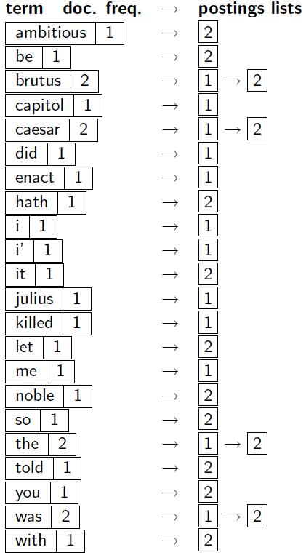
Indexing steps: Dictionary & Postings
Map: doc collection --→ list(termID, docID)
Entry with the same termId are merged
Reduce: (<termID1, list(docID)>, <termID2, list(DocID)>, …) --→ (postings_list1, postings_list2, …)
Positional indexes for phrase query
Doc. frequency, term freq, positions are added.
lucene (128): doc1, 2<1, 8>
ApacheCon Europe 2012

Slide 18
Lucene: Document, Fields, Index structure
By Majirus FANSI

Slide 19
How Lucene models content: Documents & Fields
To index your raw content sources, you must first translate it into Lucene’s documents and fields
Document is what is returned as hit
It is a set of fields
Field is what searches are performed on
It is the actual content holder
Multi-valued field
Preferred to catch-all field
ApacheCon Europe 2012

Slide 20
Field options
For indexing (Enum Field.Index)
Index.ANALYZED : (body, title,…)
Index.NOT_ANALYZED: treats the field entire value as a single token (social sec number, identifier, …)
Index.ANALYZED_NO_NORMS: doesn’t store norms information
Index.NO don’t make this field value available for searching
For storing fields (Enum Field.Store)
Store.YES stores the value of the field
Store.NO recommended for large text field
Doc .add(new Field (“author”, author, Field.Store.YES, Field.Index.ANALYZED))
ApacheCon Europe 2012

Slide 21
Document and Field Boosting
Boost a document
Instruct Lucene to consider it more or less important w.r.t other documents in the index when computing relevance
Doc.setBoost (boostValue)
boostValue > 1 upgrades the document
boostValue < 1 downgrades the document
Boost a field
Instruct Lucene to consider a field more or less important w.r.t other fields
aField.setBoost(boostValue)
Be careful about multivalued field
Payload mechanism for per-term boosting
ApacheCon Europe 2012

Slide 22
Lucene Index Structure
IndexWriter.addDocument (doc) to add the document to the index
After analyzing the input, Lucene stores it in an inverted index
Tokens extracted from the input doc are treated as lookup keys.
Lucene index directory consists of one or more segments
Each segment is a standalone index (subset of indexed docs)
Documents are updated by deleting and reinserting them
Periodically IndexWriter will select segments and merge them
Lucene is a Dynamic indexing tool
ApacheCon Europe 2012

Slide 23
Boolean model
By Majirus FANSI

Slide 24
Query processing: AND
Consider the query lucene AND solr
Locate lucene in the dictionary
Retrieve its postings
Locate solr in the dictionary
Retrieves its postings
Merge the two postings
If list lengths are x and y, merge takes O(x+y) operations.
Crucial: postings sorted by docID.
8
2
4
8
16
2
4
16
32
lucene
32
64
64
128
2
8
1
3
1
2
3
5
2
5
8
solr
8
13
21
13
21
34
34
ApacheCon Europe 2012

Slide 25
Boolean queries: Exact match
The Boolean retrieval model is being able to ask a query that is a Boolean expression
Boolean Queries use AND, OR and NOT to join query terms
View each doc as set of words
Is precise: document matches condition or not
Lucene adds boolean shortcuts like + and -
+lucene +solr means lucene AND solr
+lucene -solr means lucene AND NOT solr
ApacheCon Europe 2012

Slide 26
Problem with boolean model
Boolean queries often result in either too few (=0) or too many (1000s) results
AND gives too few; OR gives too many
Considered for expert usage
As a user are you able to process 1000 results?
Limited wrt. user information need
Extended boolean model with term proximity
“Apache Lucene” ~10
ApacheCon Europe 2012

Slide 27
What do we need?
A Boolean model only records term presence or absence
We wish to give more weight to documents that have a term several times as opposed to ones that contains it only once
Need for term frequency information in the postings lists
Boolean queries just retrieve a set of matching documents
We wish to have an effective method to order the returned results
Requires a mechanism for determining a document score
encapsulates how good a match a document is for a query
ApacheCon Europe 2012

Slide 28
Ranked retrieval
By Majirus FANSI

Slide 29
Ranked retrieval models
Free text queries: Rather than a query language of operators and expressions, the user’s query is just one or more words in a human language
Rather than a set of documents satisfying a query expression, in ranked retrieval, the system returns an ordering over the (top) documents in the collection for a query
Large result sets are not an issue: just show the top k (=~10)
Premise: the ranking algorithm works
Score is the key component of ranked retrieval models
ApacheCon Europe 2012

Slide 30
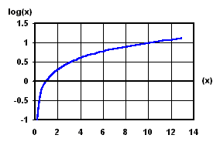
Term frequency and weighting
We would like to compute a score between a query term t and a document d.
The simplest way is to say score(q, d) = tf_{t,d}
The term frequency tf_{t,d} of term t in document d
Number of times that t occurs in d
Relevance does not increase proportionally with term frequency
Certain terms have little or no discriminating power in determining relevance
Need a mechanism for attenuating the effects of frequent terms
Less informative than rare terms
ApacheCon Europe 2012

Slide 31
tf-idf weighting
The tf-idf weight of a term is the product of its tf weight and its idf weight
Best known weighting scheme in information retrieval
Increases with the number of occurrences within a document
Increases with the rarity of the term in the collection
ApacheCon Europe 2012

Slide 32
Document vector
At this point, we may view each document as a vector
with one component corresponding to each term in the dictionary, together with a tf-idf weight for each component.
This is an |N|-dimensional vector
For dictionary terms that do not occur in a document, this weight is zero
In practice we consider d as a |q|-dimensional vector
|q| is the number of distinct terms in the query q
ApacheCon Europe 2012

Slide 33
Vector Space Model (VSM)
By Majirus FANSI

Slide 34
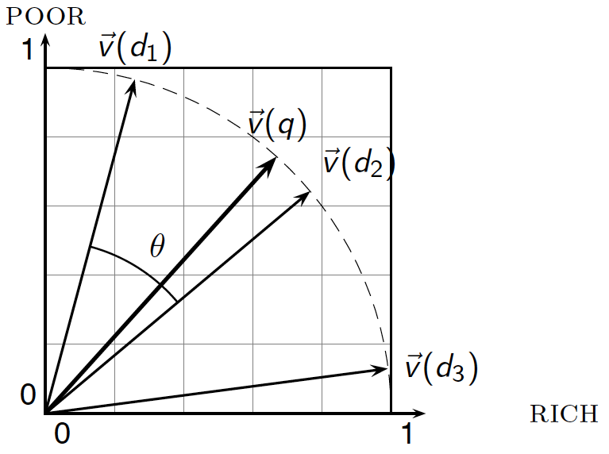
VSM principles
The set of documents in the collection are viewed as set of vectors in a vector space
One axis for each term in the query
User query is treated as a very short doc
It is represented as a vector in this space
VSM computes the similarity between the query vector and each document vector
Rank documents in decreasing order of the angle between query and document
The user is returned the top-scoring documents
ApacheCon Europe 2012

Slide 35
Cosine similarity
How do you determine the angle between a document vector and a query vector?
Instead of ranking in decreasing order of the angle (q, d)
Rank documents in increasing order of cosine(q, d)
Thus the cosine similarity
The model assign a score between 0 and 1
Cos(0) = 1
ApacheCon Europe 2012

Slide 36
cosine(query, document)
Dot product
Unit vectors
Fundamental to IR systems based on VSM
Euclidean norms
q_{i} is the tf-idf weight of term i in the query q
d_{i} is the tf-idf weight of term i in the document d
Cosine is computed on the vector representatives to compensate for doc length
Variations from one VS scoring method to another hinge on the specific choices of weights in the vector v(d) and v(q)
ApacheCon Europe 2012

Slide 37
Lucene scoring algorithm
Lucene combines Boolean Model (BM) of IR and Vector Space Model (VSM) of IR
Documents “approved” by BM are scored by VSM
This is a Weighted zone scoring or Ranked Boolean Retrieval
Lucene VSM score of document d for query q is the cosine Similarity
Lucene refines VSM score for both search quality and ease of use
ApacheCon Europe 2012

Slide 38
How does Lucene refine VSM?
Normalizing document vector by the Euclidean length of vector eliminates all information on the length of the original document
Fine only if the doc is made by successive duplicates of distinct terms
Doc-len-norm(d) normalizes to a vector equal or larger than the unit vector
It is a pivoted normalized document length.
Compensation independent of term and doc freq.
Users can boost docs at indexing time
Score of a doc d is multiplied by doc-boost(d)
ApacheCon Europe 2012

Slide 39
How does Lucene refine VSM (2)
At search time users can specify boosts to each query, sub-query, query term
The contribution of a query term to the score of a document is multiplied by the boost of that query term (query-boost(q))
A document may match a multi term query without containing all the terms of that query
Coord-factor(q,d) rewards documents matching more query terms
ApacheCon Europe 2012

Slide 40
Lucene conceptual scoring formula
Assuming the document is composed of only one field
doc-len-norm(d) and doc-boost(d) are know at indexing time.
Computed in advance and their multiplication is saved in the index as norm(d)
ApacheCon Europe 2012

Slide 41
Lucene practical scoring function DefaultSimilarity
Derived from the conceptual formula and assuming document has more than one field
Idf(t) is squared because t appears in both d and q
queryNorm(q) is computed by the query Weigth object
lengthNorm is computed so that shorter fields contribute more to the score
ApacheCon Europe 2012

Slide 42
Acknowledments
By Majirus FANSI

Slide 43
A big thank you
Pandu Nayak and Prabhakar Raghavan: Introduction to Information Retrieval
Apache Lucene Dev Team
S. Brin and L. Page: The Anatomy of a Large-Scale Hypertextual Web search Engine
M. McCandless, E. Hatcher, and O. Gospodnetic: Lucene in Action 2nd Ed
ApacheCon Europe 2012 organizers
Management at Valtech Technology Paris
Michels, Maj-Daniels, and Sonzia FANSI
Of course , all of you for your presence and attention
ApacheCon Europe 2012

Slide 44
To those whose life is dedicated to Education and Research
By Majirus FANSI

