Slide 1
Solr 4 The NoSQL Database
Yonik Seeley
Apachecon Europe 2012

Slide 2

My Background
Creator of Solr
Co-founder of LucidWorks
Expertise: Distributed Search systems and performance
Lucene/Solr committer, PMC member
Work: CNET Networks, BEA, Telcordia, among others
M.S. in Computer Science, Stanford

Slide 3
What is NoSQL
Non-traditional data stores
Doesn’t use / isn’t designed around SQL
May not give full ACID guarantees
Offers other advantages such as greater scalability as a tradeoff
Distributed, fault-tolerant architecture

Slide 4
Earliest HA Solr Configurations
Dynamic HTML Generation
Appservers
Load Balancer
HTTP search requests
Solr Searchers
Index Replication
Decoupled reads & writes
Read-side, solr was used like a NoSQL store
All data necessary to drive webapps were added to Solr documents
Database remained system of record for updaters
DB
updates
Updater
Solr Master

Slide 5
Desired Features (that we started thinking about back in 08)
Automatic Distributed Indexing
HA for Writes
Durable Writes
Near Real-time Search
Real-time get
Optimistic Concurrency

Slide 6
Solr Cloud
Distributed Indexing designed from the ground up around desired features, not CAP theorem.
Note: you must handle P – the real choice is C or A
Ended up with a CP system (roughly)
Eventual consistency is incompatible with optimistic concurrency
We still do well with Availability
All N replicas of a shard must go down before we lose writability for that shard
For a network partition, the “big” partition remains active (i.e. Availability isn’t “on” or “off”)
More: Mark Miller’s SolrCloud Architecture talk tomorrow at 14:45

Slide 7
Solr 4

Slide 8
New Top Level View
Document Oriented NoSQL Search Platform
Data-format agnostic (JSON, XML, CSV, binary)
Distributed
Fault Tolerant
HA + No single points of failure
Atomic Updates
Optimistic Concurrency
Full-Text search + Hit Highlighting
Tons of specialized queries: Faceted search, grouping, pseudo-Join, spatial search, functions

Slide 9
Quick Start
Unzip the binary distribution (.ZIP file)
Note: no “installation” required
Start Solr
3. Go!
Browse to http://localhost:8983/solr for the new admin interface
$ cd example
$ java –jar start.jar

Slide 10
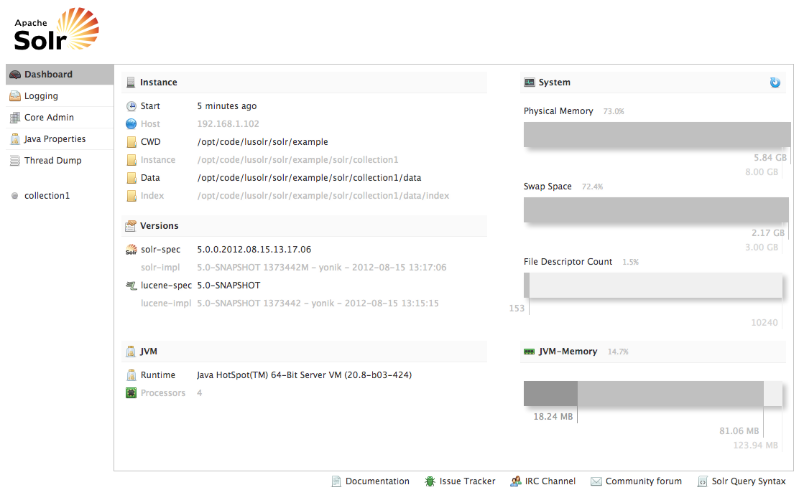

Slide 11
Add and Retrieve document
$ curl http://localhost:8983/solr/update -H 'Content-type:application/json' -d '
[
{ "id" : "book1",
"title" : "American Gods",
"author" : "Neil Gaiman"
}
]'
Note: no type of “commit” is necessary to retrieve documents via /get
(real-time get)
$ curl http://localhost:8983/solr/get?id=book1
{
"doc": {
"id" : "book1",
"author": "Neil Gaiman",
"title" : "American Gods",
"_version_": 1410390803582287872
}
}
Notes:
This is an example of realtime-get. No “commit” is needed before documents are visible via /get
Writes are durable – you can do a “kill -9” of the JVM after the add, and restart – the doc will be there.
Notice that a _version_ field was automatically added to the document

Slide 12
Atomic Updates
$ curl http://localhost:8983/solr/update -H 'Content-type:application/json' -d '
[
{"id" : "book1",
"pubyear_i" : { "add" : 2001 },
"ISBN_s" : { "add" : "0-380-97365-1"}
}
]'
$ curl http://localhost:8983/solr/update -H 'Content-type:application/json' -d '
[
{"id" : "book1",
"copies_i" : { "inc" : 1},
"cat" : { "add" : "fantasy"},
"ISBN_s" : { "set" : "0-380-97365-0"}
"remove_s" : { "set" : null } }
]'

Slide 13
Schema-less?
Schema-less: No such thing for anything based on Lucene
Fields with same name must be indexed the same way
Closest approximation: guess the type when you see a new field
Can be troublesome (adding 0 then 1.5)
Most clients still need to know the “schema”
Dynamic fields: convention over configuration
Only pre-define types of fields, not fields themselves
No guessing. Any field name ending in _i is an integer

Slide 14
Optimistic Concurrency
Conditional update based on document version
1. /get document
2. Modify document, retaining _version_
Solr
4. Go back to step #1 if fail code=409
3. /update resulting document

Slide 15
Version semantics
Specifying _version_ on any update invokes optimistic concurrency
_version_ | Update Semantics
> 1 | Document version must exactly match supplied _version_
1 | Document must exist
< 0 | Document must not exist
0 | Don’t care (normal overwrite if exists)

Slide 16
Optimistic Concurrency Example
$ curl http://localhost:8983/solr/get?id=book2
{ "doc” : {
"id":"book2",
"title":["Neuromancer"],
"author":"William Gibson",
"copiesIn_i":7,
"copiesOut_i":3,
"_version_":123456789 }}
Get the document
$ curl http://localhost:8983/solr/update -H 'Content-type:application/json' -d '
[ {
"id":"book2",
"title":["Neuromancer"],
"author":"William Gibson",
"copiesIn_i":6,
"copiesOut_i":4,
"_version_":123456789 }
]'
Modify and resubmit, using the same _version_
Alternately, specify the _version_ as a request parameter
curl http://localhost:8983/solr/update?_version_=123456789 -H 'Content-type:application/json' -d […]
Notes:
After you successfully add the modified document, it will have a new version (i.e. not equal to the _version_ you sent in)
Note: optimistic concurrency works with atomic updates also!

Slide 17
Optimistic Concurrency Errors
HTTP Code 409 (Conflict) returned on version mismatch
$ curl -i http://localhost:8983/solr/update -H 'Content-type:application/json' -d '
[{"id":"book1", "author":"Mr Bean", "_version_":54321}]'
HTTP/1.1 409 Conflict
Content-Type: text/plain;charset=UTF-8
Transfer-Encoding: chunked
{
"responseHeader":{
"status":409,
"QTime":1},
"error":{
"msg":"version conflict for book1 expected=12345
actual=1408814192853516288",
"code":409}}

Slide 18
Simplified JSON Delete Syntax
Singe delete-by-id
{"delete":”book1"}
Multiple delete-by-id
{"delete":[”book1”,”book2”,”book3”]}
Delete with optimistic concurrency
{"delete":{"id":”book1", "_version_":123456789}}
Delete by Query
{"delete":{”query":”tag:category1”}}

Slide 19
Durable Writes
Lucene flushes writes to disk on a “commit”
Solr 4 maintains it’s own transaction log
Services real-time get requests
Recover from crash (log replay on restart)
Supports distributed “peer sync”
Writes forwarded to multiple shard replicas
A replica can go away forever w/o collection data loss
A replica can do a fast “peer sync” if it’s only slightly out of data
A replica can do a full index replication (copy) from a peer

Slide 20
Near Real Time (NRT) softCommit
softCommit opens a new view of the index without flushing + fsyncing files to disk
Decouples update visibility from update durability
commitWithin now implies a soft commit
Current autoCommit defaults from solrconfig.xml:
<autoCommit>
<maxTime>15000</maxTime>
<openSearcher>false</openSearcher>
</autoCommit>
<!-- <autoSoftCommit>
<maxTime>5000</maxTime>
</autoSoftCommit> -->

Slide 21
New Queries in Solr 4

Slide 22
New Spatial Support
Multiple values per field
Index shapes other than points (circles, polygons, etc)
Well Known Text (WKT) support via JTS
Indexing:
"geo”:”43.17614,-90.57341”
“geo”:”Circle(4.56,1.23 d=0.0710)”
“geo”:”POLYGON((-10 30, -40 40, -10 -20, 40 20, 0 0, -10 30))”
Searching:
fq=geo:"Intersects(-74.093 41.042 -69.347 44.558)"
fq=geo:"Intersects(POLYGON((-10 30, -40 40, -10 -20, 40 20, 0 0, -10 30))) "

Slide 23
Relevancy Function Queries
function | semantics | example
docfreq(field,term) | Constant: number of documents containing the term | docfreq(text,’solr’)
termfreq(field,term) | Number of times term appears in a doc | termfreq(text,’solr’)
totaltermfreq(field,term) | Constant: number of times the term appears in the field over the whole index | ttf(text,’solr’)
sumtotaltermfreq(field) | Constant: sum of ttf of every term (i.e. number of indexed tokens in field) | sttf(text,’solr’)
idf(field,term) | Constant: inverse document frequency using the Similarity for the field | idf(text,’solr’)
tf(field,term) | term frequency scoring factor using the Similarity for the field | tf(text,’solr’)
norm(field) | Length normalization for the document (including any index-time boost) | norm(text)
maxdoc() | Constant: number of documents | maxdoc()
numdocs() | Constant: number of non-deleted documents | numdocs()

Slide 24
Boolean/Conditional Functions
Constants true, false
exists(field|function) returns true if a value exists for a document
if(expression,trueValue,falseValue)
if(exists(myField),100,add(f2,f3))
Note: for numerics 0==false, for strings empty==false
def(field|function,defaultValue)
def(rating,5) // returns the rating, or 5 if this doc has none
Other boolean functions: not(x), and(x,y), or(x,y), xor(x,y)

Slide 25
Pseudo-Fields
Returns other info along with document stored fields
Function queries
fl=name,location,geodist(),add(myfield,10)
Fieldname globs
fl=id,attr_*
Multiple “fl” (field list) values
&fl=id,attr_*
&fl=geodist()
&fl=termfreq(text,’solr’)
Aliasing
fl=id,location:loc,_dist_:geodist()
fl=id,[explain],[shard] TODO: [hl] for highlighting

Slide 26
Pseudo-Fields Example
$ curl http://localhost:8983/solr/query?
q=solr
&fl=id,apache_mentions:termfreq(text,’apache’)
&fl=my_constant:”this is cool!”
&fl=inStock, not(inStock)
&fl=other_query_score:query($qq)
&qq=text:search
{ "response":{"numFound":1,"start":0,"docs":[
{
"id":"SOLR1000",
"apache_mentions":1,
"my_constant":"this is cool!",
"inStock":true,
"not(inStock)":false,
"other_query_score":0.84178084
}]}

Slide 27
Pseudo-Join
id: blog1
name: Solr ‘n Stuff
owner: Yonik Seeley
Started: 2007-10-26
id: post1
blog_id: blog1
author: Yonik Seeley
title: Solr relevancy function queries
body: Lucene’s default ranking […]
id: blog2
name: lifehacker
owner: Gawker Media
started: 2005-1-31
id: post2
blog_id: blog1
author: Yonik Seeley
title: Solr result grouping
body: Result Grouping, also called […]
id: post3
blog_id: blog2
author: Whitson Gordon
title: How to Install Netflix on Almost Any Android Device
Restrict to blogs mentioning netflix:
fq={!join from=blog_id to=id}body:netflix
How it works:
Finds all documents matching “netflix”
Maps to different docs by following blog_id to id

Slide 28
Pseudo-Join Examples
Only show posts from blogs started after 2010
&fq={!join from=id to=blog_id}started:[2010 TO *]
If any post in a blog mentions “embassy”, then search all posts in that blog for “bomb” (self-join)
q=bomb
&fq={!join from=blog_id to=blog_id}embassy
If any blog post mentions “embassy”, then search all emails with the same blog owner for “bomb”
q=email_body:bomb
&fq={!join from=owner_email_user to=email_user}{!join from=blog_id to=id}embassy
Notes:
- For understanding how joins work, read right to left (i.e. in the last example, first docs matching “obama” are found, then mapped to docs following blog_od->id, then mapped to docs following owner_email_user -> email_user

Slide 29
Cross-Core Join
id: doc1
security: managers
title: doc for managers only
body: …
id: mary
security_groups: managers, employees
id: john
security_groups: employees
id: doc1
security: managers, employees
title: doc for everyone
body: …
collection1
sec1
Single Solr Server
http://localhost:8983/solr/collection1/select?q=foo
&fq={!join fromIndex=sec1 from=security_groups to=security}user:john
Notes:
The cores should be within a single solr server (i.e. cores in the same core container in a multi-core setup)
One targets the query request to the same core as the “to” field in the join. The query is executed in the core named by fromIndex (sec1 in this example) and then mapped to the current core (collection1 in this example)
Why? So one can independently change the indexes… sec1 can be updated rapidly w/o affecting other caches (like facet caches) in collection1.

Slide 30
Pseudo-Join vs Grouping
Pseudo-Join | Result Grouping / Field Collapsing
O(n_terms_in_join_fields) | O(n_docs_in_result)
Single or multi-valued fields | Single-valued fields only
Filters only (no info currently passed from the “from” docs to the “to” docs). | Can order docs within a group and groups by top doc within that group using normal sort criteria.
Chainable (one join can be the input to another) | Not currently chainable – can only group one field deep
Affects which documents match a request, so naturally affects facet numbers (e.g. you can search posts and get numbers of blogs) | New for 4.0: via optional post-group faceting, grouping can affect faceting by optionally using only the most relevant document per group.

Slide 31
Pivot Faceting
Finds the top N constraints for field1, then for each of those, finds the top N constraints for field2, etc
Syntax: facet.pivot=field1,field2,field3,…
facet.pivot=cat,inStock
 | #docs | #docs w/ inStock:true | #docs w/ instock:false
cat:electronics | 14 | 10 | 4
cat:memory | 3 | 3 | 0
cat:connector | 2 | 0 | 2
cat:graphics card | 2 | 0 | 2
cat:hard drive | 2 | 2 | 0

Slide 32
Per-segment single-valued faceting facet.method=fcs
Segment1
FieldCache
Entry
Segment2
FieldCache
Entry
Segment3
FieldCache
Entry
Segment4
FieldCache
Entry
accumulator1
accumulator2
accumulator3
accumulator4
inc
lookup
0
0
1
0
3
2
3
1
0
Base
DocSet
5
1
0
0
2
0
0
4
7
thread4
1
thread2
thread3
2
thread1
FieldCache + accumulator merger
(Priority queue)
Priority queue
flash, 5
Batman, 3

Slide 33
facet.method=fcs
Controllable multi-threading
facet.method=fcs
facet.field={!threads=4}myfield
Disadvantages
Slower unless committing multiple times per second (aggressive NRT)
Extra FieldCache merge step needed - O(nTerms)
Larger memory use (FieldCaches + accumulators)
Advantages
Rebuilds FieldCache entries only for new segments (NRT friendly)
Multi-threaded

Slide 34
Questions?

