Slide 1
Jena based Implementation of a ISO 11179 Meta-data Registry
A. Anil Sinaci, SRDC
sinaci@apache.org

Slide 2





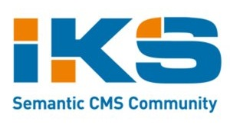

About me
PhD student at
Senior Software Engineer at
FP7 Projects:

Slide 3
Agenda
Introduction
Motivation
FP7 – SALUS & BIVEE Projects
Background
ISO/IEC 11179
Common Data Elements
Design & Implementation
Use-case
Summary
Notes:
Introduction: Metadata, interoperability and the solution shortly: what is the solution to this data interoperability problem in terms of meta-data.
Motivation: How we realized such an interoperability problem. Motivation comes from very different domains, and as I will introduce later, they expose very similar requirements in terms of data interoperability. Hence, a general solution fits into the needs.
Design & Implementation: Ontology building, our loosely coupled architecture.
Use-case: what can be done on top of such a semantic MDR? Very simple queries…

Slide 4
What is Meta-data?
data about data… (deprecated)
at design time the application contains no data
Descriptive metadata
Structural Metadata – data about the containers of data
meta-data is data
can be stored and managed
meta-data registries
Notes:
Wikipedia (and up-to-date resources) divides the definition of metadata into two: Descriptive and Structural

Slide 5
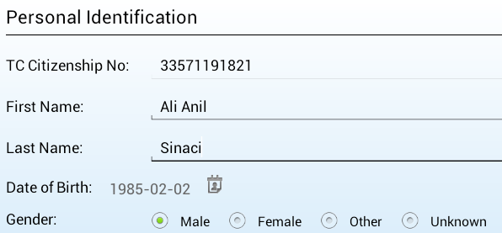

Importance of Meta-data
Meta-data
Data
Notes:
Two applications within SRDC, difference between the web and mobile versions…
Who are we referring to? A person
What are we collecting? Patient information, name, birth date etc…
How is the data represented? Coded values, strings, numbers…
Unique identifier for person
The problem of interoperability → Data interoperability leads to other interoperability problems.

Slide 6

Problem of Interoperability
Syntactic vs. Semantic
The ability to exchange information
access
The ability to use the information once it has been exchanged
understand
The figure is taken from a presentation of caSDR

Slide 7
Meta-data for Semantic Interoperability
Precise knowledge about how data is structured
More efficient and productive with a central, well-administered place to seek for meta-data
Central, easily consumable
Classifications with well-known terminology systems
Build (or map) data models based on a common meta-model
Patient
Name
Surname
Birth Date
Sex
MDR
ISO/IEC 11179
Patient
First name
Last name
Sex
Date of Birth
Patient
Firstname
Surname
Date of Birth
Gender
Notes:
MDR: Reference center… Everybody has the knowledge of the MDR and can talk MDR-based language. Like a lingua-franca in data interoperability.

Slide 8
Jena based ISO 11179
There are lots of MDR instances out there
Most of them are based on ISO/IEC 11179
have the chance to interoperate semantically
ISO/IEC 11179 ontology
common vocabulary for meta-data level
Manage all items, classifications, inter-relations and links to the external world (terminology systems, taxonomies, vocabularies)
in a triple-store
easily expose as RDF
easily import as RDF
Notes:
Standards are good. People like to follow standards (mostly).
Analogy: What made WWW possible is the interoperation of machines through standards (HTTP, HTML etc…)
Wikipedia already publishes an Ontology for ISO/IEC 11179 (informal one from Lawrence Berkeley National Laboratory). We have built our own ontology from scratch.
Although the standard exposes a relational model, we built the architecture on top of a triple store.

Slide 9
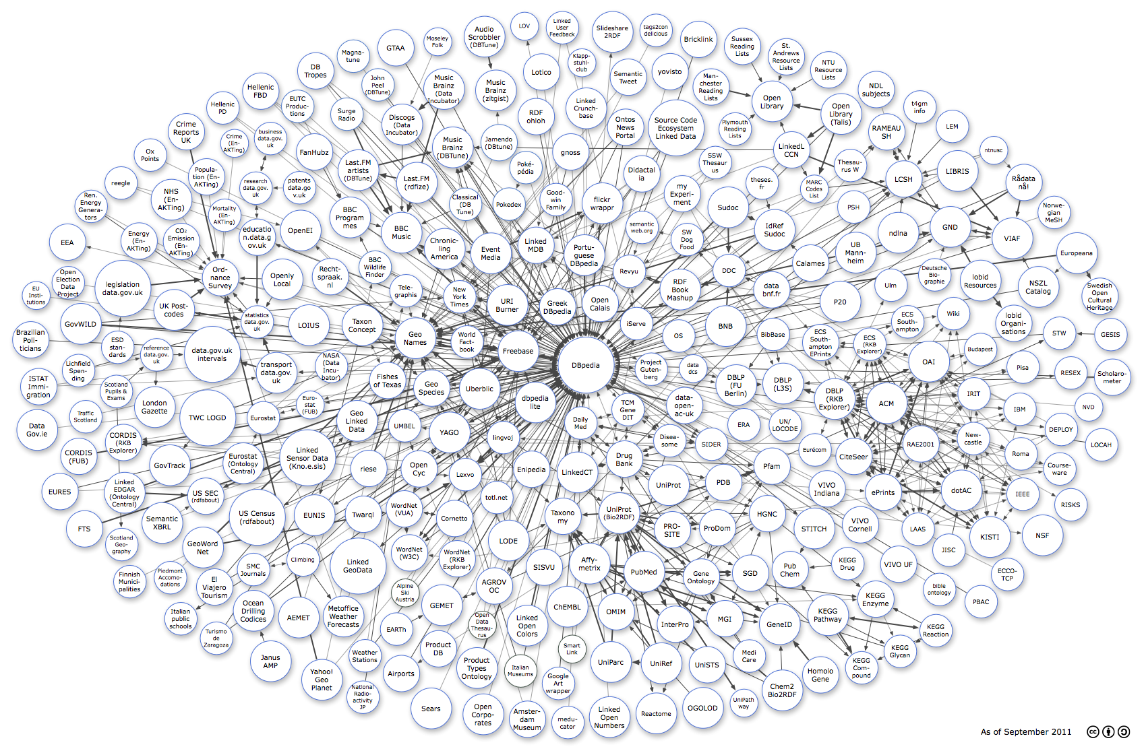
Interoperable through LOD
MDR
RDF
TripleStore
MDR
RDF
TripleStore
RDF
MDR
TripleStore
Linking Open Data cloud diagram, by Richard Cyganiak and Anja Jentzsch. http://lod-cloud.net/
Notes:
Interoperation between ISO11179 based MDRs through LOD, through RDF.

Slide 10
Motivation
The SALUS Project: Pharmacovigilance
Current post-market safety surveillance and reporting activities are largely based on reports of suspected adverse drug reactions sent to the regulatory bodies
5% of all hospital admissions in Europe are due to an adverse drug reaction (ADR)
ADRs are the fifth most common cause of hospital deaths
drug withdrawals (eg. Vioxx)
Interoperability between clinical care and clinical research domains
→ A semantic interoperability architecture based on commonly accepted data elements
http://www.salusproject.eu

Slide 11
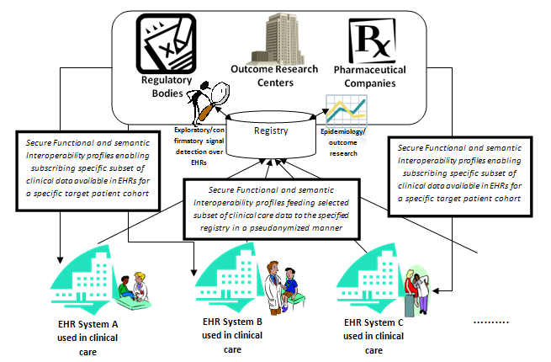
SALUS Project
Central & Semantic Meta-data Registry
Notes:
CDE Repository

Slide 12
Motivation
The BIVEE Project: Business Innovation Management
Software tools for the support of innovation & improvement management within Virtual Enterprises
Document Centric Approach
Identify document structures through common building blocks → common data elements
CCTS – OASIS UBL
based on ISO/IEC 11179
Production & Innovation Knowledge Repository → Semantic Descriptors
Interoperability among business domains of collaborating partners within a Virtual Enterprise
→ An interoperability architecture based on commonly accepted semantic descriptors (meta-data)
http://www.bivee.eu
Notes:
Apart from the classic supply chain management, ERP, MRP tools; the focus is on the management of business innovation.

Slide 13
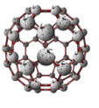
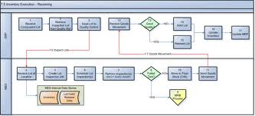
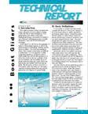
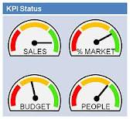


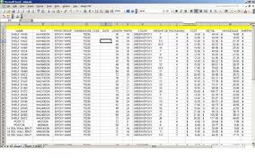

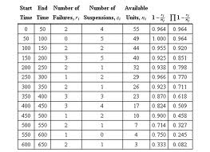

BIVEE Project
Central & Semantic Meta-data Registry
Virtual Enterprise Environment
BIVEE
Ontologies
(I-PIKR)
Value
Production
Space
Semantic
Search/
Query/
Reasoning
Semantic
Search/
Query/
Reasoning
Business
Innovation
Space
Business Processes
Innovation
related
docs
SD
SD
Semantic
Annotation
SD
Semantic
Annotation
KPIs
SD
SD
SD
SD
SD
SD
Production related docs
KPIs
F-PIKR
Innovation
Data
Production Data
VE Members
(competencies)
External
Resources
Notes:
Document Centric Approach

Slide 14
The requirement
A clear need for a Common Data Element Repository to facilitate the semantic interoperability between different application domains
to store the building blocks of data models of different domains and systems
so that different data models are described through the aggregation and association of Common Data Elements
should deal with several annotations and links to external world
several vocabularies, classification schemes and terminology systems are currently in use for different domains
should follow the characteristics of the Linked Data approach.

Slide 15
What is ISO/IEC 11179 ?
Family of standards addressing the;
Semantics of Data
Representation of Data
Registration of Data
ISO/IEC 11179 is;
Description of metadata in terms of Data Elements
Procedures to manage registry of Data Elements

Slide 16
Parts of ISO/IEC 11179
Consists of 6 parts defining
Framework for Specification
Classification
Registry Metamodel
Formulations of Data Definitions
Naming and Identification Principles
Registration
of Data Elements.

Slide 17
Purpose of ISO/IEC 11179
ISO/IEC 11179 is to promote
 Standard description of data
 Common understanding of data across organizational elements and between organizations
 Re-use and standardization of data over time, space, and applications
 Harmonization and standardization of data within an organization and across organizations
 Management of the components of data
 Re-use of the components of data

Slide 18
Benefits of ISO/IEC 11179
Similar CDE’s linked to same Concept’s;
reduced search time
All representations of a CDE can be shown together;
increased filexibility
CDE’s having same value domain can be shown together;
easy administration of registry
Concept of Object Class and Property;
allows Linked Data representation
Classification through External Vocabularies;
allows Linked Data integration

Slide 19
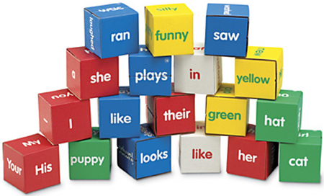
Common Data Element
Logical unit of data
Belongs to one kind of information
Set of attributes specifies;
Identification
Definition
Representation
Permissible value
Notes:
This concepts has a background in several disciplines. In computer vision, in linguistics, in artificial intelligence etc… even in compilers.

Slide 20
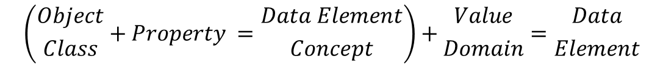
Common Data Element
Data Element
Data Element Concept
Value Domain
Object Class
Property
Representation
$$\left({Object \atop Class}+Property ={Data Element \atop Concept}\right)+{Value \atop Domain}={Data \atop Element}$$

Slide 21
Common Data Element
Data Element
Person Birth Date Value
Data Element Concept
Value Domain
Person Birth Date
Birth Date Value
Person
Birth Date
Data type: Calendar
Object Class
Property
The concept
What?
The representation
How?

Slide 22
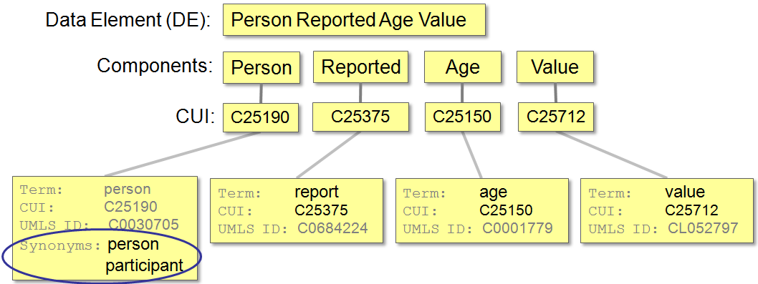
Common Data Element
Linked Data
Integration with other MDRs
Linked Data
ICD9, ICD10
SNOMED CT
LOINC
RxNorm
WHO ART
MedDRA
….
diagram adopted from http://ncicbtraining.nci.nih.gov//TPOnline/TPOnline.dll/Public%20Course/COURSENO=COUR2006121515230703800967
Notes:
Two different perspectives in terms of Linked Data integration and data interoperability. One is the precise definition of Data Elements so that different MDR implementation which can speak ISO11179 talk to each other through LOD. The other one is the linkage of the components and information items to the external resources.

Slide 23
Common Data Element
Improves the quality of data
Simplifies data sharing
Knowledge sharing
Promotes standard, consistent, universal data
Ease of development
data collection tools
Data Interoperability between
applications
development teams
enterprises
…
→ All require precise definitions of data
Notes:
If “everybody speaks the same language”, this can be something bad. Everybody should speak different languages, different cultures → sociological analogy… Fuzzy and chaotic environments IMO has more chance to innovate and reach better levels. It is better to say that “everybody can speak the same language ALSO”.

Slide 24
ISO/IEC 11179 Implementations
OneMeta MDR, Data Foundations Inc.
extendible and configurable, commercial
caDSR, US National Cancer Institute
Extension to standard, persisted on RDBMS
CCTS, UN/CEFACT
Business data model standard based on 11179
UBL is an implementation of CCTS
US National Information Exchange Model - NIEM
Notes:
OneMeta MDR is a complete 11179 implementation, extendible and configurable without progmming
commercial, does not follow semantic approach
caDSR is extension to 11179, defined schemas on database, do not expose as RDF
NIEM is based on naming and identification principles, part 5,
aims to be common model among all organizations across the U.S.

Slide 25
Organizations using ISO/IEC 11179
Australian Institute of Health and Welfare - METeOR
US Department of Justice - Global Justice XML Data Model GJXDM
US Environmental Protection Agency - Environmental Data Registry
US Health Information Knowledgebase (USHIK)
Ohio State University - open Metadata Repository (openMDR)
Minnesota Department of Education Metadata Registry (K-12 Data)
Minnesota Department of Revenue Property Taxation
The Census Bureau Corporate Metadata Repository
Statistics Canada Integrated MetaDataBase
The Environmental Data Registry
Notes:
METeOR, 11179 based MDR for health, housing and community services, endorse national standards
provides tools for search and query – we will provide standard SPARQL
GJXDM
Environmental Data Registry
USHIK
registry for healthcare related data, populated by other organization, public expose
aims to support CDE’s from different standards such as X12, NCPDP, HL7
openMDR
caGrid competible, query interface
k-12 Data
needed to comply with NIEM, XML based ISO 11179, exposes as RDF, OWL
When the time comes for these organizations to consider the Semantic Web technologies; integration with LOD would be an inevitable solution and this semantic implementation would let them easily switch between technologies. → We all talk ISO11179..!

Slide 26
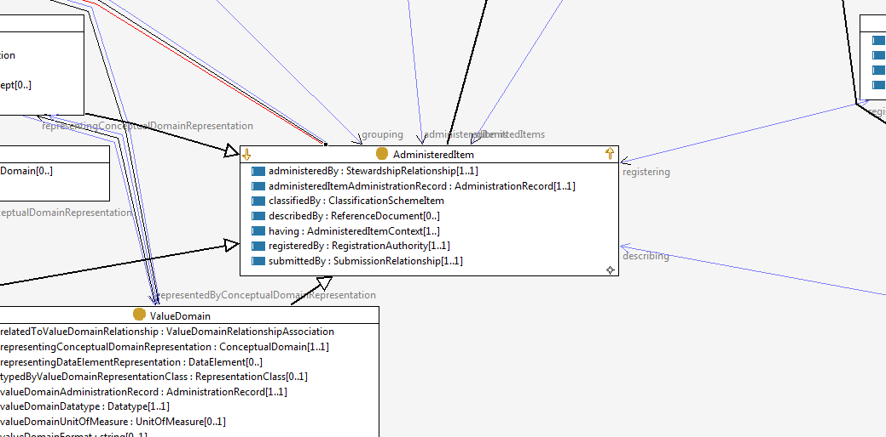
Design & Implementation ISO/IEC 11179 Ontology
Notes:
There was already a designed ontology for ISO/IEC 11179:
Lawrence Berkeley National Laboratory
A (non-normative, unofficial) OWL ontology for ISO/IEC 11179-3 version 2. Authored by Kevin D. Keck (kdkeck@lbl.gov). Last modified 2005-Jan-21
We followed a similar approach… Minor differences for the requirements of our MDR design – completely Jena based, stay consistent with the naming of ISO/IEC 11179.

Slide 27
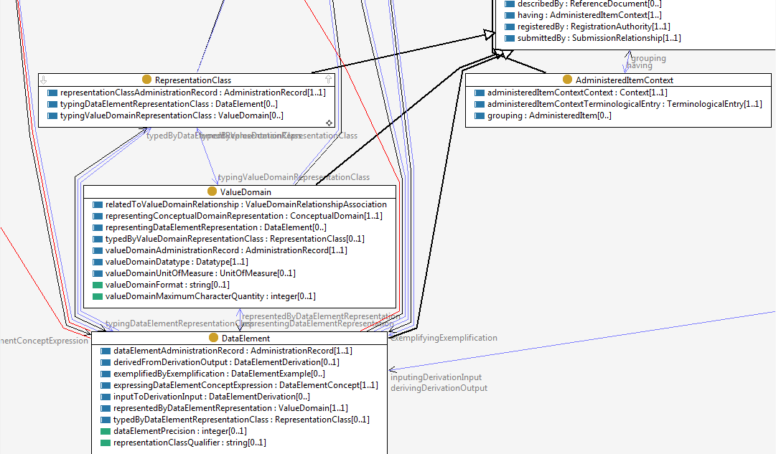
Ontology Design

Slide 28
Design & Implementation

Slide 29
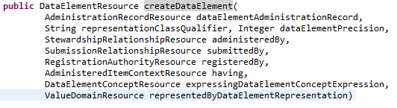
Design & Implementation
JENA RDF/OWL API

Slide 30
Use-case
Once we have an implementation for a semantic MDR
Need to populate with Common Data Elements
Mining for CDEs
Importers for different languages: XML Schema, UML, and ontology languages (RDFS/OWL)
Other applications must be built on top of the semantic MDR
New content models referring to the CDEs
Matching and mapping → Strong reasoning
Data Warehouses, Web Services, EHR Systems, Content Management Systems etc…

Slide 31
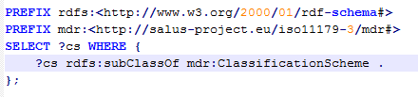

Use-case
List all “ClassificationScheme”s
List all “ObjectClass”es

Slide 32
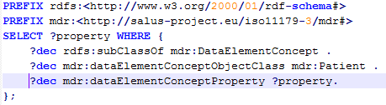
Use-case
Get all “Property”s of a Patient

Slide 33
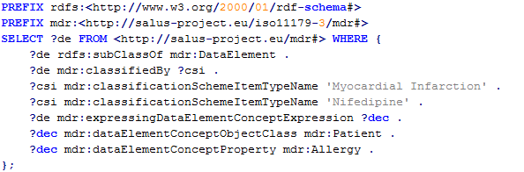
Use-case
List all “DataElement”s which are “classifiedBy” Myocardial Infarction (ClassificationSchemeItem) and Nifedipine (ClassificationSchemeItem) AND which have Allergy as “DataElementConcept”

Slide 34
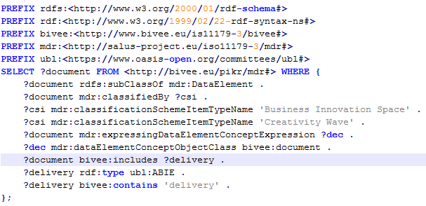
Use-case II
Notes:
Select all documents from the Creativity Wave under Business Innovation Space

Slide 35
Summary
Meta-data Registry to facilitate Semantic Interoperability through Common Data Elements (CDE)
For several different domains
ISO/IEC 11179 based
well-established and commonly accepted standard
Pure triple-store implementation access through Jena API
easy integration to Linked Data cloud
together with other MDR implementations
Importers for CDE identification
XML Schema, UML (v1.x and v2.x), RDFS/OWL based ontologies
Apache Wicket based Web interface

Slide 36
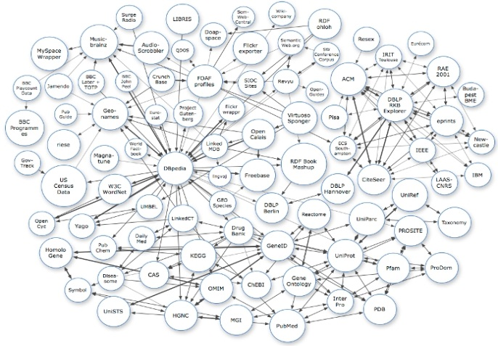
ISO/IEC 20943
Procedures for achieving metadata registry (MDR) content consistency
formalized ontology generation with well-defined concepts
Web Ontology
Metadata Registry
(ISO/IEC 11179)
DEC
OC
CD
DE
. . .
realized
MDRs
(Sets of concepts)
build
EDR
caDSR
METeOR
Our Proposal
Scope of this Part
(Environmental Data Registry)
(US National
Cancer Institute)
(Metadata Online Registry)
utilized
Process Manager
Mapping Info. and Rulus

Slide 37

Questions
Thank you for listening…
A. Anil Sinaci
@aasinaci
Special thanks to anilpacaci@gmail.com

