Slide 1

What
Can Do for You!
Fabian Christ
fchrist@apache.org

Slide 2

About Stanbol
… provides a set of reusable
components for semantic content management.
Semantic CMS
Traditional CMS

Slide 3
started within the project
Interactive Knowledge Stack – 2009 - 2012
Funded in part by a €6.58m grant from the EU for a consortium of 7 research and 6 industrial partners
A software architecture for semantically
enabled content management systems.
An open-source community to bring
semantic technologies to content
management system platforms.

Slide 4
Timeline

Slide 5
What is a Semantic CMS?
Traditional CMS
Semantic CMS
Atomic unit: Document
Properties as meta-data
  e.g. author
  tags, keywords
Keyword search for
  strings in docs
Document Management
  Document types
  Document workflow
Atomic unit: Entity
Semantic meta-data
  Defined entity types
  Linked entities
Semantic search for
  entities and their relations
Knowledge Management
  Entity management
  Ontologies

Slide 6
Do Not Replace – but Extend
No need to replace existing CMS technology
Stanbol components offer service oriented integration
Integration through a RESTful web service API
Traditional CMS
Stanbol Semantic
Services
HTTP
Database

Slide 7




Integration scenarios
REST API
Standalone
via included HTTP server
Web Application
via Servlet-Container
Embedded
as part of another
Java application
Web Apps
REST API
Java Application
OSGi Environment
App
Java API

Slide 8
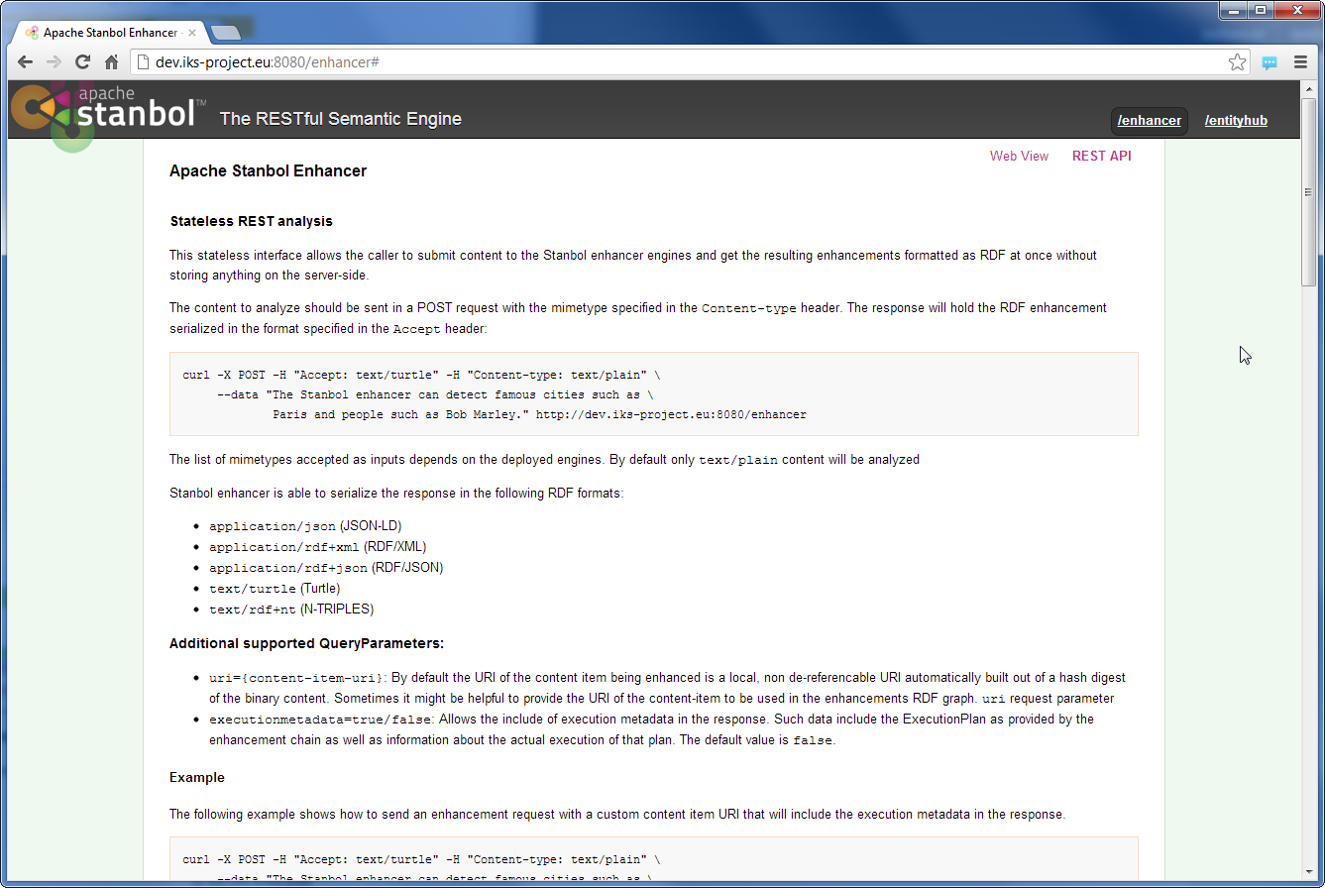
Help included
Each component offers its documentation at an HTML endpoint as part of its RESTful interface
http://localhost:8080

Slide 9
OSGi Component Architecture

Slide 10

Semantic Lifting
Lorem Hans dolor
Entity Extraction
Enhance content
Stanbol Enhancer
Manage entities
Entityhub
Store & search
Contenthub
Linked
Data
Cloud
Entity Linking
Content Store
Semantic Index
Semantic
Search

Slide 11



Enhancer and Enhancement Engines
Extract entities from unstructured textual content and link them to external data sources
Enhancement Chain
Convert
LangID
NER
Link
Unstructured
Content
Enhancements
Metadata
as RDF

Slide 12
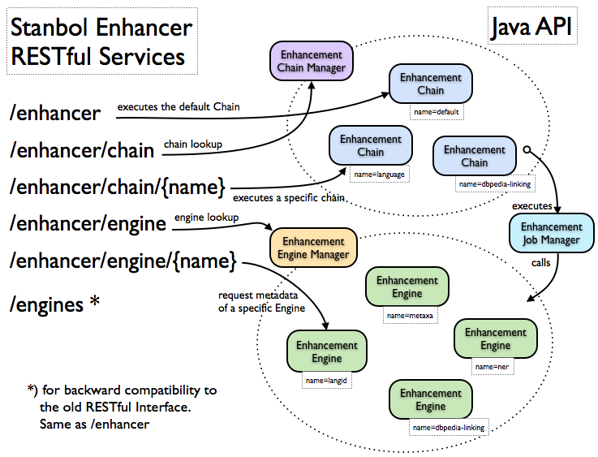
by Rupert Westenthaler

Slide 13
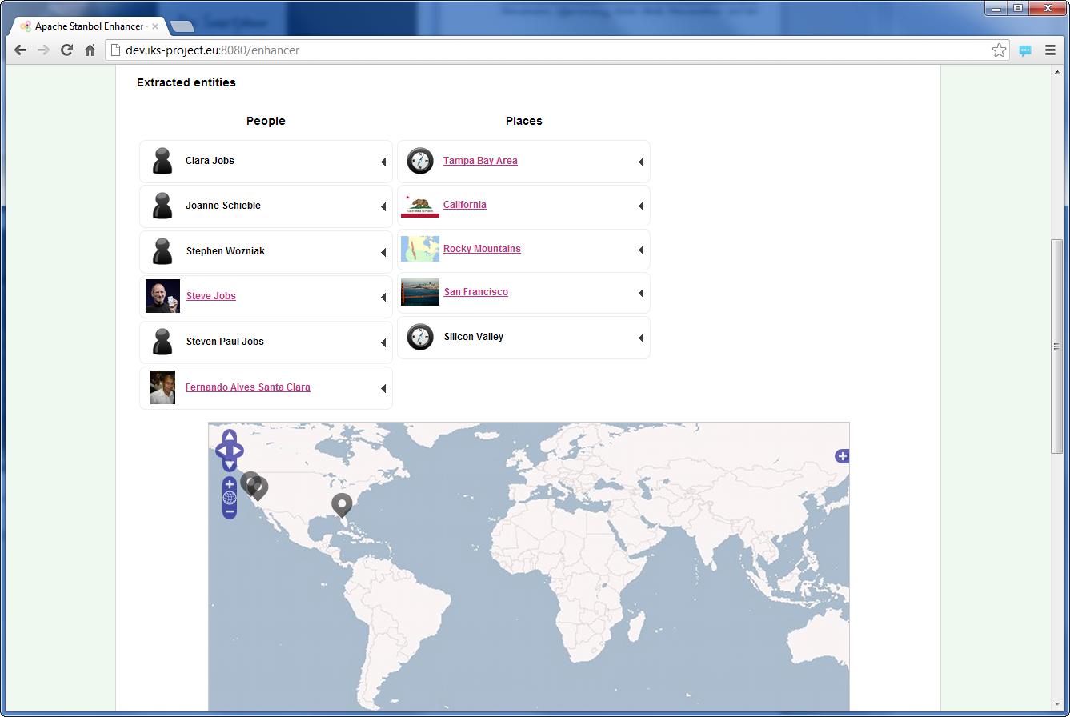
Short Enhancer
DEMO

Slide 14
Entityhub
Extracting Custom Entities
with the Stanbol Enhancer
by Rupert Westenthaler
Today 3:45 p.m.–4:30 p.m.
in Level 2 Left
Manage a network of remote sites for fast entity lookup using local caches for external and custom entity information
Local
indices
Linked Data support
dbpedia
linkedct.org
Web
Resources
Manage your entities
eHealth
Entityhub
Specific
extensions
linkedct
Reuters
Specific
Resources
Cached
entities
reuters
Local Caches
Remote Sites
Referenced Sites

Slide 15

Contenthub
Semantic Indexing and Search
for Content Management Systems
by Ali Anil Sinaci
Tomorrow 9:15 a.m.–10 a.m.
in Level 2 Left
Store and index documents along with an arbitrary number of semantic indices
Contenthub
1. enhance
Enhancer
Unstructured
Content
2. store
Storage
Layer
CMS
Store
3. semantic
index
keep in sync
with CMS
indexed via LDPath
configuration
Indexing
Layer

Slide 16
OSGi Component Architecture

Slide 17
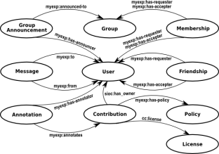
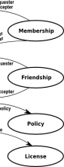
Knowledge Management & Reasoning
Manage ontology networks
Ontology Manager
Transform ontologies
Rules
Inference knowledge
Reasoners

Slide 18
Ontology Manager
Controlled environment for managing ontologies
Manage ontology networks to activate/deactivate parts of complex ontologies
Manage user sessions for ontologies allowing local user changes

Slide 19
Rules
Construction and execution of inference rules
Inference rules, also called transformation rules, take premises and return conclusions
Rules can be organized in recipes which allow to execute a set of rules as a whole
Example
  Define rules for doing integrity checks on data fetched from heterogeneous external data sources

Slide 20
Reasoners
Common API for existing reasoning services
Supports different reasoners and configuration in parallel
Supported third-party reasoners
  Jena RDFS
  OWL
  OWLMini
  HermiT

Slide 21









Uses …
Apache Felix as its OSGi environment
Apache Sling launcher and OSGi tools
Apache Maven as its build environment
Apache Clerezza as its RDF framework
Apache Jena to store triples
Apache Solr for indexing and fast entity lookup
Apache Tika to convert input
Apache OpenNLP for entity extraction
Apache Log4j for logging
…

Slide 22

for search engine optimization
http://www.sxc.hu/photo/1165440

Slide 23

for related content
http://www.sxc.hu/photo/988001

Slide 24


as a refinement service
http://www.sxc.hu/photo/959347
http://www.sxc.hu/photo/541350

Slide 25

as a semantic search engine
http://www.sxc.hu/photo/959347
http://www.sxc.hu/photo/1187880

Slide 26

for document classification
http://www.sxc.hu/photo/1187880
http://www.sxc.hu/photo/1401426

Slide 27

for your use case
Thanks for your
attention!
http://www.sxc.hu/photo/1009933

