Slide 1
Building a scalable multi-tenanted Application Server on the Cloud using Tomcat, Axis2 & Synapse
Senaka Fernando
(senaka at apache.org)

Slide 2
About the Presenter
Senaka Fernando
Committer Apache Web Services
PMC Member Apache Incubator & Apache Axis
Member, Apache Software Foundation
Technical Lead & Member Integration Technologies Management Committee, WSO2
Twitter: @senaka
ApacheCon NA 2011
Afkham Azeez
Selvaratnam Uthiayashankar
Notes:
2

Slide 3
Agenda
Overall Architecture
Elastic Load Balancer
Application Server
Data & Storage
Metering & Billing

Slide 4
Overall Architecture
ELB
AS₁
AS₂
AS₃
AS_{n}
Clients
Application Server Cluster

Slide 5
Elastic Load Balancer
Based on Apache Synapse & Apache Tribes

Slide 6
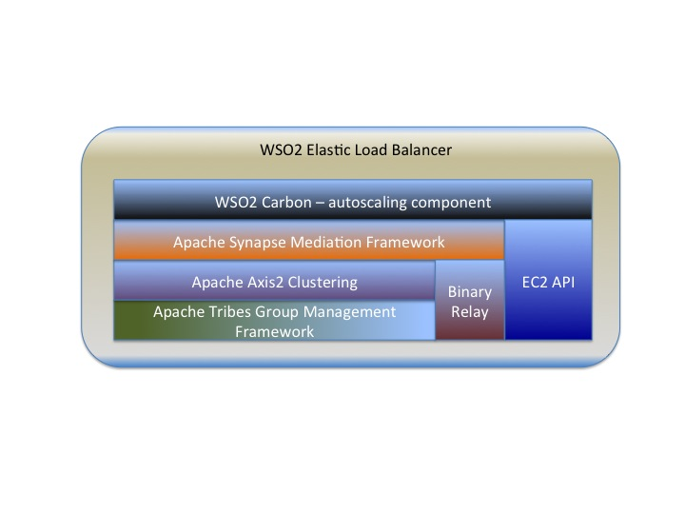
High-level Architecture

Slide 7
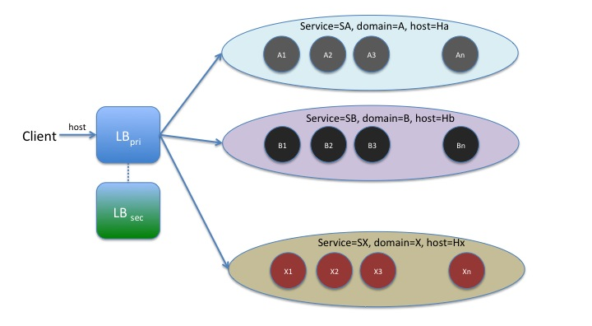
Load Balancing

Slide 8
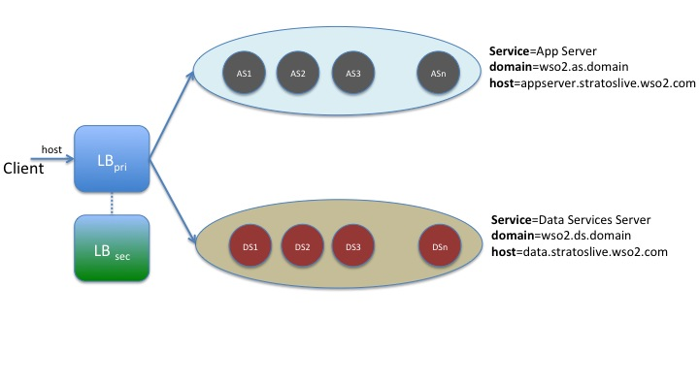
Practical Example

Slide 9
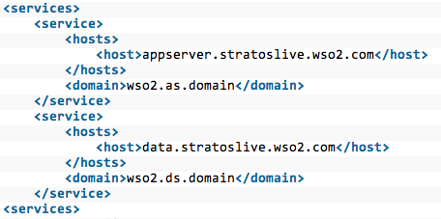
Configuration

Slide 10
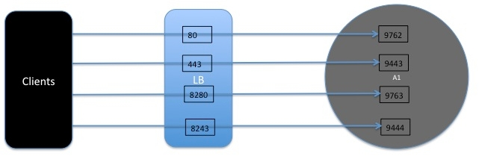
Proxy Port to Real Port Mapping

Slide 11
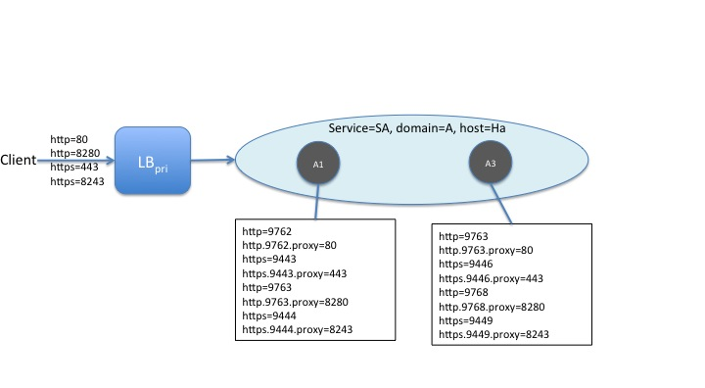
Proxy Port to Real Port Mapping

Slide 12
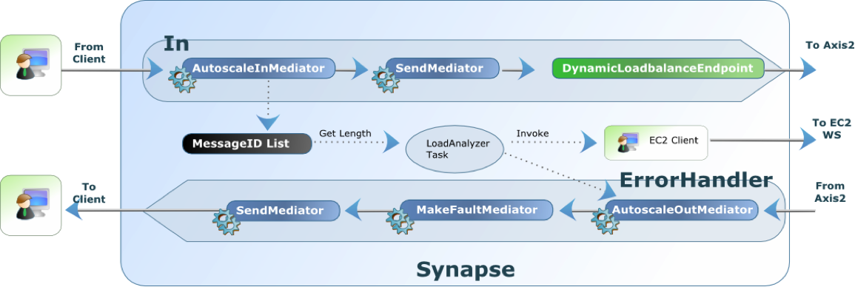
Synapse Message Flow

Slide 13
Dynamic Load Membership

Slide 14
Application Server
Based on Apache Tomcat, Apache Tribes & Apache Axis2

Slide 15
Features
Webapp hosting
Uses embedded Tomcat
Services hosting
Axis2 AAR services
Data services
etc…

Slide 16
Tomcat

Slide 17
Tomcat
Stuck thread detection valve
Multi-tenant access log
Web app lazy loader valve
Tenant-aware management console
Tenant-aware web app contexts
Tenant-aware session manager

Slide 18
Request Interception
Tenant Identification & Tenant Context Creation
Access Log Valve
Lazy Loader Valve
Stuck Thread Detector Valve
Web App
Clients

Slide 19
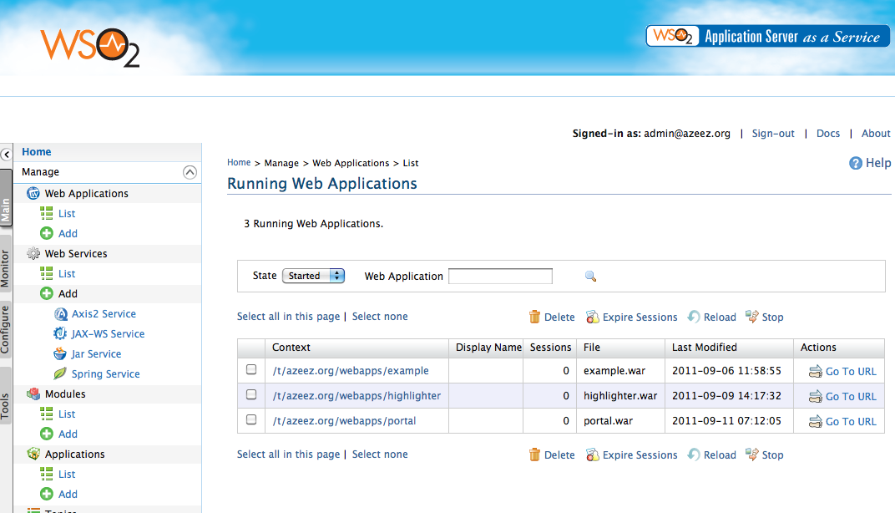
Management Console

Slide 20
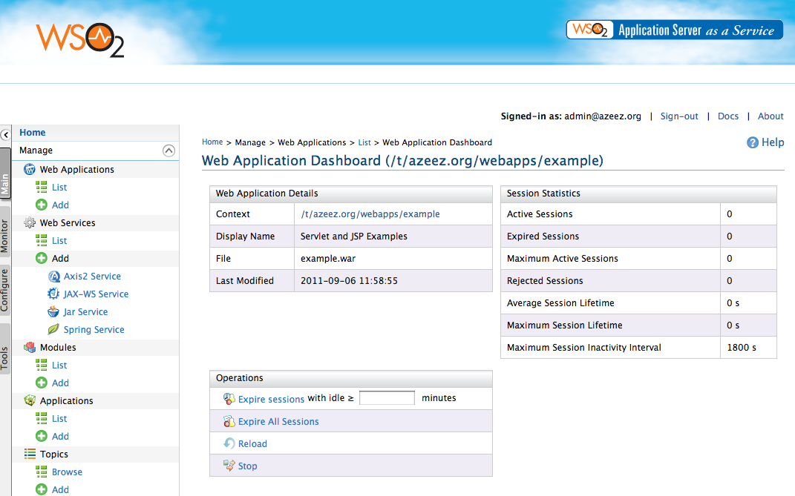
Management Console

Slide 21
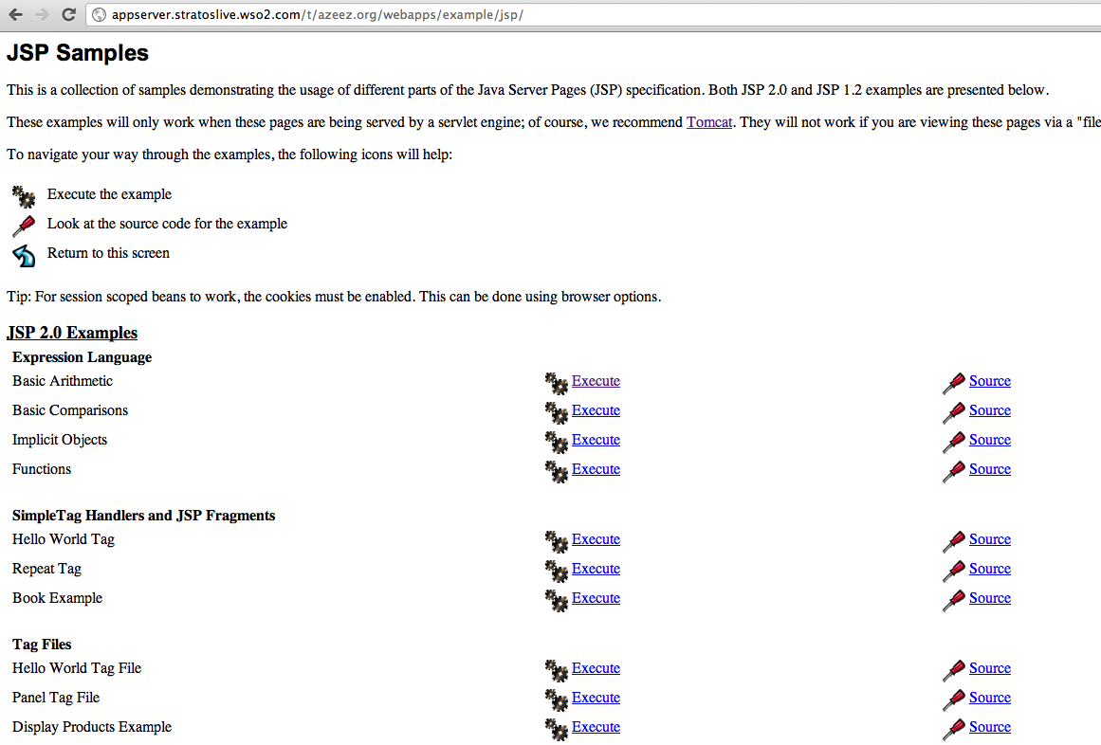
Tomcat Sample Web Application

Slide 22
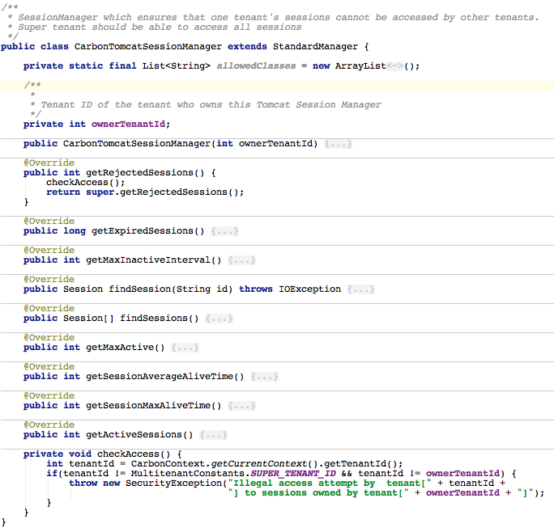
Tenant-aware Session Manager

Slide 23
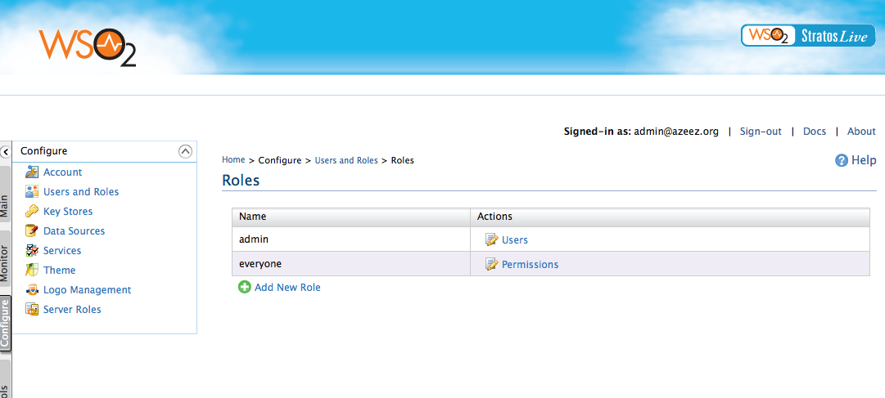
User & Role Management

Slide 24

Integrated Identity (web.xml)
Automatically ties into Stratos Identity

Slide 25

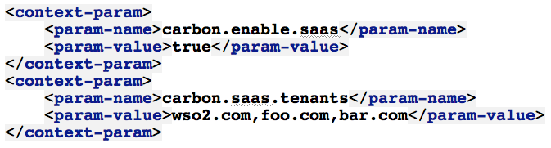
SaaS Mode
One web app shared amongst all tenants
One web app shared amongst selected tenants

Slide 26
Axis2

Slide 27
Axis2
Deployers
Webapp Deployer
AAR Deployer
Data Service Deployer
Isolated AxisConfiguration & ConfigurationContext per tenant
Lazy loading
Ghost Deployer
Multitenant Message Receiver

Slide 28
Messaging
Messaging Engine
Transports
Message Receiver
Client
In
Out
ServiceImpl
In Fault
Out Fault

Slide 29
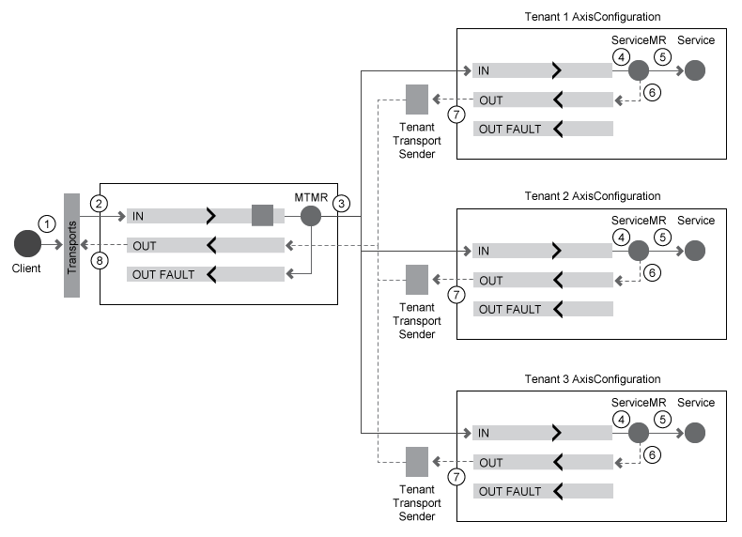
Multi-tenant Message Receiver

Slide 30
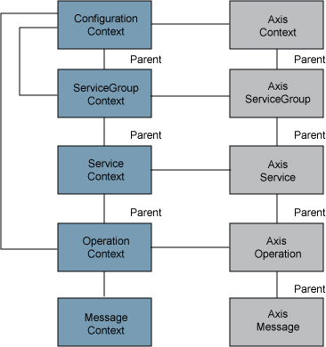
Axis2 Configuration & Contexts

Slide 31
Tenants & Super Tenant
Tenant: foo.com
Super Tenant
Tenant: bar.com

Slide 32
Pluggable Deployers
Deployment Engine
Webapp
POJO Services
Data
Services
JAXWS
Services

Slide 33
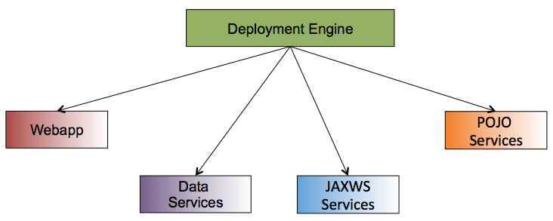
Pluggable Deployers
Tenant: foo.com
Super Tenant
Tenant: bar.com

Slide 34
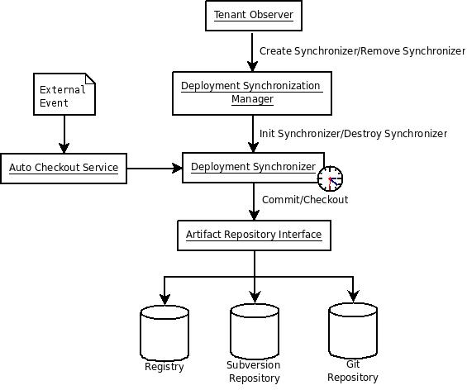
Deployment Synchronizer

Slide 35
Data & Storage

Slide 36
WSO2 Cloud Data Solutions
WSO2 Data Server
Carbonized Cassandra Cluster
Database cluster
Carbonized HDFS Cluster
<Data> PaaS Offerings
Apache Cassandra as a Service
Relational Database as a Service
HDFS as a Service
We are also planning Map/Reduce as a Service as Future work.

Slide 37
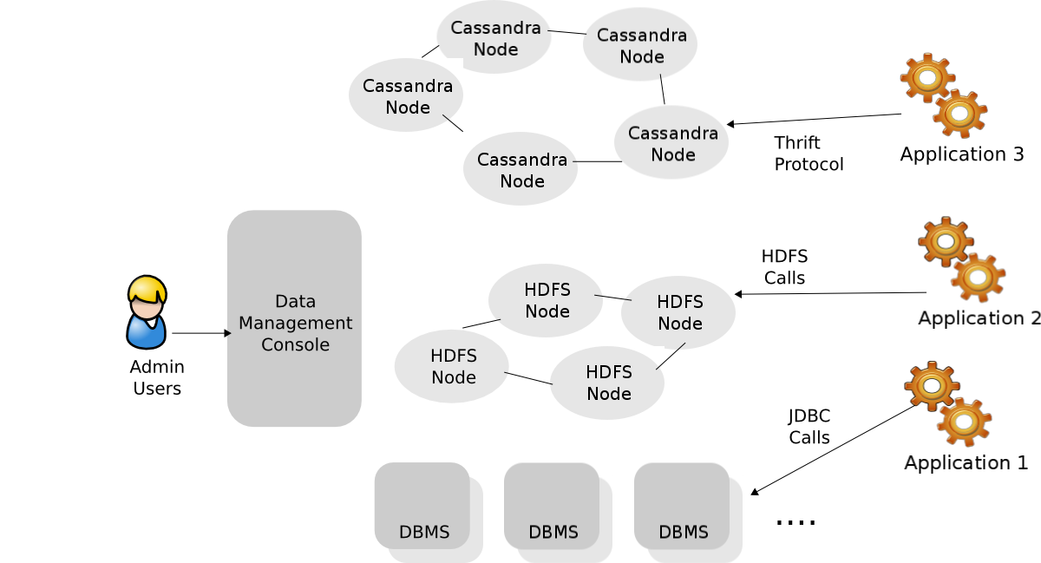
Polyglot Data Architecture

Slide 38
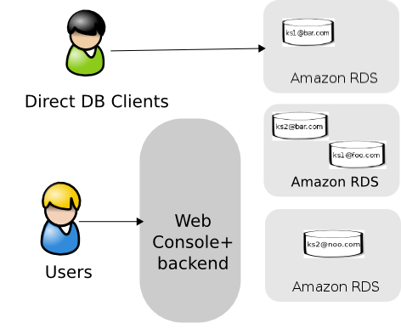
Database as a Service
Users can log in to the Stratos data page and create a Database and receive a JDBC URL.
A DB will be allocated from an Amazon RDS cluster
Tenant isolation & and integrated with WSO2 Security model.

Slide 39
Metering & Billing

Slide 40
Usage Metering/Throttling
Usage Metering
Registry Resource Volume
Number of users
App server Service Bandwidths/Request Response
ESB Mediation Data(Bandwidths Data)
Throttling
Number of users
Registry Resource Volume
Number of Request and Response counts
Service incoming and outgoing bandwidths

Slide 41
Stratos Billing
Scheduled invoice generation
Ability to view past invoices and the current(interim) invoice
Securely pay the invoice via Paypal
Notifies customers via email on payments
Notifies the super-admin on customers exceeding the credit limit
Presents a summary to the super-admin

Slide 42
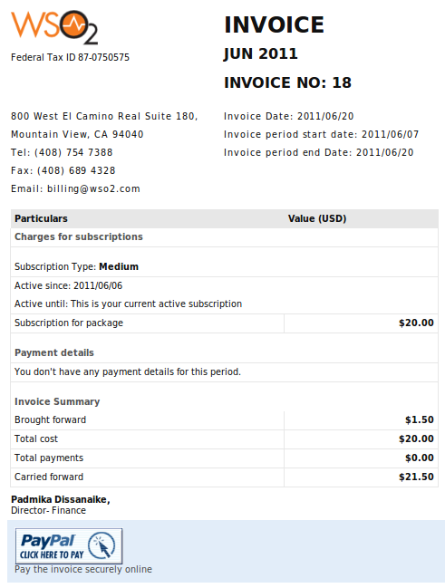
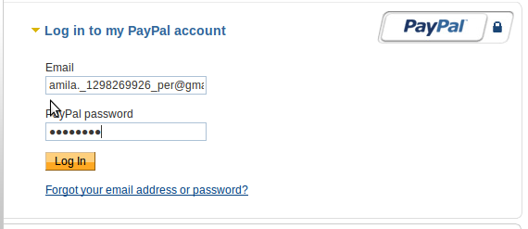
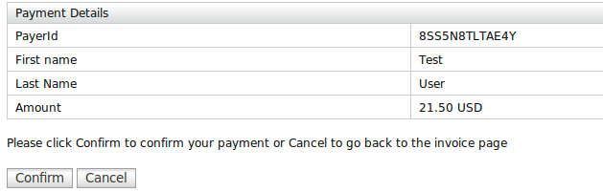
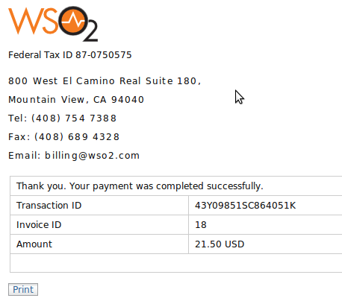

Slide 43

Image: http://www.gembapantarei.com/2009/03/how_do_lean_processes_prevent_human_error.html
Questions & Answers

Slide 44
Thank You!
Notes:
44

