Slide 1

Cassandra concepts, patterns and anti-patterns
Dave Gardner
@davegardnerisme
ApacheCon EU 2012

Slide 2

Agenda
Choosing NoSQL
Cassandra concepts (Dynamo and Big Table)
Patterns and anti-patterns of use

Slide 3
Choosing NoSQL...

Slide 4
Find data store that doesn’t use SQL
Anything
Cram all the things into it
Triumphantly blog this success
Complain a month later when it bursts into flames
http://www.slideshare.net/rbranson/how-do-i-cassandra/4
Notes:
How should we go about choosing a NoSQL solution?
This is the way that NoSQL is often approached
A light-hearted take on both how people approach NoSQL and to some extent the tools themselves

Slide 5
“NoSQL DBs trade off traditional features to better support new and emerging use cases”
http://www.slideshare.net/argv0/riak-use-cases-dissecting-the-solutions-to-hard-problems
Notes:
A good way of choosing NoSQL is by considering the tradeoffs

Slide 6
More widely used, tested and documented software..
(MySQL first OS release 1998)
.. for a relatively immature product (Cassandra first open-sourced in 2008)

Slide 7
Ad-hoc querying..
(SQL join, group by, having, order)
.. for a rich data model with limited ad-hoc querying ability (Cassandra makes you denormalise)

Slide 8
What do we get in return?

Slide 9
Proven horizontal scalability
Cassandra scales reads and writes linearly as new nodes are added

Slide 10

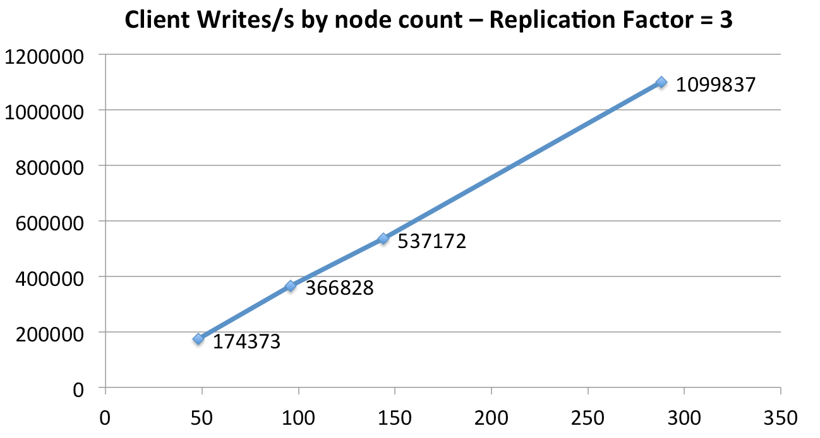
http://techblog.netflix.com/2011/11/benchmarking-cassandra-scalability-on.html

Slide 11
High availability
Cassandra is fault-resistant with tunable consistency levels

Slide 12
Low latency, solid performance
Cassandra has very good write performance

Slide 13
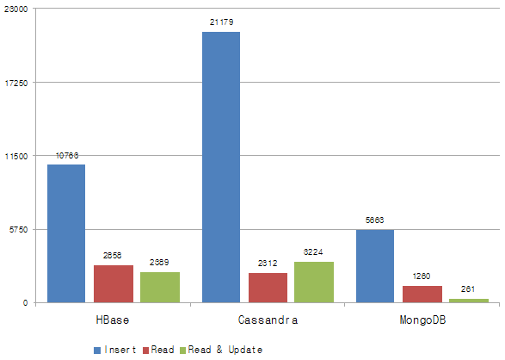
* Add pinch of salt
http://blog.cubrid.org/dev-platform/nosql-benchmarking/

Slide 14
Operational simplicity
Homogenous cluster, no “master” node, no SPOF

Slide 15
Rich data model
Cassandra is more than simple key-value – columns, composites, counters, secondary indexes

Slide 16
Choosing NoSQL...
Notes:
So we are going to be considering tradeoffs when we make our choice; but how do we know these tradeoffs are worth making?

Slide 17
“they say … I can’t decide between this project and this project even though they look nothing like each other. And the fact that you can’t decide indicates that you don’t actually have a problem that requires them.”
http://nosqltapes.com/video/benjamin-black-on-nosql-cloud-computing-and-fast_ip (at 30:15)
Notes:
Ben Black suggests that a tell tale sign that you don’t _need_ NoSQL is when you cannot decide between projects

Slide 18
Or you haven’t learned enough about them..
Notes:
I would argue that you probably cannot decide because you haven’t learned enough about the solutions and how they will fit your needs

Slide 19
What tradeoffs are you making?
How is it designed?
What algorithms does it use?
Are the fundamental design decisions sane?
http://www.alberton.info/nosql_databases_what_when_why_phpuk2011.html
Notes:
Learn about how you would model your application; learn about the key design decisions of the project itself; learn about the algorithms it uses.

Slide 20
Concepts...

Slide 21
Amazon Dynamo + Google Big Table
Consistent hashing
Vector clocks *
Gossip protocol
Hinted handoff
Read repair
http://www.allthingsdistributed.com/files/amazon-dynamo-sosp2007.pdf
Columnar
SSTable storage
Append-only
Memtable
Compaction
http://labs.google.com/papers/bigtable-osdi06.pdf
* not in Cassandra
Notes:
Cassandra is based on the distribution model of Amazon Dynamo with the data model of Google Big Table. We drop Vector Clocks from Dyanamo in favour of column-based “last write wins” conflict resolution from Big Table.

Slide 22
tokens are integers from 0 to 2¹²⁷
1
6
2
5
3
Distributed Hash Table (DHT)
4
Client
Notes:
DHT. The usual way of visualising is to draw a ring where we start at hash 0 and move round to our largest number (here 2^127).
We pick “tokens” within this space (here we have 6 nodes and hence 6 tokens).

Slide 23

1
6
2
consistent hashing
Coordinator node
5
3
4
Client
Client
Notes:
When we write or read data, we calculate a hash of the row key to decide which node should be responsible for the data.
We can connect to _any_ node in the cluster to issue our command; this will act as a coordinator node and store/get the data for us.

Slide 24
1
replication factor (RF) 3
6
2
coordinator node
5
3
4
Client
Client
Notes:
Replicas are picked by traversing round the tokens.

Slide 25
Consistency Level (CL)
How many replicas must respond to declare success?

Slide 26
For read operations
Level | Description
ONE | 1st Response
QUORUM | N/2 + 1 replicas
LOCAL_QUORUM | N/2 + 1 replicas in local data centre
EACH_QUORUM | N/2 + 1 replicas in each data centre
ALL | All replicas
http://wiki.apache.org/cassandra/API#Read

Slide 27
For write operations
Level | Description
ANY | One node, including hinted handoff
ONE | One node
QUORUM | N/2 + 1 replicas
LOCAL_QUORUM | N/2 + 1 replicas in local data centre
EACH_QUORUM | N/2 + 1 replicas in each data centre
ALL | All replicas
http://wiki.apache.org/cassandra/API#Write

Slide 28
RF = 3
CL = Quorum
1
6
2
coordinator node
5
3
4
Client
Client
Notes:
Here with RF=3 we need two of our 3 replicas to respond to consider the operation a success.
When writing, all 3 replicas will still receive the write immediately; we just won’t _require_ them to respond to consider an operation successful (for CL < ALL).

Slide 29
Hinted Handoff
A hint is written to the coordinator node when a replica is down
http://wiki.apache.org/cassandra/HintedHandoff

Slide 30
RF = 3
CL = Quorum
node offline
1
6
2
coordinator node
5
3
hint
4
Client
Client
Notes:
Pre 1.0, hints were written to a live replica. Now written to the coordinator. The hint tells the coordinator to update the unreachable replica when it comes back online.

Slide 31
Read Repair
Background digest query on-read to find and update out-of-date replicas*
http://wiki.apache.org/cassandra/ReadRepair
* carried out in the background unless CL:ALL

Slide 32
RF = 3
CL = One
1
6
2
coordinator node
5
3
4
background digest query, then update out-of-date replicas
Client
Client
Notes:
Reading at CL:ONE, we get our result from #1. There is then a % chance that we’ll query #2 and #3 for their value and then update any out-of-date replicas.

Slide 33
Big Table...

Slide 34
Sparse column based data model
SSTable disk storage
Append-only commit log
Memtable (buffer and sort)
Immutable SSTable files
Compaction
http://research.google.com/archive/bigtable-osdi06.pdf
http://www.slideshare.net/geminimobile/bigtable-4820829

Slide 35
+ timestamp
Name
Value
Column
Timestamp used for conflict resolution (last write wins)

Slide 36
we can have millions of columns *
Name
Value
Name
Value
Name
Value
Column
Column
Column
* theoretically up to 2 billion

Slide 37
Row
Name
Value
Name
Value
Name
Value
Row Key
Column
Column
Column

Slide 38
Column Family
Row Key
Column
Column
Column
Row Key
Column
Column
Column
Row Key
Column
Column
Column
we can have billions of rows

Slide 39
Write path
buffer writes and sort data
Write
Memtable
flush on time or size trigger
Memory
Disk
Commit Log
SSTable
SSTable
SSTable
SSTable
immutable

Slide 40
Sorted data written to disk in blocks
Each “query” can be answered from a single slice of disk
Therefore start from your queries and work backwards

Slide 41
Patterns and anti-patterns...

Slide 42

Notes:
I work for Hailo, these are patterns I find myself using frequently and anti-patterns I try to avoid.

Slide 43
Pattern
Storing entities as individual columns under one row

Slide 44
Pattern
one row per user
row: USERID1234
name: Dave
email: dave@cruft.co
job: Developer
we can use C* secondary indexes to fetch all users with job=developer

Slide 45
Anti-pattern
Storing whole entity as single column blob

Slide 46
Anti-pattern
one row per user
row: USERID1234
data: {"name":"Dave", "email":"dave@cruft.co", "job":"Developer"}
now we can’t use secondary indexes nor easily update safely

Slide 47
Pattern
Mutate just the changes to entities, make use of C* conflict resolution

Slide 48
Pattern
$userCf->insert(
"USER1234",
array("job" => "Cruft")
);
we only update the “job” column, avoiding any race conditions on reading all properties and then writing all, having only updated one

Slide 49
Anti-pattern
Lock, read, update

Slide 50
Pattern
Don’t overwrite anything; store as time series data

Slide 51
Pattern
one row per user; many columns (wide row)
row: USERID1234
a384cff0-26c1-11e2-81c1-0800200c9a66 {"action":"create", "name":"Dave"} 10dc4c40-26c2-11e2-81c1-0800200c9a66 {"action":"update", "name":"foo"}
column name is a type 1 UUID (time based) http://www.famkruithof.net/guid-uuid-timebased.html

Slide 52
Pattern
We can store all sorts of stuff as time series
http://rubyscale.com/2011/basic-time-series-with-cassandra/

Slide 53
Anti-pattern
Order Preserving Paritioner (OPP)
http://ria101.wordpress.com/2010/02/22/cassandra-randompartitioner-vs-orderpreservingpartitioner/

Slide 54
Pattern
Distributed counters

Slide 55
Anti-pattern
Super Columns
(a trap for the unwary)
http://rubyscale.com/2010/beware-the-supercolumn-its-a-trap-for-the-unwary/

Slide 56
In conclusion...

Slide 57
Cassandra is founded on sound design principles

Slide 58
The data model is incredibly powerful

Slide 59
CQL and a new breed of clients are making it easier to use

Slide 60
Lots of tools and integrations exist to expand the feature set

Slide 61
There is a strong community and multiple companies offering professional support

Slide 62

Thanks
Learn more about Cassandra (if you’re ever in London)
meetup.com/Cassandra-London
Learn more about the fundamentals http://nosqlsummer.org/
Watch videos from Cassandra SF 2011
http://www.datastax.com/events/cassandrasf2011/presentations
looking for a job?

Slide 63
Extending functionality
Search via Apache Solr and DataStax Enterprise http://www.datastax.com/technologies/solr
Batch processing via Apache Hadoop and DataStax Enterprise http://www.datastax.com/technologies/hadoop
Real-time analytics via Acunu Reflex http://www.acunu.com/acunu-analytics.html

