Slide 1
Semantic Indexing and Search for Content Management Systems
Suat Gönül, SRDC
suat@apache.org
prepared by
A. Anil Sinaci, SRDC
sinaci@apache.org
presented by

Slide 2


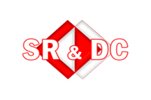


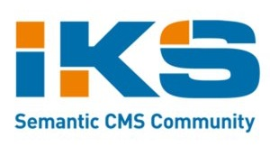

About me
PhD student at
Senior Software Engineer at
FP7 Projects:

Slide 3
Agenda
Stanbol Overview
Main scenario
Two-layered architecture
  Storage
    Revision management
  Indexing
Application of the architecture
Notes:
Stanbol overview: Overview about the Stanbol components and the main purpose/usage of the Stanbol
Main scenario: A sample scenario in which the proposed two-layered architecture will be used
Two-layered architecture: Architecture for semantic indexing and semantic search for content management systems
Application of the architecture: How the architecture is applied to our scenario.

Slide 4

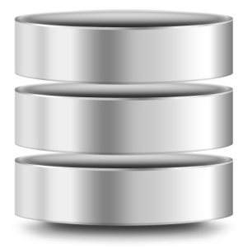
Stanbol Overview
Semantic Services
Different means of interaction
Traditional CMS

Slide 5
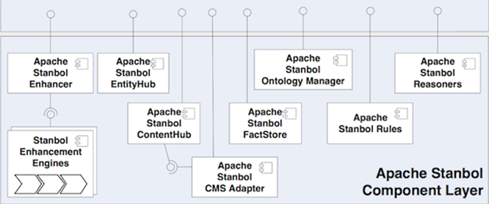
Stanbol Design
RESTful API
OSGi Services
Notes:
Enhancer: A set of enhancement engines i.e content extractors,language detectors, named entity recognizers, disambiguators, LOD adapters,etc. The engines basically takes a content and procude RDF enhancement. They can be grouped under chains so that they execute in predefined order.
Entityhub: Manages entities which are grouped under different RDF datasets; allows CRUD functionalities on them. RDF datasets can be obtained from the LOD cloud or they may be of your own.
Contenthub: The semantic indexing and search components of Stanbol. When I content submitted to this component, sends it to the Enhancer to be enhanced if it is not already, it connects to Entityhub to further gather additional information about named entities recognized within the submitted content and indexes all information in indexes which may be configured according to specific needs. This is the initial component on which we designed the semantic indexing and search architecture.
CMS Adapter:Eases the management of document in Contenthub for JCR and CMIS compliant content management systems. Also provides functionalities to generete RDF from such kind of CMSes and populates them by given external RDF data.
Factstore: The FactStore is a component that let's use store relations between entities identified by their URIs. [http://stanbol.apache.org/docs/trunk/components/factstore/]
Ontology Manager: The Apache Stanbol Ontology Manager provides facilities for managing ontologies, ontology networks and user sessions for semantic data modeled after them. It provides access to underlying model in different granularities. [http://stanbol.apache.org/docs/trunk/components/ontologymanager/]
Stanbol rules: Stanbol Rules is a component that supports the construction and execution of inference rules. [http://stanbol.apache.org/docs/trunk/components/rules/]

Slide 6
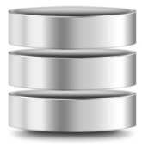
Semantic Indexing & Search Scenario
Customizable Index Configurations
Plain content
Content Enhancement
CMS
Enhanced content
Semantic Indexing
Search Services
Semantic Index
Notes:
This is the scenario/workflow describing the semantic indexing and search services architecture in generic concepts.
Explanation of the workflow:
…
In the next slides, the main workflow will be explained by presenting some screenshots.

Slide 7
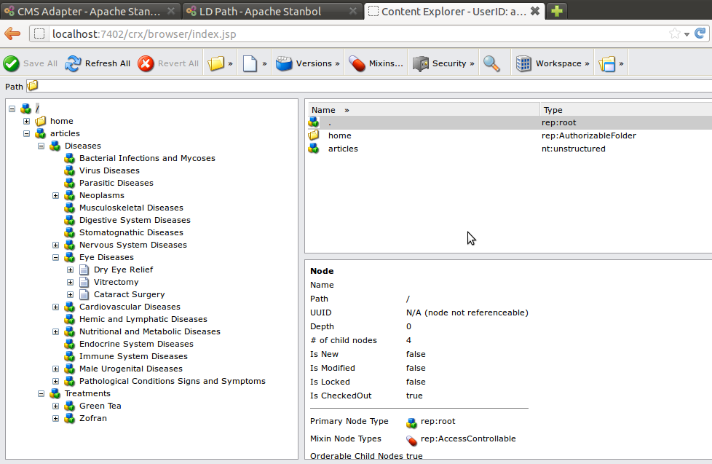
CMS Structure
Plain content
CMS
Notes:
This is a screenshot from the CRX content management system.
Health related categories and document inside them…

Slide 8
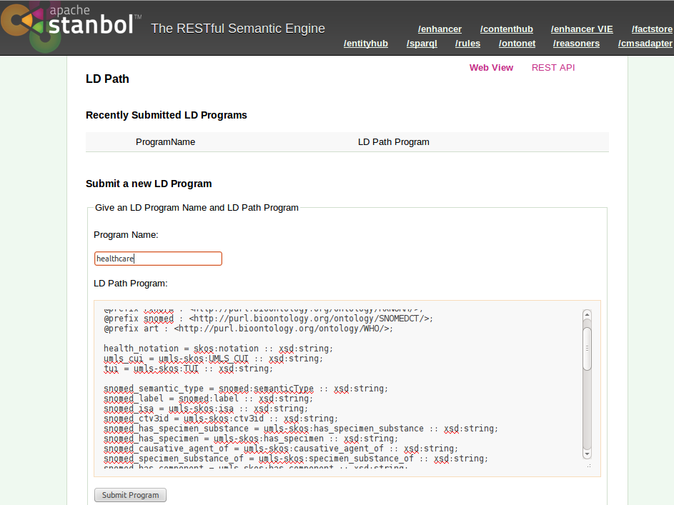
Configuring Index
Customizable Index Configurations
Notes:
To index the document inside the CMS, an healthcare specific indexing infrastructure is created with the given configurations. In this step, we aim to configure the indexing structure so that it would be compatible with the document and its additional metadata which is obtained after the document enhancement process. This is very useful especially, users have configured custom enhancement chains.
Detailed information about configuration of indexes will be given in the next slides...

Slide 9
Domain Specific Enhancements
Content Enhancement
…
<rdf:Description rdf:about="urn:enhancement-810e14ac-af3d-3310-b9bb-
74233df94ef5">
<j.6:extracted-from rdf:resource="urn:content-item-sha1-d20174d4d24878f60b02bd8b03acc677404a7998"/>
<j.6:confidence rdf:datatype="http://www.w3.org/2001/XMLSchema#double">0.8</j.6:confidence>
<rdf:type rdf:resource="http://fise.iks-project.eu/ontology/EntityAnnotation"/>
<rdf:type rdf:resource="http://fise.iks-project.eu/ontology/Enhancement"/>
<j.6:entity-label>Heart disease</j.6:entity-label>
<j.2:created
rdf:datatype="http://www.w3.org/2001/XMLSchema#dateTime">2012-04-18T05:34:27.329Z</j.2:created>
<j.2:creator
rdf:datatype="http://www.w3.org/2001/XMLSchema#string">org.apache.stanbol.
enhancer.engines.keywordextraction.engine.KeywordLinkingEngine</j.2:creator>
<j.6:entity-reference rdf:resource="http://purl.bioontology.org/ontology/SNOMEDCT/Ins_161639008"/>
<j.2:relation rdf:resource="urn:enhancement-a4f0b4e7-4992-bef2-3aa3-7b8010d0a56a"/>
</rdf:Description>
…
Notes:
Using Stanbol users can configure domain specific enhancement chains. This is done by configuring enhancement engines looking for named entities from custom datasets. In this way, external RDF datasets are seen as a superset of named entities which can be recognized within the documents. Furthermore, users can configure the enhancer component of Stanbol to get custom enhancement types in the RDF enhancements. As said in the previous slide, in our semantic indexing architecture we aim to provide indexing infrastructure compatible with the nature of enhancements. For instance in the slide a disesase entity taken from enhancements of a health related documents is seen.

Slide 10
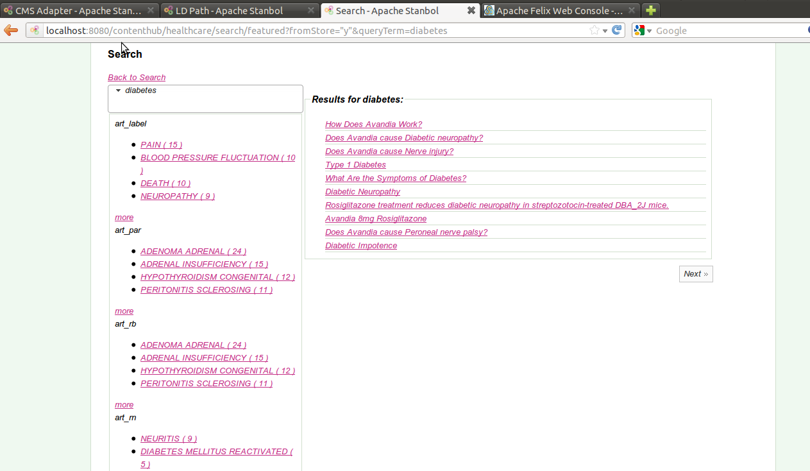
Semantic Indexing & Search
Enhanced content
Semantic Index
Search Services
Notes:
After the content enhancement process, all gathered information is stored in the indexes which were prepared previously. On top of the indexes different kinds of search are provided. These search services can also be provided considering the semantic nature of the underlying index. For instance, in the figure you see a faceted search interface. The facets are formed using the underlying index fields. The name of facets are not so informative. A little domain specific information here: art is the abbreviation of adverse reaction terminology. And the facets starting with the “art” label corresponds to different properties of entities obtained from an adverse reaction terminology dataset.

Slide 11



Two-layered Architecture
Storage Layer
Indexing Layer
Content Item Storage
Semantic Index
Content Item Storage
Semantic Index
Indexing Source
Semantic Index
Auto Sync.
CMS Adapter
File Based
JCR
CMIS
Others
Search Services
Notes:
We propose a two a layered architecture in which we realized the machinery for semantic indexing and search.
The layers are storage & indexing.
The storage layer is the layer in which we keep the actual documents/items or to be indexed. This is done by the IndexingSources. Indeed, it is not mandatory to keep the raw data of the document. IndexingSources can have different types of implementations. For instance, file based implementation of IndexingSource keeps the documents themselves in the local file system of the user. On the other hand, CMS Adapter based implementations would wrap the documens residing in the CMS itself. Usage of JCR and CMIS standards would provide to access to CMS in a standardized way. As a result, it would provide automized interaction with CMSes which are compliant with those standards.
The other layer of the architecture is the indexing layer. This layer keeps the indexes of documents. The component realizing the indexing named as Semantic Indexes. A SemanticIndex interacts with the storage layer, actually with specific IndexingSources and requests items to be indexed. After retrieval of the items, it indexes the documents and additional information according to its configuration. SemanticIndexes can be based on different frameworks. For instance, one may be based on Apache Solr framework and the other may be on Apache Jena. Based on the underlying framework, SemanticIndexes provide different search options. For instance Solr based on exposes the RESTful services of Solr index on the other hand jena based one provides a sparql endpoint on the index. SemanticIndexes keeps track of specific IndexingSource from the storage layer. They keep themselves synchronized with the changes occurred in the associated IndexingSource such as addition, deletion or update of documents.
Details are in the next slides…

Slide 12
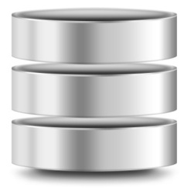
Storage Layer
RESTful Requests
Content Item Storage
Content Item Storage
Indexing Source
CMS
Enhanced content
Plain content
Enhancer
CMS Adapter
File Based
JCR
CMIS
Content check
Notes:
In the storage layer, documents can be pulled from CMSes using the JCR or CMIS standards or from the other direction they can push their documents to the Stanbol framework by calling RESTful services of related components. IndexingSources manage documents together with their enhancements. In the file based case for instance, the enhancements are compressed as a different along with the raw content in a zip file. On the other hand, in the CMS Adapter based implementations, the raw content resides in the CMS. The other parts which are created at the end of the processing in Stanbol e.g enhancements can either be pushed backed to the CMS or can be managed in the scope of IndexingSources.

Slide 13
Storage Layer
Separation of Storage layer provides
  Storage of items having different granularities
    ContentItem, Entity
  Opportunity of integration with standard based CMSes
    JCR, CMIS
Notes:
Having a separate storage layer for items to be indexed allows to use this architecture for items having different granularities. For example, one can implement an IndexingSource keeping content items, while another one may have another implementation keeping single entities. Furthermore, the opportunity of injecting different implementations of IndexingSource to the Stanbol environment provides having different interaction means with content management system. Apart from the already mentioned implementations compatible with the JCR or CMIS standards one can develop other implementations such as looking for documents from WebDav or ftp servers, etc.

Slide 14
Revision Management
IndexingSource keeps track of revisions of stored items
  When an item is created, create also a corresponding revision
  When an item is updated or deleted increase the corresponding, existing revision
Used while synchronizing the Storage and Indexing layers
Notes:
Some details about how items are tracked in IndexingSources…
IndexingSource keeps a revision for each item managed inside it. When an item is created, a revision is also created. In the lifecycle of the item, when it is updated, its revision is increased. Similarly, if the item is deleted from the IndexingSource, again its revision is increased. Please note that the revisions are simply a number, they do not include what type of change has been done or how the content of the item has changed. SemanticIndexes use revisions of items while requesting the items from the IndexingSources to be indexed. Will be explained in the later slides…

Slide 15
Revision Management - ChangeSet
IndexingSource provides the list of changed items based on a given revision through the ChangeSet structure
  getChanges(revision:long, batchSize:int):ChangeSet
ChangeSet keeps IDs of items not items themselves
Notes:
An Indexing source can provide the list of changes on the managed items as of a given starting revision through its getChanges method. The changes comes within the ChangeSet object. This object does not keep the actual content of the changed items, rather it contains identifiers of items to reference them. It also includes some other information about the revisions of resultant items such as the minimum or maximum revision number in the ChangeSet. See the example in the next slide.

Slide 16
Revision Management - ChangeSet
An example:
  After step 1:
  1 : urn:contentItem.1 //added
  1 : urn:contentItem.2 //added
  1 : urn:contentItem.3 //added
  After step 2:
  1 : urn:contentItem.1
  2 : urn:contentItem.2 //updated
  2 : urn:contentItem.3 //removed
  After step 3:
  1 : urn:contentItem.1
  2 : urn:contentItem.2
  3 : urn:contentItem.3 //added
  3 : urn:contentItem.4 //added
getChanges(0, …) =>
{urn:contentitem.1, urn:contentitem.2, urn:contentitem.3, urn:contentitem.4}
getChanges(2, …) =>
{urn:contentitem.3, urn:contentitem.4}
Notes:
In this example, we have 3 steps where we do updates on the IndexingSource. In the first step, we add 3 new items. So, each of them is assigned with a new revision which is 1. In the second step second item is updated and third item is removed. So, their revisions have been increased, so their revisions are 2 now. In the third step, there are 2 updates also. So, their revisions are set as 3. As you might understand, individual items do not have their own revisions. Rather than that the revision is increased globally. For this kind of revision management mechanism one can assign the system time as revision when a new item created, or an existing is updated or deleted. So, based on these knowledge, if one requests changes as of the start, he would get all items in the result. However, if one requests changes as of the second revision, he would only get identifiers of lastly added items.

Slide 17
Revision Management - Epoch
IndexingSource keeps an epoch indicating a common revision for all stored items
A change of the epoch means that whole data source of the IndexingSource has changed
  For instance, data source of the IndexingSource is replaced with the new DBPedia dump
  Revision registry is repopulated for the new items
Notes:
There is also the epoch concept in the revision management machinery. An epoch is a common revision for all stored items. For instance, assume that your IndexingSource keeps the DBPedia dump. So, the version of the dump can be thought as the epoch of the IndexingSource. If this epoch changes, in other words if the version of the DBPedia dump is changed when you update your IndexingSource with the new dump, the revision registry is repopulated for the whole items in the new dump.
End of the storage layer... Next: Indexing layer

Slide 18
Indexing Layer
Semantic Index
Semantic Index
Semantic Index Manager
Semantic Index
RESTful Requests
Index Configurations
LDPath
Custom Configurations
Search Endpoints
SPARQL Endpoint
Custom Search Services
Solr RESTful API
Notes:
The main component in this layer is the SemanticIndex component. I have already mentioned about this component that it may have been implemented based on different frameworks such as Solr or Clerezza. And based on their underlying infrastructure, they provide different kinds of search endpoints. This layer also introduces a manager component providing retrieval and creation of SemanticIndexes. We had also mentioned about configuration of indexes according to a specific domain. As there can be any custom configurations based on the specific implementations, by default we use the LDPath language to adjust the configuration of SemanticIndexes. While mentioning about the application of the proposed architecture on our main scenario, we will see how we benefit from this language to configure the indexes. The manager provides retrieval according to specific characteristics of SemanticIndexes such as search endpoints.

Slide 19
Indexing Layer – Semantic Index
Semantic Index
Incremental indexing
  Persists the revision of latest indexed item and corresponding epoch
  Requests changes as of the latest persisted revision
In case of epoch change, changes are requested from scratch
Notify changes
Poll changes
Indexing Source
Notes:
A SemanticIndex indexes the items retrieved from the associated IndexingSource in an iterative manner. It persists the revision of the latest indexed item and epoch of the indexed item. So, in the next iteration it requests the changes as of the latest persisted revision. In case of the the retrieved epoch is different the one persisted, the SemanticIndex requests the changes from scratch and reindexes all of the items in the IndexingSource. Rather than polling IndexingSource can notify the SemanticIndexes subscribed to it.

Slide 20
Indexing Layer – Semantic Index
State of the index
  UNINIT
  INDEXING
  ACTIVE
  REINDEXING
Notes:
UNINIT: The index was defined, the configuration is ok, but the contents are not yet indexed and the indexing has not yet started. (Intended to be used as default state after creations)
INDEXING: The (initial) indexing of content items is currently in progress. This indicates that the index is currently NOT active.
ACTIVE The semantic index is available and in sync
REINDEXING: The (re)-indexing of content times is currently in progress. This indicates that the configuration of the semantic index was changed in a way that requires to rebuild the whole semantic index. This still requires the index to be active - meaning the searches can be performed normally - but recent updates/changes to ContentItems might not be reflected. This also indicates that the index will be replaced by a different version (maybe with changed fields) in the near future.

Slide 21
OSGi Based Design
Semantic Index Manager
Semantic Index
Semantic Index
OSGi Environment
Indexing Source
Indexing Source
Semantic Index
Semantic Index
Notes:
As throughout the Stanbol, we provide an OSGi based design. Each IndexingSource and SemanticIndex are registered as standalone OSGi components. Won’t go into the details of OSGi, however it can be said that OSGi based design provides us the opportunity that we can add new IndexingSources or SemanticIndexes dynamically during the runtime of the system. SemanticIndexManager keeps track of the SemanticIndexes through the OSGi environment. In the implementations of SemanticIndexes on which we are currently working on, we also provide the underlying framework as OSGi components. Clerezza itself is an OSGi based framework, so the clerezza graphs used by associated SemanticIndexes are already available through the OSGi environment. On the other hand, Stanbol is capable of Solr cores as OSGi components, so this means that Solr based implementation of SemanticIndex also exposes the underlying Solr index as OSGi component.
This design is very useful especially for OSGi based systems which can fully utilize the provided services.

Slide 22
Application of Two-layered Approach
The first step is interaction with already deployed CMS
JCRIndexingSource connects to the CMS using the standard JCR API
  Checks the content in the CMS
JCR Compliant CMS
JCR Indexing Source
CRX
Notes:
Now, how the proposed two layered approach can be applied onto the scenario which was mentioned at the beginning of the presentation? As the target content management system, lets choose the CRX. It is a product of former Day Software (Now part of Adobe) and it is JCR standard compliant CMS. The JCRIndexingSource listens the updates from CRX through the using API.

Slide 23
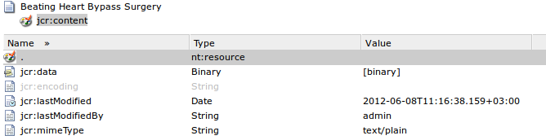
Application of Two-layered Approach
The JCRIndexingSource wraps a CMS document as a ContentItem to be processed by Stanbol.
…
Heart valves keep blood flowing in a one-way direction by opening to let the proper amount of blood flow through and then closing to prevent backflow. From the right ventricle, blood is pumped through another valve and then into the lungs, where it receives oxygen.
…
Notes:
In the figure you see a document named “Beating Heart Bypass Surgery” in the CRX CMS. It has a jcr:content property and that jcr:content property has some other additional attributes such the use who last modified the content, last modification time of the content, mime type of the content etc. And at the bottom of a slide, you see a snippet from the raw content of the document. Our JCR specific IndexingSource will interact with the CRX and then will wrap this CMS document as a ContentItem which is the main processable unit in Stanbol.

Slide 24
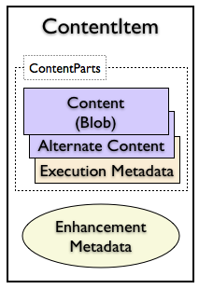
Application of Two-layered Approach
Corresponding enhanced ContentItem
…
Heart valves keep blood flowing in a one-way direction by opening to let the proper amount of blood flow through and then closing to prevent backflow. From the right ventricle, blood is pumped through another valve and then into the lungs, where it receives oxygen
…
{jcr:lastModifiedBy=admin, jcr:lastModified=2012-06-08T11:16:38,jcr:mimeType=text/plain,…}
{"@subject": "urn:enhancement-33ccf589-9982-3cba-4c88-8281b73e1096",
"@type": ["Enhancement",
"TextAnnotation"],
"confidence": 0.6,
"created": "2012-06-08T09:09:10.474Z",
"creator": "org.apache.stanbol.enhancer.engines.keywordextraction.engine.KeywordLinkingEngine",
"end": 1529,
"extracted-from": "urn:content-item-b38798a5-9856-485b-880b-6f8a6a0b9eb7",
"selected-text": {
"@literal": "of blood flow",
"@language": "en"
},
"selection-context": {
"@literal": "Heart valves keep blood flowing in a one-way...
"@language": "en"
},},...
Notes:
Here is the wrapper ContentItem. At the left hand side, you see a generic structure for ContentItem of Stanbol. When the JCRIndexingSource retrieves the raw content and additional properties of the CMS document, it sends these data to the Enhancer component of Stanbol. As a result this ContentItem is created. Raw content of the CMS document is put into the Content part and the enhancements obtained as enhancement results are put into the enhancement metadata part; also the additional properties of CMS document is created as an additional content item part.

Slide 25
Application of Two-layered Approach
In the second step, LDPath is used to configure an index configuration.
Semantic Index Manager
Semantic Index
RESTful Requests
LDPath
OSGi Environment
Notes:
In the next step, we construct the indexing infrastructure via the SemanticIndexManager by passing an LDPath configuration. As a result, we will have a SemanticIndex component and an underlying Solr core registered as separate components to the OSGi environment. Let’s see the example.

Slide 26
Application of Two-layered Approach
In the second step, LDPath is used to configure an index configuration.
Notes:
Here is the HTML interface of SemanticIndexManager where RESTful services can be called. In this figure, we pass a configuration for a health domain specific index. In the larger text area, an LDPath is seen. So, we use LDPath as a configuration language in our two-layered approach. We use this configuration mechanism in Solr based SemanticIndexes. So how actually the configuration of a Solr index is configured based on such a language?

Slide 27
LDPath
Using the previous LDPath, a Solr based SemanticIndex will be configured.
  Each line in the LDPath instance provides configuration of an index field
snomed_has_finding_site = umls-skos:has_finding_site :: xsd:string;
Index field name
Field configurations.
RDF path to be processed
for the current RDF resource
Notes:
In an LDPath instance represents a field in the Solr index.
Left hand site: name of the index field
Right hand site: Specific field configurations. Only type is seen, however Solr specific properties such as termVectors, indexed, stored can be also adjusted.
Each line also has an RDF path, this RDF path is used while populating field. For instance, when a URI is passed to our LDPath, this line will fetch its umls-skos:has_finding_site property. So, when a disease entity is recognized within the document, if it has a has finding site property the value of that property will be stored in this field.

Slide 28
Application of Two-layered Approach
Collection additional information for recognized named entities
…
<rdf:Description rdf:about="urn:enhancement-810e14ac-af3d-3310-b9bb-
74233df94ef5">
<j.6:extracted-from rdf:resource="urn:content-item-sha1-d20174d4d24878f60b02bd8b03acc677404a7998"/>
<j.6:confidence rdf:datatype="http://www.w3.org/2001/XMLSchema#double">0.8</j.6:confidence>
<rdf:type rdf:resource="http://fise.iks-project.eu/ontology/EntityAnnotation"/>
<rdf:type rdf:resource="http://fise.iks-project.eu/ontology/Enhancement"/>
<j.6:entity-label>Heart disease</j.6:entity-label>
<j.2:created
rdf:datatype="http://www.w3.org/2001/XMLSchema#dateTime">2012-04-18T05:34:27.329Z</j.2:created>
<j.2:creator
rdf:datatype="http://www.w3.org/2001/XMLSchema#string">org.apache.stanbol.
enhancer.engines.keywordextraction.engine.KeywordLinkingEngine</j.2:creator>
<j.6:entity-reference rdf:resource="http://purl.bioontology.org/ontology/SNOMEDCT/Ins_161639008"/>
<j.2:relation rdf:resource="urn:enhancement-a4f0b4e7-4992-bef2-3aa3-7b8010d0a56a"/>
</rdf:Description>
…
Notes:
This is an RDF enhancement regarding our ContentItem before representing the heart disease entity recognized within the document. The bold line is a reference to actual source of this entity. We will use this property to gather further semantically related/meaningful information regarding the entity.

Slide 29
Application of Two-layered Approach
The same LDPath, which was used to configure the index, is used to get additional information for recognized named entities
<rdf:Description rdf:about="http://purl.bioontology.org/ontology/SNOMEDCT/Ins_161639008">
<j.3:ctv3id>14O7.</j.3:ctv3id>
<j.3:UMLS_CUI>C0580320</j.3:UMLS_CUI>
<j.0:notation>161639008</j.0:notation>
<j.3:TUI>T033</j.3:TUI>
<j.3:isa>At risk of disease</j.3:isa>
<j.1:label>Heart disease</j.1:label>
<j.1:semanticType>Finding</j.1:semanticType>
<j.3:isPrimaryTopicOf rdf:resource="http://purl.bioontology.org/ontology/SNOMEDCT/Ins_161639008.meta"/>
</rdf:Description>
snomed_semantic_type = snomed:semanticType :: xsd:string;
snomed_isa = umls-skos:isa :: xsd:string;
Notes:
The same LDPath, which was used to configure the index, is used to get additional information for the heart disease entity. The top line is the URI of the heart disease entity which we saw in the previous slide. By executing the LDPath over that URI we get an RDF description as seen in the figure.
Explanation of the properties and corresponding values.
Note that the execution of the LDPath is not necessarily done by following the URI of the entity on the web. It is possible that the LDPath is executed on a specific endpoint of Entityhub component of Stanbol which caches external RDF resources to be used in the Stanbol framework.

Slide 30
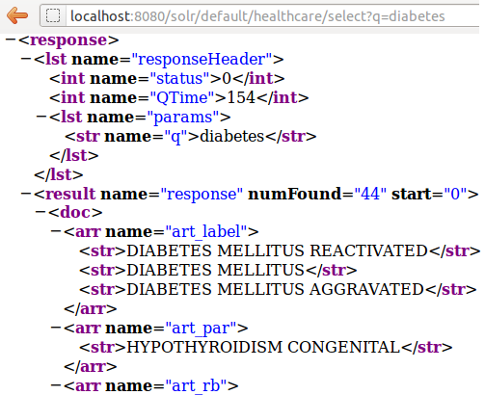
Application of Two-layered Approach
All semantically related knowledge is indexed along with the actual content in the customized index
  The underlying
  SOLR index can
  be queried
  directly through its
  RESTful services
Notes:
Explanation of the slide directly…

Slide 31
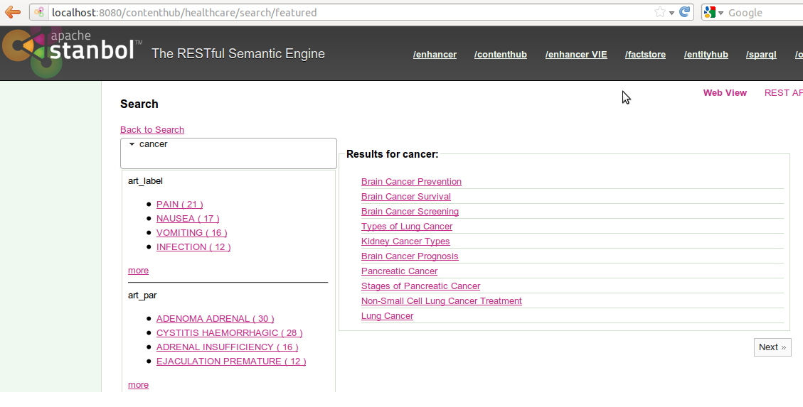
Application of Two-layered Approach
Faceted search interface over the index
Notes:
Custom search interfaces/services can be also provided on the index. For instance, this is a faceted search interface developed based on the Solr index. The facets correspond to index fields. And the values of the facets correspond to properties of named entities associated with the facet.
By configuring and caching external domain specific RDF datasets into the Stanbol framework and using them in the enhancement process, very interesting search flows can be obtained. In the figure the result of search of cancer keyword is seen. It contains 10+ documents. However, thanks to the domain specific facets those results can be constrained as in the next slide.

Slide 32
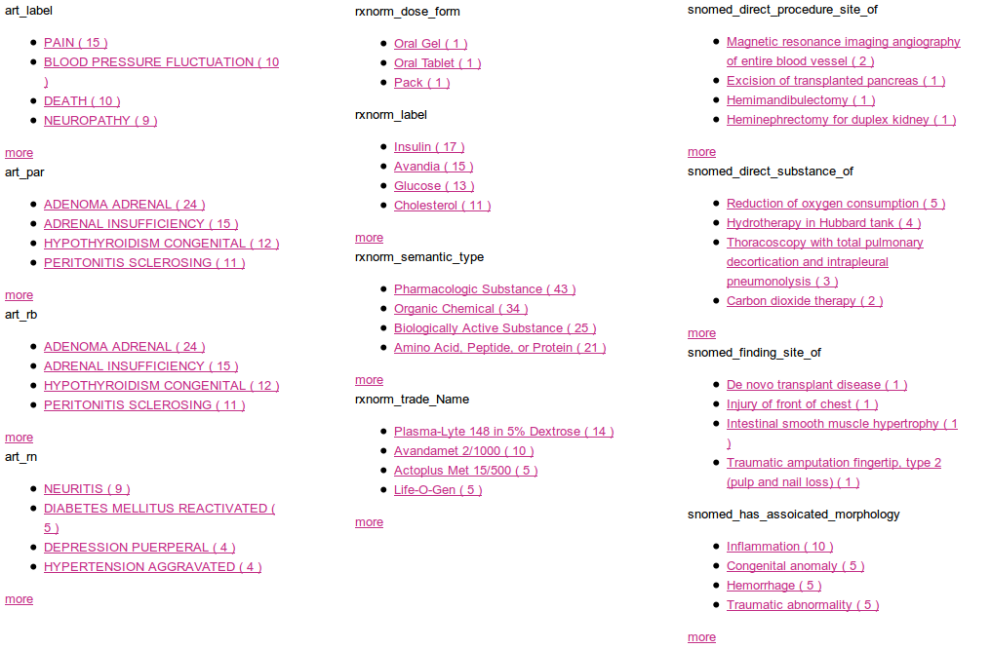
Application of Two-layered Approach
All facets

Slide 33
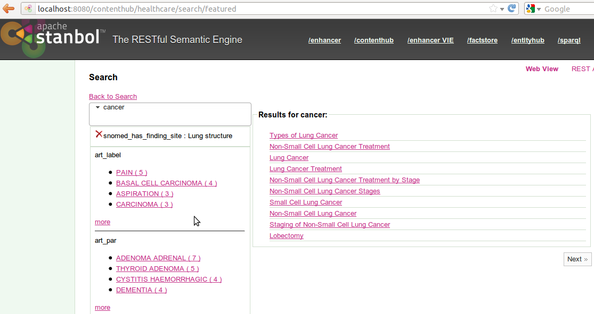
Application of Two-layered Approach
Faceted search interface over the index

Slide 34
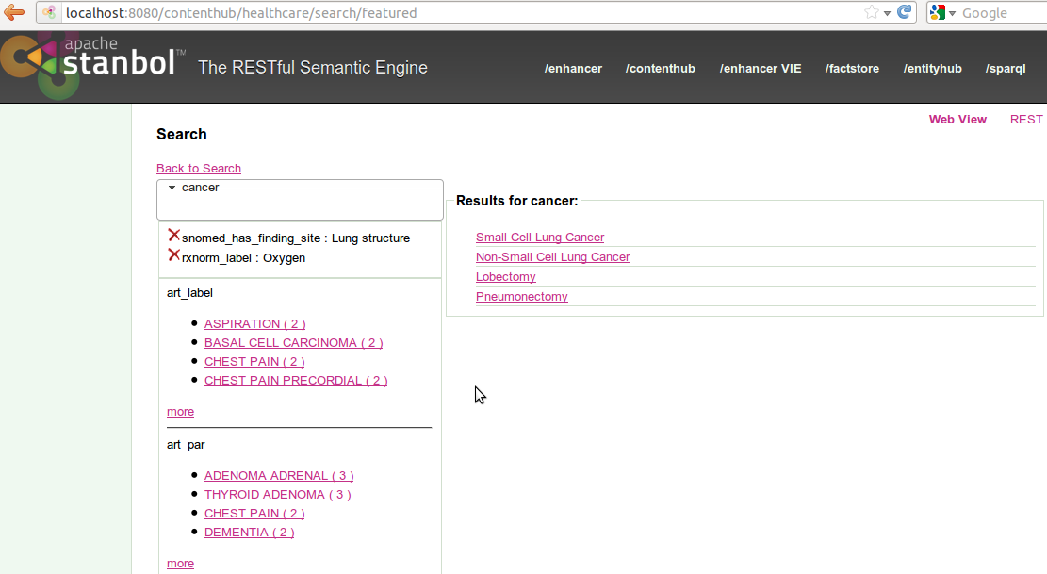
Application of Two-layered Approach
Faceted search interface over the index

Slide 35
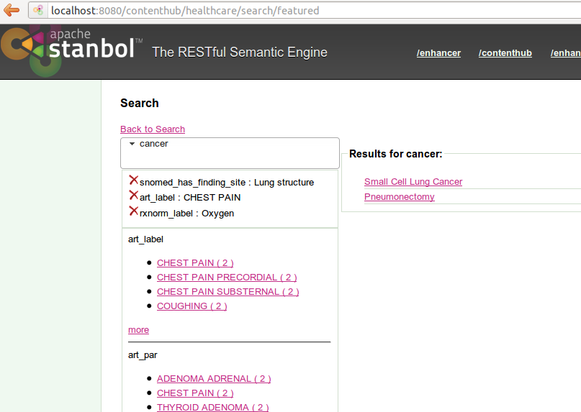
Application of Two-layered Approach
Faceted search interface over the index

Slide 36
Thank you for listening!
Questions?

