Slide 1
Hardening Enterprise Apache Installations
Sander Temme
sander@temme.net

Slide 2
Disclaimer
The information discussed in this presentation is provided "as is" without warranties of any kind, either express or implied, including accuracy, fitness for a particular purpose, reliability, or availability.
It is your webserver, and you alone are responsible for its secure and reliable operation. If you are uncertain about your approach to hardening and protection, consult a security professional.

Slide 3
Agenda
The Threat Model
Apache HTTP Server Security
Secure Apache Deployment
Application Security
Further Investigation
Notes:
Approaches to vulnerabilities

Slide 4
Newsweek.com
Newsweek Web Exclusive
Nov 5, 2008
The computer systems of both the Obama and McCain campaigns were victims of a sophisticated cyberattack by an unknown "foreign entity," prompting a federal investigation, NEWSWEEK reports today.
http://www.newsweek.com/id/167581/page/1

Slide 5
The Threat Model
Notes:
The Threat Model: let’s discuss who gets attacked, what the motive is behind these attacks and how they take place.

Slide 6
Who Gets Attacked?
Everyone!
Just because you’re small…
Notes:
Everyone is under attack. Whether you’re a small player or the Fortune 500, automated attack tools scan the entire IP range and will barrage your services with requests that identify weak spots. Even if you are serving an Intranet that is not visible to the general Internet, you should consider the possibility that people within your organization bring in trojan horses when they connect their laptops to your network.

Slide 7
Notes:
What are the motives behind these attacks? This pretty pie chart comes from the 2007 Annual Report of the Web Hacking Incident Database. It suggests that over 75% of attacks are done to steal data, to deface the website or to plant malware on it. Information Theft is particularly attractive to the malfeasants, because the results can be used for financial gain. Data can be used or sold for profit, where defacements only bring bragging rights.

Slide 8
Defacements in 2007
Notes:
This pie chart came from a survey by Zone-H. They track website defacements by having the perpetrators fill out a form. On this form, they can state their attack method and this chart was compiled from the Zone-H report over 2007. You can see that there is some low hanging fruit here: a full 40% of the attacks were accomplished through abuse of administrative credentials. Password sniffing, Man-in-the-middle, brute-forcing, social engineering, default accounts left in installations, all fall under this.
This is REALLY BAD. The problem with user login abuse is that there is no technical defense against it. You can fix bugs, you can reject malicious HTTP requests using a firewall, but a valid login and password will always get you in because that’s what they’re designed to do! The application has no way of knowing whether the password was typed by the actual user, or by an impostor who stole the password.
On the other hand, if we, collectively, were to keep better track of our passwords, we could make significant progress in reducing the number of successful intrusions.

Slide 9
Apache Security
Notes:
let’s talk about how the Apache HTTP Server team deals with vulnerabilities in the web server

Slide 10
Apache is Secure
Very few vulnerabilities reported
No critical vulnerabilities in 2.2.x
Upgrade to any new release
  announce@httpd.apache.org
Default installation locked down
  But it doesn’t do a whole lot
  http://httpd.apache.org/security/vulnerabilities-oval.xml

Slide 11
Apache Security Process
Report security problems to security@apache.org
Real vulnerabilities are assigned CVE number
Vulnerabilities are classified, fixed
New httpd version released
http://httpd.apache.org/security_report.html
http://cve.mitre.org/
http://httpd.apache.org/security/impact_levels.html
announce@apache.org

Slide 12
Secure Apache Deployment

Slide 13

















Slide 14
Apache Installation
Two ways to install Apache
  Compile from source
  Install vendor-supplied package

Slide 15
Install From Source
Download Apache Source
  http://httpd.apache.org/download.cgi
  Verify signature on tarball
./configure …; make; su make install
  ./configure --help
Create apache user and group
Notes:
Zip through this, details in handout (really)

Slide 16
Install a Package
Most vendors offer packages
  Red Hat: httpd RPM
  Debian/Ubuntu: apache2
  FreeBSD: /usr/ports/www/apache22
  …
Patched for OS/Distro
Digitally signed
Customized config
Notes:
Don’t read out slide bullets

Slide 17
Package Considerations
Different approaches
  Packages, dependencies
Directory structure variations
  Learn them
Different versioning
Custom configurations
Automated updates
  Play well with other packages
Notes:
Understand what the packagers intend and how they have set it up. Look at the configuration files, their layout, their intricacy, where on the system the components of the package go (maybe).
Figure out which distro approach you like.
Perhaps strip out the Kitchen-sink functionality

Slide 18
Apache Configuration Tips
Write your own
Formal testing
Avoid <IfModule>
Disable unused modules
Notes:
Strongly recommend to empty out the configuration file and write your own. Only take the bits from the default configuration file that you really need; strip out the comments, strip out the <IfModule> bits (if a module you need isn’t there, you want your server to fail to run, not run without that functionality), etc.
Use the Apache documentation and/or get a book like Apache: The Definitive Guide by Ben and Peter Laurie.
AAA stuff to a new slide.

Slide 19
AAA
Authentication
Authorization
Access Control
Notes:
Triple-A: Authentication, Authorization and Access Control. These configuration directives determine what privileges clients have on particular URLs. These directives are set up based on <Directory> or <Location>

Slide 20
OS Hardening
Writable directories
Chroot, FreeBSD jail, Solaris Zones
Notes:
The fewer places on the system to which the webserver can write, the fewer vulnerabilities. Making well-known spots unavailable
Remove the key from under the mat.
Anecdote: Linux server running PHPBB on a cable or DSL line. Noticed weird stuff, found that someone had downloaded files to his /tmp directory, then executed the binary which was a spam relay or C&C… but named ‘httpd’ so it didn’t show.
chroot and related virtualization techniques: they limit the amount of damage an attacker can do to the

Slide 21
OS Hardening (2)
Unnecessary services
Unused packages
Netboot for web heads
Notes:
Title: OS Hardening
The fewer places on the system to which the webserver can write, the fewer vulnerabilities. Making well-known spots unavailable
Remove the key from under the mat.
Same with chroot and related virtualization techniques:
Split slide in two

Slide 22
Windows
Use what you know!!!
Pull Server Root out of install dir
  httpd -n Apache2.2 -d c:\mysite -k config
Create apache user
  Services run as SYSTEM user
    Can write to many directories
  Write access only to c:\mysite\logs subdirectory
  Let Apache2.2 Service log on as apache
Notes:
A badly maintained Linux server is less secure than a well-maintained Windows server
Take out sub-bullets
Point to handout

Slide 23
Software and Libraries
Be on Announcements lists
Update as needed
Consider packages

Slide 24
Infrastructure
Block outgoing connections
  Web Server only serves incoming connections
Minimize incoming connections
  Port 80, port 443
  ssh, sftp, etc. through bastion
Use firewall
Notes:
Split into different slides
Limit incoming connections to necessary services (http, https) and nothing else

Slide 25
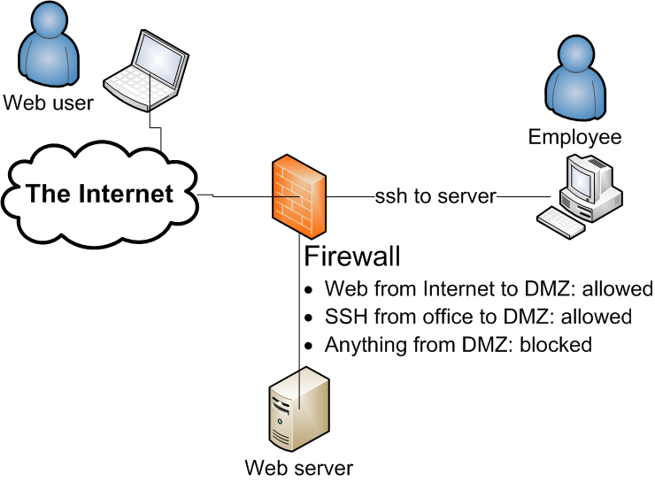
Suggested DMZ Configuration
Notes:
Introduce DMZ = De-Militarized Zone (and point to it)

Slide 26
ModSecurity
Web Application Firewall
Runs Right Inside Apache
  Can see SSL session content
Rule-based request filtering
…
Notes:
Split example onto next slide, bigger font.

Slide 27
ModSecurity Filter
# Accept only digits in content length
#
SecRule REQUEST_HEADERS:Content-Length "!^\d+$” \
"deny,log,auditlog,status:400, \
msg:'Content-Length HTTP header is not numeric', \
severity:'2',id:'960016', \
tag:'PROTOCOL_VIOLATION/INVALID_HREQ'"

Slide 28
Application Security

Slide 29
Considerations
Safest: Disconnected, turned off, buried…
Next best: flat files
Dynamic content: danger
How to mitigate danger?

Slide 30
Common Sense
Restrict what can run
Restrict what it can do
  Reach out to network?
  Write to the filesystem?
  Write to a database?
  Load scripts or modules?

Slide 31
An Important Question
WHY?
Notes:
This is the question that every web server administrator should ask about any changes made to his or her server deployment.

Slide 32
Why…
Does your server have to “see” the net?
Can users upload stuff that gets executed?
Would httpd have to write to the filesystem?
Would you expose anything but 80 and 443?
Would you serve that URL?
Would your OS execute untrusted code or scripts?
Would your users be able to log in and edit through the front door?
Does your site have to be served by a scripting engine?
Notes:
Have developer justify to admin: why is this particular change necessary
Get rid of … bullet

Slide 33
Change Management
Research
Motivation
Documentation
No Hacking!

Slide 34
Database Privileges
Bugzilla: GRANT SELECT, INSERT, UPDATE, DELETE, INDEX, ALTER, CREATE, LOCK TABLES, CREATE TEMPORARY TABLES, DROP, REFERENCES ON bugs.* TO bugs@localhost IDENTIFIED BY '$db_pass';
Wordpress: GRANT ALL PRIVILEGES ON databasename.* TO "wordpressusername"@"hostname” IDENTIFIED BY "password";
Joomla 1.5: GRANT ALL PRIVILEGES ON Joomla.* TO nobody@localhost IDENTIFIED BY 'password';
Drupal: SELECT, INSERT, UPDATE, DELETE, CREATE, DROP, INDEX, ALTER, CREATE TEMPORARY TABLES, LOCK TABLES
Gallery 2: mysql gallery2 -uroot -e"GRANT ALL ON gallery2.* TO username@localhost IDENTIFIED BY 'password'”;
Notes:
Dangerous terms: DROP; GRANT ALL PRIVILEGES
Generally: application setup should separate database creation and schema population from application database access.

Slide 35
Database Privileges (2)
Line of defense!
Apps written by coders
  Not DBAs
GRANT ALL PRIVILEGES
  Really?
Separate schema definition from app code

Slide 36
PHP Configuration
PHPIniDir directive specifies location of php.ini file
Disable dangerous features:
  register_globals = Off
  allow_url_fopen = Off
  display_errors = Off (production)
  enable_dl = Off
Notes:
Discuss each directive? Depends on time.
Put description of directives in handout.

Slide 37
Further Reading
Ryan C. Barnett, Preventing Web Attacks With Apache, 0-321-32128-6
Ivan Ristic, Apache Security, 978-0596007249
Tony Mobily, Hardening Apache, 978-1590593783
http://httpd.apache.org/security_report.html
http://www.cisecurity.org/
Mike Andrews and James A. Whittaker, How to Break Web Software, 0-321-36944-0
http://www.owasp.org/
http://csrc.nist.gov/publications/nistpubs/800-44-ver2/SP800-44v2.pdf
Notes:
Consider updating?

Slide 38
Conference Road Map
Training: Web Application Security Bootcamp – Christian Wenz
Web Intrusion Detection with ModSecurity – Ivan Ristic
(In)secure Ajax and Web 2.0 Web Sites – Christian Wenz
Geronimo Security, now and in the future – David Jencks
Securing Apache Tomcat for your Environment – Mark Thomas
Securing Communications with your Apache HTTP Server – Lars Eilebrecht
Notes:
Update this.

Slide 39
Conclusion
The threat
The mitigation
  Secure admin access
  Understand your config
  Patch and update
  Key not under mat
  Default deny

Slide 40
Thank You
http://people.apache.org/~sctemme/ApconUS2008/

