Slide 1

Introduction to the OODT Process Control System Operator's User Interface (OpsUI)
Andrew Hart, Chris Mattmann
Jet Propulsion Laboratory, California Institute of Technology {ahart,mattmann}@apache.org, 2011.11.09

Slide 2
What We Will Cover
Introduction to the OODT PCS Operator Interface
OODT Overview
What is a Process Control System (PCS)?
What Does the PCS OpsUI Accomplish?
Two Use Cases for the OpsUI + Demo
Snow Data System
National Radio Astronomy Observatory
Wrap up/Conclusion
Current State of the OpsUI
Getting involved / More information

Slide 3
My Background
Andrew Hart
NASA Jet Propulsion Laboratory
Software Engineer Data Management Systems and Technologies Group
Expertise / Interests:
Committer/PMC member Apache OODT
Interested in Web User Interfaces, User Experience, Data Management

Slide 4
Chris’s Background
Chris Mattmann
NASA Jet Propulsion Laboratory
Senior Software Engineer, Data Management Systems and Technologies Group
University of Southern California
Adjunct Assistant Professor Viterbi School Of Engineering – Computer Science Department
Expertise / Interests:
VP, Apache OODT
Interested in Software Architecture, search engines, and data management systems

Slide 5
OODT’s Background
OODT is a reference architecture and software component framework
Written in Java
Shepherd large quantities of data through computationally intensive processing steps

Slide 6
OODT Background (Cont’d)
“A data grid software infrastructure for constructing large-scale, distributed data-intensive systems”
Reference Architecture
Software Product Line
Reusable Components
Common Patterns

Slide 7
OODT Background (Cont’d)
OODT components can be used independently for single tasks (file management, directory crawling, workflow management)
Or strung together to construct full pipelines for data processing
Very configurable, well defined extension points

Slide 8
OODT Background (Cont’d)
OODT provides components and interfaces that
Facilitate the integration of data from multiple sources
Support scalable transformations of the data with full metadata provenance
Provide cataloging and archiving of the output for permanent archiving or mass distribution

Slide 9
Origins of OODT
(*abridged)

Slide 10
Origins of OODT
Conceived in 1998, funded by NASA’s Office of Space Science
Funded to address SE challenges affecting design of mission data systems

Slide 11
Origins of OODT
Traditionally, data system software is an afterthought for missions, behind:
Developing the flight instrument itself
Developing the science algorithms
Cost hidden in “science” budget

Slide 12
Origins of OODT
At the same time:
Increase in data volumes
Increase in computational complexity of the processing
Decrease in mission budgets
“Do more with less” on the data system software side
Notes:
MRO (2006) 12gb image products, TRANSLATION: 200 TB over mission lifetime. Compare to all of NASA Planetary Data System (30y) @ 20TB total

Slide 13
Origins of OODT
OODT :
Identify the core needs shared by missions
Develop a framework and reusable components
Minimize “reinventing the wheel”

Slide 14
Principles behind OODT

Slide 15
Principles behind OODT
Division of labor, with loose coupling between components
Compartmentalized functionality allows ‘pick-and-choose’ rather than ‘all or nothing’
The major components of OODT communicate over well-defined, standard interfaces
Easy to integrate OODT into existing data systems

Slide 16
Principles behind OODT (Cont’d)
Treatment of metadata as a first-class citizen
Descriptions of the data (the information model) are often as important as the data itself
Metadata provides a container for capturing information about the data as it passes through OODT
All OODT components share the same basic metadata model

Slide 17
Principles behind OODT (Cont’d)
Technology Independence
Interfaces allow swapping out the back-end technology
Example: File Manager Catalog
Oracle DB
Apache Lucene
Apache Hive
Don’t get bitten in the 0x61 0x73 0x73 when vendors suddenly decide to charge for a technology

Slide 18
The OODT Process Control System (PCS)

Slide 19
The OODT PCS
As OODT matured, certain patterns emerged in the way components were being configured
PCS is a pattern for a full-fledged data processing pipeline, comprised of stock OODT components + custom processing algorithms

Slide 20
The OODT PCS (Cont’d)
Orbiting Carbon Observatory
“precise, time-dependent global measurements of atmospheric carbon dioxide (CO₂) from an Earth orbiting satellite” – oco.jpl.nasa.gov/mission
Operational data processing pipeline specs:
10k jobs / day
50 GB/day output (~150 TB over mission lifetime)
10s of millions of catalog entries (archived products)

Slide 21
The OODT PCS (Cont’d)
OCO Process Control System Functions
Automatic File Ingestion
Pulling external data files into a “staging area”
Metadata extraction from staged files into a metadata catalog
Triggers for ingestion from staging area to long-term archive

Slide 22
The OODT PCS (Cont’d)
OCO Process Control System Functions
Data Management
Track stored data (files + metadata) in a file catalog
Stage appropriate data as input to pipeline processing

Slide 23
The OODT PCS (Cont’d)
OCO Process Control System Functions
Pipeline Processing
Automatic initiation of processing based on conditions
Tracking data + metadata through pipeline phases
Monitoring and logging of processing status

Slide 24
The OODT PCS (Cont’d)
OCO Process Control System Functions
Resource Management
Allocate processing jobs to available resources
Monitor and log jobs and resource status

Slide 25
The OODT PCS (Cont’d)
OCO Process Control System Functions
Product Delivery
Cataloging and archiving of final generated products
Availability of full processing pedigree (metadata)

Slide 26
The OODT PCS (Cont’d)
OCO Process Control System Functions
User interface
Monitor status of PCS components, pipeline processing, and compute resources
File Manager catalog browsing

Slide 27
The OODT PCS (Cont’d)
File Catalog Browsing
File Ingest/Access
Data Queries/Retrievals
User Interface
(GUI & CLI)
System Monitoring
Job Scheduling
Product Delivery
Legend
PCS
Data Files
Control
Data Flow
Product Delivery
Spacecraft
Files
PGEs
Testbed Algorithms
Automatic File Ingestion
Ancillary
Files
OCO
Products
Files, Metadata
Simulated Data and Parameters, Test Algorithms
Telemetry
Files
PGE Input Params
File Cataloging
File Movement
File Access Control
Information Management & Process Control
(Servers, Executables & APIs)
System Monitoring
Rule Processing
Job Initiation/Load Balancing
Staging Area / Local Storage
Life-Of-Mission Storage
File Catalog
Credit: C. Mattmann, D. Freeborn, D. Woollard

Slide 28
The OCO PCS OpsUI

Slide 29
The OODT PCS (Cont’d)
The OCO PCS OpsUI was the first complete implementation of a browser-based user interface that
Provided a single access point to all services
Allowed monitoring of the “lights-out” mission ops
Allowed web-based configuration of the containers for the mission science algorithms (PGEs)

Slide 30
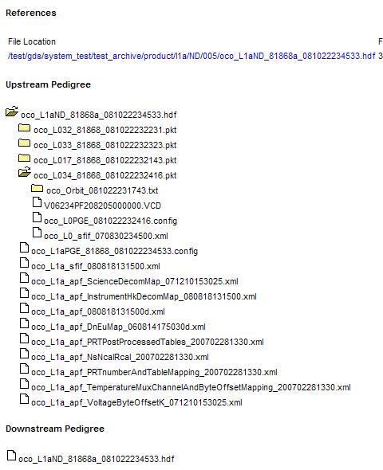
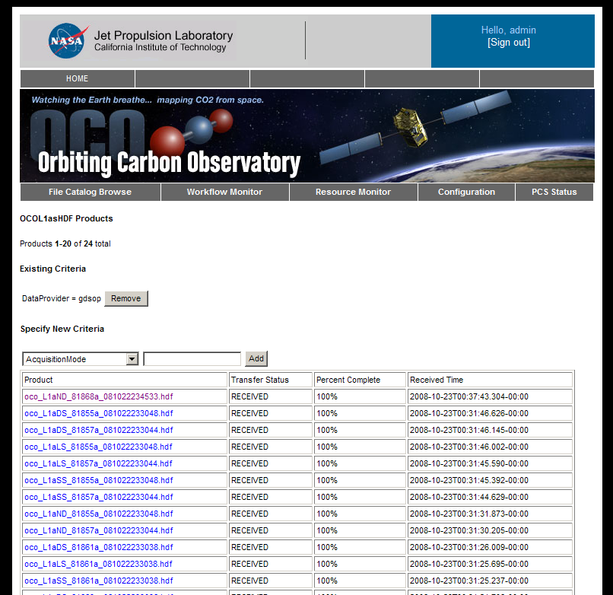
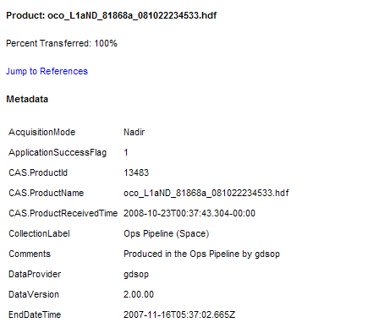
File and Metadata Browsing
Full File Pedigree tracking and reporting
Notes:
Dana will add something ‘file-pedigree…’ text box explaining the screenshots.

Slide 31
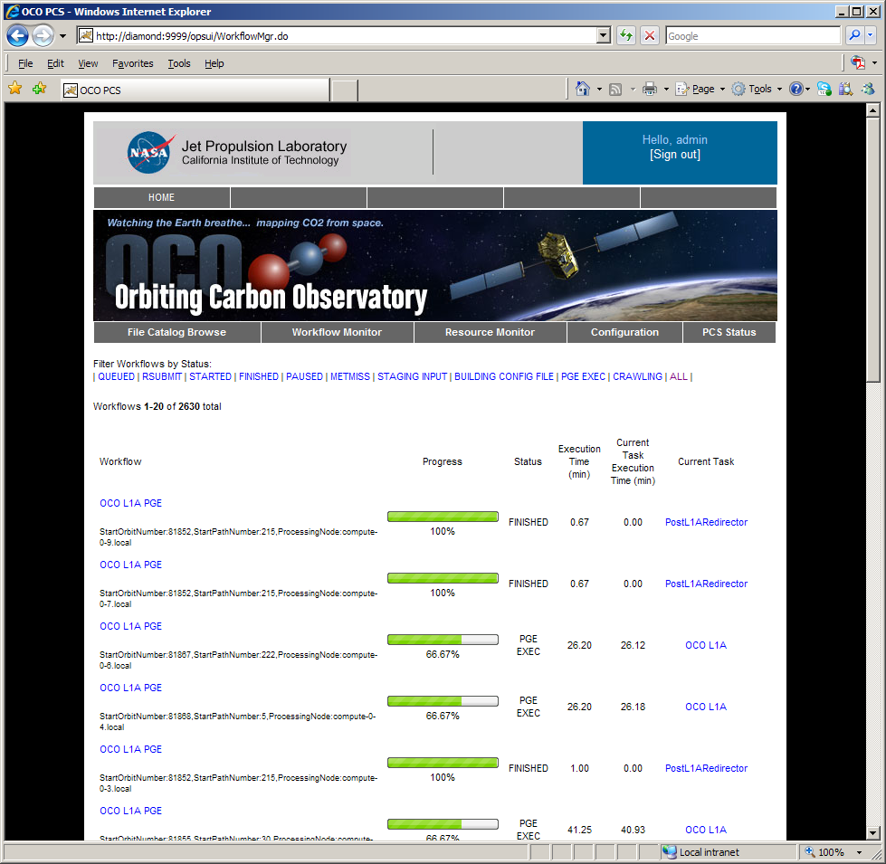
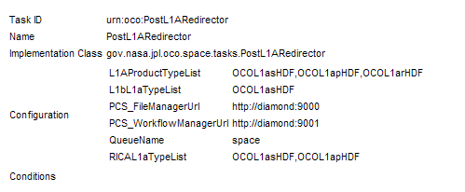
Advanced Workflow Monitoring

Slide 32
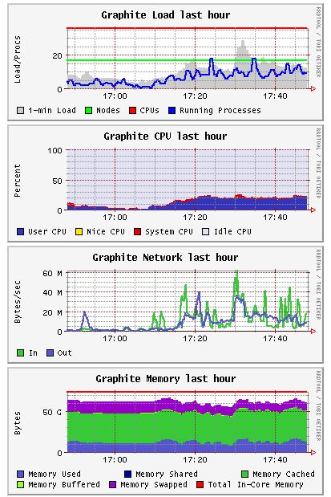
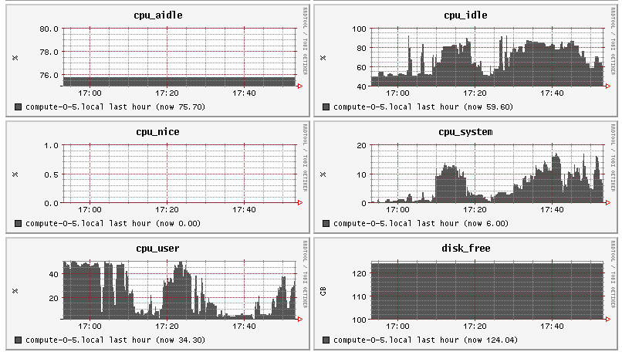
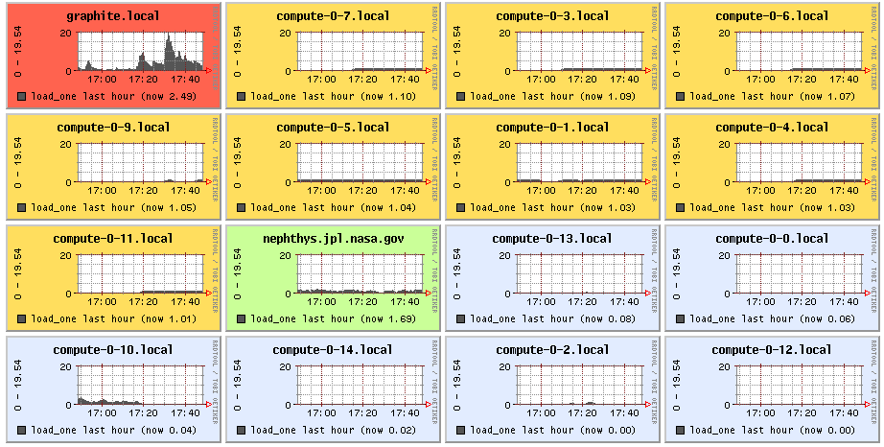
Resource Monitoring

Slide 33
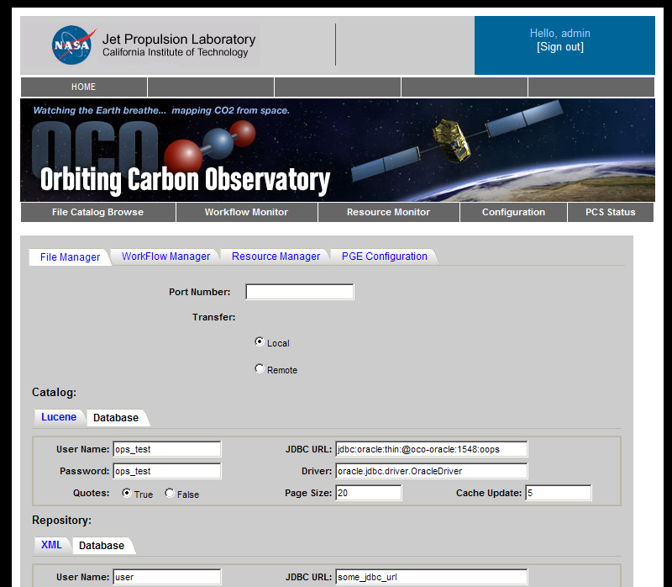
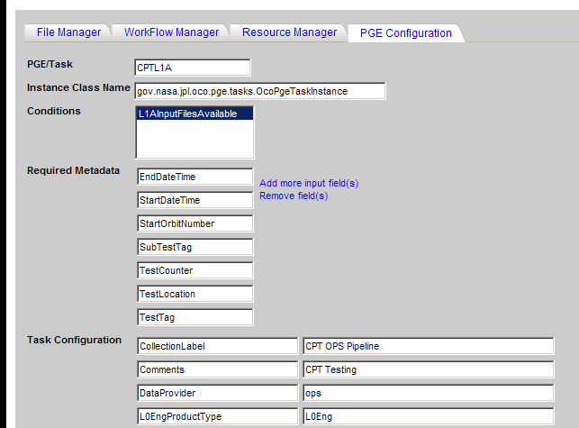
Server and PGE Configuration

Slide 34
The OODT PCS OpsUI
At Apache

Slide 35
OODT-157
Lessons learned from the OCO OpsUI development helped set the stage for creating a “generic” OpsUI
PCS components and services already part of OODT (since incubation)

Slide 36
OODT-157
Port the application from Struts to Apache Wicket
Why Wicket? “just Java + HTML”
Great parallelism between front/back end dev.
Replace mission-specific assets with a new skin
Clean up layouts,
Make the application easily skinnable

Slide 37
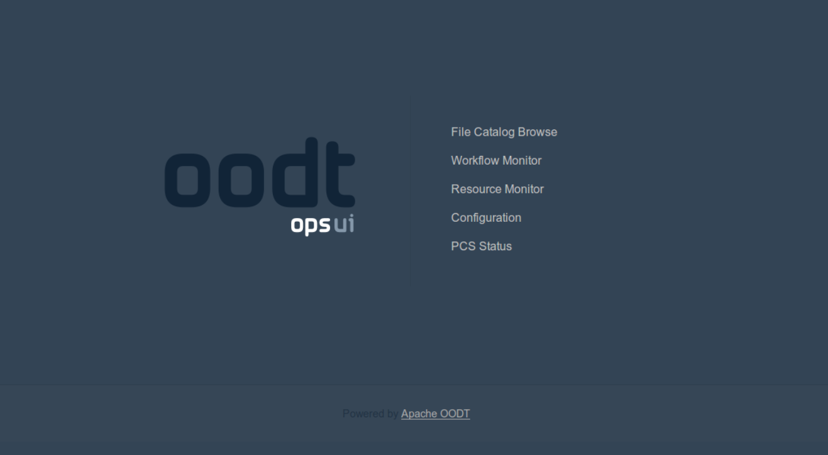
OODT OpsUI

Slide 38
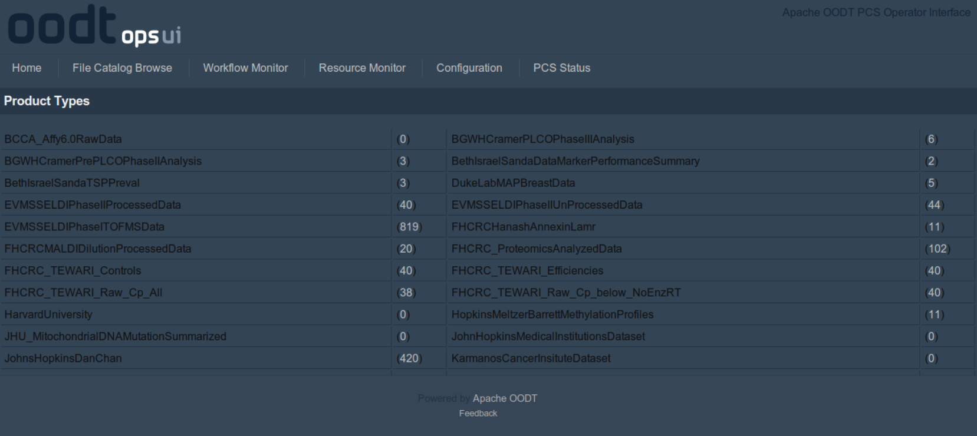
OODT OpsUI

Slide 39
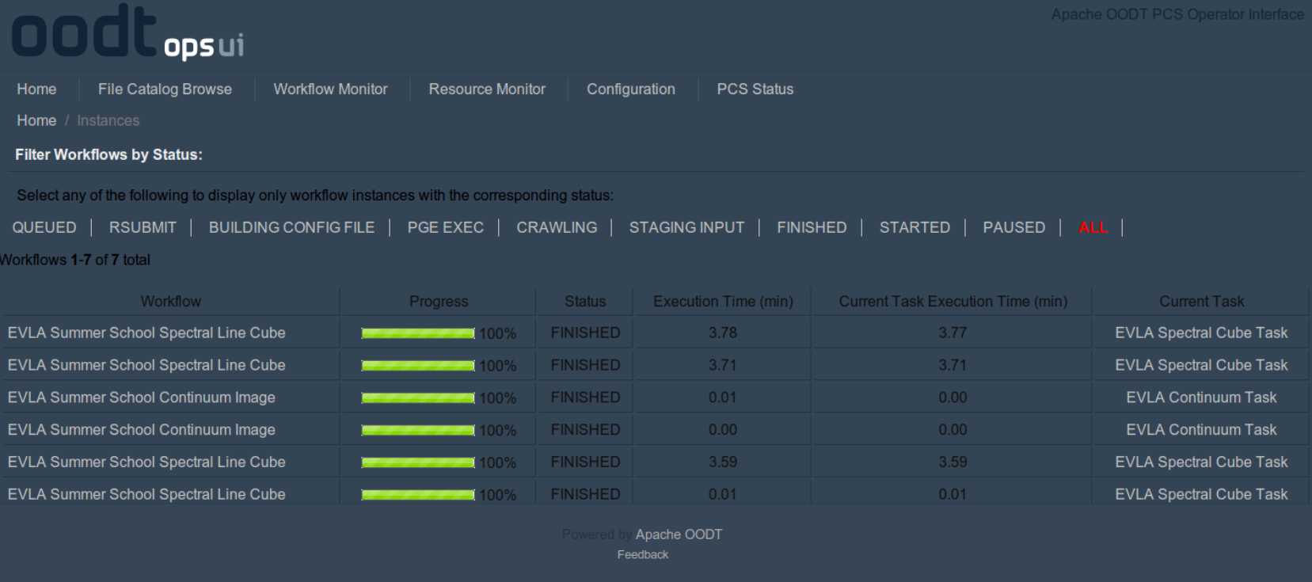
OODT OpsUI

Slide 40
OpsUI Use Cases
(Demonstration)

Slide 41
Snow Data System
Snow Hydrology studies for the Western United States
Track snow levels in the Colorado River Basin
Improve the accuracy of MODIS satellite-based observations
Importance:
70% of water supply for the Western US is derived from snowfall in the region. Accurate projections are crucial for water management

Slide 42
Snow Data System
The Data: 10 years of remote-sensing observations from the MODerate Imaging Spectroradiometer (MODIS) instrument on the Earth-orbiting Aqua and Terra satellites (http://modis.gsfc.nasa.gov/)
The Algorithms:
MODSCAG: Snow –covered area and grain size
MODICE: Areas of year-round snow & ice coverage
MOD-DRFS: Dust radiative forcing in snow
The Product:
GeoTIFF image files with corrected/ improved observations

Slide 43

NRAO EVLA
Ad-hoc user pipelines for data processing
Existing pipeline interface hard-coded, inflexible
Utilize Common Astronomical Software Applications (CASA) for processing
Generate a spectral line cube from terrestrial radio telescope observations

Slide 44
Demo

Slide 45
OpsUI Next Steps

Slide 46
OpsUI Next Steps
Available today in the OODT trunk
Progress being tracked in OODT-157
Scheduled for inclusion in OODT 0.4

Slide 47
OpsUI Next Steps
Playing with it today:
OODT-346: Development of a Maven archetype for simplified install:
svn co http://svn.apache.org/repos/asf/oodt/trunk/mvn/archetypes/opsui/ \
opsui-archetype
cd opsui-archetype
mvn install
…then in another directory…
svn co http://svn.apache.org/repos/asf/oodt/trunk/pcs/opsui/
cd opsui
mvn install
…then run…
mvn -DarchetypeGroupId=org.apache.oodt -DarchetypeArtifactId=opsui-archetype \
-DgroupId=my.com -DartifactId=my-ops-ui -Dversion=1.0 archetype:generate
…that will create a my-ops-ui project. ‘cd’ into there and type:
tomcat:run-war
Credit: Paul Ramirez

Slide 48
More Information
Web:
http://oodt.apache.org
JIRA:
https://issues.apache.org/jira/browse/OODT
Wiki:
https://cwiki.apache.org/confluence/display/OODT
Email:
user@oodt.apache.org

Slide 49
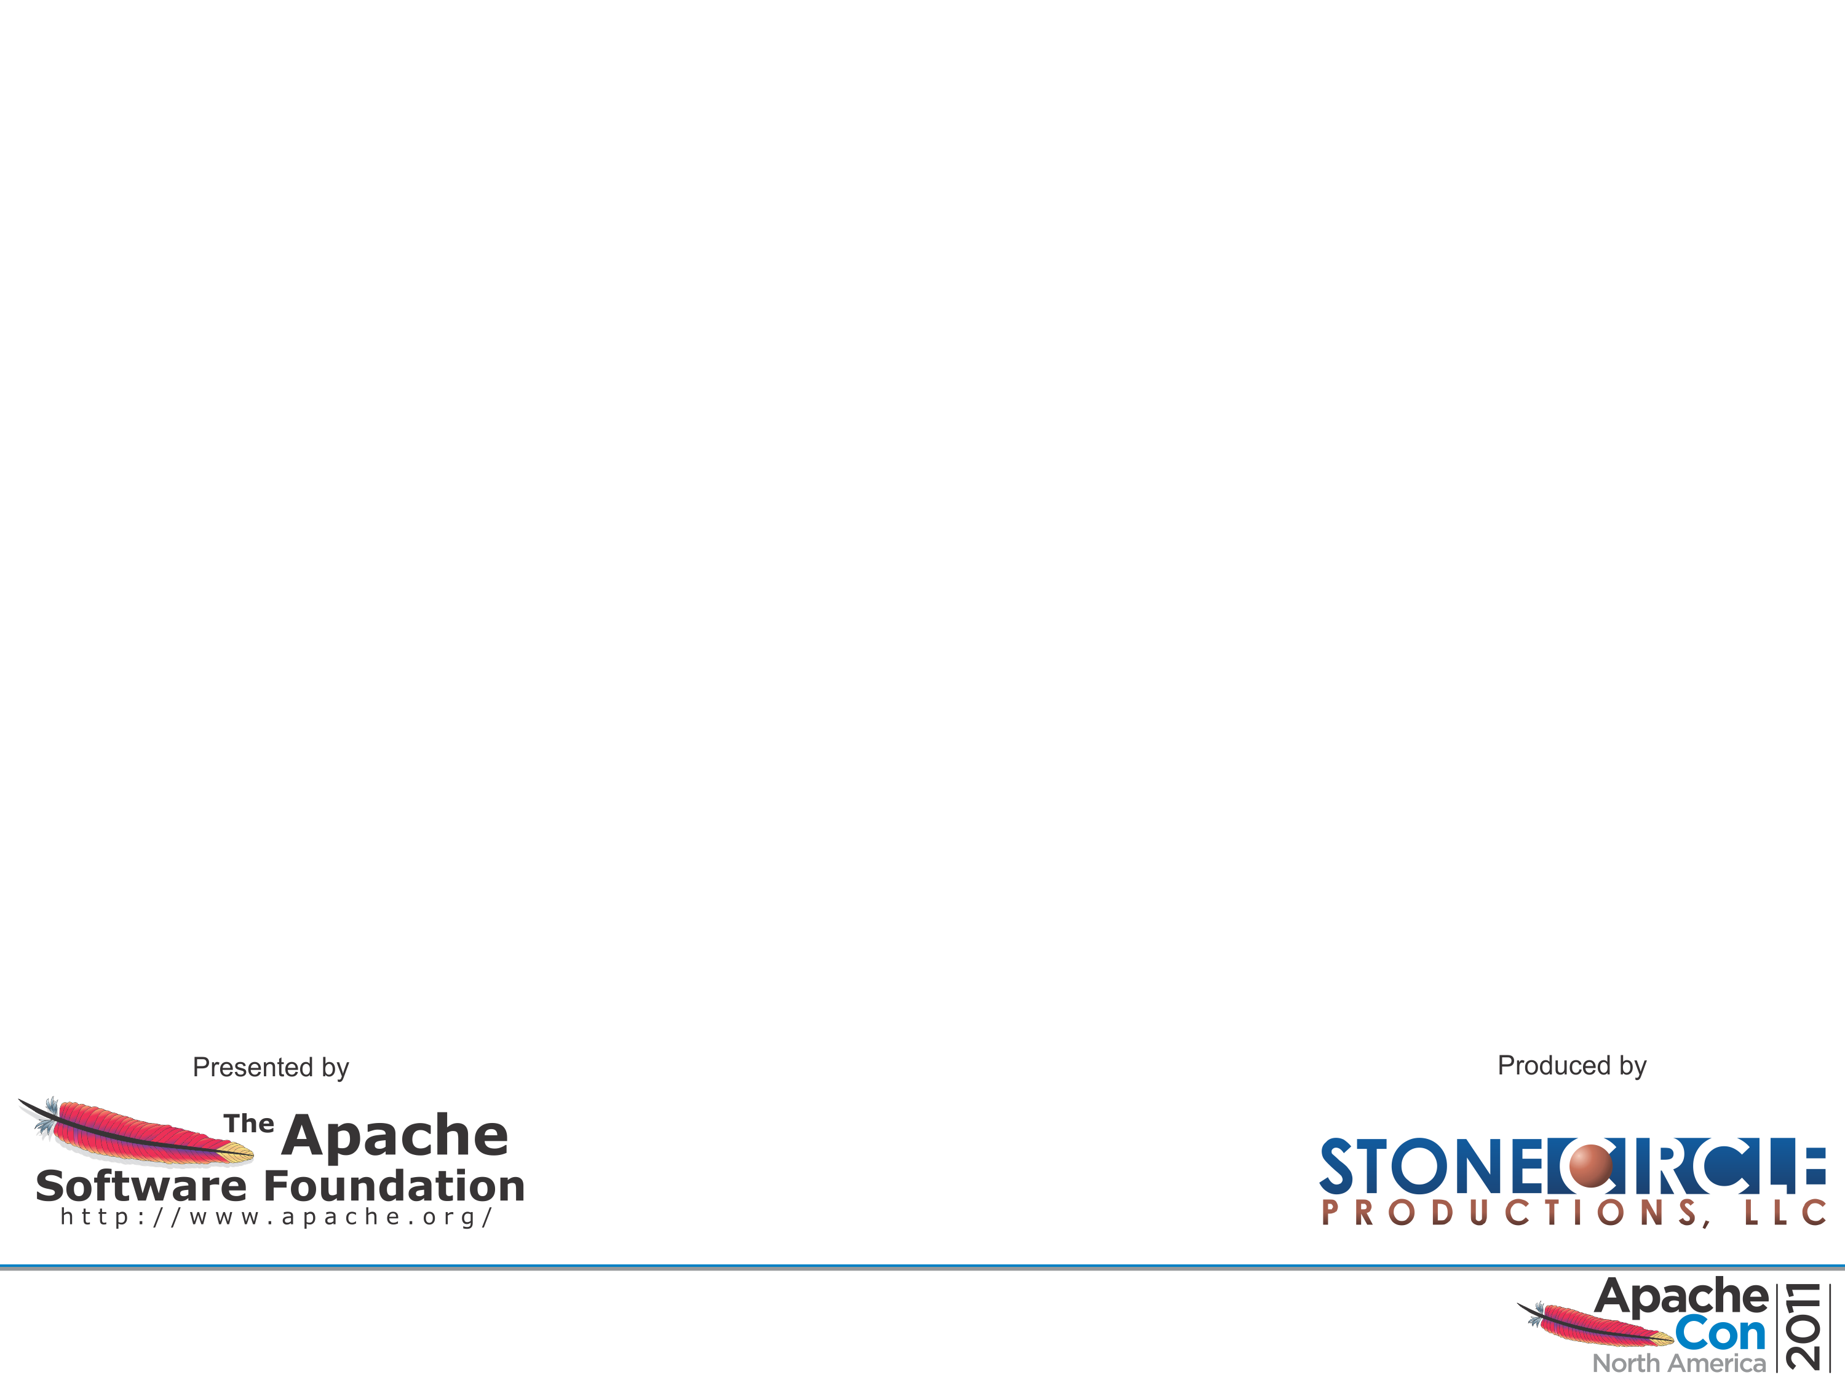
Contact
Andrew Hart
ahart@apache.org
http://people.apache.org/~ahart
Chris Mattmann
mattmann@apache.org
http://sunset.usc.edu/~mattmann

Slide 50
Thanks!

