Slide 1

OODT @ JPL Science Data Systems
Emily Law, CalTech JPL
emily.law@jpl.nasa.gov, Nov 09, 2011

Slide 2
What I Will Cover
Topic
Who I am
SDS Background
The challenge
Strategy
Deployment
Experience
Wrap up

Slide 3

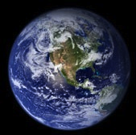

My Background
Emily Law
CalTech JPL
Science Data System Manager
Experience

Slide 4
SDS History
JPL has a long history of building data systems for the purpose of supporting scientific research
Automated data pipelines
New technologies
Robust system architectures
State of our science in the 21st century requires both innovation in s/w architectures and technologies to keep pace in the area of data systems

Slide 5
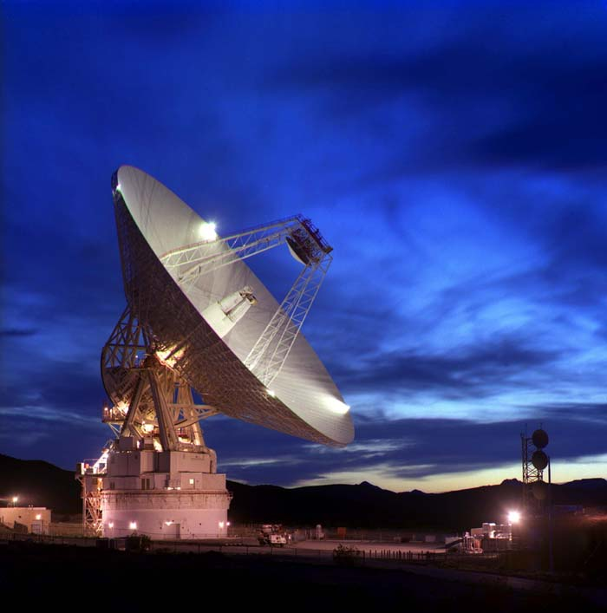
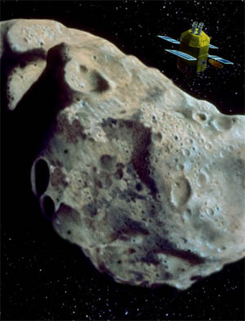
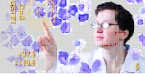

SDS Domains
Earth science
Planetary science
Astrophysics
Biomedical research

Slide 6
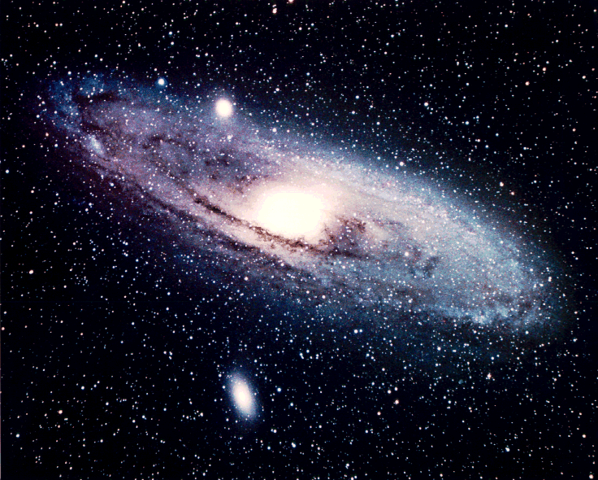
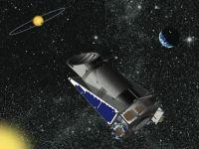
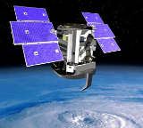
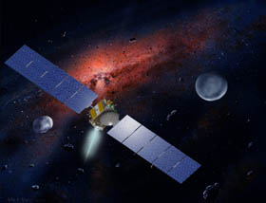
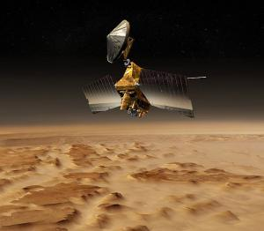
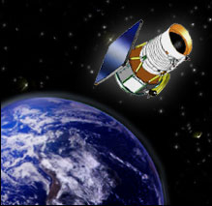
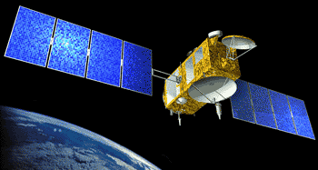
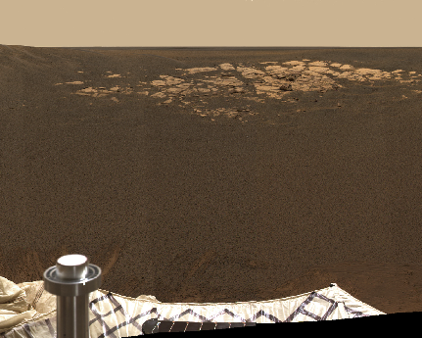
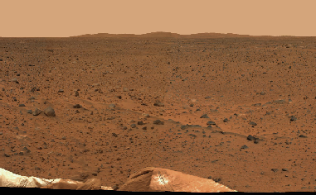
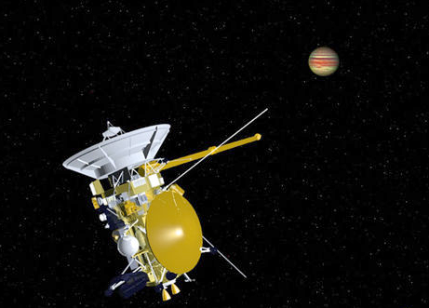

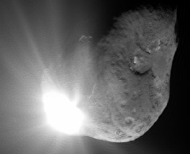
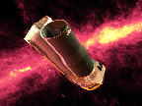
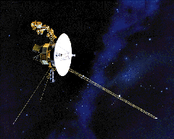

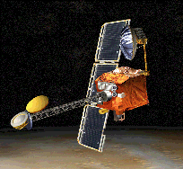
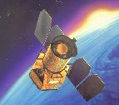

Across the Solar System
Mars Odyssey
Kepler
Cassini
CloudSat
Spitzer
Spirit
Stardust-NExT
ACRIMSAT
Opportunity
GRACE
GALEX
Dawn
Mars Reconnaissance Orbiter
Deep Impact-Epoxi
Two Voyagers
(Plus ASTER, MISR, TES, MLS, AIRS, M³, MIRO, Herschel, Planck, and LRO Diviner instruments)
Jason 1 and Jason 2
(WISE)

Slide 7
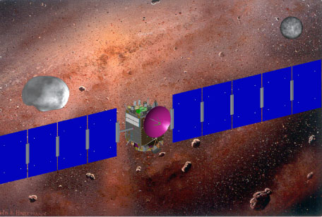
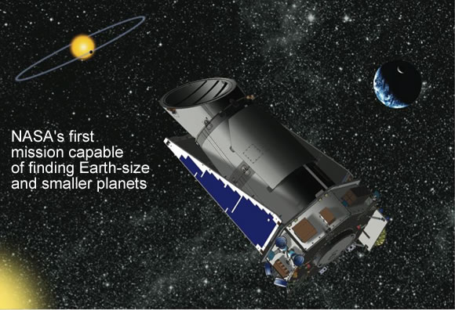
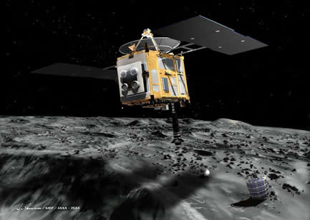
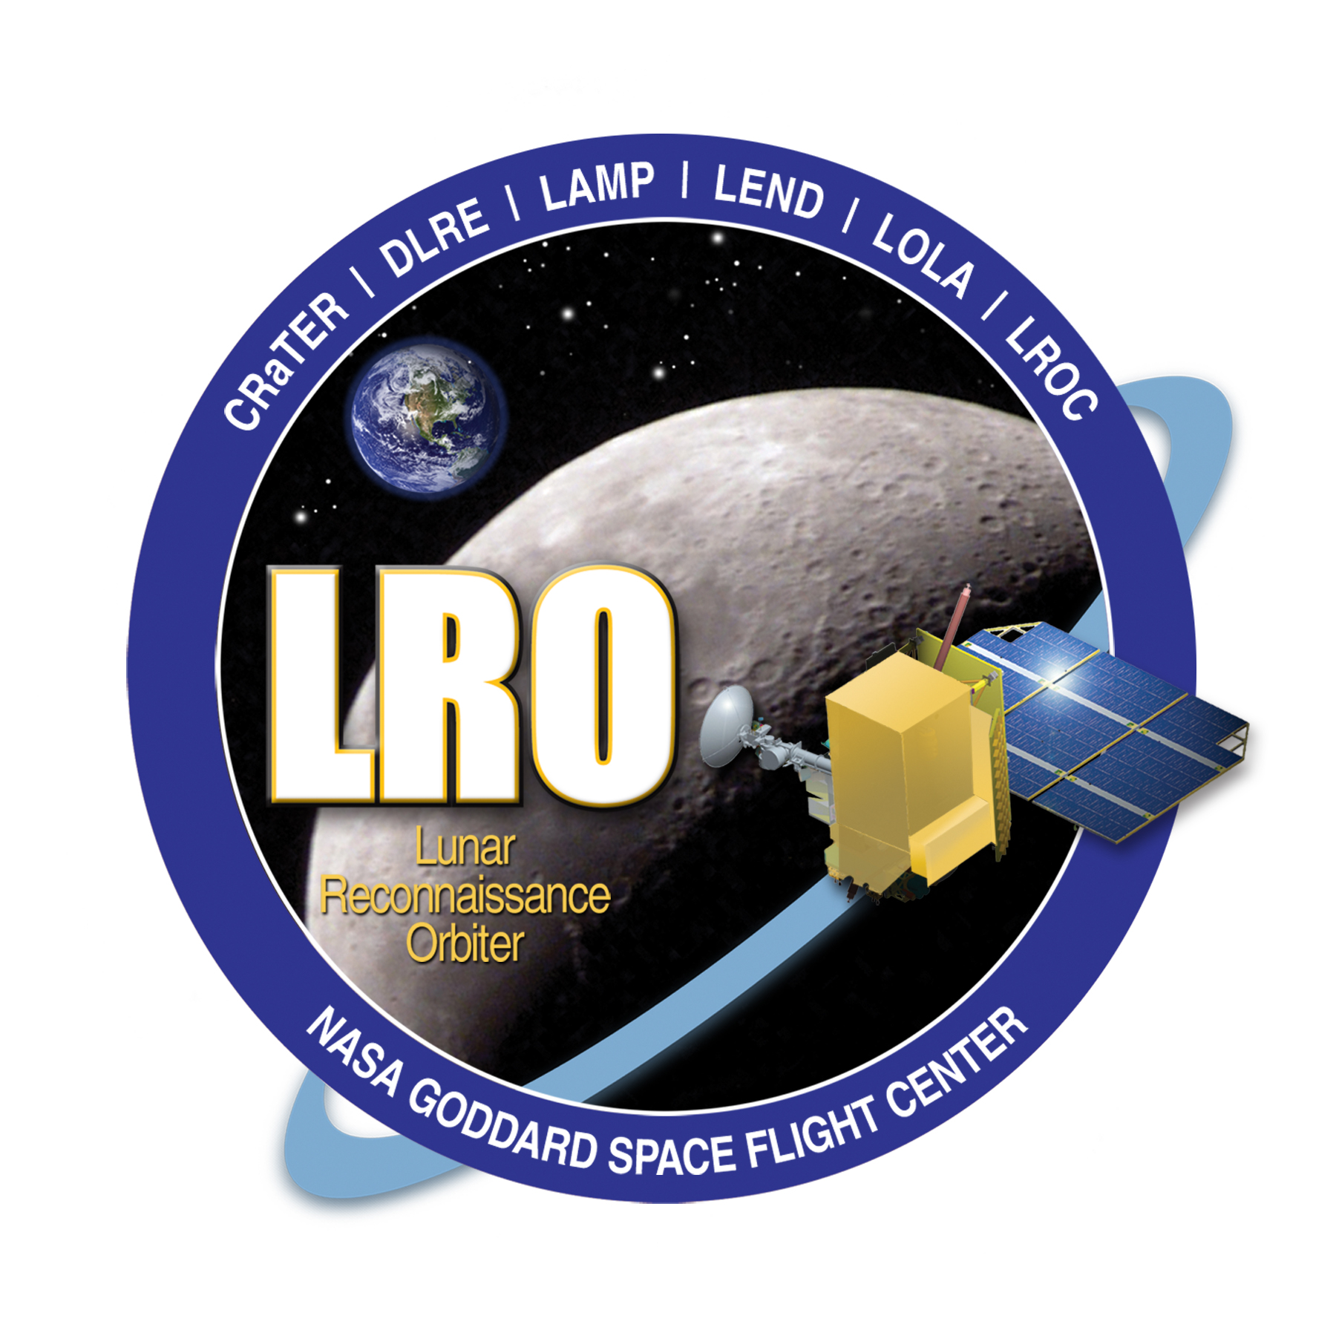
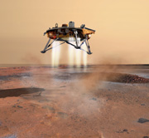
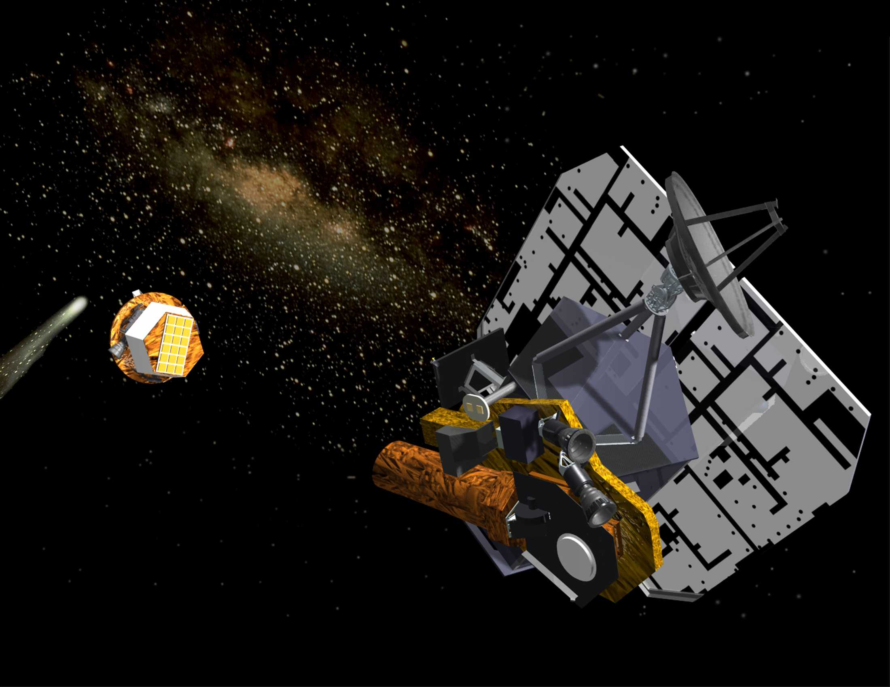
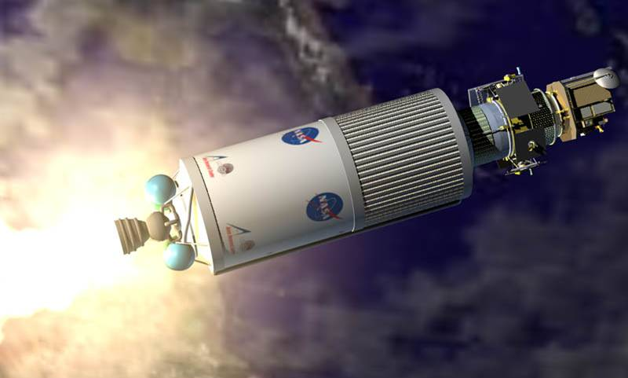
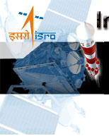
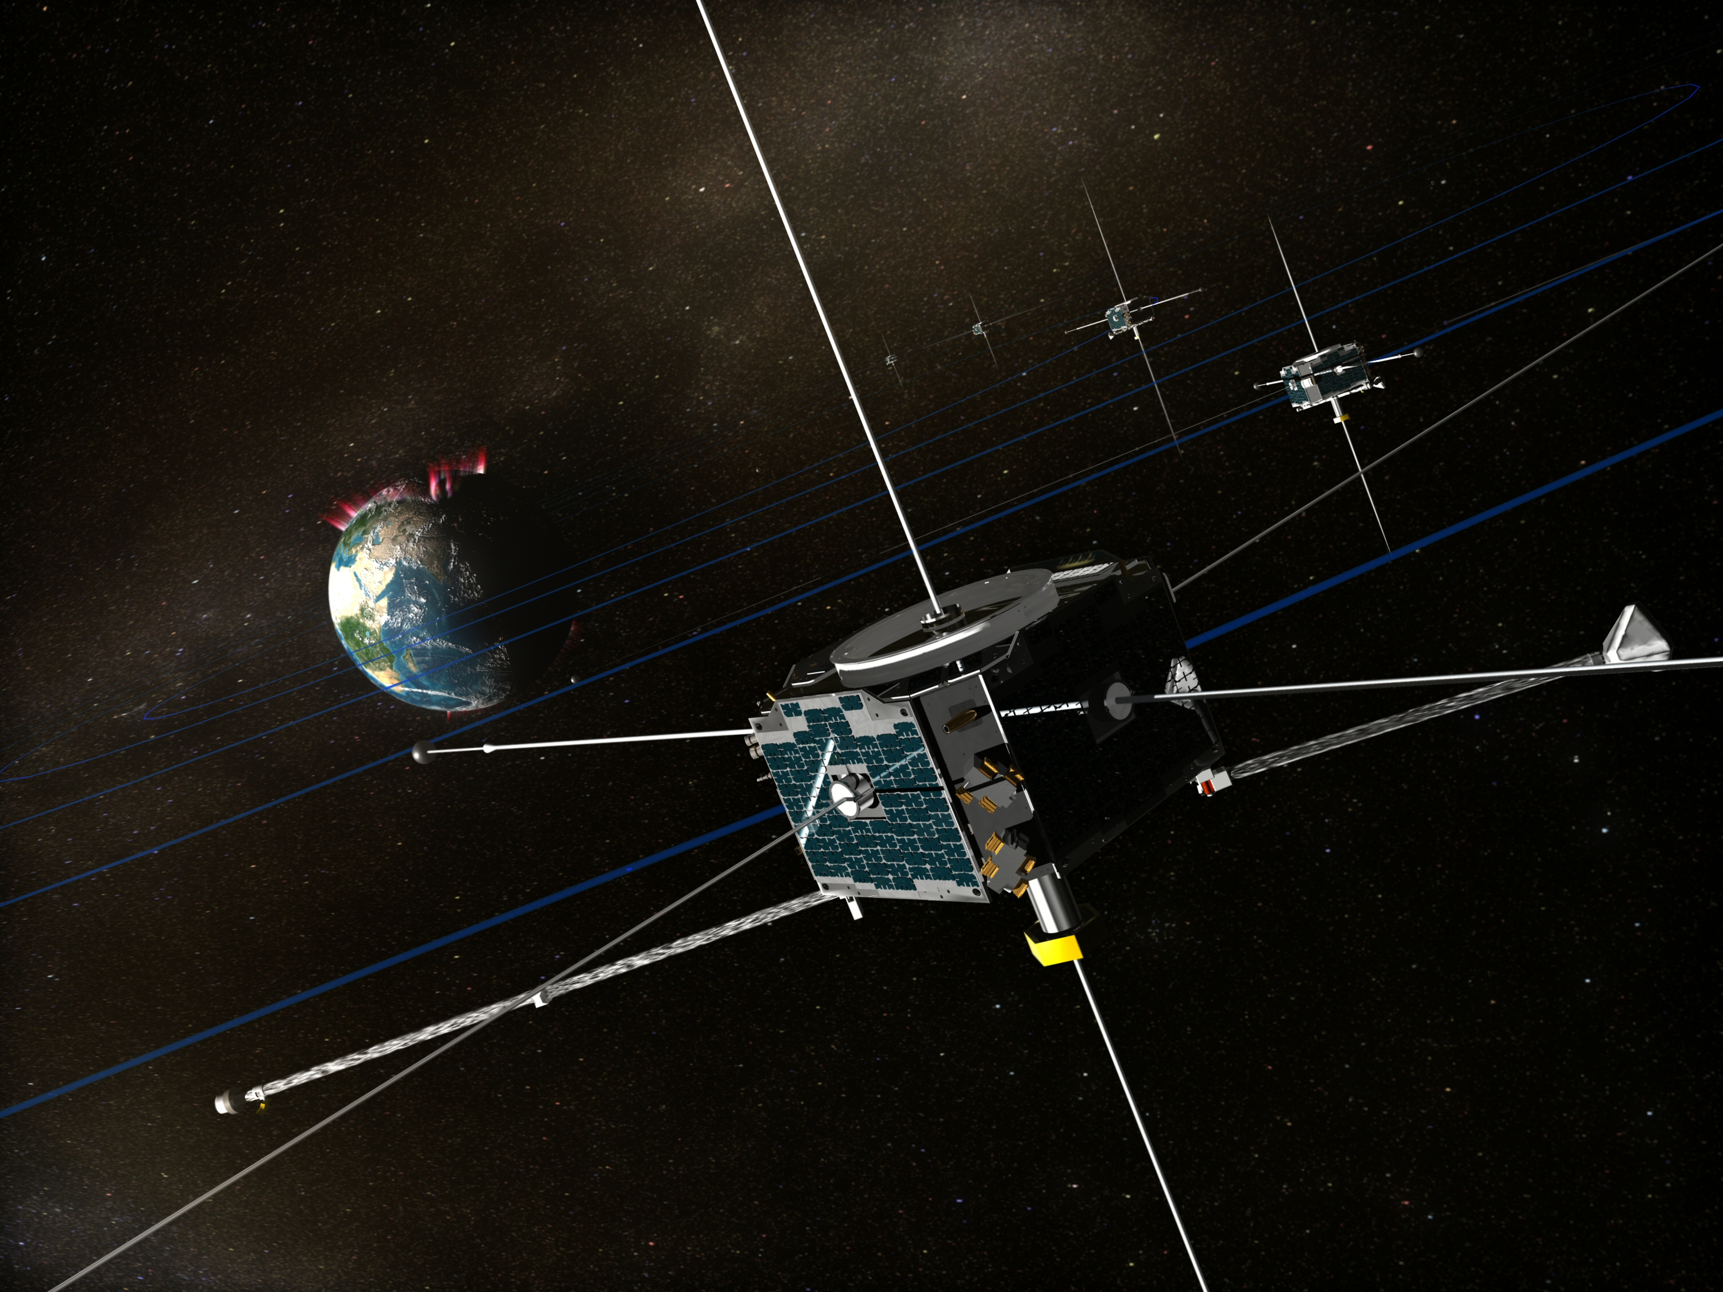
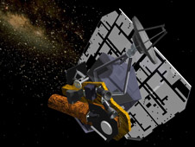

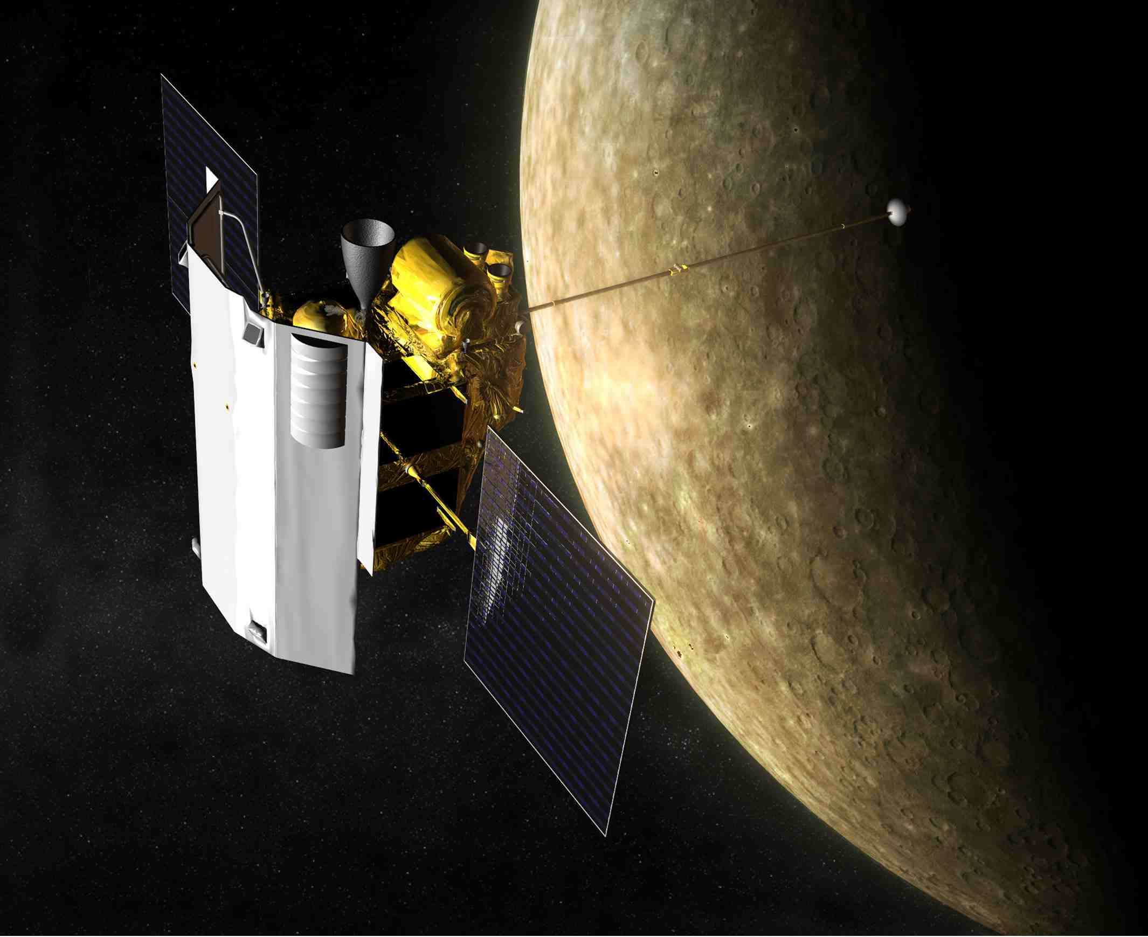
Planetary Science Missions
July 2008
Oct 2008
Jan 2009
Apr 2009
July 2009
Oct 2009
Jan 2010
Apr 2010
July 2010
Oct 2010
DAWN MGA
Kepler Launch
MUSES-C Re-Entry
LCROSS Impact
PHX EDL
LRO Launch/LOI
LCROSS Launch
EPOXI Comet Encounter
GOES-O Launch
Chandrayaan Launch
ARTEMIS Lunar Transfer
L2 & L1 Insertions
EPOXI Earth Flyby
ROSE Earth Swingby3
MSGR Mercury Flyby 2
Two Voyagers
MSGR Mercury Flyby 3
(WISE)

Slide 8
Space Science Data System
Relay Satellite
Simple Information Object
Spacecraft / lander
Science
Data Archive
Primitive Information Object
Primitive Information Object
Science Information Package
Science Information Package
Science
Data Processing
Science Products - Information Objects
Telemetry Information Package
Science Information Package
Data Analysis and Modeling
Science Information Package
Instrument
Planning
Information
Object
Planning
Information
Object
Data Acquisition
and Command
Science Team
Mission Operations
Instrument /Sensor
Operations
Common Meta Models for Describing Space Information Objects
Common Data Dictionary end-to-end

Slide 9
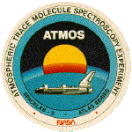
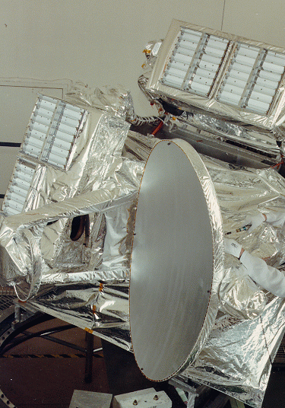
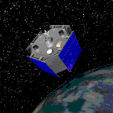



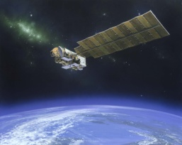

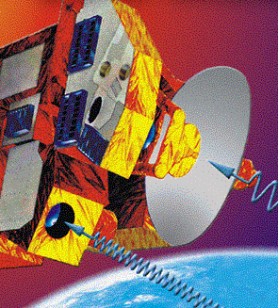
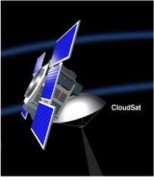
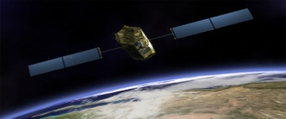
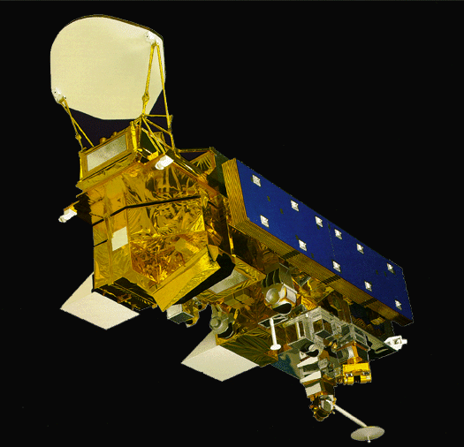
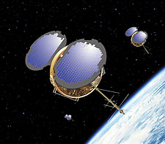
Atmospheric Science Missions
ATMOS & MLS
were instrumental in understanding ozone depletion
*Decadal Survey Mission
PI-Led
ACRIMSAT
measures the total amount of solar energy reaching the Earth
MISR/ACE* distinguishes different
aerosols, and cloud forms to develop 3-D
models
AIRS/GACM*
measures air temperature
and humidity
for input into weather forecasts
TES
makes the
first-ever measurements of tropospheric ozone from space
CloudSat
ACE*
will improve estimates of cloud properties
OCO/ Ascends*
will improve estimates of carbon sources and sinks
GPSRO*
will provide all-weather temperature, water vapor, and electron density profiles for weather, climate and space weather
ATMOS (1985)
UARS MLS
(1991– Present)
ACRIMSAT
(1999–
Present)
MISR on TERRA
(1999– Present)
AIRS on
AQUA (2002– Present)
TES on AURA
(2004–Present)
MLS on AURA
(2004– Present)
Orbiting Carbon Observatory Mission
(2009)
CloudSat
(2006)
GPSRO
(2010–2013)
1985
1991
1999
2002
2004
2005
2008
2010

Slide 10
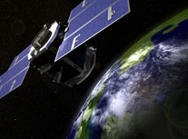

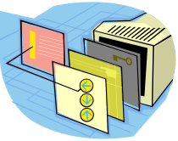

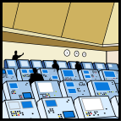
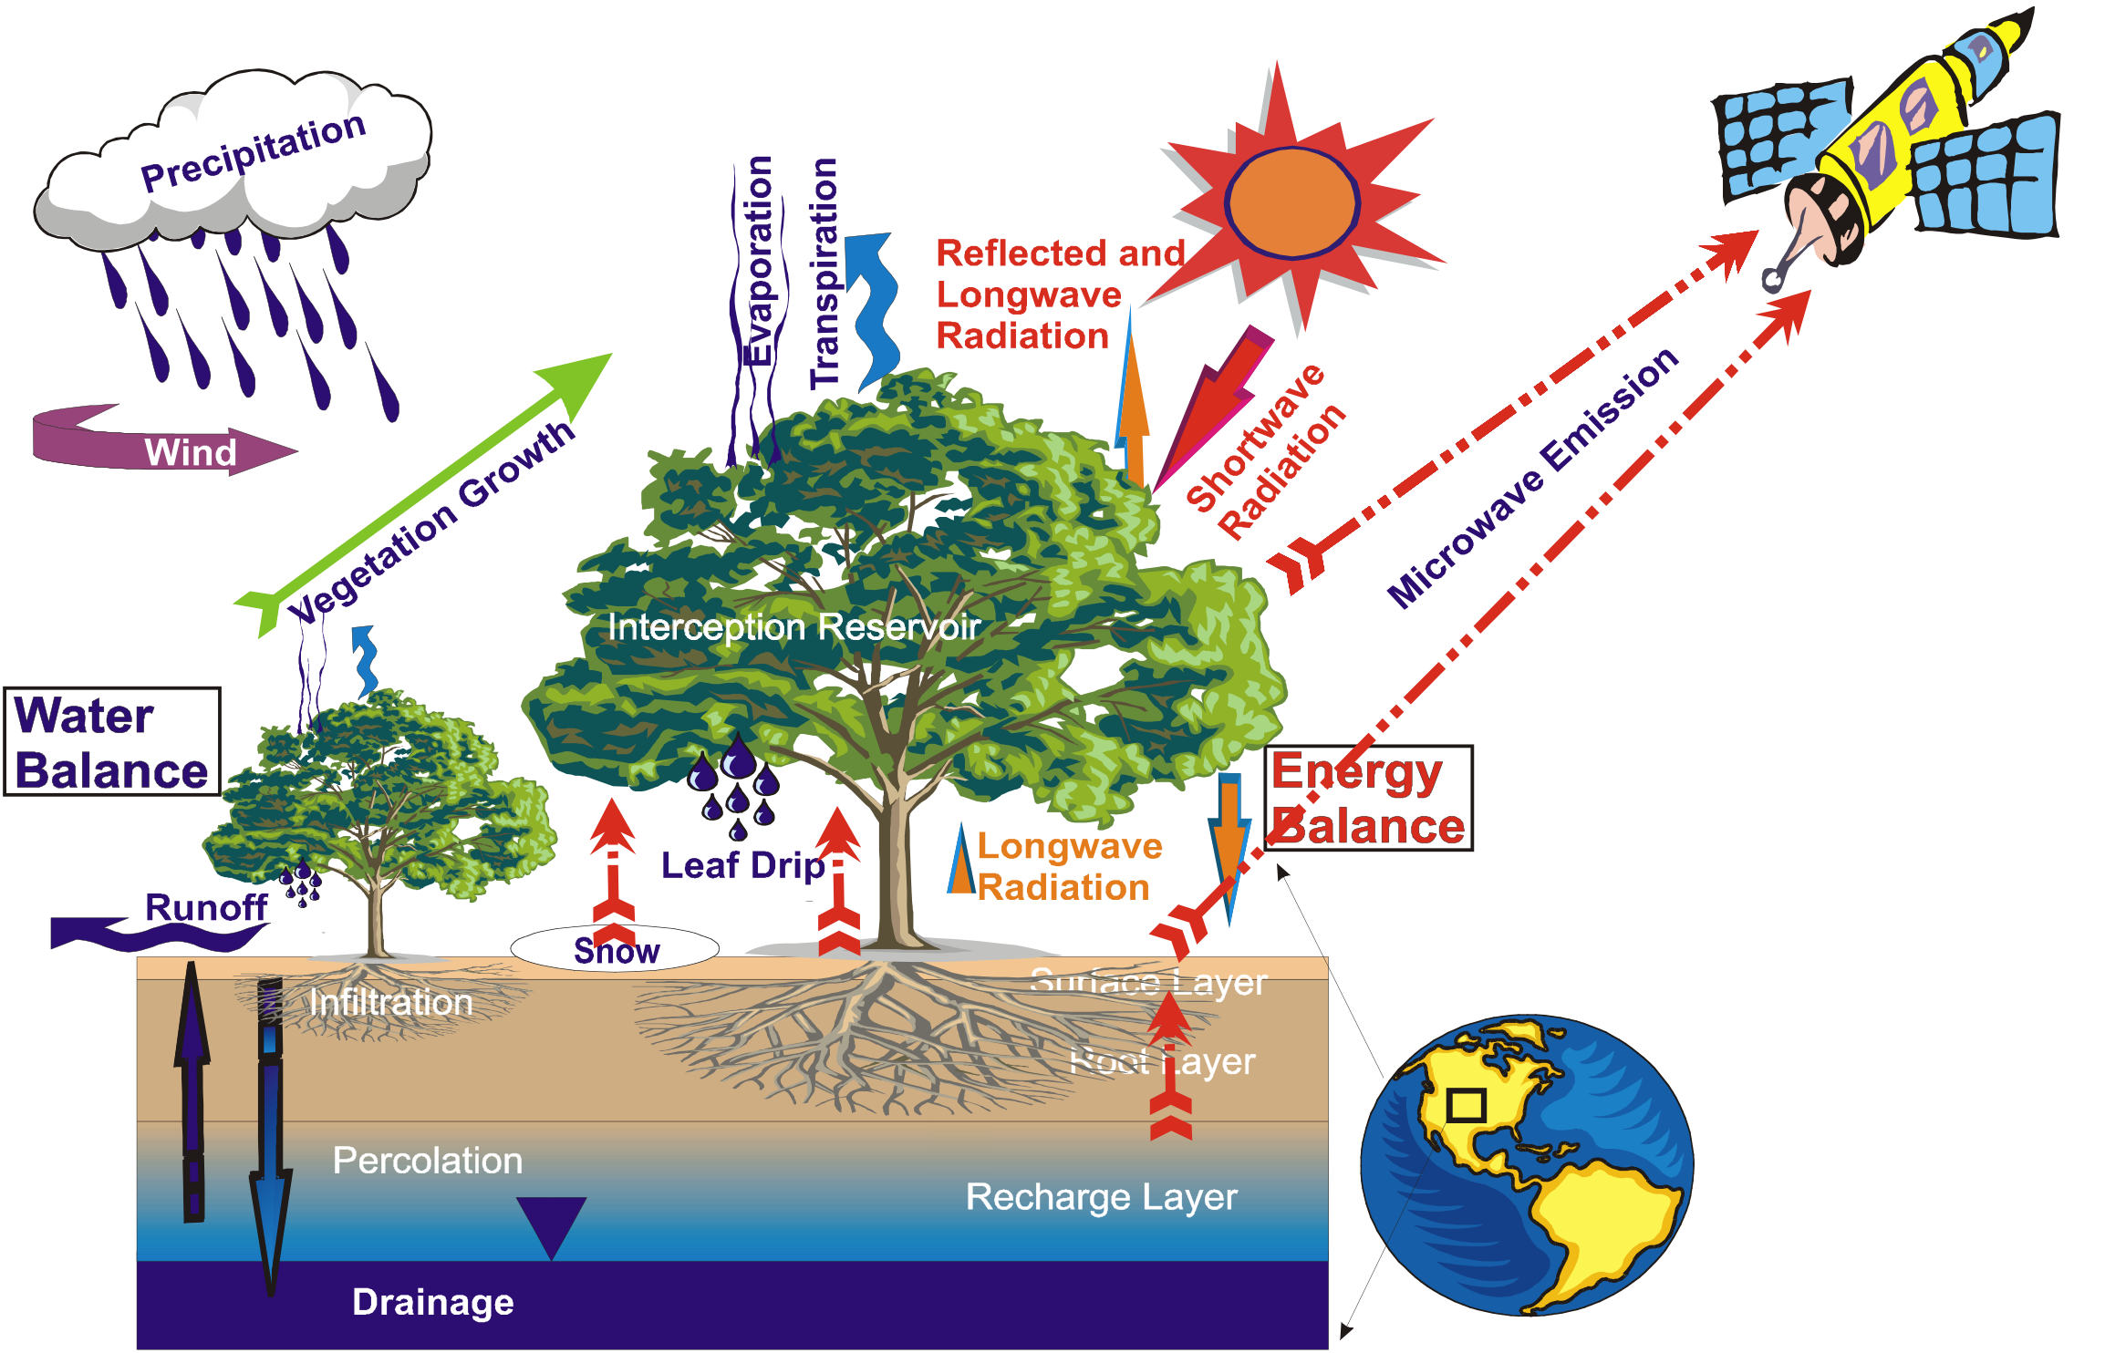



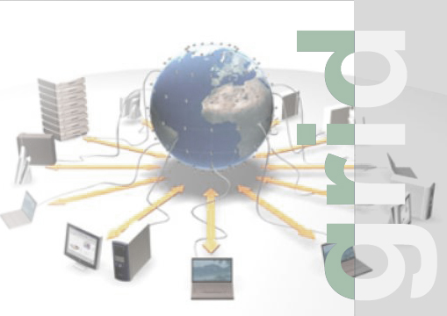
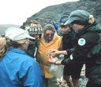


Earth Science Data System
On Board Processing
Science
Data Processing
Science Teams
TDRS Network
Research
Mission Operations
Network w/
Cloud Storage
& Computation
Mission Operations
NASA Mission/Multi-Mission Data & Science Centers
Analysis, Modeling and Application
Environments
Instrument Operations
Science
Data
Manage
Data Acquisition
and
Command
Instrument Operations
Applications
L0A
Processing
L0A
Processing
EDOS/Ground Data Systems
Archive Data Centers
Decision
Support
Other
Data Systems
(e.g. NOAA)

Slide 11
The Challenge
Architecting and developing the End-to-End Science Data Systems (SDS) to support science needs and enable scientific research for various domains
Science data generation
Data capture, end-to-end
Discovery and access science data by the community

Slide 12

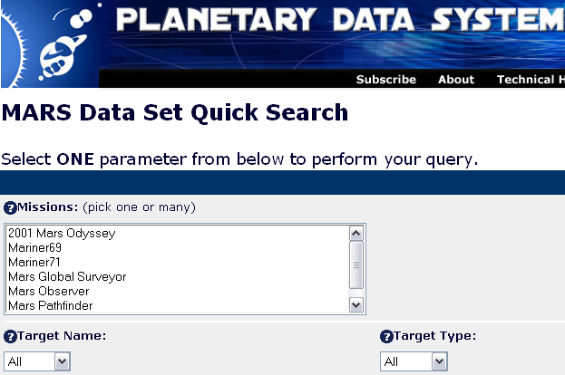
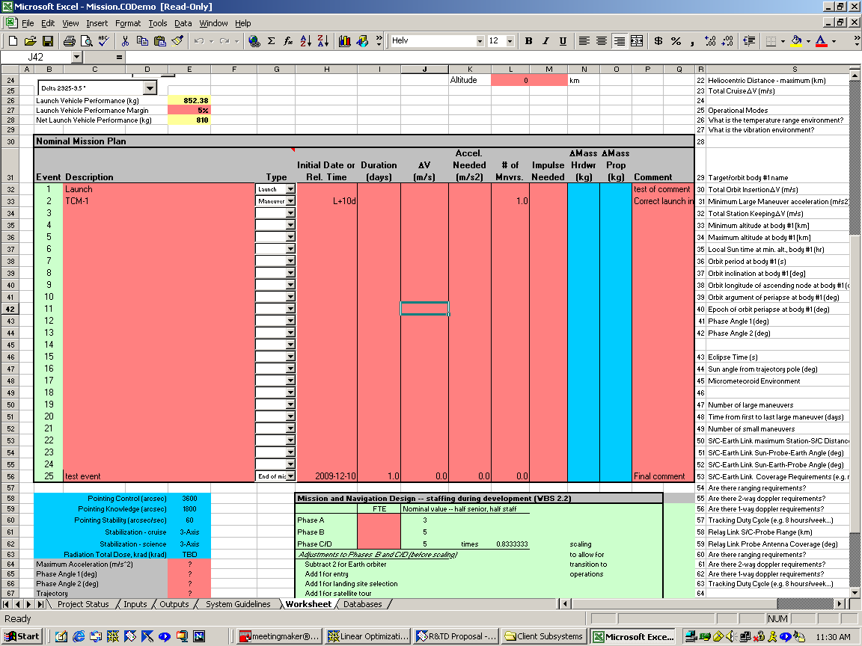
Strategy
Applied technology research
Open Source
Product Lines
Emerging technologies
OODT
Reusable
Data
Grid
Framework
Mission
Data
Repositories
OODT
API
Visualization Tools
Biomedical
Data
Repositories
OODT
API
Web Search Tools
OODT
API
Engineering
Data
Repositories
Analysis Tools

Slide 13
SDS Functional Architecture

Slide 14
A SDS Implementation

Slide 15
Underlying Infrastructure OODT Framework
OODT/Science Web Tools
Archive
Client
Navigation Service
OBJECT ORIENTED DATA TECHNOLOGY FRAMEWORK
Catalog & Archive
Service
Profile
Service
Product
Service
Query
Service
Bridge to
External
Services
Other
Service 1
Other
Service 2
Profile
XML Data
Data
System 1
Data
System 2

Slide 16
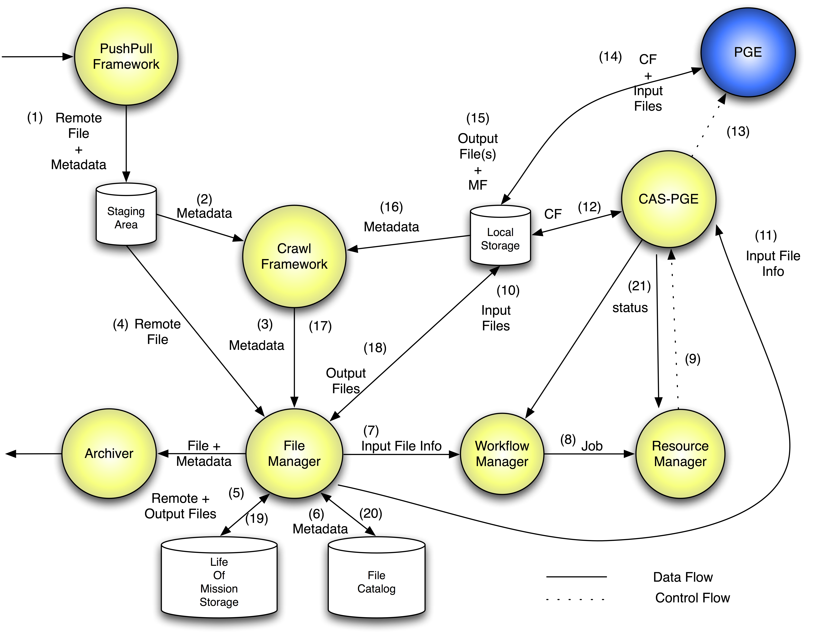
SDS OODT Components
Automatic File Ingestion
Product Delivery
Information Management & Process Control

Slide 17
Mission Deployments
SeaWinds
Orbiting Carbon Observatory (OCO-2)
NPP Sounder PEATE
QuickSCAT
SMAP

Slide 18
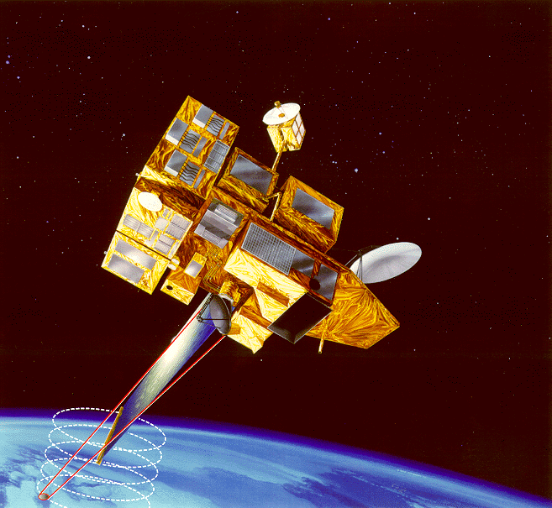
Mission Experience
SeaWinds
Used OODT CAS
Focus on Workflow
Separation of computational resources
Provided “lights out” operations
SeaWinds on ADEOS II (Launched
Dec 2002)

Slide 19
Deployment to a Mission
Reuse components
Mission-specific customizations
Server Configuration
Product metadata specification
Metadata extractor
Processing Rules
PGE Configuration
Compute Node Usage Policies

Slide 20
Other Deployments
Planetary Data System
Early Detection Research Network
Children’s Hospital LA Virtual Pediatric Intensive Care Unit
Climate Data Exchange
Airborne Cloud Computing Environment
Lunar Mapping & Modeling Project
Various Technology and Prototype data systems (e.g NRAO:EVLA)

Slide 21
Planetary Science Experience
Planetary Data System (PDS)
Geographically distributed
Multi-nodes, highly diverse data sets
Reuse
Single Filesystem Query Handler
Products & Profile Servers

Slide 22
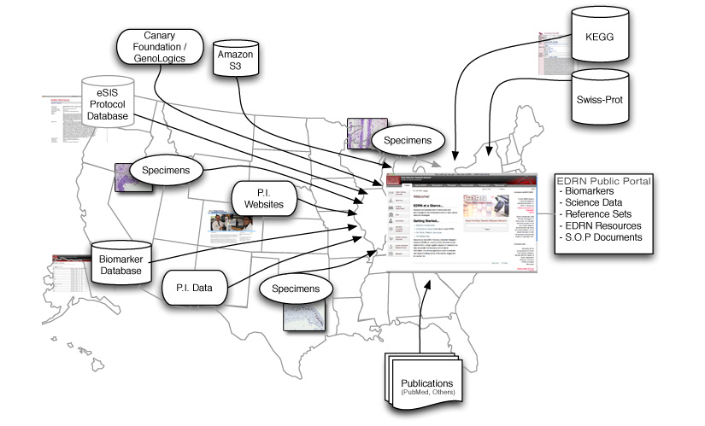
Health Informatics Experience
Early Detection Research Network (EDRN)
Geographically distributed, Multi-institution
Common Data Elements (CDE)
Reuse
Query Handler
Products & Profile Servers
CAS

Slide 23
Benefits (1 of 2)
Proven capabilities that meet SDS requirements:
Data ingestion
Data management
Workflow and resource management
Data Access
Data distribution/delivery

Slide 24
Benefits (2 of 2)
Reduce cost and time of development
Reduce risk of development
Allow projects to focus on project needs
Ease to plug-in, scale and extend
Provide lights out operations
Applicable to other domains

Slide 25
User Experience
Allow time to learn
Attend training
Participate
Submit issues
Share ideas
Flow features back to OODT

Slide 26
OODT Experience
Provide more documentation / user guides
Provide training
Improve deployment speed
Improve installation process
Recruit additional committers

Slide 27
SDS Experience
Drive shared infrastructure and science services
Drive innovation through peer review
Contribution through defined process
Better leverage skills and capabilities
Beneficial to non-science disciplines

Slide 28
Moving Forward
Align projects behind SDS strategy
End-to-end architecture
Collaboration & delivery using open source and product lines
Expanding
Recruiting & Training

Slide 29
Wrap Up
OODT – Key framework for JPL SDS that enable science return
Way forward - Bigger and better
Be part of building it out

Slide 30
Credits & Acknowledgement
Key Members of the JPL OODT teams
Dan Crichton, Chris Mattmann, Steve Hughes, Andrew Hart, Sean Kelly, Sean Hardman, Paul Ramirez, Cameron Goodale, Dana Freeborn, Mike Cayanan, Luca Cinquini
Projects, Sponsors, Collaborators
PDS, EDRN, ACCE, ESG, NASA missions…

Slide 31
Thank You!

Slide 32

Contact
Emily Law
Emily.law@jpl.nasa.gov
Dan Crichton
Daniel.crichton@jpl.nasa.gov
Chris Mattmann
Chris.a.mattmann@jpl.nasa.gov

