Slide 1

Bet You Didn’t Know Lucene Can…
Grant Ingersoll
Chief Scientist | Lucid Imagination
@gsingers

Slide 2


A Funny Thing Happened On the Way To…
“Apache Lucene(TM) is a high-performance, full-featured text search engine library written entirely in Java. It is a technology suitable for nearly any application that requires full-text search, especially cross-platform.”
- http://lucene.apache.org
Notes:
That’s the description of Lucene, but hey, it’s good for other things too
Let’s explore these
We’ll start easy, then get into things that are mathematically similar to search and then talk some crazy stuff

Slide 3
What can Lucene solve?
DB/NoSQL-like problems
Search-like problems
Stuff

Slide 4
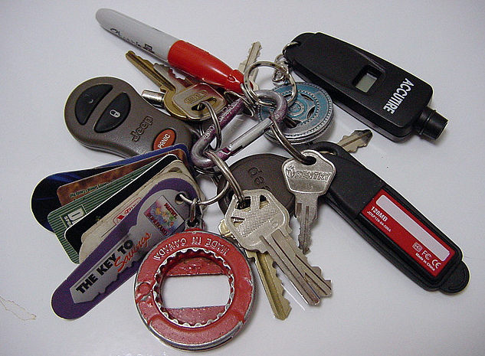
… Find your Keys?
Lucene/Solr is a reasonably fast key-value store
Bonus: search your values!
NoSQL before NoSQL was cool
10 M doc index: 600,000 lookups per second, single threaded, read-only
Not hard to remove the read-only assumption or the single node assumption
Notes:
Oh, BTW, it can do search over the values
Keys can be anything, not just strings

Slide 5
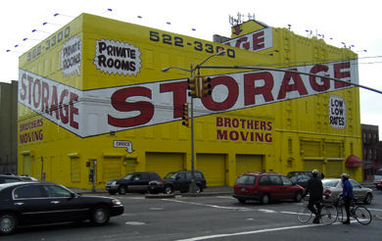
…Store your Content?
Solr or Tika + Lucene can index popular office formats
Solr can backup/replicate and scale as content grows
Commit/rollback functionality
Can dynamically add fields
No schema required up front
Retrieval is fast for keys or arbitrary text
Trunk/4.x:
Column storage
Pluggable storage capabilities
Joins (a few variations)
Notes:
Commit/rollback not totally the same as DB

Slide 6
Search-like Problems

Slide 7
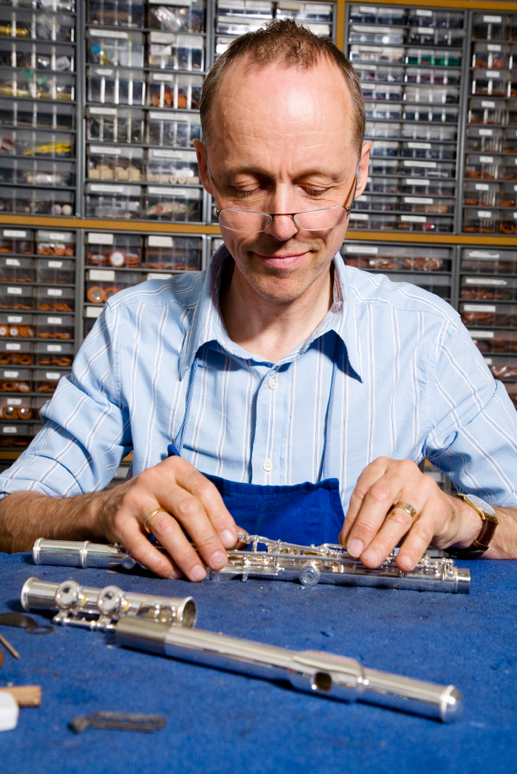
… Find you a Date?
Sex: Male
Seeking: Female
Age: 53
Job: Flute Repair shop owner
Location: Moose Jaw, Saskatchewan
Likes: rap music, cricket, long walks on the beach, Thai food
Dislikes: classical music, cats
Meet Bob
Likes: | Rap music | Cricket | Long walks on the beach | Thai food
Likes: | Rap music | Cricket | Long walks on the beach | Thai food
Payload
 | 5 | 2 | 10
Notes:
Lucene is a perfectly good content based recommendation engine. In fact, this can fall under the category of “search”
Lots of flexibility around representing features
http://www.lucidimagination.com/search/document/5485be0137448eca/problems_with_itembasedrecommender_with_lucene#c82c577e1e28259f

Slide 8

Along comes Mary
Sex: Female
Seeking: Male
Age: 47
Job: CEO
Location: Moose Jaw, Saskatchewan
Likes: Hip hop, sunsets, Korean food
Dislikes: cats
Meet Mary
Filters | Queries
Sex, Seeking, Age (as RangeQuery), Job, Location (as spatial) | Likes: OR, Phrases, Payload Queries
 | Dislikes: As Not Queries or down boosted or perhaps ignore?
 | Boosts: Popularity, Secret Sauce

Slide 9
Will Mary and Bob Find Love?
?
CEO | Owner, Chief Executive Officer, Executive
Sunsets | Beaches, outdoors
Korean Food | Asian Food
Age Range Match | Yes
Match
Notes:
You remembered your synonyms and associations, right? Maybe bootstrap from Wordnet or other resource? Perhaps you even used Lucene to calculate co-occurences
You can tweak the system as needed to come up w/ appropriate queries, etc.

Slide 10
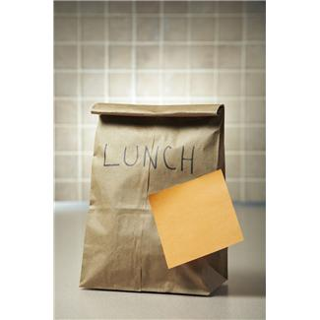
… Label Your Content?
Given a new, unseen document, label it with one one or more predefined labels
Supervised Machine Learning
Train
Set of data annotated with predefined labels
Test
Evaluate how well classifier can determine your content

Slide 11
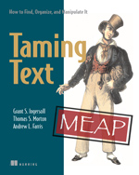
Simple Vector Space Classifiers
K Nearest Neighbor (kNN)
Each Training Document indexed with id, category and text field
Pick Category based on whichever category has the most hits in the top K
Simple TF-IDF (TFIDF)
Training
Index category and concatenation of all content with that label
Pick Category based on which ever document has best score
Query: “Important” terms from new, unseen document
Use Lucene’s More Like This to generate the Query
Chapter 7

Slide 12
Training Data
Politics
Obama fundraising
Republican Fundraising
Sports
Vikings win Super Bowl
Carolina Hurricanes earn first Stanley Cup
Entertainment
Spongebob caught shoplifting
Brangelina on a Rampage
Obama clashes with Republicans
Minnesota Twins capture World Series
Megastar clashes with Paparazzi
Notes:
Let’s say you have a bunch of training data

Slide 13
Simple TF-IDF Model
Training
Politics | Sports | Entertainment
obama fundraising republican fundraising obama clashes with republicans | vikings win super bowl carolina hurricanes earn first stanley cup minnesota twins capture world series | spongebob caught shoplifting brangelina rampage megastar clashes paparazzi
Test/Production
Input document is the query!
e.g.: patriots lose super bowl

Slide 14
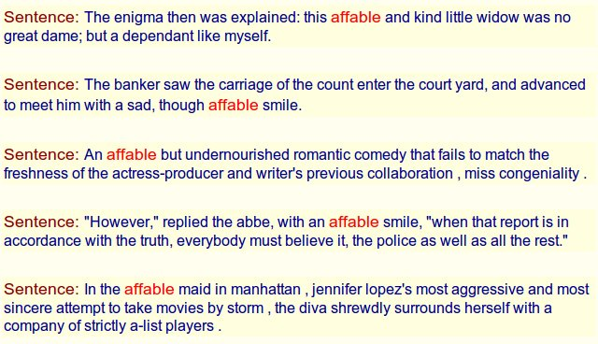
Help you Learn a New Language?
Manu Konchady uses Lucene to teach new languages
Find exactly where a match occurred
Can also identify languages! (Solr)
Analyzers can help you tokenize, stem, etc. many languages

Slide 15

… Detect Plagiarism?
For each document
For each sentence
Index Sentence and calculate a hash for each document
Hash function has property that similar sentences will hash to the same value
For each new document
For each sentence
Query: hash (optionally also search for the sentence)
Can also do this at the document level by calculating hash for whole document
Contrib’d by Andrzej Bialecki and Erik Hatcher

Slide 16
… Find the Bad Guys?
Problem: Is Bob “Bad Guy” Johnson the same person as Robert William Johnson?
Called Record Linkage or Entity Resolution
Common problem in business, finance, marketing, etc.
Index contains all user profiles
Ad hoc
Query: incoming user profile
Tricks: fuzzy queries, alternate queries
Post process results
Systematic: pairwise similarity (More Like This for all docs)
Notes:
Pairwise similarity: compare all documents

Slide 17
…Make you more money?
Who says a search needs to just do keyword matching using good old TF-IDF?
Solr makes it easy to:
Rerank documents based on things like price, inventory, margin, popularity, etc.
Apply Business Rules
Hardcode results
Scale for the Holiday season

Slide 18
… Play Jeopardy!?
Indeed, IBM Watson uses Lucene
Critical component of Question Answering (QA) is often retrieval
How to build a simple QA system?
Documents can be:
Whole text, paragraph, sentences
Position-based queries (spans) to find where keywords match
Index part of speech tags and possibly other analysis
Queries:
Classify based on Answer Type
Retrieve passages based on keywords plus answer type
Score passages!
Chapter 9
Notes:
Scoring is easier said than done, but simple approach can be effective for fact-based questions

Slide 19
Stuff

Slide 20
… Make you a Better Programmer?
If your tests aren’t failing from time to time, are you really doing enough testing?
We’ve introduced some serious randomized testing
We run randomized tests every 30 minutes, ad infinitum
Random Locales, time zones, index file format, much, much more
Some in the community also randomize JVMs continuously
We liked what we built so much, we now publish it as its own module
https://issues.apache.org/jira/browse/LUCENE-3492
https://github.com/carrotsearch/randomizedtesting
More References at end of talk

Slide 21
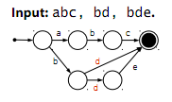
… Run Circles Around Previous Versions of Lucene?
Finite State Transducers
Pluggable Indexing Models
Codecs
Pluggable Scoring Models
BM25, Information based, others
http://bit.ly/dawid-weiss-lucene-rev

Slide 22
Crazy Stuff

Slide 23
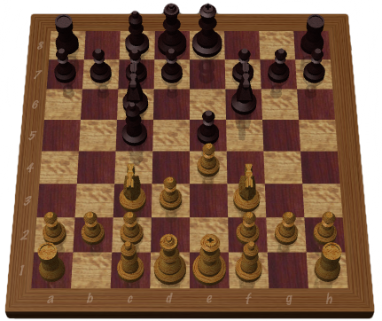
…Play Chess?!? – THOUGHT EXPERIMENT
Well, maybe not play, but, could we help?
Premise: Even though chess has a very large number of possibilities, most board positions have been played before
Could you assist with real time analysis?
Index large collection of previously played games
Document A
Sequence of all moves of the game
Metadata
Query: PrefixQuery of current board + Function
Results: Ranked list of moves most likely to lead to a win
Alternatives: index board positions, subsequences of moves (n-grams)

Slide 24
What else?
In case you haven’t noticed, Lucene can do a lot of things that are not “traditional search”
I’d love to hear your use cases!

Slide 25
Resources
http://lucene.apache.org
@gsingers / grant@lucidimagination.com
http://www.lucidimagination.com
http://lucene.grantingersoll.com

Slide 26
References and Credits
Unit Testing:
http://wiki.apache.org/lucene-java/RunningTests
Robert Muir: http://lucenerevolution.org/sites/default/files/test%20framework.pdf
Dawid Weiss’ Lucene Eurocon talk: http://bit.ly/vaxdUC
Images:
Keys: http://www.flickr.com/photos/crazyneighborlady/355232758/
Storage: http://www.flickr.com/photos/d_e_/7641738/sizes/m/in/photostream/

