Slide 1

Open Sourcing Commercial Software - Apache Traffic Server
Bryan Call
ApacheCon 2011
Yahoo! Engineer and Apache Commiter
Notes:
Helpful hints and things to think about when open sourcing
Things we ran into and the process we took for OSing TS

Slide 2
Overview
Why Open Source
Things To Consider
What License
Different Approaches
What We Did
  Buy-in From Upper Management
  Identifying Licensing Issues
  Security Audit
  Patents
  Existing Contracts
  Code Cleanup
  Apache Foundation
  Getting The Word Out
Realized Benefits

Slide 3
Why Open Source?
Work with community to accelerate development and innovation
Good will from technical community (giving back)
Can be a way to commoditize software
  Catch up with competitors that are father ahead
Software doesn’t give you a competitive edge or differentiator in the market
Won’t help competitors the are heavily invested in their existing software

Slide 4
Things To Consider
Security Concerns
  Ability for people to find exploits in the code
  A lot of hallway conversations about why we are open sourcing and security concerns
Some competitors may benefit using your software
Can lose some control over what goes into the code
Notes:
Better code base in the long run
Can use compile time flags or configuration option to remove unwanted features

Slide 5
What License?
GNU General Public License (GPL)
BSD
Apache License
Mozilla Public License
Notes:
http://www.opensource.org/licenses/category

Slide 6
Different Approaches
“Fake Open Source”
  Not under OSI approved license
“Throw Code Over Wall”
  Post tarball and walk away
Develop Internally, Post Externally
  In-house development, public repository
Open Monarchy
  Public discussion, public repository
  Corporation or lead developer makes final decisions
Consensus-Based Development
  Decisions are based on consensus of the commiters
Notes:
Ben Collins-Sussman and Brian Fitzpatrick – subversion

Slide 7
What We Did

Slide 8
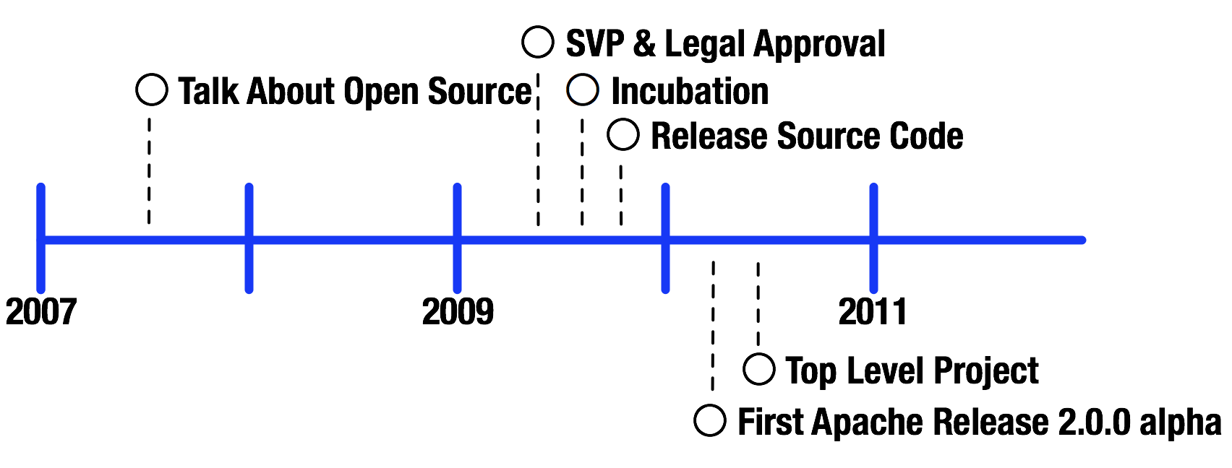
Timeline
Notes:
Of course more release after 2.0.0
Incubation – process for accepting new products into the Foundation
Top Level Project - graduating from the Incubator

Slide 9
Buy-in From Upper Management
Helps/required to have support from upper management
Most time consuming task
  SVP and legal

Slide 10
Why Apache Foundation?
Already had successful and good relationship (Hadoop)
Doug Cutting worked at Yahoo! and became the Champion of the project
Collaborative and meritocratic development process
Notes:
Edge services is part of cloud group with hadoop in it
OS group was suggesting Apache
Running an OS project was new to all of us in the group

Slide 11
Identifying Licensing Issues
Commercial license scanning
  Expensive
  Palamida (http://www.palamida.com)
Document changes that will need to be done
License incompatibilities
  Apache / GPL
Notes:
26 pages – $770 a page
DEMO

Slide 12
Security Audit
Static code analysis
  Coverity, RATS, Flawfinder
  2500+ issues resolved
grep for potential leaks of information
  Hostnames, email addresses, specific internal code, etc.
Internal tools for code scans
Internal security team approval
Created contingency plans in case exploit was found
Second most time consuming task

Slide 13
Patents
Reviewed all possible patents the code might be using
  100+ patents to review and flagged important ones
  Giving up patents that the code uses
Notes:
111 patents – dismissed 16 quickly – 95 detailed review for 6 people
I am not a lawyer ☺

Slide 14
Trademarks
Donated our trademarks for Traffic Server to the Apache Foundation

Slide 15
Existing Contracts
Legal reviewed contracts and agreements with individuals and companies
  Reseller could have delayed open sourcing and signed an agreement

Slide 16
Code Cleanup
Removing code we didn’t want to open source
  Authentication, streaming, NTTP, FTP
Removing code we couldn’t open source
  Internal features
    Adding client ip and signature to the HTTP request headers
    Blocking certain types of requests (PURGE, DELETE)
  SNMP
Results
  750,000 lines (SLOC count) before
  Down to 350,000 lines in a couple week
Notes:
DEMO

Slide 17
Apache Foundation
Helpful in defining process around open sourcing
  Incubation process
Requirements for building community
  Diverse (not just Yahoo employees)
Infrastructure to run an open source project
  Version control
  Mailing lists
  Build servers
  IRC bots
  Bug tracking
  Website
  Software distribution

Slide 18
Apache Foundation
Knowledgeable people around licensing and legal issue
Legal assistance
Existing Apache members helped and are helping with the project

Slide 19
Apache Foundation
2009-07-13 Project enters incubation
2009-10-29 Source code migration completed
2010-03-13 Apache Traffic Server v2.0.0-alpha is released
2010-04-21 The Apache board establishes Apache Traffic Server as a TLP

Slide 20
Getting The Word Out
OSCON 2009
  So where is the code?
ApacheCon 2009
  Inktomi developers show interest
Press releases
Apache hackaton in January 2010
2010 and 2011 lots of conferences

Slide 21
Getting The Word Out
OSCON 2009
  So where is the code?
ApacheCon 2009
  Inktomi developers show interest
Press releases
Apache hackaton in January 2010
2010 and 2011 lots of conferences

Slide 22
Results

Slide 23
Since Open Sourcing
64bit support
2x to 5x speed improvement
Cache enhancements
Ported to other OSes
  Many Linux distros, OSX, FreeBSD, Solaris
Many design changes and bug fixes
Features fixes that weren’t being used

Slide 24
Community
Very important for a project to be successful
Apache Foundation does a great job to help build communities
Need people that are social and consensus builders
Healthy community will continue on even if one company or person stops contributing

Slide 25
Mistakes
Code leaked that was under NDA, removed the code in 12/2009
Exploit was found this year 4/2011

Slide 26
Benefits
Better code base
People that work on it care – not a job
  Hobby and/or interested in the project
More developers working on it
Notes:
More work as been done to the code base after open sourcing – Yahoo gets bogged down in bug fixes and helping properties

Slide 27
Adoption At Yahoo
Haven’t realized benefits of open sourcing Traffic Server
Management changed and shifted focus on other projects
Meeting next week to talk about using ATS
Notes:
New management afraid of loosing control – meeting a apachecon 2009 (paul querna, Justin (President)
Team members told not to spend work time on ATS

Slide 28
Final Words
Weren’t experts at open sourcing at the start
Different ways to open source
  Use a method that has already worked
Glad that Traffic Server is part of the Apache Foundation
Notes:
checksfv
Books written about how to open source and building communities
If you want a consensus based development look hard at Apache

Slide 29
Contact Info
Email: bcall@apache.org

Slide 30
Links
Traffic Server
  http://trafficserver.apache.org/
Incubator Status
  http://incubator.apache.org/projects/trafficserver.html
Incubation Policy
  http://incubator.apache.org/incubation/Incubation_Policy.html
Code changes
  http://people.apache.org/~bcall/work_done_opensource/release_2.0.0_commits.txt
Files Removed
  http://people.apache.org/~bcall/work_done_opensource/YTSCleanupFor2FilesToRemove.html

Slide 31
Videos
What's In It for Me? Benefits from Open Sourcing Code
  http://www.youtube.com/watch?v=ZtYJoatnHb8&feature=relmfu
How Open Source Projects Survive Poisonous People
  http://www.youtube.com/watch?v=ZSFDm3UYkeE&feature=relmfu
Eric S. Raymond and his opinion of the GPL
  http://www.youtube.com/watch?v=gEPg2M1qbEs&feature=related
Richard Stallman, GNU, Linux, and Support
  http://www.youtube.com/watch?v=JnqcBdCOKrI&feature=related

