Slide 1

Building a scalable multi-tenanted Cloud-native Application Server using Tomcat, Axis2 & Synapse

Slide 2
Building a scalable multi-tenanted Cloud-native Application Server using Tomcat, Axis2 & Synapse
Afkham Azeez
azeez@{apache.org , wso2.com}
WSO2 Inc
Selvaratnam Uthaiyashankar
shankar@{apache.org, wso2.com}
WSO2 Inc

Slide 3
About the Presenters
Afkham Azeez
PMC member Apache Axis, Committer Synapse & Web Services
Member, Apache Software Foundation
Co-author, Axis2 Web Services
Director of Architecture, WSO2 Inc
Blog: http://blog.afkham.org
Selvaratnam Uthaiyashankar
PMC member Apache Axis & committer Web Services
Member, Apache Software Foundation
Senior Manager & Senior Architect, WSO2 Inc
© WSO2 2011
Notes:
3

Slide 4
Agenda
Overall Architecture
Elastic Load Balancer
AppServer
Logging
Data & storage
Metering & billing

Slide 5
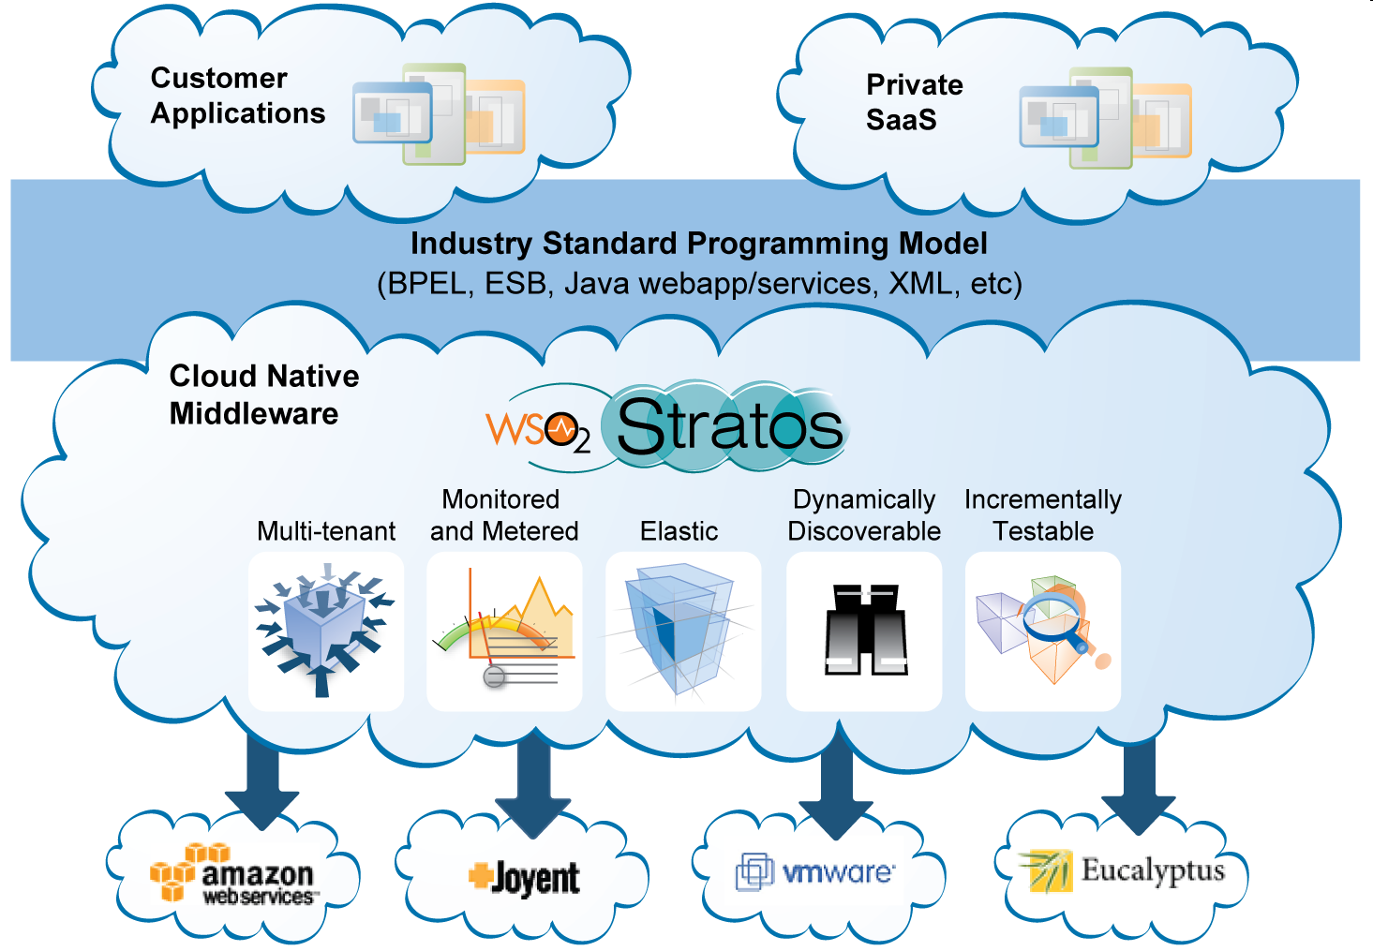
Cloud Nativity

Slide 6
Overall Architecture
ELB
AS₁
AS₂
AS₃
AS_{n}
Clients
Application Server - Elastic Cluster

Slide 7
Elastic Load Balancer
- Based on Apache Synapse & Apache Tribes

Slide 8
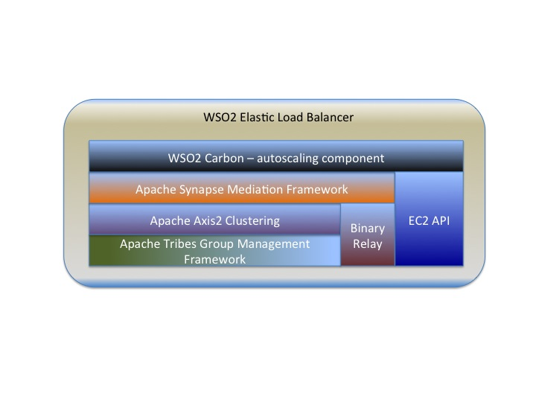
Highlevel Architecture

Slide 9
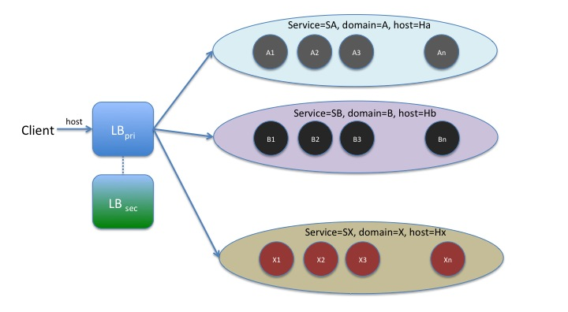
Service Cluster Aware Load Balancing

Slide 10
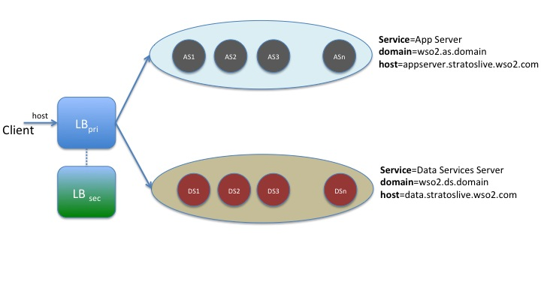
Practical Example

Slide 11
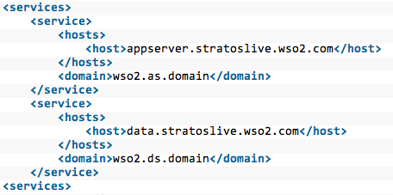
Configuration

Slide 12
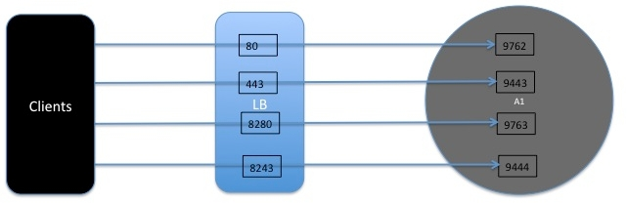
Proxy Port to Real Port Mapping

Slide 13
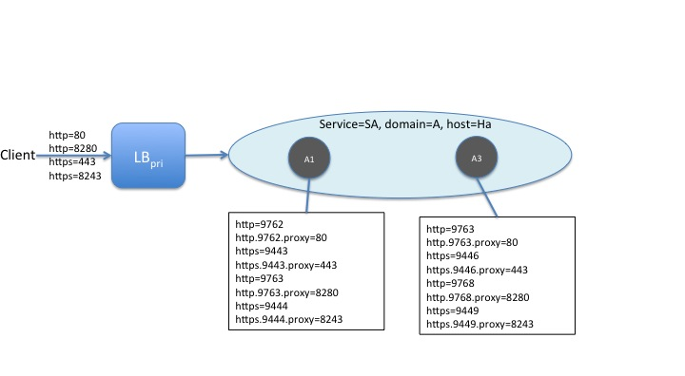
Proxy Port to Real Port Mapping

Slide 14
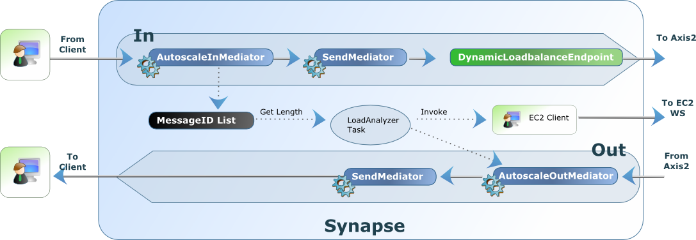
Synapse Message Flow

Slide 15
Membership Channels

Slide 16
AppServer
- Based on Apache Tomcat, Apache Tribes & Apache Axis2

Slide 17
Features
Webapp hosting
Uses embedded Tomcat
Services hosting
Axis2 AAR services
JAXWS services
Data services
etc…

Slide 18
Tomcat

Slide 19
Tomcat
Stuck thread detection valve
Multi-tenant access log
Webapp lazy loader valve
Tenant-aware Tomcat realm
Tenant-aware management console
Tenant-aware webapp contexts
Tenant-aware session manager

Slide 20
Request Interception
Tenant Identification &
Tenant Context Creation
Access Log Valve
Lazy Loader Valve
Stuck Thread Detector Valve
WebApp
Clients

Slide 21
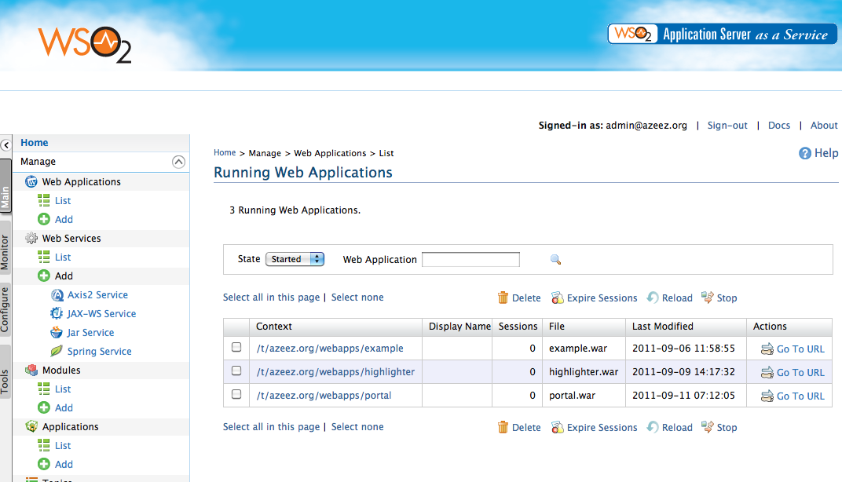
Management Console

Slide 22
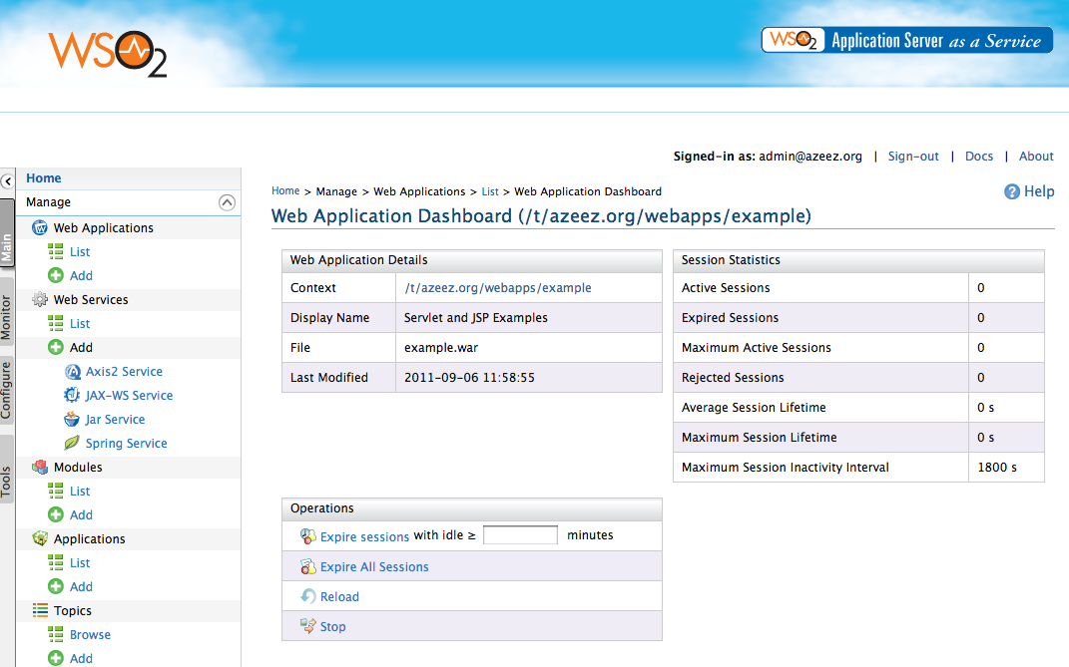
Management Console

Slide 23
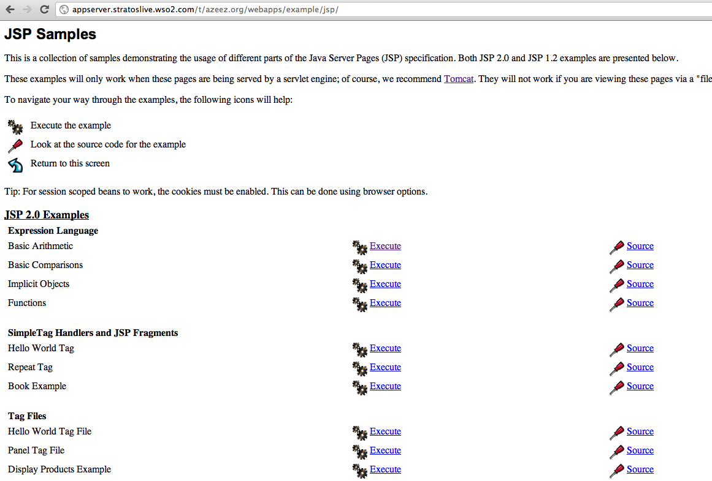
Tomcat Sample Webapp

Slide 24
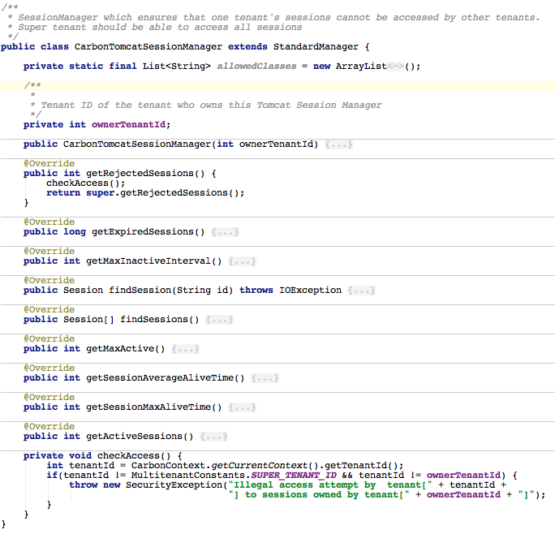
Tenant-aware Session Manager

Slide 25
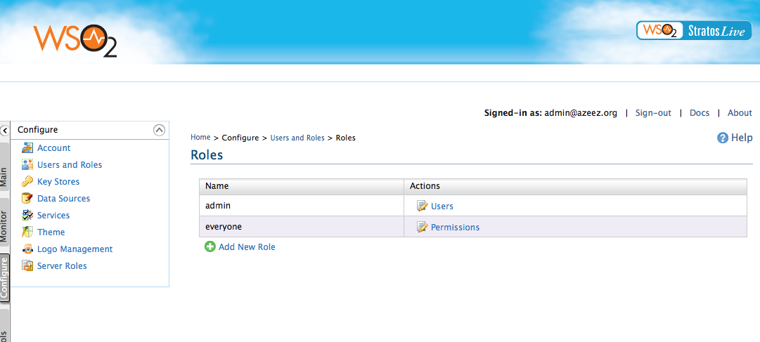
User & Role Management

Slide 26

web.xml - Integrating Identity into WebApps
Automatically ties into Identity Management infrastructure

Slide 27

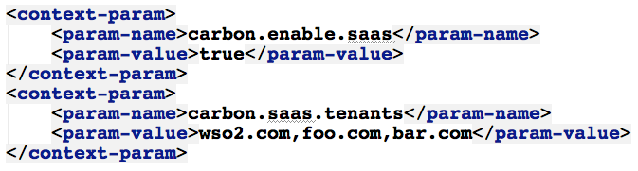
SaaS Mode
One webapp shared amongst all tenants
One webapp shared amongst selected tenants

Slide 28
Axis2
Notes:
Shankar will take over from here

Slide 29
Messaging
Messaging Engine
Transports
Message Receiver
Client
In
Out
Service
Impl
In Fault
Out Fault

Slide 30
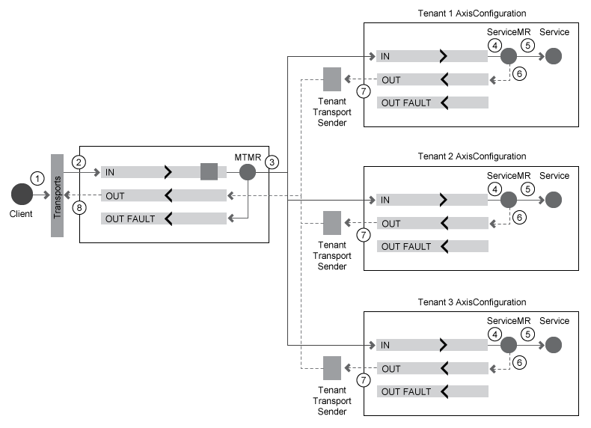
Multi-tenant Message Receiver

Slide 31
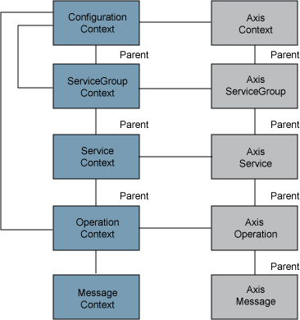
Axis2 Configuration & Contexts

Slide 32
Tenants & Super Tenant
Tenant: foo.com
Super Tenant
Tenant: bar.com

Slide 33
Pluggable Deployers
Deployment Engine
Webapp
POJO Services
Data
Services
JAXWS
Services

Slide 34
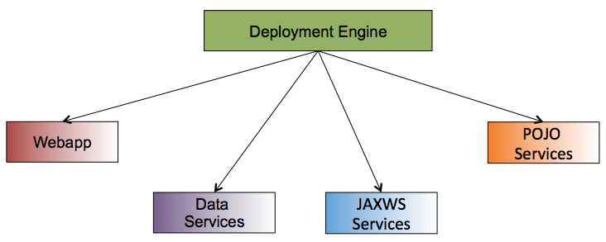
Pluggable Deployers
Tenant: foo.com
Super Tenant
Tenant: bar.com

Slide 35
Ghost Artifact Deployer
Lazy loading deployment artifacts
Load the tenant configuration & only the required artifact
Unload artifacts & tenants after a period of inactivity

Slide 36
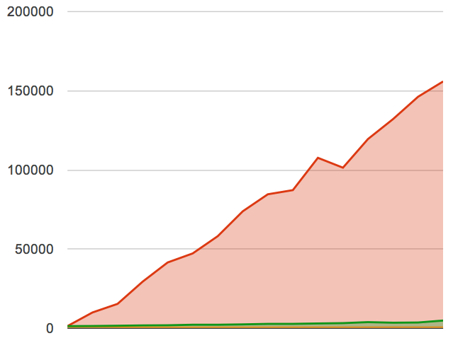
Ghost Artifact Deployer - Performance
Initial Response Time (ms)
Number of artifacts

Slide 37
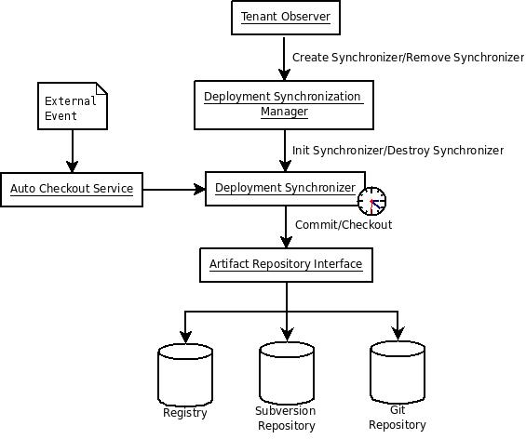
Deployment Synchronizer

Slide 38
Tenant-aware Security Manager
Main security manager delegates security verifications to tenant level security managers
Different tenants can have different security policies
Security policies are tied to the multi-tenancy package assigned to the tenant

Slide 39
Logging

Slide 40
Distributed Logging
Every service and custom applications logs are captured by the log4j/commons loggings settings
Logs are partitioned & stored by tenant
Logs are sent to the Manager service via syslog
Logs are then viewable / downloadable by tenant admins

Slide 41
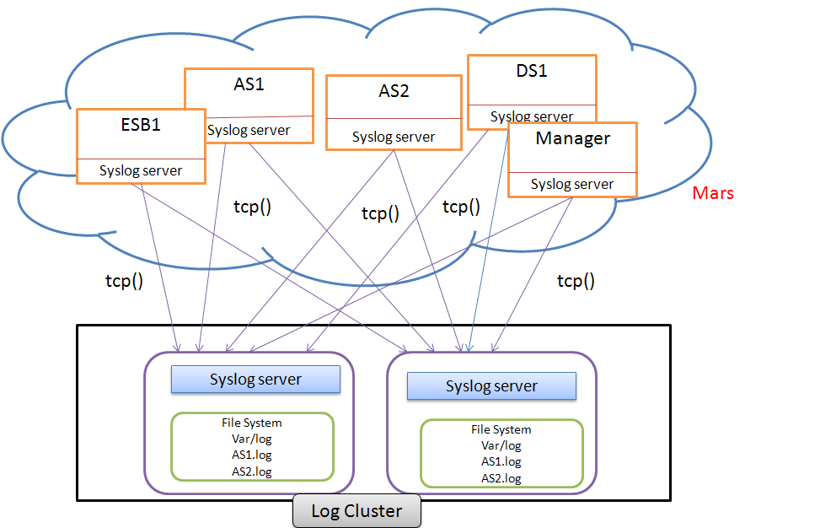
MT-Logging Deployment Architecture

Slide 42
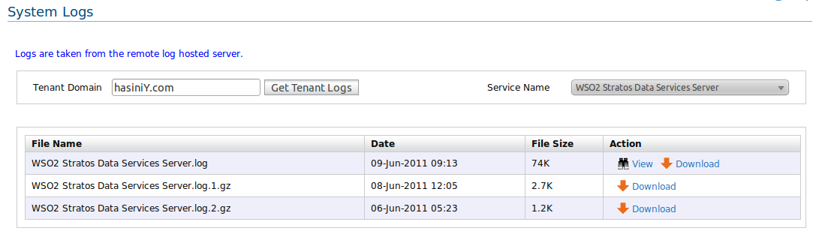
Log Viewer – Stratos Manager {Super-Tenant}

Slide 43
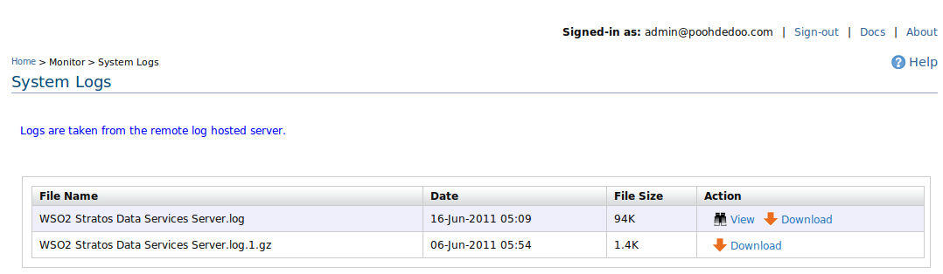
Log Viewer – Stratos Data Services Server {Tenant User}

Slide 44
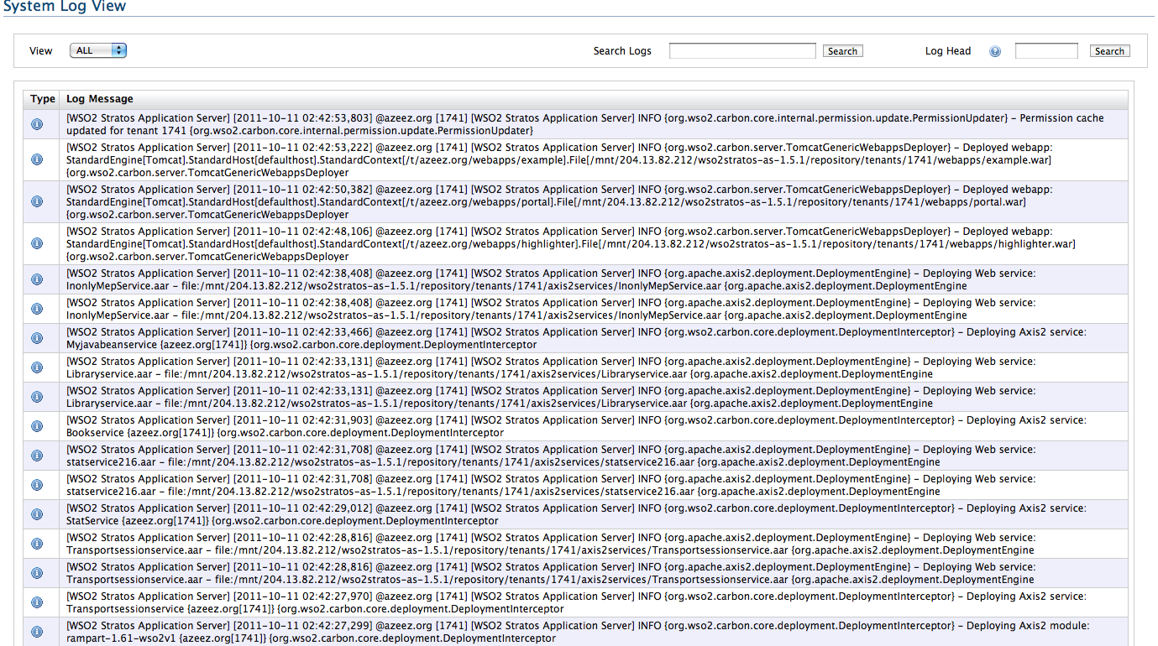
AppServer Logs

Slide 45
Data & Storage

Slide 46
WSO2 Cloud Data Solutions
WSO2 Data Server
Carbonized Cassandra Cluster
Database cluster
Carbonized HDFS Cluster
<Data> PaaS Offerings
Apache Cassandra as a Service
Relational Database as a Service
HDFS as a Service
We are also planning MapReduce as a Service as Future work.

Slide 47
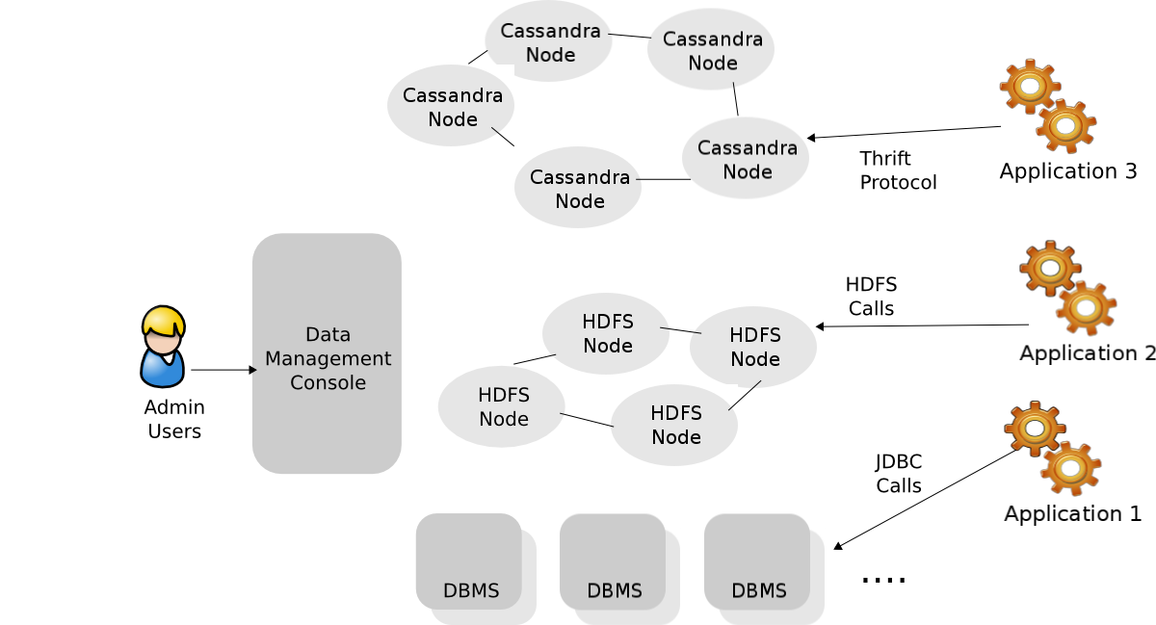
Polyglot Data Architecture

Slide 48
Metering & Billing

Slide 49
Metering
Each services collects
Number of service calls
Request/response bandwidth
Registry bandwidth (upload, download)
Total registry space usage
Send above to BAM publishers, which sends the data to the BAM Service
BAM summarizes periodically
Summarized data will be centrally accessible

Slide 50
Throttling
Restrict tenants from using more than the allocated resources, depending on the usage plan
Number of users per tenant
Storage space
Number of requests to webapps, services etc

Slide 51
Usage Metering/Throttling
Number of users
Incoming and outgoing bandwidths
Request Response count

Slide 52
Billing
Scheduled invoice generation
Ability to view past invoices and the current(interim) invoice
Securely pay the invoice via Paypal
Notifies the customer via email on received payments
Notifies the super-admin on customers exceeding the credit limit
Presents a summary view to the super-admin

Slide 53
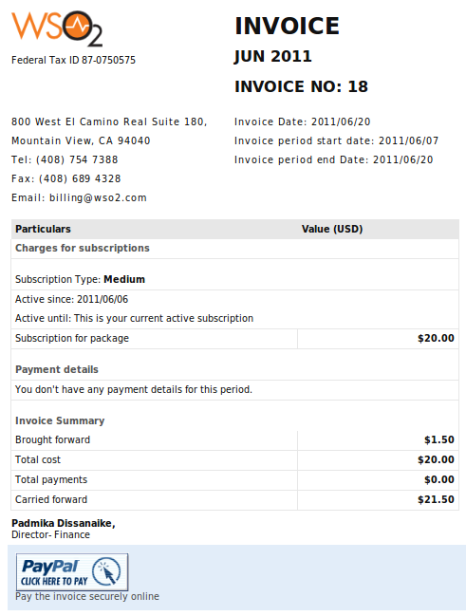
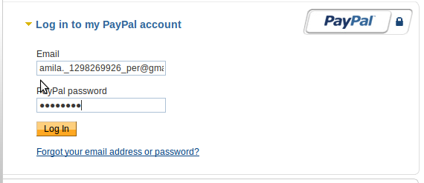
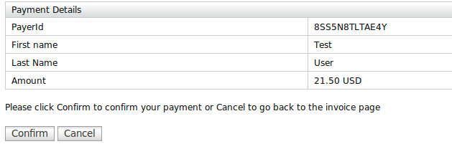
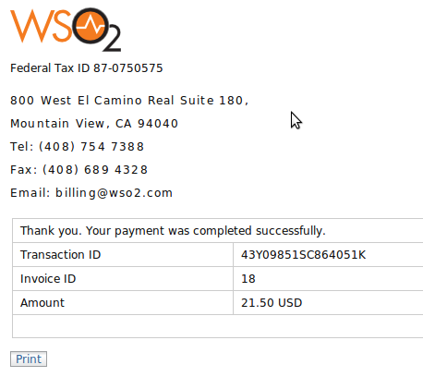

Slide 54
Recap
Attributes essential for an AppServer running on the Cloud
Elasticity, user management, data, logging, metering, throttling, billing
How Tomcat, Axis2 & Synapse were used to build a cloud-native AppServer

Slide 55
Questions?

Slide 56
Thank You!
Notes:
56

