Slide 1
Rapid and flexible clinical data extraction and processing using Apache OODT
Ricky Nguyen
rnguyen@chla.usc.edu
CHLA, VPICU

Slide 2
Overview
What is the VPICU?
Gathering Clinical Research Data
Applying Apache OODT
Benefits of OODT
Future Work

Slide 3
What is the VPICU?
Laura P. and Leland K. Whittier
Virtual Pediatric Intensive Care Unit
Founded in 1998
Funded by Whittier Foundation, Federal Grants
Multidisciplinary Team (clinicians, clinical researchers, statisticians, computer scientists, etc)

Slide 4
What is the VPICU?
To create a common information space for the international community of care givers providing critical care for children.
Every critically ill child will have access to the Virtual PICU which will provide the essential information required to optimize their outcome.

Slide 5
What is the VPICU?
Leverage information technologies to improve care
Quality improvement
Support critical care research
Data-driven discovery and decision support

Slide 6
What is the VPICU?
Leverage information technologies to improve care
Quality improvement
How does my institution compare with others?
Support critical care research
Does pre-operative drug X prevent bradycardia?
Is shock index (SI = HR/SBP) predictive of mortality?
Data-driven discovery and decision support
How does my current patient compare to those for whom the outcomes are known?

Slide 7
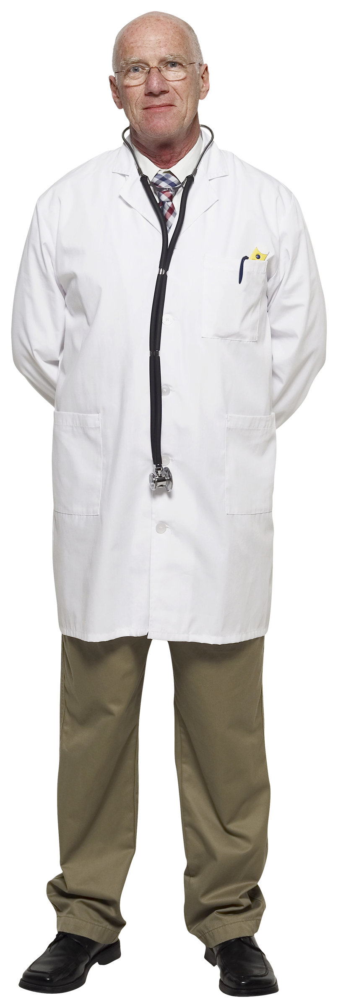
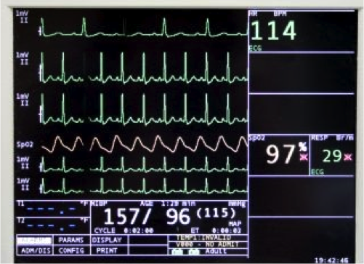
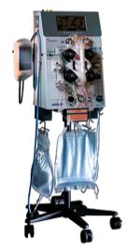
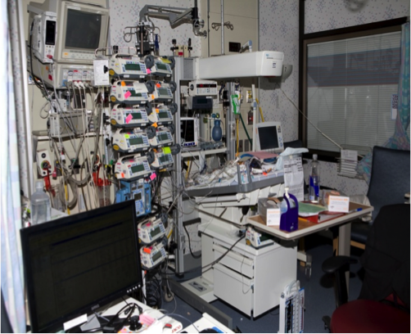
Gathering Research Data
EHR

Slide 8
Gathering Research Data
EHR
???

Slide 9
Data Sources (and their issues)
Electronic Health Records (EHR)
Cerner KIDS (proprietary formats, hospital-wide)
ICU Flowsheets
Philips CareVue (decommissioned systems)
Homegrown applications
PICUDB (supplementary/redundant/inconsistent)
Bedside monitor data
Philips IntelliVue (high volume, associated by bed)
Anesthesia operative data
Philips CompuRecord (proprietary formats)

Slide 10
Clinical Data Challenges
Secondary use
Many data sources and technologies
Massive amounts of data, and growing
Proprietary formats
Missing, Incomplete, Inconsistent
Restrictions on use
Legal, ethical, privacy considerations (HIPAA)

Slide 11
Gathering Research Data
EHR
???

Slide 12
Gathering Research Data
EHR
Met
Met
Data
Data
Met
Data
Met
Met
Data
Data
Met
Data
Met
Met
Data
Data
Met
Met
Data
Data

Slide 13
Applying Apache OODT
OODT XML Product Server
OODT Crawler
OODT File Mgr OODT Catalog (Lucene)
OODT Workflow Mgr
EHR
Met
Met
Data
Data
Met
Data
Met
Met
Data
Data
Met
Data
Met
Met
OODT Workflow Tasks
OODT PGE Tasks
Data
Data
Met
Met
Data
Data
Heterogeneous
Data Products

Slide 14
Applying Apache OODT
XML PS (with Tomcat), Crawler (with Tika)
Extract, decouple from data sources
File Mgr, Catalog (with Lucene)
Archive data products and catalog metadata
Workflow/PGE tasks
Transform data products
Annotate with metadata toward common model
Management utilities (Wicket, Tomcat, etc)
Workflow Manager, Resource Manager, Curator, PCS OpsUI, Workflow Monitor

Slide 15
Benefits of OODT
Loose coupling, modular
Highly configurable
Quick iteration
Annotate data products with common metadata
Easy integration with Apache toolset
Access to community expertise and support

Slide 16
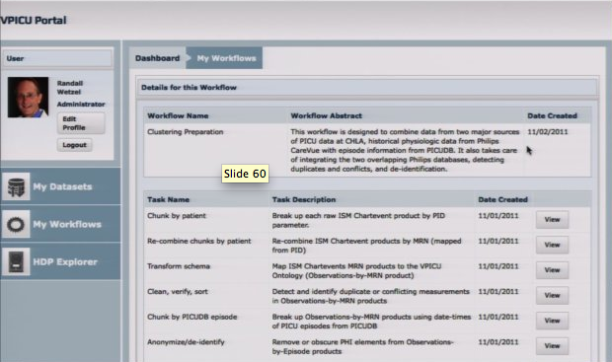
Future Work
OODT XML Product Server
OODT Crawler
Data Access/Sharing Web Portal
OODT Grid
Product Server
Profile Server
Query Handler
OODT File Mgr OODT Catalog (Lucene)
OODT Workflow Mgr
EHR
Met
Met
Data
Data
Met
Data
Philadelphia
Los Angeles
Met
Met
Data
Data
Met
Data
OODT Query Services
Met
Met
OODT Workflow Tasks
OODT PGE Tasks
Data
Data
Oakland
Atlanta
OODT Grid
Product Server
Profile Server
Query Handler
Met
Met
OODT Grid
Product Server
Profile Server
Query Handler
Data
Data

Slide 17
VPICU Team

Slide 18
More info…
http://mucmd.org/
Twitter:
@vpicu
@mucmd
Facebook Pages:
Virtual PICU
Meaningful Use of Data
CBMS 2011
An Informatics Architecture for the Virtual Pediatric Intensive Care Unit
rnguyen@chla.usc.edu

Slide 19
VPICU Team
Clinical Researchers - CHLA
Randall Wetzel
Roby Khemani
Patrick Ross
Sarah Rubin
Jeff Terry
Computer Scientists - CHLA
Paul Vee
David Kale
Ricky Nguyen
Sheryl John
Data systems and software architecture
Dan Crichton, NASA JPL
Chris Mattmann, NASA JPL, USC
Andrew Hart, NASA JPL
Cameron Goodale, NASA JPL
Large-scale statistical analysis
Amy Braverman, NASA JPL, UCLA
Human-computer interaction, visualization
Jeff Heer, Stanford
Diana MacLean, Stanford
Pia Pal, Stanford
Machine Learning, similarity search
Ben Marlin, UMass Amherst
Artificial Intelligence, probabilistic models
Christian Shelton, UC Riverside
Busra Celikkaya, UC Riverside

