Slide 1

A multi-tenant Architecture for Apache Axis2

Slide 2
A multi-tenant Architecture for Apache Axis2
Afkham Azeez
azeez@{apache.org , wso2.com}
WSO2 Inc
Senaka Fernando
senaka@{apache.org, wso2.com}
WSO2 Inc

Slide 3
About the Presenters
Afkham Azeez
PMC member Apache Axis, Committer Synapse & Web Services
Member, Apache Software Foundation
Co-author, Axis2 Web Services
Director of Architecture, WSO2 Inc
Blog: http://blog.afkham.org
Senaka Fernando
PMC member Apache Axis & incubator, committer Web Services
Member, Apache Software Foundation
Product Manager & Associate Tech Lead, WSO2 Inc
© WSO2 2011
Notes:
3

Slide 4
Agenda
Core Axis2 architectural concepts
How Axis2 has been multi-tenanted

Slide 5
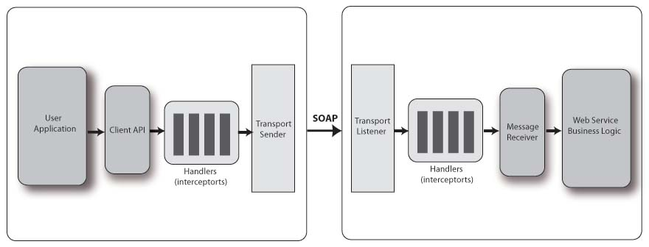
What is Axis2?
Axis2 is a Web Services engine
Successor to the widely used Apache Axis SOAP stack.

Slide 6
Message Handling
To fully support the Web services stack (including WSRM, WSSec, WSSecureConversation, etc)
We need to support a pluggable message handling model
Transport
Service
Implementation
handler
SOAP message

Slide 7

Composability

Slide 8
Composability
The whole architecture of WS-* has been designed around this model
Use what you need
And no more
Don’t replicate technology in different standards
All the standards should work together

Slide 9
Basic Composability
WS-Security
WS-ReliableMessaging
WS-AtomicTransactions
Transactional
Secure
Transactional
Secure
Reliable
Transactional
Secure
Reliable
Reliable

Slide 10
Composability
SOAP Headers that work together
Common usage of base components
SOAP
WS-Addressing
The right building blocks, e.g.
Reliable pub/sub
WSRM + WS-Eventing
Secure Single Sign-on
WS-Trust + WS-Security

Slide 11
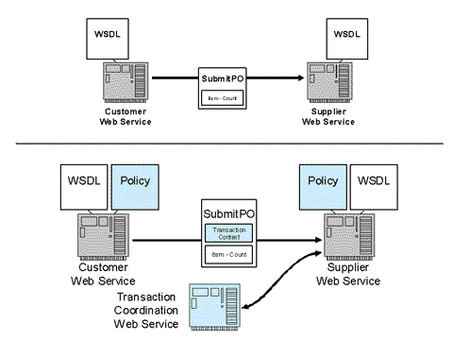
Composability example

Slide 12
Composability
The aim is to be able to plug in different capabilities independently
For example:
Add reliable messaging support and security at the same time
However, the combinations can be complex
Validate the signature
Store the message
Decrypt the body
Invoke the service

Slide 13
Axis2 and composability
Axis1 had a simple handler chain model
The only way to compose different handlers was to manually add and get the order correct
Axis2 has a more flexible model; that means adding a new capability is just a matter of plugging in a module

Slide 14
Phases, Modules, Handlers
Transport
In
Pre-
dispatch
Dispatch
Post-
Dispatch
Phase rule
handler1
handler2
Module
Axis2

Slide 15
Type of Phases
Global phases
Handlers in these phases always run irrespective of the service
Transport, Security, PreDispatch and Dispatch are considered as global phases
These are defaults in the standard axis2.xml
Service phases
Any phase that runs after Dispatch phase
Handlers in these phases are specific to the service

Slide 16
Axis2 – Run Time
Message Context
Engine
XML
Message
Transport
Phase X
Application
Phase Y
Phase Z
Message
Receiver
Notes:
Skills Matter – 2006 16

Slide 17
Axis2 – Inside Message Context
MessageContext abstract class
<soap:Envelope> <soap:Body> <myNS:OrderSushi> ... </myNS:OrderSushi> </soap:Body> </soap:Envelope>
Execution Chain
Handlers
“property1”
Boolean.TRUE
“property2”
someObject
Property Bag
Message
Pointers to OperationContext, ServiceContext, ConfigurationContext
Notes:
Skills Matter – 2006 17

Slide 18
Stages of Message Processing
Three important stages
Transport Receiver
Transport related processing
Dispatching
Finding service and operation
Message Receiver
Last handler of the chain

Slide 19
Dispatching
Two aspects of dispatching
Finding the corresponding descriptions
Finding the corresponding contexts
Default dispatchers
AddressingBasedDispatcher
RequestURIBasedDispatcher
SOAPActionBasedDispatcher
SOAPMessageBodyBasedDispatcher

Slide 20
Message Receiver
The last handler of the execution chain
Message Exchange Pattern (MEP) dependent
Does the actual business logic invocation
Ability to write custom Message Receivers
Some default Message Receivers
RawXMLINOnlyMessageReceiver
RawXMLINOutMessageReceiver
RPC*MessageReceiver

Slide 21

MessageReceiver

Slide 22
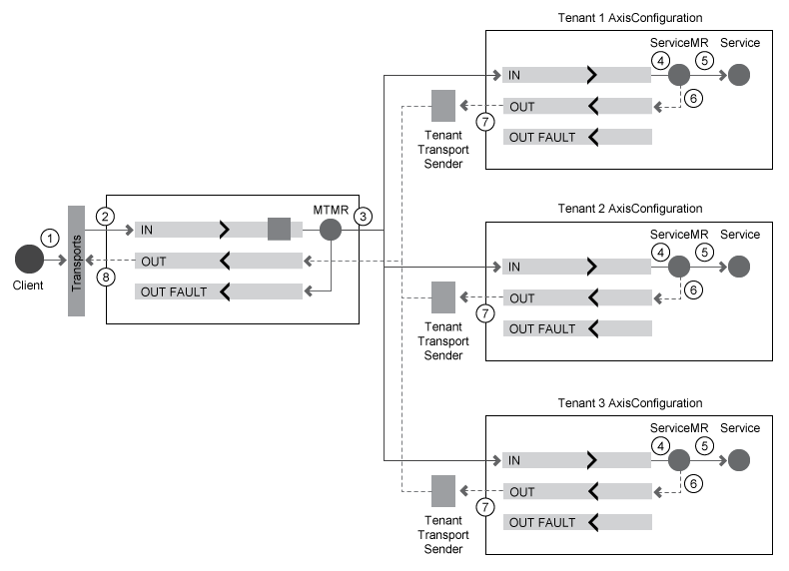
Multi-tenant Message Receiver

Slide 23
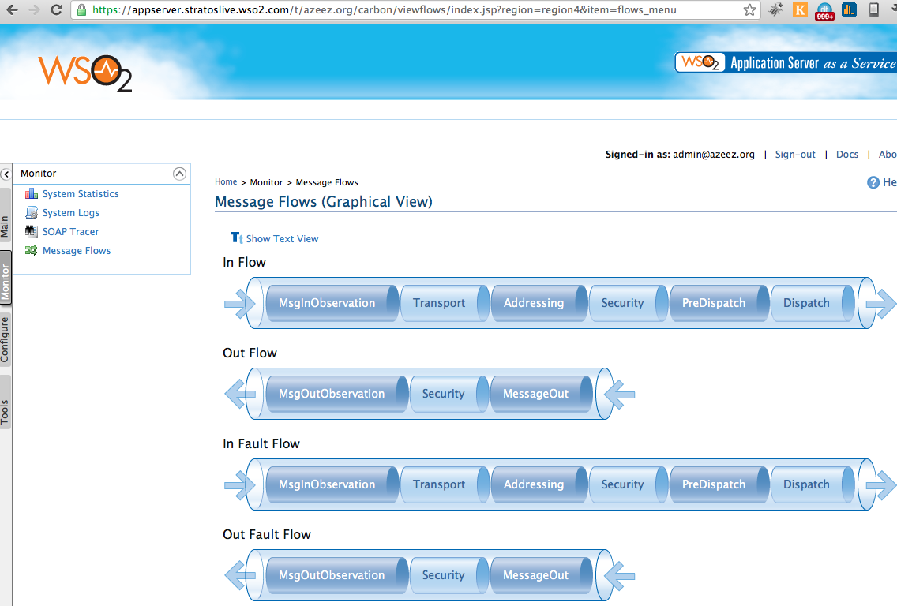
Tenant-specific Flow

Slide 25
Description & Context Hierarchy
Descriptions keep static information
Information extracted from deployment descriptors
An example is the class that a specific MessageReceiver will call
Contexts keep runtime information
This information needs to be managed for various scopes
For example session specific data
Essential to keep them separate! :)
Notes:
Senaka will continue from here

Slide 26
Context Hierarchy
ConfigurationContext:
Is the runtime representation of the whole system.
To start Axis2 system you need to have configuration context.
ServiceGroupContext:
To keep states of a service group throughout the session
A service group is simply a collection of related services
ServiceContext:
Will represent the run time of one service
The context lifetime will be the lifetime of the session.
OperationContext:
This context is to represent the lifetime of an MEP (Message Exchange Patterns)
MessageContext:
Represents the lifetime of an incoming or outgoing message

Slide 27
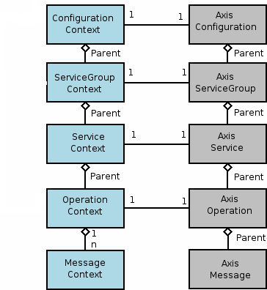
Context Hierarchy Cont…

Slide 28
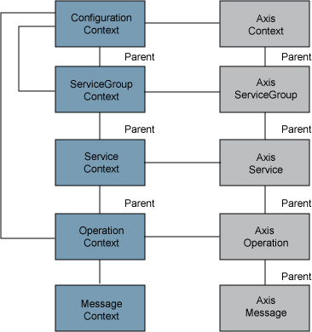
Tenants & Super Tenant
Tenant: foo.com
Super Tenant
Tenant: bar.com

Slide 29
Class Loading
Service isolation
Each service (in each tenant) gets its own class loader
For example two services can use two different versions of same third party library
Module isolation
Each module gets its own class loader
Modules can also be versioned
Different services can engage different versions of the same module

Slide 30
Axis2 Repository
axis2.repo
services
foo.aar
bar.aar
modules
abc.mar
xyz.mar

Slide 31
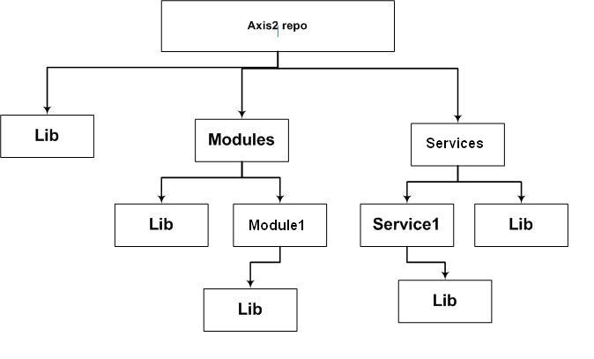
How Class Loading Hierarchy is Built

Slide 32
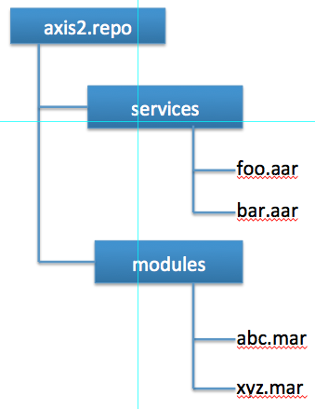
Tenant Axis2 Repo
Tenant: foo.com
Super Tenant
Tenant: bar.com

Slide 33
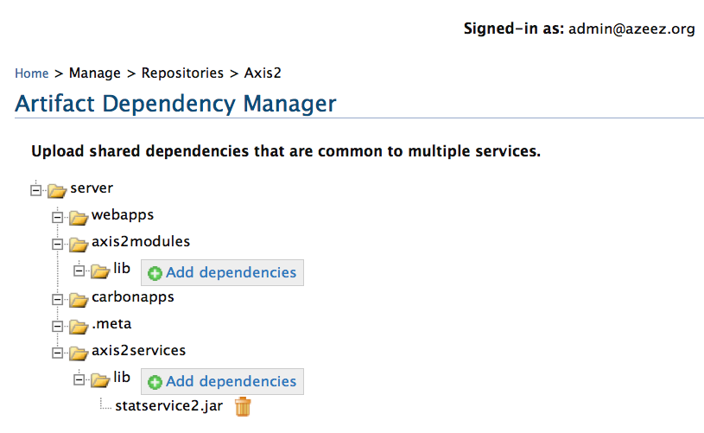
Tenant Axis2 Repo Management

Slide 34
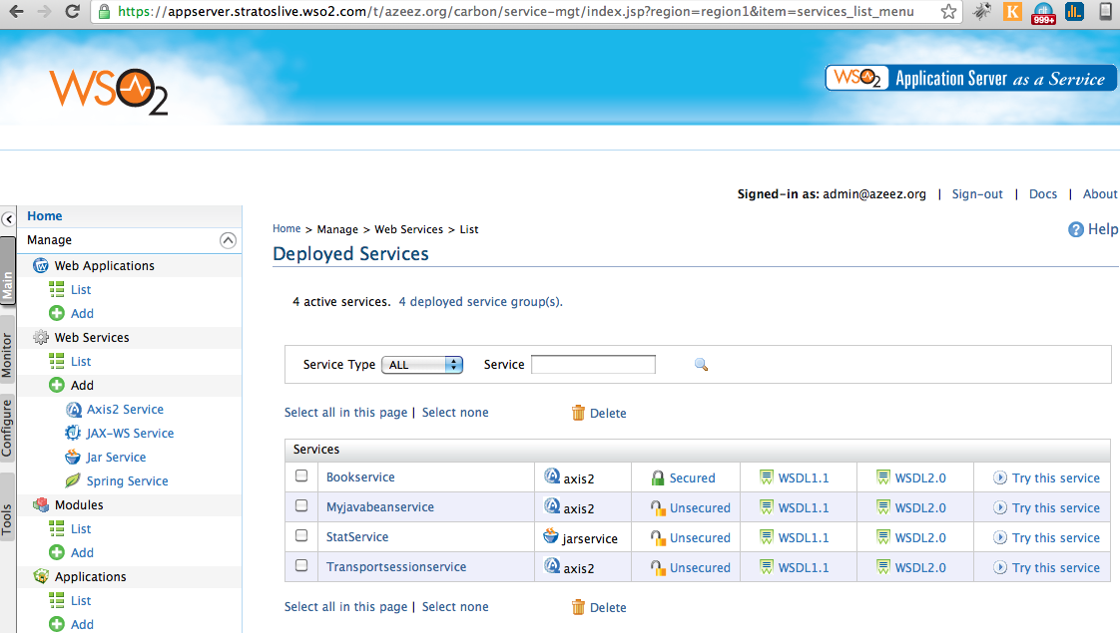
Tenant-specific Services

Slide 35
Pluggable Deployers
Deployment Engine
Webapp
POJO Services
Data
Services
JAXWS
Services

Slide 36
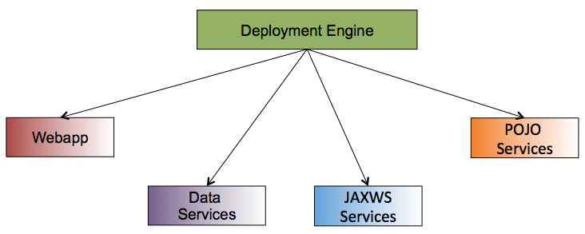
Pluggable Deployers
Tenant: foo.com
Super Tenant
Tenant: bar.com

Slide 37
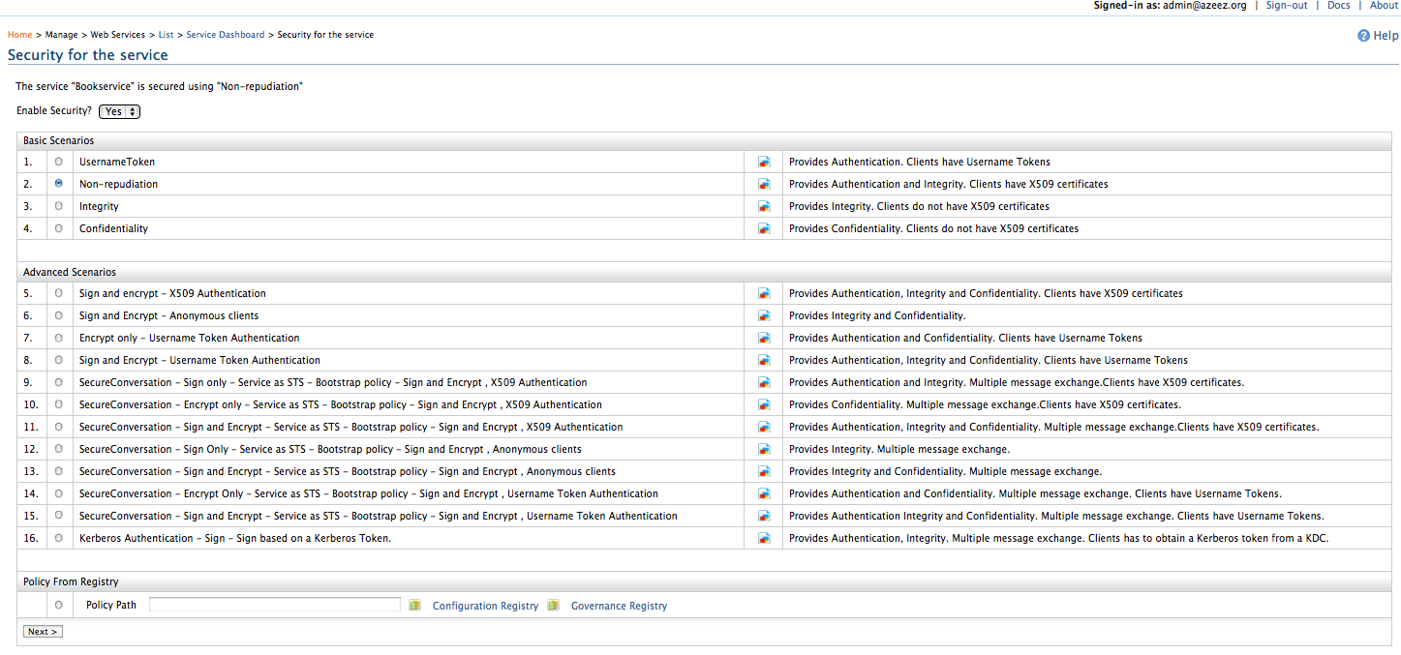
Securing Services

Slide 38
Lazy Loading
Tenant AxisConfiguration & ConfigurationContext are created only when required
If a tenant is inactive for sometime, these will be unloaded & GCd
Instances when lazy loading happens
First request received
Tenant management console is loaded
A scheduled tenant task is executed

Slide 39
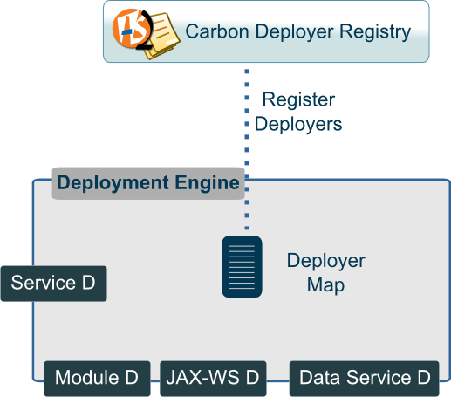
Ghost Artifact Deployer

Slide 40
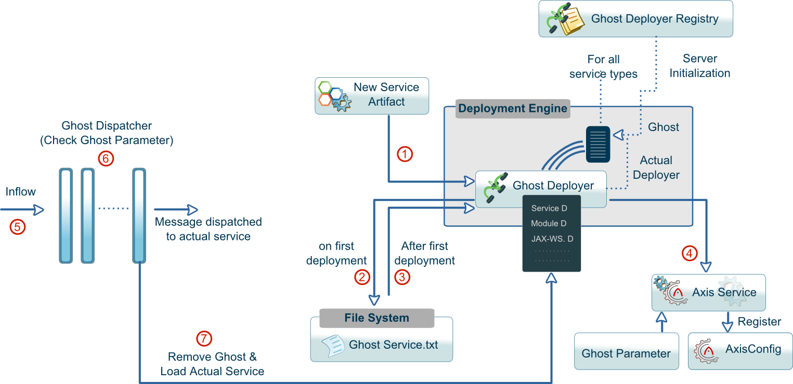
Ghost Artifact Deployer

Slide 41
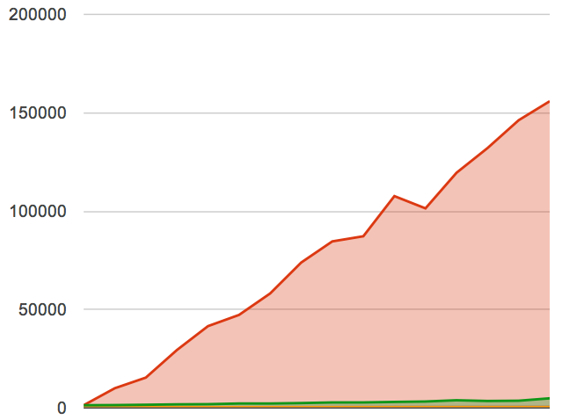
Ghost Deployer - Performance
Initial Response Time (ms)
Without GD
With GD
Number of artifacts

Slide 42
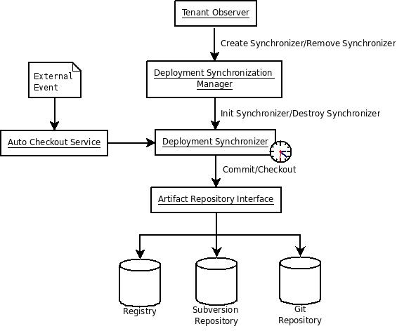
Deployment Synchronizer

Slide 43
Tenant-aware Security Manager
Main security manager delegates security verifications to tenant level security managers
Super tenant can enforce different security policies on tenants
Security policies are tied to the multi-tenancy package assigned to the tenant

Slide 44
Distributed Logging
Every service and custom applications logs are captured by the log4j/commons loggings settings
Logs are partitioned & stored by tenant
Logs are sent to the Manager service via syslog
Logs are then viewable / downloadable by tenant admins

Slide 45
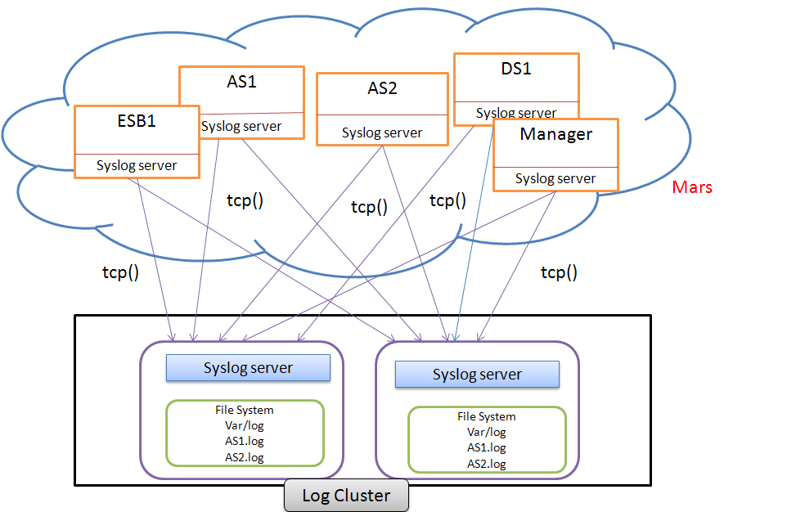
MT-Logging Deployment Architecture

Slide 46
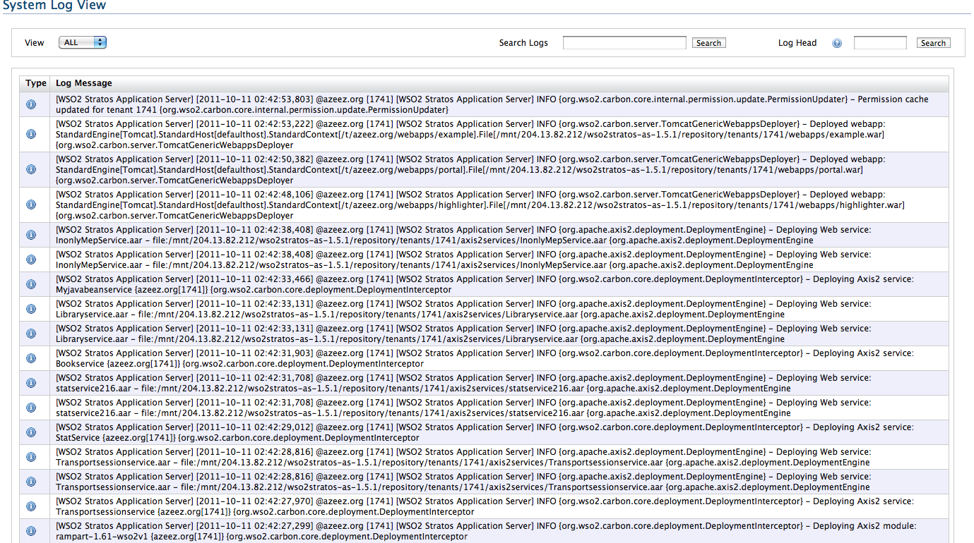
AppServer Logs

Slide 47
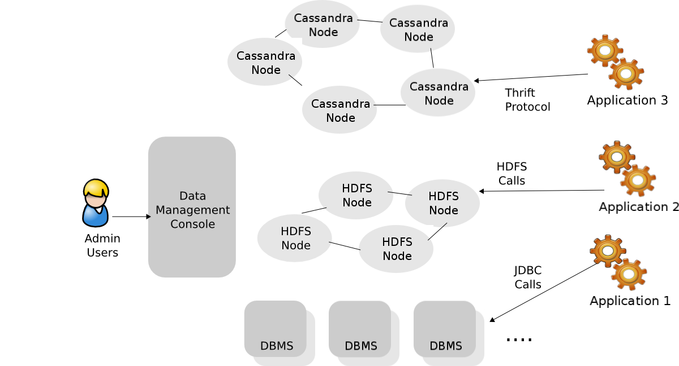
Polyglot Data Architecture

Slide 48
Metering, Throttling & Billing
Some of the key cloud-native attributes
In a multi-tenanted setup, you should be able to meter all important aspects
e.g. service request count, request/response sizes etc
You may decide to throttle certain aspects
You may decide to bill for certain aspects
e.g. bandwidth/CPU time usage

Slide 49
Recap
Axis2 concepts
Messaging, deployment, configurations & contexts
How Axis2 has been multi-tenanted
MultitenantMessageReceiver, lazy loading, ghost artifact deployer, data, logging, metering/throttling/billing

Slide 50
Questions?

Slide 51
Thank You!
Notes:
51

