Slide 1





Chefs with Feathers:
The Sakai Project
Carl Hall
Hallway Technologies
10 November 2011

Slide 2
What I Will Cover
My Background
Learning Management Systems
Sakai
History
Projects
OSS and academia

Slide 3
My Background
Co-owner, Hallway Technologies
Sakai OAE server team co-lead
2011 Sakai Fellow
Sling committer
Avid cyclist, software & music junkie
Godfather to 6
8 pets

Slide 4
Learning Management Systems
Online classrooms
Virtual Learning Environment
Collaborative Learning Environment
Modeled around brick and mortar institutions
Terms, classes

Slide 5
Learning Management Systems
Syllabus
Announcements
Messages
Assignments
Gradebook
Roster
Calendar
Tests & Quizzes

Slide 6
Learning Management Systems
Open Source
Sakai (Java)
Moodle (PHP)
Instructure (RoR)
Proprietary
Blackboard (Angel, WebCT)
Desire2Learn
Pearson OpenClass

Slide 7

Sakai CLE
Collaboration of Indiana, MIT, Michigan, Stanford
Michigan's “CHEF” name graduates to “Sakai”
v1.0 released in 2005
Used by over 300 institutions around the world

Slide 8
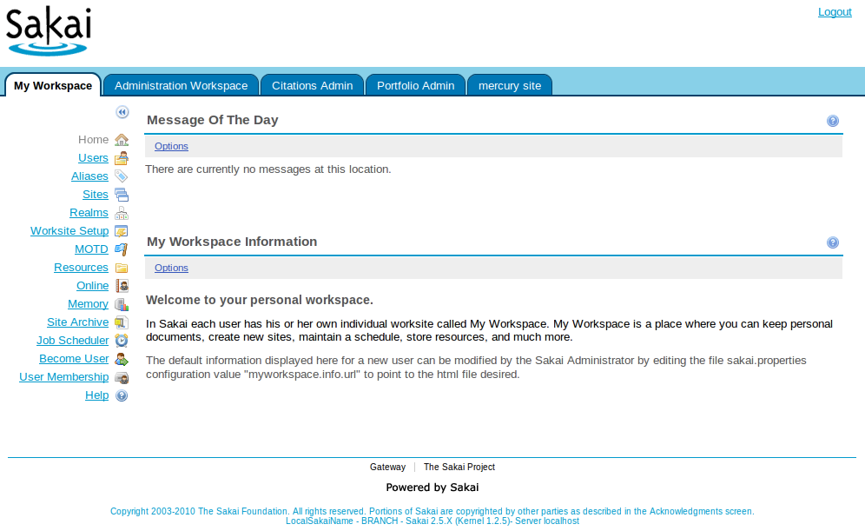
Sakai CLE

Slide 9
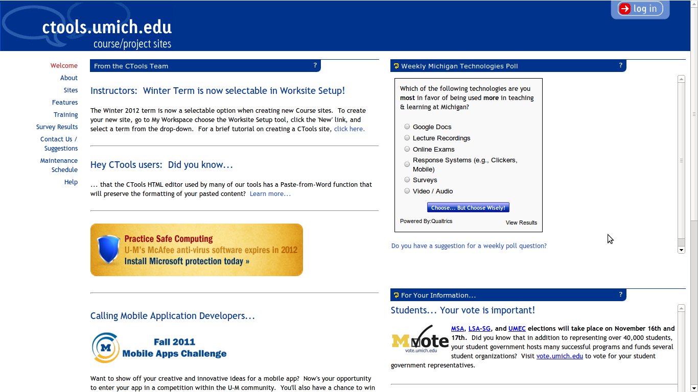
Sakai CLE

Slide 10
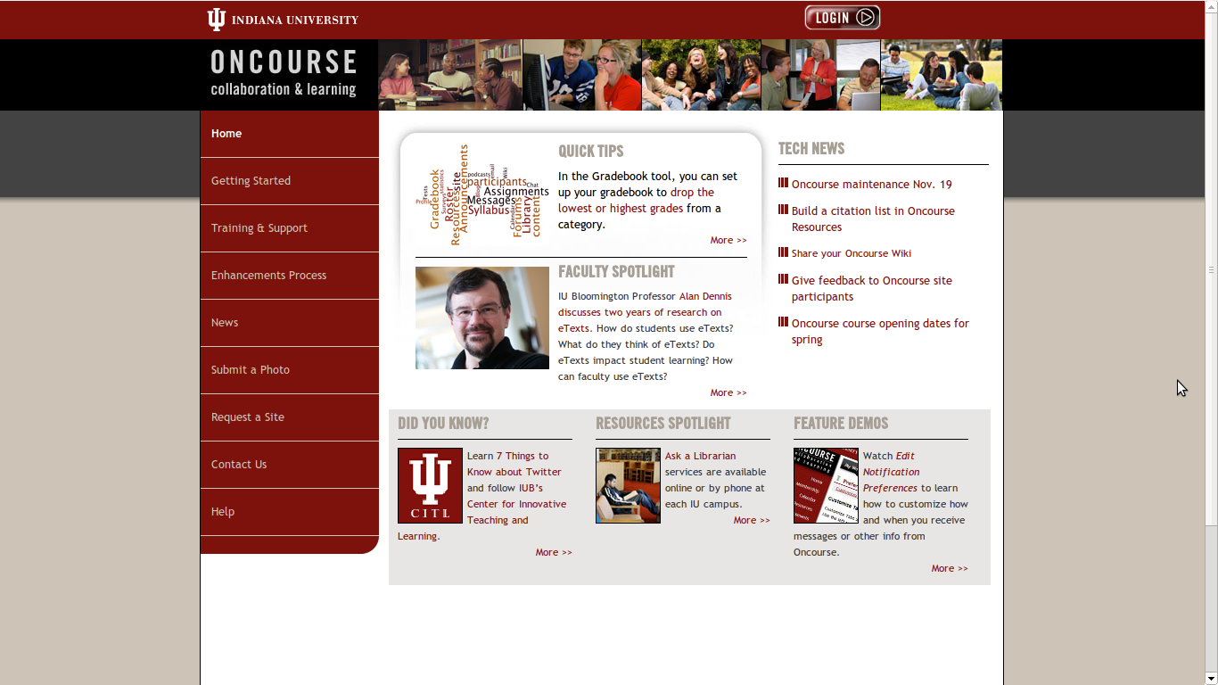
Sakai CLE

Slide 11
CLE - Under The Hood
Runs on Apache Tomcat
Wired together using Spring
Velocity, JSP, JSF, RSF, Wicket...
54 projects in core
340 subprojects in core
We love Apache
28 Apache projects
72 Apache artifacts

Slide 12
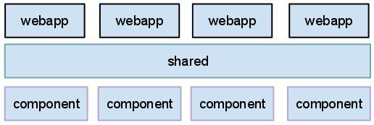
CLE - Under The Hood
Custom classloaders on top of Tomcat
shared tier
isolated services

Slide 13

Sakai OAE
Rethink, Redesign, Rewrite
Break the traditional LMS form
User always owns content
Promote sharing, openness, discovery
Academic social networking

Slide 14
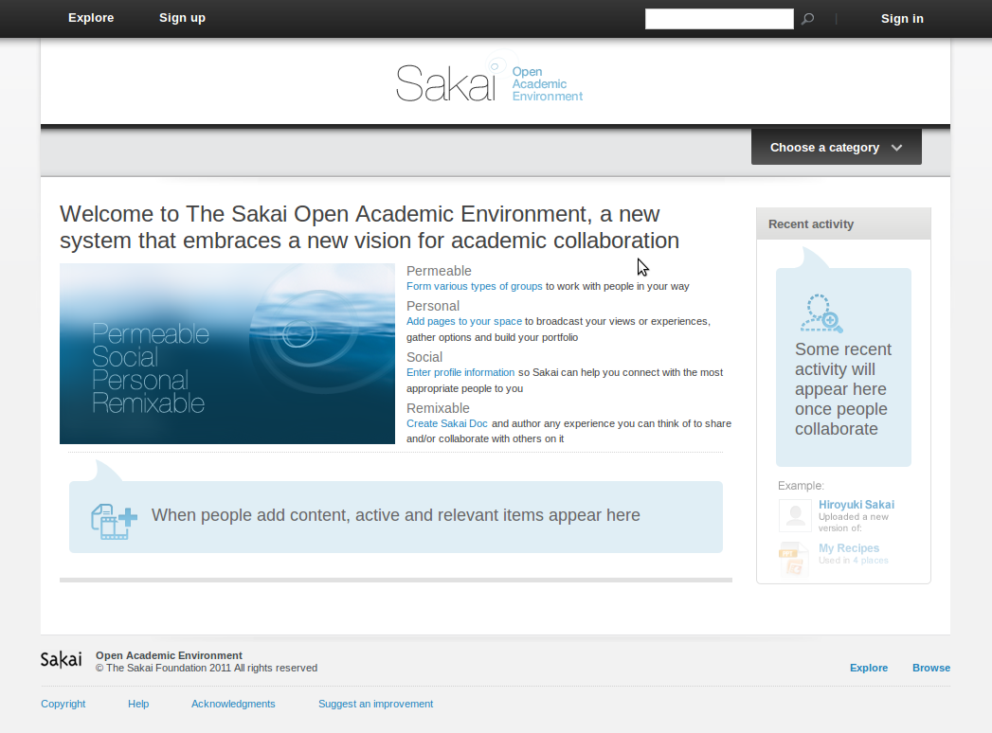
Sakai OAE

Slide 15
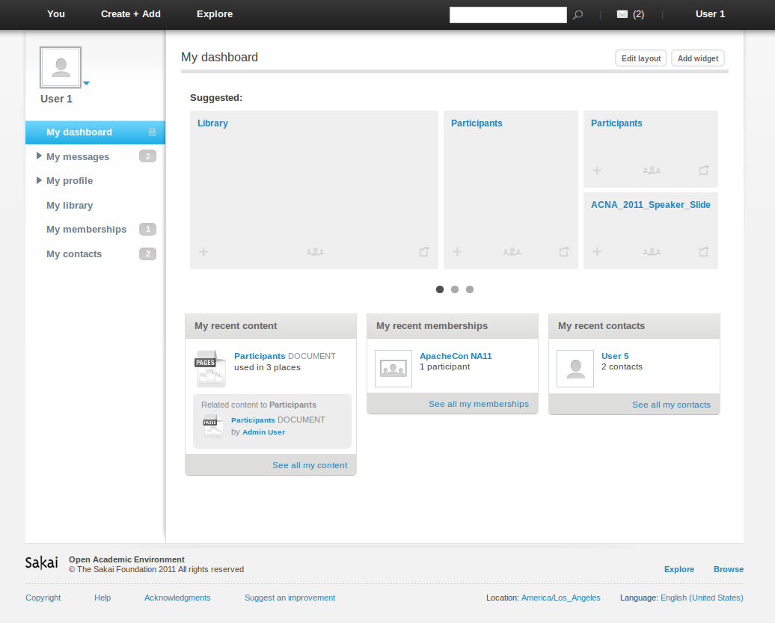
Sakai OAE

Slide 16
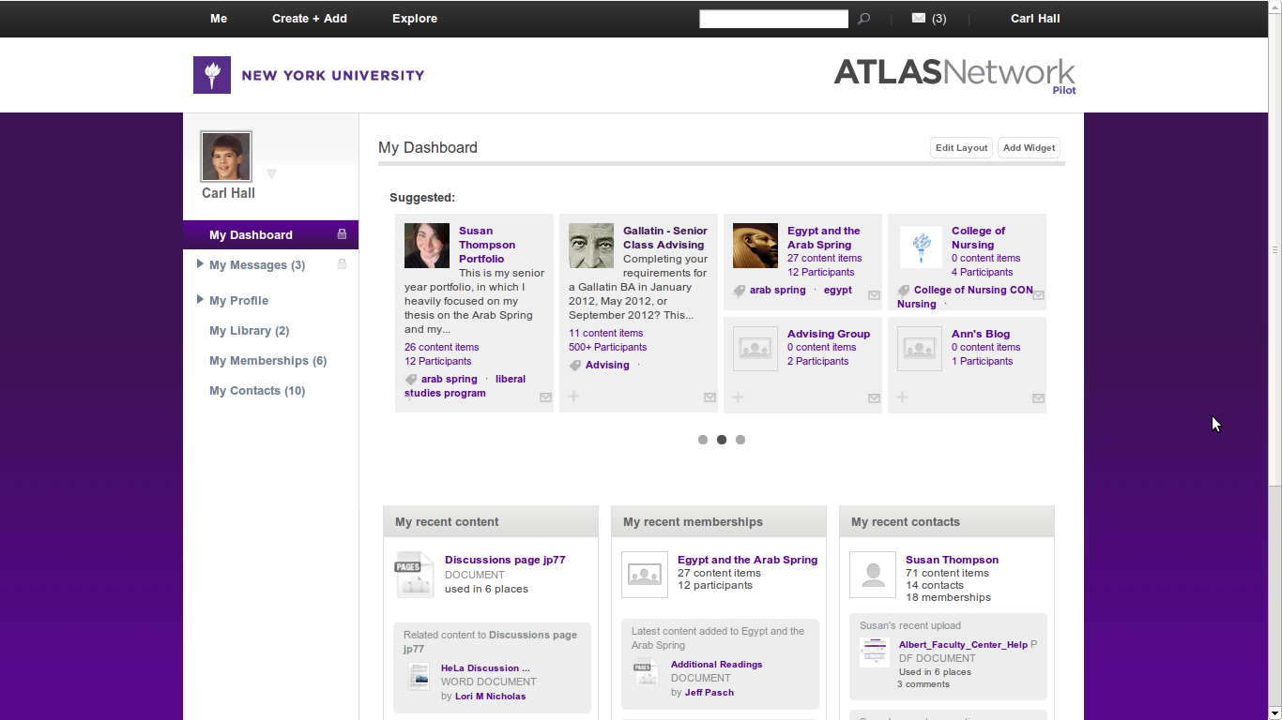
Sakai OAE

Slide 17
OAE - Under The Hood
Built on Apache Sling
56 core bundles
22 contrib bundle
Replaced JCR with storage shim
Deviated from hierarchical storage
Continued affair with Apache
41 Apache projects
237 Apache artifacts

Slide 18
OAE - Under The Hood
JSON feeds from server using REST
Client-side templating with JavaScript

Slide 19
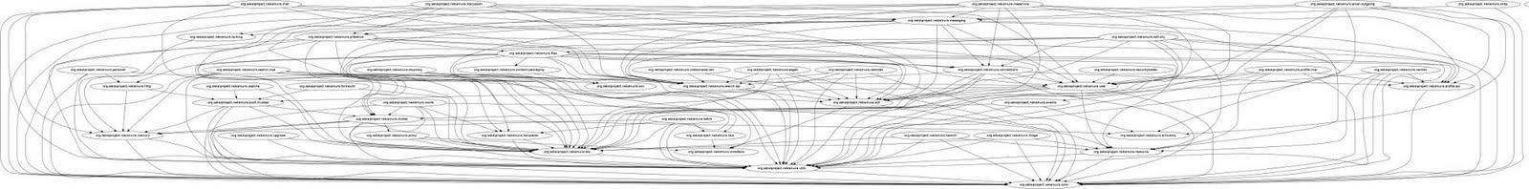
Dependency Graph

Slide 20
OSS Citizens
Report bugs
Contribute patches
Committers
Sling
Shindig
Velocity

Slide 21
Our House
Sakai Foundation
Community Source Software
Institutional & commercial contributors
Core maintainers
Tool maintainers

Slide 22
Our House
Foundation Board Members
Technology Coordination Committee
Steering Group
User Reference Group
Technology Reference Group
Dev team for each tool/project
51 mailing lists on collab.sakaiproject.org

Slide 23
Communication
Driven by deployers
Teaching & learning professionals
Professors
Students
Administrators

Slide 24

Why is an Open-source LMS important?

Slide 25
Learn From Academia
Share with your colleagues
Work together for non-financial goals
Research is valuable

Slide 26
Teach To Academia
Engage students in OSS
Collaborate solutions, not just results
Share early, share often
Become community citizens

Slide 27
Contact
Carl Hall
carl@hallwaytech.com
http://thecarlhall.wordpress.com

