Slide 1
Apache Airavata (Incubating) Gateway to Grids & Clouds
Suresh Marru smarru@apache.org, Nov 10th 2011

Slide 2
Outline
Introducing Airavata
High level architecture
Initial community
Potential synergies
Rave, Wookie
Axis2, ODE
OODT, Tikka
Oozie, Hadoop

Slide 3
My Background
Suresh Marru
Indiana University
Program Director, XSEDE Science Gateways
Area of interest
Distributed Systems, Grid & Cloud computing
Service oriented architectures & workflow systems

Slide 4
Airavata Mentors
Ate Douma
Paul Fremantle
Ross Gardler (Champion)
Chris A. Mattmann
Aleksander Slominski
Sanjiva Weerawarna

Slide 5
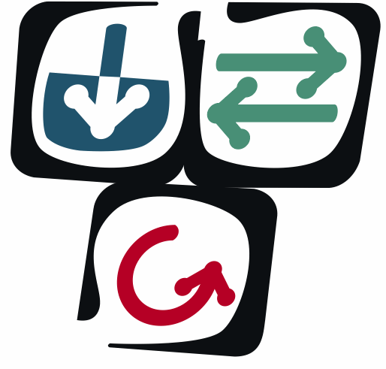
NSF TeraGrid Objectives
DEEP Science: enabling terascale and petascale science
make science more productive through an integrated set of very-high capability resources
address key challenges prioritized by users
WIDE Impact: empowering communities
bring TeraGrid capabilities to the broad science community
partner with science community leaders - “Science Gateways”
OPEN Infrastructure, OPEN Partnership
provide a coordinated, general purpose, reliable set of services and resources
partner with campuses and facilities
Notes:
DEEP- To ensure that we are harnessing the enormous power of the TeraGrid resources as an integrated system we have the Advanced Support for TeraGrid Applications (ASTA) program that involves our distributed user support team (~20 people across 8 sites, coordinated by GIG). The ASTA program places 1/4 to 1/2 of a support person in a scientific application team for 4 to 12 months, working with that team to exploit TeraGrid capabilities. The ASTA program supports roughly a dozen teams at a time, with a goal of 20-25 teams supported per year.
WIDE- For over 2 decades the NSF high performance computing program, including TeraGrid, has served several thousand users very effectively. However, NSF alone funds tens of thousands of scientists, most of whom have computational requirements that do not frequently require supercomputers. The TeraGrid Science Gateways program is a set of partnerships with discipline-specific teams who are providing computational infrastructure for their science communities. The partnerships involve integrating TeraGrid as a computational and data management “service provider” embedded in the science-community infrastructure. Over a twenty we portal style science gateways are part of this program, with more being added continually. In addition, this program includes a peer-grid interoperation effort with Open Science Grid and a desktop application effort that is leveraging an NIH-funded biomedical project directed by Rick Stevens at the University of Chicago.
OPEN- TeraGrid began as an infrastructure involving four partner sites, grew to nine sites, and is currently organized as a set of resource providers and a central “grid infrastructure group” (GIG) providing central services and support as well as management and operations. This structure allows TeraGrid to grow to dozens of resource provider sites, making it an “open” partnership. In addition, TeraGrid architecture is service-oriented, stressing open source standards such as are deployed with key software including the Globus Toolkit GT4, Condor, and other tools. In order to partner with the broader community of universities and other service and resource providers, TeraGrid is defining a set of “campus partnerships” during 2006. The goal of these partnership programs is to work with campuses (where most TeraGrid users reside) to improve and streamline TeraGrid access from campus systems, as well as to work with campuses to develop a set of frameworks that can be used to create national-scale cyberinfrastructure for computation and for data federation. These programs will explicitly reach beyond the R1 institutions to include the broader R&E community.

Slide 6
XSEDE Vision
The eXtreme Science and Engineering Discovery Environment (XSEDE) will:
enhance the productivity of scientists and engineers by providing them with new and innovative capabilities
and thus
facilitate scientific discovery while enabling transformational science/engineering and innovative educational programs
Notes:
Providing capabilities and services beyond flops
We provide the integrated environment allowing for the coherent use of the various resources and services supported by NSF.

Slide 7
Extended Collaboration for Science Gateways
ECSS: Support communities that wish to use XD resources via science gateways and/or data repositories
Gateway Software Incubator: Evaluates new software and makes recommendation to gateway community.
Gateway community building: Actively engage gateway developers in sharing experiences and learning from each other.
Gateway Helpdesk: Specialized personnel assist in gateway tickets.
XSEDE Interactions: Interface between gateway developers and XD architecture and operations groups.

Slide 8
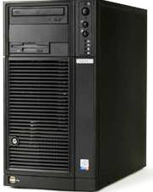
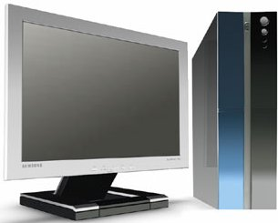
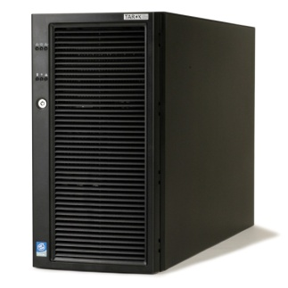
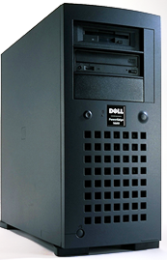
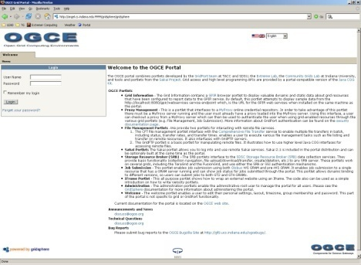
Using Grid Credentials from Portals
Grid Certificate(or proxy), username, password
MyProxy Server
Step 0
Workstation
Username, password
Grid Proxy
Username, password
Proxy, Job Request
Step 1
Job Status, Output
Job Submit or
File Transfer request
Output
Portal Interaface
Step 2,3,,
Gateway Server
Compute Servers

Slide 9
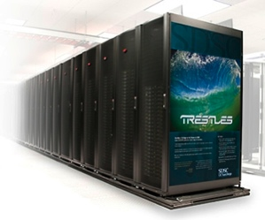
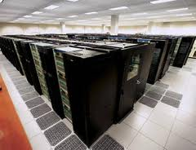
Abstractions
Gateway Frameworks
EC2 API
Globus
Unicore
Genesis 2
Globus
Load Leveler
Sun Grid Engine
LSF
PBS/Torque

Slide 10
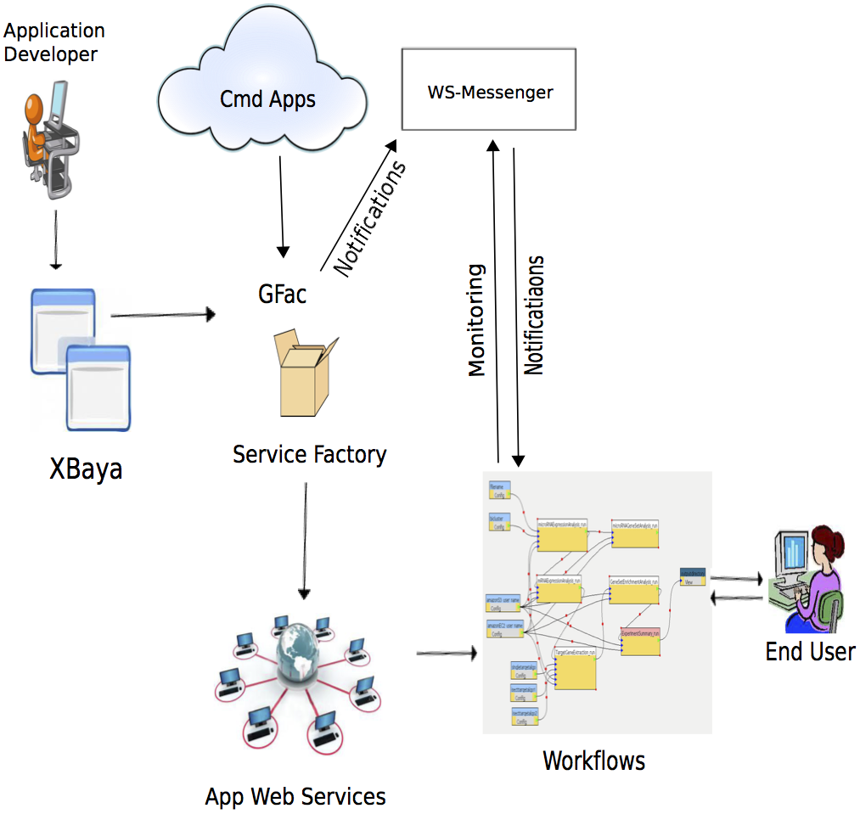
Airavata high level view

Slide 11
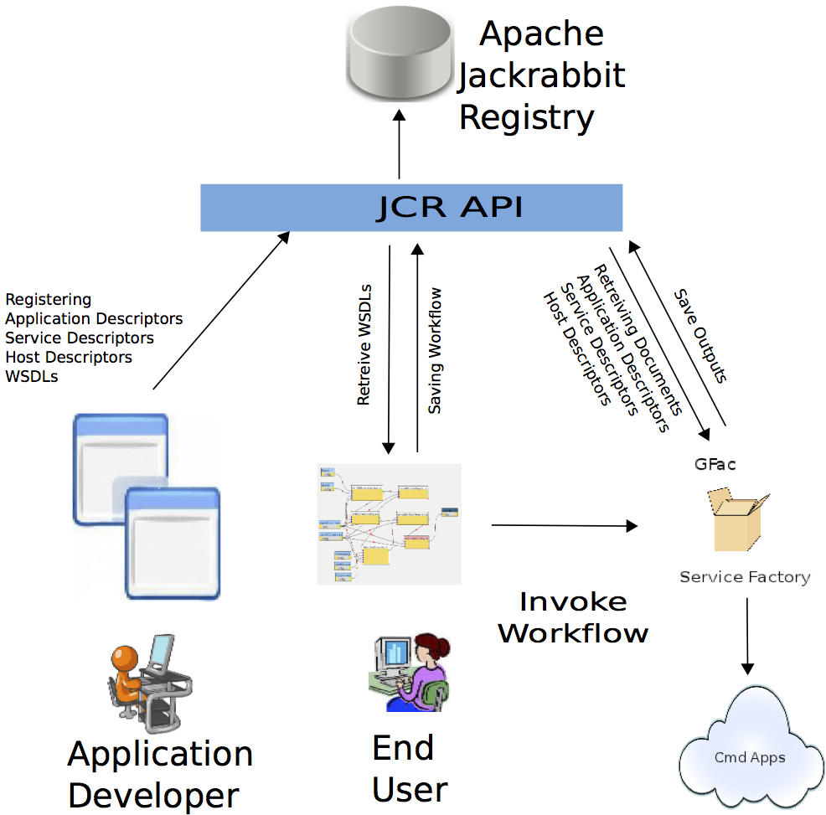
Registries

Slide 12
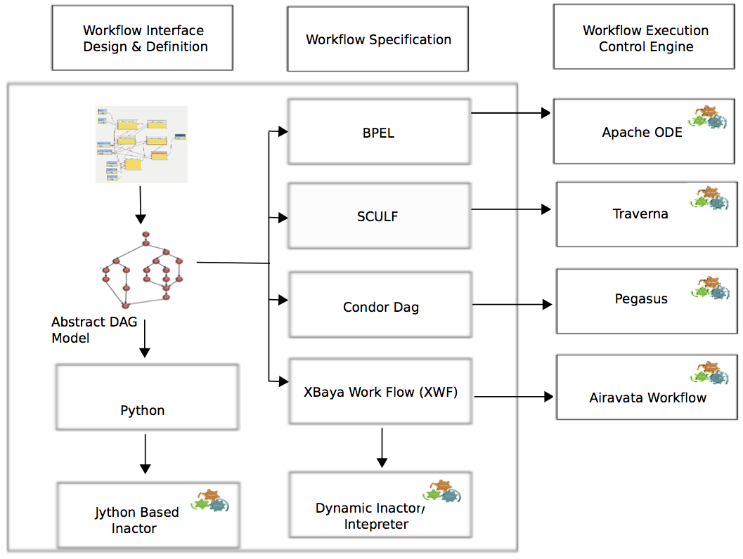
Airavata Workflow Architecture

Slide 13
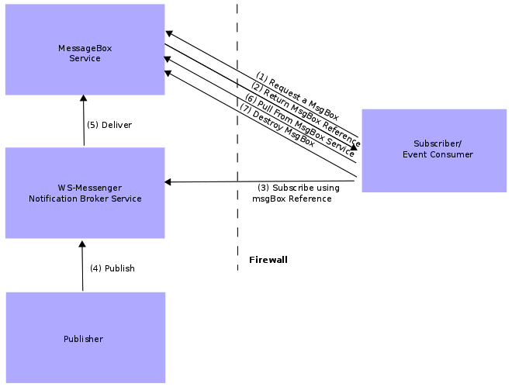
Airavata WS Messenger

Slide 14
Synergies with Apache Projects
Web Interfaces/gadgets/widgets – Rave
Web Service Engines – Axis2, CXF
Workflow Engines – ODE, Oozie
Distributed Infrastructures – Hadoop family
Data & Metadata management – Tikka, OODT
Registries and Searching – Jackrabbit, Lucene

Slide 15
Contact
Suresh Marru
smarru@apache.org
airavata-dev@incubator.apache.org
http://airavata.org

