Slide 1
ManifoldCF for Content Acquisition
Karl Wright, Nokia Inc. kwright@apache.org, 11/10/2011

Slide 2
What this presentation is about
An introduction to ManifoldCF
Presenter: Karl Wright, original ManifoldCF developer
Challenge: Getting content into a search engine, keeping it up to date, and securing it

Slide 3
Information about me
My name is Karl Wright
Principal Software Engineer at Nokia, Inc.
Former Principal Software Engineer at MetaCarta, Inc.
Core committer for ManifoldCF
Author of ManifoldCF in Action

Slide 4
ManifoldCF…
Pulls documents from disparate sources
Writes documents into the target(s) of your choice
Provides an end-user authorization mechanism
Synchronizes, doesn’t just crawl once!
Has bounded memory usage
Is reasonably performant
Is extendible to new kinds of repositories
Shows you what it is doing
Is resilient against restart

Slide 5
ManifoldCF vs. Nutch, Heritrix
 | Heritrix | Nutch | ManifoldCF
Tree operations? | No | Yes | Some
Web only? | Yes | Http, ftp, svn | All sorts of content
UI? | Yes | No | Yes
Restartable? | Painful | Uses Hadoop | Yes
Incremental? | Not really | Basic support | Yes
Max docs | “web scale” | 100,000,000 | Technically no limit; 10,000,000 tested (using postgresql)
Docs/sec | 80+ per instance | Scales as needed | 80+ per instance (using postgresql)
Memory bounded? | No | Uses Hadoop | Yes
Security model? | No | No | Yes

Slide 6
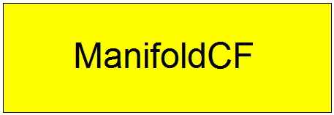
How does ManifoldCF fit?

Slide 7
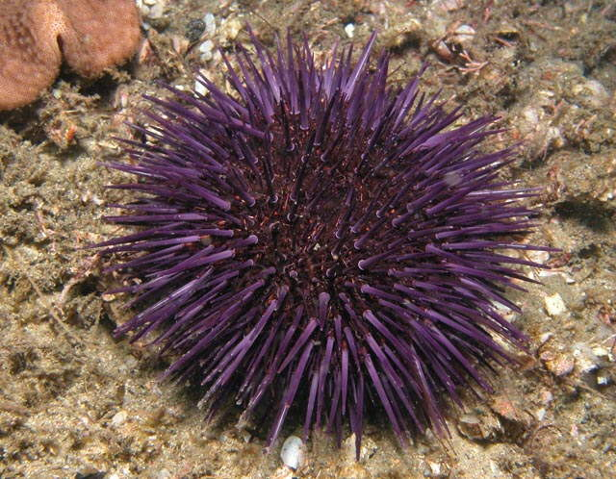
Just how many kinds of document repositories are out there?
File systems (CIFS too)
Windows shares
The Web (RSS too)
Wikis
Databases
CMIS repositories
SharePoint (Microsoft)
FileNet (IBM)
Documentum (EMC)
LiveLink (OpenText)
Meridio (Autonomy)
Many, many more

Slide 8
What is a connector?
A connector is code implementing an interface
ManifoldCF uses three kinds of ‘connector’
“Authority connector” understands a specific authorization entity, e.g. AD or LiveLink
“Repository connector” understands a specific content repository, e.g. Windows shares or Documentum
“Output connector” understands a specific output destination, e.g. Apache Solr or OpenSearchServer

Slide 9
Connections and jobs
A ‘connection’ is a configured instance of a ‘connector’ object
Connections are pooled
Max number of similar connections is configurable
Jobs describe “what” and “when”, not “how”
Has a repository connection and an output connection
Not really a task; but rather a set of documents

Slide 10
ManifoldCF Document Flow

Slide 11
ManifoldCF’s Crawling Models
Push vs. Pull
Observation: ‘Push’ model may require notifications to be queued ¹
Observation: ‘Push’ is no longer an option if ANY notification is overlooked ²
Observation: There are no real-world systems I’ve found that really support ‘push’!
ManifoldCF uses ‘pull’ exclusively right now
Notes:
If you don’t queue them, you slow down the repository’s “save” transactions
E.g. ACL changes don’t show up as a document change, so such repositories can’t notify you when document access changes

Slide 12
ManifoldCF’s Crawling Models, ctd.
For incremental ‘pull’:
Need to periodically identify documents that have ‘changed’ within a given time window
Changes include “add”, “modify”, or “delete”
Only a few repositories can tell you about “delete”
Connectors in ManifoldCF declare their ability to detect different kinds of changes

Slide 13
Continuous vs. Periodic Crawling
‘Continuous’ crawling
Can’t delete documents from index unless they are discovered missing on refetch
Can refetch or expire documents on a dynamic schedule
Can reseed, also on a schedule
‘Periodic’ crawling
MODEL_ADD_CHANGE_DELETE, MODEL_ADD, or MODEL_ALL
A MODEL_ALL connector is “stupid”, a MODEL_ADD_CHANGE_DELETE one is “brilliant”
Two kinds of cycle: Seeding, discovery/processing/indexing, (maybe) clean up
Complex decision as to which kind happens, based on both connector model and job state

Slide 14
Crawling models, graphic

Slide 15
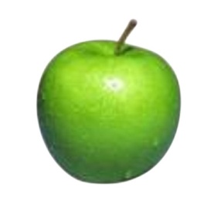
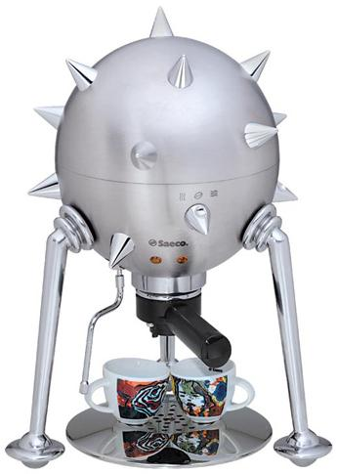
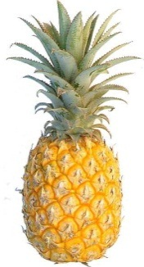
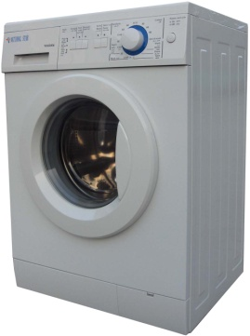
Dealing with Disparate Systems
Connection configuration stored as XML in the database
A job’s document specification and output specification are also stored as XML
Connector-defined unlimited strings for document identifier, document version, output version, access token
Connector provides UI for editing its configuration, specification

Slide 16
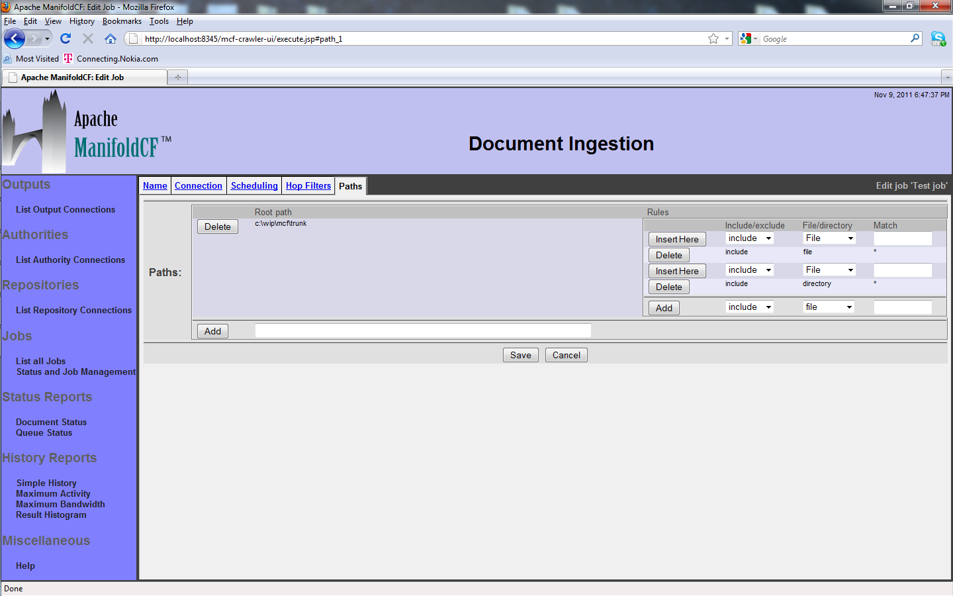
Example: File system job

Slide 17
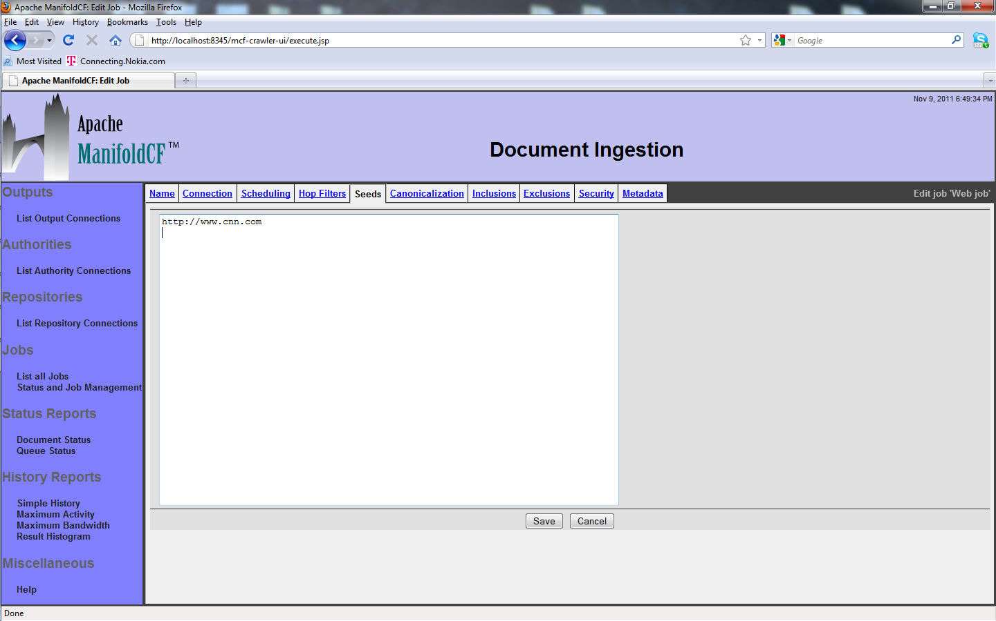
… vs. Web Job

Slide 18
MCF Process Architecture

Slide 19
ManifoldCF Authorization Requirements
Observation: Every repository has its own notion of document authorization
Observation: Most repositories are effectively ACL-based
Observation: Active Directory handles 95% of enterprise authentication
ManifoldCF idea: Enforce repository’s existing security model, rather than inventing something new

Slide 20
ManifoldCF Document Authorization
Observation: A separate crawl for each end user is not going to work
Observation: Post-filtering of search results has some nasty edge cases ¹
Observation: Document security doesn’t change very often ²
Observation: User changes should take effect immediately ³
ManifoldCF filters by search-engine query
Document access tokens are passed to the target
User access tokens are obtained at search time, via the MCF Authority Service
Notes:
(1) Imagine picking out 10’s of results from 1,000,000’s of candidates
(2) Thus, people don’t seem to expect search engine results to change without explicit update
(3) E.g. “user lockout”

Slide 21
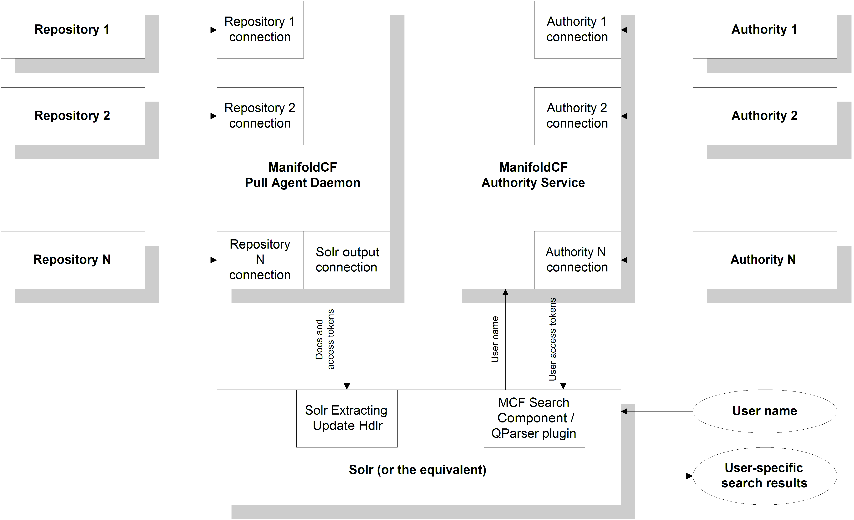
MCF Security Architecture

Slide 22
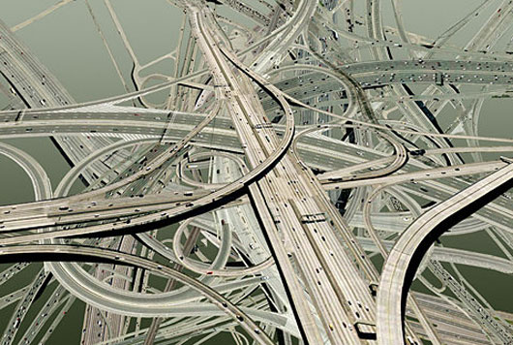
Securing Documents from Multiple Repositories
You can define multiple authority connections in ManifoldCF
Each authority connection supplies its own access tokens
Every repository connection has an MCF authority connection
All access tokens from an authority are qualified with the authority connection name

Slide 23
So how do I write a connector?
Write a class implementing an interface
IOutputConnector
IAuthorityConnector
IRepositoryConnector
Build and deploy
Register it, or add it to connectors.xml for the Quick Start
That’s it! You’re done!
Read ManifoldCF in Action if you want to do it right

Slide 24
Who has used ManifoldCF?

Slide 25
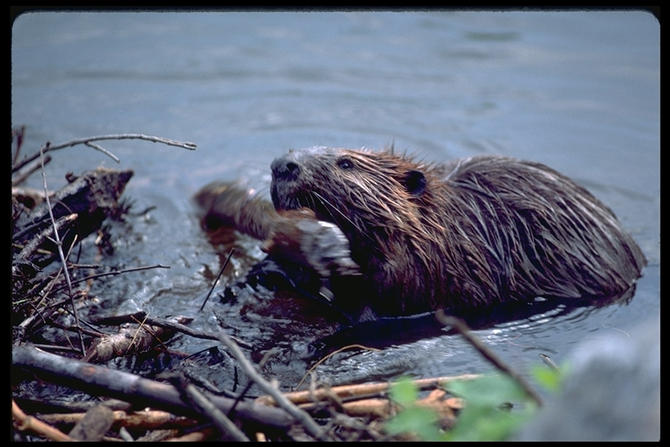
What’s new in the last 12 months?
Name change
Three releases
ManifoldCF in Action
Quick Start example
ManifoldCF API Service (REST style, uses JSON)
Scripting language
Solr plugin distribution
Hsqldb, Derby support
Wiki connector
CMIS repository connector
OpenSearchServer output connector

Slide 26
What’s coming?
Better scalability via NoSQL (Voldemort?)
Post-search document filtering support
Always more connectors and performance improvements
MySQL support

Slide 27
Shameless Plug for “ManifoldCF in Action”
Available as “early access” from Manning Publishing
Helpful for users, integrators, and connector writers
Won’t be put into production until ManifoldCF grows, so please help us to do that!

Slide 28
Resources
ManifoldCF in Action, from Manning Publishing
http://www.manning.com/wright
ManifoldCF deployment instructions
http://incubator.apache.org/connectors/how-to-build-and-deploy.html
ManifoldCF API documentation
http://incubator.apache.org/connectors/programmatic-operation.html
ManifoldCF script language documentation
http://incubator.apache.org/connectors/script.html

Slide 29
Contact
Karl Wright
kwright@apache.org
http://manifoldcfinaction.blogspot.com

