Slide 1
The Apache Way Done Right
The Success of Hadoop
Eric Baldeschwieler
CEO Hortonworks
Twitter: @jeric14

Slide 2
What is this talk really about?
What is Hadoop and what I’ve learned about Apache projects by organizing a team of Apache Hadoop committers for six years…
Sub-topics:
Apache Hadoop Primer
Hadoop and The Apache Way
Where Do We Go From Here?

Slide 3
What is Apache Hadoop?
Set of open source projects
Transforms commodity hardware into a service that:
Stores petabytes of data reliably
Allows huge distributed computations
Solution for big data
Deals with complexities of high volume, velocity & variety of data
Key attributes:
Redundant and reliable (no data loss)
Easy to program
Extremely powerful
Batch processing centric
Runs on commodity hardware
One of the best examples of open source driving innovation and creating a market

Slide 4
Apache Hadoop projects
Core Apache Hadoop
Related Hadoop Projects
Pig
(Data Flow)
Hive
(SQL)
HBase
(Columnar NoSQL Store)
MapReduce
(Distributed Programing Framework)
Ambari
(Manaement)
Zookeeper
(Coordination)
HCatalog
(Table & Schema Management)
HDFS (Hadoop Distributed File System)

Slide 5
Hadoop origins
Nutch project (web-scale, crawler-based search engine)
Distributed, by necessity
Ran on 4 nodes
DFS & MapReduce implementation added to Nutch
Ran on 20 nodes
Yahoo! Search team commits to scaling Hadoop for big data
Doug Cutting mentors team on Apache/Open process
Hadoop becomes top-level Apache project
Attained web-scale 2000 nodes, acceptable performance
Adoption by other internet companies
Facebook, Twitter, LinkedIn, etc.
Further scale improvements, now 4000 nodes, faster
Service providers enter market
Hortonworks, Amazon, Cloudera, IBM, EMC, …
Growing enterprise adoption
2002 - 2004
2004 - 2006
2006 - 2008
2008 - 2009
2010 - Today

Slide 6
Early adopters and uses
data analytics
analyzing web logs
advertising optimization
machine learning
web search
mail anti-spam
text mining
content optimization
customer trend analysis
ad selection
video & audio processing
data mining
user interest prediction
social media

Slide 7
Hadoop is Mainstream Today

Slide 8
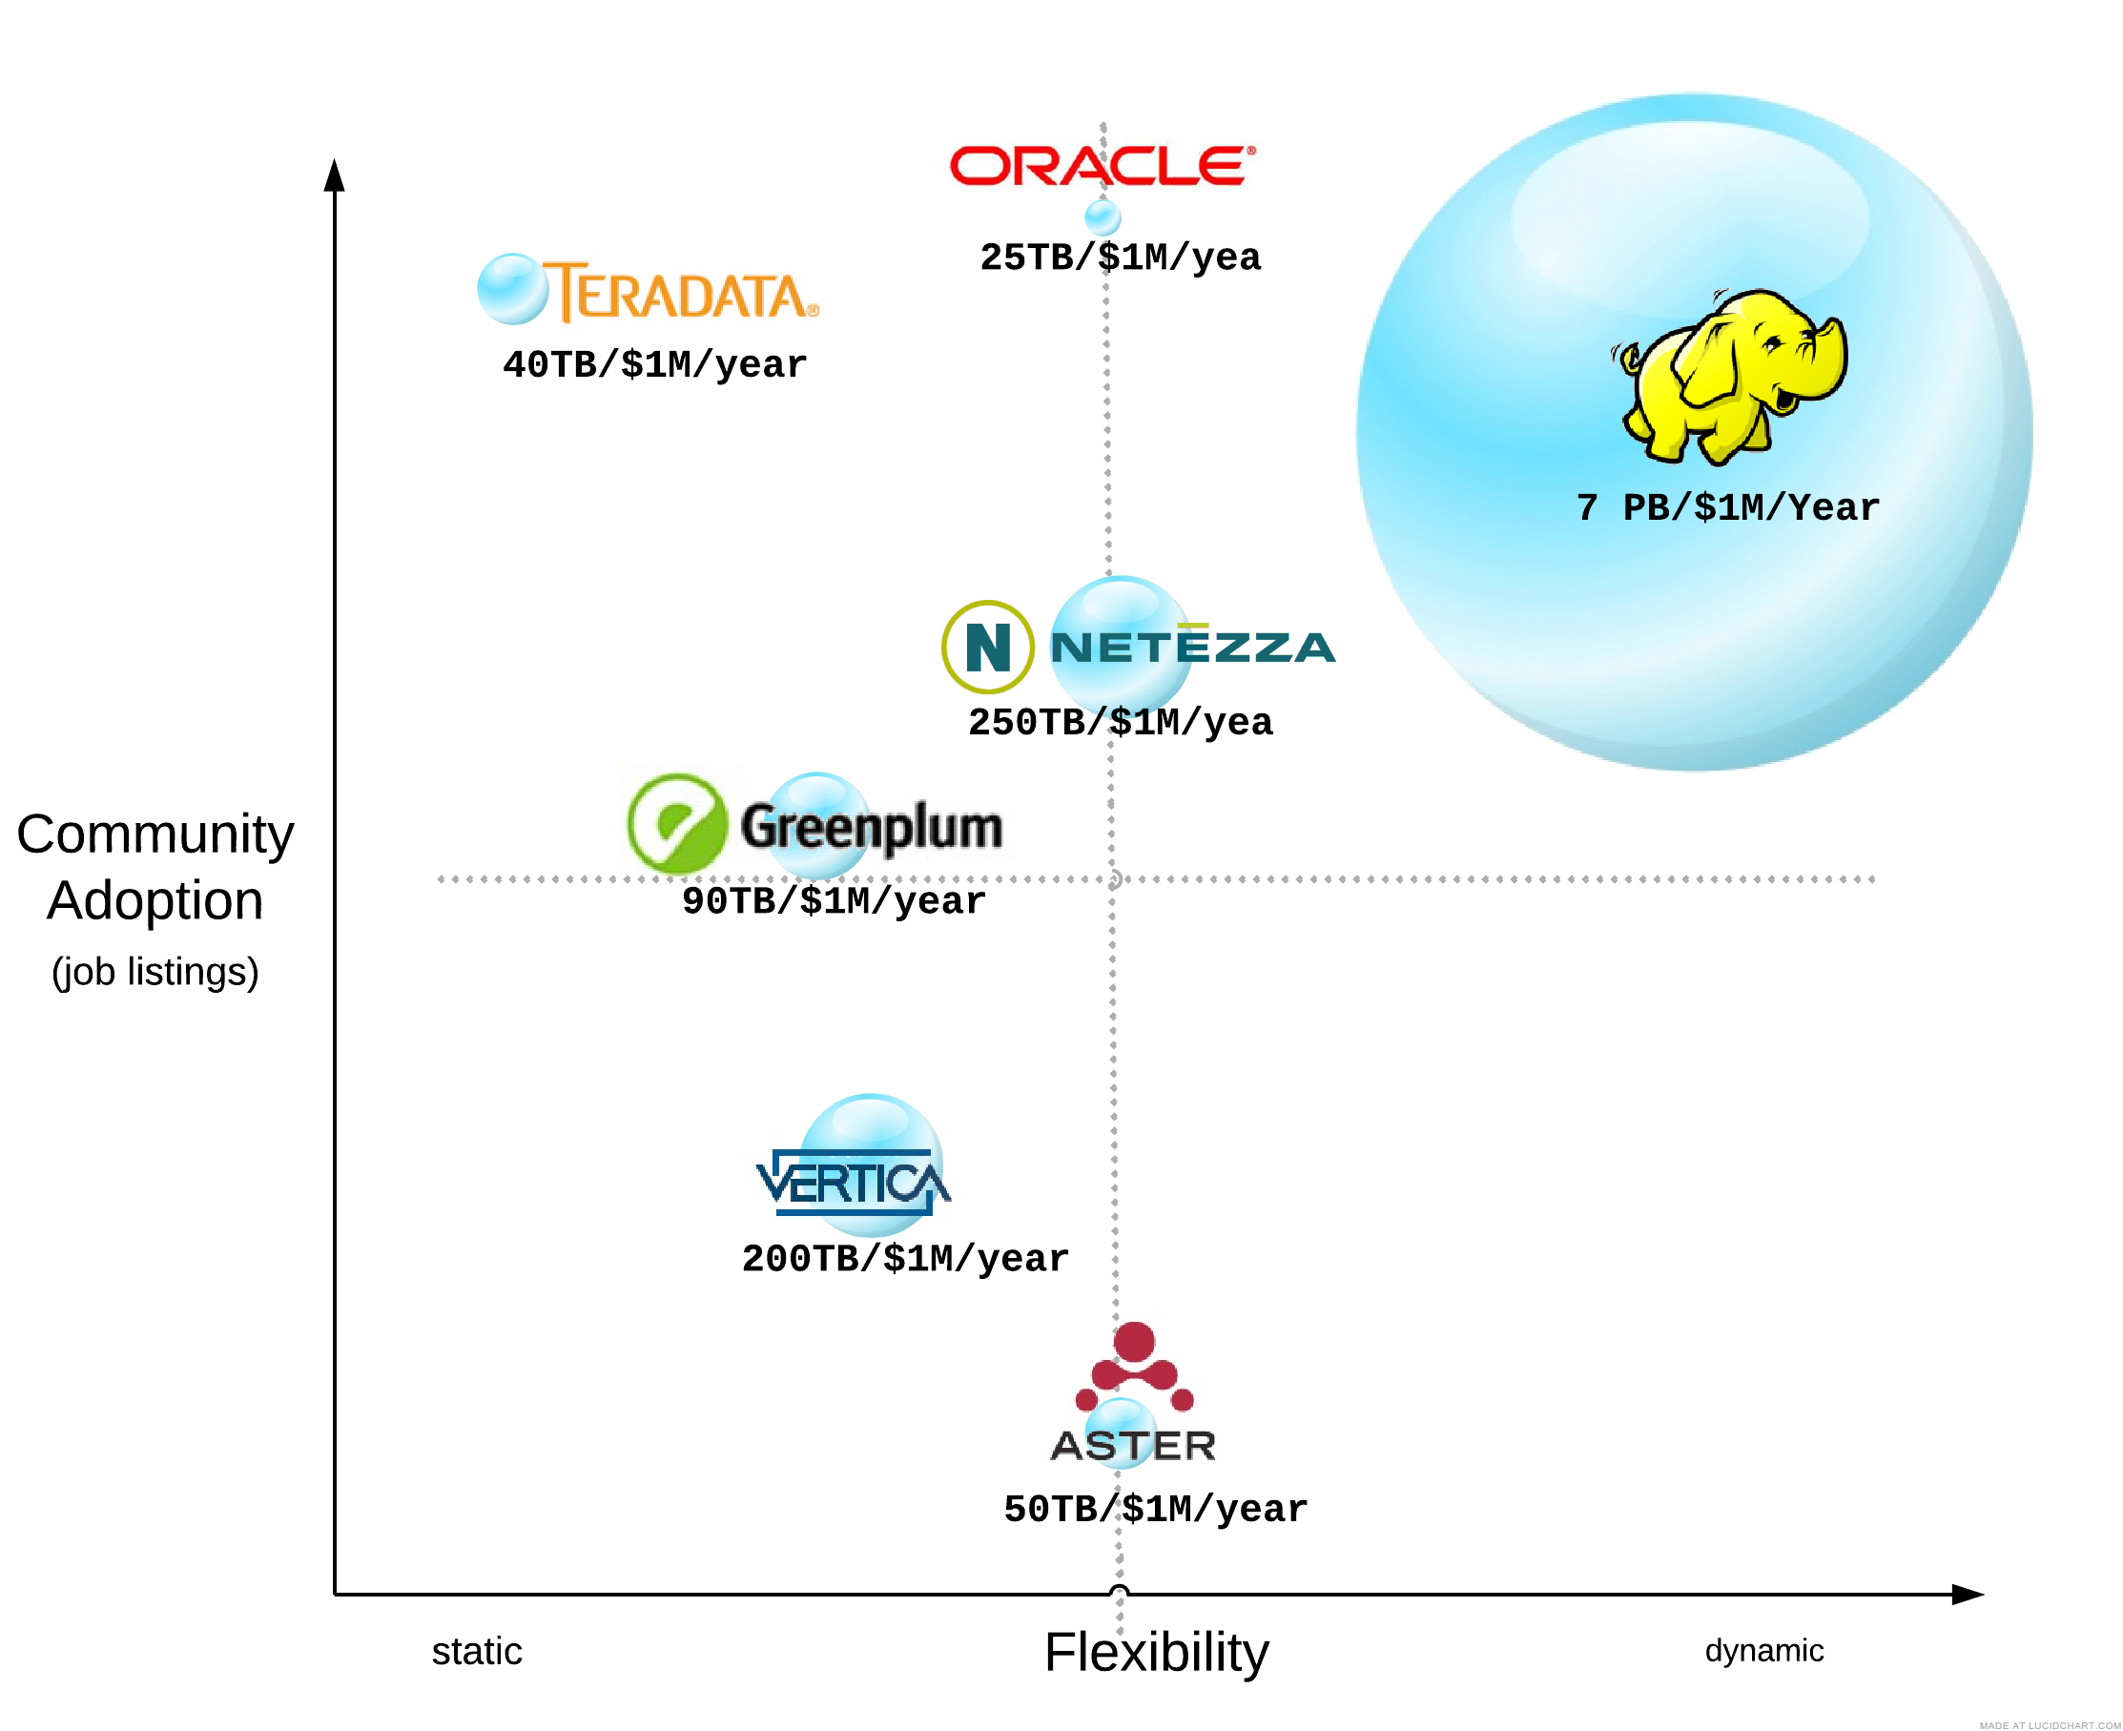
Big Data Platforms Cost per TB, Adoption
Size of bubble = cost effectiveness of solution
Source:

Slide 9
HADOOP @ YAHOO!
Some early use cases
© Yahoo 2011

Slide 10
CASE STUDY
YAHOO! WEBMAP (2008)
twice the engagement
What is a WebMap?
Gigantic table of information about every web site, page and link Yahoo! knows about
Directed graph of the web
Various aggregated views (sites, domains, etc.)
Various algorithms for ranking, duplicate detection, region classification, spam detection, etc.
Why was it ported to Hadoop?
Custom C++ solution was not scaling
Leverage scalability, load balancing and resilience of Hadoop infrastructure
Focus Search guys on application, not infrastructure
© Yahoo 2011

Slide 11
CASE STUDY
WEBMAP PROJECT RESULTS
twice the engagement
33% time savings over previous system on the same cluster (and Hadoop keeps getting better)
Was largest Hadoop application, drove scale
Over 10,000 cores in system
100,000+ maps, ~10,000 reduces
~70 hours runtime
~300 TB shuffling
~200 TB compressed output
Moving data to Hadoop increased number of groups using the data
© Yahoo 2011

Slide 12
CASE STUDY
YAHOO SEARCH ASSIST™
twice the engagement
Database for Search Assist™ is built using Apache Hadoop
Several years of log-data
20-steps of MapReduce
 | Before Hadoop | After Hadoop
Time | 26 days | 20 minutes
Language | C++ | Python
Development Time | 2-3 weeks | 2-3 days
© Yahoo 2011

Slide 13
HADOOP @ YAHOO! TODAY
40K+ Servers
170 PB Storage
5M+ Monthly Jobs
1000+ Active users
© Yahoo 2011

Slide 14
CASE STUDY
YAHOO! HOMEPAGE
twice the engagement
Personalized
for each visitor
Result:
twice the engagement
Recommended links
News Interests
Top Searches
+79% clicks
vs. randomly selected
+160% clicks
vs. one size fits all
+43% clicks
vs. editor selected
© Yahoo 2011

Slide 15
CASE STUDY
YAHOO! HOMEPAGE
SCIENCE
HADOOP
CLUSTER
Serving Maps
Users - Interests
Five Minute Production
Weekly Categorization models
» Machine learning to build ever better categorization models
USER
BEHAVIOR
CATEGORIZATION
MODELS (weekly)
PRODUCTION
HADOOP
CLUSTER
» Identify user interests using Categorization models
SERVING
MAPS
(every 5 minutes)
USER
BEHAVIOR
SERVING SYSTEMS
ENGAGED USERS
Build customized home pages with latest data (thousands / second)
© Yahoo 2011

Slide 16
CASE STUDY
YAHOO! MAIL
Enabling quick response in the spam arms race
SCIENCE
450M mail boxes
5B+ deliveries/day
Antispam models retrained
every few hours on Hadoop
PRODUCTION
“
40% less spam than Hotmail and 55% less spam than Gmail
“
© Yahoo 2011

Slide 17
Traditional Enterprise Architecture Data Silos + ETL
Traditional Data Warehouses,
BI & Analytics
Serving Applications
Web Serving
NoSQLRDMS
…
Traditional ETL &
Message buses
EDW
Data Marts
BI / Analytics
Traditional ETL &
Message buses
Serving Logs
Social Media
Sensor Data
Text Systems
…
Unstructured Systems

Slide 18
Hadoop Enterprise Architecture Connecting All of Your Big Data
Traditional Data Warehouses,
BI & Analytics
Serving Applications
Web Serving
NoSQLRDMS
…
Traditional ETL &
Message buses
EDW
Data Marts
BI / Analytics
Apache Hadoop
EsTsL (s = Store)
Custom Analytics
Traditional ETL &
Message buses
Serving Logs
Social Media
Sensor Data
Text Systems
…
Unstructured Systems

Slide 19
Hadoop Enterprise Architecture Connecting All of Your Big Data
Traditional Data Warehouses,
BI & Analytics
Serving Applications
Web Serving
NoSQLRDMS
…
Traditional ETL &
Message buses
EDW
Data Marts
BI / Analytics
Apache Hadoop
EsTsL (s = Store)
Custom Analytics
Gartner predicts
800% data growth
over next 5 years
Traditional ETL &
Message buses
80-90% of data
produced today
is unstructured
Serving Logs
Social Media
Sensor Data
Text Systems
…
Unstructured Systems

Slide 20
Hadoop and The Apache Way

Slide 21
Yahoo! & Apache Hadoop
Yahoo! committed to scaling Hadoop from prototype to web-scale big data solution in 2006
Why would a corporation donate 300 person-years of software development to the Apache foundation?
Clear market need for a web-scale big data system
Belief that someone would build an open source solution
Proprietary software inevitably becomes expensive legacy software
Key competitors committed to building proprietary systems
Desire to attract top science & systems talent by demonstrating that Yahoo! was a center of big data excellence
Belief that a community and ecosystem could drive a big data platform faster than any individual company
A belief that The Apache Way would produce better, longer lived, more widely used code

Slide 22
The bet is paying off!
Hadoop is hugely successful!
Hadoop is perceived as the next data architecture for enterprise
Project has large, diverse and growing committer base
If Yahoo were to stop contributing, Hadoop would keep improving
Hadoop has become very fast, stable and scalable
Ecosystem building more than any one company could
Addition of new Apache components (Hive, HBase, Mahout, etc.)
Hardware, cloud and software companies coming now contributing
I guess the Apache Way works…

Slide 23
But, success brings challenges
Huge visibility and big financial upside!
Harsh project politics
Vendors spreading FUD & negativity
The PMC challenged for control of Hadoop
Calls for Standards body outside Apache
Abuse of the Apache Hadoop brand guidelines
Increasing size and complexity of code base
Very long release cycles & unstable trunk
0.20 to 0.23 is taking ~3 years
New users finding Hadoop too hard to use
It takes skilled people to manage and use
There are not enough such people

Slide 24
What is the Apache Way?
What is Apache about? – From the Apache FAQ
Transparency, consensus, non-affiliation, respect for fellow developers, and meritocracy, in no specific order.
What is Apache not about? – From the Apache FAQ
To flame someone to shreds, to make code decisions on IRC, to demand someone else to fix your bugs.
The Apache Way is primarily about Community, Merit, and Openness, backed up by Pragmatism and Charity. - Shane Curcuru
Apache believes in Community over Code. (I hear this a lot)

Slide 25
Boiling it down a bit
Community over Code - Transparency, Openness, Mutual Respect
Meritocracy, Consensus, Non-affiliation
Pragmatism & Charity

Slide 26
Hadoop & the Apache Way, forward
Community over Code - Transparency, Openness, Mutual Respect
Aggressive optimism & a no enemies policy pays dividends
Leaders must publish designs, plans, roadmaps
It’s ok if people meet and then share proposals on the list!
Meritocracy, Consensus, Non-affiliation
Influence the community by contributing great new work!
Acknowledge domain experts in various project components
Fight! Your vote only counts if you speak up.
Rejecting contributions is ok.
Assigning work via whining is not!
Pragmatism & Charity
Hadoop is big business, companies are here to stay, use them
Mentor new contributors!
Make Hadoop easier to use!

Slide 27
Where Do We Go From Here?
Vision:
Half of the world’s data will be processed by Apache Hadoop within 5 years
Ubiquity is the Goal!

Slide 28
How do we achieve ubiquity?...
Integrate with existing data architectures
Extend Hadoop project APIs to allow make it easy to integrate and specialize Hadoop
Create an ecosystem of ISVs and OEMs
Make Apache Hadoop easy to use
Fix user challenges, package working binaries
Improve and extend Hadoop documentation
Build training, support & pro-serve ecosystem

Slide 29
Build a strong partner ecosystem!
Unify the community around a strong Apache Hadoop offering
Make Apache Hadoop easier to integrate & extend
Work closely with partners to define and build open APIs
Everything contributed back to Apache
Provide enablement services as necessary to optimize integration
Hadoop Application Partners
Integration & Services Partners
Serving & Unstructured Data Systems Partners
DW, Analytics & BI Partners
Hardware Partners
Cloud & Hosting Platform Partners

Slide 30
To change the world… Ship code!
Be aggressive - Ship early and often
Project needs to keep innovating and visibly improve
Aim for big improvements
Make early buggy releases
Be predictable - Ship late too
We need to do regular sustaining engineering releases
We need to ship stable, working releases
Make packaged binary releases available

Slide 31
Hadoop: Now, Next, and Beyond
Roadmap Focus: Make Hadoop an Open, Extensible, and Enterprise Viable Platform, and Enable More Applications to Run on Apache Hadoop
“Hadoop.Beyond”
Stay tuned!!
“Hadoop.Next”
(hadoop 0.23)
Extensible architecture
MapReduce re-write
Enterprise robustness
Extended APIs
“Hadoop.Now”
(hadoop 0.20.205)
Most stable version ever
RPMs and DEBs
Hbase & security

Slide 32
Hortonworks @ ApacheCon
Hadoop Meetup Tonight @ 8pm
Roadmap for Hadoop 0.20.205 and 0.23
Current status (suggestions, issues) of Hadoop integration with other projects
Owen O’Malley Presentation, Tomorrow @ 9am
“State of the Elephant: Hadoop Yesterday, Today and Tomorrow”
Salon B
Visit Hortonworks in the Expo to learn more

Slide 33
Thank You
Eric Baldeschwieler
Twitter: @jeric14

Slide 34
Extra links
WWW.Hortonworks.com
http://developer.yahoo.com/blogs/hadoop/posts/2011/01/the-backstory-of-yahoo-and-hadoop/
http://www.slideshare.net/jaaronfarr/the-apache-way-presentation
http://incubator.apache.org/learn/rules-for-revolutionaries.html

