Slide 1

Provisioning distributed OSGi applications in a cloud
Guillaume Nodet, FuseSource gnodet@gmail.com, November 2011

Slide 2




My Background
Guillaume Nodet
Software Fellow at FuseSource
ASF member
PMC member of ActiveMQ, Camel, CXF, Felix, Geronimo, Karaf, Mina, ODE, ServiceMix
OSGi Enterprise Expert Group
Twitter: http://twitter.com/gnodet/
LinkedIn: http://www.linkedin.com/in/guillaumenodet
Blog: http://gnodet.blogspot.com/
A Progress Software Company

Slide 3
The Challenge
Install, configure and run OSGi based applications in large scale deployments
A Progress Software Company

Slide 4
Fuse Fabric
http://fabric.fusesource.org/
Open source software for configuring, provisioning and running OSGi deployments on any machines
physical, virtual, private, public clouds
Keeps you DRY from those rainy clouds ☺
Weave your container into an easy to manage fabric
A Progress Software Company

Slide 5
Fuse Fabric: what does it do?
Remote deployment and config
Provisioning of features across machines
Distributed configurations
Profiling of features / configs
Distributed applications
Distributed OSGi
Middleware / integration support
CXF, Camel, ActiveMQ
A Progress Software Company

Slide 6
What is Fabric
Registry
Agents
Profiles
Provisioning
Remoting
… and more
A Progress Software Company

Slide 7
Registry
Based on Apache ZooKeeper
A highly available, scalable, distributed, configuration, consensus, group membership, leader election, naming, and coordination service
Proven track record
Support network splits
A Progress Software Company

Slide 8
ZooKeeper Data Model
Hierarchical namespace
Each znode has data and children
Data is read and written in its entirety
A Progress Software Company

Slide 9
Agent
Karaf instance
Connected to the registry
Listen to registry changes
Automatic provisionning
A Progress Software Company

Slide 10
Profiles
List of znodes
OSGi configuration
Other documents
One or more profiles associated to an agent
Support multiple inheritance
Versioned
A Progress Software Company

Slide 11
Runtime agent data
Alive (ephemeral)
IP
Parent agent
JMX URL
SSH URL
JMX domains
A Progress Software Company

Slide 12
Provisioning
fabric-agent uses a know config PID
At boot time and each time the profiles are updated, provisioning is applied
List of repositories, features, bundles
Using OBR internally to compute the set of bundles to deploy
Update / install / uninstall as required
A Progress Software Company

Slide 13
Provisioning (cont.)
Update features / bundles
Update karaf bundles
Update the OSGi framework
Update system / osgi properties
A Progress Software Company

Slide 14
Versioning
All profiles are stored in a version
An agent points to a given version
All updates on the current version are propagated immediately
Rolling updates
A Progress Software Company

Slide 15
Deployment
Fabric can create agents
Locally
Remotely as child instances
Remotely from scratch using an SSH access
In the cloud, creating the VM
A Progress Software Company

Slide 16
Deployment (cont.)
Fabric can create agents
Locally
Remotely as child instances
Remotely from scratch using an SSH access
In the cloud, creating the VM
A Progress Software Company

Slide 17
Distributed OSGi
Implementation of distributed OSGi defined in Enterprise OSGi v4.2
Remoting mechanism for transparent calls between OSGi services
Uses proxies on remote services
A Progress Software Company

Slide 18
Distributed OSGi (cont.)
Using ZooKeeper for discovery
Accessible remotely outside OSGi
Full support for OSGi filters
No change for the client
Add service.exported.interfaces=* on the service
Optimized IO
HawtDispatch, tcp pool, multiplexing, optimized protocol, support for protobuf, support for asynchronous calls
> 25000 req/s on my laptop
A Progress Software Company

Slide 19
Distributed OSGi (cont.)
A Progress Software Company

Slide 20
Commands
Registry
zk-cluster zk:create zk:delete zk:set zk:get zk:import zk:export zk:list
Profile
fabric:create-profile fabric:edit-profile fabric:display-profile fabric:domains fabric:list-profiles
Agent
fabric:create-agent fabric:delete-agent fabric:list-agent fabric:connect fabric:start fabric:stop fabric:zk-cluster
A Progress Software Company

Slide 21
Other features
Camel, CXF, ActiveMQ extensions
Centralized security configuration
Metrics collections into RRD
… and more to come …
A Progress Software Company

Slide 22

Demo
A Progress Software Company

Slide 23
Wrap up
Open source software for configuring, provisioning and running OSGi deployments on any machines.
Featuring various components for integration based projects and an optimized distributed OSGi implementation.
A Progress Software Company

Slide 24
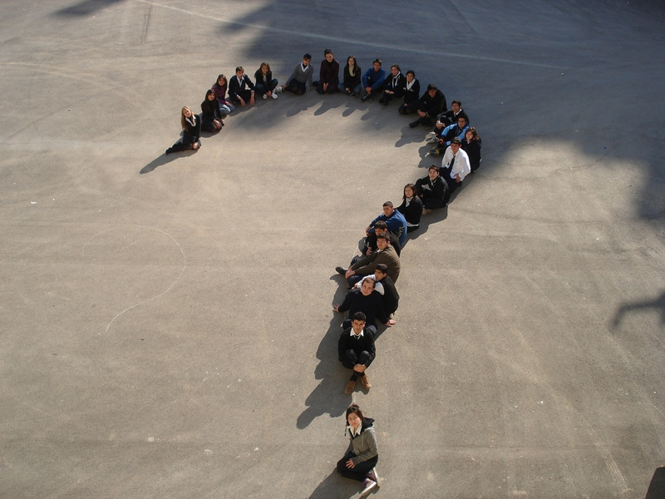
Questions
A Progress Software Company

Slide 25
Links
Fuse Fabric
http://fabric.fusesource.org/
https://github.com/fusesource/fabric
Apache ZooKeeper
http://zookeeper.apache.org/
Apache Karaf
http://karaf.apache.org/
Guillaume Nodet
http://gnodet.blogspot.com/
gnodet@gmail.com
FuseSource
http://fusesource.com/
A Progress Software Company

