Slide 1
State of the Elephant
Hadoop yesterday, today, and tomorrow
Owen O’Malley
owen@hortonworks.com
@owen_omalley

Slide 2
Ancient History
Back in 2005
Hired by Yahoo to create new infrastructure for Seach WebMap
WebMap was graph of entire web:
100 billion nodes
1 trillion edges
300 TB compressed
Took weeks to create
Started designing and implementing C++ framework based on GFS and MapReduce.

Slide 3
Ancient History
In 2006
Prototype was starting to run!
Decided to throw away Juggernaut and adopt Apache Hadoop.
Already open source
Running on 20 machines
Nice OO interfaces
Enabled Hadoop as a Service for Yahoo
Finally got WebMap on Hadoop in 2008

Slide 4
What is Hadoop?
A framework for storing and processing big data on lots of commodity machines.
Up to 4,000 machines
Up to 20 PB
High reliability done in software
Automated failover for data and computation
Implemented in Java

Slide 5
What is Hadoop?
HDFS – Distributed File System
Combines cluster’s local storage into a single namespace.
All data is replicated to multiple machines.
Provides locality information to clients
MapReduce
Batch computation framework
Jobs divided into tasks. Tasks re-executed on failure
User code wrapped around a distributed sort
Optimizes for data locality of input

Slide 6
Hadoop Usage at Yahoo
Yahoo! uses Hadoop a lot
43,000 computers in ~20 Hadoop clusters.
Clusters run as shared service for yahoos.
Hundreds of users every month
More than 1 million jobs every month
Four categories of clusters: Development, Alpha, Research, & Production
Increased productivity and innovation

Slide 7
Open Source Spectrum
Closed Source
MapR, Oracle
Open Releases
Redhat Kernels, CDH
Open Development
Protocol Buffers
Open Governance
Apache

Slide 8
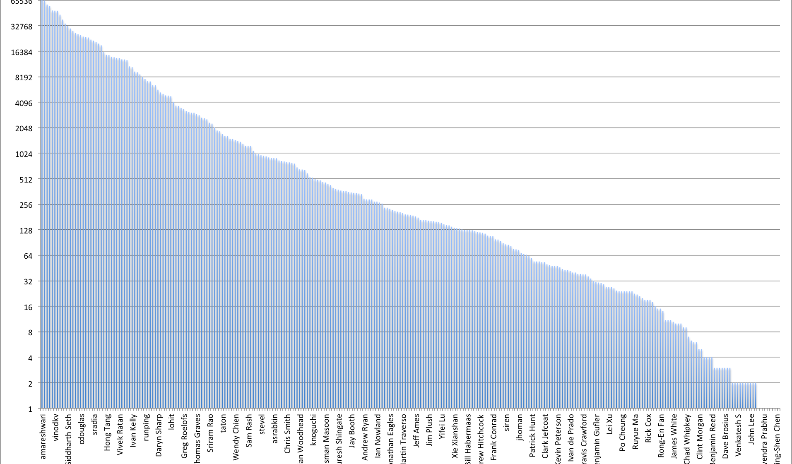
287 Hadoop Contributors

Slide 9
Release History
59 Releases
Branches from the last 2.5 years:
0.20.{0,1,2} – Stable, but old
0.20.2xx.y – Current stable releases (Should be 1.x.y!)
0.21.0 – Unstable
Upcoming branches
0.23.0 – Release candidates being rolled (2.0.0??)

Slide 10
Today
Features in 0.20.203.0
Security
Multi-tenancy limits
Performance improvements
Features in 0.20.204.0
RPMs & Debs
New metrics framework supported
Improved handling of disk failures
Features in 0.20.205.0
HBase support
Experimental WebHDFS
Support renewal of arbitrary tokens by MapReduce

Slide 11
0.20.203.0
Security
Prior versions of Hadoop trusted the client about the user’s login
Strong authentication using Kerberos (and ActiveDirectory)
Authenticates both the user and the server.
MapReduce tasks run as the user
Audit log provides accurate record of who read or wrote which data
Multi-tenancy limits
Users do a *lot* of crazy things with Hadoop.
Hadoop is an extremely effective if unintentional DOS attack vector
If users aren’t given limits, they impact other users.
Performance Improvements
Vastly improved Capacity Scheduler
Improved MapReduce shuffle

Slide 12
0.20.204.0
Installation packages for popular operating systems
Simplifies installation and upgrade
Metrics 2 framework
Allows multiple plugins to receive data
Disk failure improvements
Allow servers to continue when a drive fails
Required for machines with more disks

Slide 13
0.20.205.0
Support for HBase
Adds support for sync to HDFS
WebHDFS
Experimental HTTP/REST interface to HDFS
Allows read/write access
Thin client supports other languages
Web Authentication
SPENGO plugin for Kerberos web-UI authentication
Add JobTracker for renewing and cancelling non-HDFS Delegation tokens
Hbase, MapReduce, and Oozie delegation tokens can be renewed

Slide 14
Tomorrow – 0.23.0
Timeline
First alpha versions in January
Final version in mid-2012
MapReduce V2 (aka YARN)
Federation
Performance improvements
MapReduce libraries ported to new API

Slide 15
MapReduce v2 (aka YARN)
Separate cluster compute resource allocation from MapReduce
MapReduce becomes a client-library
Increased innovation
Can run many versions of MapReduce on the same cluster
Users can pick when they want to upgrade MapReduce
Supports non-MapReduce compute paradigms
Graph processing
Giraph
Iterative processing
Hama
Mahout
Spark

Slide 16
Architecture

Slide 17
Advantages of MapReduce v2
Persistent store in Zookeeper
Working toward HA
Generic resource model
Currently based on RAM
Scales further
Much simpler state
Faster heartbeat response time
Wire protocols managed with Protocol Buffers

Slide 18
Federation
HDFS scalability limited by RAM for NameNode
Entire namespace is stored in memory
Scale out by partitioning the namespace between NameNodes
Each manages a directory sub-tree
Allow HDFS to share Data Nodes between NameNodes
Permits sharing of raw storage between NameNodes
Working on separating out the block pool layer
Support clients using client side mount table
/project/foo -> hdfs://namenode2/foo

Slide 19
And Beyond…
High Availability
Question: How often has Yahoo had a NameNode’s hardware crash?
Answer: Once
Question: How much data was lost in that crash?
Answer: None
Automatic failover only minimizes downtime
Wire Compatibility
Use Protocol Buffers for RPC
Enable communication between different versions of client and server
First step toward supporting rolling upgrades

Slide 20
But wait, there is more
Hadoop is just one layer of the stack
Updatable tables – HBase
Coordination – Zookeeper
Higher level languages – Pig and Hive
Graph processing – Giraph
Serialization – Protocol Buffers, Thrift and Avro
How do you get all of the software installed and configured?
Apache Ambari
Controlled using CLI, Web UI, or REST
Manages clusters as a stack of components working together
Simplifies deploying and configuring Hadoop clusters
Let’s you check on the current state of the servers

Slide 21
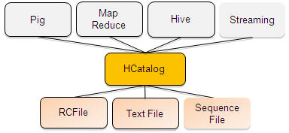
HCatalog (aka HCat)
Manages meta-data for table storage
Based on Hive’s metadata server
Uses Hive language for metadata manipulation operations
Provides access to tables from Pig, MapReduce, and Hive
Tables may be stored in RCFile, Text files, or SequenceFiles

Slide 22
Questions?
Thank you!
My email is owen@hortonworks.com
Planning discussions occur on development lists
common-dev@hadoop.apache.org
hdfs-dev@hadoop.apache.org
mapreduce-dev@hadoop.apache.org

