Slide 1
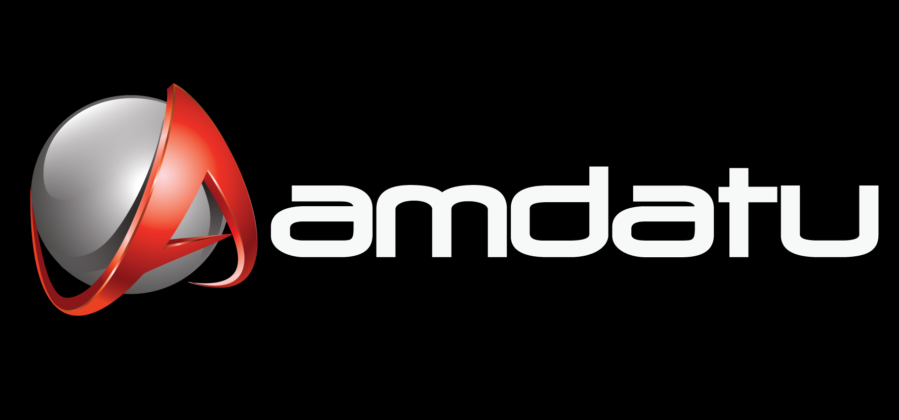
Rapid Application Development for Dynamic Cloud Applications ApacheCon NA 2011
Notes:
bramk

Slide 2
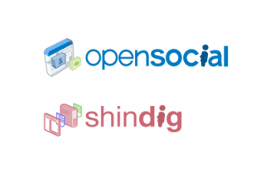
Agenda
Who we are
Amdatu
Platform
Projects
Demo
Q&A
Notes:
bramk

Slide 3
Speakers
Bram de Kruijff
GX Software
Lead Architect R&D
Java / OSGi / Web
Amdatu Platform PMC
Marcel Offermans
Fellow at Luminis Technologies
Java /OSGi / Embedded
Member at Apache
PMC: Felix, Incubator, PPMC: ACE, Celix
Amdatu Platform PMC
http://www.gxsoftware.com
http://www.luminis-technologies.com
Notes:
bramk

Slide 4
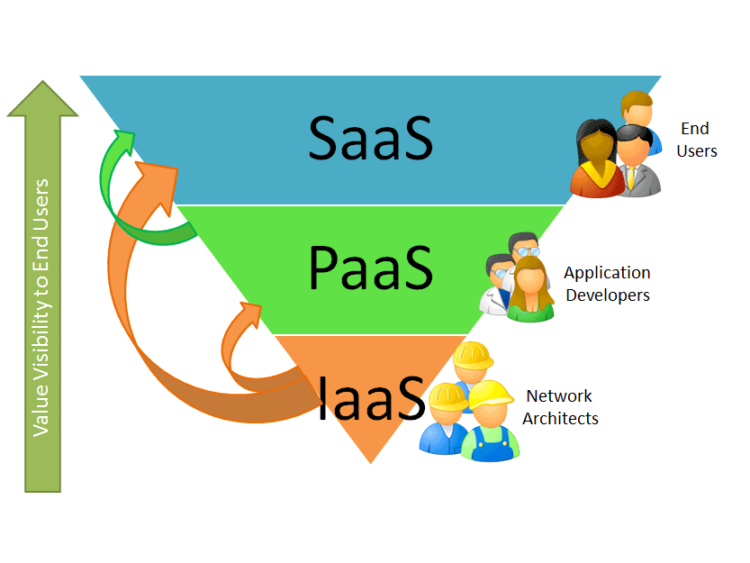
Positioning
Amdatu is an open source application platform for open service oriented and cloud aware application composition
source: http://www.saasblogs.com
Infrastructure – functions– components – composites - applications
Notes:
marrs

Slide 5
Concept
Scalable multi-tenant web services and turnkey end-use applications
Application model and custom software
Reusable software and cloud components
Proprietary cloud environments and services
Notes:
marrs

Slide 6
Layering
Applications are assembled from reusable software components and frameworks on top of the OSGi™ based core platform
Application
Frameworks
Applications
Foundation
components
Core platform
Notes:
bramk

Slide 7
Platform
Amdatu Platform
Java™ based / Leverages OSGi™
development model
Dynamic application provisioning and management
Service Fabric, clustering and IaaS management
Cloud aware Web/REST WOA application model
SDK / tooling
App
Fws
Applications
Foundation
services
Core
Notes:
bramk

Slide 8
Lifecycle
Amdatu provides a fully integrated continuous software lifecycle based on dynamic provisioning
Declarative configuration
Metatype / custom
Runtime provisioning
Apache ACE
OSGi™ DeploymentAdmin
Standard tools
Maven / Ant
BNDTools / OBR
Configuration
Provisioning
Composition
Monitoring
Management
Development
Notes:
bramk

Slide 9
Deployment
A deployment is a dynamic topology of cloud compute resources running Management Agents (AMA) managed by a Management Server (AMS)
Management / Provisioning
AMS
(management servers)
AMA
(management agents)
AMA
(management agents)
Logging / Reporting
Infrastructure
Mngmnt
Node
lifecycle
Node
lifecycle
Cloud Infrastructure
(compute nodes)
Notes:
marrs

Slide 10
Multi-tenancy
The Amdatu service based multi-tenant application model allows any application to transparently operate multi-tenant
Fully transparent
No code pollution
Third party code
Configuration based
Add/remove tenants at runtime
Service configuration per tenant
Web framework support
Default hostname based resolver
Pluggable
GET / HTTP/1.1
Host: john.com
Tenant: john
Tenant: frank
Webfront
Service
Webfront
Service
Recommender
Service
Recommender
Service
Storage
Service
Storage
Service
Notes:
marrs

Slide 11
Service Fabric
The Amdatu service fabric provides a highly scalable communication layer supporting component level scale-out
Management
Dynamic configuration
Logical clusters
Pub/Sub messaging
OSGi Remote service
Transparent service invocation
Storage
API
Storage
API/IMPL
Service
API
Service
API
Service Fabric
Notes:
bramk

Slide 12
Web Framework
RESTful service design and application decomposition are the basis for a WOA style application scale-out architecture
Layered systems
Dynamically scalable
Configuration
Managed endpoints
Support for
Servlets/Filters
JAX-RS
Static resources
JSP
GET / HTTP/1.1
Host: john.com
Webfront
HTTP/REST
Recommender
HTTP/REST
Products
HTTP/REST
Storage
HTTP/REST
Notes:
bramk

Slide 13
Projects
Amdatu Projects
Application frameworks, reusable
components and foundation
services
Multi-tenant RESTful webservices and subsystems and applications
App
Fws
Applications
Foundation
services
Core
Notes:
marrs

Slide 14
Amdatu Mngmnt
Amdatu Management server
IaaS management
Configuration management
Tenant Management
Powered by Apache ACE
Notes:
marrs

Slide 15
Amdatu Identity
Collection of authentication and authorization services
OAuth 1.0 server and client
Working on OpenID client and server
Authentication and authorization services, based on OSGi UserAdmin
Gadget UI (login and user management)
Notes:
marrs

Slide 16
Amdatu BigData
Apache Cassandra based NoSQL storage
Multi-tenant (one keyspace per tenant)
Dynamic Keyspace and ColumnFamily registration through service (whiteboard)
Thrift / Hector based Persistence Managers
Storage implementations (i.e. OAuth consumers, Gadget registry, UserAdmin)
Notes:
bramk

Slide 17
Amdatu OpenSocial
Apache Shindig based OpenSocial server
Multi-tenant social services
Gadget container
Gadget registry
Dashboard
Notes:
bramk

Slide 18
Amdatu Semantic
Collection of semantic tools
Sesame RDF store
RDF2Go API
SPARQL endpoint
Type-safe SPARQL ORM Java API
Notes:
marrs

Slide 19
Amdatu Storage
Blob storage based on jclouds
Configurable Service Factory
BlobStoreService per configuration
(e.g. both S3 and Azure)
Exposes configured jclouds API
Notes:
marrs

Slide 20
Demo
Demo
Notes:
bramk

Slide 21
Future
Amdatu Platform
Dynamic scaling and topology management
Advance cloud and IaaS integration
Improvements, improvements, …
Amdatu Projects
Amdatu Search Appliance
Amdatu Management Server
Amdatu Device Deployment
Amdatu Cloud Storage
Amdatu Profile Service
Notes:
marrs

Slide 22
Community
Amdatu is a community effort! Learn more at our website and mailing lists.
http://www.amdatu.org
amdatu-developers@amdatu.org
amdatu-users@amdatu.org
Notes:
marrs

