Slide 1
Apache CloudStack's Plugin Model:
Balancing the Cathedral with a Bazaar
Adding Hyper-V Support
donal.lafferty@citix.com
Feb 26th, 2012

Slide 2
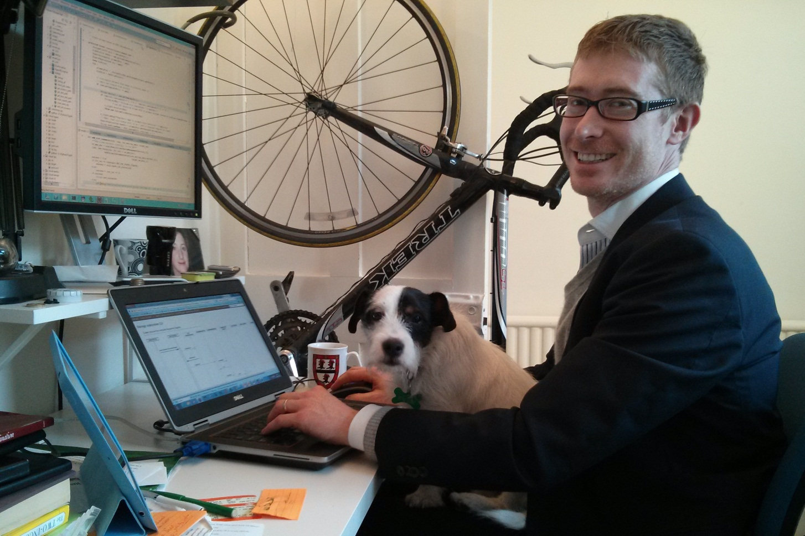
Familiar?

Slide 3
The Call For Submissions sets the context
“Open Source Community Leadership Drives Enterprise-Grade Innovation”
  CloudStack’s plugin model permits enterprise-grade adaptions
“Apache initiatives play a key role in powering today's Cloud”
  Plugin model allows cloud to adapt to compute loads (not the other way around)
“particular focus on those [talks] demonstrating real-world experience of solving specific problems.”
  Case study of adding Hyper-V support as a newcomer

Slide 4
Innovators Need the System to be Disaggregated
CloudStack WebServices API
OAM&P API
End User API
AWS API
Pluggable Service API Engine
Business Logic
Provisioning
Accounts
Resource Mgr
Capacity Mgr
Update
Mgr
Rules Mgr
HA
Mgr
Security Mgr
KVM
VMWare
XenServer
OVM
Events Manager
Orchestration
Adapters
Usage Manager
VM Manager
Storage Mgr
Network Mgr
Template Mgr
Snapshot Manager
Network Guru
Domain Manager
Network Element
Account Mgr
Deployment Planner
Limits Manager
Hypervisor Guru
Framework
Agent Manager
Cluster Manager
Data Access Layer

Slide 5

Jimmy
McMillan…

Slide 6
Disaggregation Started with Hardware Management
CloudStack Orchestration
Adapters
CloudStack Provisioning Plugins
Network Manager
Template Manager
Storage Manager
VM Manager
Snapshot Manager
Network Guru
KVM
VMWare
XenServer
OVM
HypervisorGuru
Etc…
Framework
Agent Manager
Cluster Manager
Data Access Layer

Slide 7
Understand that the Plugin serves two masters
Server Component:
  Java
  Adapter APIs
  DAO
  RESTful API
ServerResource:
  Agent Proxy, e.g. KVM
    ‘Message Bus’ of JSON over TCP
  Direct connect, e.g. XenServer
Rest API
Plugin API
Implementation
Data Access Layer
ServerResource
Optional. Required if Plugin needs to be co-located with the resource
Implements translation layer to talk to resource
Communicates with server component via JSON

Slide 8
That’s the theory…
… is it achievable?

Slide 9
Follow the process for new features
https://cwiki.apache.org/confluence/display/CLOUDSTACK/Adding+new+features+and+design+documents
    Announce over mailing list
      Attempt to get consensus: awareness & acceptance
    Publish Functional Spec & Design
    JIRA ticket for feature
    Setup a Dev Environment
    Branch on github, use your own (public) branch
    Submit changes to Review Board
      post-review for large packages of changes.
Decide on the wiki you want
    Incubator wiki cleaner, simpler view
      http://incubator.apache.org/cloudstack/develop/developer-faq.html
    CloudStack wiki for in depth development
      https://cwiki.apache.org/confluence/display/CLOUDSTACK/Home
    Avoid the pre-Apache wiki (http://wiki.cloudstack.org/dashboard.action)

Slide 10
Simpler Steps Make it Easier to Learn CloudStack
CloudStack Manager
CloudStack Manager
Phase 1:
Hyper-V Types
Phase 2:
Hyper-V Types
Plugin Server Component
Plugin Server Component
Proxy ServerResource
ServerResource
Message Bus
WS-Management
Connected Agent
WMI (or PowerShell)
WMI
Hyper-V Server 2012
Hyper-V Server 2012
XenServer Cluster
(System VMs)
Hyper-V based
System VMs

Slide 11
Reuse and repurpose rather than rewrite
Phase 1
Remote
Agent
WMI via Python
Server Resource (KVM)
Agent
Message Bus
AgentShell
O/S

Slide 12
ServerResource commands are easier to log and replay
public interface HypervisorResource extends ServerResource {
StartAnswer execute(StartCommand cmd);
StopAnswer execute(StopCommand cmd);
RebootAnswer execute(RebootCommand cmd); }
@Test
public void TestCreateCommand() {
String sample = "{\"volId\":10,\"pool\":{\"id\":201,\"uuid\":\""+testLocalStoreUUID+"\",\"host\":\"10.70.176.29\"" +
",\"path\":"+testLocalStorePathJSON+",\"port\":0,\"type\":\"Filesystem\"},\"diskCharacteristics\":{\"size\":0," +
"\"tags\":[],\"type\":\"ROOT\",\"name\":\"ROOT-9\",\"useLocalStorage\":true,\"recreatable\":true,\"diskOfferingId\":11," +
"\"volumeId\":10,\"hyperType\":\"Hyperv\"},\"templateUrl\":"+testSampleTemplateURLJSON+",\"contextMap\":{},\"wait\":0}";
…

Slide 13
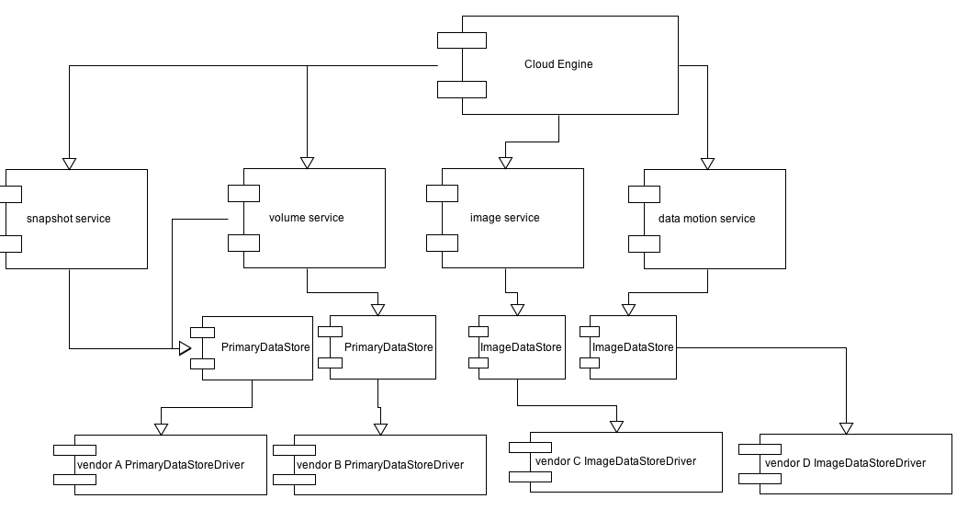
CloudStack is evolving, it may fix your problem
Storage disaggregated
SystemVM creation broadened & simplified
XenServer Cluster
(System VMs)
Hyper-V based
System VMs

Slide 14
Make advance preparations for IP clearance
# Copyright (c) 2010 Cloud.com, Inc
#
# Licensed under the Apache License, Version 2.0 (the "License"); you may
# not use this file except in compliance with the License. You may obtain
# a copy of the License at
#
# http://www.apache.org/licenses/LICENSE-2.0
#
# Unless required by applicable law or agreed to in writing, software
# distributed under the License is distributed on an "AS IS" BASIS, WITHOUT
# WARRANTIES OR CONDITIONS OF ANY KIND, either express or implied. See the
# License for the specific language governing permissions and limitations
# under the License.
http://www.apache.org/licenses/
  http://www.apache.org/legal/src-headers.html
  http://apache.org/licenses/LICENSE-2.0.html#apply

Slide 15
Bonus Tips – Read at your leisure
SystemVMs have logs
  Connect form hypervisor console, user:root, password: 6m1ll10n.
    Avoids SSH over 3392 with management server RSA keys
Import Maven projects into Eclipse using m2e
Maven debuggable task paused waiting for Eclipse to attach:
export MAVEN_OPTS="-Xdebug -Xnoagent -Djava.compiler=NONE -Xrunjdwp:transport=dt_socket,address=4000,server=y,suspend=y
        See http://www.mojavelinux.com/blog/archives/2007/03/remote_debugging_with_jetty/
Expand Log4j logging
  Change Threshold from INFO to TRACE
    :%s/INFO/TRACE/g

Slide 16
Summary
Innovators Need the System to be Disaggregated
Disaggregation Started with Hardware Management
Understand that the Plugin serves two masters
Follow the process for new features
Simpler Steps Make it Easier to Learn CloudStack
Repurpose rather than rewrite
ServerResource commands are easier to log and replay
Keep an eye out for evolving solutions
Make advance preparations for IP clearance

Slide 17
“It is not the strongest of the species that survives, nor the most intelligent that survives. It is the one that is the most adaptable to change.”
– Charles Darwin

Slide 18
References
Theory behind plugins http://www.youtube.com/watch?v=FMM-YgK1jmg
Disaggregating CloudStack
  http://www.slideshare.net/buildacloud/cloudstack-collaboration-conference-12-refactoring-cloud-stack
  http://www.youtube.com/watch?v=iGk3s68Meh0
Hyper-V Plugin Wiki
  https://cwiki.apache.org/CLOUDSTACK/hyper-v-2012-30-support.html

