Slide 1
Apache Student Induction: Catalyzing Collaborative Student Research Projects
Suresh Marru
Shahani Markus Weerawarana

Slide 2
!!Opportunity!!
Theo Schlossnagle quote from this morning’s keynote:
“ASF is special, the apache brain trust is unparalleled.”

Slide 3
What are other efforts in this area …
Before we discuss some concrete take home points, lets discuss the relevant landscape

Slide 4
Global, grassroots, nonprofit organization (US-501.c.3 pending).
Supports travel and technology education for STEM scholars from regions affected by the global economic crisis.
Beneficiaries “pay it forward” by volunteering to serve as technology evangelists in their home communities in a way that supports STEM-Trek’s broader mission. One way is to help job-seekers improve vocational technical skills. In doing so, they have an opportunity to inform average citizens how science, technology, engineering, and mathematics impact lives. With increased social awareness, STEM-Trek scholars become more considerate innovators in the future.
www.stem-trek.org, FaceBook, LinkedIn or follow on Twitter @STEMTrek.
Slide Source: STEM-TREK

Slide 5
STEM-Trekkers pay-it-forward!
Be a technology evangelist in your home community!
Help others learn by contributing whitepapers and participate in online symposiums!
Leverage and expand STEM-Trek’s knowledge network to help solve unique challenges that are identified in the field!
Volunteer! STEM-Trekkers learn how all people (esp. those with disabilities and/or limited technical skills) access information.
Become more socially aware. Develop more useful and accessible solutions in the future (avert the lost generation).
FIRST APPLICATION DEADLINE MARCH 15, 2013!!!
http://www.stem-trek.org/opportunities/
Slide Source: STEM-TREK

Slide 6
www.google-melange.org
www.google-melange.com

Slide 7
What is Google Summer of Code?
Google Summer of Code is a program designed to encourage college student participation in open source software development.

Slide 8
Key Goals of GSOC:
Inspire young developers to begin participating in open source development
Provide students in computer science and related fields the opportunity to do work related to their academic pursuits during the summer
Give students more exposure to real-world software development scenarios (e.g. distributed development, software licensing questions, mailing list etiquette, etc.)
Get more open source code created and released for the benefit of all
Help open source projects identify and bring in new developers and committers

Slide 9
Global opportunities by GSOC
GSOC has opened opportunities for student participation in open source projects from around the world.

Slide 10
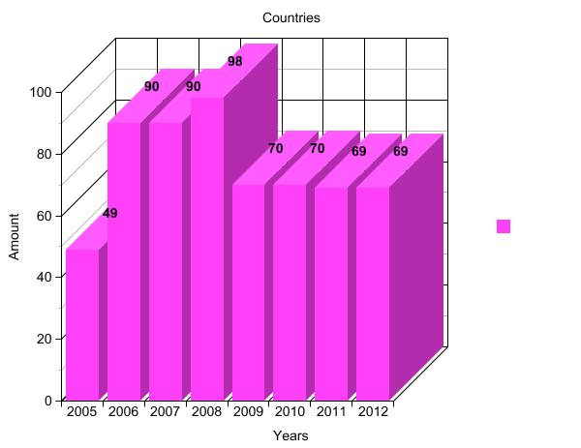
GSoC in numbers: Countries

Slide 11
GSoC Top Schools

Slide 12
GSoC Success at ASF
Apache PMC Perspective:
Paid software developer for the summer.
Attracting a new member into the project community.
Etc.
Student Perspective
Opportunity to gain (open source) software development experience.
Good payment for rewarding work.
Ability to network and become known within a structured, distributed setting.

Slide 13
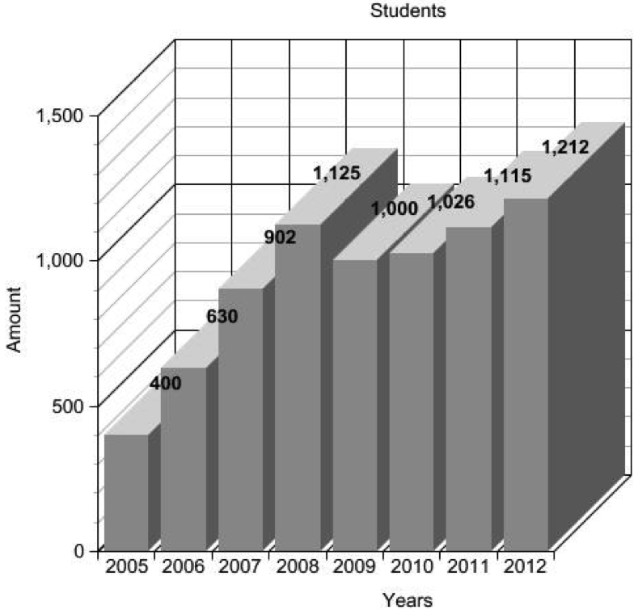
GSoC in numbers: Students
Number of students maxed and stabilized around 1200.
This is not expected to grow in near future, understandable, still thank you Google!!
We need to figure out how to scale, ideas????

Slide 14
How can we sustain GSoC Students?
PMCs need to be more engaged and create tutorials and hand hold the students early on.
Remember to teach “Apache Way”
Be more welcoming and appreciative – basically motivate and get them interested.
This extra effort will pay off PMCs with long term commitments.

Slide 15
Success Story from Apache Airavata Student: Milinda Pathirage
Key Success: Integrated Cross Apache Projects
Whirr API

Slide 16
Core Contributions beyond GSOC
Milinda realized he could execute his GSOC project, but had great thoughts on how we can fundamentally improve Airavata Architecture to make it easy for future extensions.
Developer community agreed to the new Architecture.
Simple
Easy extendibility.
Airavata has adopted his proposed new architecture

Slide 17
Enhanced Airavata Architecture
Global InHandlers
Provider specific InHandlers
Job Execution Context
Provider Logic
Application specific In Handlers
Application specific OutHandlers
Global OutHandlers
Provider specific OutHandlers

Slide 18
Going beyond GSOC – Student research projects
Students have to meet academic research goal….

Slide 19
Student Research Projects based on ASF Projects
University of Moratuwa Master’s Research Projects
Initial brainstorming session
Apache Airavata
Apache Rave
Apache OODT
Short Research ideas
Published to students
Three students select 3 projects out of the 5 listed.

Slide 20
Notable Characteristics
Research project duration: 1+ years
Many interim deadlines and milestones specified by the MSc Program
Research proposal
Literature review report
etc.
Each student has a "local" supervisor and project "mentors"

Slide 21
Undergraduate Final Year Project
MetCat: Designing a Metadata Catalog for Airavata
Was not so successful as expected.
Lessons Learned
Importance of having an engaged “local” supervisor within the academic institution
Encouraging the students to be more “engaged”.

Slide 22
Next Steps …
Create an “Apache student research project idea bank” for students to pick projects year round
Capstone Projects
Undergraduate group projects
Graduate Research Projects
Framework to create win-win scenarios for the student(s) and the Apache project PMC

Slide 23
Win-Win for Student(s)
Harness student skills and interests
Make the project work relevant and “required” by aligning with students’ academic curriculum
As a final year (research) project
As a Masters-level research project
Create an interesting and challenging research problem
Sense of satisfaction and achievements
Research publications
Presentations at ApacheCon and similar conferences
Committership

Slide 24
Win-Win for PMC
Long term (typically 1 year) participant in the project (not a software developer for ~3 months)
Accomplish meaningful research-oriented goals either within the project or cross-cutting projects
Teach open source/community participation to the next generation workforce :-)

Slide 25
Potential Best Practice
Have a “local” advisor/supervisor from the academic institution
Eliminates student learning curve and motivation related issues from PMC mentors
The local supervisor would track and ensure project milestones are achieved and that academic deadlines are met
The win-win for the local advisor would be:
Enhanced research collaboration network
Research publications

Slide 26
More thoughts …
Structure of Research Project Idea Bank
Engagement model with "local supervisor"
Engagement model with students

Slide 27
Volunteers?
Watch for email threads on community PMC – dev@community.apache.org
Or contact us directly:
smarru@apache.org
shahani@apache.org

