Slide 1

Transparent HTTP with
Apache Traffic Server

Slide 2
Speaker
Alan M. Carroll, PMC
  Started working on Traffic Server in summer 2010.
  Implemented
    Transparency
    IPv6
    Other stuff
  Works for Network Geographics
    Provides ATS and other development services

Slide 3
Goal
A starting point for deploying ATS as a transparent HTTP proxy
Provide sample scripts
Help you understand what the commands in the scripts are intended to accomplish
Guide to useful tools

Slide 4
Outline
Basic theory
Drill down to increasing detail for deployment
Trouble shooting
Commands not discussed directly
  Not really helpful
  You can look ahead to appendix scripts and ask questions on them that relate to slides

Slide 5
Basic THeory
What are we trying to do?

Slide 6
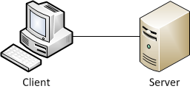
Transparency Basics
Quick review to avoid misunderstandings
Use standard client / server terminology
  Client initiates connection
  Server receives connection
  Users think this is how it works:
  Transparency contributes to this
  illusion in the presence of proxies

Slide 7
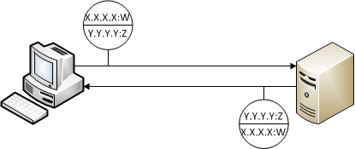
Two Halves make a whole
Slightly more sophisticated view
  Two half connections
  Identified by 5-tuple, but we’ll presume TCP
  So it’s a 4-tuple for us
    Local IP address:port, Remote IP address:port
  “Local” and “Remote” are viewpoint based

Slide 8
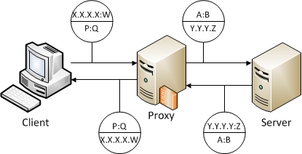
Proxying
You want to modify network traffic
  Use a proxy to intercept connections
  If just monitor and track, not modify, use a sniffer. Much easier.
Basic proxy operation
Notes:
Example sniffer: Snort with alerting and logging

Slide 9
Proxying makes two
A proxied connection is really two connections
  Two independent connections
    Client <-> Proxy
    Proxy <-> Server
  They only look related because the proxy is clever
Proxy address:port pairs (P:Q and A:B)
  Proxy types are simply terms for how these pairs are selected

Slide 10
Proxy Types
Address used by proxy | Client connects to Proxy Address | Client connects to Server Address
Server accepts from Proxy Address | Explicit Proxy (Not transparent) | Inbound transparent
Server accepts from Client Address | Outbound transparent | Fully transparent

Slide 11
HTTP Proxies
ATS is an HTTP proxy/cache
To modify traffic proxy must understand traffic
  Other traffic must be handled as opaque data
ATS understands HTTP
  Can modify/cache headers as well as content
  Can rely on data present in HTTP headers
ATS does not understand HTML
  But your plugin can
Notes:
HTTP can carry non-HTML traffic

Slide 12
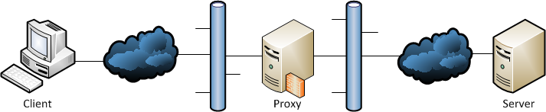
Putting the Proxy in your network
Proxy goes between the client and the server

Slide 13
Proxy Topologies
Routed
  Proxy is between different networks
Bridged
  Same network on both sides of the proxy
WCCP (Cisco routers only)
  Router intercepts for proxy elsewhere
  Enables pass through failover
  IPv4 only

Slide 14
Why Transparency
Transparency makes a proxied topology look like the simple client / server topology
Should you use transparency?
  From whom do you want to hide the proxy?
    Hide from clients?
    Hide from server?
Pick from four basic types of transparency

Slide 15
Proxy Types
Address used by proxy | Client connects to Proxy Address | Client connects to Server Address
Server accepts from Proxy Address | Explicit Proxy (Not hidden) | Inbound transparent (hidden from clients)
Server accepts from Client Address | Outbound transparent (hidden from servers) | Fully transparent (hidden from clients and servers)

Slide 16
Examples / Use Cases
Explicit proxy
  The original way, everyone knows there’s a proxy
  Used primarily when there is no other choice.
Outbound transparent
  CDN
    Clients connect to explicit (advertised) proxy address
    Server addresses are hidden from clients, servers could use non-routable addresses
    Servers can still see client address on connection

Slide 17
Examples / Use Cases
Inbound transparent
  Corporate: hide internal addresses behind proxy without client configuration
Fully transparent
  Proxy is not visible to clients or servers - no changes required for clients or servers, they still see each others’ addresses
  Corporate use
    Need to proxy
    Need to have servers see distinct IP addresses for clients
    Infeasible to configure clients for explicit proxy
Notes:
Full transparency is the common case

Slide 18
Deployment
Putting ATS in your network

Slide 19
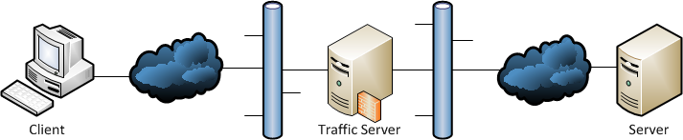
Deploying
Routed and Bridged require ATS inline
WCCP requires intercepting router to be inline
Packets must pass through intercepting box
Simplified required topology looks like
Notes:
Note that WCCP is a bit different
Packets must pass through in both directions

Slide 20
Adapt ATS to your network
Because ATS can work in various modes you should pick the mode that works best in your network
No mode is “better” than another, the modes are more or less appropriate for your network

Slide 21
Generic Deployment
Normal packet flow is through ATS box
Need to divert specific flows to ATS
  Use iptables/ebtables to mark packets
  Use routing table to re-route packets to ATS
  Configure ATS to handle those packets
  Tweak host OS
See appendices for detailed commands

Slide 22
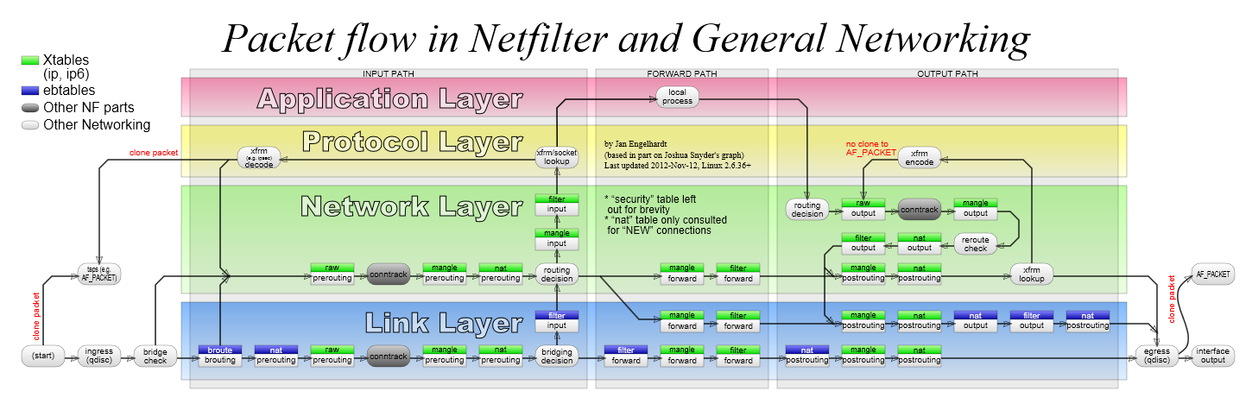
Simplified Linux Packet Handling
Now that I’ve scared you, let’s look at just what we need to know for HTTP transparency
Notes:
Now you can appreciate the very simplified drawings for the rest of the slide show

Slide 23
TPROXY
Short for “Transparent PROXY”
Linux kernel feature to support binding foreign IP addresses
Accessible through iptables and socket options
Should be present in modern Linux kernels

Slide 24
Building ATS
Transparency will be enabled by default if possible
  Can forced with --enable-tproxy=force option
  Uses built in values
  Also with --enable-tproxy=19 to force a value (e.g. 19) for the sockopt parameter
  Need Linux Kernel 2.6.31.13 or later
Requires POSIX capabilities, libcap-devel

Slide 25
Generic Pre-Deployment
Decide on ATS options
  Type of transparency
  Routed, bridged, WCCP
Enumerate server intercept ports
Pick firewall mark
Select inbound, outbound interfaces
Select ATS proxy port(s)
Verify clients can connect to server
Notes:
Make sure it works *before* you put ATS in!
Check from client to server

Slide 26
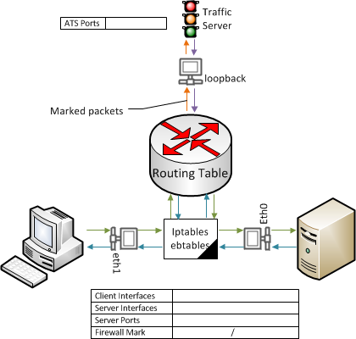
Generic Setup

Slide 27
Pre-deployment cautions
ATS box is in line so all other traffic will pass through it
Firewall mark and ATS proxy ports are arbitrary and local so select to avoid interference with other activity on the host

Slide 28
ebtables
Break packets out of layer 2 bridge
Packets then processed as in other cases
Can do both IPv4 and IPv6 with ebtables

Slide 29
iptables
Set firewall mark to enable special routing
  Can use entire mark or a bit range and value
  Only need 1 bit
  Mark based on server port and host interface
Mark TPROXY for inbound transparent
  Required for ATS to accept connection with foreign destination address
Redirect to ATS proxy port
Use ip6tables for IPv6
Notes:
Use a bit range if other firewall mark things are going on.
Outbound side doesn’t need TPROXY because it does not ACCEPT

Slide 30
iptables
iptables is used for many things, including firewalling
Lots of potential cross interference
ATS uses the mangle table only
Default iptables configuration will block ATS operation – test client to server connectivity through ATS host without ATS

Slide 31
Routing table
Use policy routing to force table for packets with ATS firewall mark
  Add table for intercepted packets
  Table sends everything to loopback
Side tables mean no direct interaction with normal routing table
Notes:
“ip rule” – list rules -> tables

Slide 32
ATS Configuration
Create proxy port(s) marked transparent as needed
ATS proxy port must agree with iptables redirection for inbound transparent

Slide 33
ATS Transparency Options
Transparency mode
  tr-in = inbound transparent
  tr-out = outbound transparent
  tr-full = fully transparent
    Can also use tr-in:tr-out
tr-pass = transparent pass through
Options other than ipv6,ipv4 may collide with transparency
Notes:
We’ll talk about pass through later
We’ll also talk about some of the other proxy port options and why they may not work

Slide 34
Host OS Configuration
Enable packet forwarding
Disable reverse path check (rp_filter) on transparent physical interfaces
Do routing or bridged configuration
  But that’s already done because of course you’ve checked for connectivity before deploying ATS
Notes:
I’m not sure why rp_filter breaks TPROXY but all my experiments show it must be disabled. RFC 3704
rp_filter is also the only thing I have found that can be “wrong” while passing pre-ATS connectivity checks

Slide 35
Specific Deployment Cases
Appendix has scripts for each case
Main script for standard routed/bridged cases
  Can use full case for either half case
Example on using NAT instead of TPROXY
Discussion on using WCCP
Notes:
Do we need iptables for outbound transparent?
We’ll talk later about the NAT case specifically

Slide 36
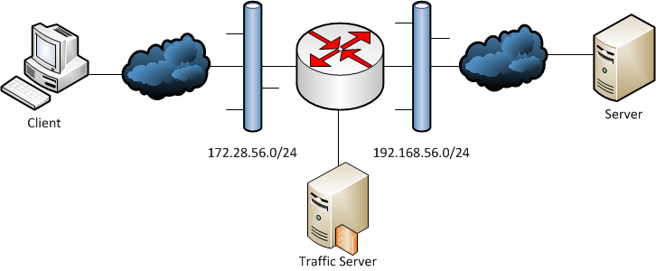
WCCP Topology
Router does packet interception for ATS

Slide 37
WCCP
Past end of life Cisco protocol, still in use
  Significant parts undocumented, no support
Effectively remote control policy routing
  Heartbeat to allow bypass on cache failure
Best with 3 (or more) interfaces
Can be done with 2 interfaces using tunnels
Pointless if not inbound transparent

Slide 38
WCCP ATS Configuration
Configuration values
  proxy.config.wccp.addr STRING <IPv4 address>
  proxy.config.wccp.services STRING <path>
Services file describes WCCP services for ATS
  Need two groups – inbound and outbound
  Must match router config
Other configuration as for previous cases

Slide 39
WCCP Host Configuration
For L2 use routed transparent case
For tunnel use 2 firewall bits
  One for packets from tunnel (TPROXY marked)
  One for packets from ATS to put in tunnel
Two interface router requires use of tunnel
Tunnel requires disabling PMTU discovery
Notes:
Non-Cisco routers may have problems because they don’t check against interfaces for traffic, and so can’t distinguish packets before and after ATS processing.

Slide 40
ATS Plugins
Can control outbound transparency per connection
Can control server address per connection
Still a few bugs on URLs because HTTP headers are different

Slide 41
Trouble shooting
Making it work

Slide 42
Trouble Shooting
Step One: Make it work without ATS
  Cannot over emphasize this
  Always see Step One
Notes:
Iptables –list -v -x # –vv for lots of data
Ebtables –t broute –L –Lc
Tcpdump –w <file>

Slide 43
Trouble Shooting Tools
Tcpdump
  Almost always installed
  Requires only text interface
  Directly or to make capture files for Wireshark
Wireshark
  Graphical interface, very powerful
iptables, ebtables hit counts
netstat --tcp --listen -n

Slide 44
Trouble Shooting – ATS logging
Debug messages have a tag
Turn on with
proxy.config.diags.debug.enabled INT 1
Set output tags with
  traffic_server command line option
  –T “tag1|tag2”
  records.config value
  proxy.config.diags.debug.tags STRING “tag1|tag2”
Value for tags is regular expression
  So “host” matches tags like “host”, “host_db”

Slide 45
Troubleshooting Checklist
Remove ATS ebtables, iptables, routing – do you have connectivity?
Enable ATS – are all the processes running?
Check ATS logs to verify startup success. Look for error messages!
  traffic.out
  error.log
  dmesg
Notes:
There are many failure conditions due to bad ATS configuration but almost all of them are reported so look for those reports!

Slide 46
Troubleshooting Checklist
Review configuration
  Verify iptables target port, ATS proxy port match
  Check iptables for packet / connection filtering
  Bridge mode – ebtables set up?
  Policy routing in place?
  Check OS tweaks (ip_forward, rp_filter)

Slide 47
Troubleshooting Checklist
Capture client side
  SYN-ACK from ATS?
  Connection / request sent?
Capture loopback
  Client SYN packets redirected?
  SYN-ACK from ATS?
Capture server side – packets outbound?
Check ATS logs for connections

Slide 48
Trouble Shooting Notes
Be careful using IP addresses to determine packet sources – the whole point of transparency is to fiddle with those
Each packet has a MAC address which is useful for determining original source
Can also use the “IP id” value to trace packet sources (shown in some tools)

Slide 49
ATS Logging
Enable debugging out
  -T “tags”
  Edit records.config values
    proxy.config.diags.debug.enabled INT 1
    Proxy.config.diags.debug.tags STRING “tag1|tag2”
Useful tags
  “hostdb”, “dns” – see outbound connections
  “http_accept” – see inbound connections
  “tproxy” - extra TPROXY related events
Output to etc/trafficserver/traffic.out
Notes:
Double check tags

Slide 50
WCCP Trouble shooting
Router: show ip wccp
ATS tag “wccp”
Look for heartbeat packets via packet capture
Check for redirected packets
Check that both service groups are working

Slide 51
Issues
Potential problems from field experience
  Origin server address resolution
  Port transparency
  Proxy port address binding
  Keep Alive
  HTTPS
  Non-HTTP tunneling
  IP family lock
  Currently limited to Linux variants

Slide 52
Origin Server Address
Origin server resolved twice – client, ATS
If server has RR DNS these may differ
Can cause problems (MS Windows Update)
Inefficient (two lookups per access)
May complicate local DNS server setup
Can override to use client supplied address
  proxy.config.http.use_client_target_addr INT 1
  But lose some control (trust client to resolve correctly)

Slide 53
Proxy Port Address Binding
Transparent ports can’t bind to local address
Inbound must de facto bind to ANY_ADDR
Outbound must bind to client source address
This leads to binding to loopback interface, not any physical interface
Proxy port options ip-in,ip-out can conflict

Slide 54
Port Transparency
By default server connection can have a different client port than actual client
Can configure ATS to use the client port
  proxy.config.http.use_client_source_port INT 1
Requires outbound transparency
Can lead to port jamming via Keep-Alive (TS-1424)
Linux kernel shares port space for port binding to foreign addresses -> ~64K connection limit
Notes:
On Linux, there is a kernel issue where “any port” binding is a single port space for all IP addresses. This means you can only have ~64K outbound connections if you do not explicitly bind the address *and* port.

Slide 55
Keep Alive
ATS doesn’t always match keep alive between client side and server side.
Can cause “port shift”
In practice seems to matter only rarely

Slide 56
HTTPS
HTTPS proxying requires certificates
  ATS must terminate the connections
  Easy for CDN situations
  Can’t just slap on ssl proxy port option
HTTPS can be blind tunneled
  Can still check IP addresses but little else

Slide 57
Non-HTTP Tunneling
There exist protocols that use port 80 and HTTP like headers but are not HTTP
By default ATS rejects the connection
TS-1423 patch enables this – use with caution

Slide 58
IP Family lock
ATS handles cross IP family connections
  E.g. IPv4 client connection, IPv6 server connection
Not possible with transparency
  Preserving the address implies preserving family
TS-1307 – DNS lookup for outbound transparent forces family
Proxy port option ip-resolve is ignored, forced to client if outbound transparent

Slide 59
Remapping
In general remapping “works”
Be careful – client and ATS will differ on the IP address for server
Currently explicitly inhibited if ATS uses server address from client connection
  Not sure now why I did that…
Can do more sophisticated things in plugin

Slide 60
Linux Required
Depends on TPROXY, iptables, policy routing
Requires POSIX capabilities or equivalent
  Transparent binding is a privileged operation
Want it to work on other operating systems? Volunteers always appreciated!

Slide 61
Script Kiddies
For inbound transparent ISP case, script kiddies probing for open servers
ATS will accept connections to any foreign IP address:port
Script thinks everything has an open port at intercept ports
Can have an impact on ATS loading
Notes:
You can’t really prevent this from inside ATS because even with negative caching you can’t tell it’s a bad address until after ATS accepts the client connection. There are things you can do with ipsets but that’s way beyond the scope of this talk.

Slide 62
Appendix
Scripts and Resources

Slide 63
Resources
ATS has online documentation, a wiki, mailing lists, bug tracker, and IRC channel. Access these via
  http://trafficserver.apache.org
NG Consulting services
  http://network-geographics.com

Slide 64
A beginning…
These scripts are just starting points
  Customize for local conditions
  Illustrate essential commands and basic options
  Plenty of other documentation for commands

Slide 65
Environmental Concerns
Scripts presume
  Client interface is eth1
  Server interface is eth0
  Server side network is 192.168.56.0/24
  Client side network is 172.28.56.0/24
  ATS proxy port is 8080

Slide 66
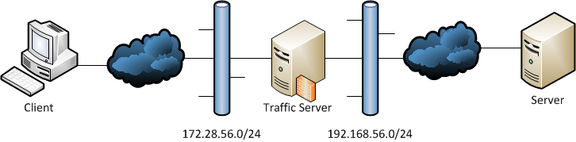

Routed Topology
Bridged Topology

Slide 67
ATS Configuration Examples
As of ATS 3.2 use the configuration value
proxy.config.http.server_ports STRING
for all proxy ports
Each proxy port has a descriptor string of colon separated values
  Two proxy ports, at 8080 for IPv4 and IPv6
  8080:ipv4:tr-full,ipv6:8080:tr-full
  Outbound transparent at 9090, IPv4, passthrough
  tr-out:tr-pass:9090

Slide 68
Setup Script
Script for bridged and routed cases
Set shell variables to control setup
Works from a cold start
  Pick out pieces for less intrusive operation
File name ‘acna-universal.sh’

Slide 69
#!/bin/sh
### Universal version for all 6 cases (bash)
# Set these to control the script operations
TOPOLOGY='BRIDGED'
# TOPOLOGY='ROUTED'
# Transparency. Set both to 1 for full.
INBOUND=1 # set to 0 for not inbound transaprent
OUTBOUND=1 # set to 0 for not outbound transaprent
## System tweaks
# Enable IP forwarding
echo 1 > /proc/sys/net/ipv4/ip_forward
# Disable RP filter. Oddly, not needed on loopback
echo 0 > /proc/sys/net/ipv4/conf/eth0/rp_filter
echo 0 > /proc/sys/net/ipv4/conf/eth1/rp_filter
if [ $TOPOLOGY = 'BRIDGED' ] ; then
## Set up the bridge interfaces
# Update cluster interface if set to a subsumed interface
brctl addbr br0
ifconfig br0 up
brctl stp br0 off
brctl addif br0 eth0
brctl addif br0 eth1
# Turn off addresses on physical interfaces to avoid confusion
ifconfig eth0 0 0.0.0.0
ifconfig eth1 0 0.0.0.0
## Put an address on the bridge virtual interface
#ifconfig br0 192.168.56.11 netmask 255.255.255.0 up
## Or use DHCP:
# Shutdown current DHCP client operation, terminate any leases.
# This avoids problems with subsumed interfaces holding addresses
dhclient -r
# Start DHCP client daemon for bridge interface
dhclient br0
## Do the same for IPv6 if needed
#ip -6 addr add fc01:192:168:56::11/64 dev br0
fi
## Set up policy routing for redirected packets
# Clear any existing rules.
ip rule delete fwmark 1/1 > /dev/null 2>&1
ip -6 rule delete fwmark 1/1 > /dev/null 2>&1
# Add new rules
ip rule add fwmark 1/1 table 1
ip -6 rule add fwmark 1/1 table 1
# Set routes to use rules
ip route add local 0/0 dev lo table 1
ip -6 route add local ::/0 dev lo table 1
if [ $TOPOLOGY = 'BRIDGED' ] ; then
# Routing tables need to have a default route via br0 and not via one of the
# physical interfaces. The latter seems to break anything that goess off the local
# network. Sometimes you have to delete those routes explicitly.
# ip route delete default via 192.168.56.1 dev eth0
# br0 must have an address on the same network as the default gateway addr
ip route add default via 192.168.56.1
#ip -6 route add default via fc01:192:168:56::11
fi

Slide 70
## Iptables setup
# IPv4
# Brutal - get rid of everything else in the mangle table and put our stuff in
iptables -t mangle --flush PREROUTING
if (( $INBOUND )) ; then
iptables -t mangle -A PREROUTING -i eth1 -p tcp -m tcp --dport 80 -j TPROXY --on-ip 0.0.0.0 --on-port 8080 --tproxy-mark 1/1
fi
if (( $OUTBOUND )) ; then
iptables -t mangle -A PREROUTING -i eth0 -p tcp -m tcp --sport 80 -j MARK --set-mark 1/1
fi
# Be sure we're not filtering packets before they go to ATS (default on Linux)
# This disables *all* firewall protection. Don't do this if you want to preserver
# any filtering! In that case verify the filter rules don't break connectivity.
# I use this because the default installed rules are a problem.
iptables -t filter --flush FORWARD
ip6tables -t filter --flush FORWARD
iptables -t filter --flush INPUT
ip6tables -t filter --flush INPUT
# You might need to flush the mangle table as well, if there's cruft there.
if (( $INBOUND )) ; then
ip6tables -t mangle -A PREROUTING -i eth1 -p tcp -m tcp --dport 80 -j TPROXY --on-ip :: --on-port 8080 --tproxy-mark 1/1
fi
if (( $OUTBOUND )) ; then
ip6tables -t mangle -A PREROUTING -i eth0 -p tcp -m tcp --sport 80 -j MARK --set-mark 1/1
fi
if [ $TOPOLOGY == 'BRIDGED' ] ; then
## EBTables setup - bounce all port 80 TCP traffic to iptables (layer 3 routing)
# Flush the table - again, you'll need to do more testing if this isn't viable
ebtables -t broute -F
if (( $INBOUND )) ; then
# enable routing for traffic to web server
ebtables -t broute -A BROUTING -p IPv4 --ip-proto tcp --ip-dport 80 -j redirect --redirect-target DROP
ebtables -t broute -A BROUTING -p IPv6 --ip6-proto tcp --ip6-dport 80 -j redirect --redirect-target DROP
fi
if (( $OUTBOUND )) ; then
# do the same from traffic from web server
ebtables -t broute -A BROUTING -p IPv4 --ip-proto tcp --ip-sport 80 -j redirect --redirect-target DROP
ebtables -t broute -A BROUTING -p IPv6 --ip6-proto tcp --ip6-sport 80 -j redirect --redirect-target DROP
fi
fi

Slide 71
Transparency with NAT
Can use the iptables NAT capability for inbound transparent
ATS proxy port is not marked inbound transparent!
For outbound transparent could use TPROXY but then why use NAT inbound?
Must resolve server address in ATS, the client resolved server address is destroyed by NAT
IMHO only useful for inbound transparent case to avoid TPROXY entirely
See appendix script for implementation details

Slide 72
NAT style
Proxy ports “8080”
iptables
iptables –t nat –A PREROUTING –i eth1 –p tcp –m tcp --dport 80 –j REDIRECT --to-port 8080
Enable IP forwarding
echo 1 > /proc/sys/net/ipv4/ip_forward

Slide 73
WCCP Setup
Example router config
  Tunnel addresses are on the 10.28.56.0/24 network
  ATS host shares outside interface network (192.168.56.0/24)
no ip source-route
ip wccp check services all
ip wccp 51 password apache
ip wccp 52 password apache
interface Tunnel0
ip address 10.28.56.1 255.255.255.0
tunnel source 192.168.56.12
tunnel destination 192.168.56.11
interface FastEthernet0/0
ip address 192.168.56.12 255.255.255.0
ip wccp redirect exclude in
ip wccp 52 redirect in
interface FastEthernet0/1
ip address 172.28.56.12 255.255.255.0
ip wccp 51 redirect in
Notes:
These are not as well tested

Slide 74
ATS Host config for WCCP (example)
# Man page says 'delete' but that doesn't work. Must use 'del'
ip tunnel del wccp-tunnel > /dev/null 2>&1
ip tunnel add wccp-tunnel mode gre remote 192.168.56.12 local 192.168.56.11 nopmtudisc
ip link set wccp-tunnel up # must be up or route add will complain
ip addr add 10.28.56.2/24 dev wccp-tunnel
ip route add 10.28.56.0/24 dev wccp-tunnel
ip route add 172.28.56.0/24 dev eth0 via 192.168.56.12
# Clear out old cruft. Really should parse the output of
# ip rule list. Someday...
ip rule delete fwmark 1/3 > /dev/null 2>&1
ip rule delete fwmark 1/1 > /dev/null 2>&1
ip rule delete fwmark 2/3 > /dev/null 2>&1
ip rule delete fwmark 2/2 > /dev/null 2>&1
ip rule add fwmark 1/3 table 1
ip rule add fwmark 2/3 table 2
if [ ! -z "$(ip route show table 1)" ] ; then
ip route delete table 1;
fi
if [ ! -z "$(ip route show table 2)" ] ; then
ip route delete table 2;
fi
ip route add local 0.0.0.0/0 dev lo table 1
ip route add default dev wccp-tunnel via 10.28.56.2 table 2
# Clear current iptables
iptables -t mangle --flush
# Bypass local network traffic
iptables -t mangle -A PREROUTING -s 192.168.56.0/24 -i eth0 -j ACCEPT
iptables -t mangle -A PREROUTING -d 192.168.56.0/24 -i eth0 -j ACCEPT
iptables -t mangle -A PREROUTING -i wccp-tunnel -p tcp -m tcp -j TPROXY --tproxy-mark 1/3 --on-port 8080
iptables -t mangle -A OUTPUT -p tcp -m tcp --sport 80 -j MARK --set-mark 2/3
echo 1 > /proc/sys/net/ipv4/ip_no_pmtu_disc

Slide 75
WCCP services file
security = {
key = "apache";
option = "MD5";
};
services = (
{
name = "ATS Client";
description = "Capture packets from client.";
id = 51;
type = "DYNAMIC";
priority = 240;
protocol = 6;
primary-hash = ( "src_ip" );
ports = ( 80 );
assignment = ( "hash" );
forward = ( "gre" );
return = ( "gre" );
routers = ( "172.28.56.12" );
},
{
name = "ATS Server";
description = "Capture packets from origin server.";
id = 52;
type = "DYNAMIC";
priority = 240;
protocol = 6;
primary-hash = ( "dst_ip" );
ports = ( 80 );
port-type = "src";
assignment = ( "mask" );
forward = ( "gre" );
return = ( "gre" );
routers = ( "172.28.56.12" );
}
);

