Slide 1
Case Study: Apache OODT Framework Application for Support to the Joint Polar Satellite System (JPSS)
Richard Ullman, Peyush Jain, Wayne McCullough
NASA Goddard Space Flight Center, Greenbelt MD
ApacheCon NA
Portland, OR
February 26-28, 2013

Slide 2
Agenda
GRAVITE Overview
Investigator Processing System (IPS) Design using OODT
Performance Measures

Slide 3
GRAVITE Overview
(Government Resource for Algorithm Verification, Independent Test, and Evaluation)

Slide 4

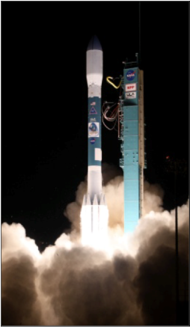


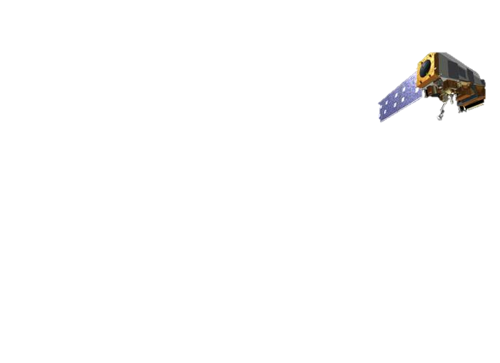
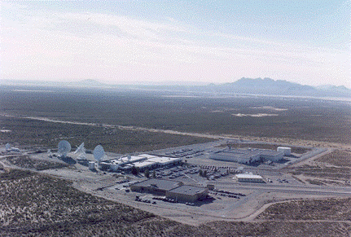


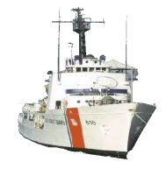
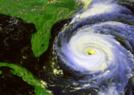
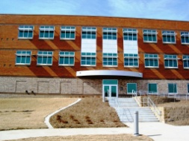
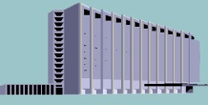


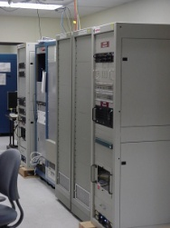
JPSS-1 Mission Architecture
GPS
TDRSS
Space Segment
Science Data Segment
CLASS
(Archive)
JPSS-1
User
Community
WSC
T&C (S-band)
SMD (Ka-band)
Launch
Segment
Space/Ground Communications Node
Polar Ground Stations
(Svalbard, Fairbanks,
McMurdo, Troll)
Cal/Val Node (GRAVITE)
ESPC
NOAA (NWS)
Ingest
Management & Ops Node
NSOF
CBU
NSOF MMC
Data Del
Data Del
Product Generation
AFWA
Field Terminal Users
Ground Network Node
DQM
CBU MMC
Process
Infra
Process
Infra
Product Distribution
Data Mgt
Data Mgt
J1 Simulator
Node
(FVTS)
Ingest
Ingest
JPSS SMD Hub
at NSOF
JPSS SMD Hub at CBU
Data Processing Node (IDPS)
Ancillary Data Relay
NAVY
FNMOC/ NAVOCEANO
JPSS Ground System
Ground Segment
Key:
Mission Data
Command and Telemetry
Ancillary Data
Climate User
Community

Slide 5
JPSS-1 Mission System
Space Segment
Ground Segment
Satellite
Ground System
NOAA Environmental Satellite Processing Center (ESPC)
Spacecraft
Instruments
Management & Operations Node
Ground Network Node
Space / Ground Communications Node
Ground Support Equipment
Simulation Node
Calibration & Validation Node
Ingest
Launch Segment
Product
Generation
Data Processing Node
Common Ground System Support Node
Launch Vehicle
Launch Facilities
Product Distribution
Field Terminal Support Node
Infrastructure
External Interfaces
National Weather Service
(NWS) & Other NOAA Users
Field Terminal Users
NASA Space Network
NASA Flight Dynamics Facility
NASA Science Data System
Operational Users:
AFWA / FNMOC / NAVOCEANO
NOAA Comprehensive Large-Array Stewardship System (CLASS)
NASA Conjunction Assessment and Risk Analysis (CARA)

Slide 6
Overview:
GRAVITE Purpose
GRAVITE is the Calibration & Validation Node to support JPSS mission data products and algorithm operational science:
  Instrument Calibration
  Product Validation
  Algorithm Verification
  Algorithm and Product Operational Tuning
  Product Data Quality Support
  Algorithm Investigation

Slide 7
Overview:
GRAVITE Definition
GRAVITE design is two-faceted:
  “Bring the computer to the data” Siting at NSOF places analysis and support CPU in the same datacenter as the original data production. Blade center CPUs are applied in a variety of ways on a large store of mission data.
  “Bring the data to the computer” GRAVITE is a store-and-forward fan-out for remote science “Local Computing Facilities (LCFs)” to receive mission data for analysis.
GRAVITE is:
  A mission data support system; Class “C” under NASA standard 7150.2A

Slide 8
Overview:
Design Philosophy
Follow NASA 7150.2A
AND strive whenever practical to:
  Use Open Source with PARTICIPATION
    Release custom components to the open source community drives build quality that must survive anonymous and unsympathetic peer review.
  Adapt processes to core off-the-shelf components rather than use exotic extensions or custom build.
  Design for the “general abstract case.” A few core components are preferable to many special purpose components.
  Reconfigure or re-factor rather then reinvent.

Slide 9

Overview:
GRAVITE Subsystems
IDPS
Correlative Sources
G-ADA
Correlative Sources
Ingest
CLASS
Processing
Data Access and Distribution
CLASS
Inventory
ICF
Portal
LCFs
login

Slide 10
Overview:
GRAVITE Subsystems
GRAVITE – Government Resource for Algorithm Verification, Independent Test, and Evaluation
  Inventory – Science Mission Data and Correlative data as defined and required for calibration and validation activities.
  IPS - Investigator-led Processing System, a production system. Runs PGEs for Cal/Val artifacts, Algorithm Support artifacts, and Data Quality Monitoring artifacts.
  G-ADA – GRAVITE Algorithm Development Area, an instance of the algorithm operational production environment. Runs Algorithms for alternate processing and unit test.
  ICF – Investigator Computing Facility, a commodity Linux system for general investigation using the data inventory.
  Portal – Knowledge and coordination sharing through Blogs, Wikis, Action trackers, etc.
  Ingest – Inserts data into the inventory.
  Distribution – Push or Pull; to external partners or internal subsystems.
  LCF – Local Computing Facilities: Generically interfacing institutional computing facilities.

Slide 11
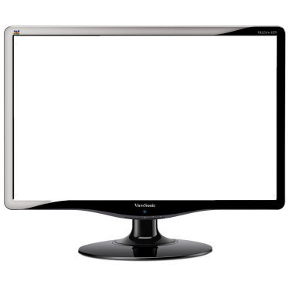










Overview:
IPS
Data Sources
END
Result
DIST
INGEST
START
Investigator
Data
Store
PGE
Trigger
Result
PGE
Staff / AIT
Operator
PGE Creation and Integration
PGE Operation and Result Distribution
The Investigator Processing System (IPS) is a set of components that provides a data-rich, data-driven and operator-managed production service for the ACVST investigator to direct routine, well defined “near-line” production in support of Cal/Val, Algorithm Operation, and Product Quality Monitoring.

Slide 12









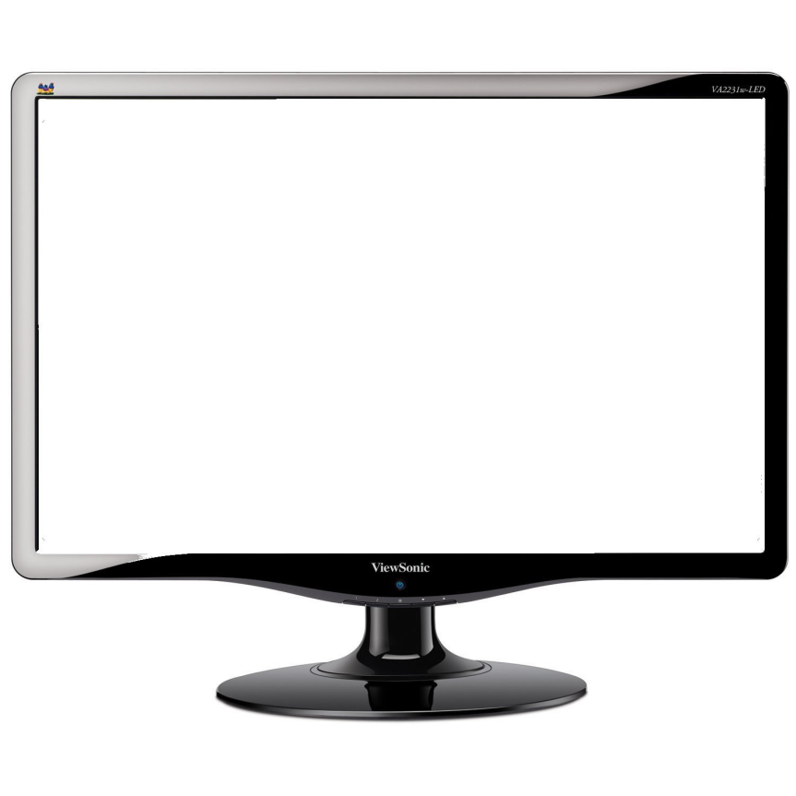

Overview:
ICF
Data
Store
etc.
Mission and
Correlative
Data
Data Center CPU
user and shared workspaces
user and GRAVITE applications
libraries, compilers, COTS,
GOTS, ADL, etc
Portal
The Investigator Computing Facility (ICF) provides virtual private network entry for ACVST investigator to interactively use custom and shared computing applications to the resource. To the LCF workstation, the CPU, data store and portal are “in the cloud”.
VPN
Local
Computing
Facility (LCF) Investigator Workstation

Slide 13


GRAVITE Overview:
ADA
Data Sources
END
Result
DIST
INGEST
START
Investigator
Data
Store
Result
ADA User
Alternate Production and Result Distribution
GRAVITE Algorithm Development Area (ADA) provides an “operations-like” environment for trained ADA investigators “alternate production” of proposed algorithm changes or of baseline algorithms using alternate inputs.

Slide 14




Overview:
ADA
Unit Functional Test
START
Unit Regression Test
Investigator
ACP
ACP
END
Result
DRAT / AERB
Forward ACP for integration into Operations
JAM / AIT
Operator
Unit Test of ACP
GRAVITE Algorithm Development Area (ADA) provides an “operations-like” environment for unit testing of proposed algorithm changes in the form of an Algorithm Change Package (ACP). After verification, ACP is forwarded to CGS contractor for integration.

Slide 15
Overview:
GRAVITE : Scope of Discussion
IDPS
Correlative Sources
G-ADA
Correlative Sources
Ingest
CLASS
Processing
Data Access and Distribution
CLASS
Inventory
ICF
Portal
LCFs
login

Slide 16
IPS Design

Slide 17
Driving Requirements
  The GRAVITE shall ingest a sum total of up to 5.0 TB/day across its point-to-point and web-based interfaces.
  The GRAVITE shall allow authorized users to upload data for ingest.
  The GRAVITE shall allow operators and authorized users to classify data, software, and documentation as unrestricted, proprietary, licensed or ITAR.
  The GRAVITE shall generate searchable metadata parameters for ingested data items.
  The GRAVITE shall provide authorized users access to stored data and hosted documentation based on their account permissions.
  The GRAVITE shall allow operators and authorized users to execute automated data processing jobs.
The GRAVITE shall perform automatic removal of data files once past their assigned retention period.

Slide 18
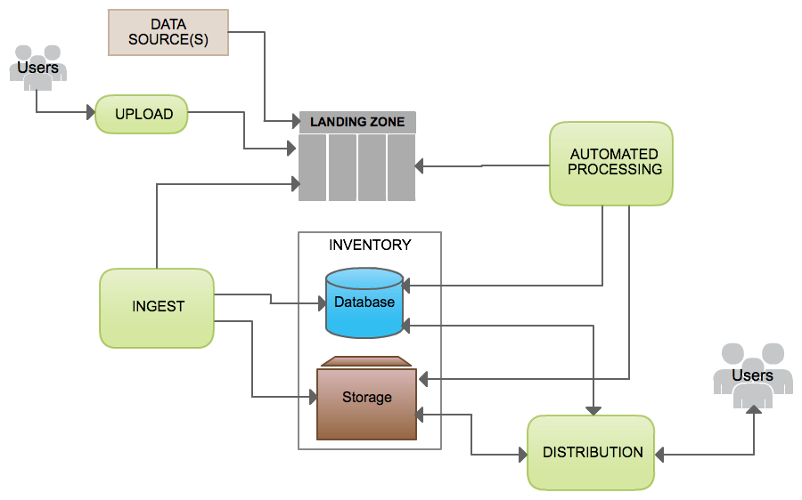
Overview

Slide 19
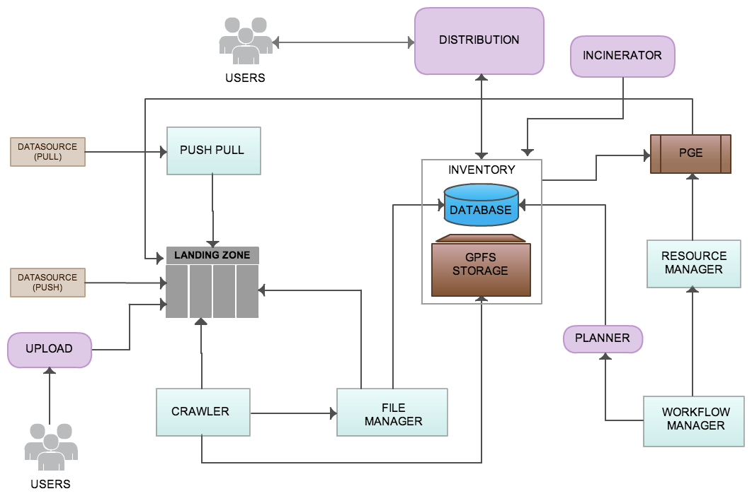
Overview
INGEST

Slide 20
Overview
AUTOMATED PROCESSING
INGEST

Slide 21
Overview
DISTRIBUTION
AUTOMATED PROCESSING
INGEST

Slide 22
Overview
DISTRIBUTION
AUTOMATED PROCESSING
UPLOAD
INGEST

Slide 23
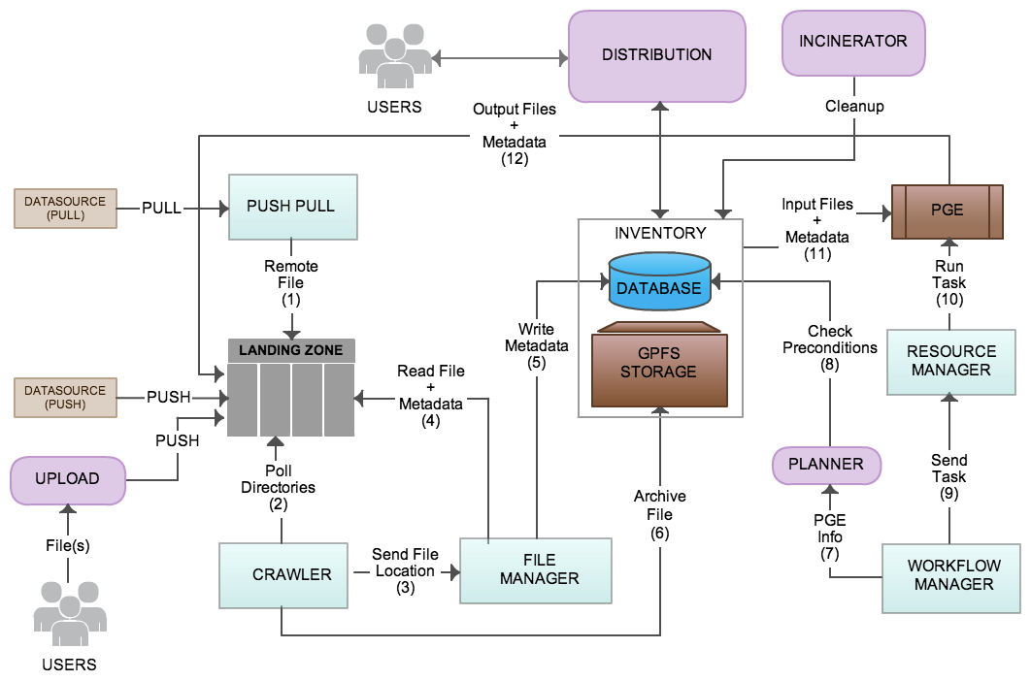
Overview

Slide 24
Overview
Data sources either push files to the landing zone or Push Pull component pulls remote files and place them on the landing zone.
Crawler component looks for new files on landing zone and passes file locations to File Manager component.
File Manager reads file metadata; writes metadata related entries to the database. Crawler archives files in storage.
Workflow Manager sends PGE information to the Planner. Planner checks to see if all pre-conditions are met for running a PGE. If conditions are met, Workflow Manager component sends a task to Resource Manager component.
Resource Manager executes task on available machine. Outputs are sent to the landing zone for ingest.
Database and storage together makes up Inventory
Distribution component makes data available to the users.

Slide 25
Overview
OODT components:
  Push Pull
  Crawler
  File Manager
  Workflow Manager
  Resource Manager
New development:
  Distribution
  Upload Tool
  Inventory
  Planner
  Incinerator

Slide 26
Ingest

Slide 27
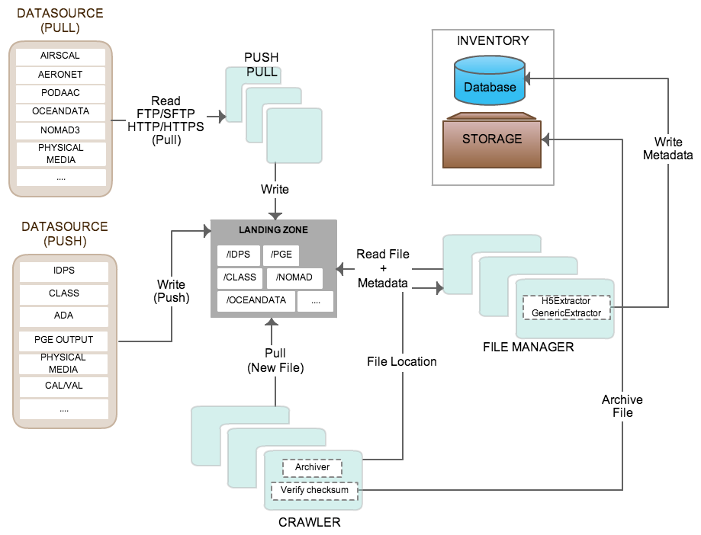
Ingest

Slide 28
Ingest
Pulls data from sources like AERONET, NOMAD3, PODAAC, physical media, etc. to the landing zone.
IDPS, CLASS, ADA, Users, PGEs, etc. pushes data to the landing zone.
Separate Crawler instances monitor directories and subdirectories for each data source for new files.
Crawler verifies checksum. Crawler sends file location to File Manager. It is also responsible for moving files from landing zone to storage.
File Manager defines H5 and generic metadata extractors to extract metadata and populate the database.

Slide 29
Distribution

Slide 30
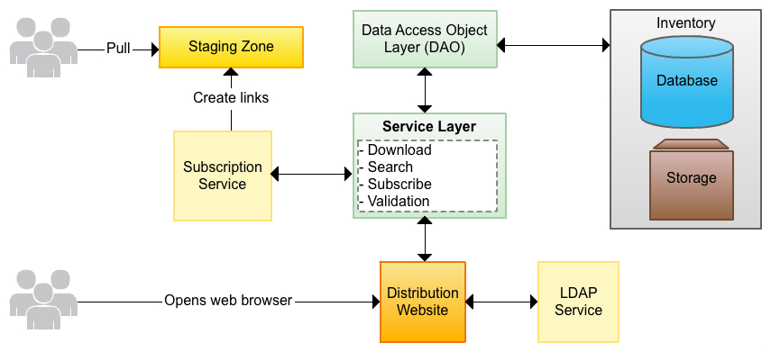
Distribution

Slide 31
Distribution
Users will be authenticated via LDAP.
Users will be able to perform extensive searches and retrieve datasets via web portal.
Users will be able to subscribe to specific datasets via web portal. Subscription service will create links to subscribed files in the staging area (under GRAVITE).
Database will be accessed only via Data Access Object (DAO) layer.
Service layer will use DAOs to validate and process user requests.

Slide 32
Upload

Slide 33
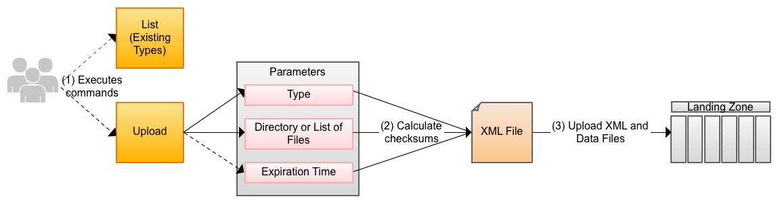
Upload

Slide 34
Upload
Upload tool allows users to insert arbitrary data into system
Upload tool will be passed three different parameters
  Type
  Source files
  Expiration Time
An XML file will be created so that the ingest module knows where to upload the files to on the Landing Zone

Slide 35
Automated Processing

Slide 36
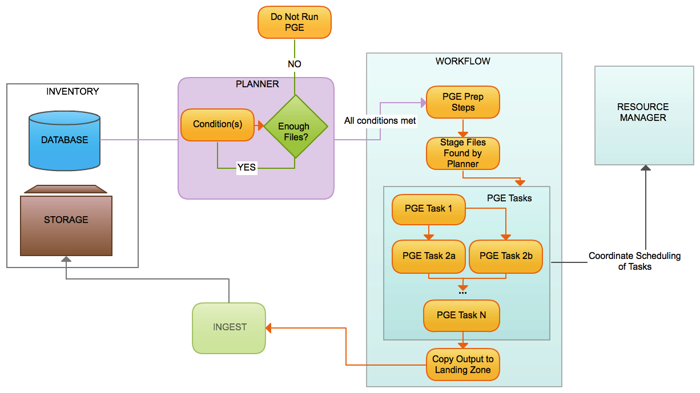
PGE

Slide 37
PGE
The PGE Planner will verify that all input files have been received.
  The Planner will check the inventory for all granule-based input files.
  The Planner will check for all other non-granule inputs necessary for the PGE to run
Workflow is initiated by the planner
  Creates working directory
  Stages files found by planner
PGE comprised of several tasks
  Tasks are then sent to the Resource Manager for execution
On completion, Output files sent to landing zone
  Ingest task will add them to inventory

Slide 38
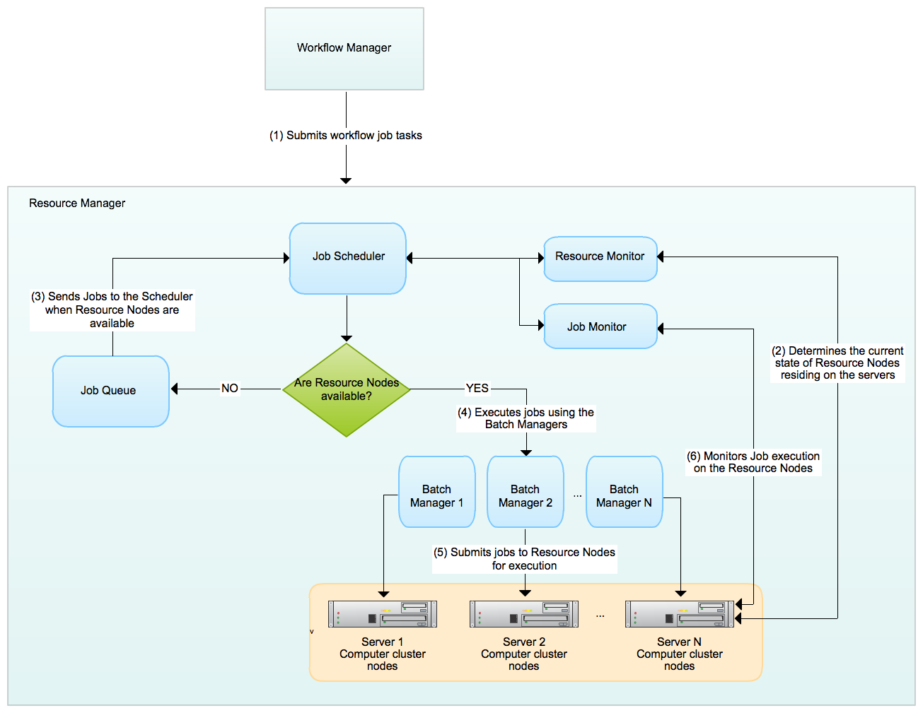
Resource Manager

Slide 39
Resource Manager
The Workflow Manager submits workflow job tasks to the Resource Manager.
The Resource Manager uses the Resource Monitor to check the current state of the Resource Nodes to execute the jobs on.
If no Resource Nodes are available for job execution, the Scheduler queues the jobs using the Job Queue.
If Resource Nodes are available, the Job scheduler uses the Batch Managers to submit the jobs for execution to the available Resource Nodes on the servers.
The Job scheduler uses the Job Monitor to check the status of job executions.

Slide 40
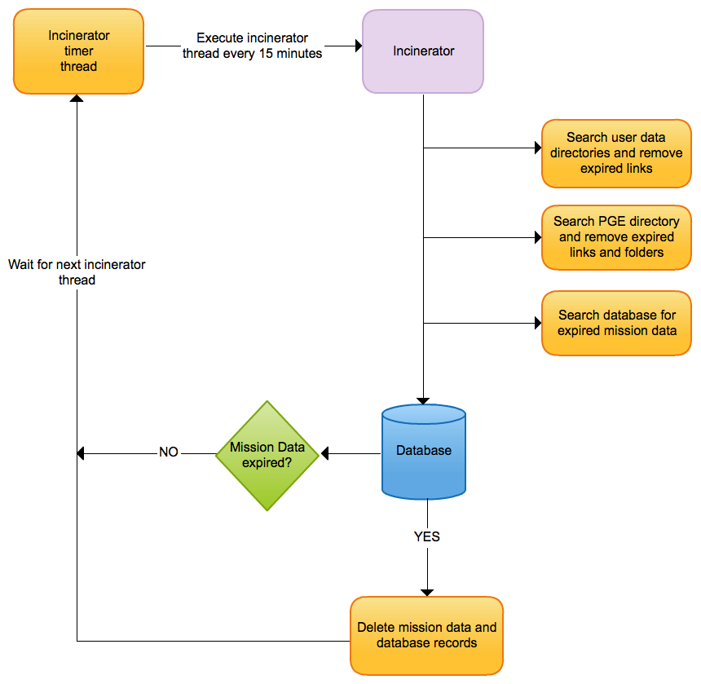
Incinerator

Slide 41
Incinerator
The Incinerator is scheduled to run every 15 minutes.
The Incinerator searches user data directories and removes links after configurable time expires.
Incinerator searches PGE directory and removes links and folders after configurable time expires.
Incinerator checks database for expired mission data based on their expiration date and if the data is expired, the data gets deleted with its corresponding database record.
Configurable time to expire links and folders is nominally set to 7 days.

Slide 42
Database
PostgreSQL
  Open source database
  Designed to support high transaction, mission-critical applications
  Supports Geospatial searching capability
  Replication support
  Error messages are descriptive
PostGIS
  Extension to PostgreSQL
  Spherically correct spatial searches
Hibernate
  Industry Standard ORM (object relational mapping)
  Low Overhead
  High Maintainability and Flexibility

Slide 43
Database
Every data file will have records in the database.
  Essential file information will be stored and updated when appropriate.
  Metadata is stored, dependent upon file type.
The information needed to run subscriptions is stored in the database.
The information needed to plan and prepare a PGE execution is stored in the database.

Slide 44
Statistics
Tables created for Ingest, Distribution, and PGE
  Ingest
    Files & bytes per Source ingested in a period of time
  Distribution
    Files & bytes served per user
    Files served via local subscriptions per user
  PGE
    Run time
    Exit status
    Jobs started/completed per unit time
    Backlog per unit time (jobs queued not started)

Slide 45
Performance

Slide 46
Hardware/Software Mapping
Hardware For Tests:
  Each IBM Blade:
    Intel Xeon Processor E5-2640 6C 2.5GHz 15MB Cache 1333MHz 95W (2)
    IBM 256GB SATA 2.5" MLC HS Entry SSD (2)
    QLogic 2-pt 10Gb Converged Network Adapter(CFFh) (1)
  IBM GPFS Storage
  Tests done on single NSD Server for GPFS
    Connected via Fibre Channel to single SAN in RAID-6 configuration
Software:
  Red Hat 6.3 (Operating System)
  Eclipse Juno (IDE)
  PostgreSQL 9.1.6 (Database)
  JDK 1.6 (Java)
  Maven 2.2 (Manages project build, reporting, and documentation)
  Python 2.7 (Python)
  h5dump 1.8.9 (Dumps directory of hdf5 into XML)

Slide 47
Performance Methodology
Strategy
  Identify each step of task
  Do performance testing of each step
  Verify that each step can exceed necessary performance
Components to Verify:
  Ingest
  Inventory
  PGE
  Distribution

Slide 48
Ingest Tasks
Ingest Tasks
  Detect
  Verify
  Extract Metadata (H5Dump)
  Store File info and Metadata in Database
  Archive data
One orbit is 102 minutes
  Each task must be take less than one orbit for one orbit of data.
  The total cost of tasks must be less than one orbit

Slide 49
Ingest Performance: Verify and Extract

Slide 50
Ingest Performance: Verify and Extract
Verify Performance of HDF Dump & Metadata extraction
  Each task needed to be performed once per file
Worst Performance Single Thread: 8.6 FPS (23.25 minutes per orbit)
Many Threads: 19.55 FPS (10.25 minutes per orbit)
Conclusions:
  We can perform these tasks in the needed time.
  We can increase performance by parallelizing the job.
  Increasing the parallelization results in diminishing returns more than five concurrent tasks.

Slide 51
Database Performance
Operation | No Load (MM:SS) | Heavy Load (MM:SS)
Insert | 0:53 | 1:29
Update | 0:58 | 1:30
Get | 0:39 | 0:44
Delete | 0:03 | 0:05
Total Per Orbit | 2:34 | 3:49
Database Performance
  Estimated total cost of DB operations per orbit: 2.6 minutes
    Includes incinerator, PGE, and distribution usage
    Ingest only: 1.85 minutes
  3.8 of DB operations under heavy load.

Slide 52
Ingest Tasks Performance
Ingest (One orbit is 102 minutes)
  Detect
    Crawl Files: 0.4 minutes per Orbit
      (the time it takes to look through one orbit of files (~12,000 files))
  Verify
    7.9 minutes per Orbit for Checksum of files.
  Extract Metadata (H5Dump)
    2.7 minutes per Orbit/ 74 fps
      (the time it takes to pull the metadata into xml format, and unmarshal the XML)
    10.6 minutes per Orbit/ 18 fps for verify (checksum) and H5Dump
  Store File info and Metadata in Database
    1.85 minutes per Orbit
  Archive data
    0.4 minutes to move.
Total: 13.2 minutes

Slide 53
OODT Ingest Performance

Slide 54
OODT Ingest Performance
Goals
  Must take less time to ingest one orbit of all files than the duration of orbit. (102 minutes)
  Required: 5 TB/day = 73 minutes for 262 GB of one Orbit Data
  Want to do ingest in half this:
    Reasonable safety margin.
    Handles unexpected higher loads.
Results
  Function of number of file managers used.
  Performance improves with more file managers.
  Diminishing returns at about 7.
    7 File Managers on 1 machine: 22 mins 52 secs for one orbit of data (262 GB)

Slide 55
PGE Performance

Slide 56
Performance Metrics
Test Methodology:
  A single PGE is run on NSIPS and timed.
  A single PGE is run on the GV3 hardware within the OODT framework and timed.
  A single PGE is run within the GV3 hardware outside of OODT and timed.
As shown, OODT does not add any meaningful overhead with regard to executing a PGE. For example,
  VIIRS SST PGE
    Within OODT: 33.8 minutes
    Run on command line: 36.7 minutes
OODT can perform single PGEs faster than NSIPS. For example,
  VIIRS SST PGE
    NSIPS: 70 minutes
    GV3: 36.7 minutes

Slide 57
Multiple Instance PGE Performance

Slide 58
Performance Metrics
Test methodology
  The VIIRS SST and VIIRS IMG GEO PGEs were selected for performance testing.
  OODT has the capability to run multiple PGEs in parallel.
  All tests execute between 2, 3, or 4 PGEs in parallel.
  OODT sends PGE tasks to two servers.
  All PGEs are run in parallel.
Completion times for the slowest PGE are shown.
The OODT PGE performance exceeds NSIPS performance.

Slide 59
Distribution Performance
Distribution Performance Analysis
  System not built; Analyze tasks based on knowledge and other tests.
  Cost to do a search (see database performance: ~1 s per search)
  Cost to create links (known to be minimal cost on POSIX systems)
  Cost to download is primarily limited by user connection
    Lesser extent limited by GRAVITE network load, GPFS. (see networking section). Believe this because:
      Checksum task from ingest reads every byte of a file.
      Read one orbit in 7.9 minutes.
      Information about file access in low load, one CPU, one node GPFS configuration.

Slide 60
Performance: Summary
Conclusion: The proposed hardware, software, and design can exceed our requirements.
  Ingest can exceed requirements by at least a factor of 2.
  Database is capable of performing under heavy load.
  With new hardware, PGEs run faster within OODT framework than the previous system.
  Analysis of distribution system shows it should not be limited by software components.

Slide 61
Backup Slides

Slide 62
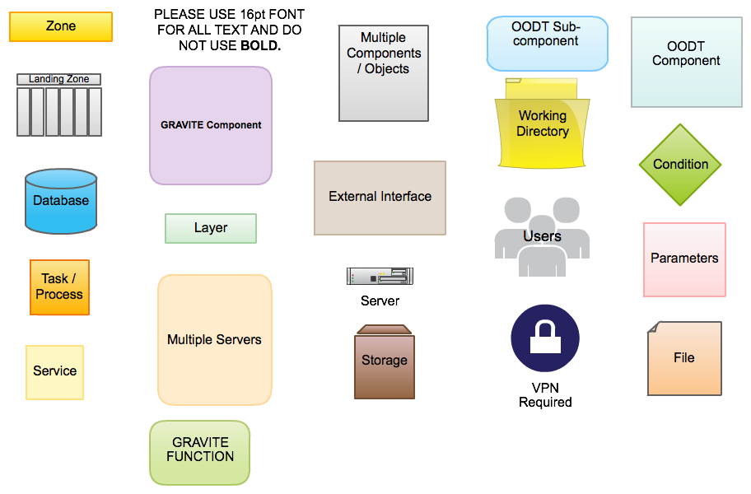
Diagram Key

Slide 63
Acronym and Abbreviation List
ADA: Algorithm Development Area
AERONET: Aerosol Robotic NETwork
CGS: Common Ground System
DQM: Data Quality Monitoring
FPS: Files per Second
GRAVITE: Government Resource for Algorithm Verification, Independent Test, and Evaluation
IDPS: Interface Data Processing System
ICF: Investigator Computing Facility
IPS: Investigator-led Processing System
LCF: Local Computing Facility
LDAP: Lightweight Directory Access Protocol
NOMAD: NOAA Operational Model Archive Distribution System
NSD: Network Shared Disk
OTS: Off The Shelf
PGE: Product Generation Executable
PODAAC: Physical Oceanography Distributed Active Archive Center
SST: Sea Surface Temperature
VIIRS: Visible Infrared Imaging Radiometer Suite

