Slide 1
A Look at Apache OODT Balance Framework
Shakeh Elisabeth Khudikyan
NASA Jet Propulsion Laboratory,
California Institute of Technology

Slide 2
Overview
Brief overview of Apache OODT
Problem – Solution
What is Balance?
Installation & Configuration Demonstration
Notes:
Give a brief overview of OODT – how it started and very top-level talk about what it does.
large framework - all details cant be discussed in one hour so my talk today will focus on the Balance framework
why develop Balance? What were the issues and how we decided to handle it? We will be looking at the architecture, giving a demo of how to install and configure your own balance web application

Slide 3
The Start
Originally developed at
NASA's Jet Propulsion Laboratory
Funded initially in 1998 by NASA’s Office of Space Science
Envisioned as a national software framework for sharing data across heterogeneous, distributed data repositories
Credit: C. Mattmann
Notes:
developed at the Jet Propulsion Laboratory with funding from the NASA Office of Space Science. It was build to reduce redundancy and overhead in the development of science data systems for NASA missions
formed the basis for a software product line approach to developing mission software for data management.
success →led to broader recognition
with the extension of the core set of components we have gained the ability to support a greater range of data management and processing use cases.

Slide 4
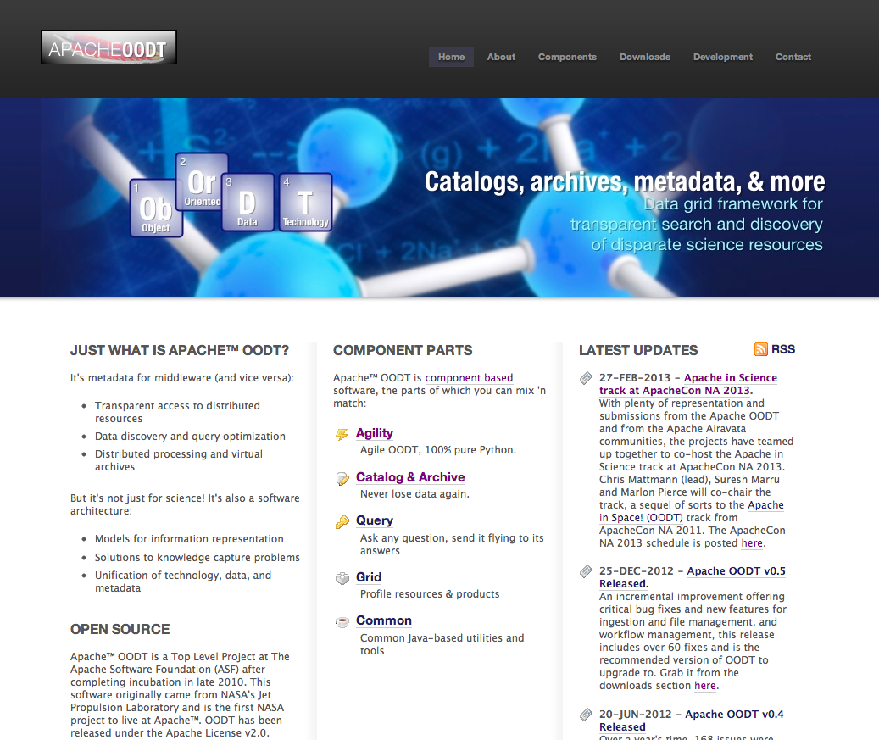
OODT at Apache
Entered “incubation” at the Apache Software Foundation in 2010
Selected as a top level Apache Software Foundation project in January 2011
The first NASA project to live at Apache™.
Notes:
As the software matured, it became apparent that aspects of the framework were applicable to a wider set of situations involving the cataloging, processing, and dissemination of data and metadata
enter incubation in 2010
Top Level Project at The Apache Software Foundation (ASF) after completing incubation in late 2010. This became the first NASA project to live at Apache™. OODT has been released under the Apache License v2.0.

Slide 5
Just What is OODT?
Object Oriented Data Technology
http://oodt.apache.org
Notes:
Set of software components designed to facilitate the rapid construction of robust software systems for large-scale data management.
Composed of loosely connected components –give projects the flexibility to decide for themselves what components to use
the data collected by scientists and engineers in these disparate disciplines can be jointly searched, stored, retrieved, and analyzed, from anywhere in the world
File Manager does Data Management
Tracks all of the stored data, files & metadata
Workflow Manager does Pipeline Processing
Automates processing when all run conditions are ready
Monitors and logs processing status

Slide 6
The Solution is Apache OODT Balance!
Interaction primarily via command line
No reusable front end components
Supports reuse
Provides a common, modular code base
Highly configurable layer to interface with Apache OODT core
Notes:
Common practice has been to expose components via command line, disjoint, no seamless integration
Balance is the solution. It has been designed to mitigate these struggles
works smoothly with an existing system and can be activated and used as if it had been built into the system

Slide 7
What is Balance?
Lightweight PHP Web Application Framework
Great support for Apache OODT integration
Creates a standard environment
Available as a PHP Extension and Application Repository package
Notes:
provides a common codebase where one can quickly build PHP web applications
Great a layer to interfaces with core OODT services.
Because Balance was developed in a fast-paced environment, it was designed to make common Web-development tasks fast and easy.
This standard environment is available through PEAR, which makes it extremely easy to install and maintain
Standard environment → that you can built modules that count on the running environment

Slide 8
Application Skeleton
classes/
modules/
scripts/
widgets/
static/
css/
img/
js/
libs
views/
common/
errors/
.htaccess
config.ini
hooks.php
index.php
More on this later
Store all resources
Plain PHP files
Configure application
Kickoff Balance bootstrap!
Notes:
Standardized structure Web framework that encourages rapid development and clean design. -> Organized to easily read and modify content
Classes → All app classes would go
Modules → Our extensions are organized exactly in the same format as the application with all the same directories in place for consistency – these are what we call modules but we will talk more about modules later
Scripts → Request that are processed but it does not directly present the user with anything. widgets reusable bits of view code that can be placed on many application pages
Static → this is a great place to add jquery libraries and skins – Easily add your own skin and libraries
Views →
No template language required, plain PHP,
Support for common sections -> headers, footers, menus
Support for nesting of multiple views
Config.ini → all configuration for application will be done in this file
Main Index.php → will initialize the balance library

Slide 9
Balance Library
Balance Core
Interfaces
Notes:
The library consist of the core code and interfaces

Slide 10
Balance Core
Application Class
Request Class
Response Class
Data Response Class
Notes:
Application → Main class for OODT Balance web applications. Contains utility methods and definitions that provide standard functionality across the site
ApplicationRequest → Provides methods for interpreting and processing a resource request
ApplicationResponse → Provides functions for dynamically constructing and delivering a response to a resource request
ApplicationDataResponse provides a standard response object for use by application data providers.
Works off the KEY=>VALUE paradigm is more or less universal and suits (or is at least compatible with) a broad array of data sources.

Slide 11
Interfaces
Authentication Provider
Authorization Provider
Data Provider
Widget Provider

Slide 12
Installation & Configuration Demonstration
Easily install and quickly configure your site using OODT Balance

Slide 13
PEAR Package Install
Apache OODT PEAR channel – for easy install
http://pear.apache.org/oodt/
JIRA Issue: INFRA-5910
https://issues.apache.org/jira/browse/INFRA-5910
Workaround
$ svn co https://svn.apache.org/repos/asf/oodt/tags/0.4/balance/lib/pear/ balance_lib
$ cd balance_lib
$ pear package
$ sudo pear install --force Org_Apache_Oodt_Balance-0.*.0.tgz

Slide 14
Overview
Balance Extensions → “Modules”
Modules Available
OODT at Work
Modules Demonstration

Slide 15
Balance Extensions (Modules)
Self-contained
Loosely connected
“Drop-in” applications
“With
component-oriented software, just grab what you need and apply dabs of software glue.”
Notes:
If components are tightly integrated, it becomes difficult to assemble the pieces into different configurations or to replace a component with a different implementation without causing a ripple of changes across the system.
So we have created a framework that has components loosely coupled. A number of extensions, called 'modules', have been built for Balance. Modules add self-contained functionality to Balance and speed application development through reuse.

Slide 16
Modules Available
CAS-Browser: Browse a File Manager Catalog
Monitor: Monitor an OODT Workflow Manager
Profile: Instant LDAP profile management
Newsfeeds: Flexible Text & RSS Feed support
Puny: Content manager
Wizard: Integrated multi-page forms
Credit: A. Hart

Slide 17
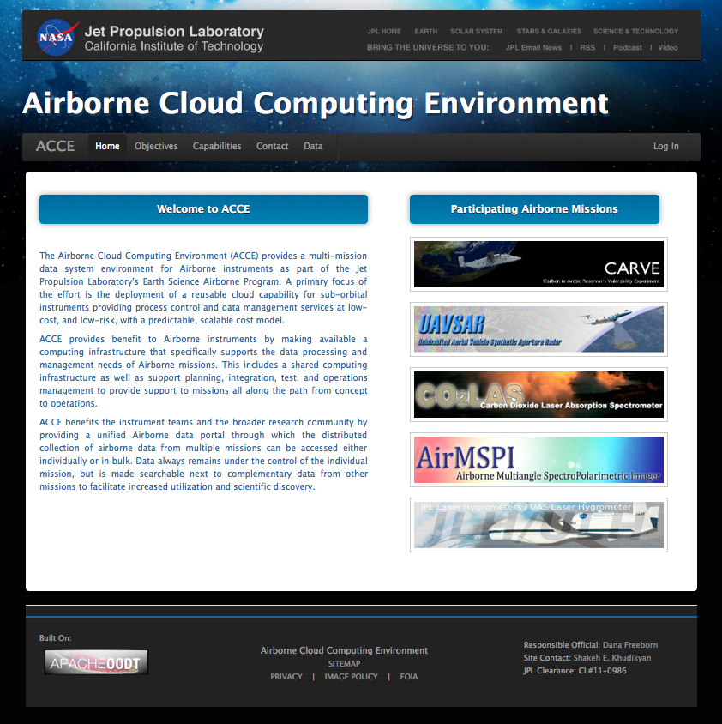
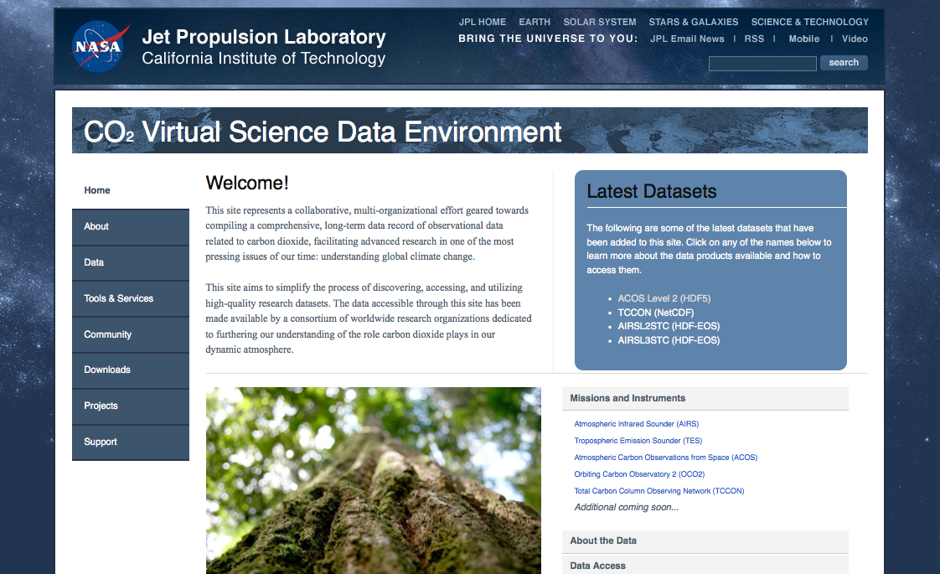
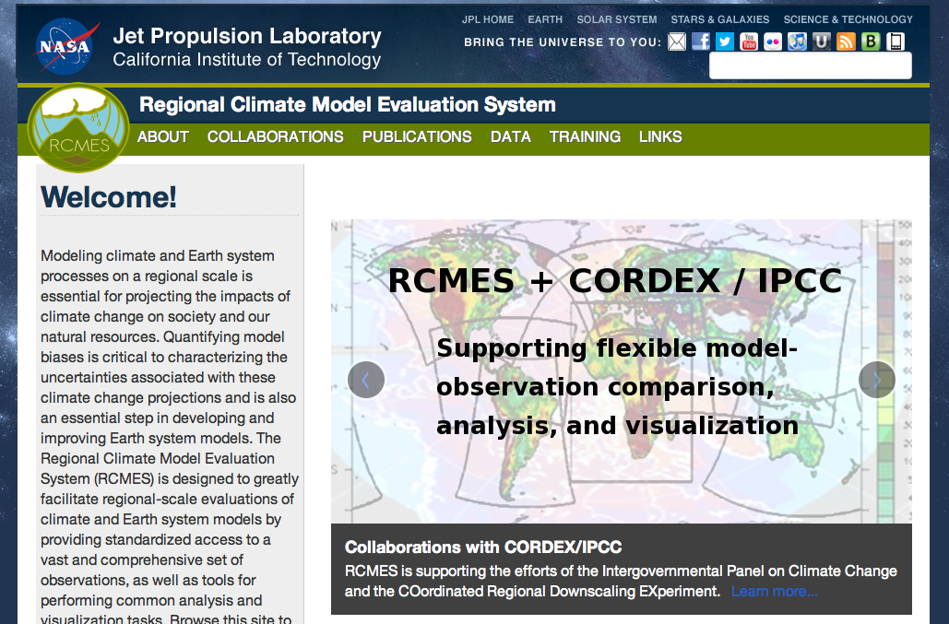
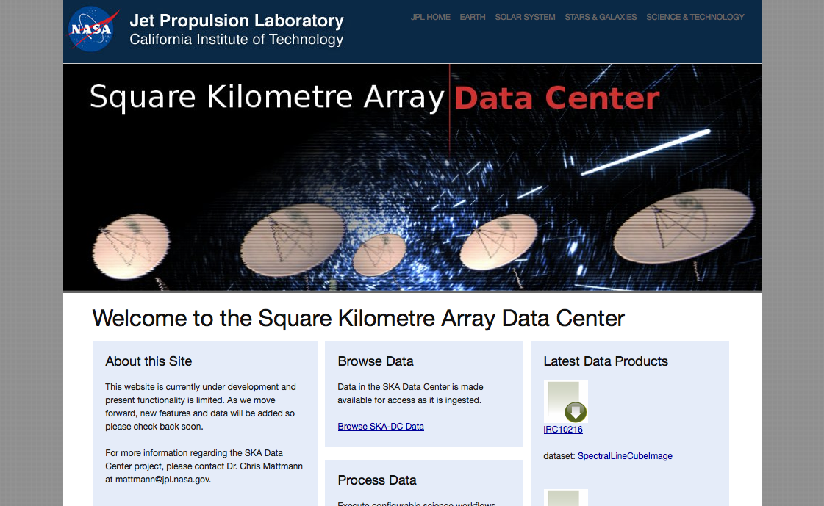
OODT at Work
CO2
EDRN
ACCE
RCMES
SKA
Works for planetary science, earth science, radio astronomy, biomedicine, astrophysics, and more
Notes:
Works for a diverse set of science data system activities in planetary science, earth science, radio astronomy, biomedicine, astrophysics, and more

Slide 18
Module Demonstration

Slide 19
Thank you!
It’s constantly evolving - join and help!
http://oodt.apache.org
WIKI: https://cwiki.apache.org/OODT/
JIRA: https://issues.apache.org/jira/browse/OODT
Join the mailing list:
dev@oodt.apache.org

