Slide 1

Best Practices for CouchDB Developers on Windows Azure
Brian Benz, Sr. Technical Evangelist
Microsoft Open Technologies, Inc.
bbenz@Microsoft.com

Slide 2
Agenda
App Demo
Windows Azure
CouchDB
Windows Azure Virtual Machines
Windows Azure Web Sites
Options for working with Azure VMs and Web Sites
Under the hood of the app:
Node.js
Grunt
Q&A

Slide 3
Demo
Conference Scheduling App
Windows Azure, Virtual Machines, Web Sites, CouchDB, node.js, grunt
Notes:
Slide Objective:
Demo
Notes:
See DEMO-GettingStartedVMs

Slide 4
Demo Link
http://a-jamepi-conf-couchdb-twitter.azurewebsites.net/#home/schedule
https://github.com/axemclion/conference
Notes:
Slide Objective:
With the introduction of Windows Azure Virtual Machines and Virtual Networks there are an entirely new set of workloads that are suitable.

Slide 5
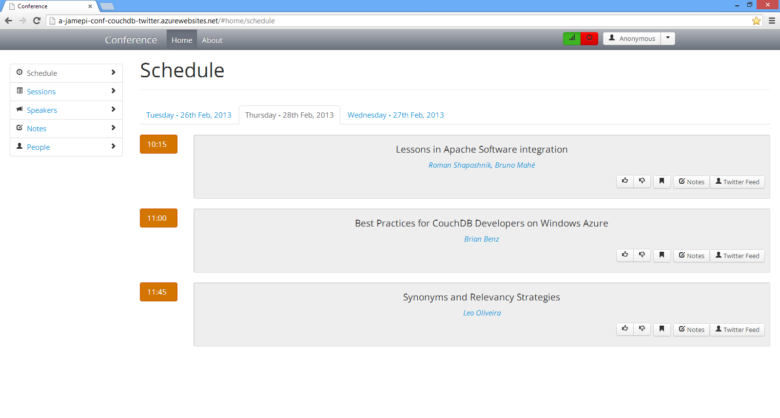

Slide 6
Conference Scheduler
Attendees can track sessions, vote sessions up and down
Offline Capabilities
IndexedDB
CouchDB VM for Data Storage
Web site hosting the application
Node.js
Grunt

Slide 7
Demo Architecture
WAWS
Windows Azure Virtual Machine
Browser app
Node.js
Grunt
Node.js app:
Store and Retrieve Schedule
Filter by criteria
Store in CouchDB
CORS-SERV
CouchDB

Slide 8
Windows Azure in 60 Seconds
A brief high-level overview for those who are new to Windows Azure

Slide 9


Cloud Computing
Packaged Software
Infrastructure
(as a Service)
Platform
(as a Service)
Software
(as a Service)
Applications
Applications
You manage
Applications
Applications
Data
Data
Data
Data
You manage
Runtime
Runtime
Runtime
Runtime
Middleware
Middleware
Middleware
Middleware
Managed by vendor
You manage
O/S
O/S
O/S
Managed by vendor
O/S
Virtualization
Virtualization
Managed by vendor
Virtualization
Virtualization
Servers
Servers
Servers
Servers
Storage
Storage
Storage
Storage
Networking
Networking
Networking
Networking
Notes:
Slide Objectives:
Explain the differences and relationship between IaaS, PaaS, and SaaS in more detail.
Speaker Notes:
Here’s another way to look at the cloud services taxonomy and how this taxonomy maps to the components in an IT infrastructure.
Packaged Software
With packaged software a customer would be responsible for managing the entire stack – ranging from the network connectivity to the applications.
IaaS
With Infrastructure as a Service, the lower levels of the stack are managed by a vendor. Some of these components can be provided by traditional hosters – in fact most of them have moved to having a virtualized offering.
Very few actually provide an OS
The customer is still responsible for managing the OS through the Applications.
For the developer, an obvious benefit with IaaS is that it frees the developer from many concerns when provisioning physical or virtual machines.
This was one of the earliest and primary use cases for Amazon Web Services Elastic Cloud Compute (EC2).
Developers were able to readily provision virtual machines (AMIs) on EC2, develop and test solutions and, often, run the results ‘in production’.
The only requirement was a credit card to pay for the services.
PaaS
With Platform as a Service, everything from the network connectivity through the runtime is provided and managed by the platform vendor.
The Windows Azure best fits in this category today.
In fact because we don’t provide access to the underlying virtualization or operating system today, we’re often referred to as not providing IaaS.
PaaS offerings further reduce the developer burden by additionally supporting the platform runtime and related application services.
With PaaS, the developer can, almost immediately, begin creating the business logic for an application.
Potentially, the increases in productivity are considerable and, because the hardware and operational aspects of the cloud platform are also managed by the cloud platform provider, applications can quickly be taken from an idea to reality very quickly.
SaaS
Finally, with SaaS, a vendor provides the application and abstracts you from all of the underlying components.

Slide 10
Windows Azure: What It Is
Win·dows·Az·ure [win-dohz-azh-er]
Noun: A comprehensive set of services that enable you to quickly build, deploy and manage applications across a global network of Microsoft-managed datacenters.
99.95% Monthly SLA
Pay only for what you use

Slide 11



Windows Azure: What It Is
Flexible
Open
Solid

Slide 12

Windows Azure: What It Is
Global Footprint

Slide 13



Windows Azure: What It Is
Virtual Machines
Cloud Services
Web Sites

Slide 14































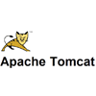



Windows Azure: What It Is
Flexible

Slide 15
Windows Azure: What It Is
Host
Build
Consume
IaaS
PaaS
SaaS

Slide 16
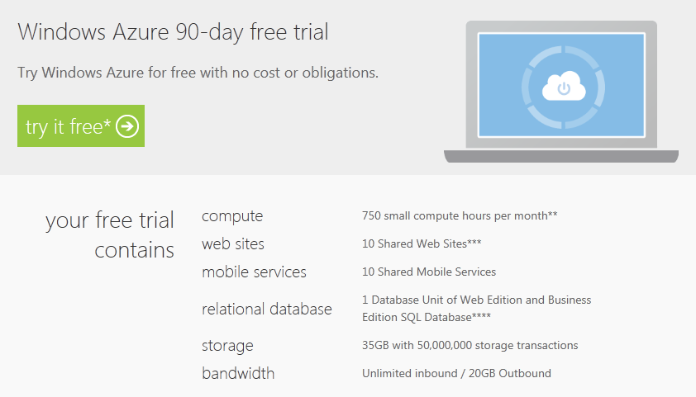
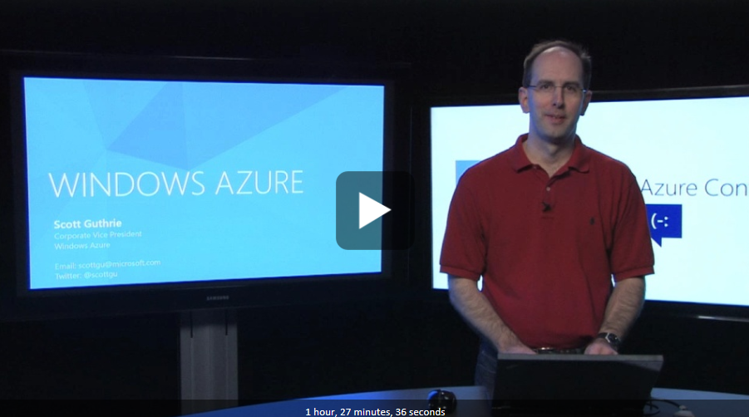
Getting Started
Sign up for a free trial
http://www.windowsazure.com/en-us/pricing/free-trial/
Learn about the latest features
http://channel9.msdn.com/Events/WindowsAzureConf/2012/KEY01

Slide 17


+
CouchDB on Windows Azure provides all the benefits customers have come to expect from cloud computing: elasticity, on-demand capacity, faster time to market, and pay-for-what-you-use pricing.
CouchDB offers built-in support for horizontal scaling
Windows Azure offers built-in support for responsive auto-scaling

Slide 18
Clusters: High Availability
Your Application
Cluster
Driver
Primary
Secondary
Secondary
Clustered nodes hosted on Windows Azure worker roles or virtual machines

Slide 19
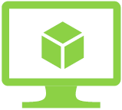
Virtual Machines
Deploying CouchDB on Windows Azure virtual machines

Slide 20





Windows Azure Virtual Machines
Ubuntu 12.04
CentOS 6.2
OpenSUSE 12.1
SUSE Linux Enterprise Server SP2
Windows Server 2008 R2
Windows Server 2012

Slide 21
Virtual Machine Sizes
VM Size | CPU Cores | Memory | Bandwidth (Mbps) | # Data Disks
Extra Small | Shared | 768 MB | 5 | 1
Small | 1 | 1.75 GB | 100 | 2
Medium | 2 | 3.5 GB | 200 | 4
Large | 4 | 7 GB | 400 | 8
Extra Large | 8 | 14 GB | 800 | 16
Each Persistent Data Disk Can be up to 1 TB

Slide 22

Deploying to Virtual Machines
Compared to worker role (PaaS), VM-based clusters offer more control, as well as more responsibility
Create new Virtual Machine – Windows 2012
Start or install a Browser
Download CouchDB
Run the Installer and Launch
Start Futon to verify install
Also available: Install Scripts Windows Azure 2008 Images:
http://ossonazure.interoperabilitybridges.com/articles/couchdb-installer-for-windows-azure

Slide 23
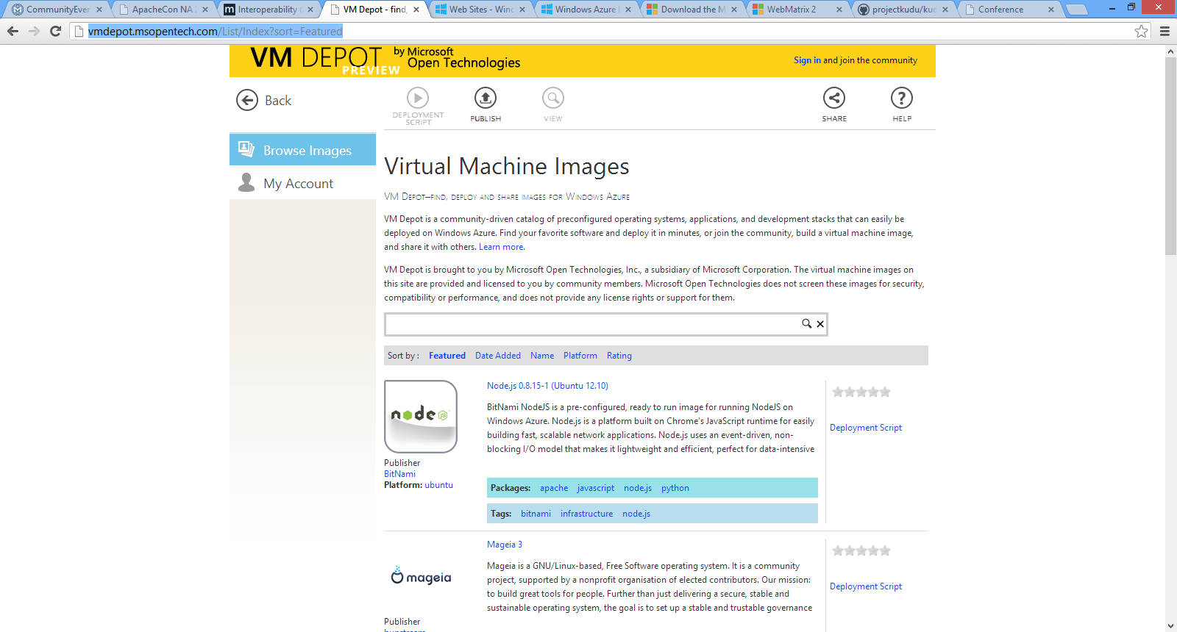
VM Depot
http://vmdepot.msopentech.com
Call to action: Developers can use VM Depot to reach new audiences!

Slide 24
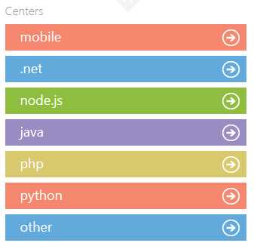
Windows Azure Developer Center
CouchDB drivers:
Open-source SDKs for popular programming languages, to get you up and running quickly
Choice of popular IDEs such as Visual Studio and Eclipse
Consistent REST protocols and APIs across Windows Azure services
.NET driver
Node.js driver
Java driver
PHP driver
Python driver
Driver download page
http://www.windowsazure.com/en-us/develop/overview/

Slide 25
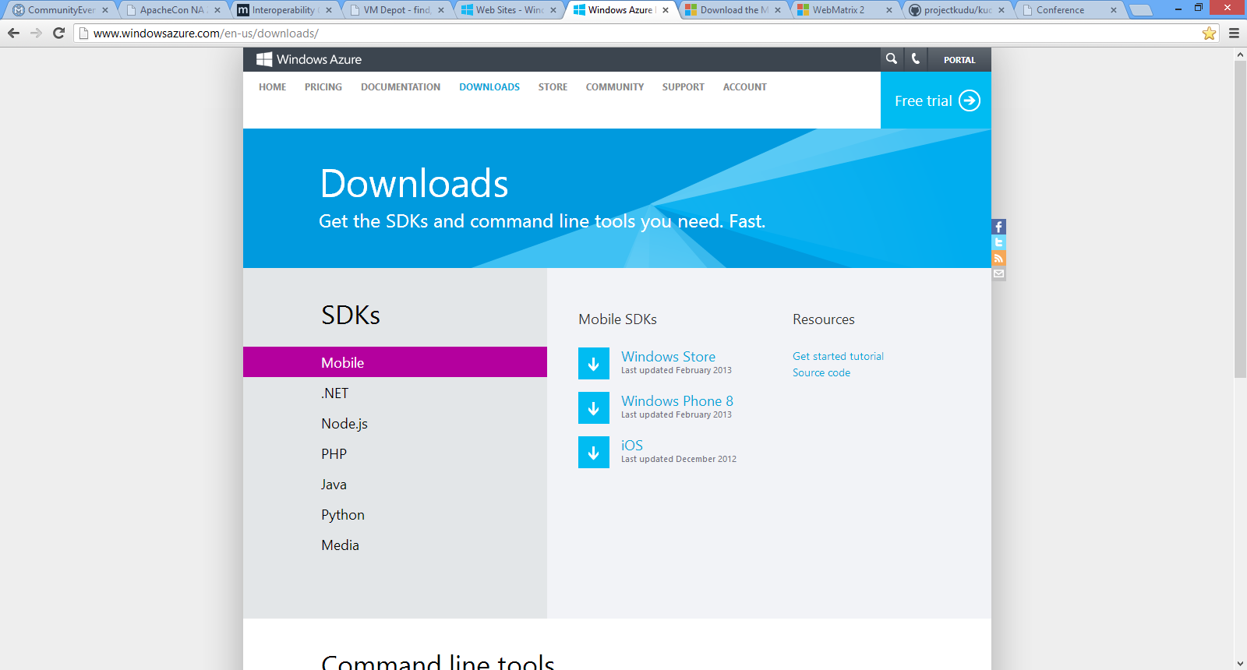

Slide 26
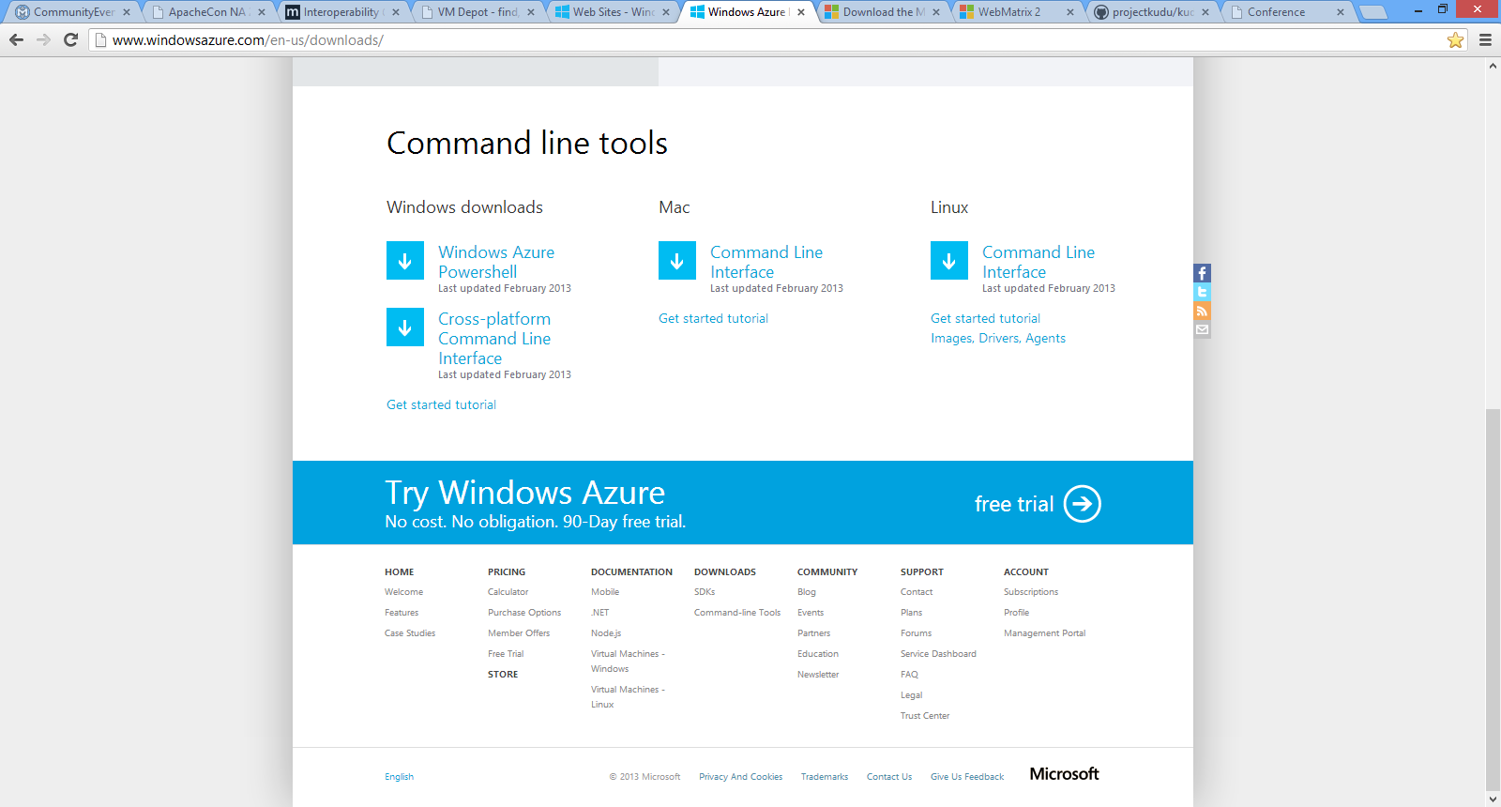

Slide 27
Command Line Syntax Overview
prompt>
azure
topic
verb
options
account
account location
account affinity-group
vm
vm disk
vm endpoint
vm image
service
service cert
site
config
download
import
list
show
delete
start
restart
shutdown
capture
create
attach
detach
browse
set
username
password
dns-prefix
vm-name
lb-port
target-image-name
source-path
disk-image-name
size-in-gb
thumbprint
value
-v
-vv

Slide 28
Example: Provisioning a Cluster
azure vm create couchsd "OpenLogic__OpenLogic-CentOS-62-20120531-en-us-30GB.vhd" username password -l "West US" -e
azure vm create couchsd "OpenLogic__OpenLogic-CentOS-62-20120531-en-us-30GB.vhd" username password -l "West US" -e 23 -c
azure vm create couchsd "OpenLogic__OpenLogic-CentOS-62-20120531-en-us-30GB.vhd" username password -l "West US" -e 24 -c
azure vm endpoint create couchsd 27017 27017
azure vm endpoint create couchsd-2 27018 27018
azure vm endpoint create couchsd-3 27019 27019

Slide 29
VM Management and Automation
Active Directory Group Policy
Windows Remote Management (WinRM)
SCOM 2012 Support for Managing Virtual Machines
Full REST API for Programmatic Automation and Management
Windows Azure PowerShell Cmdlets
Cross Platform Scripting (Linux, Mac and Windows)
Windows Azure Monitoring Service (On Roadmap)
Notes:
Slide Objective:
Simple slide to highlight the different options available for management and automation.

Slide 30
Scripting Capabilities
Automation Support
Windows Azure PowerShell Cmdlets
Cross Platform Scripting Built on node.js
Capabilities
Provisioning, Removal
Reboot, Start
Import and Export VM settings
Support for Windows and Linux VMs
Domain Join at Provision for Windows
Fully Customize VM with Data Disks and Endpoint Configuration
Automate Virtual Network Settings
Notes:
Slide Objective:
Highlight some of the functionality available to Windows Administrators to automate management / provisioning of virtual machines in the cloud.

Slide 31
PaaS and SaaS
Deploying CouchDB as Cloud Services and
Software-As-A-Service

Slide 32

Deploying CouchDB as a Cloud Service
Windows Azure cloud services run on a fully automated, highly scalable cloud platform
Ongoing management of the OS and infrastructure is handled by Windows Azure
Infinitely scalable, on demand
App and CouchDB in same cloud service provides security
PaaS approach is the easiest way to deploy CouchDB on Windows Azure
For quick and simple deployment, use the CouchDB on Azure Worker Role Install: http://ossonazure.interoperabilitybridges.com/articles/couchdb-installer-for-windows-azure#h2Section5

Slide 33













Founded May 2008
Database-as-a-service (DBaaS)
Managed, hosted fork of CouchDB
Incremental MapReduce engine
Horizontal scaling & built-in Lucene search
8 Cloudants are committers to Apache CouchDB
13,000+ users

Slide 34


Cloudant’s Commitment to Apache CouchDB
25% of Apache CouchDB project committers work at Cloudant
Apache CouchDB roadmap
BigCouch: Horizontal scaling framework
based on Amazon Dynamo paper
folding into the next Apache release
Fauxton: Futon replacement
modular CouchDB Web dashboard
live JSON editor with JavaScript hinting

Slide 35
Hybrid Approaches
Combining hosted services, cloud applications, and on-premises applications

Slide 36

Your App
Your Data
IaaS Virtual Machines
IaaS Virtual Machines
PaaS Cloud Services
PaaS Cloud Services
PaaS Web Sites
SaaS
Git Deployments
Other sites, local apps, etc.
Self-hosted

Slide 37
Which approach is best for you?
 | Deployment Complexity | Operational Responsibility | Flexibility | OS | Security
IaaS | Some | High | High | Linux or Windows | Custom
PaaS | Some | Low | High | Windows only | Built-in
SaaS | Low/none | None | Limited | N/A | Built-in

Slide 38
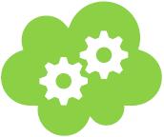
Web Sites
Deploying Web Sites on Windows

Slide 39



Windows Azure
Your Datacenter
Virtual Machines
Cloud Services
Web Sites
Applications
Applications
Applications
Applications
Data
Data
Data
Data
Firewall
Firewall Rules
Firewall Rules
Network
Virtual Network
Virtual Network
O/S
O/S
Virtualization
Hardware
Focus on the Application
Notes:
NOTE: Add spectrum (arrow) that shows the “PaaS Continuum”
We’re going to talk about a new sevice. You think about WAWS as the highest level service, abstracts away .. .. .. even web server.
Reducing complexity, reducing management overhead.
Add animation to build out each part -> final click reviels the cloud box at the bottom.

Slide 40

Windows Azure Web Sites
powerful web sites in seconds
start simple
code smart
go live
start free, scale up and out as you go, friction-free and without the headaches
with classic asp, asp.net, php or node.js, develop on Windows, OSX or Linux
deploy live in seconds, easily monitor performance, rapidly diagnose and fix issues

Slide 41



web sites
shared
reserved
1
shared
Shared instanceS
:-)

Slide 42
web sites
shared
reserved
2
shared
Shared instanceS
:-)
:-)

Slide 43

web sites
shared
reserved
1
0
reserved
Shared instanceS
RESERVED instance
:-)
:-)
:-)

Slide 44
web sites
shared
reserved
2
reserved
RESERVED instance
RESERVED instance
:-)
:-)

Slide 45


web sites
shared
reserved
2
reserved
RESERVED instance
RESERVED instance
:-)
:-)
:-)
:-)
:-)
:-)
:-)
:-)

Slide 46




Supported Web Frameworks
Bring your own runtime…

Slide 47

Supported Publishing Methods
FTP://
TFS
WebDeploy
Notes:
Git Deployment is Native, or through a Service hook from CodePlex, GitHub or BitBucket

Slide 48












partners

Slide 49



Windows Azure Web Sites
start simple
code smart
go live
Notes:
*free offer of 10 web sites for Spring 2012 Preview
*Create new sites from the gallery or from scratch
*if your web site runs on Internet Information Services (IIS) 7, it will run on Windows Azure Web Sites

Slide 50
Start Simple
Get started with 10 free web sites
Create new sites in seconds
Easily manage and scale your sites
Automatic load balancing and shared storage across instances
Scale out or up to reserved instances for improved performance and scale
Notes:
Add images to these three slides with the bullets – more metro, alive

Slide 51
Code Smart
Use ASP.NET, ASP, PHP, Node.js or Custom
SQL Azure or MySQL databases
Start with open source apps
Develop with VS and WebMatrix
Supports any Web development tool on any platform (Windows, OSX, Linux)
Notes:
Add images to these three slides with the bullets – more metro, alive

Slide 52
Go Live
Rapid deployment for quick iteration
Integrated source control with Team Foundation Server (TFS) and Git
Built-in monitoring of perf and usage data
Quick access to request logs, failed requests diagnostics and diagnostics
Notes:
Add images to these three slides with the bullets – more metro, alive

Slide 53
Node.js and Grunt
Deploying Web Sites on Windows Azure Web Sites

Slide 54
What is Node.js?
A JavaScript runtime environment
Server-side JavaScript
Compiled for speed
Command line
JavaScript API for network and file system access
Designed for high concurrency
Events, not threads or processes
Never blocks, not even for I/O
Uses CommonJS framework syntax
Close to real OO

Slide 55
Why Use Node.js ?
JavaScript on server-side and client-side
Event loop with a stack
Node.JS serves requests in an event loop
Large number of simultaneous requests.
Avoids Context Switching
Waiting for I/O or Synchronization operation to complete.
Node attaches JS callbacks to I/O requests
The “event driven” part
When the original IO is completed, a callback to the server completes the request.

Slide 56
Speedy I/O With Events
Threads | Events
Threads lock apps / threads | One thread
Listens for incoming requests | Process from queue
Multiple threads dependent on multiple processes | State saved for each event
Depends on context switching | Not dependent on I/O or Synchronization

Slide 57
Node.js with Grunt
Node.js - Scalable, Event-Driven HTTP server
JavaScript and simple API
Grunt on Node.js
Deployment and Task Management

Slide 58
Application Scenarios
Web Sites
Cloud Services
Virtual Machines
Modern web apps
Perfect if your app consists of client side markup and scripting, server side scripting and a database. Powerful capability to scale out and up as needed.
Multi-tier applications
Cloud-based applications that separate application logic into multiple tiers (i.e. caching middle tier, asynchronous background processes like order processing) using both Web and Worker Roles
Enterprise server applications
Run your existing enterprise applications in the cloud, such as SQL Server, SharePoint Server or Active Directory.
Continuous development
Deploy directly from your source code repository, using Git or Team Foundation Service.
Apps that require advanced administration
Cloud-based applications that require admin access, remote desktop access or elevated permissions
Porting existing line of business apps
Choose an image from the library or upload your own VHD.
Popular open source apps
Launch a professional looking site with a few clicks using apps like WordPress, Joomla!, Drupal, DotNetNuke and Umbraco
Apps that require advanced networking
Cloud-based applications that require network isolation for use with Windows Azure Connect or Windows Azure Virtual Network
Windows or Linux operating system
Support for Windows Server, along with community and commercial versions of Linux. Connect virtual machines with cloud services to take full advantage of PaaS services.
Notes:
Leave in appendix for QA when the question is asked.

Slide 59
Other Resources
Microsoft Open Technologies Blog: http://blogs.msdn.com/b/interoperability
VM Depot: http://vmdepot.msopentech.com
Windows Azure development: www.WindowsAzure.com
SDKs and Command Line Tools:
http://www.windowsazure.com/en-us/downloads/
Windows Azure Training Kit: http://windowsazure-trainingkit.github.com/
Microsoft Web Platform Installer:
http://www.microsoft.com/web/downloads/platform.aspx
Web Matrix
http://www.microsoft.com/web/webmatrix/
Project Kudu
https://github.com/projectkudu/kudu
The application I showed today
https://github.com/axemclion/conference

Slide 60
Q&A

