Slide 1

Building distributed systems using Helix
http://helix.incubator.apache.org
Apache Incubation Oct, 2012
@apachehelix
Kishore Gopalakrishna, @kishoreg1980http://www.linkedin.com/in/kgopalak

Slide 2
Outline
Introduction
Architecture
How to use Helix
Tools
Helix usage

Slide 3






Examples of distributed data systems

Slide 4
Lifecycle
Cluster Expansion
Fault tolerance
Throttle data movement
Re-distribution
Multi node
Replication
Fault detection
Recovery
Single Node
Partitioning
Discovery
Co-location
Notes:
Moving from single node to scalable, fault tolerant distributed mode is non trivial and slow, even though core functionality remains the same.

Slide 5
Typical Architecture
App.
App.
App.
App.
Network
Cluster manager
Node
Node
Node
Node

Slide 6
Distributed search service
Node 1
Node 2
Node 3
INDEX SHARD
P.1
P.2
P.3
P.4
P.5
P.6
P.3
P.4
P.5
P.6
P.1
P.2
REPLICA
Partition management
Fault tolerance
Elasticity
Multiple replicas
Even distribution
Rack aware placement
Fault detection
Auto create replicas
Controlled creation of replicas
re-distribute partitions
Minimize movement
Throttle data movement
Notes:
Limit the number of partitions on a single node,

Slide 7
Distributed data store
Node 1
Node 2
Node 3
P.1
P.2
P.3
P.5
P.6
P.7
P.9
P.10
P.11
P.4
P.5
P.6
P.8
P.1
P.2
P.12
P.3
P.4
P.1
P.9
P.10
P.11
P.12
P.7
P.8
SLAVE
MASTER
Partition management
Fault tolerance
Elasticity
Multiple replicas
1 designated master
Even distribution
Fault detection
Promote slave to master
Even distribution
No SPOF
Minimize downtime
Minimize data movement
Throttle data movement

Slide 8
Message consumer group
Similar to Message groups in ActiveMQ
guaranteed ordering of the processing of related messages across a single queue
load balancing of the processing of messages across multiple consumers
high availability / auto-failover to other consumers if a JVM goes down
Applicable to many messaging pub/sub systems like kafka, rabbitmq etc

Slide 9
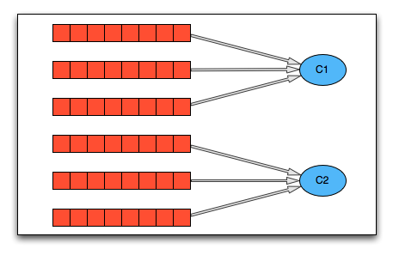
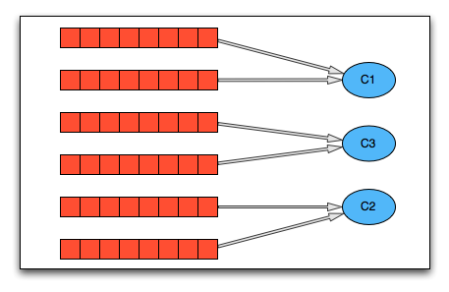
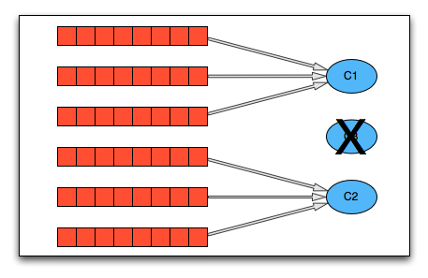
Message consumer group
ASSIGNMENT
SCALING
FAULT TOLERANCE

Slide 10
Zookeeper provides low level primitives.
We need high level primitives.
Application
Framework
Consensus
System
Node
Partition
Replica
State
Transition
File system
Lock
Ephemeral
Application
Zookeeper
Notes:
You must define correct behavior of your system.
How do you partition?
What is the replication factor? Are replicas the same or are there different roles such as master/slave replicas?
How should the system behave when nodes fail, new nodes are added etc.
This differs from system to system.
2. Once you have defined how the system must behave, you have to implement that behavior in code, maybe on top of ZK or otherwise. That implementation is non-trivial, hard to debug, hard to test.
Worse, in response to requirements, if the behavior of the system were to change even slightly, the entire process has to repeat.
MOVING FROM ONE SHARD PER NODE to MULTIPLE SHARD PER NODE
Instead, wouldn't it be nice if all you had to do was step 1 i.e. simply define the correct behavior of your distributed system and step 2 was somehow taken care of?

Slide 12
Outline
Introduction
Architecture
How to use Helix
Tools
Helix usage
Notes:
Core helix concepts
What makes it generic

Slide 13
Terminologies
Node | A single machine
Cluster | Set of Nodes
Resource | A logical entity e.g. database, index, task
Partition | Subset of the resource.
Replica | Copy of a partition
State | Status of a partition replica, e.g Master, Slave
Transition | Action that lets replicas change status e.g Slave -> Master

Slide 14
Core concept
State Machine
Constraints
Objectives
States
Offline, Slave, Master
Transition
O->S, S->M,S->M, M->S
States
M=1, S=2
Transitions
concurrent(0->S) < 5
Partition Placement
Failure semantics
COUNT=2
minimize(max_{nj∈N} S(n_{j}) )
t₁≤5
S
t₁
t₂
t₃
t₄
O
M
COUNT=1
minimize(max_{nj∈N} M(n_{j}) )
Notes:
In this slide, we will look at the problem from a different perspective and possibly re-define the cluster management problem.
So re-cap to solve dds we need to define number of partitions and replicas, and for each replicas we need to different roles like master/slave etc
One of the well proven way to express such behavior is use a state machine

Slide 15
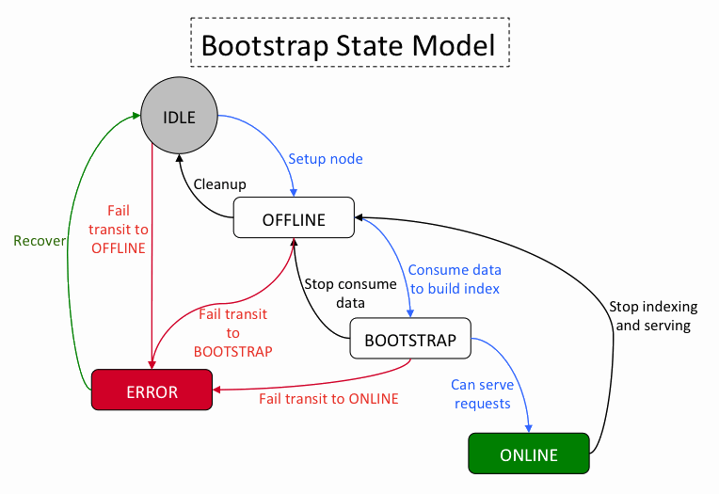
Helix solution
Message consumer group
Distributed search
Offline
Online
Start consumption
MAX=1
MAX per node=5
Stop consumption
MAX=3
(number of replicas)
Notes:
Dynamically change number of replicas
Add new resources, add nodes
Change behavior easily
Change what runs where
elasticity

Slide 16
IDEALSTATE
P1
N1:M
N2:S
P2
N2:M
N3:S
P3
N3:M
N1:S
Configuration
3 nodes
3 partitions
Constraints
1 Master
Even distribution
2 replicas
1 Slave
StateMachine
Replica placement
Replica
State

Slide 17
CURRENT STATE
N1
P1:OFFLINE
P3:OFFLINE
N2
P2:MASTER
N3
P3:MASTER
P2:SLAVE
P1:MASTER

Slide 18
EXTERNAL VIEW
P1
N1:O
N2:M
P2
N2:M
N3:S
P3
N3:M
N1:O

Slide 19
Helix Based System Roles
RESPONSE
COMMAND
Node 1
Node 2
Node 3
P.1
P.2
P.3
P.5
P.6
P.7
P.9
P.10
P.11
P.4
P.5
P.6
P.8
P.1
P.2
P.12
P.3
P.4
P.1
P.9
P.10
P.11
P.12
P.7
P.8

Slide 20
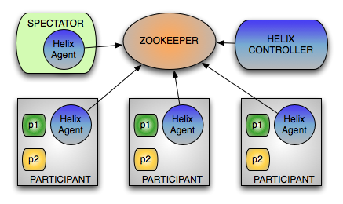
Logical deployment
Notes:
Design choices
Communication
ZK optimizations
Multiple deployment options
No SPOF

Slide 21
Outline
Introduction
Architecture
How to use Helix
Tools
Helix usage

Slide 22
Helix based solution
Define
Configure
Run

Slide 23
Define: State model definition
States
All possible states
Priority
Transitions
Legal transitions
Priority
Applicable to each partition of a resource
e.g. MasterSlave
S
O
M

Slide 24
Define: state model
Builder = new StateModelDefinition.Builder(“MASTERSLAVE”);
// Add states and their rank to indicate priority.
builder.addState(MASTER, 1);
builder.addState(SLAVE, 2);
builder.addState(OFFLINE);
//Set the initial state when the node starts
builder.initialState(OFFLINE);
//Add transitions between the states.
builder.addTransition(OFFLINE, SLAVE);
builder.addTransition(SLAVE, OFFLINE);
builder.addTransition(SLAVE, MASTER);
builder.addTransition(MASTER, SLAVE);

Slide 25
Define: constraints
 | State | Transition
Partition | Y | Y
Resource | - | Y
Node | Y | Y
Cluster | - | Y
COUNT=2
S
O
M
COUNT=1
 | State | Transition
Partition | M=1,S=2 | -

Slide 26
Define:constraints
// static constraint
builder.upperBound(MASTER, 1);
// dynamic constraint
builder.dynamicUpperBound(SLAVE, "R");
// Unconstrained
builder.upperBound(OFFLINE, -1;

Slide 27
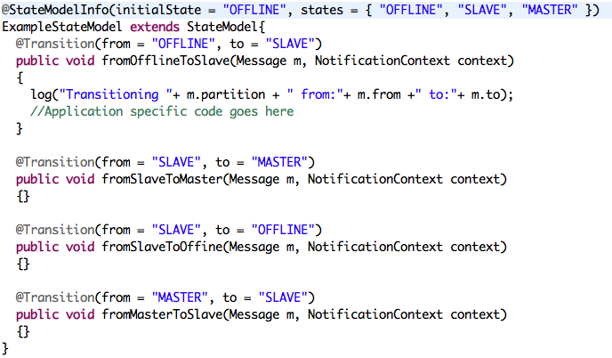
Define: participant plug-in code

Slide 28
Step 2: configure
helix-admin –zkSvr <zkAddress>
CREATE CLUSTER
--addCluster <clusterName>
ADD NODE
--addNode <clusterName instanceId(host:port)>
CONFIGURE RESOURCE
--addResource <clusterName resourceName partitions statemodel>
REBALANCE ➔SET IDEALSTATE
--rebalance <clusterName resourceName replicas>
Notes:
Mention configuration etc

Slide 29

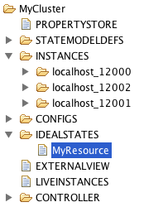
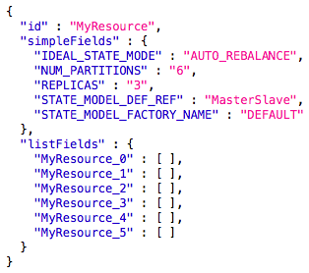
zookeeper view
IDEALSTATE

Slide 30
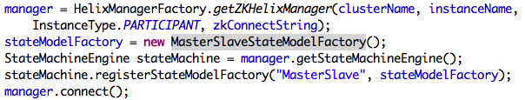
Step 3: Run
START CONTROLLER
run-helix-controller -zkSvr localhost:2181 –cluster MyCluster
START PARTICIPANT

Slide 31
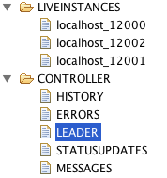
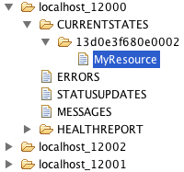
zookeeper view

Slide 32
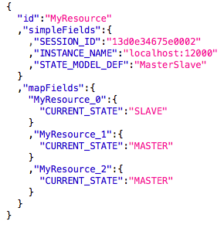
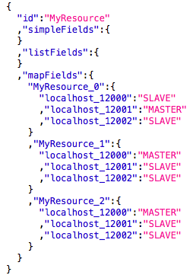
Znode content
CURRENT STATE
EXTERNAL VIEW

Slide 33
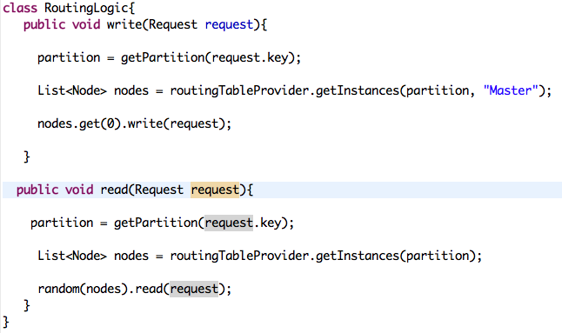
Spectator Plug-in code

Slide 34
Helix Execution modes

Slide 35
IDEALSTATE
P1
N1:M
N2:S
P2
N2:M
N3:S
P3
N3:M
N1:S
Configuration
3 nodes
3 partitions
Constraints
1 Master
Even distribution
2 replicas
1 Slave
StateMachine
Replica placement
Replica
State

Slide 36
Execution modes
Who controls what
 | AUTO REBALANCE | AUTO | CUSTOM
Replica placement | Helix | App | App
Replica State | Helix | Helix | App

Slide 37
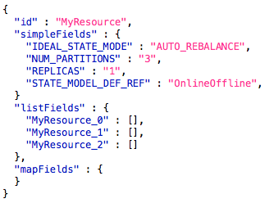
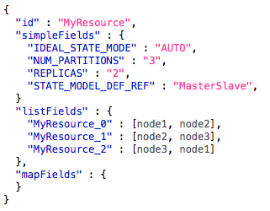
Auto rebalance v/s Auto
AUTO REBALANCE
AUTO

Slide 38
In action
Auto rebalance MasterSlave p=3 r=2 N=3
Auto MasterSlave p=3 r=2 N=3
Node1 | Node2 | Node3
P1:M | P2:M | P3:M
P2:S | P3:S | P1:S
Node 1 | Node 2 | Node 3
P1:M | P2:M | P3:M
P2:S | P3:S | P1:S
On failure: Auto create replica
and assign state
On failure: Only change states to satisfy constraint
Node 1 | Node 2 | Node 3
P1:O | P2:M | P3:M
P2:O | P3:S | P1:S
 | P1:M | P2:S
Node 1 | Node 2 | Node 3
P1:M | P2:M | P3:M
P2:S | P3:S | P1:M
Notes:
Auto rebalance:
Applicable to message consumer group, search
Auto
Distributed data store

Slide 39
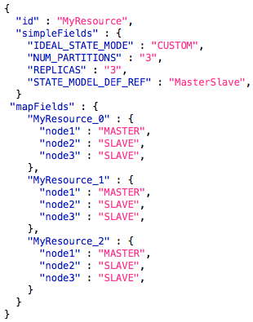
Custom mode: example

Slide 40
Custom mode: handling failure
Custom code invoker
Code that lives on all nodes, but active in one place
Invoked when node joins/leaves the cluster
Computes new idealstate
Helix controller fires the transition without violating constraints
P1
N1:M
N2:S
P2
N2:M
N3:S
P3
N3:M
N1:S
P1
N1:S
N2:M
P2
N2:M
N3:S
P3
N3:M
N1:S
Transitions
1 | N1 | M→S
2 | N2 | S→ M
1 & 2 in parallel violate single master constraint
Helix sends 2 after 1 is finished

Slide 41
Outline
Introduction
Architecture
How to use Helix
Tools
Helix usage

Slide 42
Tools
Chaos monkey
Data driven testing and debugging
Rolling upgrade
On demand task scheduling and intra-cluster messaging
Health monitoring and alerts
Notes:
Allows one to come up with common tools
Think of maven plugins

Slide 43
Data driven testing
Instrument –
Zookeeper, controller, participant logs
Simulate – Chaos monkey
Analyze – Invariants are
Respect state transition constraints
Respect state count constraints
And so on
Debugging made easy
Reproduce exact sequence of events

Slide 44
Structured Log File - sample
timestamp | partition | instanceName | sessionId | state
1323312236368 | TestDB_123 | express1-md_16918 | ef172fe9-09ca-4d77b05e-15a414478ccc | OFFLINE
1323312236426 | TestDB_123 | express1-md_16918 | ef172fe9-09ca-4d77b05e-15a414478ccc | OFFLINE
1323312236530 | TestDB_123 | express1-md_16918 | ef172fe9-09ca-4d77b05e-15a414478ccc | OFFLINE
1323312236530 | TestDB_91 | express1-md_16918 | ef172fe9-09ca-4d77b05e-15a414478ccc | OFFLINE
1323312236561 | TestDB_123 | express1-md_16918 | ef172fe9-09ca-4d77b05e-15a414478ccc | SLAVE
1323312236561 | TestDB_91 | express1-md_16918 | ef172fe9-09ca-4d77b05e-15a414478ccc | OFFLINE
1323312236685 | TestDB_123 | express1-md_16918 | ef172fe9-09ca-4d77b05e-15a414478ccc | SLAVE
1323312236685 | TestDB_91 | express1-md_16918 | ef172fe9-09ca-4d77b05e-15a414478ccc | OFFLINE
1323312236685 | TestDB_60 | express1-md_16918 | ef172fe9-09ca-4d77b05e-15a414478ccc | OFFLINE
1323312236719 | TestDB_123 | express1-md_16918 | ef172fe9-09ca-4d77b05e-15a414478ccc | SLAVE
1323312236719 | TestDB_91 | express1-md_16918 | ef172fe9-09ca-4d77b05e-15a414478ccc | SLAVE
1323312236719 | TestDB_60 | express1-md_16918 | ef172fe9-09ca-4d77b05e-15a414478ccc | OFFLINE
1323312236814 | TestDB_123 | express1-md_16918 | ef172fe9-09ca-4d77b05e-15a414478ccc | SLAVE

Slide 45
No more than R=2 slaves
Time | State | Number Slaves | Instance
42632 | OFFLINE | 0 | 10.117.58.247_12918
42796 | SLAVE | 1 | 10.117.58.247_12918
43124 | OFFLINE | 1 | 10.202.187.155_12918
43131 | OFFLINE | 1 | 10.220.225.153_12918
43275 | SLAVE | 2 | 10.220.225.153_12918
43323 | SLAVE | 3 | 10.202.187.155_12918
85795 | MASTER | 2 | 10.220.225.153_12918

Slide 46
How long was it out of whack?
Number of Slaves | Time | Percentage
0 | 1082319 | 0.5
1 | 35578388 | 16.46
2 | 179417802 | 82.99
3 | 118863 | 0.05
83% of the time, there were 2 slaves to a partition
93% of the time, there was 1 master to a partition
Number of Masters | Time | Percentage
0 | 15490456 | 7.164960359
1 | 200706916 | 92.83503964

Slide 47
Invariant 2: State Transitions
FROM | TO | COUNT
MASTER | SLAVE | 55
OFFLINE | DROPPED | 0
OFFLINE | SLAVE | 298
SLAVE | MASTER | 155
SLAVE | OFFLINE | 0

Slide 48
Outline
Introduction
Architecture
How to use Helix
Tools
Helix usage

Slide 49
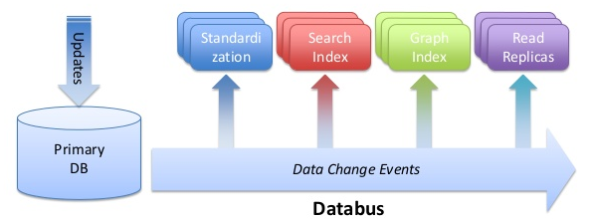
Helix usage at LinkedIn
Espresso
Notes:
Used in production and manage the core infrastructure components in the company
Operation is easy and easy for dev ops to operate multiple systems

Slide 50
In flight
Apache S4
Partitioning, co-location
Dynamic cluster expansion
Archiva
Partitioned replicated file store
Rsync based replication
Others in evaluation
Bigtop
Notes:
S4
Apps and processing tasks, each have different state model
Multitenancy
multiple resources

Slide 51
Auto scaling software deployment tool
States
Download, Configure, Start
Active, Standby
Constraint for each state
Download < 100
Active 1000
Standby 100
Notes:
Define states
How many you want in each state
State model
Helix provides MasterSlave OnlineOffline LeaderStandby
Two master system
Automatic replica creation

Slide 52
Summary
Helix: A Generic framework for building distributed systems
Modifying/enhancing system behavior is easy
Abstraction and modularity is key
Simple programming model: declarative state machine
Notes:
Provides the right combination of abstraction and flexibility
Code is stable and deployed in production
Integration between multiple systems co-locating
Good thing helps think more about your design putting in right level of abstraction and modularity

Slide 53
Roadmap
Features
Span multiple data centers
Automatic Load balancing
Distributed health monitoring
YARN Generic Application master for real time Apps
Stand alone Helix agent

Slide 54


website | http://helix.incubator.apache.org
user | user@helix.incubator.apache.org
dev | dev@helix.incubator.apache.org
twitter | @apachehelix, @kishoreg1980
Notes:
contribution

