Slide 1
Innovative Foundation For an Open Source API Management Platform
Asanka Abeysinghe
@asankama

Slide 2
APIs ?
Photo credit : http://blogs.ukoln.ac.uk/good-apis-jisc/

Slide 4
Business APIs
An API is a business capability delivered over the Internet to internal or external consumers
Network accessible function
Available using standard web protocols
With well-defined interfaces
Designed for access by third-parties
A Managed API is:
Actively advertised and subscribe-able
Available with SLAs
Secured, authenticated, authorized and protected
Monitored and monetized with analytics

Slide 5
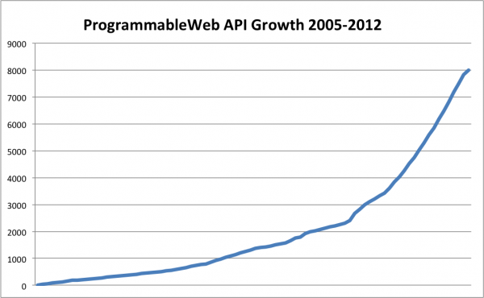
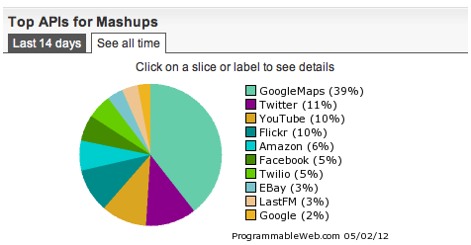
Growth which can’t be ignored

Slide 6
The API billionaires
More than 15 billion calls per day, 75% through APIs
More than 1 billion calls per day
More than 5 billion calls per day
More than 260 billion objects stored in S3
More than 3.1 billion transactions per day

Slide 7
APIs and Business Consumers
Business
Browsers
Game Consoles
Cloud Services
Gas Stations
Tablets
Smart Phones
Connected Cars
Partners
Social Networks

Slide 8
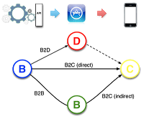
APIs Create a New Relationship
B2D

Slide 9
API Usage
External
Public API
Private API
Internal
Public API
Private API

Slide 10
Demand for APIs
Picture Credit : http://www.newscientist.com/blogs/onepercent/2012/01/letting-gamers-experience-the.html

Slide 11
Demand for APIs – cont..
RESTful
OAuth
JSON
WEB API Design

Slide 12
Business Services
Heterogeneous
Styles
SOAP
RESTful
Bindings
SOAP/HTTP/s
POX/HTTP/s
POX/JMS
JSON/HTTP/s
File {CSV, EDA, COBOL}
Development languages {Java, WCF, PHP, C/C++, JavaScript}
Functionality {Focused on internal service consumers/ applications}
Silos, owned by various BUs, no control

Slide 13
API Façade Pattern
External Format (Demand)
Façade
Mediation
Backend Services

Slide 14
API Ecosystem Model
From SOA lessons learned, best practices roles
API Creator
Builds, manages, and versions API
Understand business and technical requirements
Cares about usage and scaling
Seeks feedback, ratings, usage
API Publisher
Publishes, Promotes and encourages consumers to adopt APIs
Determines usage patterns and how to best monetize asset
Monitors and secures
API Consumer
Understands the interface definition
Subscribes and connects application to API
Monitors own usage and cost basis
Provides feedback and ratings

Slide 15
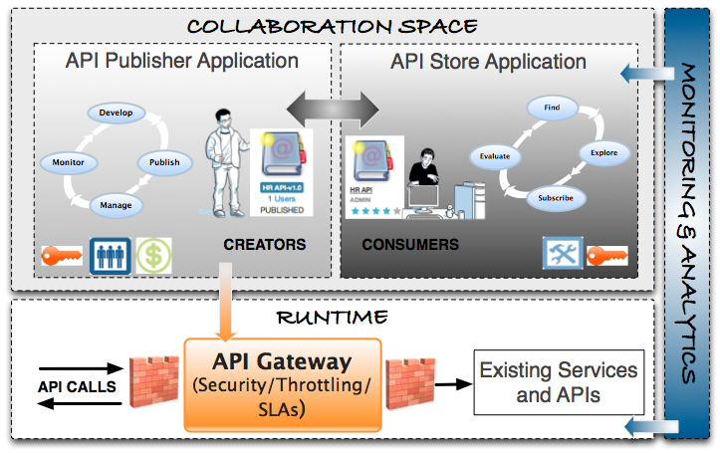
API Manager Components

Slide 16
Component Architecture
API Gateway
API Store
API Publisher
API Auth Server
API Analytics
Platform
Ext Auth
Ext Analytics2.0
ELB
Ext LB
RDBMS
2.0
Event Receiver
Event Analyzer + Dashboard
Event Store

Slide 17
Apache Family
API Gateway
ELB
API Auth Server
Event Receiver
Apache Thrift ™
API Store
Event Analyzer
API Publisher
Event Store

Slide 18
Apache Modules and Carbon
OSGify

Slide 19
APIs in Action
API Publisher
Create
API Publisher
Order-API(created)
Order-API(published)
Publish
API Subscriber
API Store
Order Service
Subscribe
Order-API(listed)
Get API Key
Application
Consume
API Gateway
Consume
Order-API(published)

Slide 20
Synapse Runtime

Slide 21
APIs and Resources
URI = Schema://host:port/authority/path[?query]
e.g. http://localhost:8280/trade/1.0.0/order/{orderID}

Slide 22
APIs Map to HTTP Methods

Slide 23
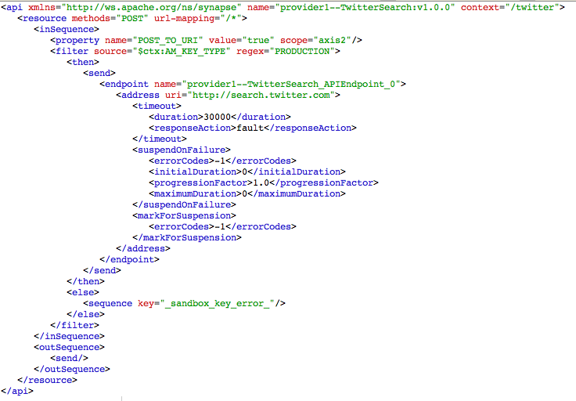
Sample Configuration

Slide 24
APIs in Action - OAuth
API Subscriber
API Gateway
Auth Handler (OAuth)
Application
Auth / Key Management Server
User Store

Slide 25
OAuth-2.0
Keys
Consumer Key
Consumer Secret
Access Token
Profiles
OAuth Core Specification
Bearer Token Profile
JSON Web Token (JWT) Bearer Profile
SAML2.0 Bearer Assertion Profile

Slide 26
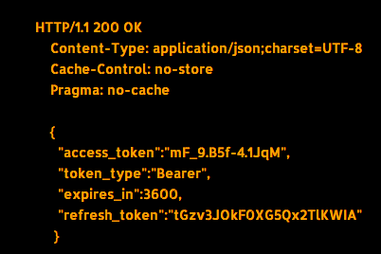
CMD $:…..

Slide 27
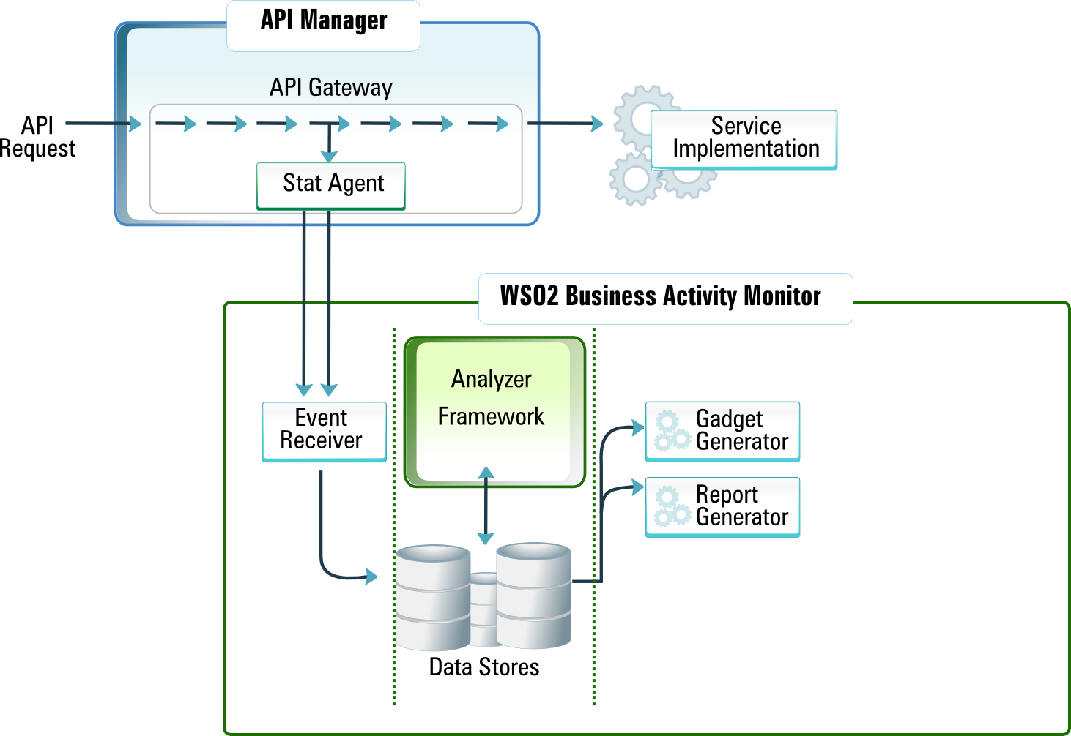
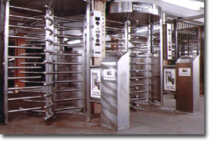
Data to Scale : API Statistics
Picture Credit : http://www.mta.info/

Slide 28
The Feedback Cycle
Gather API data
Decide
Adjust parameters
Slice and Dice

Slide 29
Gathering API data
What if you want custom data off of API requests?
Plug-in a monitoring extension – mediator
Net total of each order – total=259
API Manager
Analytics

Slide 30
Slice and Dice
Customers who have placed orders above 2 mil USD
Select customer_name, sum(order_amount) from Orders groupby customer_name
Customer_name | Sum(order_amount)
Coyote | 2,332,223
Acme | 10,654,333

Slide 31
Decide
Check for trends
Compare past results
Get help with Reporting & Dashboards

Slide 32
Adjust Parameters
Increase server capacity
Increase redundancy
Retire APIs
Introduce new versions

Slide 33
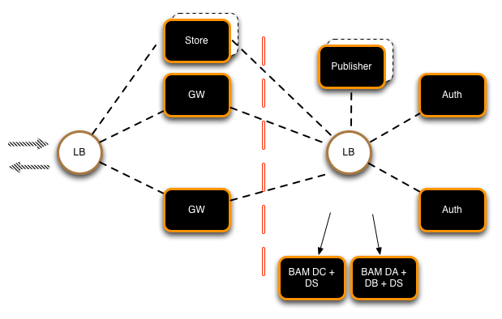
Deployment : Pattern 1

Slide 34
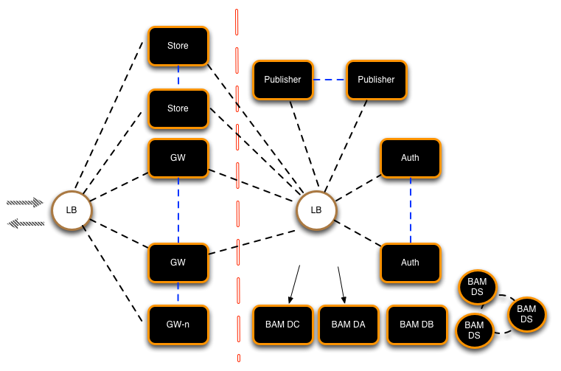
Deployment : Pattern 2

Slide 35
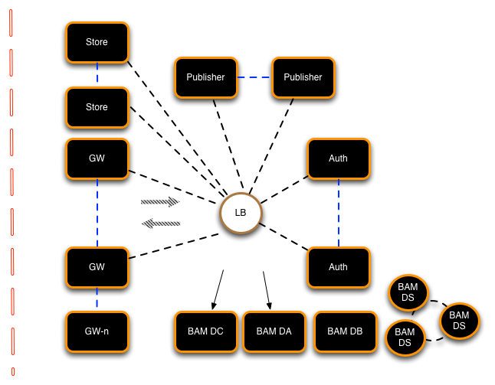
Deployment : Pattern 3

Slide 36
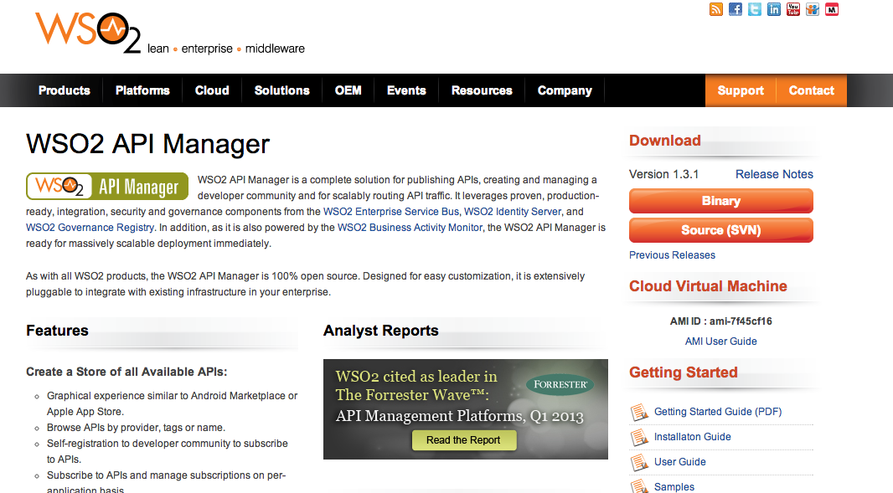
Product : http://wso2.com/products/api-manager/

Slide 37
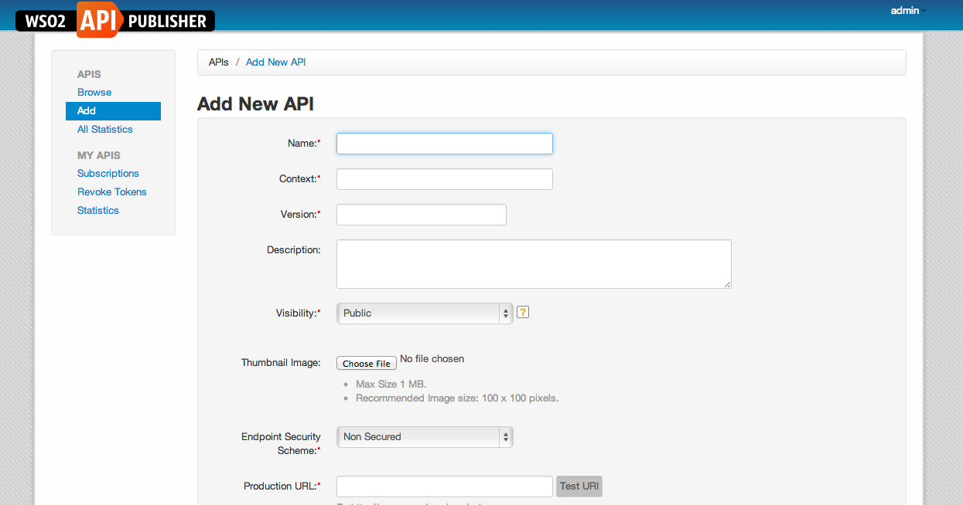

Slide 38
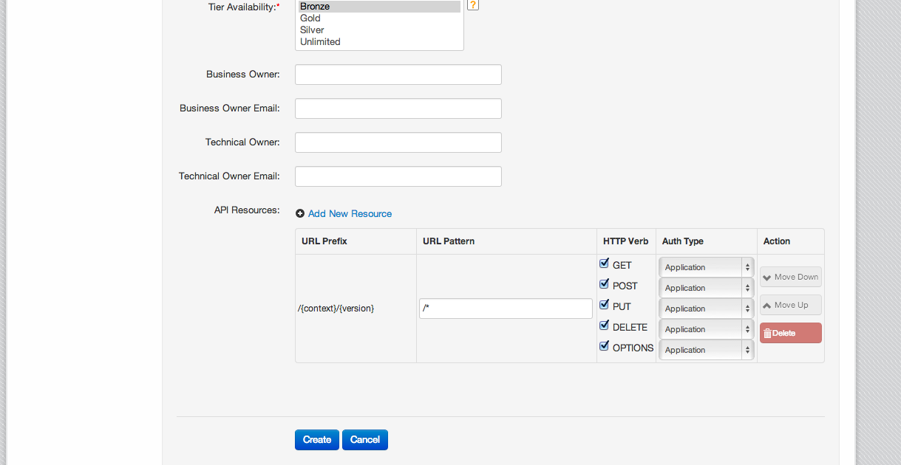

Slide 39
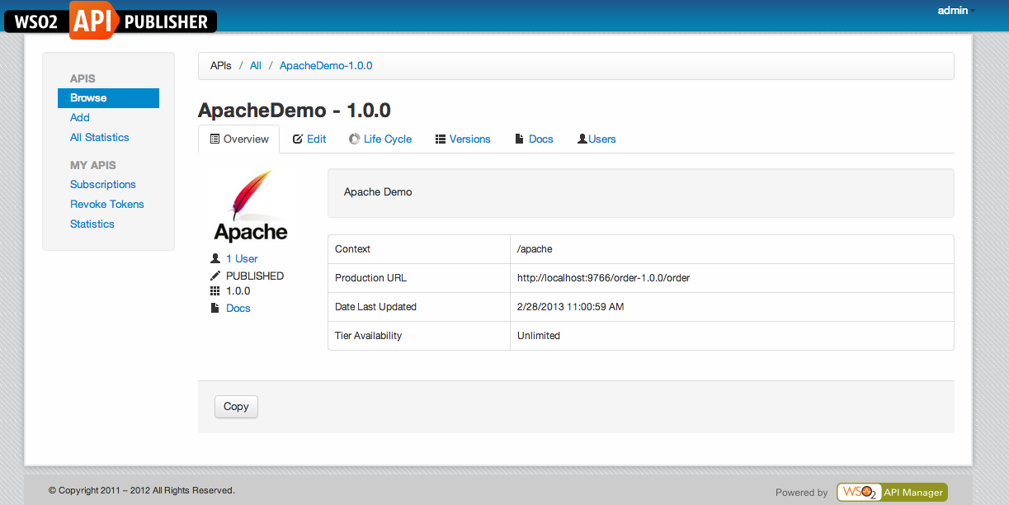

Slide 40
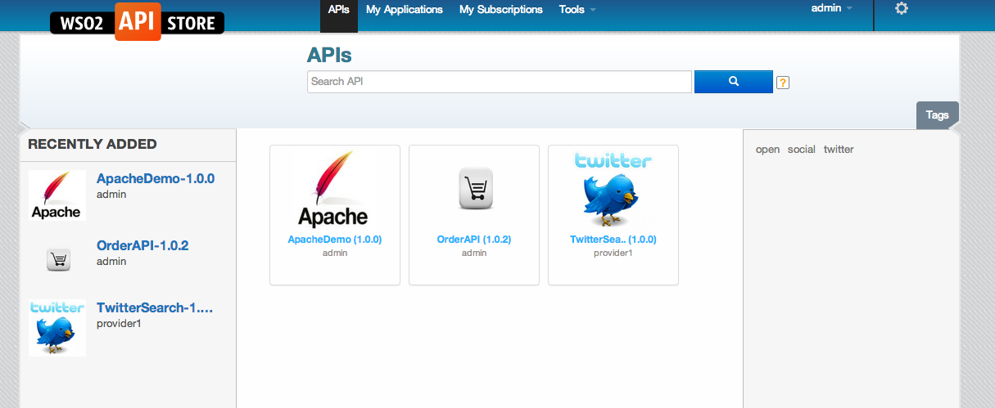

Slide 41
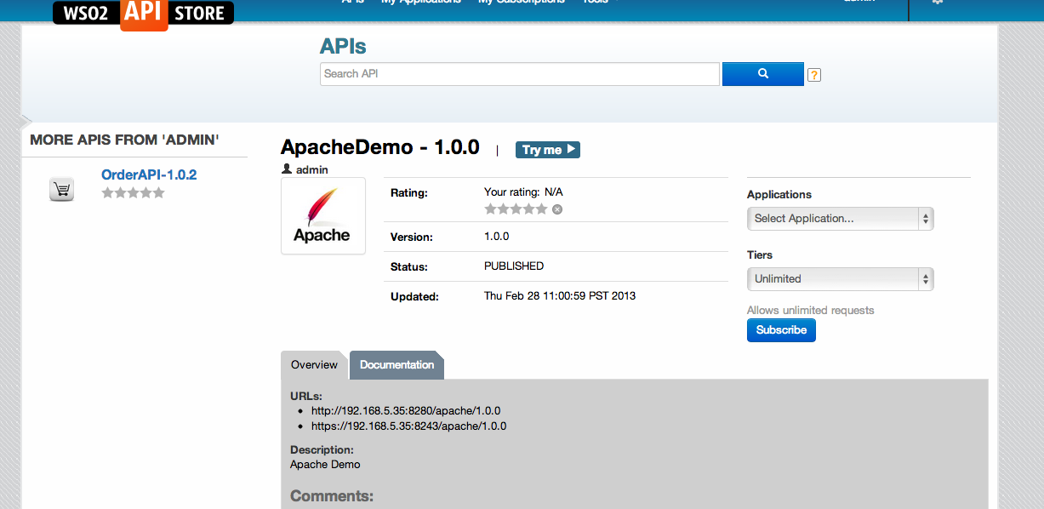

Slide 42
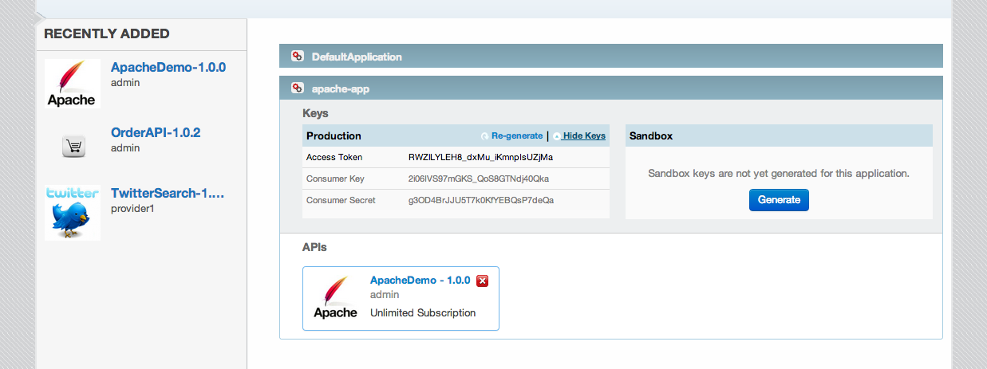

Slide 43
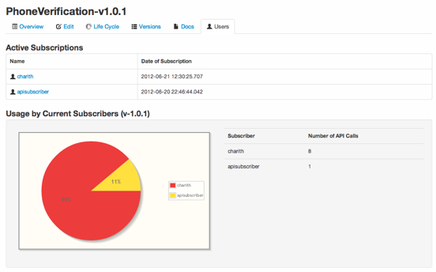
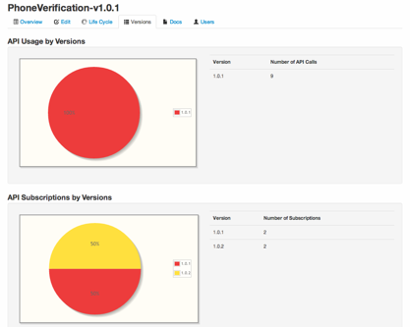
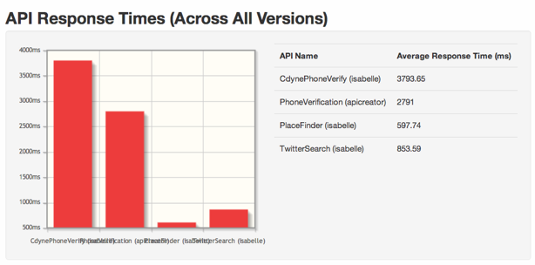
API Analytics

Slide 44
Summary
Open Source Enterprise API Management Platform, utilizing Apache Modules
Find and subscribe/buy APIs
API Store and Governance
Manage, secure and protect APIs
API Management and Gateway
Monitor and Monetize APIs
API Monitoring and Analytics

