Slide 1
Zen: A Graph Data Model on HBase
Raghavendra Prabhu (RVP)
Xun Liu

Slide 2
HBase @ Pinterest - 2012
Original use case: materialized home feed
Replaced Redis
Need: elasticity, high write load, serve from disk/SSD
Challenges:
Running on public cloud (AWS)
User facing use case (MTTR, latency, fault tolerance etc.)

Slide 3
HBase @ Pinterest - 2013
Need: highly elastic key-value store
Access from Python
Support “move fast”
Low operational overhead

Slide 4
Enter UMegaStore
Storage-as-a-Service: Key-value thrift API on top of HBase
Features:
Key partitioning to balance load
Master-slave clusters, semi automatic failover
Speculative execution
Multi-tenancy with traffic isolation

Slide 5
Storage-as-a-service was a great step forward, but could we do better?

Slide 6
“Given how robust the messenger is on day one, it’s surprising to learn that Pinterest built the entire product in three months.” — The Verge

Slide 7
Example: Messages Data Model
Participates
Contains
Message 1
User
Conversation
Message 2
Message N
User

Slide 8
Realization
These object models closely resemble a graph
Objects are nodes, edges represent relationships
Typical needs:
retrieve data for a node or edge
get all outgoing edges from a node
get all incoming edges from a node
count incoming or outgoing edges for a node

Slide 9
Enter Zen
Provides a graph data model instead of key-value
Automatically creates necessary indexes
Materializes counts for efficient querying
Implemented on top of HBase

Slide 10
Zen API
Nodes:
addNode, removeNode, getNode
Node id: globally unique 64-bit integer
ID | 123
Prop 1 | Val 1
Prop 2 | Val 2

Slide 11
Zen API
Edges:
addEdge, removeEdge, getEdge
Edge Ref: (edgeType, fromId, toId)
Score for ordering
Edge Ref | 120, 123, 4567
Prop 1 | Val 1
Prop 2 | Val 2

Slide 12
Zen API
Edge Queries:
getEdges, countEdges, removeEdges
struct EdgeQuery {
1: required NodeId nodeId;
2: required EdgeDirection direction;
3: optional TypeId edgeType;
}

Slide 13
Zen API
Property Indexes
Unique index
Ensures a property value is unique across all nodes of a type
Non-unique index
Allows retrieval by property value
Works for both nodes and edges

Slide 14
Illustration: Messages on Zen
Type: Participates
Type: Contains
Id:1234
Id:2345
Id:3456
Type: User
Name: “Ben Smith” [unique]
Status: Active
Type: Conversation
Started: 12 Aug 2014 08:00
Header: “Great pin!”
Pin Id: 10001 [non-unique]
Type: Message
Sent: 12 Aug 2014 08:00
Text: “Great pin!”

Slide 15
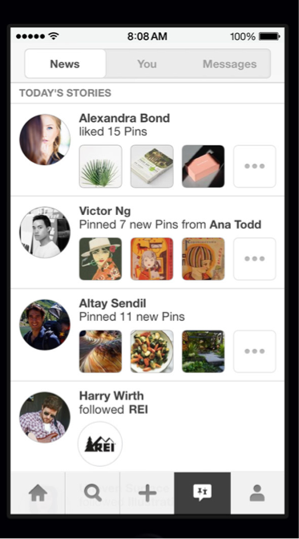
Zen @ Pinterest - 2014
Close to 10 million operations every second
Smart Feed
Messages
News
Interests

Slide 16
Zen Schema Design

Slide 17
Zen - Property
 | Data
 | type | name | score | distance
12345 (node) | 10 | Ben Smith
12345-20-67890 (edge) |  |  | 1000 | 1 mile

Slide 18
Zen - Property Index
 | Data
 | ID
unique-10-name=ben smith | 12345
nonuniq-10-lastname=smith-12345
nonuniq-10-lastname=smith-67890
Notes:
Clients can define index on properties. Index can be either unique or non-unique for the node or edge type.
CAS to ensure unique constraint
Tall table to allow split of hot index value.

Slide 19
Zen - Edge Score Index
 | Data
12345-out-20-1000-67890
12345-out-20-1001-67891
12345-in-30-990-67892
12345-in-30-991-67893
Notes:
We encode the row key like the following:
For each node-id, direction and edge type, we append the score, then the node-id on the other side.
This way, all edges for a given node-id, direction and edge-type are stored together in ascending order of the edge scores.
The pagination is then a simple range scan.

Slide 20
Zen - Edge Count
 | Data
 | Count
12345-out-20 | 2
12345-in-30 | 4

Slide 21
Production Learnings

Slide 22
1. Avoid Hot Regions
Salt row keys to achieve uniform distribution
Reverse bits of auto increment integers
Prepend hash to row keys
Pre-split regions using uniform split
Tall table

Slide 23
2. Batch For Throughput
Bottleneck: HLog sync
Deferred HLog sync can lose data
Batching:
Client-side: batch APIs for clients to do bulk insertion
Server-side: Zen Server to buffer edits across clients and flush together

Slide 24
3. Tune For Performance
Memory v.s. Latency
Default: BLOOMFILTER => ‘ROW’, BLOCKSIZE => '8192'
Special: BLOOMFILTER => ‘NONE’, BLOCKSIZE => ‘32768'
CPU v.s. Data Size
Default: DATA_BLOCK_ENCODING => ‘FAST_DIFF’, COMPRESSION => ‘SNAPPY'
Special: DATA_BLOCK_ENCODING => ‘PREFIX’, COMPRESSION => ‘NONE’

Slide 25
4. Namespace for Isolation
Dedicated HBase cluster for big applications
Shared cluster with dedicated namespace for smaller ones
Namespace 1
Namespace 2
Node
Edge
Index
Node
Edge
Index

Slide 26
5. Coprocessor For Efficiency
Use Case: remove a large number of edges (feeds)
Usual Way:
Scan all edges of a node
Delete edges beyond a limit
Major compact to remove delete markers
Coprocessor
Trim in a major compaction coprocessor

Slide 27
6. Best Effort Data Consistency
No distributed transaction: keep things simple and fast
Best effort to maintain data consistency:
Manual rollback in Zen server upon failures
Offline MapReduce jobs (Dr Zen) to scan and fix inconsistencies
Notes:
…

Slide 28
Takeaways
The graph data model can be a convenient abstraction to cut down product development time.
HBase has worked very well as a storage backend for Zen for large scale user facing workloads.

