Slide 1
https://github.com/stealthly/go_kafka_client

Slide 2
Joe Stein
Developer, Architect & Technologist
Founder & Principal Consultant => Big Data Open Source Security LLC - http://stealth.ly
Big Data Open Source Security LLC provides professional services and product solutions for the collection, storage, transfer, real-time analytics, batch processing and reporting for complex data streams, data sets and distributed systems. BDOSS is all about the "glue" and helping companies to not only figure out what Big Data Infrastructure Components to use but also how to change their existing (or build new) systems to work with them.
Apache Kafka Committer & PMC member
Blog & Podcast - http://allthingshadoop.com
Twitter @allthingshadoop

Slide 3
Overview
Just enough Kafka
Just enough Go
Why a new Go Kafka Client
Producers in Go
Code
Syslog
MirrorMaker
Consumers in Go
Work management
Partition ownership
Blue / Green Deploys
Offset management
Distributed Reactive Streams

Slide 4
Apache Kafka
Apache Kafka
http://kafka.apache.org
Apache Kafka Source Code
https://github.com/apache/kafka
Documentation
http://kafka.apache.org/documentation.html
FAQ
https://cwiki.apache.org/confluence/display/KAFKA/FAQ
Wiki
https://cwiki.apache.org/confluence/display/KAFKA/Index

Slide 5
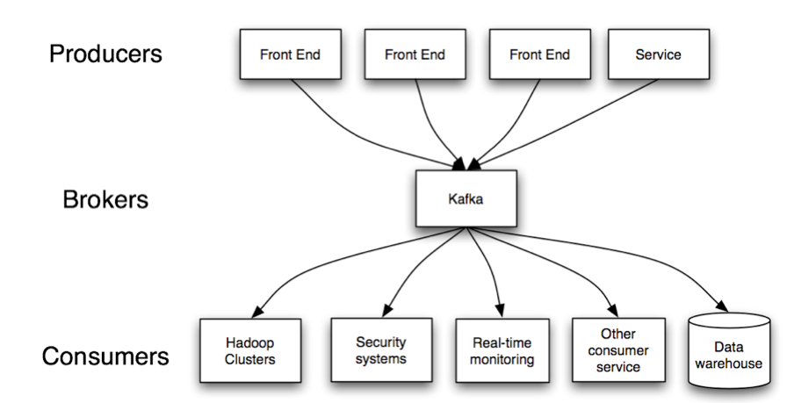
Kafka is a distributed, partitioned, replicated commit log service. It provides the functionality of a messaging system, but with a unique design.

Slide 6
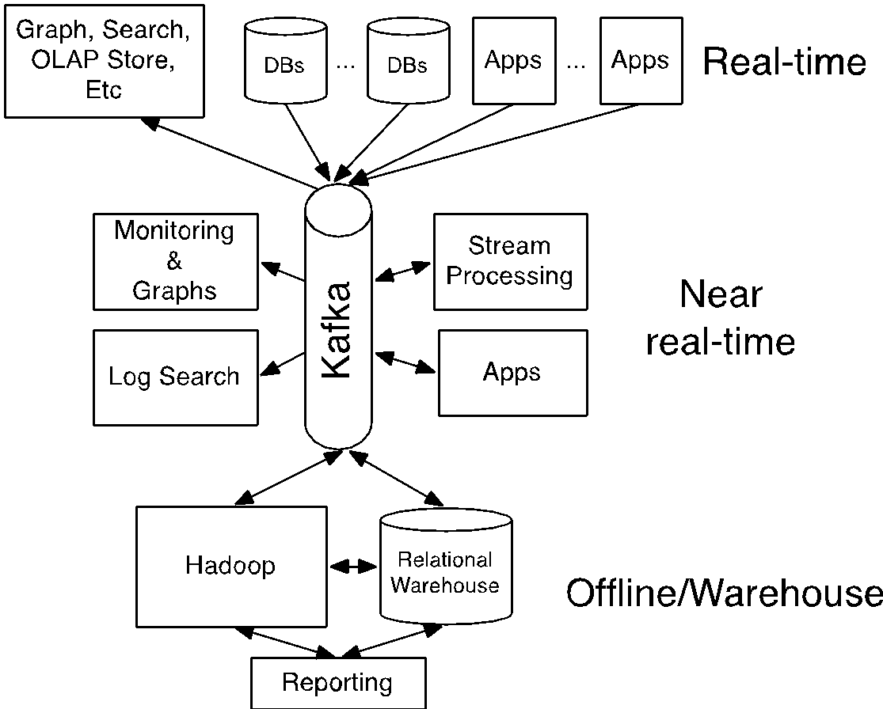

Slide 7
I heart logs
http://shop.oreilly.com/product/0636920034339.do?sortby=publicationDate

Slide 8
Really Quick Start (Go)
1) Install Vagrant http://www.vagrantup.com/
2) Install Virtual Box https://www.virtualbox.org/
3) git clone https://github.com/stealthly/go-kafka
4) cd go-kafka
5) vagrant up
6) vagrant ssh brokerOne
7) cd /vagrant
8) sudo ./test.sh

Slide 9
Just enough Go
Produces statically linked native binaries without external dependencies
Built in package management with source commit definition
Share memory by communicating
Code to read to start learning go http://www.somethingsimilar.com/2013/12/27/code-to-read-when-learning-go/

Slide 10
Why another Go client?
Go Kafka Client https://github.com/stealthly/go_kafka_client wraps Sarama https://github.com/Shopify/sarama
More real world use for producers
High level consumer (lots more on this in a few minutes)
The option to maybe wrap librdkafka https://github.com/edenhill/librdkafka the high perforamcen c/c++ library in the future

Slide 11
Go Kafka Client - Getting started
Prerequisites:
Install Golang http://golang.org/doc/install
Make sure env variables GOPATH and GOROOT exist and point to correct places
Install GPM https://github.com/pote/gpm
go get github.com/stealthly/go_kafka_client && cd $GOPATH/src/github.com/stealthly/go_kafka_client
gpm install
Optional (for all tests to work):
Install Docker https://docs.docker.com/installation/#installation
cd $GOPATH/src/github.com/stealthly/go_kafka_client
Build docker image: docker build -t stealthly/go_kafka_client .
docker run -v $(pwd):/go_kafka_client stealthly/go_kafka_client
After this is done you're ready to write some code!
For email support https://groups.google.com/forum/#!forum/kafka-clients

Slide 12
Producers

Slide 13
Producer Code
client, err := sarama.NewClient(uuid.New(), []string{brokerConnect}, sarama.NewClientConfig())
if err != nil {
panic(err)
}
config := sarama.NewProducerConfig()
config.FlushMsgCount = flushMsgCount
config.FlushFrequency = flushFrequency
config.AckSuccesses = true
config.RequiredAcks = sarama.NoResponse //WaitForAll
config.MaxMessagesPerReq = maxMessagesPerReq
config.Timeout = 1000 * time.Millisecond
config.Compression = 2
producer, err := sarama.NewProducer(client, config) if err != nil {
panic(err)
}

Slide 14
Magic Happens Here =8^)
go func() {
for {
message := &sarama.MessageToSend{Topic: topic, Key: sarama.StringEncoder(fmt.Sprintf("%d", numMessage)), Value: sarama.StringEncoder(fmt.Sprintf("message %d!", numMessage))}
numMessage++
producer.Input() <- message
time.Sleep(sleepTime)
}
}()
go func() {
for {
select {
case error := <-producer.Errors():
saramaError <- error
case success := <-producer.Successes():
saramaSuccess <- success
}
}
}()

Slide 15
Syslog Producer
https://github.com/stealthly/go_kafka_client/tree/master/syslog
docker run -p --net=host stealthly/syslog --topic syslog --broker.list host:port
--producer.config - property file to configure embedded producers. This parameter is optional. --tcp.port - TCP port to listen for incoming syslog messages. Defaults to 5140. --tcp.host - TCP host to listen for incoming syslog messages. Defaults to 0.0.0.0. --udp.port - UDP port to listen for incoming syslog messages. Defaults to 5141. --udp.host - UDP host to listen for incoming syslog messages. Defaults to 0.0.0.0. --num.producers - number of producer instances. This can be used to increase throughput. Defaults to 1 --queue.size - number of messages that are buffered for producing. Defaults to 10000. --log.level - log level for built-in logger. Possible values are: trace, debug, info, warn, error, critical.Defaults to info. --max.procs - maximum number of CPUs that can be executing simultaneously. Defaults to runtime.NumCPU().

Slide 16
Syslog Producer + Metadata
option to transform via --source “anything” --tag key1=value1 --tag key2=value2 --log.type 3
package syslog.proto;
message LogLine
{
message Tag
{
required string key = 1;
required string value = 2;
}
required string line = 1;
optional string source = 2 [default = ""];
repeated Tag tag = 3;
optional int64 logtypeid = 4 [default = 0];
repeated int64 timings = 5;
}

Slide 17
MirrorMaker
https://github.com/stealthly/go_kafka_client/tree/master/mirrormaker
Preserve order
Preserve partition number
Prefix destination topic (e.g. dc1_) so you know where it came from and avoid collision
Everything else you expect

Slide 18
Consumer

Slide 19
Work management
Fan out
Sequential processing guarantees
Ack communication from work to retry
Failure “dead letter” so work can continue

Slide 20
Partition Ownership
Not just “re-balance”
Consistent single known state
Strategies (plural)
Round Robin
Range
More to come! e.g. manual assignment

Slide 21
Blue / Green Deployments
Jim Plush & Sean Berry from CrowdStrike=> https://www.youtube.com/watch?v=abK2Q_aecxY

Slide 22
Offset Management / Bookkeeping
At least once processing guarantee
Plugable
Per partition batch commit
Exactly once processing, happens after work is done
Always commits highest offset

Slide 23
Consumer Example
https://github.com/stealthly/go_kafka_client/blob/master/consumers/consumers.go
func main() {
config, topic, numConsumers, graphiteConnect, graphiteFlushInterval := resolveConfig()
consumers := make([]*kafkaClient.Consumer, numConsumers)
for i := 0; i < numConsumers; i++ {
consumers[i] = startNewConsumer(*config, topic)
}
}
func startNewConsumer(config kafkaClient.ConsumerConfig, topic string) *kafkaClient.Consumer {
config.Strategy = GetStrategy(config.Consumerid)
config.WorkerFailureCallback = FailedCallback
config.WorkerFailedAttemptCallback = FailedAttemptCallback
consumer := kafkaClient.NewConsumer(&config)
topics := map[string]int {topic : config.NumConsumerFetchers}
go func() {
consumer.StartStatic(topics)
}()
return consumer
}

Slide 24
Consumer Example
func GetStrategy(consumerId string) func(*kafkaClient.Worker, *kafkaClient.Message, kafkaClient.TaskId) kafkaClient.WorkerResult {
consumeRate := metrics.NewRegisteredMeter(fmt.Sprintf("%s-ConsumeRate", consumerId), metrics.DefaultRegistry)
return func(_ *kafkaClient.Worker, msg *kafkaClient.Message, id kafkaClient.TaskId) kafkaClient.WorkerResult {
kafkaClient.Tracef("main", "Got a message: %s", string(msg.Value))
consumeRate.Mark(1)
return kafkaClient.NewSuccessfulResult(id)
}
}
func FailedCallback(wm *kafkaClient.WorkerManager) kafkaClient.FailedDecision {
kafkaClient.Info("main", "Failed callback")
return kafkaClient.DoNotCommitOffsetAndStop
}
func FailedAttemptCallback(task *kafkaClient.Task, result kafkaClient.WorkerResult) kafkaClient.FailedDecision {
kafkaClient.Info("main", "Failed attempt")
return kafkaClient.CommitOffsetAndContinue
}

Slide 25
Distributed Reactive Streams

Slide 26
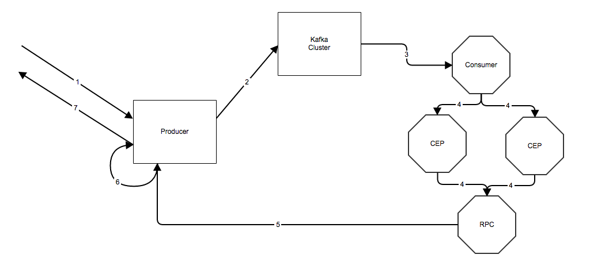
Distributed Reactive Streams

Slide 27
Questions?
/*******************************************
Joe Stein
Founder, Principal Consultant
Big Data Open Source Security LLC
http://www.stealth.ly
Twitter: @allthingshadoop
********************************************/

