Slide 1

Datacenter Management with Apache Mesos
mesos.apache.org
@ApacheMesos
Benjamin Hindman – @benh

Slide 2

I’ve got tons of data ...

Slide 3

… more everyday!

Slide 4
That must be why they call it a datacenter.

Slide 5

I’d love to answer some questions with the help of my data!

Slide 6
I think I’ll try Hadoop.

Slide 7

your datacenter

Slide 8

+ Hadoop

Slide 9
happy?

Slide 10

Not exactly …

Slide 11
… Hadoop is a big hammer, but not everything is a nail!

Slide 12

I’ve got some iterative algorithms, I want to try Spark!

Slide 13
datacenter management

Slide 14
datacenter management

Slide 15

datacenter management

Slide 16
static partitioning

Slide 17

Oh noes! Spark wants to read and write data to HDFS!

Slide 18


Hadoop …
(map/reduce)
(distributed file system)

Slide 19
HDFS

Slide 20
HDFS

Slide 21
Could we just give Spark it’s own HDFS cluster too?

Slide 22
HDFS

Slide 23
HDFS

Slide 24
HDFS

Slide 25
HDFS
tee incoming data
(2 copies)

Slide 26
HDFS
tee incoming data
(2 copies)
periodic copy/sync

Slide 27

That sounds annoying … let’s not do that. Can we do any better though?

Slide 28
HDFS

Slide 29
HDFS

Slide 30
HDFS

Slide 31
happy now?

Slide 32
No! We’ve decided to start doing real time computation with Storm …

Slide 33
datacenter management

Slide 34

datacenter management

Slide 35
happy now!?

Slide 36
Not really … during the day I’d rather give more machines to Spark but at night I’d rather give more machines to Hadoop!

Slide 37
datacenter management

Slide 38
datacenter management

Slide 39
datacenter management

Slide 40
datacenter management

Slide 42
And failures require more datacenter management!

Slide 43
datacenter management

Slide 44
datacenter management

Slide 45
datacenter management

Slide 49


Slide 50
I don’t want to deal with this!

Slide 51
the datacenter …
rather than think about the datacenter like this …

Slide 52
… is a computer
think about it like this …

Slide 53
datacenter computer
applications
resources
filesystem

Slide 54
mesos
applications
kernel
resources
filesystem

Slide 55
Okay, so how does it work?

Slide 56
Step 1: HDFS

Slide 57
Step 2: Mesos
run a “master” (or multiple for high availability)

Slide 58

Step 2: Mesos
run “slaves” on the rest of the machines

Slide 59
Step 3: Frameworks

Slide 60
Step 3: Frameworks

Slide 61
Step 3: Frameworks

Slide 62
Step 3: Frameworks

Slide 63
Step 3: Frameworks

Slide 64
Step 3: Frameworks

Slide 65
Step 3: Frameworks

Slide 66
Step 3: Frameworks

Slide 67
Step 3: Frameworks

Slide 68
Step 3: Frameworks

Slide 69
Step 3: Frameworks

Slide 70
Step 3: Frameworks

Slide 71
Step 3: Frameworks

Slide 72
tep 4: Profit
$

Slide 73
tep 4: Profit (utilize)
$
just one big pool of resources,
utilize single machines more fully!

Slide 74
tep 4: Profit (utilize)
$

Slide 75
tep 4: Profit (utilize)
$

Slide 76
tep 4: Profit (utilize)
$

Slide 77
tep 4: Profit (utilize)
$

Slide 78
tep 4: Profit (utilize)
$

Slide 79
tep 4: Profit (statistical multiplexing)
$

Slide 80
tep 4: Profit (statistical multiplexing)
$

Slide 81
tep 4: Profit (statistical multiplexing)
$

Slide 82
tep 4: Profit (statistical multiplexing)
$

Slide 83
tep 4: Profit (statistical multiplexing)
$

Slide 84
tep 4: Profit (statistical multiplexing)
$
reduces CapEx and OpEx!

Slide 85
tep 4: Profit (statistical multiplexing)
$
reduces latency!

Slide 86
tep 4: Profit (statistical multiplexing)
$

Slide 87
tep 4: Profit (failures)
$

Slide 88
tep 4: Profit (failures)
$

Slide 89
tep 4: Profit (failures)
$

Slide 90
This sounds pretty good!

Slide 91
Other than Hadoop, Spark, and Storm, what else can I run on Mesos?

Slide 92
frameworks
Hadoop (github.com/mesos/hadoop)
Spark (github.com/mesos/spark)
DPark (github.com/douban/dpark)
Storm (github.com/nathanmarz/storm)
Chronos (github.com/airbnb/chronos)
MPICH2 (in mesos git repository)
Aurora (proposed for Apache incubator)

Slide 93
What about XYZ?

Slide 94
port an existing framework
strategy: write a “wrapper” which launches existing components on mesos
~100 lines of code to write a wrapper (the more lines, the more you can take advantage of elasticity or other mesos features)
see src/examples/ in mesos repository

Slide 95
write a new framework!
as a “kernel”, mesos provides a lot of primitives that make writing a new framework relatively easy
primitives: extracted commonality across existing distributed systems/frameworks (launching tasks, doing failure detection, etc) … why re-implement them each time!?

Slide 96
case study: chronos
distributed cron with dependencies
developed at airbnb
~3k lines of Scala!
distributed, highly available, and fault tolerant without any network programming!
http://github.com/airbnb/chronos

Slide 97
Hmm … if Mesos gives me a datacenter computer … can I run stuff other than analytics?

Slide 98
case study: aurora
run N instances of my server, somewhere, forever
(where server == arbitrary command line)
developed at Twitter
runs hundreds of production services, including ads!
recently proposed for Apache Incubator!

Slide 99
aurora

Slide 100

aurora

Slide 101

aurora

Slide 102

aurora

Slide 103

aurora

Slide 104
But what about resource isolation!? I don’t want my end users to have to wait for our website to load because of resource contention!

Slide 105
resource isolation
Linux control groups (cgroups)
CPU (upper and lower bounds)
memory
network I/O (traffic controller)
filesystem (lvm, in progress)

Slide 106
conclusions
datacenter management is a pain

Slide 107
conclusions
mesos makes running frameworks on your datacenter easier as well as increasing utilization and performance while reducing CapEx and OpEx!

Slide 108
conclusions
rather than build your next distributed system from scratch, consider using mesos

Slide 109
conclusions
you can share your datacenter between analytics and online services!

Slide 110
Questions?
mesos.apache.org
@ApacheMesos

Slide 111
framework commonality
run processes simultaneously (distributed)
handle process failures (fault-tolerance)
optimize execution (elasticity, scheduling)

Slide 112
primitives
scheduler – distributed system “master” or “coordinator”
(executor – lower-level control of task execution, optional)
requests/offers – resource allocations
tasks – “threads” of the distributed system
…

Slide 113


scheduler
Apache
Hadoop
Chronos

Slide 114
scheduler
(1) brokers for resources
(2) launches tasks
(3) handles task termination

Slide 115
brokering for resources
(1) make resource requests
2 CPUs
1 GB RAM
slave *
(2) respond to resource offers
4 CPUs
4 GB RAM
slave foo.bar.com

Slide 116
offers: non-blocking resource allocation
exist to answer the question:
“what should mesos do if it can’t satisfy a request?”
(1) wait until it can
(2) offer the best allocation it can immediately

Slide 117
offers: non-blocking resource allocation
exist to answer the question:
“what should mesos do if it can’t satisfy a request?”
(1) wait until it can
(2) offer the best allocation it can immediately

Slide 118
resource allocation
request
Apache
Hadoop
Chronos

Slide 119
resource allocation
request
Apache
Hadoop
Chronos
allocator
dominant resource fairness
resource reservations

Slide 120
resource allocation
request
Apache
Hadoop
Chronos
allocator
dominant resource fairness
resource reservations
pessimistic
optimistic

Slide 121
resource allocation
request
Apache
Hadoop
Chronos
allocator
dominant resource fairness
resource reservations
pessimistic
optimistic
no overlapping offers
all overlapping offers

Slide 122
resource allocation
offer
Apache
Hadoop
Chronos
allocator
dominant resource fairness
resource reservations

Slide 123
“two-level scheduling”
mesos: controls resource allocations to framework schedulers
schedulers: make decisions about what to run given allocated resources

Slide 124
end-to-end principle
“application-specific functions ought to reside in the end hosts of a network rather than intermediary nodes”

Slide 125
tasks
either a concrete command line or an opaque description (which requires a framework executor to execute)
a consumer of resources

Slide 126
task operations
launching/killing
health monitoring/reporting (failure detection)
resource usage monitoring (statistics)

Slide 127
resource isolation
cgroup per executor or task (if no executor)
resource controls adjusted dynamically as tasks come and go!

Slide 128
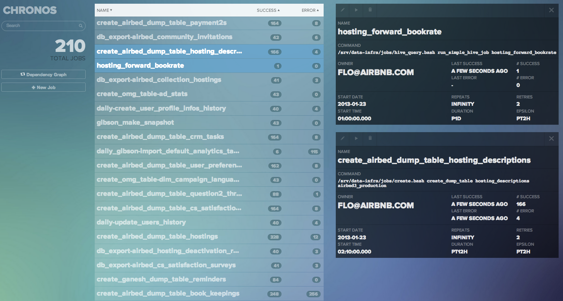
case study: chronos
distributed cron with dependencies
built at airbnb by @flo

Slide 129
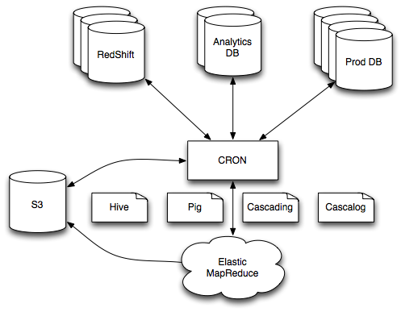
before chronos

Slide 130
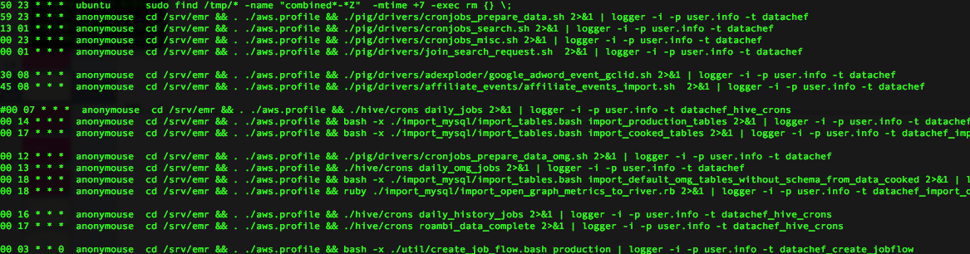
before chronos
single point of failure (and AWS was unreliable)
resource starved (not scalable)

Slide 131
chronos requirements
fault tolerance
distributed (elastically take advantage of resources)
retries (make sure a command eventually finishes)
dependencies

Slide 132
chronos
leverages the primitives of mesos
~3k lines of scala
highly available (uses Mesos state)
distributed / elastic
no actual network programming!

Slide 133
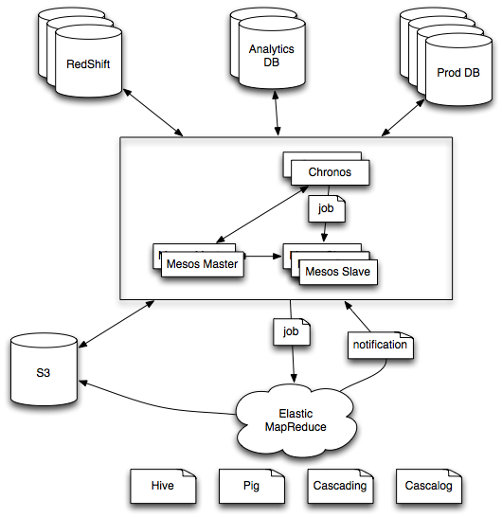
after chronos

Slide 134
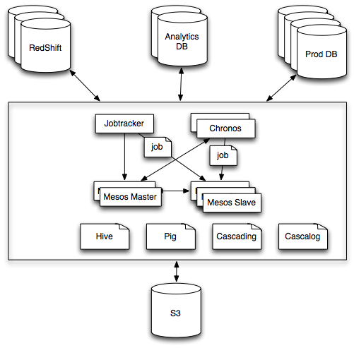
after chronos + hadoop

Slide 135
case study: aurora
“run 200 of these, somewhere, forever”
built at Twitter

Slide 136
before aurora
static partitioning of machines to services
hardware outages caused site outages
puppet + monit
ops couldn’t scale as fast as engineers

Slide 137
aurora
highly available (uses mesos replicated log)
uses a python DSL to describe services
leverages service discovery and proxying (see Twitter commons)

Slide 138
after aurora
power loss to 19 racks, no lost services!
more than 400 engineers running services
largest cluster has >2500 machines

Slide 139
Mesos
Hadoop
Spark
MPI
Storm
Chronos
Mesos
Node
Node
Node
Node
Node
Node
Node
Node
Node
Node
Node
Notes:
Before and after pics

Slide 140
Mesos
Hadoop
Spark
MPI
…
Mesos
Node
Node
Node
Node
Node
Node
Node
Node
Node
Node
Node
Notes:
Before and after pics

Slide 141
Mesos
Hadoop
Spark
MPI
Storm
…
Mesos
Node
Node
Node
Node
Node
Node
Node
Node
Node
Node
Node
Notes:
Before and after pics

Slide 142
Mesos
Hadoop
Spark
MPI
Storm
Chronos
…
Mesos
Node
Node
Node
Node
Node
Node
Node
Node
Node
Node
Node
Notes:
Before and after pics

