Slide 1

Tachyon: Reliable File Sharing at Memory-Speed Across Cluster Frameworks Haoyuan Li UC Berkeley

Slide 2
Outline
Motivation
System Design
Evaluation Results
Release Status
Future Directions
Outline | Motivation| Design | Results| Status| Future

Slide 3
Memory is King
Outline| Motivation | Design | Results| Status| Future

Slide 4
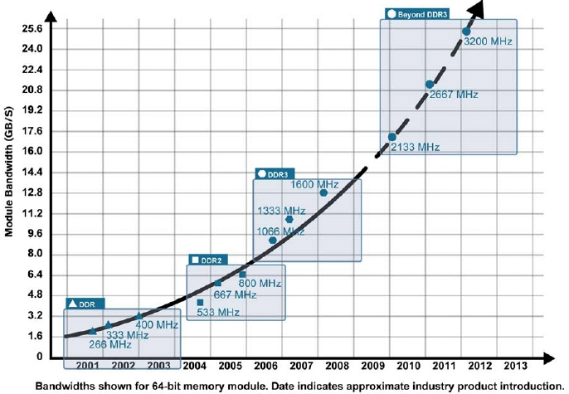
Memory Trend
RAM throughput increasing exponentially
Outline| Motivation | Design | Results| Status| Future

Slide 5
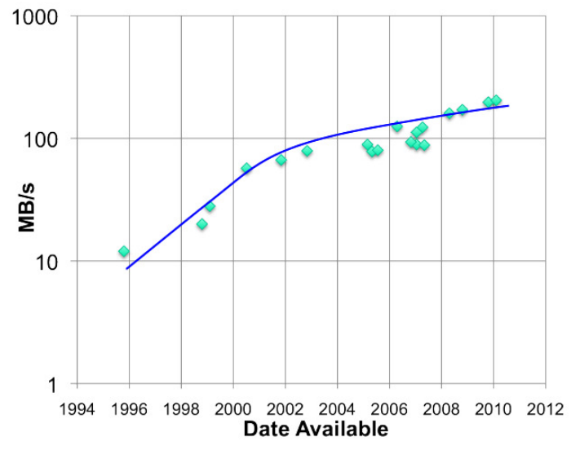
Disk Trend
Disk throughput increasing slowly
Outline| Motivation | Design | Results| Status| Future

Slide 6
Consequence
Memory locality key to achieve
Interactive queries
Fast query response
Outline| Motivation | Design | Results| Status| Future

Slide 7
Current Big Data Eco-system
Many frameworks already leverage memory
e.g. Spark, Shark, and other projects
File sharing among jobs replicated to disk
Replication enables fault-tolerance
Problems
Disk scan is slow for read.
Synchronous disk replication for write is even slower.
Outline| Motivation | Design | Results| Status| Future

Slide 8
Tachyon Project
Reliable file sharing at memory-speed across cluster frameworks/jobs
Challenge
How to achieve reliable file sharing without replication?
Outline| Motivation | Design | Results| Status| Future

Slide 9
Idea
Re-computation (Lineage) based storage using memory aggressively.
One copy of data in memory (Fast)
Upon failure, re-compute data using lineage (Fault tolerant)
Outline| Motivation | Design | Results| Status| Future

Slide 10
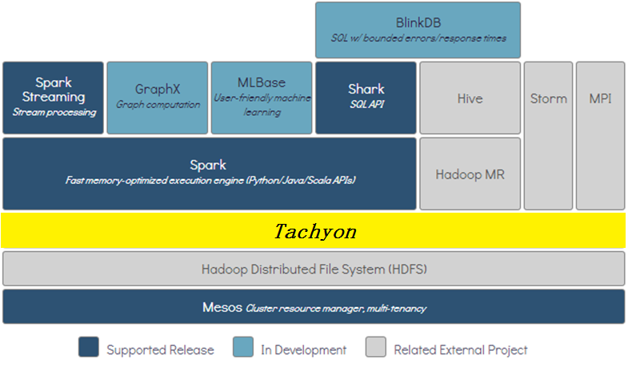
Stack
Outline| Motivation | Design | Results| Status| Future

Slide 11
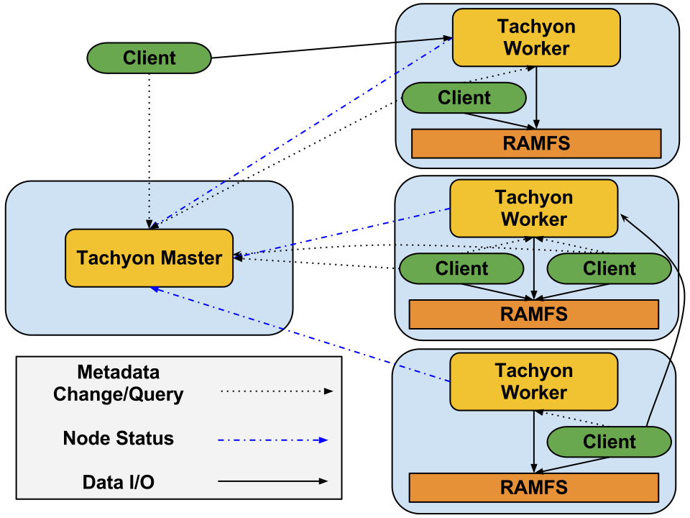
System Architecture
Outline| Motivation | Design | Results| Status| Future

Slide 12
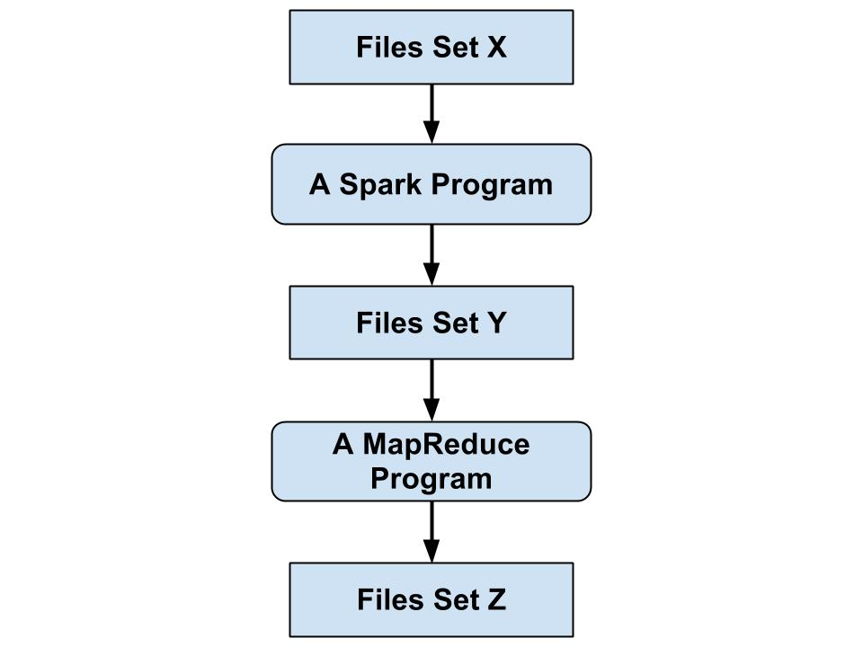
Lineage
Outline| Motivation | Design | Results| Status| Future

Slide 13
Lineage Information
Binary program
Configuration
Input Files List
Output Files List
Dependency Type
Outline| Motivation | Design | Results| Status| Future

Slide 14
Fault Recovery Time
Re-computation Cost?
Outline| Motivation | Design | Results| Status| Future

Slide 15
Example
Outline| Motivation | Design | Results| Status| Future

Slide 16
Asynchronous Checkpoint
Better than using existing solutions even under failure.
Bounded recovery time (Naïve and Snapshot asynchronous checkpointing).
Outline| Motivation | Design | Results| Status| Future

Slide 17
Master Fault Tolerance
Multiple masters
Use ZooKeeper to elect a leader
After crash workers contact new leader
Update the state of leader with contents of caches
Outline| Motivation | Design | Results| Status| Future

Slide 18
Implementation Details
15,000+ lines of JAVA
Thrift for data transport
Underlayer file system supports HDFS, S3, localFS, GlusterFS
Maven, Jenkins
Outline| Motivation | Design | Results| Status| Future

Slide 19
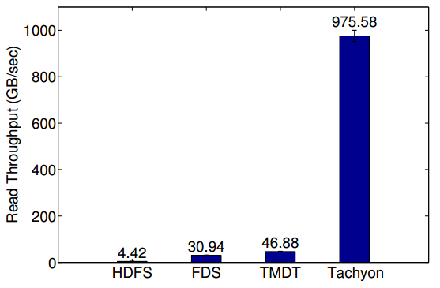
Sequential Read using Spark
Theoretical Maximum Disk Throughput
Flat Datacenter Storage
Outline| Motivation | Design | Results | Status| Future

Slide 20
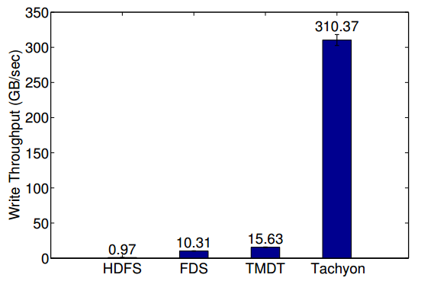
Sequential Write using Spark
Theoretical Maximum Disk Throughput
Flat Datacenter Storage
Outline| Motivation | Design | Results | Status| Future

Slide 21
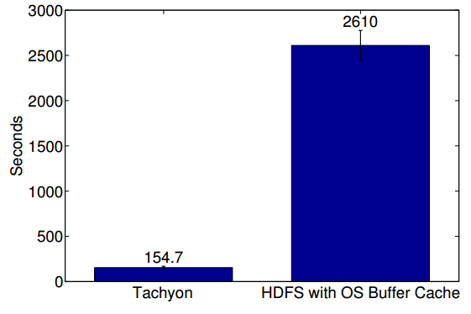
Realistic Workflow using Spark
Outline| Motivation | Design | Results | Status| Future

Slide 22
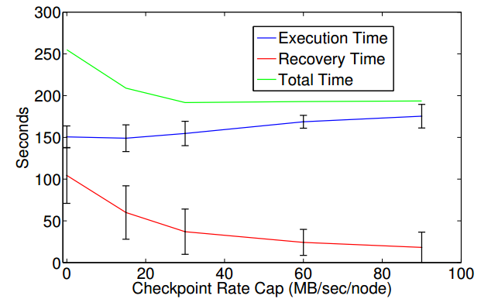
Realistic Workflow Under Failure
Outline| Motivation | Design | Results | Status| Future

Slide 23
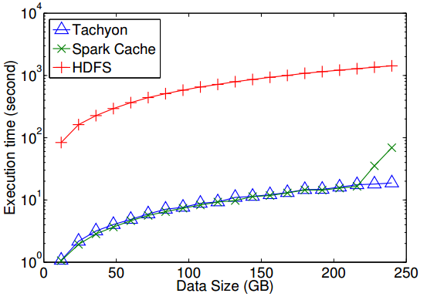
Conviva Spark Query (I/O intensive)
Tachyon outperforms Spark cache because of JAVA GC
More than 75x speedup
Outline| Motivation | Design | Results | Status| Future

Slide 24
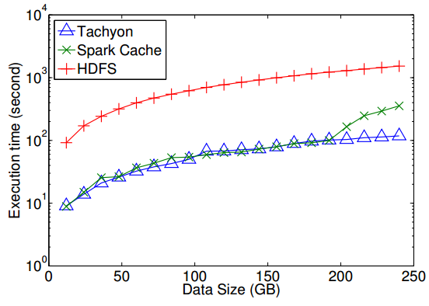
Conviva Spark Query (less I/O intensive)
12x speedup
GC kicks in earlier for Spark cache
Outline| Motivation | Design | Results | Status| Future

Slide 25






Alpha Status
Releases
Developer Preview: V0.2.1 (4/25/2013)
Contributions from:
Outline| Motivation | Design | Results | Status | Future

Slide 26
Alpha Status
First read of files cached in-memory
Writes go synchronously to HDFS (No lineage information in Developer Preview release)
MapReduce and Spark can run without any code change (ser/de becomes the new bottleneck)
Outline| Motivation | Design | Results | Status | Future

Slide 27
Current Features
Java-like file API
Compatible with Hadoop
Master fault tolerance
Native support for raw tables
WhiteList, PinList
Command line interaction
Web user interface
Outline| Motivation | Design | Results | Status | Future

Slide 28
Spark without Tachyon
val file = sc.textFile(“hdfs://ip:port/path”)
Outline| Motivation | Design | Results | Status | Future

Slide 29
Spark with Tachyon
val file = sc.textFile(“tachyon:// ip:port/path”)
Outline| Motivation | Design | Results | Status | Future

Slide 30
Shark without Tachyon
CREATE TABLE orders_cached AS SELECT * FROM orders;
Outline| Motivation | Design | Results | Status | Future

Slide 31
Shark with Tachyon
CREATE TABLE orders_tachyon AS SELECT * FROM orders;
Outline| Motivation | Design | Results | Status | Future

Slide 32
Experiments on Shark
Shark (from 0.7) can store tables in Tachyon with fast columnar Ser/De
20 GB data / 5 machines | Spark Cache | Tachyon
Table Full Scan | 1.4 sec | 1.5 sec
GroupBys (10 GB Shark Memory) | 50 – 90 sec | 45 – 50 sec
GroupBys (15 GB Shark Memory) | 44 – 48 sec | 37 – 45 sec
Outline| Motivation | Design | Results | Status | Future

Slide 33
Experiments on Shark
Shark (from 0.7) can store tables in Tachyon with fast columnar Ser/De
20 GB data / 5 machines | Spark Cache | Tachyon
Table Full Scan | 1.4 sec | 1.5 sec
GroupBys (10 GB Shark Memory) | 50 – 90 sec | 45 – 50 sec
GroupBys (15 GB Shark Memory) | 44 – 48 sec | 37 – 45 sec
4 * 100 GB TPC-H data / 17 machines | Spark Cache | Tachyon
TPC-H Q1 | 65.68 sec | 24.75 sec
TPC-H Q2 | 438.49 sec | 139.25 sec
TPC-H Q3 | 467.79 sec | 55.99 sec
TPC-H Q4 | 457.50 sec | 111.65 sec
Outline| Motivation | Design | Results | Status | Future

Slide 34
Future
Efficient Ser/De support
Fair sharing for memory
Full support for lineage
Next release is coming soon
Outline| Motivation | Design | Results | Status | Future

Slide 35
Acknowledgment
Research Team: Haoyuan Li, Ali Ghodsi, Matei Zaharia, Eric Baldeschwieler , Scott Shenker, Ion Stoica
Code Contributors: Haoyuan Li, Calvin Jia, Bill Zhao, Mark Hamstra, Rong Gu, Hobin Yoon, Vamsi Chitters, Reynold Xin, Srinivas Parayya, Dilip Joseph
Outline| Motivation | Design | Results | Status | Future

Slide 36
Questions?
http://tachyon-project.org
https://github.com/amplab/tachyon

