Slide 1

Spark Streaming
Large-scale near-real-time stream processing
Tathagata Das (TD)
along with
Matei Zaharia, Haoyuan Li, Timothy Hunter, Scott Shenker, Ion Stoica, and many others
UC BERKELEY

Slide 2
What is Spark Streaming?
Extends Spark for doing large scale stream processing
Scales to 100s of nodes and achieves second scale latencies
Efficient and fault-tolerant stateful stream processing
Simple batch-like API for implementing complex algorithms

Slide 3

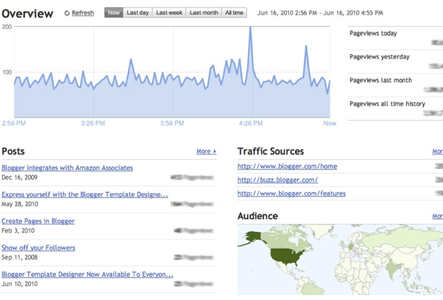
Motivation
Many important applications must process large streams of live data and provide results in near-real-time
  Social network trends
  Website statistics
  Ad impressions
  …
Distributed stream processing framework is required to
  Scale to large clusters (100s of machines)
  Achieve low latency (few seconds)

Slide 4

Integration with Batch Processing
Many environments require processing same data in live streaming as well as batch post processing
Existing framework cannot do both
  Either do stream processing of 100s of MB/s with low latency
  Or do batch processing of TBs / PBs of data with high latency
Extremely painful to maintain two different stacks
  Different programming models
  Double the implementation effort
  Double the number of bugs

Slide 5

Stateful Stream Processing
Traditional streaming systems have a record-at-a-time processing model
  Each node has mutable state
  For each record, update state and send new records
mutable state
input
records
node 1
node 3
input
records
State is lost if node dies!
Making stateful stream processing be fault-tolerant is challenging
node 2
Notes:
Traditional streaming systems have what we call a “record-at-a-time” processing model. Each node in the cluster processing a stream has a mutable state. As records arrive one at a time, the mutable state is updated, and a new generated record is pushed to downstream nodes. Now making this mutable state fault-tolerant is hard.

Slide 6
Existing Streaming Systems
Storm
  Replays record if not processed by a node
  Processes each record at least once
  May update mutable state twice!
  Mutable state can be lost due to failure!
Trident – Use transactions to update state
  Processes each record exactly once
  Per state transaction to external database is slow

Slide 7
Spark Streaming

Slide 8
Discretized Stream Processing
Run a streaming computation as a series of very small, deterministic batch jobs
live data stream
Spark
Streaming
Chop up the live stream into batches of X seconds
Spark treats each batch of data as RDDs and processes them using RDD operations
Finally, the processed results of the RDD operations are returned in batches
batches of X seconds
Spark
processed results

Slide 9
Discretized Stream Processing
Run a streaming computation as a series of very small, deterministic batch jobs
live data stream
Spark
Streaming
Batch sizes as low as ½ second, latency of about 1 second
Potential for combining batch processing and streaming processing in the same system
batches of X seconds
Spark
processed results

Slide 10
Example – Get hashtags from Twitter
val tweets = ssc.twitterStream()
DStream: a sequence of RDDs representing a stream of data
Twitter Streaming API
batch @ t+1
batch @ t
batch @ t+2
tweets DStream
stored in memory as an RDD (immutable, distributed)

Slide 11
Example – Get hashtags from Twitter
val tweets = ssc.twitterStream()
val hashTags = tweets.flatMap (status => getTags(status))
new DStream
transformation: modify data in one DStream to create another DStream
batch @ t
batch @ t+1
batch @ t+2
tweets DStream
flatMap
flatMap
flatMap
hashTags Dstream
[#cat, #dog, … ]
…
new RDDs created for every batch

Slide 12
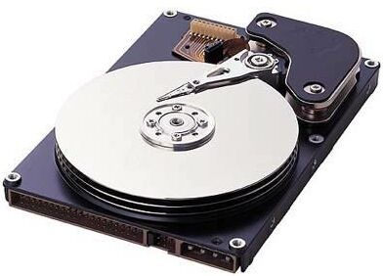
Example – Get hashtags from Twitter
val tweets = ssc.twitterStream()
val hashTags = tweets.flatMap (status => getTags(status))
hashTags.saveAsHadoopFiles("hdfs://...")
output operation: to push data to external storage
batch @ t
batch @ t+1
batch @ t+2
tweets DStream
flatMap
flatMap
flatMap
hashTags DStream
save
save
save
every batch saved to HDFS

Slide 13
Example – Get hashtags from Twitter
val tweets = ssc.twitterStream()
val hashTags = tweets.flatMap (status => getTags(status))
hashTags.foreach(hashTagRDD => { ... })
foreach: do whatever you want with the processed data
batch @ t
batch @ t+1
batch @ t+2
tweets DStream
flatMap
flatMap
flatMap
hashTags DStream
foreach
foreach
foreach
Write to database, update analytics UI, do whatever you want

Slide 14
Java Example
Scala
val tweets = ssc.twitterStream()
val hashTags = tweets.flatMap (status => getTags(status))
hashTags.saveAsHadoopFiles("hdfs://...")
Java
JavaDStream<Status> tweets = ssc.twitterStream()
JavaDstream<String> hashTags = tweets.flatMap(new Function<...> { })
hashTags.saveAsHadoopFiles("hdfs://...")
Function object

Slide 15
Window-based Transformations
val tweets = ssc.twitterStream()
val hashTags = tweets.flatMap (status => getTags(status))
val tagCounts = hashTags.window(Minutes(1), Seconds(5)).countByValue()
sliding window operation
window length
sliding interval
window length
DStream of data
sliding interval

Slide 16
Arbitrary Stateful Computations
  Specify function to generate new state based on previous state and new data
  Example: Maintain per-user mood as state, and update it with their tweets
updateMood(newTweets, lastMood) => newMood
moods = tweets.updateStateByKey(updateMood _)

Slide 17
Arbitrary Combinations of Batch and Streaming Computations
Inter-mix RDD and DStream operations!
  Example: Join incoming tweets with a spam HDFS file to filter out bad tweets
  tweets.transform(tweetsRDD => { tweetsRDD.join(spamHDFSFile).filter(...)
  })

Slide 18
DStream Input Sources
Out of the box we provide
  Kafka
  HDFS
  Flume
  Akka Actors
  Raw TCP sockets
Very easy to write a receiver for your own data source

Slide 19
Fault-tolerance: Worker
RDDs remember the operations that created them
Batches of input data are replicated in memory for fault-tolerance
Data lost due to worker failure, can be recomputed from replicated input data
tweets
RDD
input data replicated
in memory
flatMap
hashTags
RDD
lost partitions recomputed on other workers
All transformed data is fault-tolerant, and exactly-once transformations

Slide 20
Fault-tolerance: Master
Master saves the state of the DStreams to a checkpoint file
  Checkpoint file saved to HDFS periodically
If master fails, it can be restarted using the checkpoint file
More information in the Spark Streaming guide
  Link later in the presentation
Automated master fault recovery coming soon

Slide 21
Performance
Can process 6 GB/sec (60M records/sec) of data on 100 nodes at sub-second latency
  Tested with 100 text streams on 100 EC2 instances with 4 cores each

Slide 22
Comparison with Storm and S4
Higher throughput than Storm
  Spark Streaming: 670k records/second/node
  Storm: 115k records/second/node
  Apache S4: 7.5k records/second/node
Notes:
Streaming Spark offers similar speed while providing FT and consistency guarantees that these systems lack

Slide 23
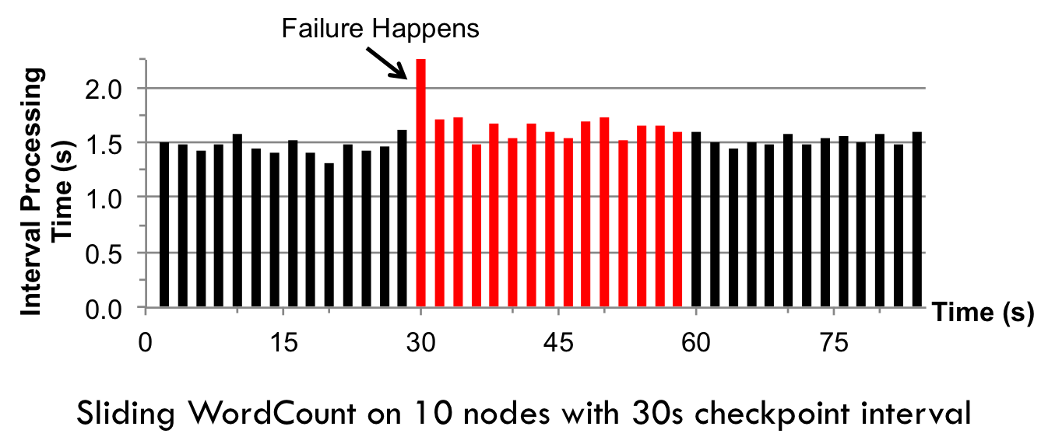
Fast Fault Recovery
Recovers from faults/stragglers within 1 sec

Slide 24
Real Applications: Mobile Millennium Project
Traffic transit time estimation using online machine learning on GPS observations
Markov chain Monte Carlo simulations on GPS observations
Very CPU intensive, requires dozens of machines for useful computation
Scales linearly with cluster size

Slide 25
Real Applications: Conviva
Real-time monitoring and optimization of video metadata
Aggregation of performance data from millions of active video sessions across thousands of metrics
Multiple stages of aggregation
Successfully ported to run on Spark Streaming
Scales linearly with cluster size

Slide 26
Unifying Batch and Stream Processing Models
Spark program on Twitter log file using RDDs
val tweets = sc.hadoopFile("hdfs://...")
val hashTags = tweets.flatMap (status => getTags(status))
hashTags.saveAsHadoopFile("hdfs://...")
Spark Streaming program on Twitter stream using DStreams
val tweets = ssc.twitterStream()
val hashTags = tweets.flatMap (status => getTags(status))
hashTags.saveAsHadoopFiles("hdfs://...")

Slide 27
Vision - one stack to rule them all
Explore data interactively using Spark Shell to identify problems
Use same code in Spark stand-alone programs to identify problems in production logs
Use similar code in Spark Streaming to identify problems in live log streams
$ ./spark-shell
scala> val file = sc.hadoopFile(“smallLogs”)
...
scala> val filtered = file.filter(_.contains(“ERROR”))
...
scala> val mapped = filtered.map(...)
...
object ProcessProductionData {
def main(args: Array[String]) {
val sc = new SparkContext(...)
val file = sc.hadoopFile(“productionLogs”)
val filtered = file.filter(_.contains(“ERROR”))
val mapped = filtered.map(...)
...
}
}
object ProcessLiveStream {
def main(args: Array[String]) {
val sc = new StreamingContext(...)
val stream = sc.kafkaStream(...)
val filtered = file.filter(_.contains(“ERROR”))
val mapped = filtered.map(...)
...
}
}

Slide 28
Vision - one stack to rule them all
Ad-hoc Queries
Batch Processing
Stream Processing
Spark
+
Shark
+
Spark
Streaming

Slide 29
Today’s Tutorial
Process Twitter data stream to find most popular hashtags
Requires a Twitter account
Need to setup Twitter OAuth keys
  All the instructions in the tutorial
Your account is safe!
  No need to enter your password anywhere, only enter the keys in configuration file
  Destroy the keys after the tutorial is done

Slide 30
Conclusion
Integrated with Spark as an extension
  Takes 5 minutes to spin up a Spark cluster to try it out
Streaming programming guide –
  http://spark.incubator.apache.org/docs/latest/streaming-programming-guide.html
Paper – tinyurl.com/dstreams
Thank you!

