Slide 1
Using Spark @ Conviva
29 Aug 2013

Slide 2

Summary
Who are we?
What is the problem we needed to solve?
How was Spark essential to the solution?
What can Spark enable us to do in the future?
Notes:
Summary of what the talk will be about:
Just relay bullet points. This is a 10 sec slide

Slide 3
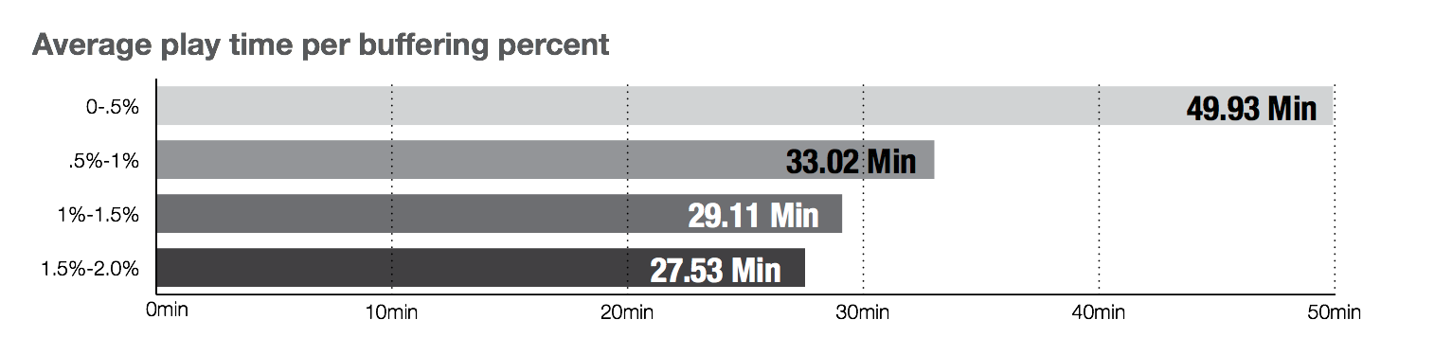
Some context…
Quality has a huge impact on user engagement in online video
Notes:
Summary of what the talk will be about:
Just relay bullet points. This is a 10 sec slide

Slide 4
What we do
Optimize end user online video experience
Provide historical and real-time metrics for online video providers and distributers
Maximize quality through
Adaptive Bit Rate (ABR)
Content Distribution Network (CDN) switching
Enable Multi-CDN infrastructure with fine grained traffic shaping control
Notes:
First bullet point: Describe use cases (e.g. Alerting on publishing errors, providing insight into how quality can affect engagement)
We are in a unique position to provide a more holistic view of quality regardless of ecosystem.
Can we bring up key customers such as HBO, or do we keep this anonymous?

Slide 5



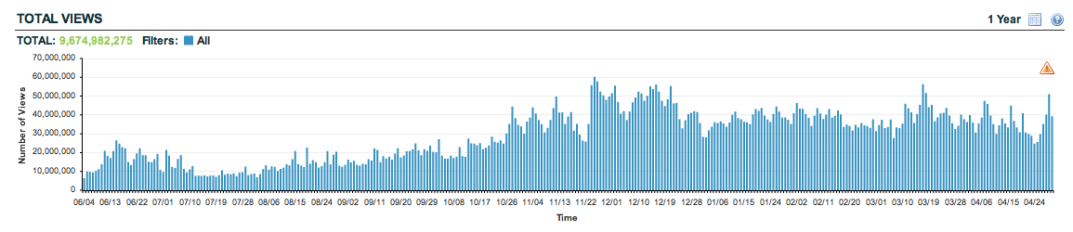




What traffic do we see?
About four billion streams per month
Mostly premium content providers (e.g., HBO, ESPN, BSkyB, CNTV) but also User Generated Video sites (e.g., Ustream)
Live events (e.g., NCAA March Madness, FIFA World Cup, MLB), short VoDs (e.g., MSNBC), and long VoDs (e.g., HBO, Hulu)
Various streaming protocols (e.g., Flash, SmoothStreaming, HLS, HDS), and devices (e.g., PC, iOS devices, Roku, XBOX, …)
Traffic from all major CDNs, including ISP CDNs (e.g., Verizon, AT&T)
Notes:
Using this instrumentation we see a very large variety of international traffic. All in all, Conviva monitors close to 4 billions of streams per month….
Focus mostly on the premium customers

Slide 6
The Truth
Video delivery over the internet is hard
There is a big disconnect between viewers and publishers
Notes:
Changing gears a bit to get more specific
Video delivery over the internet is a hard problem, and this is compounded by the fact that publishers are often blind to the performance (or lack there of) of their delivery platform.

Slide 7
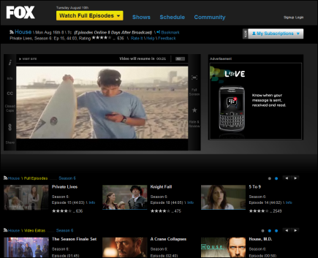
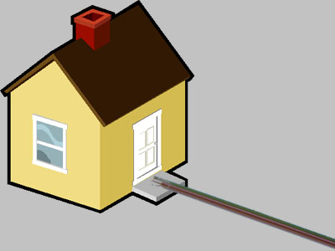
The Viewer’s Perspective
Start of the viewer’s perspective
Video Player
ISP & Home Net
?
Notes:
The viewer only has visibility into what they see on their screen, and sometimes into the state of their home network

Slide 8



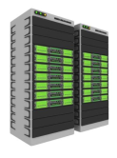
The Provider’s Perspective
Video Source
Encoders & Video Servers
CMS and Hosting
Content Delivery Networks (CDN)
?
Notes:
Whereas the provider sees the massive complexity of an internet video delivery system and the various platforms they serve, with little to no insight into how it all actually performs.

Slide 9
Closing the loop
Video Source
Video Player
Encoders & Video Servers
ISP & Home Net
CMS and Hosting
Content Delivery Networks (CDN)

Slide 10
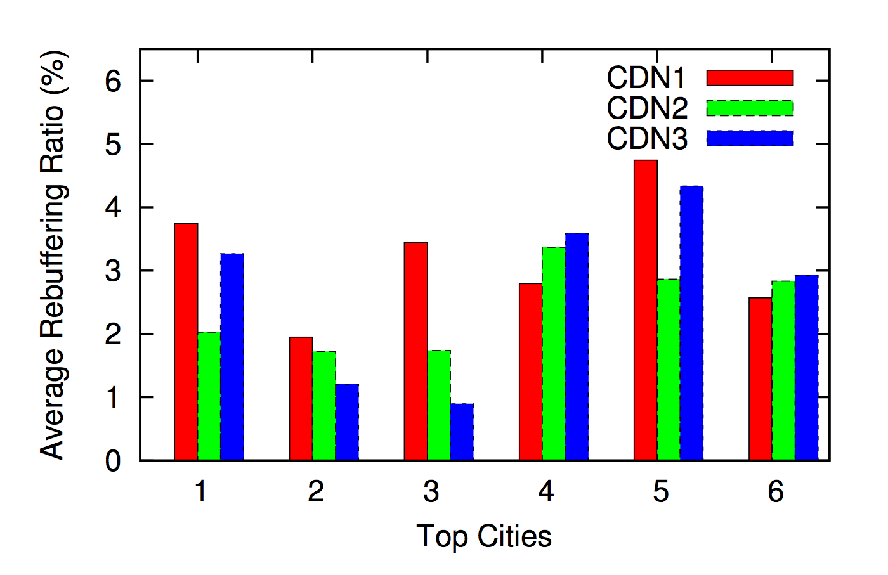
The Truth
Video delivery over the internet is hard
CDN variability makes it nearly impossible to deliver high quality everywhere with just one CDN
SIGCOMM ‘12
Notes:
(Explain graphic. Mention that Conviva published)
This last point brings us to one of the most ambitions projects that conviva has undertaken: (Next slide)

Slide 11
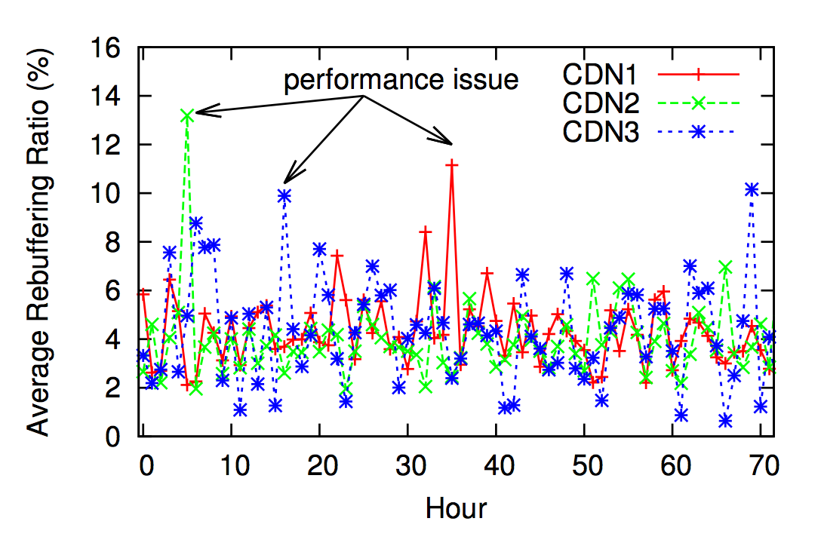
The Truth
Video delivery over the internet is hard
CDN variability makes it nearly impossible to deliver high quality all the time with just one CDN
SIGCOMM ‘12
Notes:
In addition to this (as we have seen), a single CDN doesn’t provide consistent performance that is expected from users. (referring to included graphic)
This last point brings us to one of the most ambitions projects that conviva has undertaken: (Next slide)

Slide 12
The Idea
Where there is heterogeneity, there is room for optimization
For each viewer we want to decide what CDN to stream from
But it’s difficult to model the internet, and things can rapidly change over time
So we will make this decision based on the real-time data that we collect
Notes:
Just relay slide
Focus just on CDN aspect

Slide 13
The Idea
San Francisco
Hong Kong
For each CDN, partition clients by City
For each partition compute Buffering Ratio
New York
Seattle
London
Avg. buff ratio of users in Region[1] streaming from CDN1
CDN1 (buffering ratio)
Avg. buff ratio of users in Region[1] streaming from CDN2
CDN2 (buffering ratio)
Notes:
Relay the slide
Not clear this a 3d grid

Slide 14
The Idea
For each partition select best CDN and send clients to this CDN
San Francisco
Hong Kong
New York
Seattle
London
CDN1 (buffering ratio)
CDN2 (buffering ratio)
Notes:
We want an oracle that selects the best CDN on a given partition and then assume that all clients stream from that CDN.
We will describe what ‘best’ means later, for that is a challenge in itself.

Slide 15
The Idea
For each partition select best CDN and send clients to this CDN
San Francisco
Hong Kong
New York
Seattle
London
CDN1 (buffering ratio)
CDN2 >> CDN1
CDN2 (buffering ratio)
Notes:
We want an oracle that selects the best CDN on a given partition and then assume that all clients stream from that CDN.
We will describe what ‘best’ means later, for that is a challenge in itself.

Slide 16
The Idea
For each partition select best CDN and send clients to this CDN
San Francisco
Hong Kong
New York
Seattle
London
CDN1 (buffering ratio)
CDN2 (buffering ratio)
Notes:
We want an oracle that selects the best CDN on a given partition and then assume that all clients stream from that CDN.
We will describe what ‘best’ means later, for that is a challenge in itself.

Slide 17
The Idea
For each partition select best CDN and send clients to this CDN
San Francisco
Hong Kong
New York
Seattle
London
CDN1 (buffering ratio)
CDN2 (buffering ratio)
Best CDN (buffering ratio)

Slide 18
The Idea
What if there are changes in performance?
San Francisco
Hong Kong
New York
Seattle
London
CDN1 (buffering ratio)
CDN2 (buffering ratio)
Best CDN (buffering ratio)
Notes:
We need to use an online algorithm in order to adapt to changes in the environment

Slide 19
The Idea
Use online algorithm respond to changes in the network.
San Francisco
Hong Kong
New York
Seattle
London
CDN1 (buffering ratio)
CDN2 (buffering ratio)
Best CDN (buffering ratio)

Slide 20




How?
Coordinator implementing an optimization algorithm that dynamically selects a CDN for each client based on
Individual client
Aggregate statistics
Content owner policies
control
Coordinator
All based on real-time data
CDN 1
Business Policies
Continuous measurements
CDN 2
CDN 3
Content owners
(CMS & Origin)
Clients
Notes:
We already have a bespoke streaming metrics processing system

Slide 21
What processing framework do we use?
Twitter Storm
Fault tolerance model affects data accuracy
Non-deterministic streaming model
Roll our own
Too complex
No need to reinvent the wheel
Spark
Easily integrates with existing Hadoop architecture
Flexible, simple data model
Writing map() is generally easier than writing update()
Notes:
Clearly a problem like this requires distributed computing power, but it there is still the question of which one?
Twitter Storm, though powerful is too focused on the streaming architecture and has a subsequently limited API. Because it is pure streaming, it is very difficult to parameterize the input state to produce deterministic output for something like a simulation It can’t do things like batch sessions for something like LP calculation
We could potentially build our own, but we wanted to spend our time building SDN algorithms, not building distributed computing frameworks
Spark provides the most flexible, robust computing model that allows for our admittedly very complex application

Slide 22
Spark Usage for Production
Spark Node
Spark Cluster
Spark
Node
Compute performance metrics in spark cluster
Relay performance information to decision makers
Spark Node
Spark Node
Spark Node
Storage Layer
Decision Maker
Decision Maker
Decision Maker
Clients
Notes:
We use spark to compute a decision / state table that is then used to make decisions in real time by a simple query responder caching layer.
Entire state for 1 minute can be computed in 5-8 seconds
Architecture allows decisions to be made in constant time (<1ms) and can handle spark master failure. Only cost will be stale data.

Slide 23
Results
Non-buffering views
Average Bitrate (Kbps)
Notes:
By leveraging a multi CDN infrastructure and optimizing CDN selection we were able to take a customer from middle of the pack in terms of overall performance, to one of the top performing customers that we have.
Can compute 3 million sessions per day, chunked per minute in 6 to 15 seconds

Slide 24
Spark’s Role
Spark development was incredibly rapid, aided both by its excellent programming interface and highly active community
Expressive:
Develop complex on-line ML decision based algorithm in ~1000 lines of code
Easy to prototype various algorithms
It has made scalability a far more manageable problem
After initial teething problems, we have been running Spark in a production environment reliably for several months.
Notes:
Problems: dealing with cryptic errors and inexplicable crashes on earlier versions. Still difficult to debug spark problems. In s

Slide 25
Problems we faced
Silent crashes…
Often difficult to debug, requiring some tribal knowledge
Difficult configuration parameters, with sometimes inexplicable results
Fundamental understanding of underlying data model was essential to writing effective, stable spark programs
Notes:
Problems: dealing with cryptic errors and inexplicable crashes on earlier versions. Still difficult to debug spark problems. In s

Slide 26
Enforcing constraints on optimization
Imagine swapping clients until an optimal solution is reached
50%
CDN1 (buffering ratio)
50%
CDN2 (buffering ratio)
Constrained Best CDN
(buffering ratio)
Notes:
Essentially we compromise on clients where there is the lowest cost to performance to satisfy the constraints.

Slide 27
Enforcing constraints on top of optimization
Solution is found after clients have already joined.
Therefore we need to parameterize solution to clients already seen for online use.
Need to compute an LP on real time data
Spark Supported it
20 LPs
Each with 4000 decisions variables and 350 constraints
5 seconds.
Notes:
We add yet another requirement of needing to compute multiple LP’s in realtime…
20 LPs on each with ~4000 decision variables

Slide 28
Tuning
Can’t select a CDN based solely on one metric.
Select utility functions that best predict engagement
Confidence in a decision, or evaluation will depend on how much data we have collected
Need to tune time window
Select different attributes for separation
Notes:
Essentially we compromise on clients where there is the lowest cost to performance to satisfy the constraints.

Slide 29
Tuning
Need to validate algorithm changes quickly
Simulation of algorithm offline, is essential
Notes:
Essentially we compromise on clients where there is the lowest cost to performance to satisfy the constraints.

Slide 30
Spark Usage for Simulation
HDFS with Production traces
Spark Node
Spark
Node
Spark Node
Load production traces with randomized initial decisions
Generate decision table (with artificial delay)
Produce simulated decision set
Evaluate decisions against actual traces to estimate expected quality improvement
Spark Node
Spark Node
Notes:
The only extra code written to build this, involved the evaluation code and the basic harness. All of the evaluation and decision making code could be directly reused. Simulations can run over 6x faster than realtime, though with a larger cluster, this could potentially be even faster.

Slide 31
Future of Spark and Conviva
Leverage spark streaming
Unify live and historical processing
Develop platform to build various processing ‘apps’ (e.g. Anomaly Detection, Customer Tailored Reporting)
Can share the same data API
Will all have consistent input
Notes:
Spark will allow us to unify our historic and live processing stacks, and remove the disjointed paradigms between the two.
With a unified stack we will have a data processing stack that is able to support multiple ‘apps’ in addition to go such as anomaly detection

Slide 32
In Summary
Spark was able to support our initial requirement of fast fault tolerant performance computation for an on-line decision maker
New complexities like LP calculation ‘just worked’ in the existing architecture
Spark has become an essential tool in our software stack
Notes:
Spark will allow us to unify our historic and live processing stacks, and remove the disjointed paradigms between the two.
With a unified stack we will have a data processing stack that is able to support multiple ‘apps’ in addition to go such as anomaly detection

Slide 33
Thank you!
Notes:
Spark will allow us to unify our historic and live processing stacks, and remove the disjointed paradigms between the two.
With a unified stack we will have a data processing stack that is able to support multiple ‘apps’ in addition to go such as anomaly detection

Slide 34
Questions?
Notes:
Spark will allow us to unify our historic and live processing stacks, and remove the disjointed paradigms between the two.
With a unified stack we will have a data processing stack that is able to support multiple ‘apps’ in addition to go such as anomaly detection

