Slide 1

Tachyon: memory-speed data sharing
Haoyuan (HY) Li, Ali Ghodsi,
Matei Zaharia, Scott Shenker, Ion Stoica
UC Berkeley
Notes:
Good morning everyone. My name is Haoyuan, you can call me HY. I’m going to present Tachyon. This is a join work with…
In this talk, I’m going to give an quick overview of Tachyon at the beginning, and then shows the progress have been made since the last retreat. In the end, I’m going to present the system’s roadmap.

Slide 2
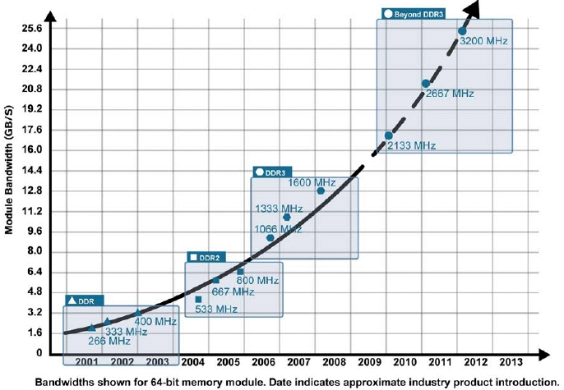
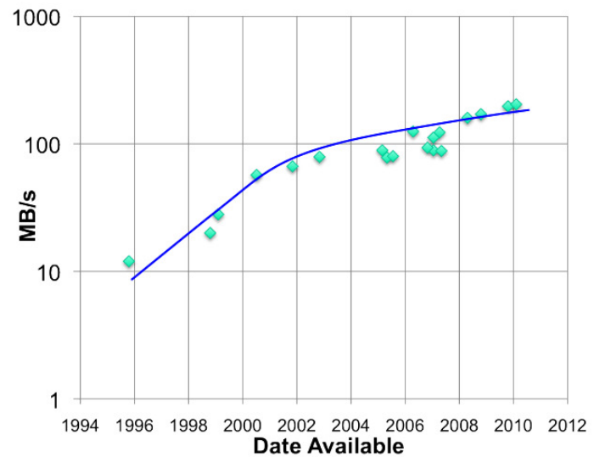
Memory trumps everything else
RAM throughput increasing exponentially
Disk throughput increasing slowly
Memory-locality key to interactive response time

Slide 3
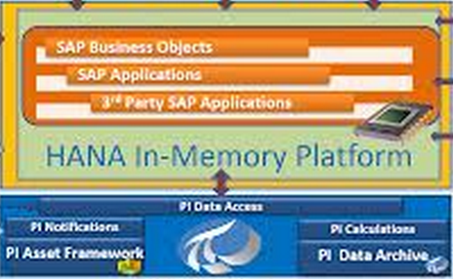

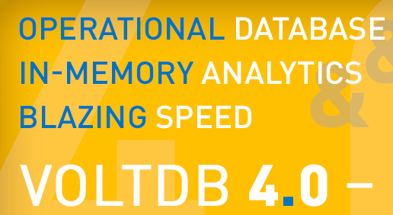
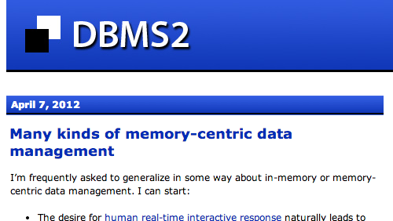
Realized by many…
Frameworks already leverage memory
  e.g. Spark, Shark, GraphX, …
Notes:
Spark is one example. It uses RDD concept to do fast in memory computation. As we have heard a lot about it here, it has been applied in many companies with great performance. However, there are still several problems.

Slide 4

Example: -
Fast in-memory data processing within a job
  Keep only one copy in-memory copy JVM
  Track lineage of operations used to derive data
  Upon failure, use lineage to re-compute data
Lineage Tracking
map
join
reduce
filter
map
Notes:
No replication, no going to disk! And this is what makes Spark *fast*

Slide 5
Challenge 1
Spark Task
execution engine &
storage engine
same JVM process
Spark memory
block manager
block 1
block 3
HDFS
disk
block 1
block 2
block 3
block 4

Slide 6
Challenge 1
crash
execution engine &
storage engine
same JVM process
Spark memory
block manager
block 1
block 3
HDFS
disk
block 1
block 2
block 3
block 4

Slide 7
Challenge 1
JVM crash: lose all cache
crash
execution engine &
storage engine
same JVM process
HDFS
disk
block 1
block 2
block 3
block 4

Slide 8
Challenge 2
JVM heap overhead:
GC & duplicate memory per job
execution engine &
storage engine
same JVM process
(GC & duplication)
Spark Task
Spark Task
Spark mem
block manager
Spark mem
block manager
block 1
block 3
block 3
Block 1
HDFS
disk
block 1
block 2
block 3
block 4
Notes:
----- Meeting Notes (1/5/14 18:59) -----
Remove "Many framework"

Slide 9
Challenge 3
Different jobs share data:
Slow writes to disk
storage engine &
execution engine
same JVM process
(slow writes)
Spark Task
Spark Task
Spark mem
block manager
Spark mem
block manager
block 1
block 3
block 3
block 1
HDFS
disk
block 1
block 2
block 3
block 4
Notes:
----- Meeting Notes (1/5/14 18:59) -----
Remove "Many framework"

Slide 10
Challenge 3
Different frameworks share data:
Slow writes to disk
storage engine &
execution engine
same JVM process
(slow writes)
Spark Task
Hadoop MR
Spark mem
block manager
YARN
block 1
block 3
HDFS
disk
block 1
block 2
block 3
Block 4
Notes:
----- Meeting Notes (1/5/14 18:59) -----
Remove "Many framework"

Slide 11
Tachyon
Reliable data sharing at memory-speed within and across cluster frameworks/jobs

Slide 12
Challenge 1 revisited
Spark Task
execution engine &
storage engine
same JVM process
Spark memory
block manager
block 1
HDFS
disk
Tachyon
in-memory
block 1
block 1
block 2
block 3
block 3
block 4
block 4

Slide 13
Challenge 1 revisited
crash
execution engine &
storage engine
same JVM process
Spark memory
block manager
block 1
HDFS
disk
Tachyon
in-memory
block 1
block 1
block 2
block 3
block 3
block 4
block 4
HDFS
disk
block 1
block 2
block 3
block 4

Slide 14
Challenge 1 revisited
JVM crash: keep memory-cache
crash
execution engine &
storage engine
same JVM process
HDFS
disk
Tachyon
in-memory
block 1
block 1
block 2
block 3
block 3
block 4
block 4
HDFS
disk
block 1
block 2
block 3
block 4

Slide 15
Challenge 2 revisited
Off-heap memory storage
No GC & one memory copy
execution engine &
storage engine
same JVM process
(no GC & duplication)
Spark Task
Spark Task
Spark mem
Spark mem
block 1
block 4
HDFS
disk
Tachyon
in-memory
block 1
block 1
block 2
block 3
block 3
block 4
block 4
HDFS
disk
block 1
block 2
Block 3
Block 4
Notes:
----- Meeting Notes (1/5/14 18:59) -----
Remove "Many framework"

Slide 16
Challenge 3 revisited
Different frameworks share
at memory-speed
execution engine &
storage engine
same JVM process
(fast writes)
Spark Task
Hadoop MR
Spark mem
YARN
block 1
HDFS
disk
Tachyon
in-memory
block 1
block 1
block 2
block 3
block 3
block 4
block 4
HDFS
disk
block 1
block 2
Block 3
Block 4
Notes:
----- Meeting Notes (1/5/14 18:59) -----
Remove "Many framework"

Slide 17
Tachyon and Spark
Spark’s of off-JVM-heap RDD-store
In-memory RDDs (serialized)
Fault-tolerant cache
Enables
avoiding GC overhead
fine-grained executors
fast RDD sharing

Slide 18
Tachyon research vision
Vision
Push lineage down to storage layer
Use memory aggressively
Approach
One in-memory copy
Rely on recomputation for fault-tolerance

Slide 19
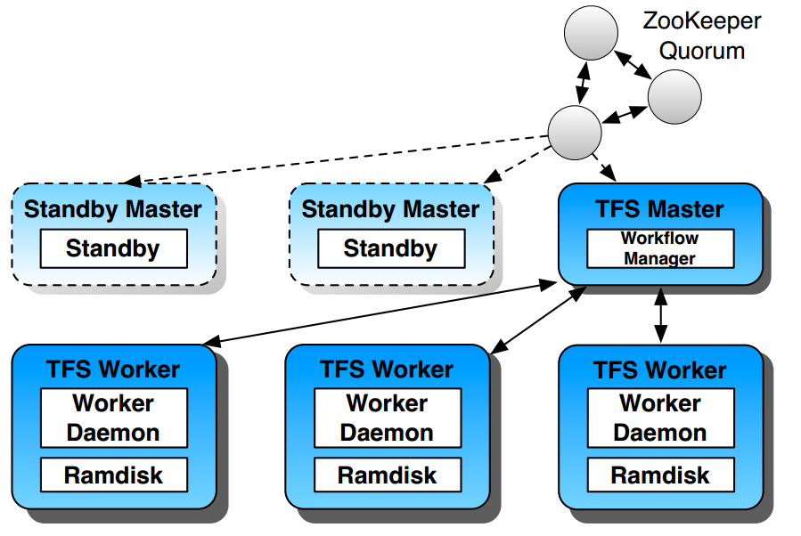
Architecture

Slide 20
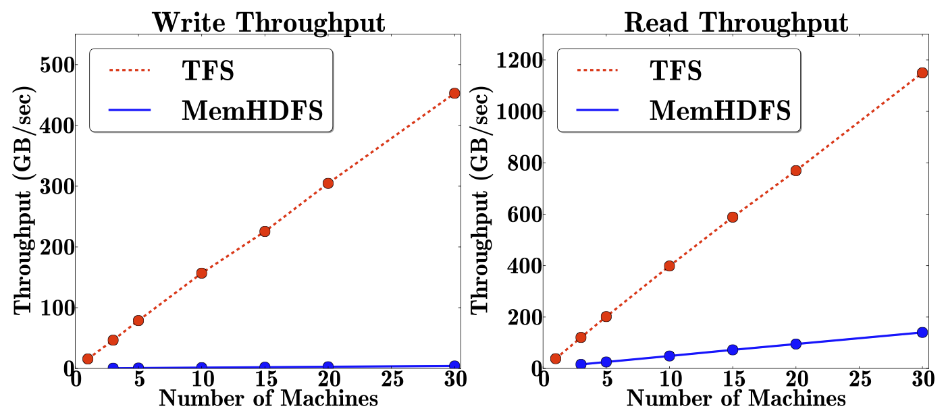
Comparison with in Memory HDFS

Slide 21
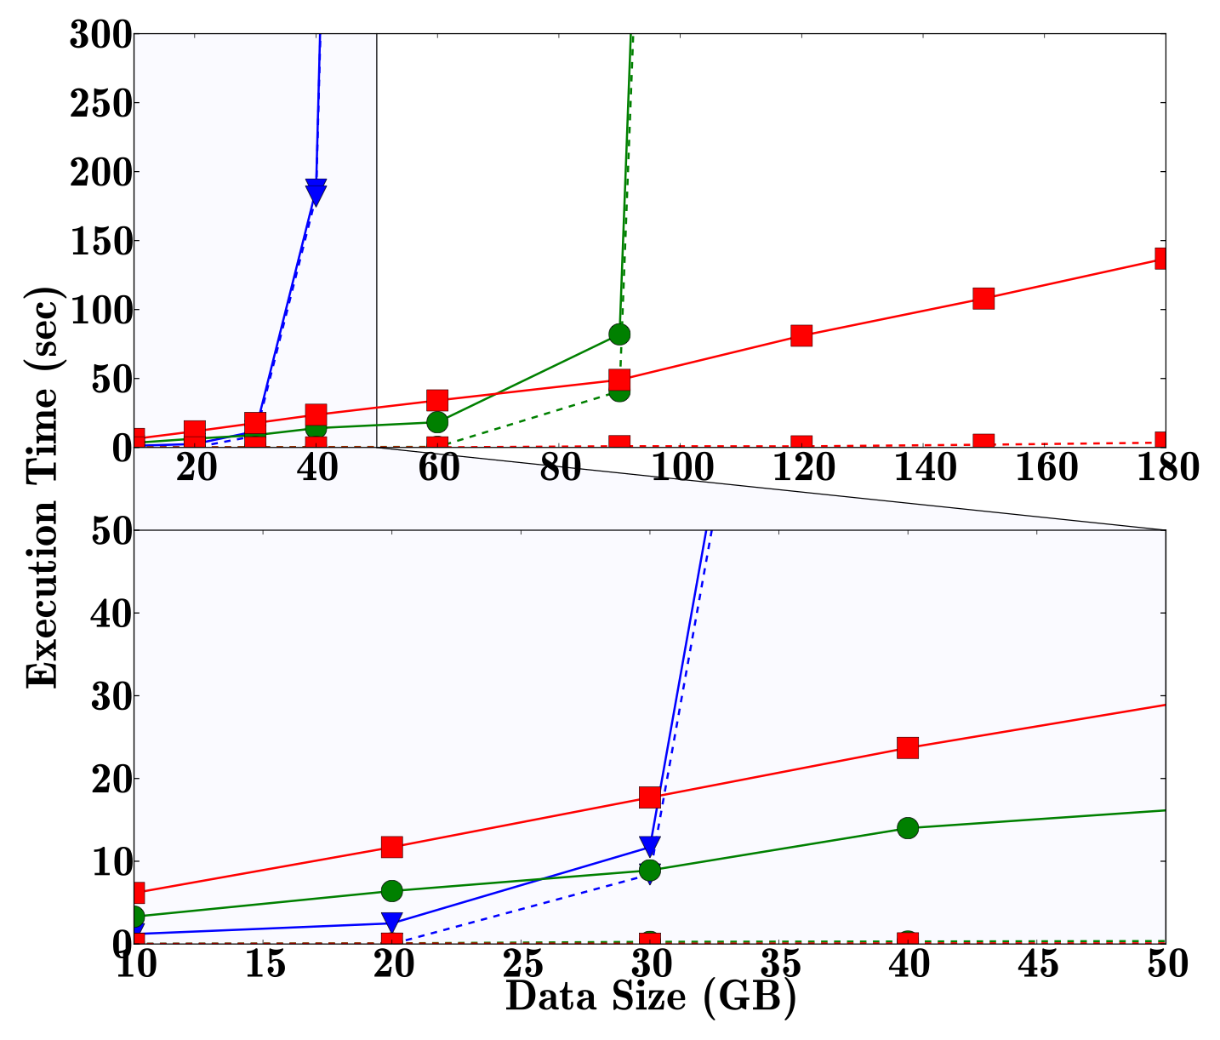
Further Improve Spark’s Performance
Grep
Notes:
BLOW UP

Slide 22
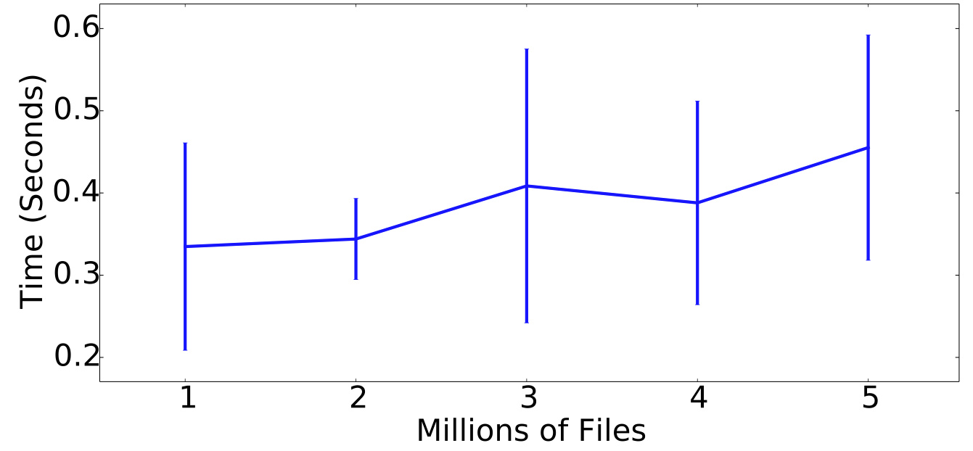
Master Faster Recovery

Slide 23
Open Source Status
New release
  V0.4.0 (Feb 2014)
  20 Developers (7 from Berkeley, 13 from outside)
  11 Companies
  Writes go synchronously to under filesystem
  (No lineage information in Developer Preview release)
  MapReduce and Spark can run without any code change
  (ser/de becomes the new bottleneck)

Slide 24
Using HDFS vs Tachyon
Spark
  val file = sc.textFile(“hdfs://ip:port/path”)
Shark
  CREATE TABLE orders_cached AS SELECT * FROM orders;
Hadoop MapReduce
  hadoop jar examples.jar wordcount hdfs://localhost/input hdfs://localhost/output

Slide 25
Using HDFS vs Tachyon
Spark
  val file = sc.textFile(“tachyon://ip:port/path”)
Shark
  CREATE TABLE orders_tachyon AS SELECT * FROM orders;
Hadoop MapReduce
  hadoop jar examples.jar wordcount tachyon://localhost/input tachyon://localhost/output

Slide 26

Thanks to Redhat!
Notes:
No need to manually install Tachyon
Just do “apt-get install tachyon” and it will automatically be installed!

Slide 27
Future Research Focus
Integration with HDFS caching
Memory Fair Sharing
Random Access Abstraction
Mutable Data Support
Notes:
----- Meeting Notes (1/5/14 18:59) -----
Storeage Level, RMDA, SSD, HDD

Slide 28












Acknowledgments
Calvin Jia, Nick Lanham, Grace Huang, Mark Hamstra,
Bill Zhao, Rong Gu, Hobin Yoon, Vamsi Chitters,
Joseph Jin-Chuan Tang, Xi Liu, Qifan Pu, Aslan Bekirov, Reynold Xin, Xiaomin Zhang, Achal Soni, Xiang Zhong, Dilip Joseph, Srinivas Parayya, Tim St. Clair,
Shivaram Venkataraman, Andrew Ash
Notes:
----- Meeting Notes (1/5/14 18:59) -----
Put this to the end.

Slide 29
Tachyon Summary
High-throughput, fault-tolerant in-memory storage
Interface compatible to HDFS
Further improve performance for Spark, Shark, and Hadoop
Growing community with 10+ organizations contributing

Slide 30
Thanks!
More: https://github.com/amplab/tachyon

