Slide 1
Getting the Most out of Django’s User Model
Julia Looney

Slide 2
The User Model
django.contrib.auth.models.User
Notes:
So first, let’s talk about the User model. It’s the core of Django’s authentication system. It represents the people who will be using your app.

Slide 3
The User Model
  Attributes:
  username (primary key)
  password
  email
  first_name
  last_name
Notes:
Out of the box, it has many useful attributes and methods for managing a standard user base. Users can interact with your app in many different ways, and Django has it mostly covered.

Slide 4
What if we want more?
  Custom fields
  Custom permissions
  Custom model manager
  Alternative identifier to ‘username’
Notes:
But although Django provides some great things out of the box, there will always be situations when we want more.
Slide list
These are all things we can customize, but depending on what we want to customize, there are different ways of implementation.
Let’s start by looking at an example app to see why we would need more from the User model.

Slide 5
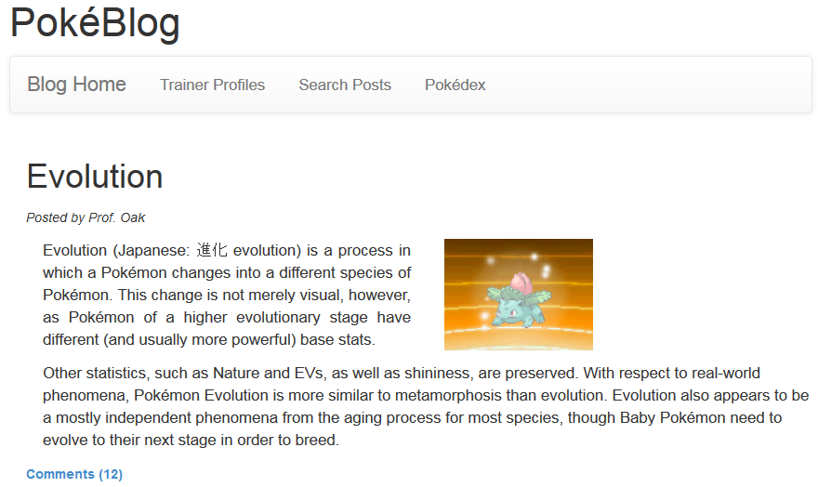
Notes:
So here is our example app – A blog where users can make posts and leave comments. Because Users are a very important part to how this app works, we’ll need to do some customization on the User model to make things go smoothly. Let’s look at our options.

Slide 6
Option 1: Proxy model
  Requires the least amount of steps
  Good for when you only need to customize a few things
Notes:
Our first option is to create a Proxy model, and is done by extending the User model. With this, we are just tacking on some extra stuff to Django’s user model without changing the database. This is simpler to implement, but only good if you need to customize a few things.

Slide 7
Option 2: One-to-one Relationship
  Requires only a few more steps
  Good for when you need more attributes
Notes:
option 2 is to create a new model that has a 1-1 relationship with the User model. This allows us to add additional attributes to the User model. Even though these first two options have their limits, they’re often exactly what we need to do to make our app better.

Slide 8
Option 3: Custom User Model
  More steps, but more freedom
  Good for when:
          you need different required fields
          you need custom permissions
          you want to add validators
Notes:
The third option is to create our own, custom User model. Doing it this way is more complicated, but it allows us more freedom with customization. It’s good for if we want a different required field, such as email instead of username, when we want to add custom permissions for the user model, or if we wanted to add validators to our User model fields.

Slide 9
Scenario 1
Notes:
So now let’s go through some examples for when to use each option. Let’s look at our app again for a scenario.

Slide 10
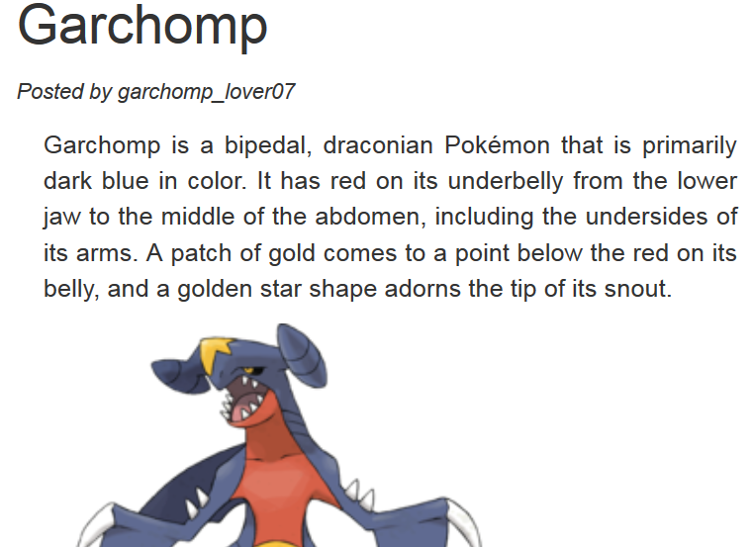
Notes:
Here is a post from our popular blog app. If we look at the ‘posted by’ section, we can see (that things aren’t quite how we want them to be). By default, when users are displayed on a template, Django shows their username. In order to show a user’s real name, we would have to type user.first_name and user.last_name each time we wanted it displayed. This can be cumbersome. Who wants to type all that out everywhere in the app? This is where we can customize the user model to our advantage .

Slide 11
Option 1: Using a Proxy Model
Notes:
This is where option 1 comes in, which is to use a proxy model. So what is a proxy model, exactly? It’s a way of creating an alias for an existing model that you can add methods to without adding anything to the database.

Slide 12
Option 1: Using a Proxy Model
  Good for:
  Using a custom model manager
  Using custom model methods
  Limitations:
  Can’t add additional attributes
  Can’t change the database
Notes:
By creating a proxy for the User model, we can have a copy of the User model that we can add additional methods to. But because the proxy model doesn’t actually create a new database table, we can’t actually add anything to our proxy model that would require database migrations, which is why it’s limited to just adding methods. On the other hand, it’s really convenient that we can customize the user model without having to make database migrations.
So going back to our example, if we added a dunder string method to our User proxy model, we could change the default behavior of how our users are displayed so that it shows the user’s name instead of their username.
Let’s take a look at how it’s implemented.

Slide 13
Option 1: Using a Proxy Model
  Author(User):
  class Meta:
  proxy = True
Notes:
To set up a proxy for the user model, the first thing that we do is create a new model that inherits the user model. Then all we do is add a meta class where we set proxy to True.
This tells Django the Author model is actually another name for the User model. All Authors will actually be treated as regular Users

Slide 14
Option 1: Using a Proxy Model
  Author(User):
  class Meta:
  proxy = True
  def __str__(self):
  return self.first_name
Notes:
Now we can add additional functions to our proxy model. By adding a dunder string function, we can have the Author model (which is actually the User model) display the person’s name by default instead of their username. This saves a lot of typing!
Of course, we could also add other methods here, as well as model managers.
(pause)
So now that we have this set up, let’s look at our app again.

Slide 15
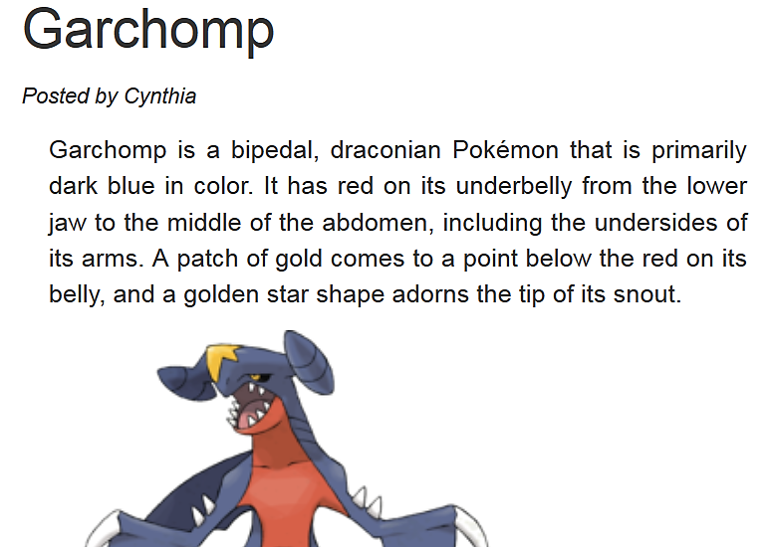
Notes:
Going back to our blog post, we can see that by default, our app is showing the user’s name instead of their username! Now we can see who exactly posted on our blog without having to type out all of the user’s attributes.

Slide 16
Scenario 2
Notes:
So obviously the proxy model option can be a bit limited, even though it is useful in certain situations. So let’s talk about another scenario where we might need more.
Say we want to have user profiles for our blog app. What if we want to build a profile?

Slide 17
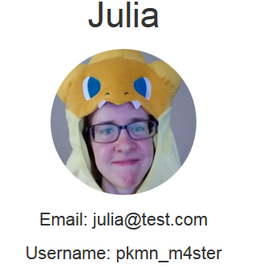
Notes:
So here’s my profile on our blogging website.
As you can see, with just the basic attributes Django provides us, we wouldn’t have a very interesting profile. What if we want our users to be able to add their location or a description about themselves? Fortunately, there are ways of adding attributes to the User model.

Slide 18
Option 2: Using a 1-1 relationship
Notes:
For this, we would use option 2, which is to set up a 1-1 relationship.

Slide 19
Option 2: 1-1 Relationship
  Good for:
  Adding custom fields
  Down Side:
  Need to keep track of another model
  Requires additional steps
Notes:
This will do everything the proxy model did in addition to allowing us to add custom fields.
With this option, though, we are actually going to be creating a new table in the database to store our additional attributes, so it has a few more steps than the proxy model did. In my own experience, I’ve found this to be the one of the most useful ways to customize the User model, especially if we want to create a user profile.

Slide 20
Option 2: 1-1 Relationship
  class Profile(models.Model):
  user = models.OneToOneField(User)
Notes:
So how do we set up this relationship? We start by creating a new model, which we will call Profile. When we create our new Profile model, we will make user one of its attributes, linked to the User model itself. This relationship means that every profile will be associated with one user, and every user will have one profile.

Slide 21
Option 2: 1-1 Relationship
  class Profile(models.Model):
  user = models.OneToOneField(User)
  location = ...
  bio = ...
  ...
Notes:
With that set up, we can now add our additional attributes that we want on the User model. With this set up, we now have a model that will hold additional attributes for the User model.

Slide 22
Option 2: 1-1 Relationship
  print(user.first_name)
  >>> Julia
  print(user.profile.location)
  >>> Austin
Notes:
Accessing these additional attributes is similar to accessing the user model’s attributes. Instead of doing user dot attribute, we do user dot profile dot attribute for the extras.

Slide 23
Option 2: 1-1 Relationship
  Additional Steps:
  Handling User saves & updates
  Handling deletion
  Handling Profile creation upon User creation
  Include in Django Admin
Notes:
For our Profile model to work smoothly, we’ll need to consider a few additional steps. When the User model is saved or updated, we’ll also want to save our profile model, since they are linked. Similarly, we’ll also need to handle creation and deletion – when a user is deleted, we’ll want to delete their profile object, and if a new user is created, we’ll want to have a profile created for them. These are common situations, and Django has some documentation on how this can be set up.
It’s also possible to add the additional profile attributes to the Django admin User form with just a few lines of code, which are also provided on the Django docs.

Slide 24
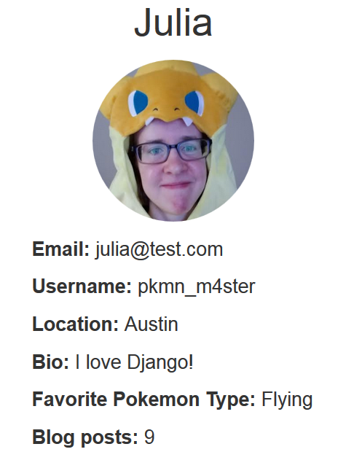
Notes:
So here’s our improved user profile, now with more interesting attributes which are saved along with the User model itself!

Slide 25
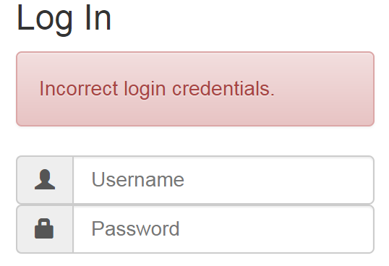
Scenario 3
Notes:
So we’ve had some complaints from our users. When they go to log in, they can’t remember the username they used to sign up. To fix this, we decided that it would be best if users were identified with their email address instead of their username.
But the user model customization options we’ve tried so far can’t do that. We need to customize even more.

Slide 26
Option 3: Create a custom User Model
Notes:
Now it’s time for option 3, which is to create our own, custom user model that would replace the one Django provided us.

Slide 27
Option 3: Custom User Model
  Django’s AbstractBaseUser
  Provides basic User implementation and password handling
Notes:
Fortunately, Django has left us a nice way to create a custom user model. We can inherit from Django’s AbstractBaseUser model to create our own custom user model so we don’t have to start from scratch. This provides basic user implementation and password handling. We just have to fill in the missing parts.

Slide 28
Option 3: Custom User Model
  class MyUser(AbstractBaseUser):
  email = ...
  fav_type = ...
Notes:
Here is our basic setup for a custom user model. All we need to do is inherit from the AbstractBaseUser class and we can start setting up our model’s attributes.

Slide 29
Option 3: Custom User Model
  class MyUser(AbstractBaseUser):
  email = ...
  fav_type = ...
  USERNAME_FIELD = ‘email’
Notes:
The USERNAME_FIELD attribute of the Abstract User class lets us specify what we want to use as the User Model’s unique identifier. This will allow us to make email address the unique identifier for our custom User model, and allow users to log in with email addresses instead of usernames.

Slide 30
Option 3: Custom User Model
  settings.py
  AUTH_USER_MODEL = ‘my_app.MyUser’
Notes:
We also need to let Django know that we overrode the User model in settings.py. To do this, we only need to set a single attribute in settings.py.

Slide 31
Option 3: Custom User Model
  Additional Steps:
  Set up User Manager
  Set up Django Admin Forms
Notes:
So although the AbstractBaseUser sets up a lot of nice things for us, it leaves a few things for us to set up as well. Mostly, these things include setting up a user manager in models.py. This will allow you to define functions for how users and superusers are created. We’ll also need to set up a form to edit our custom user model in the Django admin. Fortunately, these things are spelled out in the Django docs with fully implemented examples that can be customized.
But once you take care of all of these things, you’ll have your own customized user model.

Slide 32
Recap
  Proxy model for adding methods
  1-1 Relationship for adding fields
  Custom User for full customization
Notes:
So now that we have been through the three options, hopefully you now have an idea about which to use in what situation.
Just to recap....
Proxy model is good for adding methods, and does not require any changes to the database
1-1 relationship is good for adding fields, and does create a new table in the database
A custom user model will replace the default user model for full customization

Slide 33

Resources
https://github.com/jlooney
jlooney@utexas.edu
Or Julia.m.looney@gmail.com
@looneydev
Notes:
For basic code snippets on these three options, feel free to take a look at my github repository. I’ve also provided links there to the Django documentation I’ve mentioned throughout the presentation.
Thank you!

