Slide 1
Ben Golub Solomon Hykes
CEO, Docker CTO, Founder, Chief Maintainer…

Slide 2


Welcome to DockerCon – Day 1
Overall
6 keynotes
30 talks (over 150 submitted)
550 attendees (400+ waiting list)
Docker University
Hackathon
Plumbers conference
Multiple networking events
Today’s highlights
John Engates
CTO
Brian Stevens
EVP & CTO
Birds-of-a-Feather Lunch
Happy Hour: 6:00pm - 7:00pm
After party: 7:00pm - 11:42pm

Slide 3
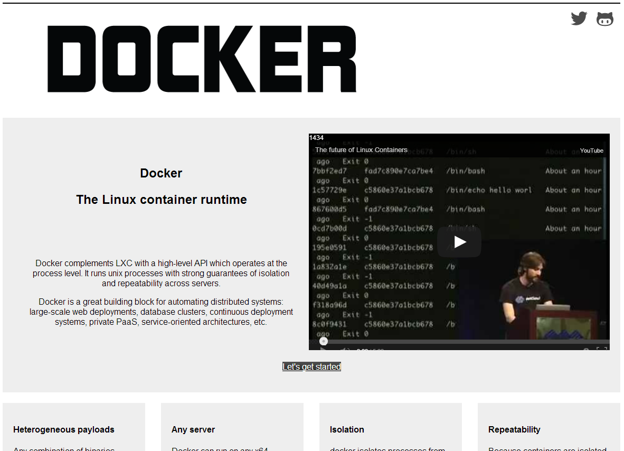
March 20, 2013: Docker Launches

Slide 4
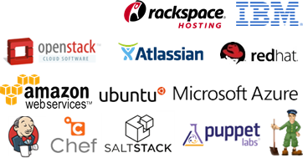
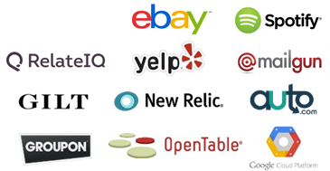

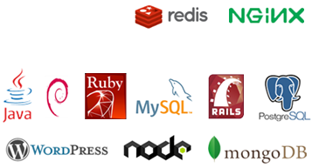
15 Months Later: An Incredible Platform and Ecosystem
Community
460+ Contributors
250+ Meetups on Docker
2.75M Downloads
6.7K Projects on GitHub
Partners
Users
Support
Enterprise Support
Robust Documentation
Implementation, Integration, Training
Network of Partners
The Docker Platform
Docker Engine
Docker Hub
Build, Ship, and Run
Content
Official Repos & 14K+ Dockerized Apps

Slide 5
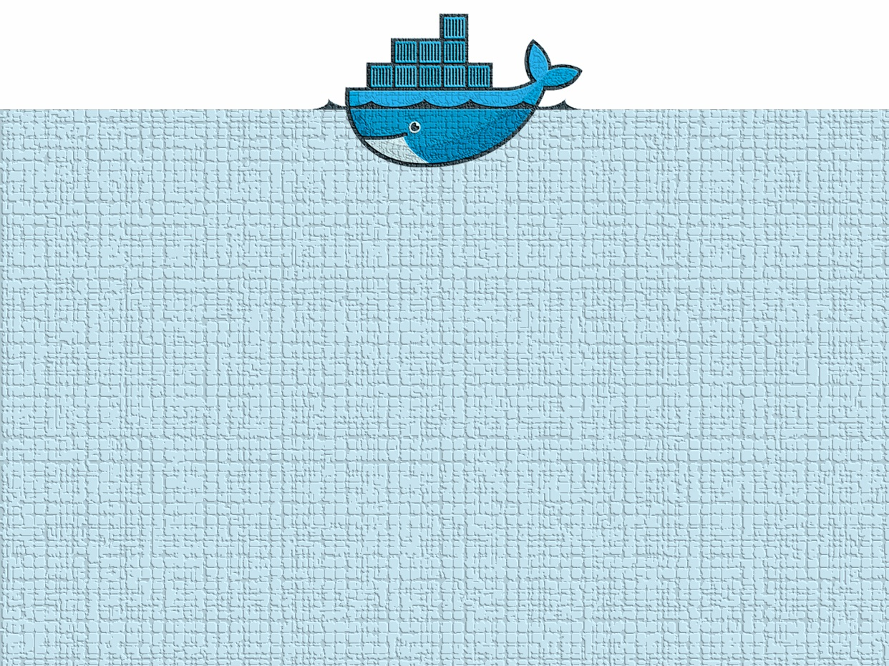
THANK
YOU!
2.75M+
downloads
250+
meetups
6K+
pull requests
12K+
stars
460+
contributors
90+
cities
6.7K+
projects
14K+
dockerized
8.5K+
commits
30+
countries

Slide 6
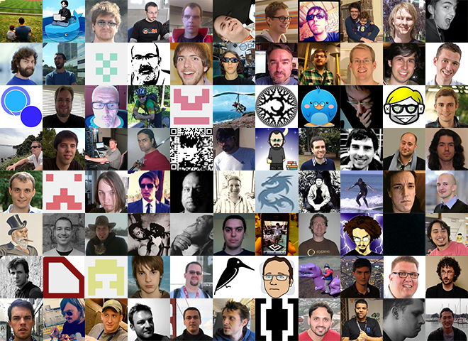
460+
contributors

Slide 7
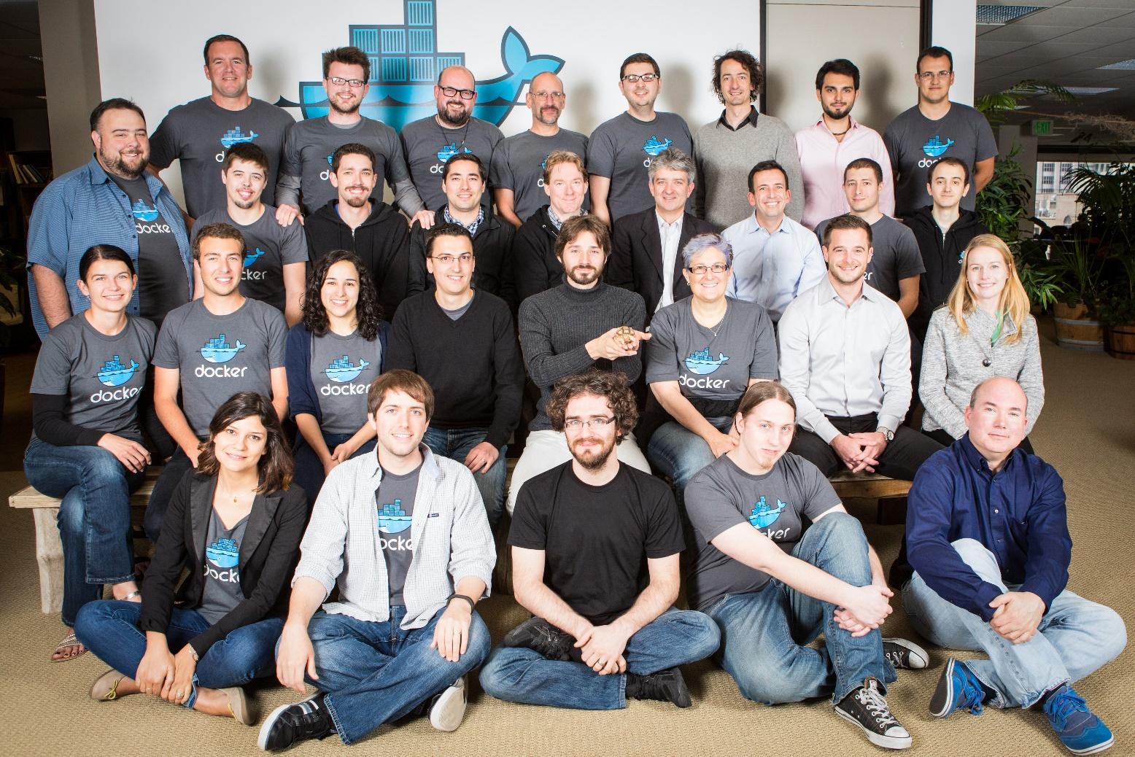
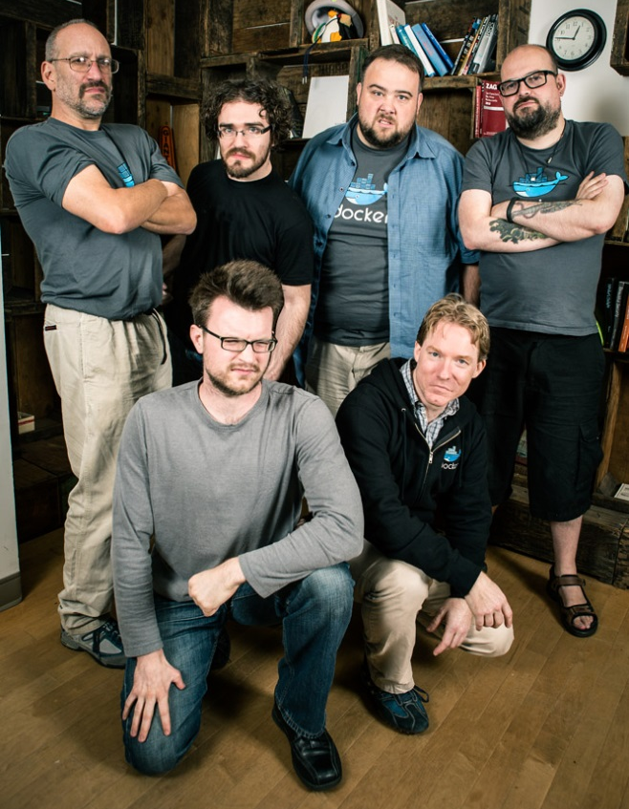
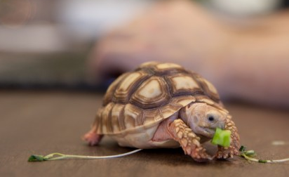
42 People and a Turtle
Now up to 42 people
(and our pet
turtle, Gordon)

Slide 8
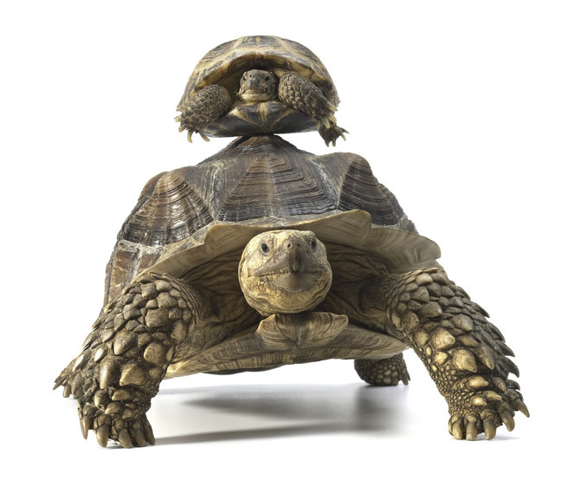
Thank You to the Giants
Namespaces (IBM)
Cgroups (Google)
LXC tools
The Linux Kernel
Git
SELinux (Red Hat)
Solaris Zones
BSD Jails
+++
We know we’re riding on your shoulders

Slide 9



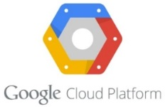

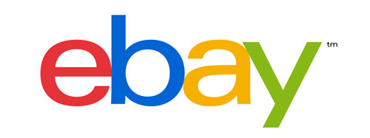


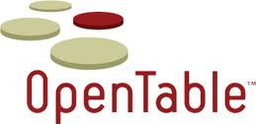






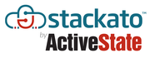

Thank You Users/Use Cases*
*A small subset of the 100s who are using and/or writing about us
Thanks to those above for talking about their experiences at DockerCon

Slide 10

Thank You to the Brave
!
To all those brave enough to cheerfully ignore our warnings about using us in production
CAUTION
ACHTUNG!
CUIDADO
UWAGA!
POZOR!
VIGYAZAT!
谨慎
ВНИМАНИЕ!
FORSIGTIG

Slide 11
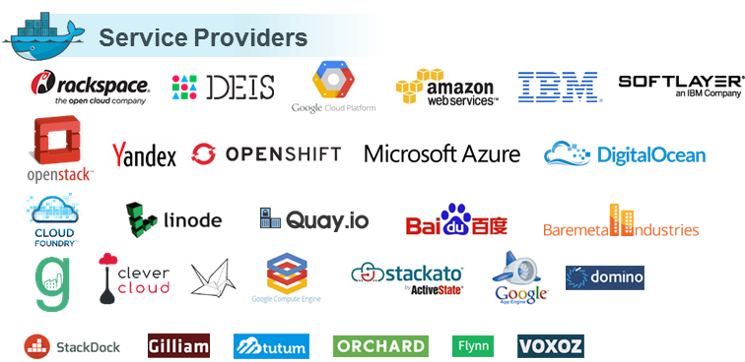
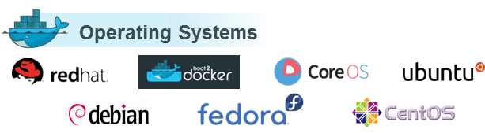
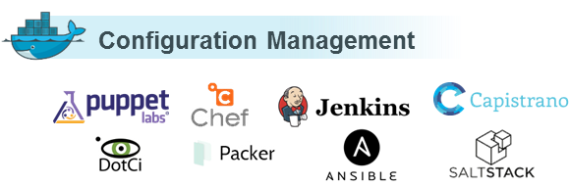
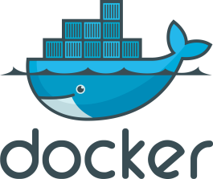
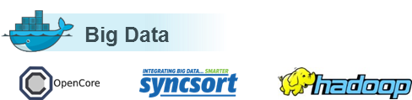
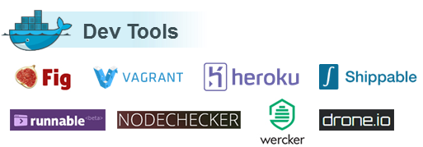
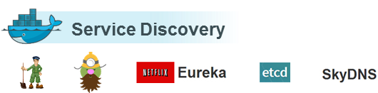
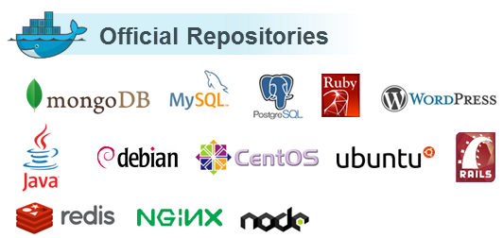
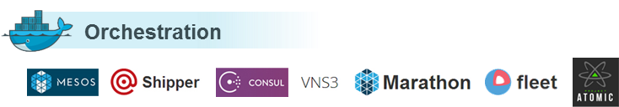
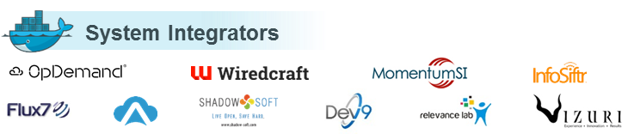
Thank You Partner Ecosystem

Slide 12











Thank You Our Sponsors
Without you, this conference wouldn’t have happened
(or… we would have served ramen and pizza)

Slide 13
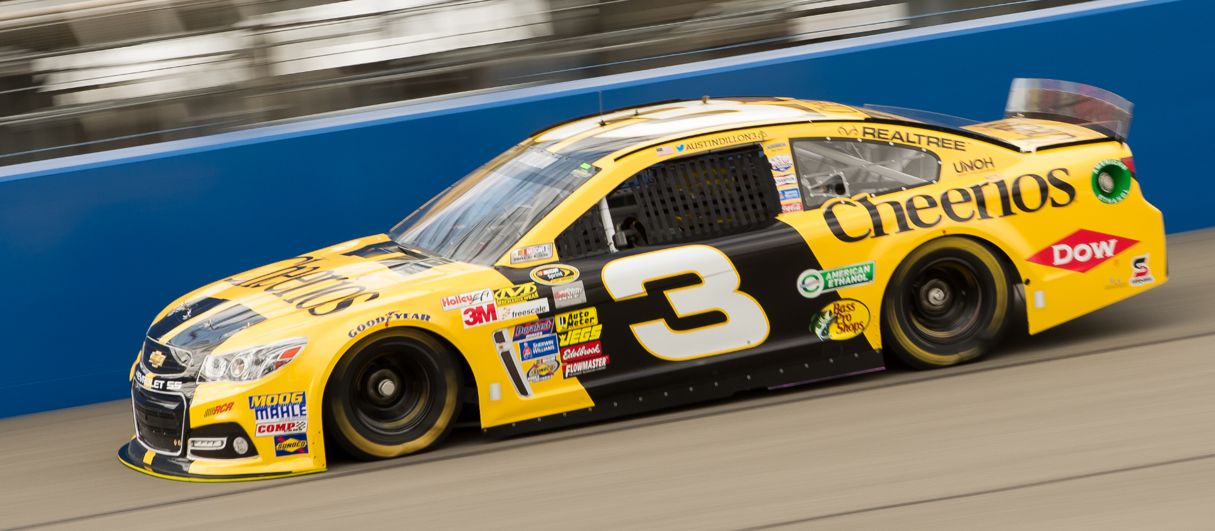
Thank You: NASCAR
For inspiring the design of the last several slides
Image credit: Beelde Photography / Shutterstock.com

Slide 14
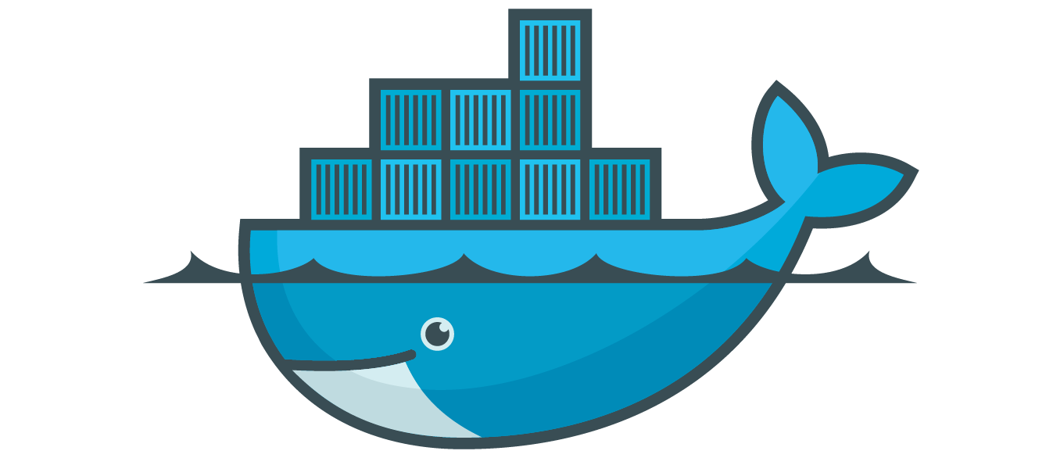













Our New Logo

Slide 15
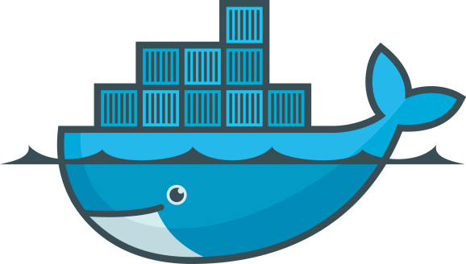
Agenda
Community
460+ Contributors
250+ Meetups on Docker
2.75M Downloads
6.7K Projects on GitHub
Partners
Users
Support
Enterprise Support
Robust Documentation
Implementation, Integration, Training
Network of Partners
The Docker Platform
Docker Engine
Docker Hub
Build, Ship, and Run
Content
Official Repos & 14K + Dockerized Apps

Slide 16


User Case Study: GILT
Michael Bryzek

Slide 17
Agenda
Community
460+ Contributors
250+ Meetups on Docker
2.75M Downloads
6.7K Projects on GitHub
Partners
Users
Support
Enterprise Support
Robust Documentation
Implementation, Integration, Training
Network of Partners
The Docker Platform
Docker Engine
Docker Hub
Build, Ship, and Run
Content
Official Repos & 14K + Dockerized Apps

Slide 18

There are four major announcements in the next few slides
See if you can spot them all!
Image courtesy of Waldo.wikia.com

Slide 19
Apps Have Fundamentally Changed
~2000 | 2014
Long lived | Development is iterative and constant
Monolithic and built on a single stack | Built from loosely coupled components
Deployed to a single server | Deployed to a multitude of servers

Slide 20

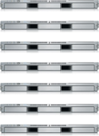
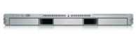
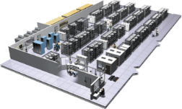
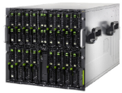
The Problem in 2014
User DB
Analytics DB
Static website
postgresql + pgv8 + v8
Queue
hadoop + hive + thrift + OpenJDK
nginx 1.5 + modsecurity + openssl + bootstrap 2
Redis + redis-sentinel
Multiplicity of Stacks
Do services and apps interact appropriately?
Web frontend
Background workers
Ruby + Rails + sass + Unicorn
API endpoint
Python 3.0 + celery + pyredis + libcurl + ffmpeg + libopencv + nodejs + phantomjs
Python 2.7 + Flask + pyredis + celery + psycopg + postgresql-client
Development VM
Production Cluster
Public Cloud
Multiplicity of Hardware Environments
QA Server
Can I migrate smoothly and quickly?
Disaster Recovery
Production Servers
Contributor’s Laptop
Customer Data Center

Slide 21

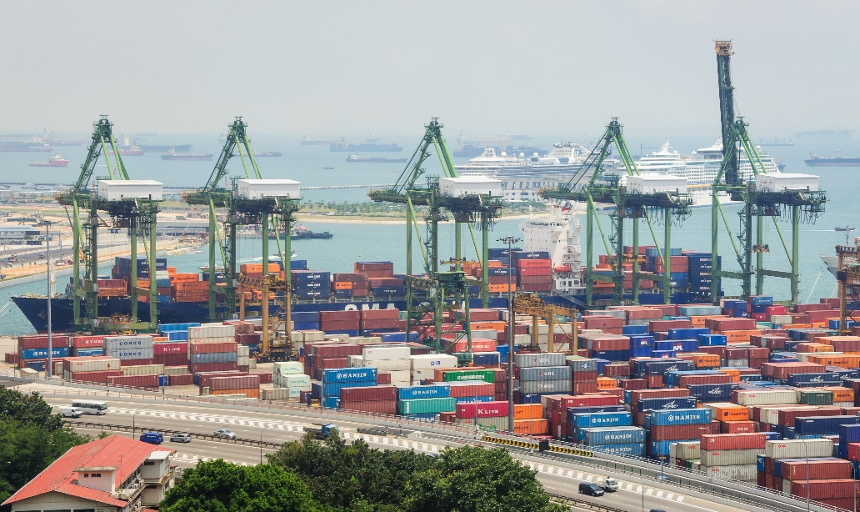
The Right Approach to Containers Matters
Separation of concerns
Automation
Efficiency
Broad ecosystem
Images courtesy of PokkO / Shutterstock.com, Lewis Hine - http://www.archives.gov/research_room/research_topics/american_cities/images/american_cities_069.jpg

Slide 22
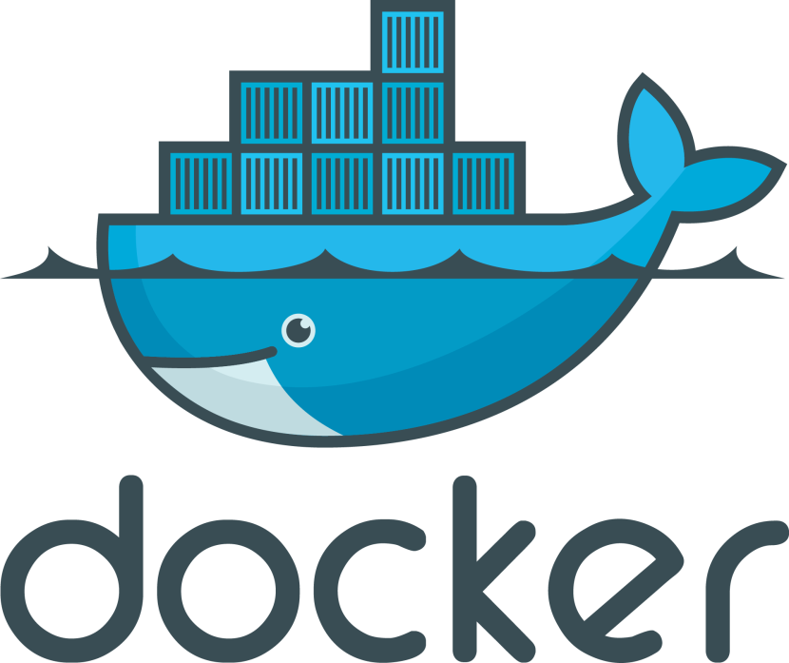
An Open Platform to Build, Ship, and Run Distributed Applications

Slide 23
An Open Platform…
API
Engine
Hub
open source software at the heart
of the Docker platform
cloud-based platform services for distributed applications
API

Slide 24




























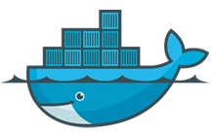








An Open Platform…
Any App
+ 14K apps
+ 6K projects
API
Engine
Hub
open source software at the heart
of the Docker platform
cloud-based platform services for distributed applications
API
Any infrastructure
Physical
Virtual cloud

Slide 25




…to Build, Ship, and Run
Source Code
Repository
Analytics
DB
Docker
Docker
Docker
Source
Docker
Docker
Docker
DockerFile
Linux OS
Linux OS
Linux OS
Prod Machine
Prod Machine
Prod Machine
Docker Hub
Infrastructure Management
Docker
Users
Collab
Physical
Dev
Boot2Docker
Provenance
Policy
Ship
Mac/Win Dev Machine
Build
Registries
Docker
Docker
Docker
Docker
Docker
Docker
Public
Curated
Private
VM
VM
VM
Docker
Infrastructure Management
Docker
QA
Linux OS
Virtual
QA Machine
Docker Hub API
Third Party Tools
TEST
TEST
Run
GCE
RAX
IBM
++
Staging
TEST
TEST
Cloud
TEST

Slide 26




…Distributed Applications
User
DB
Web
Frontend
Analytics
DB
Queue
Background
Workers
API
Endpoint
Data
Data
Development VM
Production Cluster
Public Cloud
QA Server
Disaster Recovery
Production Servers
Contributor’s Laptop
Customer Data Center

Slide 27

Announcing Docker Engine 1.0
Available today!
Quality
Stable core
All major Linux platforms and distributions
Execution engine plug-ins: LXC, libcontainer
Filesystem plug-ins: AUFS, BTRFS, device mapper
Host networking, link hostnames
boot2docker: Mac OS X and Windows
Support for SELinux and AppArmor
TLS auth, systemd slices, release hashes
Source Code
Repository
DockerFile
Docker
Boot2Docker
Mac/Win Dev Machine
Docker
Linux OS
QA Machine
…and a whole lot more!

Slide 28
Announcing Docker Hub 1.0
Available today!
Free accounts
Users can create unlimited free repositories
Private repositories
Over 14K free apps
Official Repos and publisher program
User tools – console, profile, auth
Collaboration – orgs, groups, activity feeds
Automated builds
Workflow automation with webhooks
Integration with GitHub, Bitbucket, and more
APIs for 3rd party tools and services
Docker Hub
Users
Collab
Provenance
Policy
Registries
Public
Curated
Private
Docker Hub API
Third Party Tools
…and a whole lot more!

Slide 29
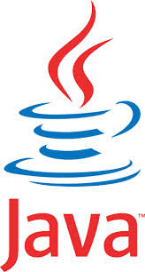

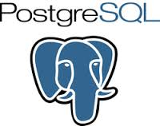



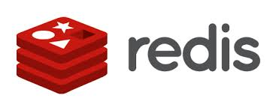

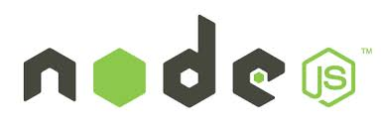




Announcing: Official Repositories
Available today!
Launching with 13 applications
Databases, web servers,
OSes and more
Quality building blocks for your apps
Free on Docker Hub Registry
Optimized and tuned for Docker
Maintained and supported
Publisher program

Slide 30

Announcing: Commercial Support
Long term support for 1.0
Delivered directly…or
Delivered through large network of providers
Special POC starter package

Slide 31
Well, Actually…
Long term support for 1.0
Delivered directly…or
Delivered through large network of providers
Special POC starter package

Slide 32










Commercial Support Partners
System Integrators

Slide 33
DEMO TIME

Slide 34
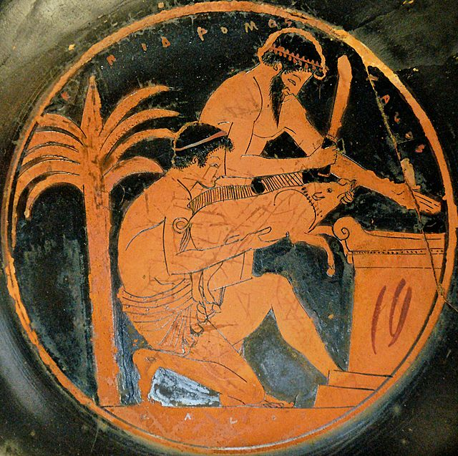
May the Demo Gods Be Pleased…
Image in Public Domain: http://en.wikipedia.org/wiki/Animal_sacrifice#mediaviewer/File:Sacrifice_boar_Louvre_G112.jpg

Slide 35


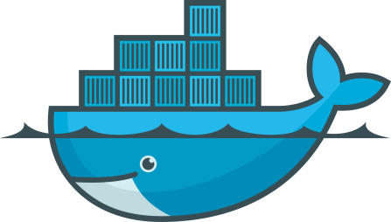





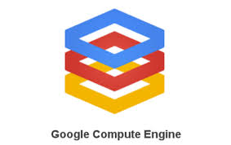
Demo
Integration Tests
Deployment
Platforms
Deployment
Platforms
Docker Hub
Revision Control
boot2docker

Slide 36





Demo
Integration Tests
Deployment
Platforms
Deployment
Platforms
Docker Hub
Revision Control
boot2docker
..and, that was just what we have today.
Tune in tomorrow to hear Solomon talk about the near future, including clustering, trust, orchestration, and more…

Slide 37
Agenda
Community
460+ Contributors
250+ Meetups on Docker
2.75M Downloads
6.7K Projects on GitHub
Partners
Users
Support
Enterprise Support
Robust Documentation
Implementation, Integration, Training
Network of Partners
The Docker Platform
Docker Engine
Docker Hub
Build, Ship, and Run
Content
Official Repos & 14K + Dockerized Apps

Slide 38
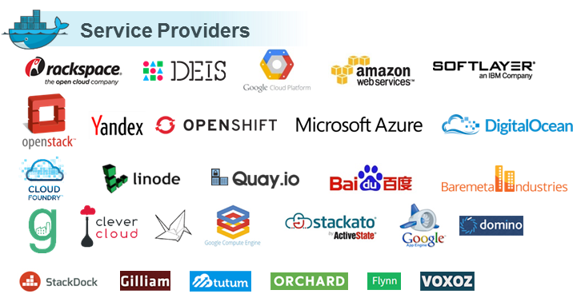
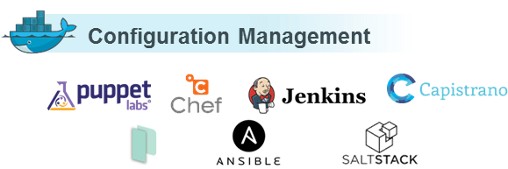
Partner Ecosystem

Slide 39
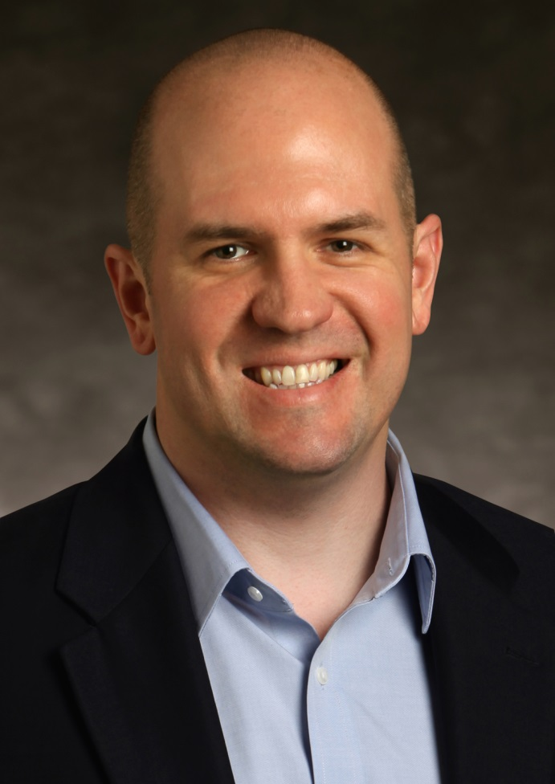

Keynote: Red Hat
John Engates, CTO

Slide 40
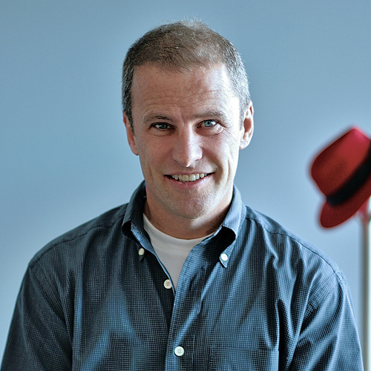
Keynote: Red Hat
Brian Stevens, EVP & CTO

Slide 41











It’s Hard to Overstate the Scope of Red Hat Commitment…

Slide 42
Once Again…Thank You!
Community
460+ Contributors
250+ Meetups on Docker
2.75M Downloads
6.7K Projects on GitHub
Partners
Users
Support
Enterprise Support
Robust Documentation
Implementation, Integration, Training
Network of Partners
The Docker Platform
Docker Engine
Docker Hub
Build, Ship, and Run
Content
Official Repos & 14K+ Dockerized Apps

Slide 43
Enjoy the 30+ Sessions Over the 2 Days!
Overall
6 keynotes
30 talks (over 150 submitted)
550 attendees (400+ waiting list)
Docker University
Hackathon
Plumbers conference
Multiple networking events
Today’s highlights
John Engates
CTO
Brian Stevens
EVP & CTO
Birds-of-a-Feather Lunch
Happy Hour: 6:00pm - 7:00pm
After party: 7:00pm - 11:42pm

