Slide 1
Immutable Infrastructure
With Docker and EC2
Docker Conf 2014
Michael Bryzek
CTO & Co-Founder Gilt
michael@gilt.com / @mbryzek
http://tech.gilt.com / @gilttech

Slide 2
What is Gilt?
Founded in 2007
World’s best brands and products at 50-70% off
New products launch at noon EST
Limited inventory – products constantly sell out
Over 1000 employees

Slide 3
Gilt Tech
~150 people
Strategy to attract great people and enable them to innovate
Lots of Small Teams
Micro services architecture
300+ services
~1000 git repos
Busy days see > 100 production releases
> 10k requests / second

Slide 4
Immutable Infrastructure Why it Matters
We believe innovation fuels growth.
Part of our strategy to accelerate innovation
Is to create truly autonomous teams
Supported by tooling and automated processes
to relentlessly decrease risk of change

Slide 5
Lots of Small Applications (LOSA)
Technology Strategy focused on:
Autonomy
Decentralization
Parallelism
Isolation

Slide 6
Teams and LOSA
Lots of Small Teams
4-10 people / team
Have all “ingredients” to succeed
Deliver across stack for most projects

Slide 7
Defining Risk

Slide 8
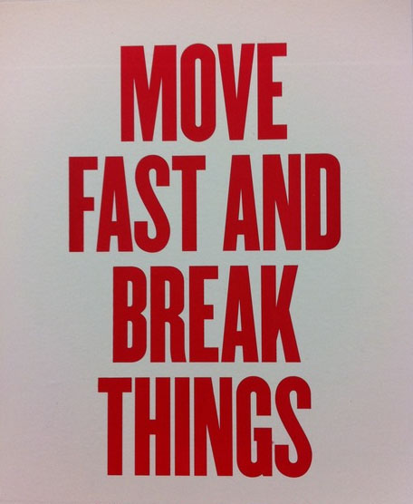

Slide 9
What that Actually Means
Move Fast
with
Minimal Risk

Slide 10
Defining Risk
Probability (event)
* Cost(event)
* Number of occurrences
There is a risk to doing nothing

Slide 11
Reducing Probability(event)
Testing
Manual or Automated
Prefer automated for long term
Not making changes
Peer review
Kaizen
Immutability
Ownership / Pride
Experience

Slide 12
Reducing Cost(event)
Small change sets
Verification in target environment
Incremental rollout
Automated rollout / rollback

Slide 13
Reducing NumberOccurrences(event)
Instant Rollback
Great Monitoring and Alerting

Slide 14
Modern Software Deployment
Foundation of continuous delivery
Each deploy immutable
Incremental rollout
Metrics and alerting

Slide 15
Continuous Delivery @ Gilt Pre Docker
sbt release-remote
Build an RPM in Jenkins
Deploy RPM to test environment
Run unit and integration tests
Deploy to one node in production
Run healthcheck, auto rollback if necessary
Repeat 4-6 on remaining nodes

Slide 16
Continuous Delivery @ Gilt w/ Docker
ionblaster new api 1.2.3
ionblaster traffic api
1.2.2 90
1.2.3 10
Build docker container
Create new “stack” of infrastructure
Run container on each node in stack
Assign DNS to new stack
Manage traffic from old to new

Slide 17
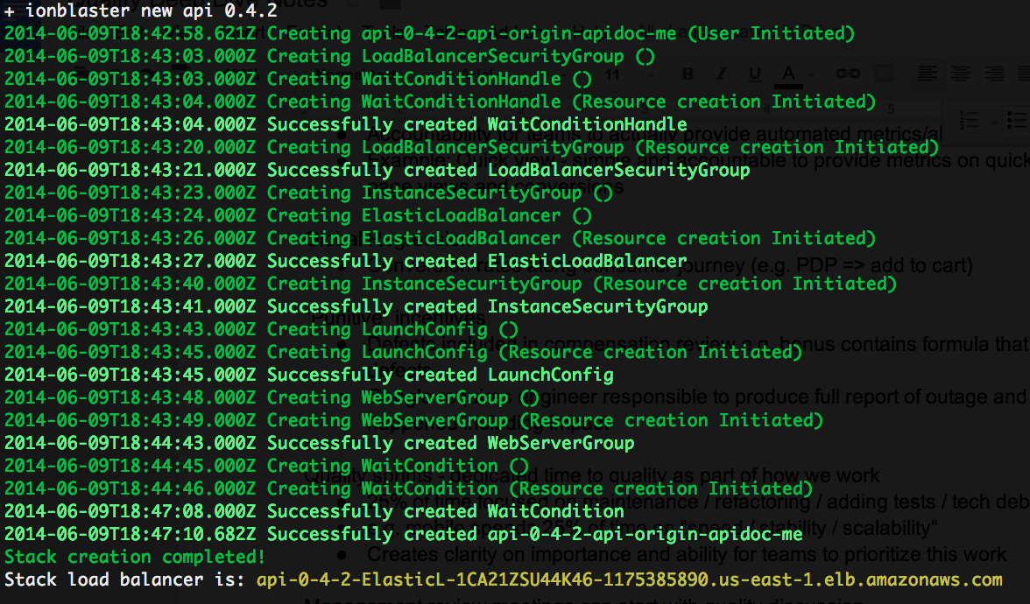
ionblaster new api 0.4.2

Slide 18
Immutable Infrastructure / Docker
Huge win w/ docker
Dependencies in Dockerfile
Focus instead on cloud and new stacks

Slide 19
Docker and Play Framework
$ sbt stage
$ more api/Dockerfile
FROM giltarchitecture/
ubuntu-openjdk-7-jre-headless:12.0.4
ADD . /apidoc
ENTRYPOINT ["/apidoc/bin/apidoc-api"]

Slide 20
Sample command to start play container image
-run “
--expose 80
-p 9000:80
giltarchitecture/apidoc-api-1-2-3
–Dhttp.port=90
-Dconfig.resource=xxx.conf
”

Slide 21
Immutability w/ Docker
Immutability emerges naturally when using Docker
Upgrade Java? New version, new infrastructure, new containers.
Security patch? New version, new infrastructure, new containers.
Eliminate surprise for application owners.

Slide 22
Automate Incremental Rollout
Core area of focus now
ionroller api 1.2.3 1.2.4 “24 hours”
Measure response time and status codes
- triggers based on tolerance between versions

Slide 23
Instant Rollback
If prior version around – just move traffic
ionblaster traffic api 1.2.3 100
If not, same as before - deploy version
But then can revise garbage collection policy for the app to decrease risk of a future event. (Kaizen)

Slide 24
Amazing Metrics and Alerting
Reporting and alerting is hard
Used nagios, graphite, open TSDB w/ limited success.
We are now building a REST API for alerting on top of influxdb (open source time series db). Plan to open source if successful.

Slide 25
Lessons Learned: Incremental Rollout
Minimize number of versions in production at any one time – e.g. “at most 2”
Garbage collection important, but keep prior versions around for long enough (1 day? 1 week?)
Different apps have different requirements on rollout time – back to calculation of Risk and the Cost(event)

Slide 26
Lessons Learned - PAAS
You must have platform as a service; impossible to build well if not your core business.
It’s tempting to build out a PAAS; but the number of tools needed to make this work reliably at scale is large.

Slide 27
Lessons Learned: Alerting
Core interface:
Send me at most one alert every n hours
Core challenge always:
Signal to noise ratio critical and first class
Human tendency to ignore over time

Slide 28
Immutable Infra w/ Docker and EC2
Decrease Probability(Event)
Immutability
Decrease Cost(Event)
Verification in target env w/ no user traffic
Incremental Rollout
Automated rollout/rollback
Reduce NumberOccurrences(event)
Instant Rollback

Slide 29
Thank You
Michael Bryzek
CTO & Co-Founder Gilt
michael@gilt.com / @mbryzek
http://tech.gilt.com / @gilttech

