Slide 1
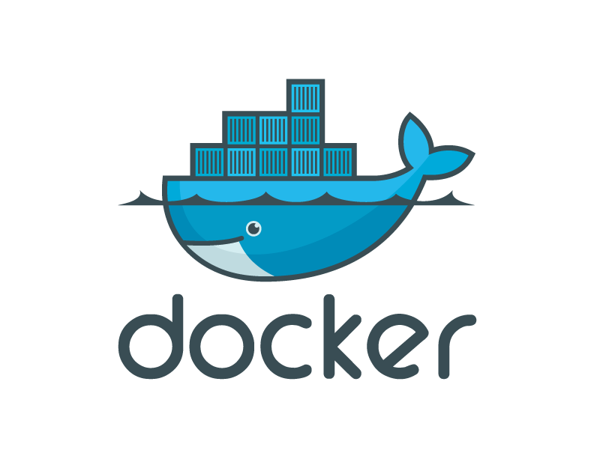
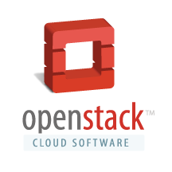
OpenStack Summit AsiaWorld Expo / November 2013

Slide 2
Agenda
The Matrix from Hell and the need for containers
Why Docker
Docker Ecosystem
Docker + OpenStack
Docker + Rackspace
Docker 101
Cross Cloud Deployment Demo
Conclusion
Q&A

Slide 3
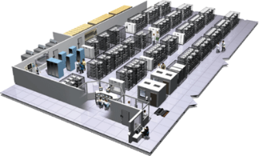
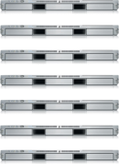
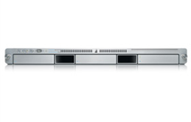
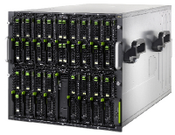
The Challenge
User DB
Static website
postgresql + pgv8 + v8
Queue
Analytics DB
nginx 1.5 + modsecurity + openssl + bootstrap 2
Do services and apps interact appropriately?
Redis + redis-sentinel
hadoop + hive + thrift + OpenJDK
Multiplicity of Stacks
Background workers
Web frontend
Python 3.0 + celery + pyredis + libcurl + ffmpeg + libopencv + nodejs + phantomjs
Ruby + Rails + sass + Unicorn
API endpoint
Python 2.7 + Flask + pyredis + celery + psycopg + postgresql-client
Production Cluster
Development VM
Public Cloud
Multiplicity of hardware environments
QA server
Can I migrate smoothly and quickly?
Disaster recovery
Customer Data Center
Contributor’s laptop
Production Servers

Slide 4
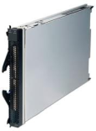
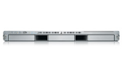
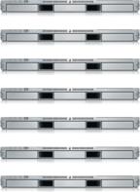
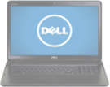
The Matrix From Hell
? | ? | ? | ? | ? | ? | ?
? | ? | ? | ? | ? | ? | ?
? | ? | ? | ? | ? | ? | ?
? | ? | ? | ? | ? | ? | ?
? | ? | ? | ? | ? | ? | ?
? | ? | ? | ? | ? | ? | ?
Static website
Web frontend
Background workers
User DB
Analytics DB
Queue
 | Development VM | QA Server | Single Prod Server | Onsite Cluster | Public Cloud | Contributor’s laptop | Customer Servers

Slide 5
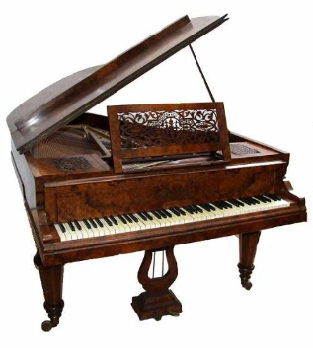
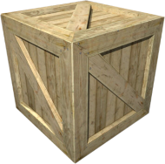
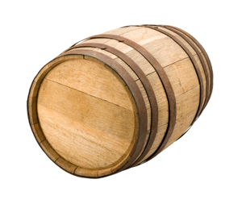
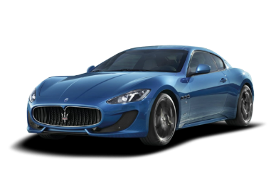
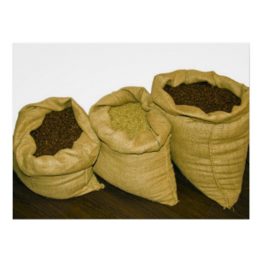
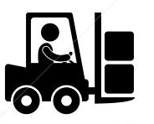
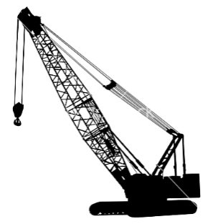
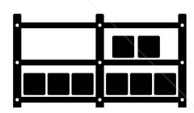
Cargo Transport Pre-1960
Do I worry about how goods interact (e.g. coffee beans next to spices)
Multiplicity of Goods
Multipilicity of methods for transporting/storing
Can I transport quickly and smoothly
(e.g. from boat to train to truck)

Slide 6
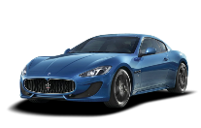
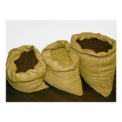
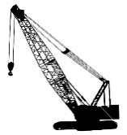
Also a matrix from hell
 | ? | ? | ? | ? | ? | ? | ?
 | ? | ? | ? | ? | ? | ? | ?
 | ? | ? | ? | ? | ? | ? | ?
 | ? | ? | ? | ? | ? | ? | ?
 | ? | ? | ? | ? | ? | ? | ?
 | ? | ? | ? | ? | ? | ? | ?

Slide 7
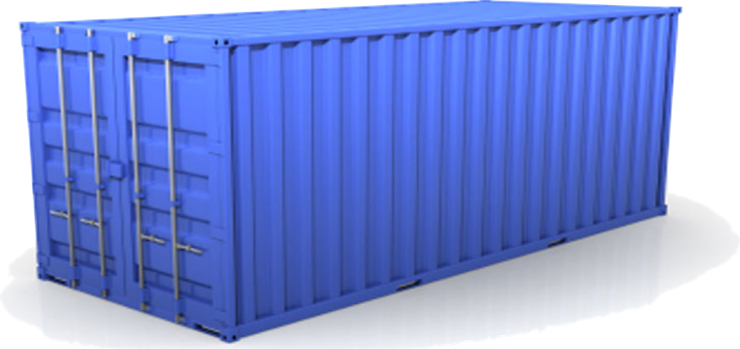
Solution: Intermodal Shipping Container
Do I worry about how goods interact (e.g. coffee beans next to spices)
Multiplicity of Goods
A standard container that is loaded with virtually any goods, and stays sealed until it reaches final delivery.
…in between, can be loaded and unloaded, stacked, transported efficiently over long distances, and transferred from one mode of transport to another
Can I transport quickly and smoothly
(e.g. from boat to train to truck)
Multiplicity of methods for transporting/storing

Slide 8
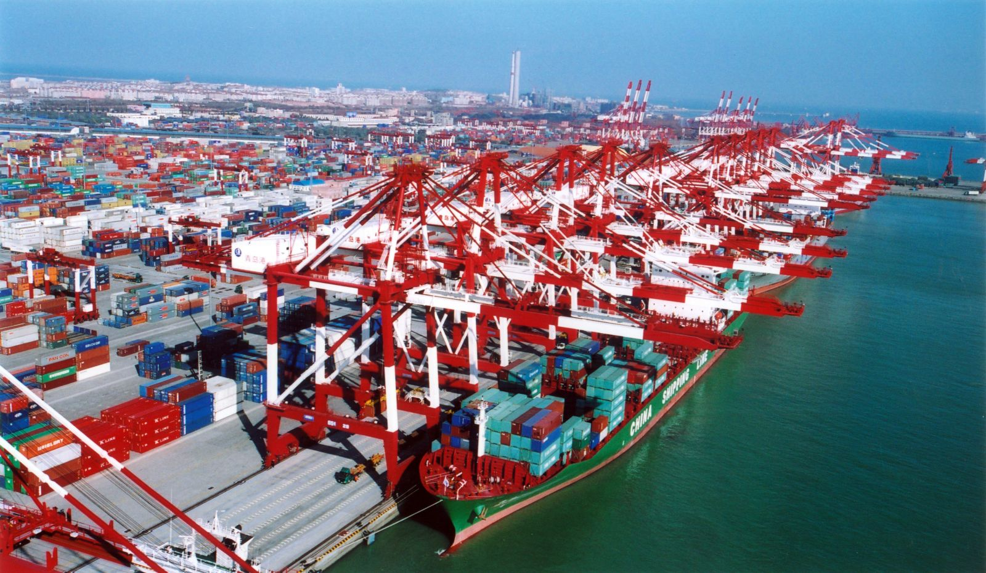

Slide 9
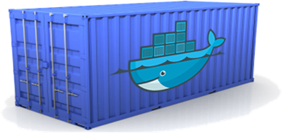
Docker is a shipping container system for code
Static website
User DB
Web frontend
Queue
Analytics DB
Do services and apps interact appropriately?
Multiplicity of Stacks
An engine that enables any payload to be encapsulated as a lightweight, portable, self-sufficient container…
…that can be manipulated using standard operations and run consistently on virtually any hardware platform
Multiplicity of hardware environments
Can I migrate smoothly and quickly
Development VM
QA server
Customer Data Center
Public Cloud
Production Cluster
Contributor’s laptop

Slide 10
Docker eliminates the matrix from Hell
Static website
Web frontend
Background workers
User DB
Analytics DB
Queue
 | Development VM | QA Server | Single Prod Server | Onsite Cluster | Public Cloud | Contributor’s laptop | Customer Servers

Slide 11
Why Developers Care
Build once…(finally) run anywhere*
A clean, safe, hygienic and portable runtime environment for your app.
No worries about missing dependencies, packages and other pain points during subsequent deployments.
Run each app in its own isolated container, so you can run various versions of libraries and other dependencies for each app without worrying
Automate testing, integration, packaging…anything you can script
Reduce/eliminate concerns about compatibility on different platforms, either your own or your customers.
Cheap, zero-penalty containers to deploy services? A VM without the overhead of a VM? Instant replay and reset of image snapshots? That’s the power of Docker
* With the 0.7 release, we will support any x86 server running a modern Linux kernel (2.6.32+)

Slide 12
Why Devops Cares?
Configure once…run anything
Make the entire lifecycle more efficient, consistent, and repeatable
Increase the quality of code produced by developers.
Eliminate inconsistencies between development, test, production, and customer environments
Support segregation of duties
Significantly improves the speed and reliability of continuous deployment and continuous integration systems
Because the containers are so lightweight, address significant performance, costs, deployment, and portability issues normally associated with VMs

Slide 13
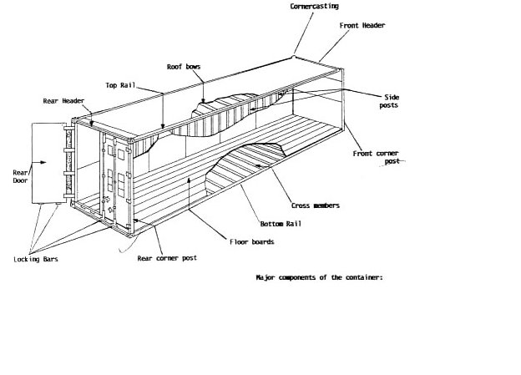
Why it works—separation of concerns
Dan the Developer
Worries about what’s “inside” the container
His code
His Libraries
His Package Manager
His Apps
His Data
All Linux servers look the same
Oscar the Ops Guy
Worries about what’s “outside” the container
Logging
Remote access
Monitoring
Network config
All containers start, stop, copy, attach, migrate, etc. the same way

Slide 14
More technical explanation
WHY
WHAT
Run everywhere
Regardless of kernel version (2.6.32+)
Regardless of host distro
Physical or virtual, cloud or not
Container and host architecture must match*
Run anything
If it can run on the host, it can run in the container
i.e. if it can run on a Linux kernel, it can run
High Level—It’s a lightweight VM
Own process space
Own network interface
Can run stuff as root
Can have its own /sbin/init (different from host)
<<machine container>>
Low Level—It’s chroot on steroids
Can also not have its own /sbin/init
Container=isolated processes
Share kernel with host
No device emulation (neither HVM nor PV) from host)
<<application container>>

Slide 15
Containers vs. VMs
App
A
App
A’
App
B
Containers are isolated,
but share OS and, where
appropriate, bins/libraries
Bins/
Libs
Bins/
Libs
Bins/
Libs
VM
Guest
OS
Guest
OS
Guest
OS
…result is significantly faster deployment, much less overhead, easier migration, faster restart
Guest
OS
Guest
OS
App A
App A’
App B
App B’
App B’
App B’
Container
Docker
Hypervisor (Type 2)
Bins/Libs
Bins/Libs
Host OS
Host OS
Server
Server

Slide 16
Why are Docker containers lightweight?
VMs
Containers
App
A
App
A
App
A’
App
A
App
A
App Δ
Bins/
Libs
Bins/
Libs
Bins/
Libs
Bins/
Libs
Bins/
Guest
OS
Guest
OS
Guest
OS
Guest
OS
Original App
(No OS to take
up space, resources,
or require restart)
Copy of
App
No OS. Can
Share bins/libs
Modified App
Copy on write allows
us to only save the diffs
Between container A and container
A’
VMs
Every app, every copy of an
app, and every slight modification
of the app requires a new virtual server

Slide 17
What are the basics of the Docker system?
Container A
Docker
Container
Image Registry
Push
Search
Pull
Source Code Repository
Run
Build
Dockerfile
For
A
Container A
Container B
Container C
Docker
Docker Engine
Host 1 OS (Linux)
Host 2 OS (Linux)

Slide 18
Changes and Updates
Docker
Container
Image Registry
App
A
Push
App Δ
Bins/
Libs
Bins/
Base
Container
Image
Container Mod A’
Container Mod A’’
App Δ
Update
App
A
Bins/
App
A’’
Bins/
Libs
Bins/
Libs
Bins/
Docker Engine
Docker Engine
Host is now running A’’
Host running A wants to upgrade to A’’. Requests update. Gets only diffs

Slide 19
Docker Registry Enables Multi-Cloud
Any Docker Image hosted on
Any Docker Registry can be run on
Any Docker Host in seconds

Slide 20
Docker Ecosystem / Community

Slide 21
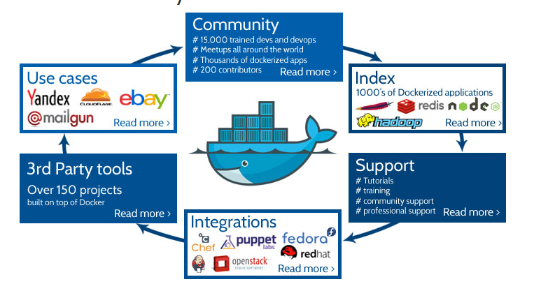
Docker Ecosystem Support
150K downloads, 15K trained users, 200+ contributors, 7K+ github stars, 1000’s of Dockerized apps

Slide 22
Docker + OpenStack
New hypervisor to enable Nova to deploy Linux containers

Slide 23
Why Docker + OpenStack
Alternative to VMs within OpenStack
Easier deployment of OpenStack itself
Cross Cloud Application Deployment
Containers Orchestration with OpenStack Heat

Slide 24
Docker + Rackspace
Testimonials from a strong partnership

Slide 36
Docker 101
New to Docker? Let’s go through it.

Slide 37
Put it all together
Real multi-cloud deployment via Docker

Slide 38
Demo Content
Application Containerized from Source
Application Goes Through Development Testing
Push to Rackspace Cloud
Provision via Horizon – Native Havana Nova Integration
http://asciinema.org/a/6243 - Muti cloud deployment
http://asciinema.org/a/6244 - Nova list / Docker Ps after deployment

Slide 39
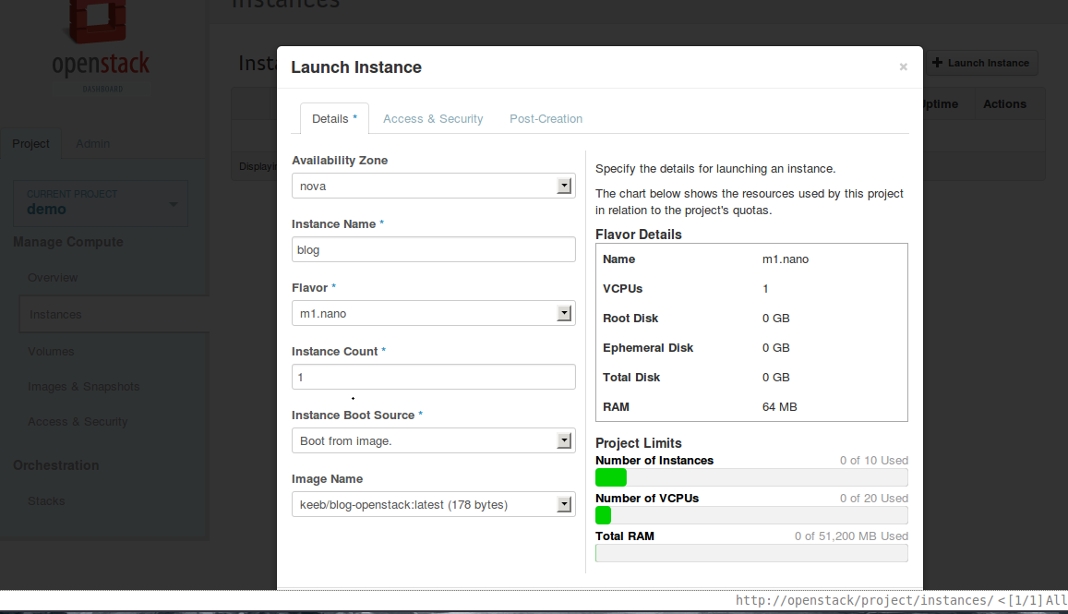

Slide 40
Conclusion / Summary

Slide 41
Want to learn more:
www.docker.io:
Documentation
Getting started: interactive tutorial, installation instructions, getting started guide,
About: Introductory whitepaper: http://www.docker.io/the-whole-story/
www.docker.com
15+ use cases
Ecosystem
Partners
Professional support & services
Github: dotcloud/docker
IRC: freenode/#docker
Google groups: groups.google.com/forum/#!forum/docker-user
Twitter: follow @docker
Meetups: Scheduled for Boston, San Francisco, Austin, London, Paris, Boulder…and Nairobi. Go to website for details

Slide 42
www.docker.io www.docker.com

