Slide 1
openMDM5: From a fat client to a scalable, omni-channel architecture
EclipseCon Europe 2015
November 4, 2015, Ludwigsburg

Slide 2


Sibylle Peter
Canoo Engineering AG
@persillie
Andreas Benzing
ICS AG
@andreasbenzing

Slide 3
openMDM IWG
„The open MDM Working group […] wants to foster and support an open and innovative eco-system providing tools and systems, qualification kits and adapters for standardized and vendor independent management of measurement data in accordance with the ASAM ODS standard.“
openMDM charter

Slide 4










Notes:
These are the current working group members – driver, service, vendor, users

Slide 5
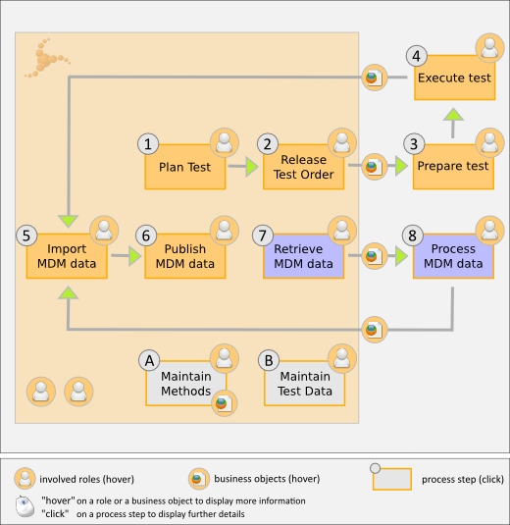
Measurement Process
Notes:
Test -> not software!
Long term/Provenance
Vendor independent -> everyone contributes functions -> uncontrolled growth
Common solution much more efficient -> Collaboration of OEMs

Slide 6
History
1999: Start of openMDM @ AUDI AG
2008: openMDM becomes open source
community gains new members
more functions, components
codebase grows
2014: Transition to Eclipse IWG
Notes:
What have we learned so far?
Single client to integrate all components -> complex build

Slide 7
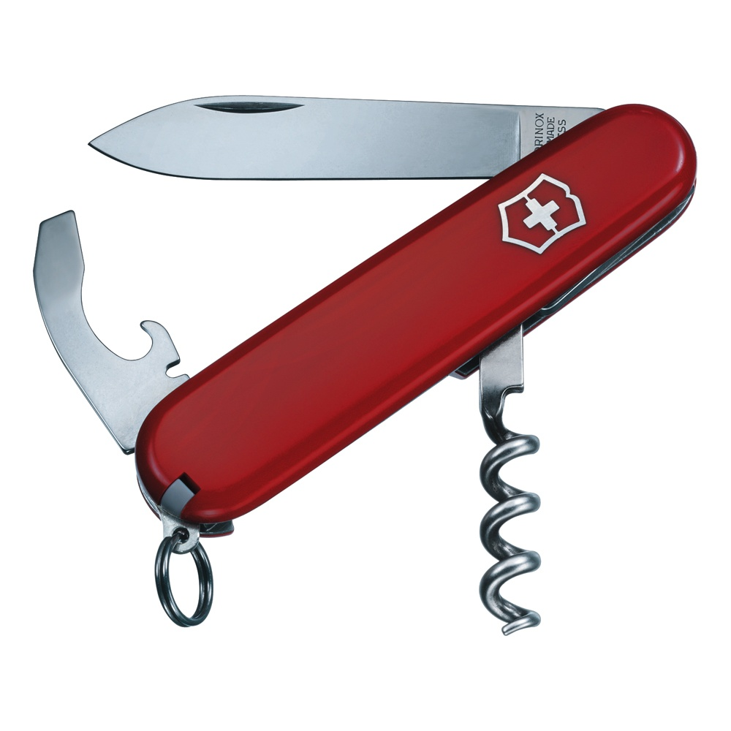
First Idea
Notes:
Simple, yet versatile tool which can be reused for multiple purposes

Slide 8
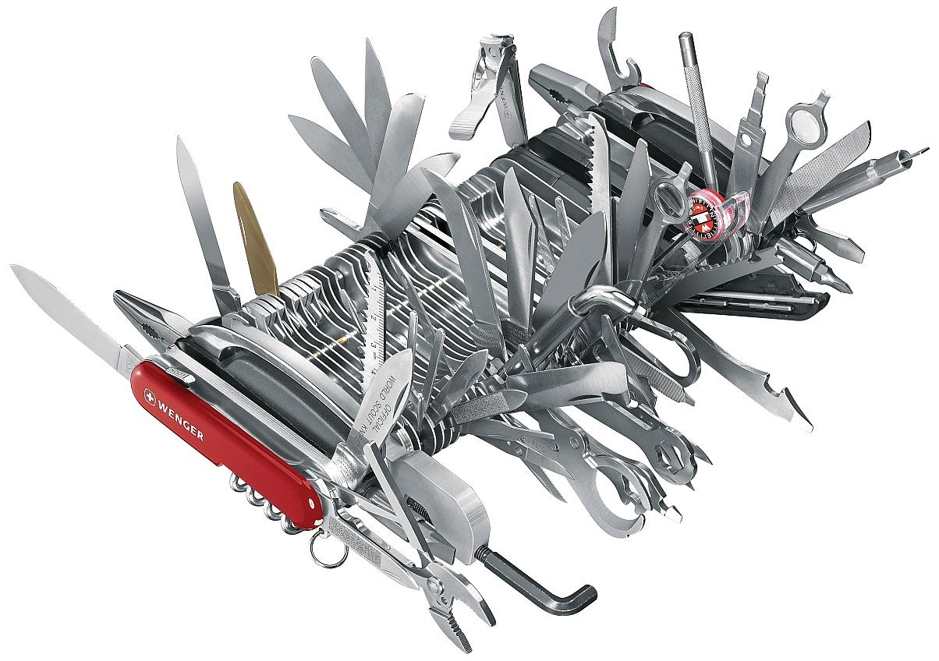
(Very) Rich-Client
Notes:
Single RCP client integrates all functionality
Swiss army knife supposed to be light!
Reuse of existing code for slightly different task
What to do?

Slide 9
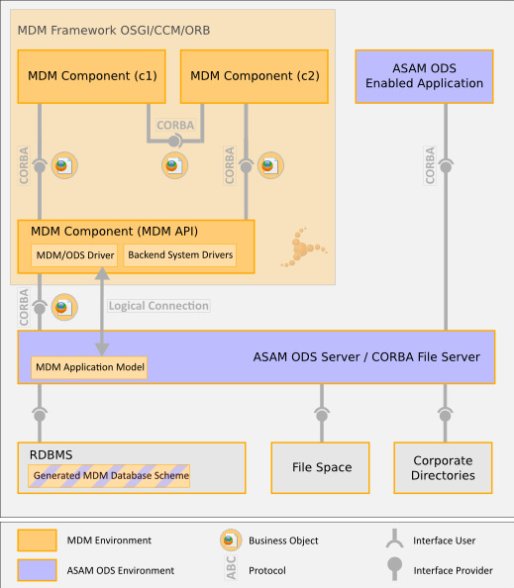
Notes:
CORBA even in UI!

Slide 10
Abstractions/Interfaces
CORBA and ODS sprawled everywhere
  Once CORBA is in place, why not use it again?
  Separate data access and logic!
Transparent data access masks bottlenecks
  Getters can trigger query to ODS server
  Data retrieval must be done explicitly!
Notes:
CORBA even in UI!

Slide 11
Separation of Concerns
Monolithic API hinders maintainability
  Extension changes entire API, all modules affected
  Modularize API!
Dependencies result in tight coupling
  Home-grown solution difficult to handle
  Establish solid dependency management!
Notes:
Dependency management depends on correct input, no late binding during runtime
Tight coupling complicates testing and runtime setup

Slide 12
Let’s build openMDM5!
Be compatible with ASAM ODS
Shield CORBA interfaces from applications
Provide method for integrating external data
Break compatibility with MDM4
Work split between driving members
Notes:
Reliable foundation for storing measured data
Used by numerous existing tools
Prevent diffusion of CORBA throughout system
Support a possibly wide range of data sources
Transfer knowledge and functionality rather than architectural decisions

Slide 13
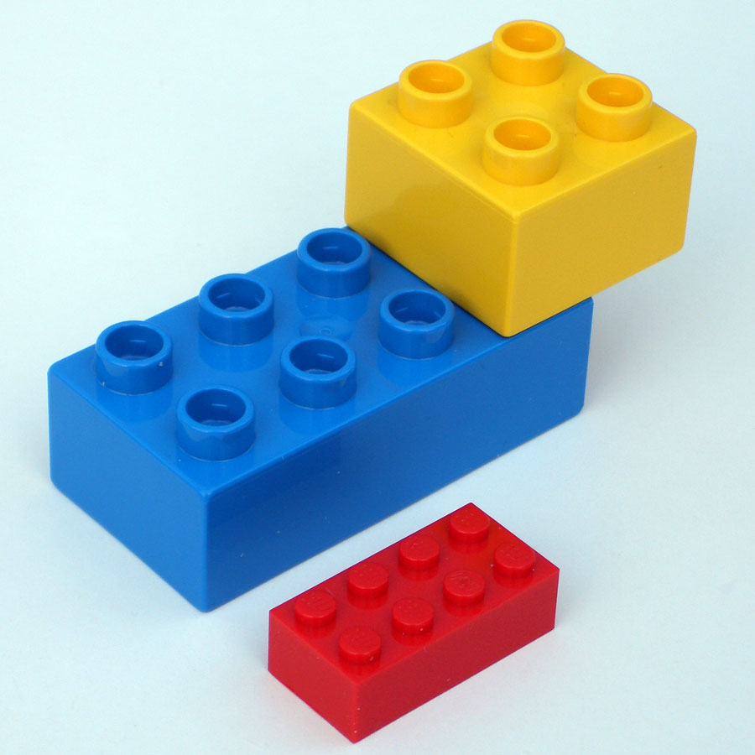
The Goal
Design a flexible, configurable, pluggable, adaptable, resilient
System
Notes:
Ok, let’ summarize
We have a monolithic system, which was optimized for one context (company), but difficult to introduce in other companies.
Every change in functionality required a change in the MDM API
There was no encapsulation - information of the storage system (ODS Servers) is leaking way up to the UI.
Now we should design:
flexible: different needs, e.g. different environment
configurable: preferred
pluggable: put your own app together
adaptable: adjust to own need
resilient: keep running if one part is missing
in short “Building blocks”

Slide 14
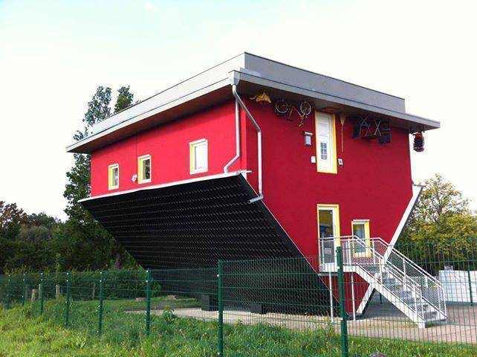
BigDesignUpFront?
http://tinyurl.com/nohztsu (flickr: juanaidrao)
Notes:
So what’s left? Big upfront Design?
While in real architectures such flaws will be detected in the plan, and there mostly only are minor changes to plan when start building, this is not the case in software architecture.

Slide 15
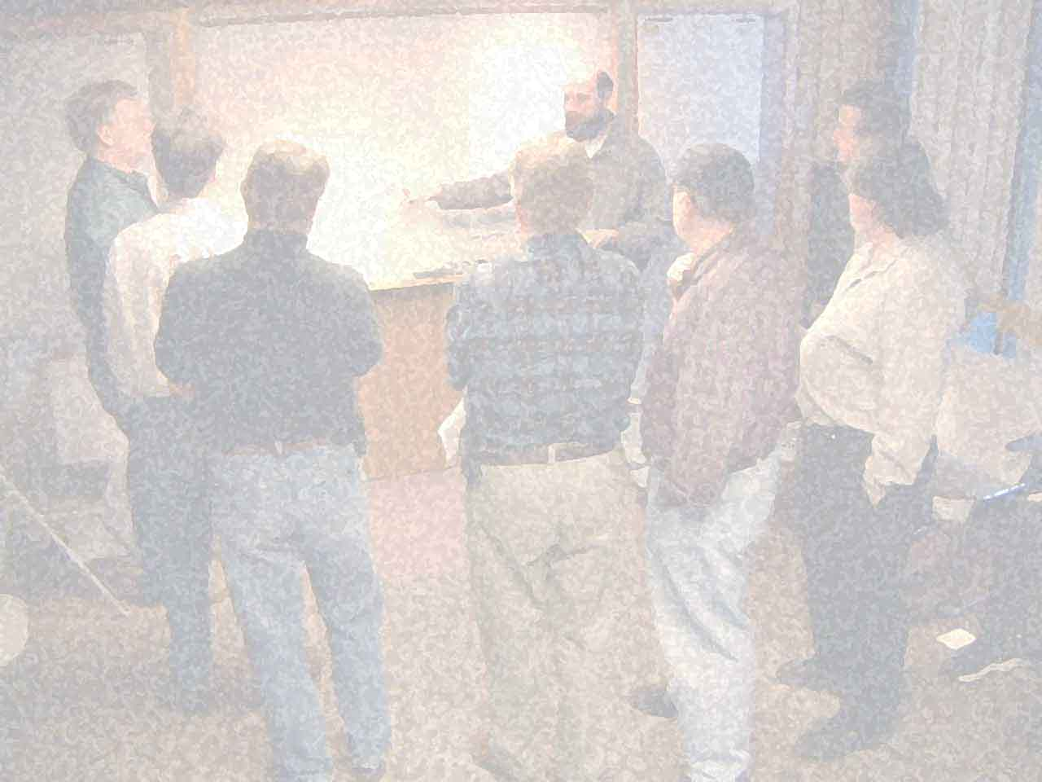
“The best architectures, requirements, and designs emerge from self-organizing teams.”
11th Principle of the agile manifesto.
Notes:
But How?
Who knows where this sentence is from? The background is a good hint.
11th Principle of the agile manifesto.

Slide 16
Notes:
We have a group (driving members, service providers) with some common interests, some not so common interests, but certainly not a team.

Slide 17
Open Source
Open-source software may be developed in a collaborative public manner.
(Source: Wikipedia)

Slide 18
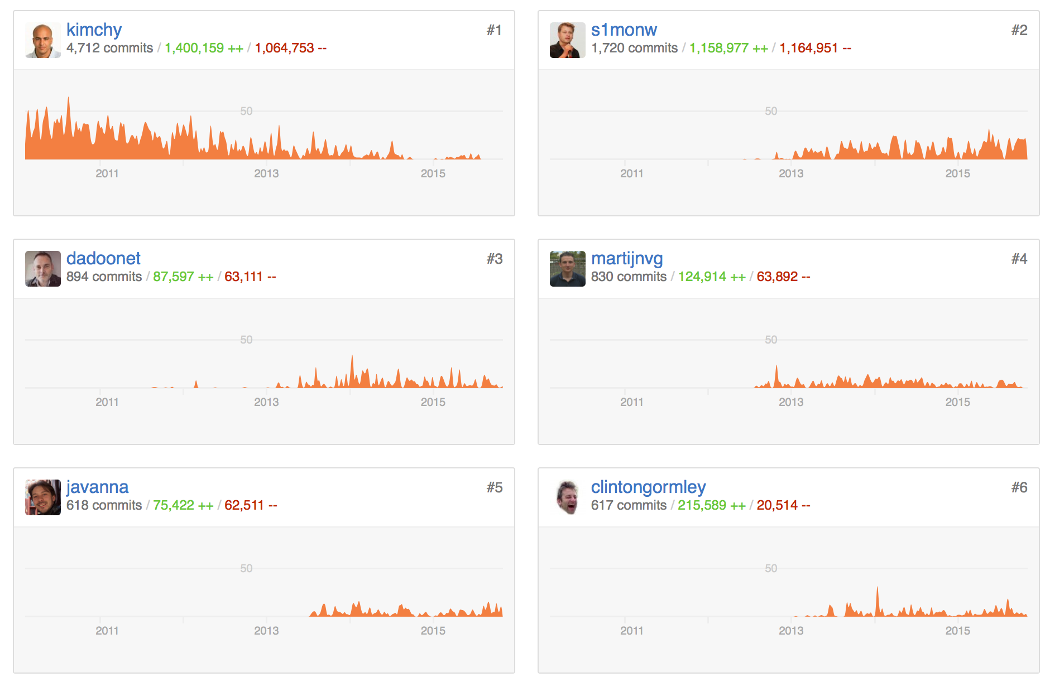
elastic/elasticsearch
Notes:
ONE Main Contributor

Slide 19
Just enough
to guide emergent architecture
Notes:
Solution!
as little as possible but as much as is needed
Joshua Kerievsky: sufficient design: invest more in where the value is -> interfaces and communication, less on the inside

Slide 20
UI
MDM API
MDM API
MDM API
Business Logic
Data Access
Business Logic
Data Access
Business Logic
Data Access
ODS
Notes:
simplified old architecture, every component did everything. As a platform eclipse rcp was used.

Slide 21
Step 1
Layers
Notes:
Simple Start, not a lot of new things, just basics

Slide 22
UI
Business Logic
MDM API
BOM
Data Access
ODS
Notes:
simplified new architecture. Most important:
Moved the MDM API (containing the MDM business object model) behind the business logic.

Slide 23
Step 2
Modularization

Slide 24
UI
Business Logic
MDM API
BOM
Data Access
ODS
Notes:
While there has been the notion of components, they were not restricted to one layer.

Slide 25
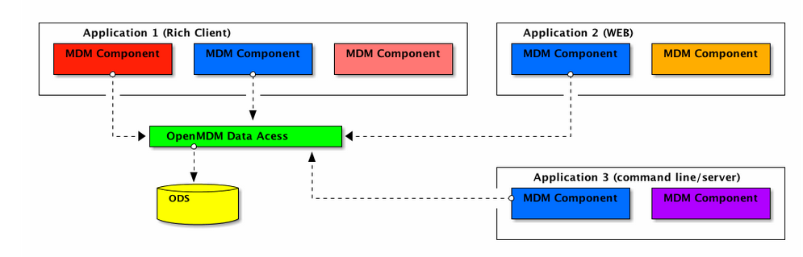

Slide 26
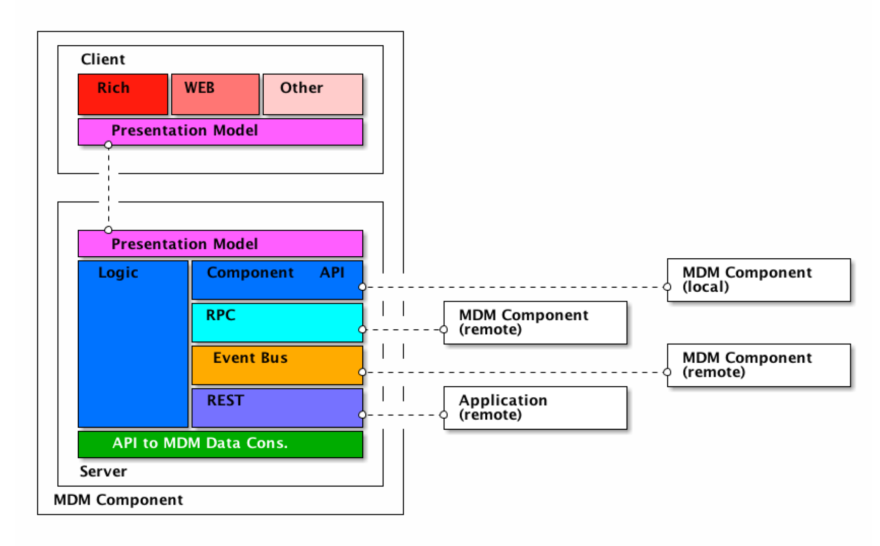
MDM Component
Adapters
Ports
Notes:
can have a UI, but can also be headless.
separation of concerns (functional use cases)
protect business logic by providing clear interfaces -> open for extension/closed for modification
Law of Demeter (Principle of Least Knowledge)

Slide 27
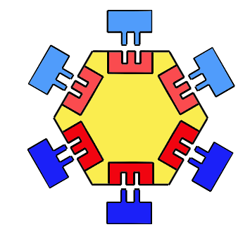
Ports & Adapter
http://www.dossier-andreas.net/software_architecture/ports_and_adapters.html (Patrick van Bergen)
Notes:
does not have to be a hexagon
defined communication channels
inbound/primary ports: are called by the users
outbound/secondary ports: called by the core logic

Slide 28
MDM Component
Notes:
Why so many Ports (aka communication channels)
Component API: Local Communication. Dependency Injection mandatory
RPC: one-to-one. Synchronous and asynchronous
Event Bus: broadcasting & notification. Asynchronous.
Remote Presentation Model: Communication to UI. Logic & behavior at server side
REST channel: communication with components on other programming platforms than the JVM (such as mobile devices like iOS or Android).

Slide 29
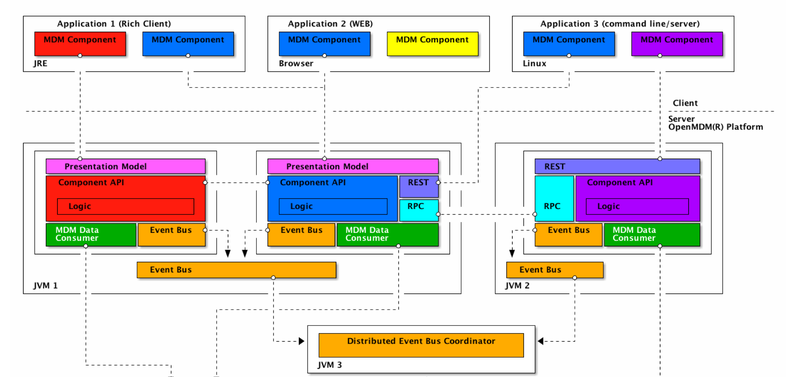
Notes:
Just to show that complicated systems can be built with this approach, if needed :-)
Note: It is NOT necessary to build everything at once, just build and use what is needed…
We haven’t clear use case, so our point was to show that be following key Design principle you get a scalable architecture.

Slide 30
And the Data???

Slide 31
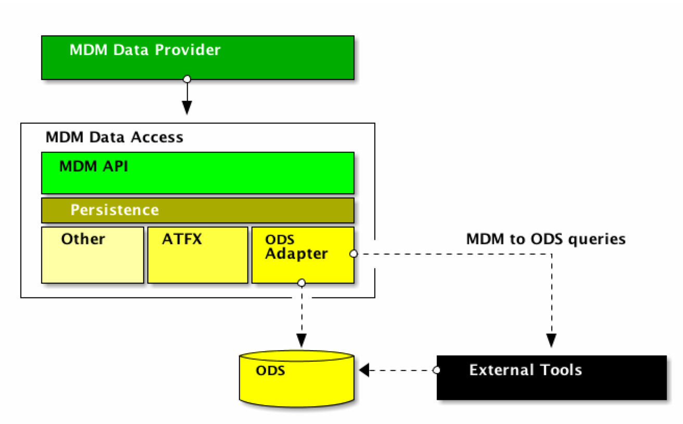
MDM Data Access Module
BOM
Notes:
Provide flexibility too
BOM: immutable Pojos (DTOs) instead of “smart” objects -> performance
-> allow other Persistence than ASAM ODS Server by encapsulating CORBA and providing OPENMDM Business Objects

Slide 32
Bringing it all together

Slide 33
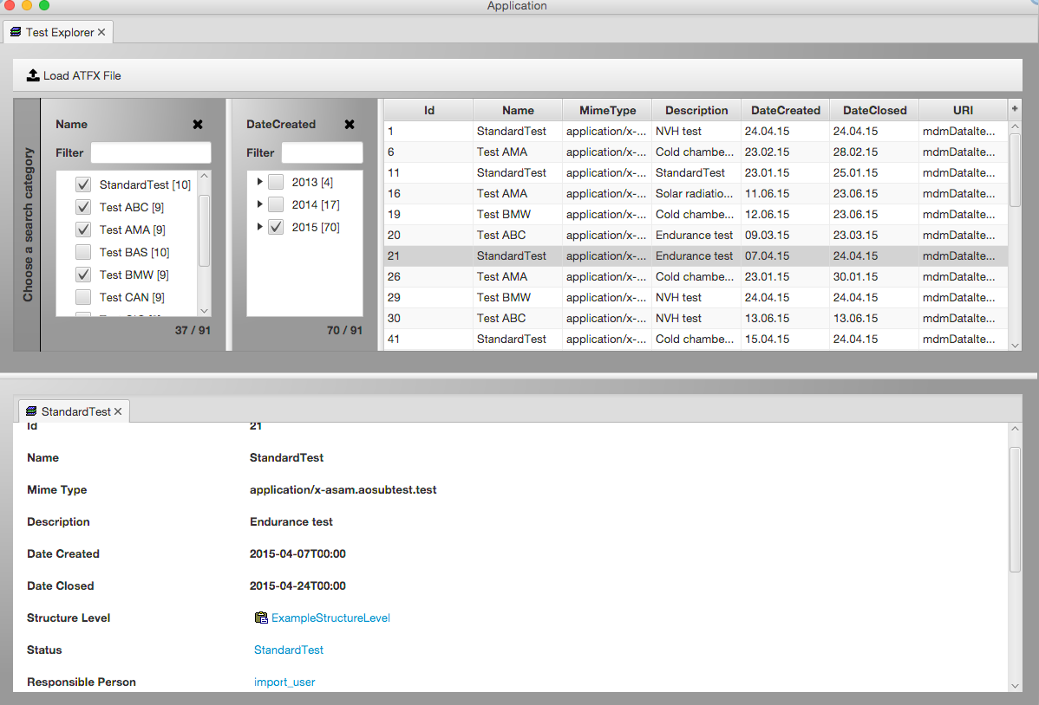
Explorer Component

Slide 34
Explorer Component
Client
Rich
PresentationModel
Server
Data Access Mock
DataProvider Component
PresentationModel
Server
Logic
Component API
Logic
Component API
Libraries
OpenMDM API
Server
Logic
Model
de.rechner.openatfx
ATFX-Datei
available at: http://git.eclipse.org/c/mdmweb (read the readme files!)

Slide 35
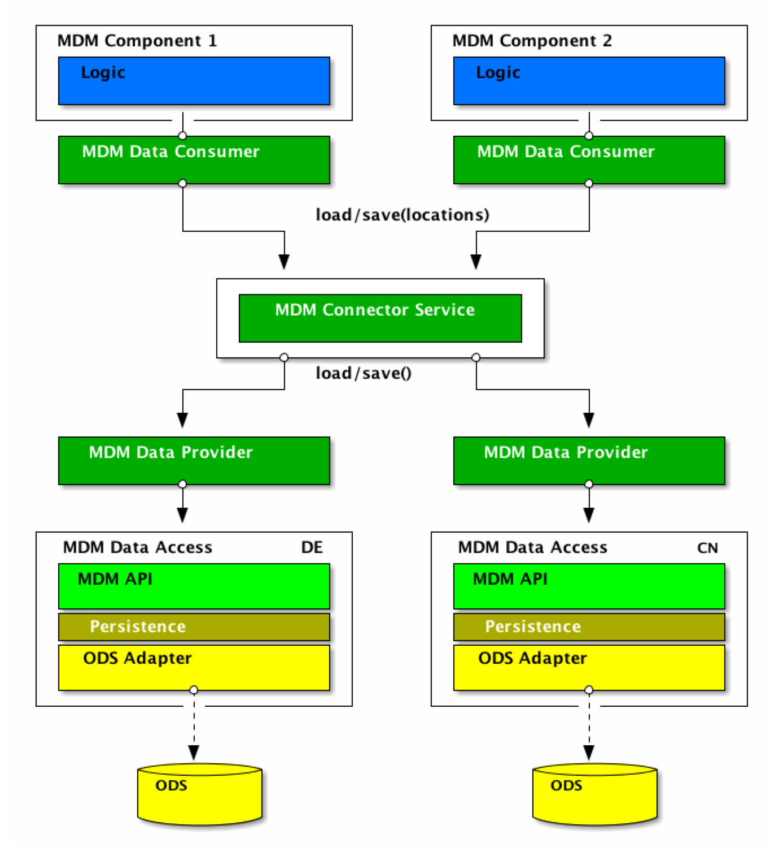
Notes:
MDM Connector Service - with adapters to both MDM Components and MDM Data Access
But wait - where das this service belong (again separation of concerns - own layer for infrastructure - platform

Slide 36
UI
Business Logic
Platform
MDM API
BOM
Data Access
ODS

Slide 37
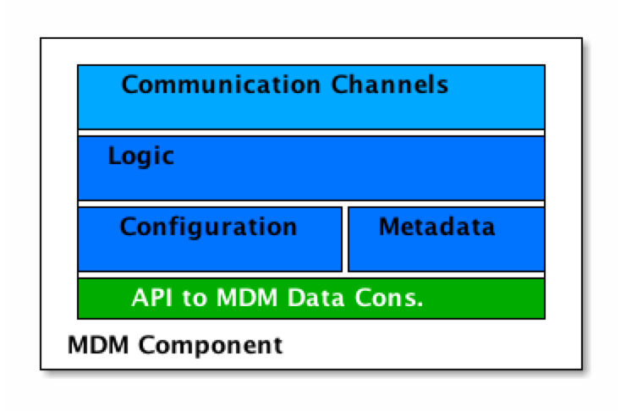
MDM Components
managed
Notes:
Component need provide information for the platform to be managed.

Slide 38
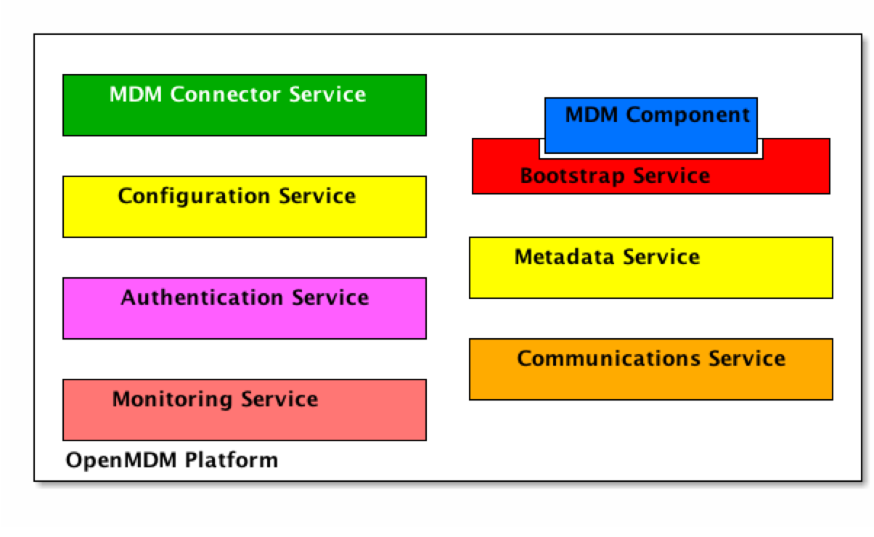
MDM Platform
Notes:
Platform most probably needs those services: With exception of MDM Connector Service not yet defined because no use case yet. (JUST enough)
MDM Connector Service: knows which Data Access is available -> fetches the data from the Location specified and aggregates - knows how to talk to Authentication Service for Authorisation
Bootstrap: will initialize the metadata of the MDM Component with correct data (using Metadata service & configuration service)
Metadata Service: looks up the actual configuration for the metadata service
Configuration Service: Knows the runtime configuration. Other components interested in a configuration should be notified if the config changes.
Authentication Service: Authentication & Authorization (who is allowed to see what data?
Communications Service (e.g. Event Bus)
Monitoring Service: operations
Other: e.g. Audit Service

Slide 39
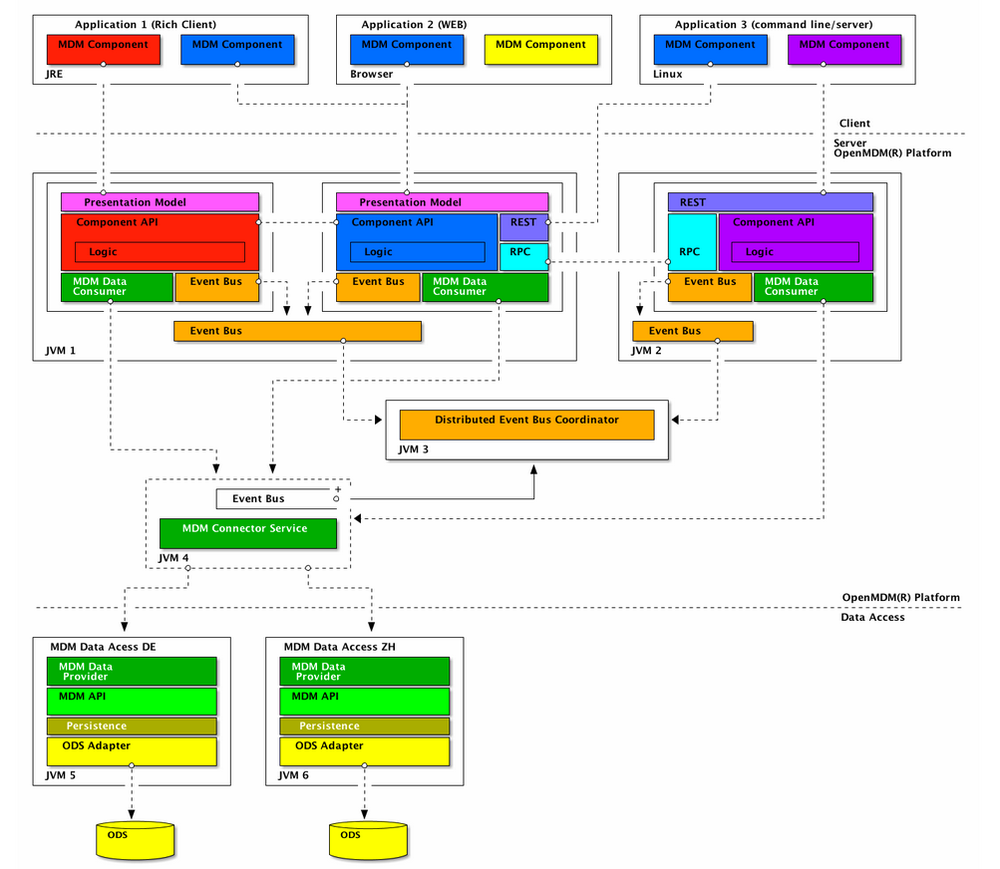
Notes:
Big Picture:
Several components on several JVM
Several clients
Several Data Store
of course it would be possible to run all components and the platform and the Data Access Module on one JVM and have only one client (e.g. WebApp)

Slide 40
Guiding Emergence
Design for testability
Design for learning
Return to design fundamentals
Make technical decisions at the last responsible moment
Use standards instead of concrete implementations
Notes:
Testability: encapsulation, clear interfaces
Learning: focus /protect the most valuable. Try to figure out the risks, makes spikes/evaluation. Try to bring out the unkowns unknowns early
Fundamentals: separation of concerns, single responsibility, Open/Closed principle, law of Demeter
Last responsible moment: don‘t make decisions too early so that they block learning/ or integration of new insights.
Standards: JEE vs. A Jboss Version.

Slide 41


Slide 42
THANK YOU!
Questions?

Slide 43
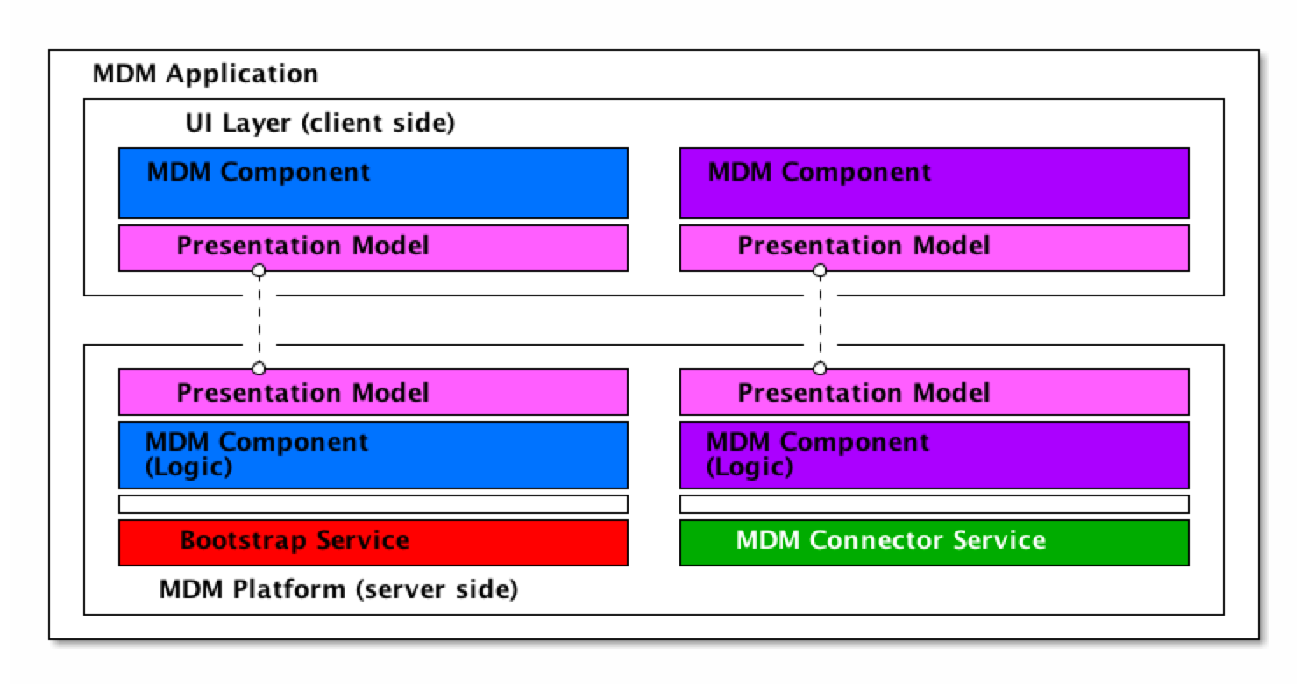

Slide 44
Technologies used
Explorer Component
Client
Rich
JavaFX & Griffon
PresentationModel
OpenDolphin
Server
Data Access Mock
DataProvider Component
PresentationModel
Server
Logic
Component API
Logic
Component API
Java 8, Google Guice
Java 8, Google Guice
Libraries
OpenMDM API
Server
Logic
Model
de.rechner.openatfx
ATFX-Datei

Slide 45
Distribution of Project modules
Explorer Component
Client
explorer-component-javafx
Rich
PresentationModel
explorer-pm
DataProvider Component
Server
Data Access Mock
Server
PresentationModel
Logic
Component API
explorer-component
dataprovider-component
Logic
Component API
dataprovider-api
explorer-component-guice
dataprovider-component-guice
explorer-api
Libraries
OpenMDM API
Server
Logic
Model
de.rechner.openatfx
ATFX-Datei

Slide 46
Deployment
RichClient
Server Mock
Client
Server
explorer-component-javafx
explorer-component
explorer-component-guice
dataprovider-component
OpenDolphin
dataprovider-component-guice
Java 8, JavaFX, Google Guice
Java 8, Google Guice
Instead of platform: components integrated in application window using Griffon (MVC framework)
Client-Server Communication: Remote Presentation model implemented in Open Dolphin.
There are .bat scripts to start client and server.
available at: http://git.eclipse.org/c/mdmweb
Notes:
Jetty used for server mock.
The rich client provides an application window in which all components can be integrated. For this Griffon is used again (MVC framework)
Client-Server Communication between MDM Component server and client parts is made using the remote presentation model pattern, implemented through Open Dolphin. There will be a JSR filed for the remote presentation model.
There are .bat scripts to start client and server.
More informations available in the README.adoc files in the root directories of the projects.

