Slide 1
The Future of F# Data and Services, At Your Fingertips, Strongly Typed
Don Syme
Principal Researcher
Microsoft Research

Slide 2
Caveat: no CTP available today

Slide 3
Today’s talk is very simple

Slide 4
Proposition 1 The world is information-rich

Slide 5
Proposition 2 Modern applications are information-rich

Slide 6
Proposition 3 Our languages are information-sparse

Slide 7
Proposition 4 We can fix this

Slide 8
Proposition 4 The future of F# is to fix this

Slide 9
Proposition 4 To fix it we will use magic

Slide 10
Proposition 4 The magic is called Type Providers

Slide 11
F# 2.0 ships with Visual Studio 2010

Slide 12
F# 2.0 Fundamentals
Succinct, Expressive, Functional
Parallel, Explorative, Data-rich, Algorithmic
Innovative, Industry/Platform-Leading
Note: F# is not a replacement for C#/VB/C++

Slide 13
A Coding Challenge: The Chemical Elements, Strongly Typed

Slide 14
demo
Language Integrated Web Data

Slide 15
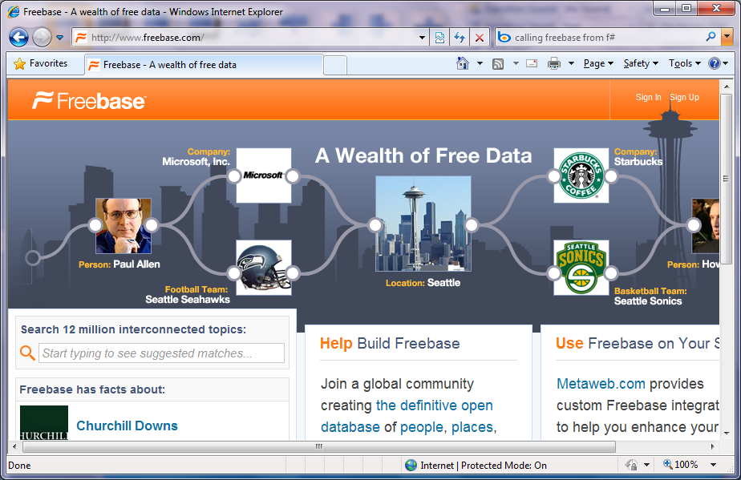
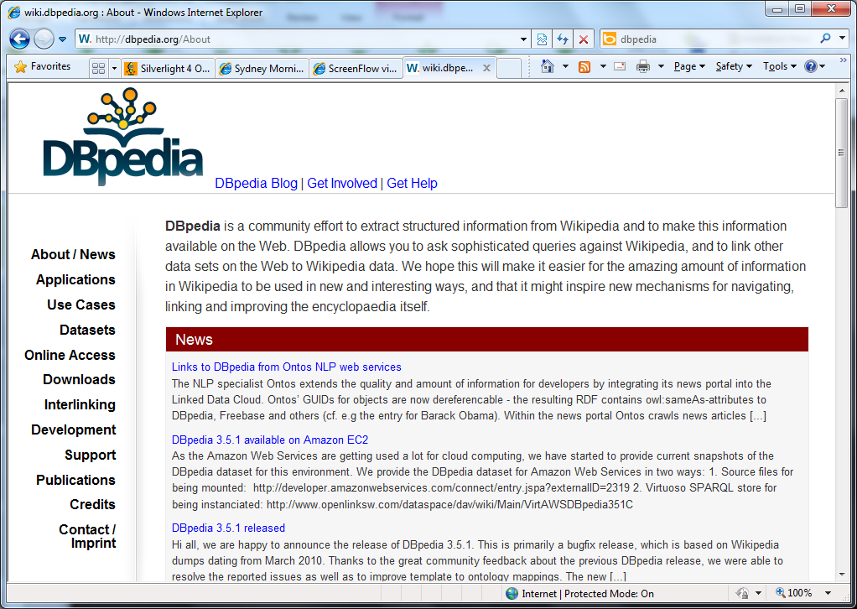
Organized Data
Enormous number of “types”
Very interlinked
Often using Wikipedia and other content
Sorry, but you can’t codegen your way out of this!!

Slide 16
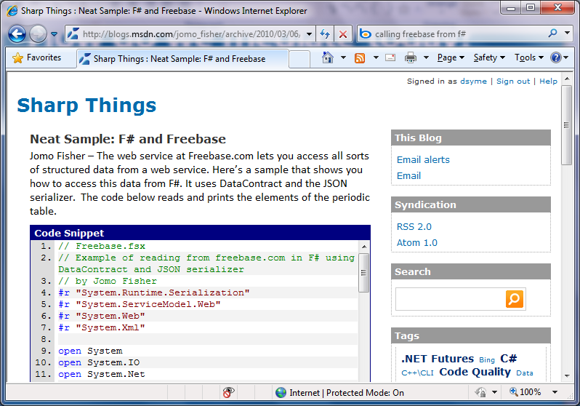
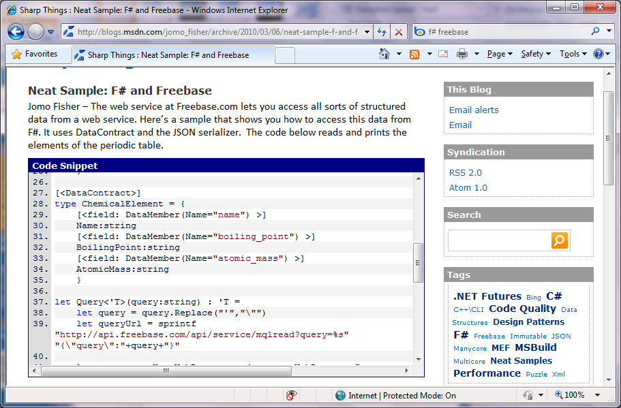
How would we do this in strongly typed languages today?

Slide 17
// Freebase.fsx
// Example of reading from freebase.com in F#
// by Jomo Fisher
#r "System.Runtime.Serialization"
#r "System.ServiceModel.Web"
#r "System.Web"
#r "System.Xml"
open System
open System.IO
open System.Net
open System.Text
open System.Web
open System.Security.Authentication
open System.Runtime.Serialization
[<DataContract>]
type Result<'TResult> = {
[<field: DataMember(Name="code") >]
Code:string
[<field: DataMember(Name="result") >]
Result:'TResult
[<field: DataMember(Name="message") >]
Message:string
}
[<DataContract>]
type ChemicalElement = {
[<field: DataMember(Name="name") >]
Name:string
[<field: DataMember(Name="boiling_point") >]
BoilingPoint:string
[<field: DataMember(Name="atomic_mass") >]
AtomicMass:string
}
How would we do this in strongly typed languages today?
let Query<'T>(query:string) : 'T =
let query = query.Replace("'","\"")
let queryUrl = sprintf "http://api.freebase.com/api/service/mqlread?query=%s" "{\"query\":"+query+"}"
let request : HttpWebRequest = downcast WebRequest.Create(queryUrl)
request.Method <- "GET"
request.ContentType <- "application/x-www-form-urlencoded"
let response = request.GetResponse()
let result =
try
use reader = new StreamReader(response.GetResponseStream())
reader.ReadToEnd();
finally
response.Close()
let data = Encoding.Unicode.GetBytes(result);
let stream = new MemoryStream()
stream.Write(data, 0, data.Length);
stream.Position <- 0L
let ser = Json.DataContractJsonSerializer(typeof<Result<'T>>)
let result = ser.ReadObject(stream) :?> Result<'T>
if result.Code<>"/api/status/ok" then
raise (InvalidOperationException(result.Message))
else
result.Result
let elements = Query<ChemicalElement array>("[{'type':'/chemistry/chemical_element','name':null,'boiling_point':null,'atomic_mass':null}]")
elements |> Array.iter(fun element->printfn "%A" element)

Slide 18
The Magic: Type Providers
F#
Web Data
Cloud Data
Enterprise
Data
Local Data
Web Services
Your Data

Slide 19
The Magic: Type Providers
Type Providers
Data and services at your fingertips
Navigation, Intellisense!
Integrate with LINQ queries
No code gen
Scalable (‘000,000s of types)

Slide 20
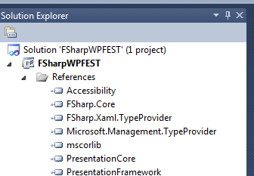

Slide 21
Our API for Type Providers
100+ lines to implement
Map information sources into the .NET type system
public interface ITypeProvider
{
Type GetType(string name,
BindingFlags bindingAttr);
Expression GetInvokerExpression(
MethodBase syntheticMethodBase,
ParameterExpression[] parameters);
event System.EventHandler Invalidate;
Type[] GetTypes();
}

Slide 22
Note: F# still contains no data Open architecture You can write your own type provider

Slide 23
Example 2: Windows Azure Marketplace: Data Market
http://datamarket.azure.com link

Slide 24
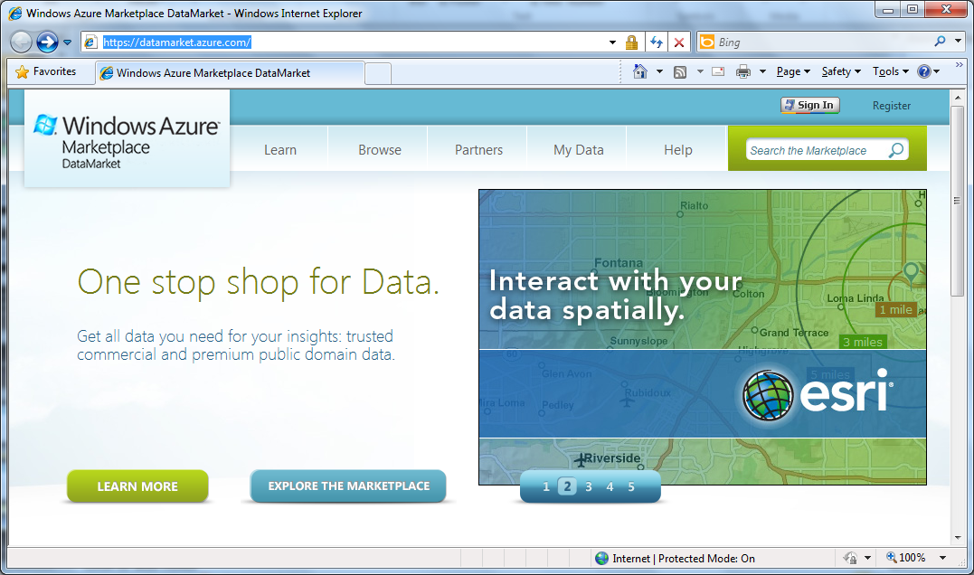

Slide 25
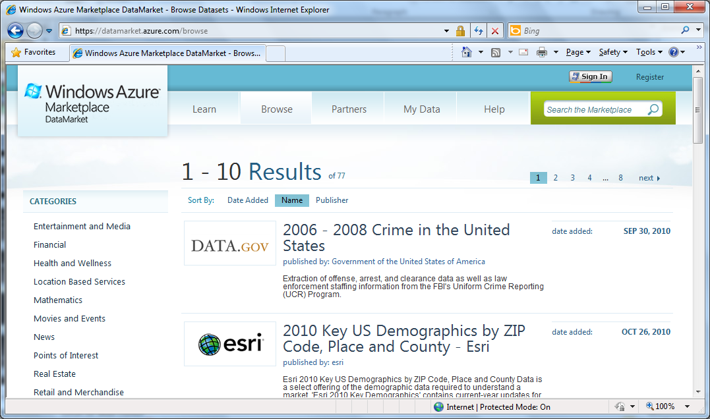

Slide 26
demo
Language Integrated Data Market Directory

Slide 27
How do we mediate today?
Untyped,
non-navigable
UI designs
WCF services
WebRequest
XmlReader
ReadJSON
SqlReader
...
Resources
objects
strings
bytes
program
Web services
Databases

Slide 28
How do we mediate today? Codegen, Codegen, Codegen!!
Ok, but…
there are problems ☺
UI designs
xaml designer
WCF services
svcutil.exe
types
+
code
Resources
resgen.exe
program
OData
datasvcutil.exe
Databases
edmgen.exe
...
yacg.exe

Slide 29
Cloud Web Phone

Slide 30
Cloud Web Phone Enterprise Local Machine

Slide 31
demo
Windows Management Instrumentation

Slide 32
Summary: Just imagine if we could access….
…web data
…data markets
…WMI & active directory
…a spreadsheet
…web services
…CRM data
…social data
…SQL data
…XML data
...
strongly typed
without explicit codegen
extensible, open

Slide 33
The solution is called Type Providers

Slide 34
Summary The world is information rich Our languages need to be information-rich too The F# Future? Consume it! Directly! Strongly typed! No walls!

Slide 35
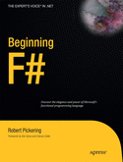
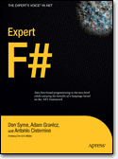
Latest Books about F#
Visit www.fsharp.net

Slide 36
More Information
Resources
F# Dev Center → http://fsharp.net
hubfs → http://msdn.com/vbasic
Windows Azure Marketplace - DataMarket → http://datamarket.azure.com
Related Talks
Enabling New Scenarios and Applications with Data in the Cloud
LINQ, Take Two: Realizing the LINQ to Everything Dream
Building Web APIs for the Highly Connected Web
The Future of C# and Visual Basic
Creating Custom OData Services: Inside Some of The Top OData Services

Slide 37
© 2010 Microsoft Corporation. All rights reserved. Microsoft, Windows, Windows Vista and other product names are or may be registered trademarks and/or trademarks in the U.S. and/or other countries.
The information herein is for informational purposes only and represents the current view of Microsoft Corporation as of the date of this presentation. Because Microsoft must respond to changing market conditions, it should not be interpreted to be a commitment on the part of Microsoft, and Microsoft cannot guarantee the accuracy of any information provided after the date of this presentation. MICROSOFT MAKES NO WARRANTIES, EXPRESS, IMPLIED OR STATUTORY, AS TO THE INFORMATION IN THIS PRESENTATION.

Slide 38
Questions/Discussion

Slide 39
Implementation
FSC.EXE
Some.Unknown.Identifier
FSharp.LanguageService.dll
-r:Provider.dll
System.Type
(synthetic)
+ how to compile
method calls to
synthetic types
FSI.EXE
app.exe or
library.dll
Provider.Runtime.dll

Slide 40
Implementation (generative)
FSC.EXE
Some.Unknown.Identifier + resolution context
-r:Provider.dll
System.Type
(real)
edmgen.exe
app.exe or
library.dll
types
Provider.Runtime.dll

