Slide 1
F# Today, F# Tomorrow Information Rich Programming Meets F# Functional Super-drug!
Don Syme, Principal Researcher, Microsoft Research
http://fsharp.net

Slide 2
Today’s talk is very simple

Slide 3
Proposition 1 The world is information-rich

Slide 4
Proposition 2 Modern applications are information-rich

Slide 5
Proposition 3 Our languages are information-sparse

Slide 6
Proposition 4 This is a problem

Slide 7
The future of F# is about fixing this

Slide 8
To fix it we will use magic ☺

Slide 9
The magic we’re adding to F# is called Type Providers

Slide 10
Type Providers + LINQ = Language Integrated Data and Services

Slide 11
But first… What is F# and why should I care?

Slide 12
F# 2.0 ships with Visual Studio 2010

Slide 13
F# is…
...a productive, supported, functional programming language that allows you to write simple code to solve complex problems.

Slide 14
Simple Code, Strongly Typed

Slide 15
Simplicity: Functions as Values
abstract class Command
{
public virtual void Execute();
}
abstract class RoverCommand : Command
{
protected Rover Rover { get; private set; }
public RoverCommand(MarsRover rover)
{
this.Rover = rover;
}
}
class BreakCommand : RoverCommand
{
public BreakCommand(Rover rover) : base(rover)
{
}
public override void Execute()
{
Rover.Rotate(-5.0);
}
}
class TurnLeftCommand : RoverCommand
{
public TurnLeftCommand(Rover rover)
: base(rover)
{
}
public override void Execute()
{
Rover.Rotate(-5.0);
}
}
OO
F#
type Command = Command of (Rover -> unit)
let BreakCommand =
Command(fun rover -> rover.Accelerate(-1.0))
let TurnLeftCommand =
Command(fun rover -> rover.Rotate(-5.0<degs>))

Slide 16
Simplicity: Functional Data
C#
Tuple<U,T> Swap<T,U>(Tuple<T,U> t)
{
return new Tuple<U,T>(t.Item2, t.Item1)
}
ReadOnlyCollection<Tuple<T,T,T>> Rotations<T>(Tuple<T,T,T> t)
{
new ReadOnlyCollection<int>
(new Tuple<T,T,T>[]
{ new Tuple<T,T,T>(t.Item1,t.Item2,t.Item3);
new Tuple<T,T,T>(t.Item3,t.Item1,t.Item2);
new Tuple<T,T,T>(t.Item2,t.Item3,t.Item1); });
}
int Reduce<T>(Func<T,int> f,Tuple<T,T,T> t)
{
return f(t.Item1) + f(t.Item2) + f (t.Item3);
}
let swap (x, y) = (y, x)
let rotations (x, y, z) =
[ (x, y, z);
(z, x, y);
(y, z, x) ]
let reduce f (x, y, z) =
f x + f y + f z
F#

Slide 17
Parallel

Slide 18
The Big Trends
THE CLOUD
MULTICORE

Slide 19
Async.Parallel [ httpAsync "www.google.com" httpAsync "www.bing.com" httpAsync "www.yahoo.com" ]
Parallel
|> Async.RunSynchronously

Slide 20
Demo

Slide 21
F# can be used for everything, but excels at analytical engines

Slide 22
F# can be used for everything, but excels at analytical engines for Client, Server, Phone, Cloud, Console

Slide 23
Example #1 (Power Company)
I have written an application to balance the national power generation schedule … for an energy company.
...the calculation engine was written in F#.
The use of F# to address the complexity at the heart of this application clearly demonstrates a sweet spot for the language … algorithmic analysis of large data sets.
Simon Cousins (Eon Powergen)

Slide 24
Examples #2/#3: Finance companies

Slide 25
Example #4: Biotech
...F# rocks - building algorithms for DNA processing
and it's like a drug. 12-15 at Amyris use F#...
F# has been phenomenally useful. I would be writing a lot of this in Python otherwise and F# is more robust, 20x - 100x faster to run and faster to develop.
Darren Platt, Amyris BioTechnologies

Slide 26
F# Futures: Information-Rich Programming

Slide 27
A Coding Challenge: The Chemical Elements, Strongly Typed

Slide 28
Language Integrated Web Data
demo

Slide 29
The Magic: Type Providers
F#
Web Data
Cloud Data
Enterprise
Data
Local Data
Web Services
Your Data

Slide 30
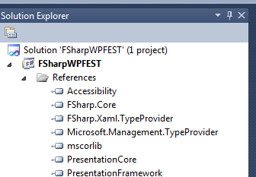

Slide 31
A Type Provider is…. A design-time component that provides a computed space of types and methods… A compiler/IDE extension… An adaptor between data/services and .NET languages…

Slide 32
// Freebase.fsx
// Example of reading from freebase.com in F#
// by Jomo Fisher
#r "System.Runtime.Serialization"
#r "System.ServiceModel.Web"
#r "System.Web"
#r "System.Xml"
open System
open System.IO
open System.Net
open System.Text
open System.Web
open System.Security.Authentication
open System.Runtime.Serialization
[<DataContract>]
type Result<'TResult> = {
[<field: DataMember(Name="code") >]
Code:string
[<field: DataMember(Name="result") >]
Result:'TResult
[<field: DataMember(Name="message") >]
Message:string
}
[<DataContract>]
type ChemicalElement = {
[<field: DataMember(Name="name") >]
Name:string
[<field: DataMember(Name="boiling_point") >]
BoilingPoint:string
[<field: DataMember(Name="atomic_mass") >]
AtomicMass:string
}
How would we do this today?
let Query<'T>(query:string) : 'T =
let query = query.Replace("'","\"")
let queryUrl = sprintf "http://api.freebase.com/api/service/mqlread?query=%s" "{\"query\":"+query+"}"
let request : HttpWebRequest = downcast WebRequest.Create(queryUrl)
request.Method <- "GET"
request.ContentType <- "application/x-www-form-urlencoded"
let response = request.GetResponse()
let result =
try
use reader = new StreamReader(response.GetResponseStream())
reader.ReadToEnd();
finally
response.Close()
let data = Encoding.Unicode.GetBytes(result);
let stream = new MemoryStream()
stream.Write(data, 0, data.Length);
stream.Position <- 0L
let ser = Json.DataContractJsonSerializer(typeof<Result<'T>>)
let result = ser.ReadObject(stream) :?> Result<'T>
if result.Code<>"/api/status/ok" then
raise (InvalidOperationException(result.Message))
else
result.Result
let elements = Query<ChemicalElement array>("[{'type':'/chemistry/chemical_element','name':null,'boiling_point':null,'atomic_mass':null}]")
elements |> Array.iter(fun element->printfn "%A" element)

Slide 33
Note: F# still contains no data Open architecture You can write your own type provider

Slide 34
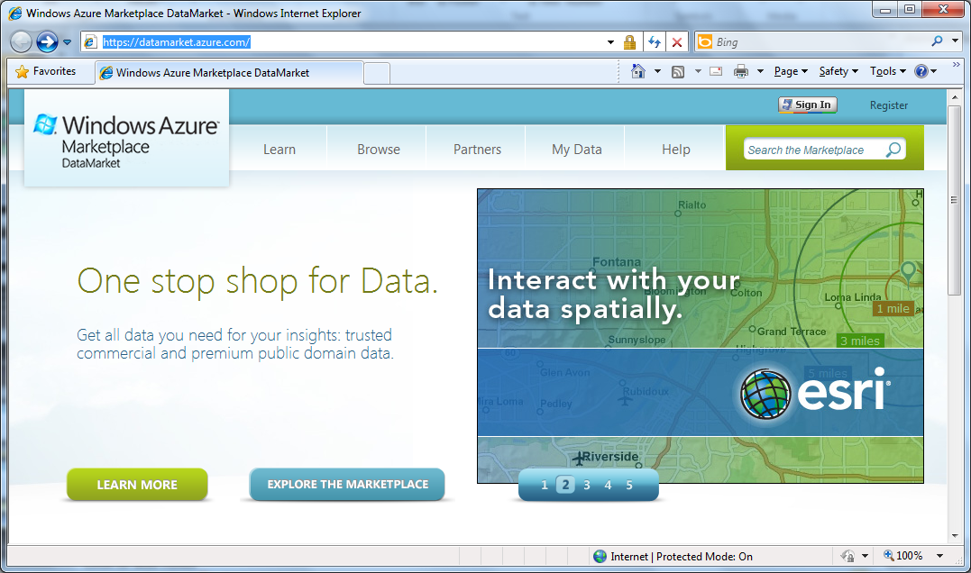

Slide 35
Language Integrated Data Market Directory
demo

Slide 36
OData
type Netflix = ODataService<"http://odata.netflix.com">
Fluent, Typed Access To OData

Slide 37
SQL Server
type SQL = SqlConnection<"Server='.\SQLEXPRESS'... ">
Fluent, Typed Access To SQL

Slide 38
SharePoint
type EmeaSite = SharePointSite<"http://myemea/">
Fluent, Typed Access To SharePoint Lists

Slide 39
F# Futures: Queries
let avatarTitles =
query { for t in netflix.Titles do
where (t.Name.Contains "Avatar") }

Slide 40
F# Futures: Queries
let avatarTitles =
query { for t in netflix.Titles do
where (t.Name.Contains "Avatar")
sortBy t.Name
take 100 }
Declarative LINQ queries

Slide 41
TypeProviders: The Vision
…web data
…data markets
…WMI & active directory
…a spreadsheet
…web services
…CRM data
…social data
…SQL data
…XML data
...
strongly typed
without explicit codegen
extensible, open

Slide 42
Summary The world is information rich Our languages need to be information-rich too The F# Future? Consume it! Directly! Strongly typed! No walls!

Slide 43
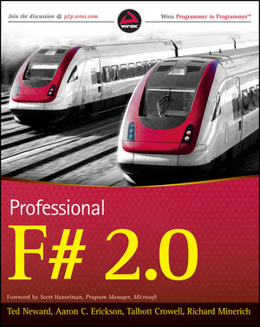
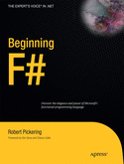
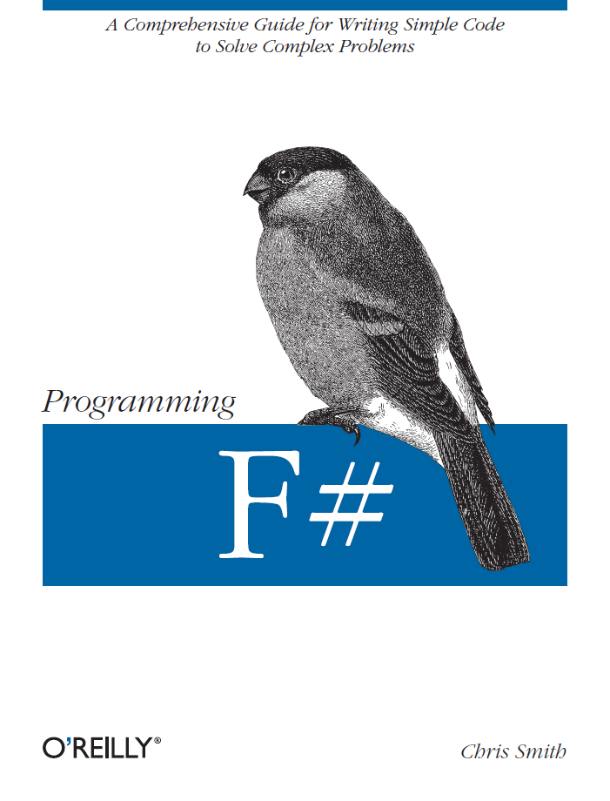
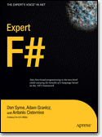
Latest Books about F#
Visit www.fsharp.net

Slide 44
Professional Tools

Slide 45
In Summary
F#
Ready for supported use in VS2010
Simple code, Simple parallelism
An amazing data-rich future ahead
Simple, expressive, productive addition to .NET

Slide 46
Questions http://fsharp.net

